Slide 1
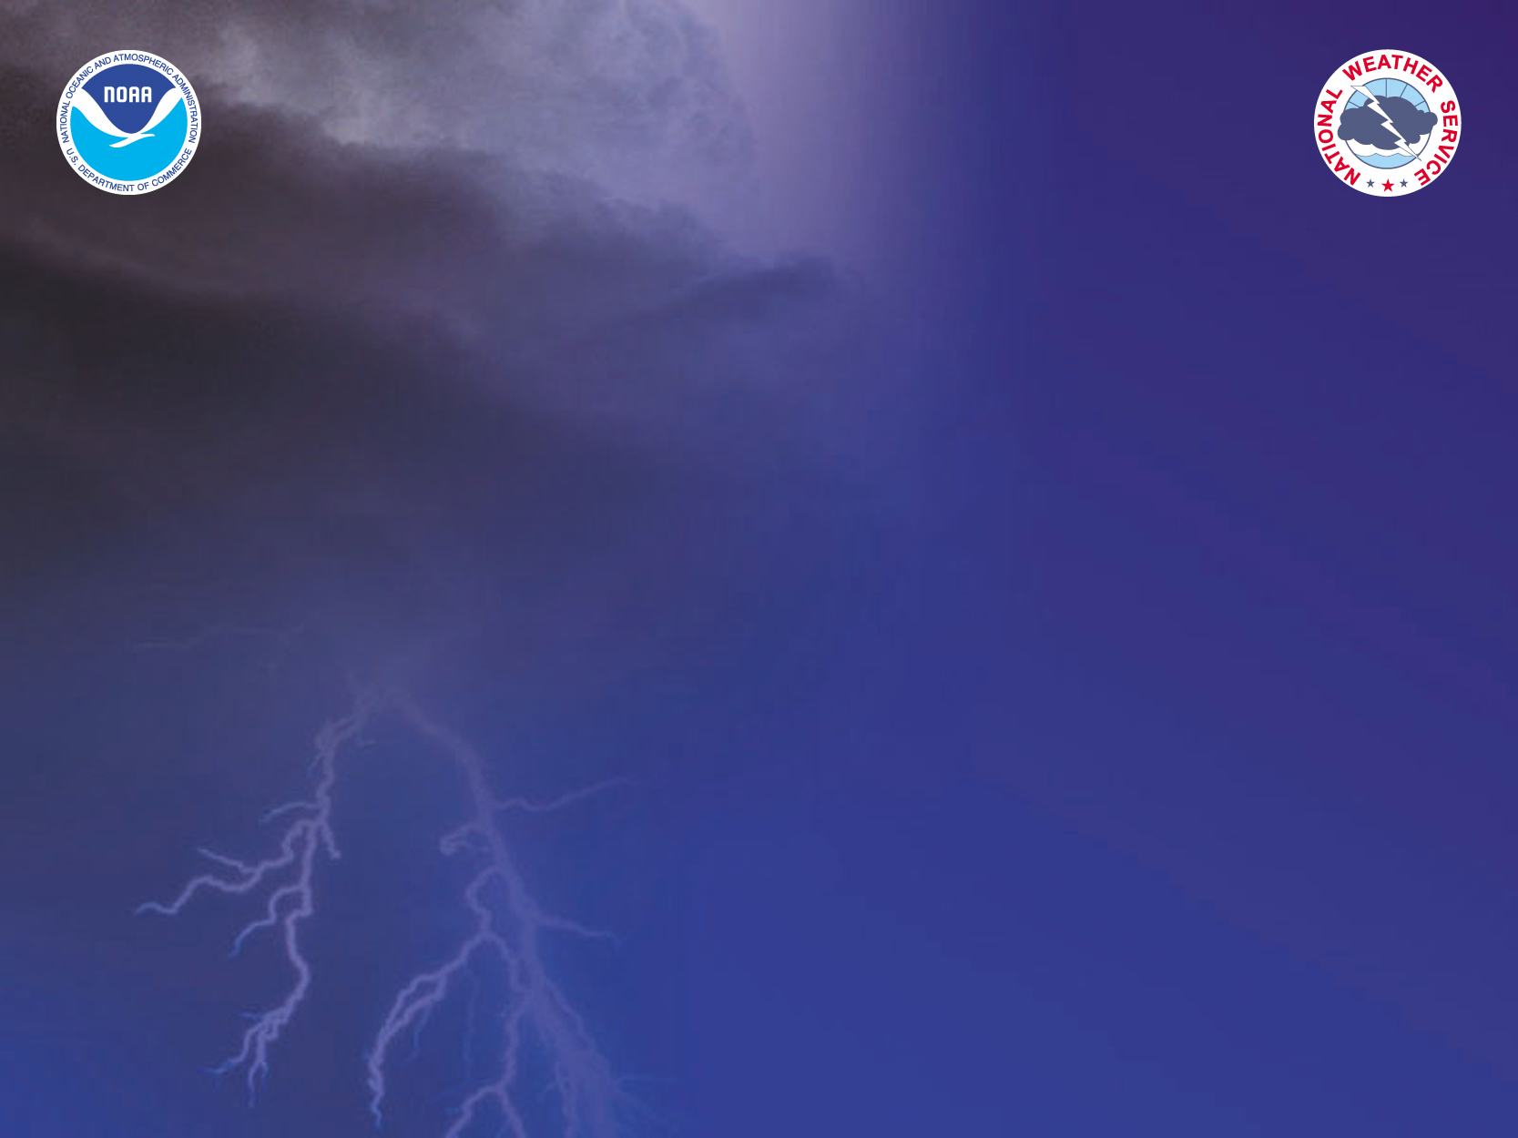
Developmental Testbed Center (DTC)
Bob Gall
June 2004

Slide 2
Vision
The DTC will be a facility where the NWP communities interact to accelerate testing and evaluation of new models and techniques for research applications and operational implementation, in a way that doesn’t interfere with current operations.

Slide 3
Why Do We Need a DTC
Currently in the US the transfer of new NWP science and technology from research into operations is inefficient.
  Primarily conducted at the operational centers
  It does not take advantage of the considerable talent elsewhere in the research community
Presently the research and operations NWP communities have divergent goals and insufficient opportunities to collaborate in an operations-like environment.
There is nowhere that these communities can join to perform extensive rigorous model testing using a common model and operational data stream without disrupting operations.

Slide 4
Goals
Link Research and Operational Communities
Speed transition of research results into operations
Accelerate improvement in weather forecasts
Develop and test promising new NWP techniques
Provide an opportunity for NWP community to perform cycled or real-time tests of model and data assimilation systems

Slide 5
The Flow of Science from Research to Operations in the WRF Era:
Bridging the “Valley of Death”
NCAR
EMC
Universities
The research community:
NRL
NOAA Labs
Others
NASA
DTC
OTC-
NCEP
OTC-
Air Force
OTC-
Navy
NCEP
Air Force
Navy
NCO
AFWA
FNMOC

Slide 6
Desired Outcomes
The DTC will have…
Established a repeatable process of testing WRF Contributed Codes for elevation to Reference Code status
Established an ongoing system for maintaining and supporting WRF Reference Code to the community
Established a sustained flow of rigorously tested new science and technologies to operations
Established a process for testing and evaluating new NWP science and technologies and retrospective testing of operational model systems
Established a working relationship between the research and operational communities

Slide 7
Basic Structure of the DTC
The physical center will be located in Boulder. Components at NCAR and FSL.
Components will be distributed at other locations
  NRL
  Visitors at their home institution
  Other?

Slide 8

The DTC Architecture
NCEP / AFWA / FNMOC
Co-Laboratory
Developmental Testbed Center
Operational Testbed Centers
WRF
Community
Visitor Program
GCE
Supercomputing
Centers
GCE—Grid Computing Environment

Slide 9
Phased Implementation
Phase 1
  Initial DTC Implementation (FY03-FY05)
Phase 2
  Fully Functional DTC (FY06-FY07)
Phase 3
  Unified Modeling in the DTC (FY08-FY09)
    Ocean Modeling, Global modeling…

Slide 10
Phased Implementation
Phase 1
    Began WRF Test Plan for operational implementation of Mesoscale Ensemble
    Strengthened working relationship between DTC partners (NCEP. AFWA, FSL, NCAR)
    Completed the basic WRF Reference Code including NMM, and EM cores and ported to FSL, NCAR and AFWA computers.
    WRF EM core implemented at NCEP for real-time predictions

Slide 11
Phased Implementation
Phase 1
  FY04
    Complete and evaluate WRF Test Plan
      Critical for NCEP IOC of WRF in FY04
    Begin providing WRF code to the community ( both NMM and EM cores)
    Begin visitor program (University and NCEP scientists)
      Model verification, testing WRF Physics packages…
    Build on the development and testing in FY04 and examine questions raised in FY03 testing
      Optimal configuration of mesoscale ensembles
      Optimal physics packages for WRF
      Develop verification infrastructure
      Impact of number and distribution of vertical levels in the two cores
    Real-time high resolution (4km) forecast test over the Mid-Western US with NWS forecasters for convection season
    Begin planning for DTC computational Enviromnent

Slide 12
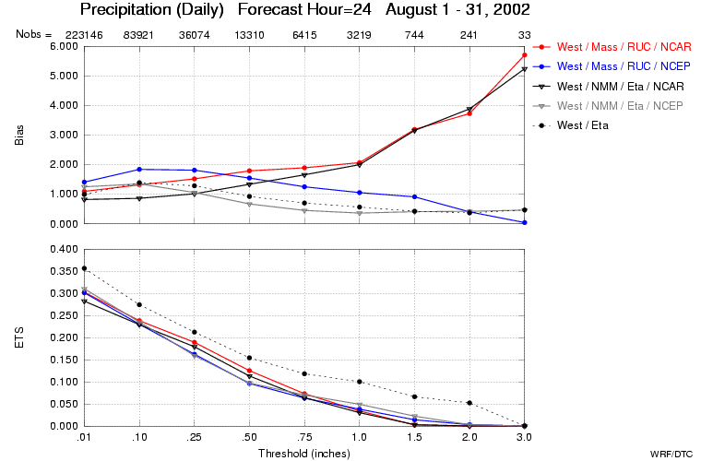
Western HRW – February 2003 – Surface T – 30 h forecast

Slide 13
Current Activities within the DTC
Visitor program this summer
  Bill Gallus ( Iowa State Univ)—Ensemble techniques
    a doctoral student—Verification techniques
  Dave Dempsey (San Francisco State Univ)—Impact of Physics packages
  Ying Lin (NCEP)—Verification Techniques
  One additional university visitor—TBD

Slide 14
Additional DTC Projects after start of 05
Conduct a real-time 4km forecast experiment over the CONUS. Emphasis on Eastern US for the winter season

Slide 15
FY 04 Funding
NCAR
  $250K
  Computer Resources ($40K/month, $200K special request)
  Space Allocation ($90K)
NOAA OAR
  $350K
  Two reassigned NOAA positions ($300K)
  Computer Resources (IJET $40K per month)
NOAA NWS
  $300K
Total from all sources including computer resources
  $2.4M

Slide 16
Eventual Annual Budget
End of Phase 3
Visitor Program $1.0 M
13 FTE technical staff $2.9 M
Other personnel 3 FTE (Admin, Director) $0.7 M
Enhancement to computing,
networking and storage $0.6 M
Space $0.2 M
Travel and other $0.1 M
Total $5.5 M

Slide 17
End

