Slide 1

Virginia Grade Level Alternative Assessment
OVERVIEW

Slide 2
Procedures 101
A student’s IEP team/504 committee examines the participation criteria established for the VGLA and finds that a student meets the criteria for participation.
  The student must have a current IEP/504-plan;
  As a result of a disability, the student demonstrates his/her individual achievement of SOL content through means other than multiple-choice formats;
  As a result of a disability, the student is unable to demonstrate his/her individual achievement on the SOL test for the assigned course or grade level using available standard and/or non-standard accommodations and/or formats.

Slide 3
Procedures 101
The student and teacher follow established local procedures to identify collection components to demonstrate individual achievement of SOL for the grade level and content area(s) considered for the VGLA.
  examine the addressed SOL for the grade level assessments being considered (blueprint).
  select appropriate work samples that demonstrate content stated in the blueprint.
  reflect demonstration of student knowledge and skills related to the specific SOL.
  complete a collection that represents the student's level of individual achievement.

Slide 4

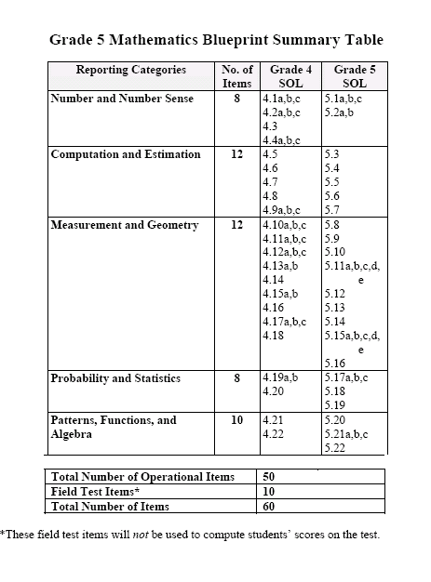

Slide 5
Recommendations
Local school divisions may create a collection matrix systems to organize evidence and structure submitted products.
Local school divisions may want to store data collected in electronic formats or systems.
Data used to assign ratings of student performance must be maintained until after the end of the official audit window and in accordance with established Library of Virginia Records Retention Schedules

Slide 6
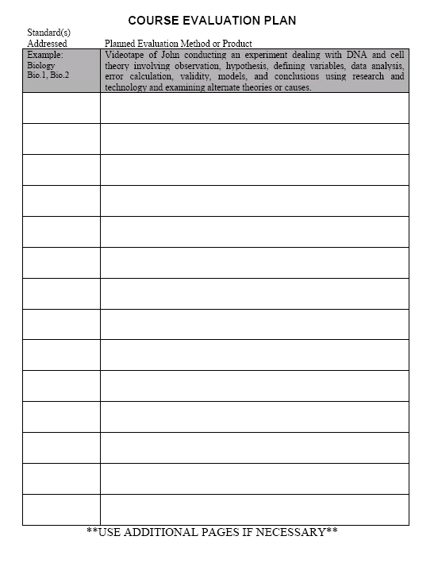
Example:
A matrix to
assist the
student and
teacher in
organizing and
collecting
evidence of
SOL from the
blueprint.

Slide 7
Procedures 101
A signed affidavit must accompany each grade level/content area submission stating that the work is that of the student alone using his/her accommodations.
  Work samples submitted must be solely that of the student.
  In the presence of a teacher and/or paraprofessional.
  Affidavit states that “I did not:
    fabricate, alter, or modify student work samples, products, or data,
    describe student behaviors that provide a negative image of the student, or
    provide any accommodation/assistive device that is not a regular part of the student’s daily instruction.”

Slide 8
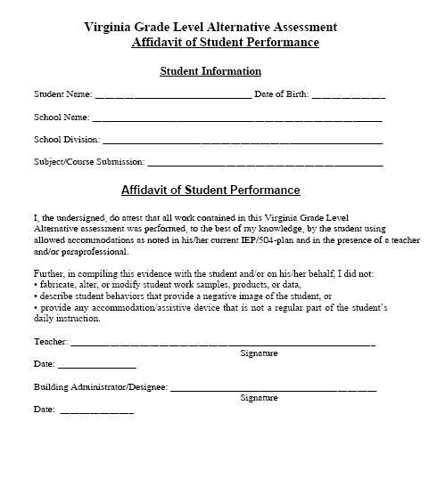

Slide 9
collection Components
A collection submitted for scoring must contain the following:
A signed VGLA Affidavit of Student Performance that demonstrates the student’s sole ownership/authorship.
Types of evidence that demonstrate individual achievement on all SOL addressed.
A signed Individual Student Review Panel Score Form School Report prepared upon completion of scoring.

Slide 10
Types of Evidence
A collection may consist of any of the following types of evidence:
Work sample
Audiotape
Videotape
Anecdotal Record
Interview
Photograph
Charts/Graphs

Slide 11
Evidence Cont’d
Evidence must demonstrate knowledge and/or skills in the SOL addressed.
Students may submit evidence for all or some of the SOL assessed from the test blueprints.
Evidence may prove more than one SOL.
All evidence must be solely the student’s work completed in the presence of a teacher or authorized school personnel.

Slide 12
Procedures 101
4. The student’s collection and the signed affidavit confirming that the work is that of the student alone are submitted to the LEA scoring committee.
  A complete collection that provides evidence for all SOL from a given content/grade level that the student has addressed during the course of study must be submitted.

Slide 13
Procedures 101
5. Based on the documentation and collection review, the school division scoring team will assign the appropriate scores based on the scoring rubric identified by the Virginia Department of Education.
  Division Director of Testing is responsible for maintaining a local scoring team.
  After receipt of all required materials, documentation and collection evidence, the local scoring team will set up a date for review of submitted VGLA entries.
  The local scoring team will use the online scoring system to rate student individual achievement in each SOL addressed for specific content/grade level VGLA submitted collection.

Slide 14
Scoring and Reporting
Real-time scoring and reporting for the Local School Division and directly to the Division of Assessment and Reporting.
Scoring teams consist of at least three to five school division representatives.
Rubric presentation.

Slide 15
Procedures 101
Randomly selected school divisions will be subject to VDOE audits to monitor program implementation, scoring, and application of participation criteria.
  10 to 15 percent of student submissions.
  provide VDOE audit staff with evidence used to establish ratings.
  agreement or non-agreement between submitted evidence and ratings provided.
  School divisions may appeal scores and/or audits through an established appeals process.

Slide 16

Questions

