Slide 1
Energy Efficiency Resource Standards: The New Kid on the Block
Steven Nadel
American Council for an Energy-Efficient Economy
NREL Seminar
July 13, 2006

Slide 2
Energy Efficiency Resource Standards
Electric and/or gas savings targets for utilities
Savings must be documented in accordance with evaluation rules established by regulators
Often a market-based trading system to exchange savings credits
Analogous to an RPS

Slide 3
Target Options
% of kWh or therm sales
% of peak kW demand
% of annual load growth

Slide 4
Why an EERS?
Achieve substantial energy and emissions savings
Performance based – emphasizes savings, not spending
Can be easier to legislate savings targets than spending amounts
Can complement or supplement a public benefit fund (PBF)

Slide 5
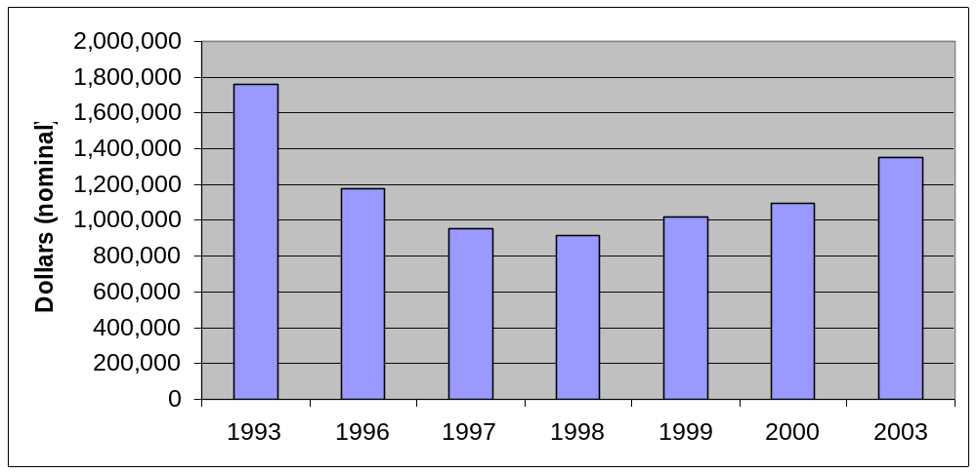
Spending on Utility Sector Energy Efficiency Programs 1992-2003 [nominal dollars]

Slide 6
States with Utility Sector Energy Efficiency Programs—Public Benefits or DSM
Blue states have public benefit funds that support EE
Green states have utility DSM under regulated structure

Slide 7
States with EERS-Like Policies
Black= has EERS
Grey= EERS pending

Slide 8
Texas
EERS in place since 1999
Reduce demand growth 10%
Measured in kW
Commission developed implementing regulations and monitors evaluations
Utilities have exceeded targets each year
Now discussion of increasing targets

Slide 9
Hawaii
RPS established in 2001 calls for 8% of kWh sales in 2005, 20% in 2020
Expanded by legislature in 2004 to count efficiency including CHP
  Make 2020 targets more achievable
In 2004, RE and EE accounted for 11.4% of sales
  68% RE, 32% EE

Slide 10
Nevada
Had RPS and in 2005 legislature modified this to raise target and include EE
Target is 15% of electricity sales in 2015
  Up to ¼ can be EE
Commission developed implementing rules including ways for 3rd parties to participate
Utilities now ramping up EE programs to achieve 3.75% savings by 2015

Slide 11
California
Ten year savings targets set by CPUC
  ~10% of electricity sales, 12% of peak demand
  Targets somewhat lower for natural gas
Implementation just beginning
  To meet targets have to double annual electricity savings and triple natural gas savings
Utilities have decoupling and shareholder incentives for reaching targets

Slide 12
Vermont
Programs run by non-profit that won an RFP to provide statewide programs
Savings targets in contract with PSB
From 2000-2004, reduced sales over 3%
New targets call for >1% additional savings each year
Discussions underway about increasing targets significantly

Slide 13
Connecticut
Added EE targets to existing RPS
  Separate targets for EE, tier 1 RE and tier 2 RE
Efficiency targets are 4% of C&I sales over the 2006-2010 period
  CHP counts
  Savings from existing PBF count
  Additional savings will need to be purchased from ESCO’s and other third parties
  Can also purchase credits from state at default rate

Slide 14
Pennsylvania
Alternative Energy Portfolio Standards Act passed in 2004
Requires 8% of power in 2021 to be meet “tier 1” requirements (clean renewables)
Requires an additional 10% of power in 2021 to meet “tier 2” requirements
  Includes efficiency, hydro, MSW & waste coal
  Tier 2 resources in 2003 were about 8% of sales
Commission developed implementing regulations including “deemed savings” values for common EE measures

Slide 15
Other States
Illinois developing a proposal similar to the one in Texas but meet 25% of load growth
NJ pursuing two approaches:
  Energy savings targets in contract with efficiency implementers (like VT)
  A pure EEPS to complement their existing PBF
Colorado – settlement agreement with largest utility sets EE targets for 2006-2013
  320 MW and 800 GWh/yr savings in 2013

Slide 16
United Kingdom
Energy Efficiency Commitment establishes savings targets for electric & gas suppliers
Covers residential sales
Many measures with deemed savings values
Required 62 billion kWh lifetime savings over 2002-2005 period
  Suppliers exceeded this target by 40%
  Many creative approaches employed
Requiring 130 billion kWh for 2005-2008
  ~0.7% savings per year

Slide 17
Italy
Italian regulator established savings obligation for gas & electric distribution companies
Initial targets cover 2005-2009
  Ramp up to 1% savings in the final year
Distributors can operate programs themselves or buy credits from 3rd parties
  Vibrant credit market established in first year

Slide 18
Other Countries
France passed law establishing energy savings targets in 2005; implementation just beginning
Flemish Region of Belgium established program in 2003; covers electric distributors
  Requires savings of about 1%/year
Distributors easily met targets in first 2 yrs

Slide 19
A Federal EERS?
Various Senators working on stand-alone EERS bills
  Similar to proposed federal RPS with growing targets
Also proposals developed for multiple “advanced” energy resource standards including:
  Efficiency (sometimes called DSM)
  Renewables
  Advanced coal (varies on how “clean”)
  New nuclear plants

Slide 20
EERS Issues
EERS implementation details
Which providers covered? (gas? size cap?)
Which measures eligible? (CHP? T&D?)
Appropriate targets?
How many years should an EERS extend?
Trading and/or cost caps?
Relationship with RPS?
Monitoring and verification?
Relationship to other policies? (PBF, decoupling)

Slide 21
ACEEE Analysis of EERS Savings
Simple spreadsheet driven off of EIA AEO 2006 forecast
Assume 0.25% savings in 1st year, 0.5% additional in 2nd year, 0.75% additional thereafter
Estimate levelized cost of 3 cents/kWh, 30 cents/therm with utility paying 1/3
Emissions savings based on generation mix in AEO, both new and old plants

Slide 22
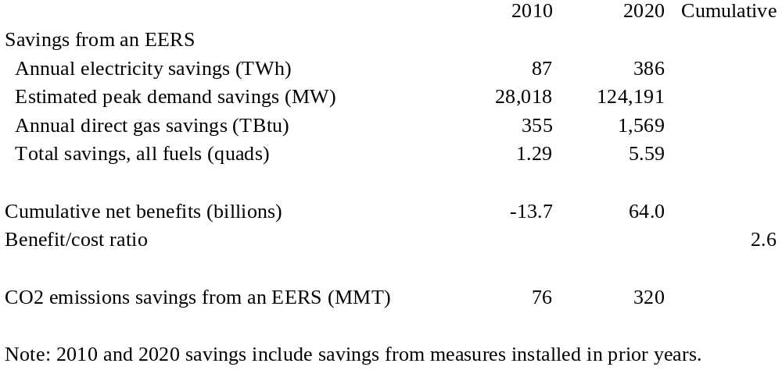
Summary of Results

Slide 23
Conclusions
An EERS is a promising energy-saving strategy for both states and the federal government
Significant experience on which to build
Savings are substantial – 4.6% reduction in 2020 energy consumption
  Approximately 3X efficiency savings of EPAct
  Savings equivalent to 40mpg CAFÉ, starting 2010

Slide 24
For More Information
ACEEE March 2006 report on Energy Efficiency Resource Standards: Experience and Recommendations. http://www.aceee.org/store/proddetail.cfm?CFID=517558&CFTOKEN=14977790&ItemID=409&CategoryID=7

