Slide 1

ICESat Ground System (IGS)
Project Status Review (PSR)
March & April, 1999
AGENDA:
Accomplishments This Month
Planned Activities Next Month
Schedule Status
Implementation Status
Mission Operations Status
Top 10 Issues
Concerns
Mark Kowaleski,
ICESat Operations Manager
301-286-7816
mark.kowaleski@gsfc.nasa.gov

Slide 2
IGS Progress - A Quick Look...
THE IGSMIT TEAM
  IGS Mission Implementation Team (IMIT) established.
COST ESTIMATES
  Completed Goddard FDS cost estimates (still way to high)
  Received S-band/X-band ground station estimates for PTP/SAFS.
  Received ISIPS Level Zero Estimates from Science
  EDOS provided very detailed cost estimates.
  No insight into DAAC estimates.
IGS BASELINE
  EDOS does L0 X-band processing and S-band Play-back handling.
  ISIPS does all L1 & L2 data production.
  New DAAC/EDOS/ISIPS architecture defined.
  MOC/FOT/FDS still TBD (pending CSOC vs. Ball Aerospace competition).

Slide 3
Activities Completed This Month
Released MOC/FOT/FDS PR package (+ JOFOC) to CSOC and to Ball Aerospace.
  Note: RFP only for L+3 years operations.
Evaluating CSOC MOC/FOT/FDS Proposal.
Mission Operations Requirements Document (IMORD) being reviewed by IGSMIT.
Held IGSMIT Kick-off meeting and first monthly team meeting (April).
Established monthly working schedule, including Mission Ops, Science Ops, Networks, and I&T Splinter Working Groups (based on Menrad’s LSAT lead).
Met with all IGS representatives (EPGS, EDOS, EBNET, FDS, DAACs, CTV, SOMO/CSOC, etc.) to solicit and confirm support for IGS implementation.
Established Mission Operations section on the ICESat Homepage.
  http://icesat.gsfc.nasa.gov/
Established process for IGS documentation, master schedule development, & status reporting.
Attended QuikSCAT Delta ORR at GSFC.
Prepared draft PSLA for SOMO support (excluding MOC/FOT/FDS - TBD).
Drafted new MSR Milestones but still need inputs from most mission elements.

Slide 4
Activities Planned for Next Month
Schedule July MOWG II and prepare topics/agenda.
Baseline IGS Architecture.
Evaluate Ball’s MOC/FOT/FDS Proposal.
Baseline SOMO/CSOC Support and finalize PSLA.
First revision of MORD.
Draft IGS Master Schedule with inputs from each mission element.

Slide 5
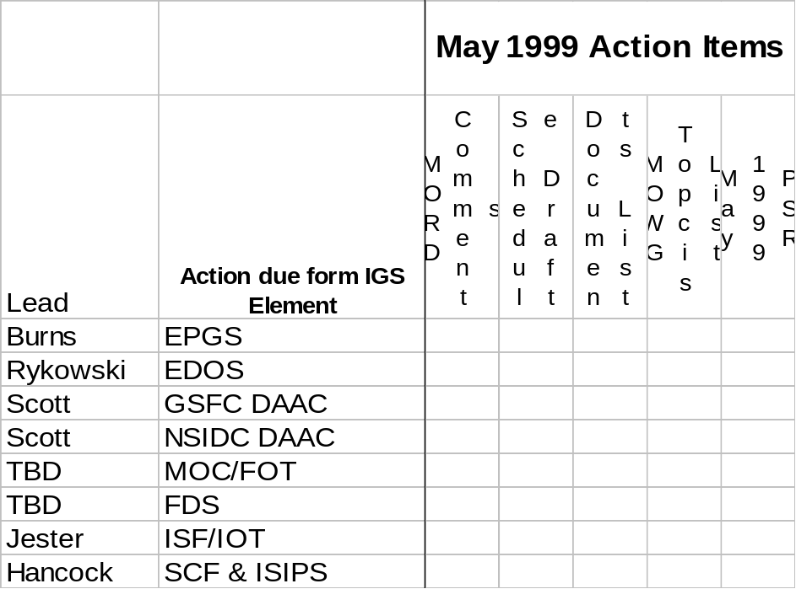
Action Items levied on IGSMIT - FYI
SHORT TERM
  Draft schedule (see schedule handouts)- 5/3/99.
  Draft Documentation List (see Master DOC list Handout) - 5/3/99.
  MORD comments (see MORD on Homepage) 5/3/99.
  May, 1999 PSR Inputs using templates (see PSR Templates) - 5/24/99.
  Support Splinter Working Groups as needed monthly.
  Sign up for IGSMIT list-serve.
  Everyone surf the ICESat Web Sites to get up to speed.
LONG TERM
  Begin MOWG II thinking, ideas, duration, topics, etc. - July 13-15, 1999.
  Plan for Mission Operations Review (MOR) 12/99.

Slide 6
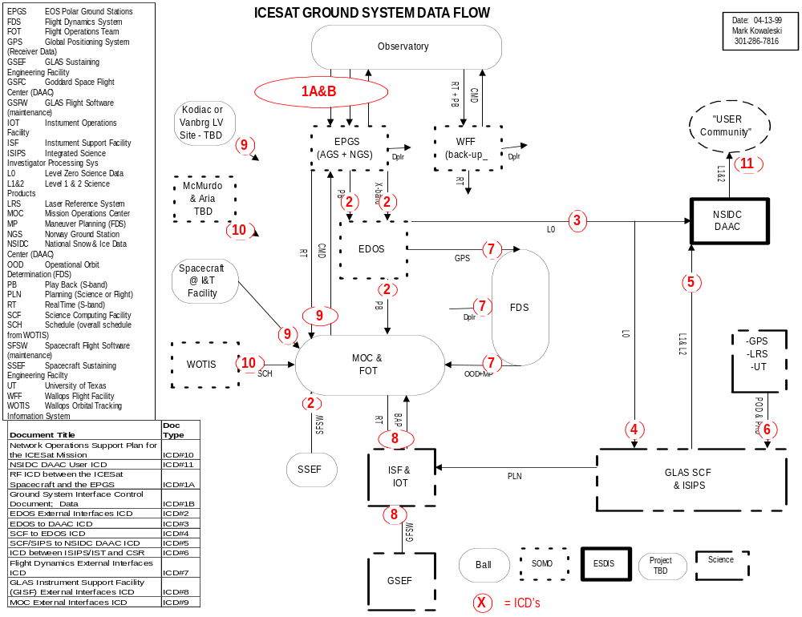
Pending Science Splinter Meeting

Slide 7
GSFC
PRELIMINARY
Orig Approval
TBD
APPVL RESP
C. SCOLESE
ICESat MASTER SCHEDULE
ACCOMP RESP
J. DEZIO
Status As Of
3/31/99
PROJECT/ELEMENT
C
98
1
2
99
3
4
1
2
00
3
4
01
4
02
Y
1
2
3
4
1
2
3
1
REVIEWS
PDR
ATP
SRR
MDR
MOR
PER
FOR
PSR
LRR
LRD
SPACECRAFT
Bus Design Modifications
Avionics and Harness In-House
PWR, C+DH + COM
BALL AEROSPACE
Procure.’s, Fab, Assy, + Test
ACDS
Ctrl Computers
Struct.
Prop
S/As
S/S Deliveries
Subsystem I+T
Slack
Float
GLAS I+T
LRD
EM Laser
Flt Laser
Environmental Testing
7/01
S/C ICD
CDR
Drill
Flt
Spare
#1
Flt Laser
Box, Pack, and Ship
GLAS INSTRUMENT
Template
Tele
Tele
#2
Flt Laser
Launch Operations
GSFC CODE 900
Detailed Design
#3
PER
PSR
Fabrication
IIRR
Delv.
Assy + Test
Beta
Version
Review ATBDs
Slack
1 Month
Exec
Final
Oral
Reviewers
Version #1
Phase
ATBDs
Reviews
Report
Version #2
SCIENCE
GSFC CODE 900
Award
Phase B
Phase C/D
AWD
FDS
CDR
CDR
CMP/
TEL
CTV
VAC
TEST
SIM+Dress
Rehearsal
CONTROL CENTER/
FOT (TBD)
PROCS
DBASE
Milestones require element input.
Phase C/D Design/Development/Integrate/Test
FOT Training
Preliminary
Draft
IGS
TEST
PLAN
AGS/NGS
NSIOC
DAAC
Science
ETE
Flow
MOWG2
FINAL
MORD
MOR
ICD’s
NISN
WOTIS
MOWG
3
Action
Plan
30 DAY
C/O
Cale
Val
GROUND SYSTEM +
OPERATIONS
ESDIS/SOMO
MORD
MOWG1 7/98
Sim
EDOS
ORR
LDR
Design and
Development
GES
DAAC
ISF
OPS ETE
Flows
GLAS
C/O
Award
LAUNCH VEHICLE
DELTA 7320
Manufacturing , Assembly, and Test
Delivery and Launch Operations
NOTE: 07/01 LRD REQUIRES PAYBACK OF REMAINING $11M FY99 BUDGET CUT AND
ADDITIONAL $10M FOR DELTA LV.

Slide 8
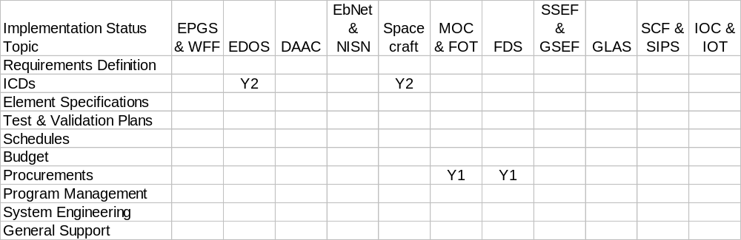
Implementation Status
G = green = blank = no problems
Y = yellow = alert to minor problem or developing condition
R = red = major problem that requires immediate attention
NOTES:
Y1: Control Center procurement delays will reach red status level if not awarded in June, 1999 (L-24). There are not FOT members named, thus the learning curve is getting steeper each passing day. Risk level due to time spent on SOMO/CSOC is high.
Y2: Data ICD is in draft form. Pending inputs from GLAS APIDs and submission by Ball (this is a Ball doc. Effects the initial work of EDOS and ISIPS.
General: Need inputs from each mission element for schedule, milestone, and requirements - no response yet from IGSMIT members.

Slide 9
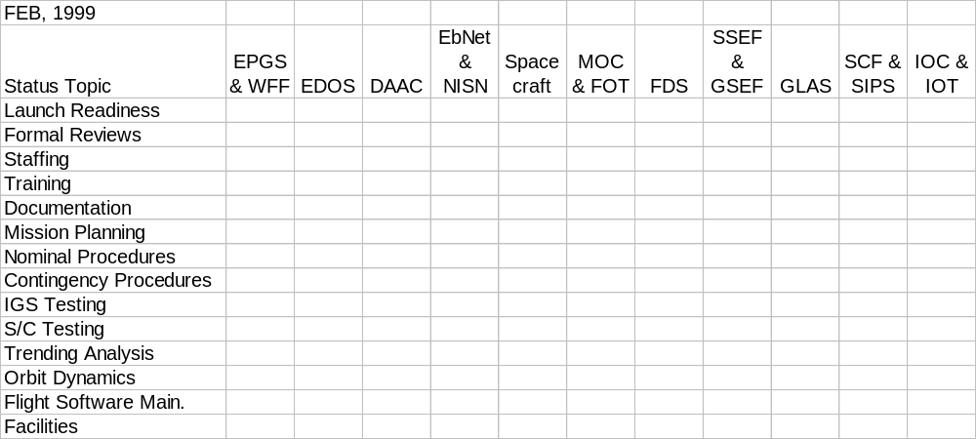
Mission Operations Status
G = green = blank = no problems
Y = yellow = alert to minor problem or developing condition
R = red = major problem that requires immediate attention
NOTES:
none

Slide 10
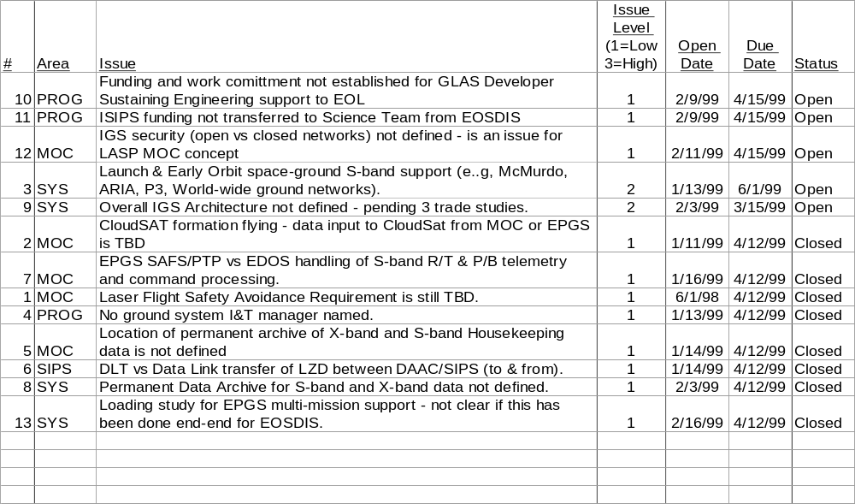
Top XX Open Issues Being Tracked
NOTES:
Closed 8 issues.
No new issues.

Slide 11
Concerns
None

