Slide 1
Reflections on
Symmetries and Neutrinos
Adam Para

Slide 2
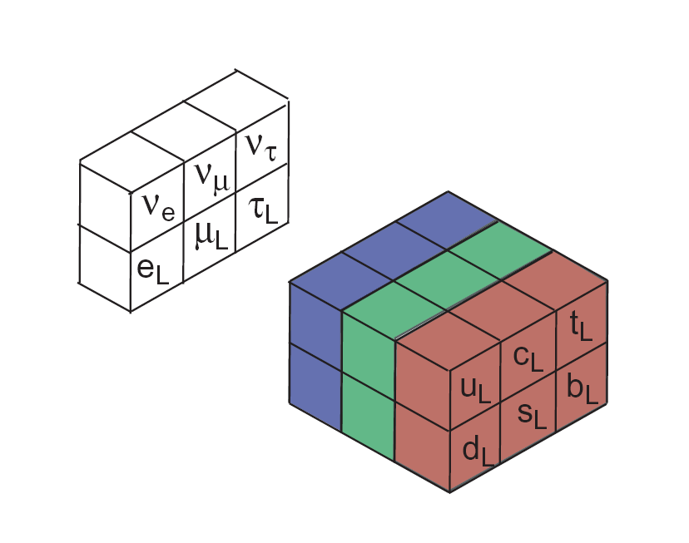
Revolutionary Developments in XX Century Physics
Special Relativity
General Relativity
Quantum Mechanics
Quantum Field Theory
Standard Model of Elementary Particles and their Interactions
Role of symmetry in physics

Slide 3
Mathematics – Physics Connection
Mathematics is the language of physics. Mathematical concepts adopted or invented by physicists to express precisely and concisely the physical ideas:
  Calculus
  Complex numbers/functions
  Differential geometry
  Group theory
  Hilbert spaces, hermitian operators
  Differential forms
Symmetries: mathematical concept with profound physics consequences
  Conservation laws
  Interactions
Spontaneously broken (hidden) symmetries [Is parity really violated ???]

Slide 4
Symmetry
What is a symmetry?
  Symmetry operation leaves the system unchanged/undistinguishable
  Property of a system having symmetry operations
  Examples:
    Space is uniform: translations and/or rotations do not change the laws of physics
    Red/blue/green quarks have the same strong interactions: we can change(rotate, mix) the quarks definition without any physical consequences
    CPT: if we replace particles by antiparticles, reflect the space and time coordinated then all the process will proceed with the same rates/probabilities
Symmetry of what?
  ‘World we live in’

Slide 5
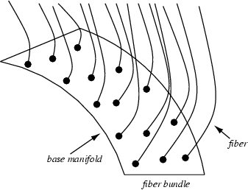
What is (the Mathematical Model of?) Our World
Internal Space:
Phase of the wave function U(1)
SU(2) rotation phase
SU(3) (color) rotation phase
Quark mixing matrix
Lepton Mixing Matrix
. . .
We live/move here, on our Home Manifold: 3+1+N dimensional space-time, N≥0

Slide 6
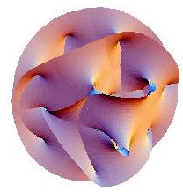
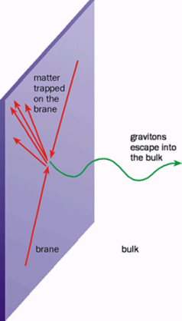
Where are the Extra Dimensions???
We (all particles of a Standard Model) are confined to a 3+1 dimensional hyperspace (brane) embedded in 3+1+N dimensional Universe
Only graviton is allowed to travel in ‘bulk’. And this is the reason why gravity appears to be so weak on our brane
Everywhere, but they are compactified to a tiny Calabi-Yau manifold at every point of ‘our’ space-time
Excitations corresponding to the quantized momentum in these dimenions → Kaluza-Klein ‘tower’

Slide 7
Symmetries of Our World
Continuous (translations, rotations)
Discrete (reflections, C,T)
3+1 space-time:
  Lorentz transformations
  Reflections
Internal space:
  U(1) phase
  SU(2) phase (weak interactions)
  SU(3) strong interactions
  Families (KM, MNS mixing matrix)
  Lepton-quark symmetry?
Extra dimensions (Calabi-Yau manifolds)

Slide 8
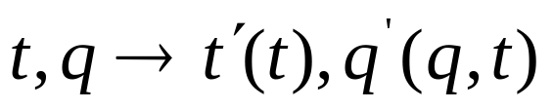
Global Symmetries ↔Conservation Laws (Noether 1915)
If the Euler-Lagrange equation of motion is invariant under a coordinate transformation
then there exist an integral of motion, i.e. a conserved quantity
Every continuous global symmetry operation has an associated conserved quantity
Examples/consequences of Neother’s theorem:
  Invariance under space translation ↔ momentum conservation
  Invariance under time translation ↔ energy conservation
  Invariance under space rotations ↔ angular momentum conservation

Slide 9
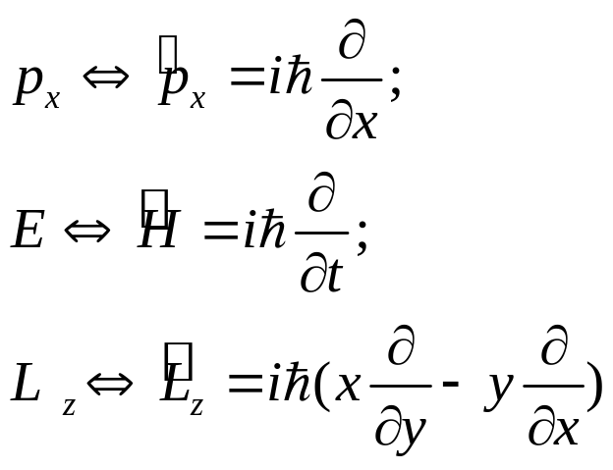
Connection Between Symmetries and Conservation Laws in Quantum Mechanics
What took long time to discover in classical physics is self-evident in Quantum Mechanics:
Operators related to conserved physical quantities are generators of the corresponding symmetry operations

Slide 10
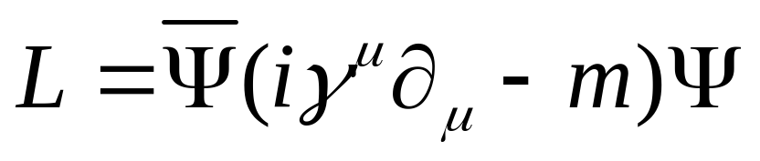
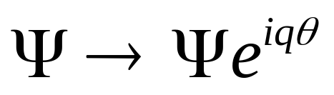
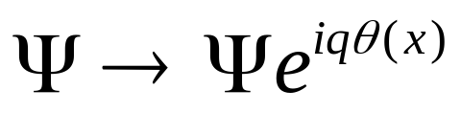
Local Symmetries ↔ Interactions
(Weyl 1919, Yang-Mills 1952)
‘Physics’ ↔ equations of motions ↔ lagrangian
Is evidently invariant under the global phase transformation ↔ charge conservation
But it requires that the phase is redefined instantaneously in the whole universe ↔ problems with special relativity. Can we propagate the phase redefinition ?

Slide 11
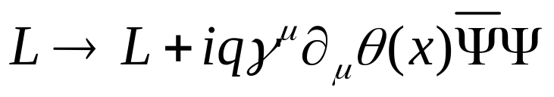
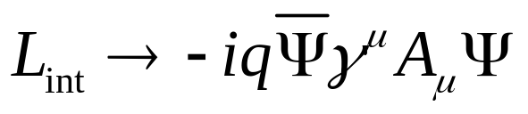
No, the lagrangian is not invariant under the local phase transformation
How to define a lagrangian invariant under the local transformation? Need additional vector field
↔ new interaction
Profound consequences:
Maxwell equations
Massless photons
Interactions of matter with radiation

Slide 12
Geometry and Interactions
Geometry of spacetime ↔ gravitation (general relativity)
Local Symmetry of the Internal Space (Gauge Symmetry) ↔ electromagnetic, weak and strong interactions
  Universal couplings
  Massless vector bosons (long range interactions)
Spontaneous symmetry breaking ↔ mass of intermediate vector bosons

Slide 13
Neutrinos
SU(2) partners of charged leptons
The only elementary fermions with Q=0
Left-handed only (no longer)
Only weakly interactions
Incredibly light (formerly massless)
Self-conjugate (own antiparticles)? Or not?
What do they have to do with symmetries??:
    Saviors/daughters of symmetries
    Symmetries killers
    Symmetries messengers
    Symmetries probes
    … examples follow…

Slide 14
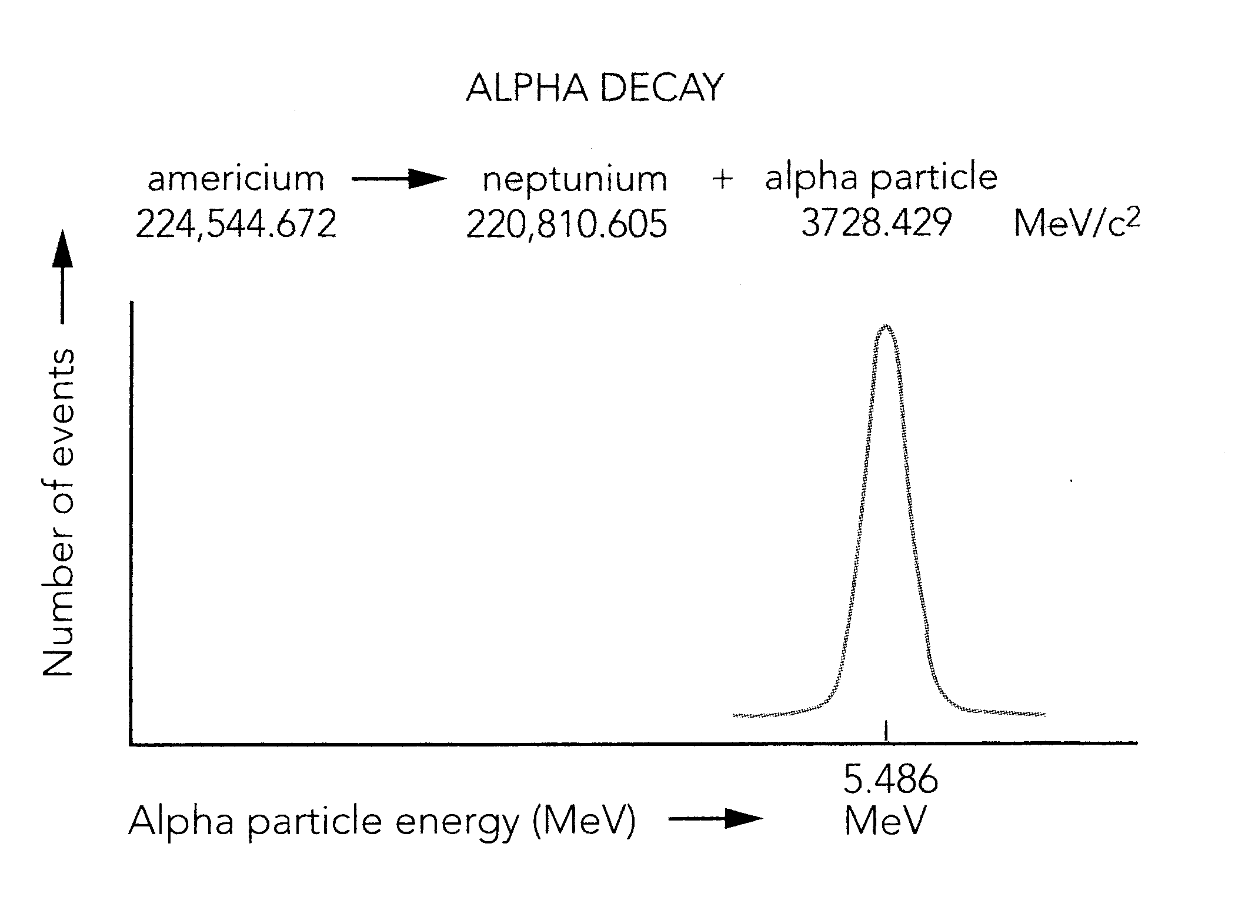

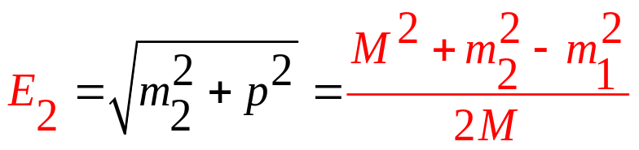
Two body decay
m₁
M
m₂
Energy-momentum conservation =>
Energy of the decay products always the same

Slide 15
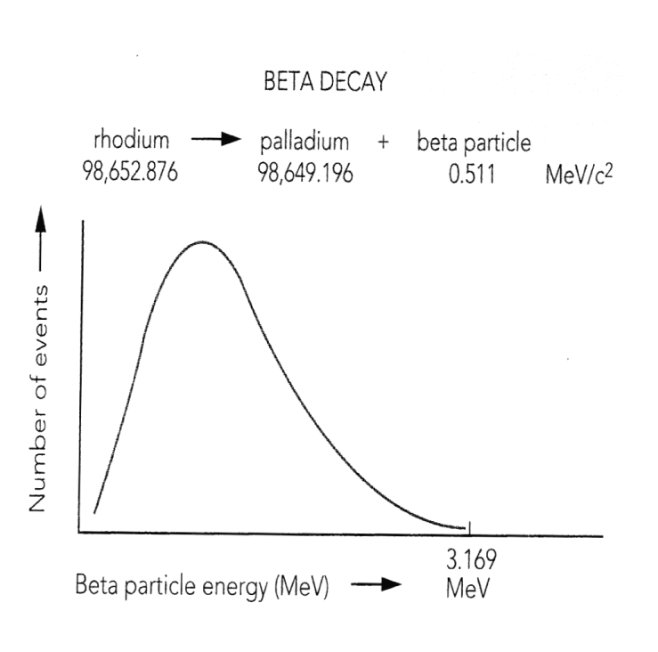
1913-1930: Puzzle of β decay
(Bohr)
Continuous spectrum of β particles
Energy is not conserved?? (Bohr)
No translational symmetry of space-time?
… or ?
Conflict between ‘theory’ and ‘Experiment’

Slide 16
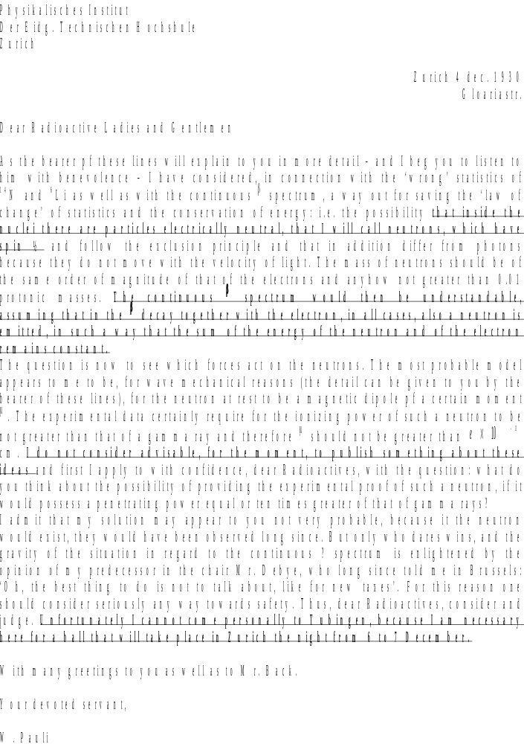
Dec 1930: An Act of Faith in Theory:
Incomplete Experiment?
A’
A
e
“I have done something very bad today by proposing a particle that cannot be detected; it is something no theorist should ever do.”
W. Pauli
Neutrino – a daughter of symmetry

Slide 17
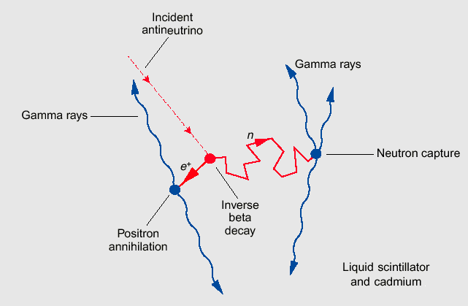
1956: A Fateful Year. For Neutrinos Too.
1956, Savannah River, Reines and Cowen:”We are happy to inform you (Pauli) that we have definitely detected neutrinos…”
A downfall of parity: T.D. Lee, C.N. Yang.
Two –component neutrino theory: a neutrino has no mirror image. (A vampire-neutrino?) Massless neutrino.
V-A theory of weak interactions (Feynmann, Gell-Mann)

Slide 18
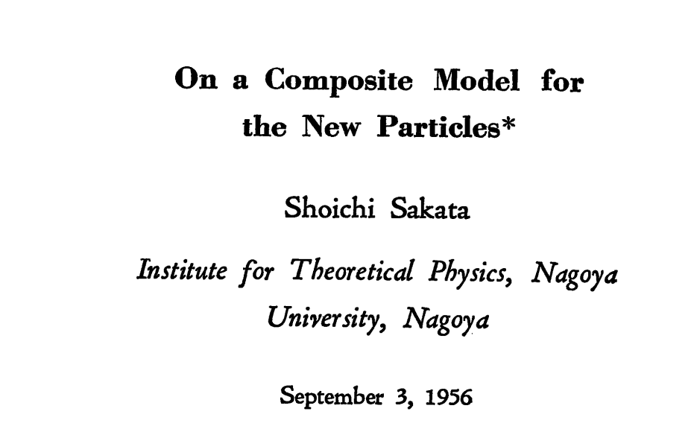
At the Same Time in Japan…
A search for new symmetries: Sakata/Nagoya/Nagoya-Kyoto model
Symmetry of strong interactions (SU(3)?)
  Baryons are bound states of 3 ‘fundamental’ baryons/ur-baryons: p,n,Λ
  Mesons are baryon-antibaryon bound states
Leptons-baryons connection/symmetry: baryons are bound states of new field B⁺ and leptons:
  p = < νB⁺ >, n = < eB⁺ >, p = < μB⁺ >
p
n
Λ
ν
e
μ

Slide 19
1962: Lederman, Schwartz, Steinberger
Two different kinds of neutrinos! If Sakata symmetry holds – there must be a new heavy baryon X
Prediction of a new heavy baryon (==charm!). Niu 1971 – discovery of charm particle (m(C)=1.78 GeV)
Maki-Nakagawa-Sakata: two neutrinos should, in general, mix. MNS neutrino mixing matrix!
Neutrinos a guide in postulating/establishing symmetries of Nature, predicting new particles.
p
X
n
Λ
ν1
ν2
e
μ

Slide 20
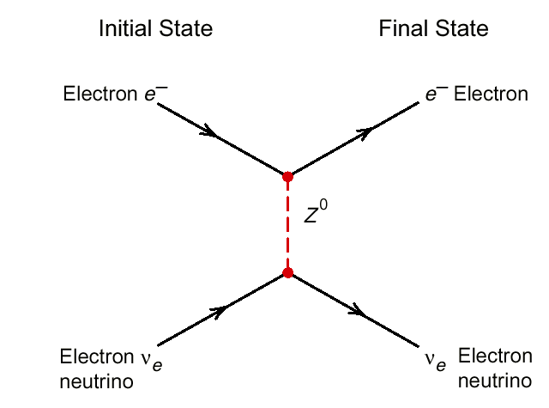
Conception of the Standard Model
Glashow, Weinberg, Salam + many others: local SU(2)xU(1) gauge symmetry (local redefinition of up-down members of the weak doublets) as a possible model for unified electromagnetic and weak interactions
Spontaneous symmetry breaking (Higgs) as a way to avoid problems with massless bosons/long range
Predictions:
  weak neutral current interactions
  Intermediate vector bosons, W/Z
  Mass of IVB ~ 80 GeV
Free parameter: weak mixing angle

Slide 21
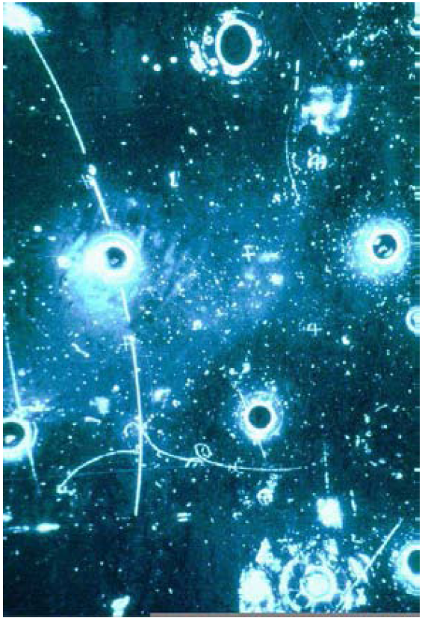
1973: Golden Event (Gargamelle)
Heavy liquid bubble chamber exposed to a medium energy beam of muon antineutrinos:
  a single energetic electron appearing in the middle of the fiducial volume
  the only plausible interpretation
ν_{μ} + e⁻ →ν_{μ} + e⁻
    Existence of neutral currents established.
    Explanation of previously reported ‘unexplained background events’.
Later, in 1984, SPS collider: existence of W± and Z⁰ established. Neutrinos (a.k.a. missing energy) an important signature
Neutrino (beam) a tool to discover new interactions.
Neutrino a signature for weak decays of new particles.

Slide 22
1970-ies, Quantum Chromodynamics
The success of the gauge symmetry approach for weak/electromagnetic interactions
Spectacular success of QED
Asymptotic freedom (Gross, Politzer, Wilczek)
➔ Quantum Chromodynamics: Strong interactions related to a local symmetry of SU(3) color phase
Strong interactions: neutrinos not involved (?)

Slide 23
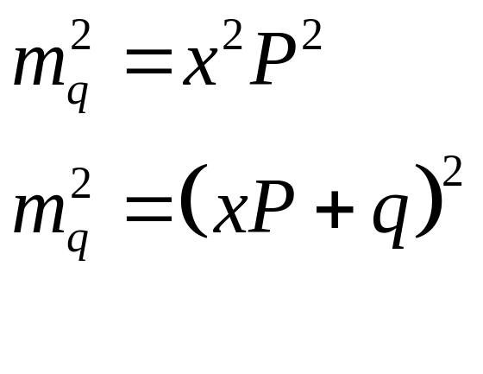
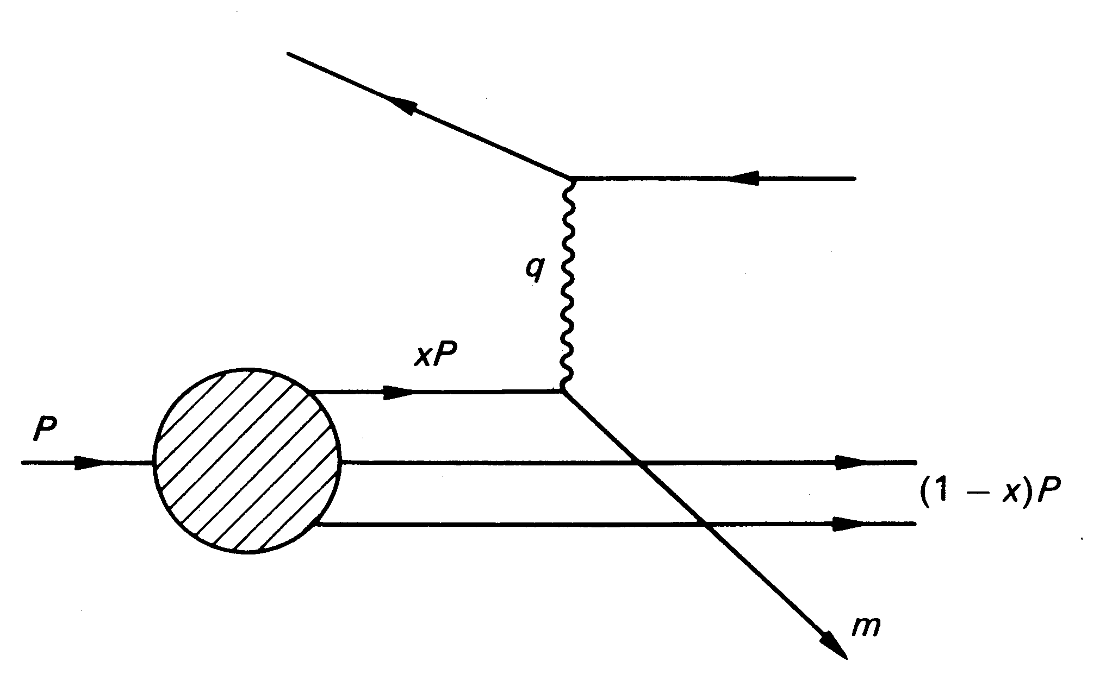

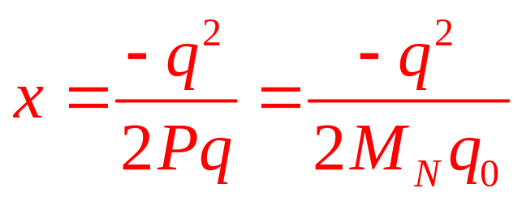
Probing Nucleon with Neutrinos
μ
ν
Neutrino scatters off a parton inside the nucleon
Probe momentum distribution of partons inside the nucleon

Slide 24
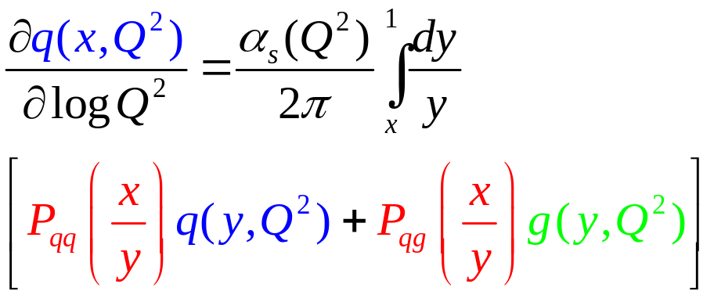
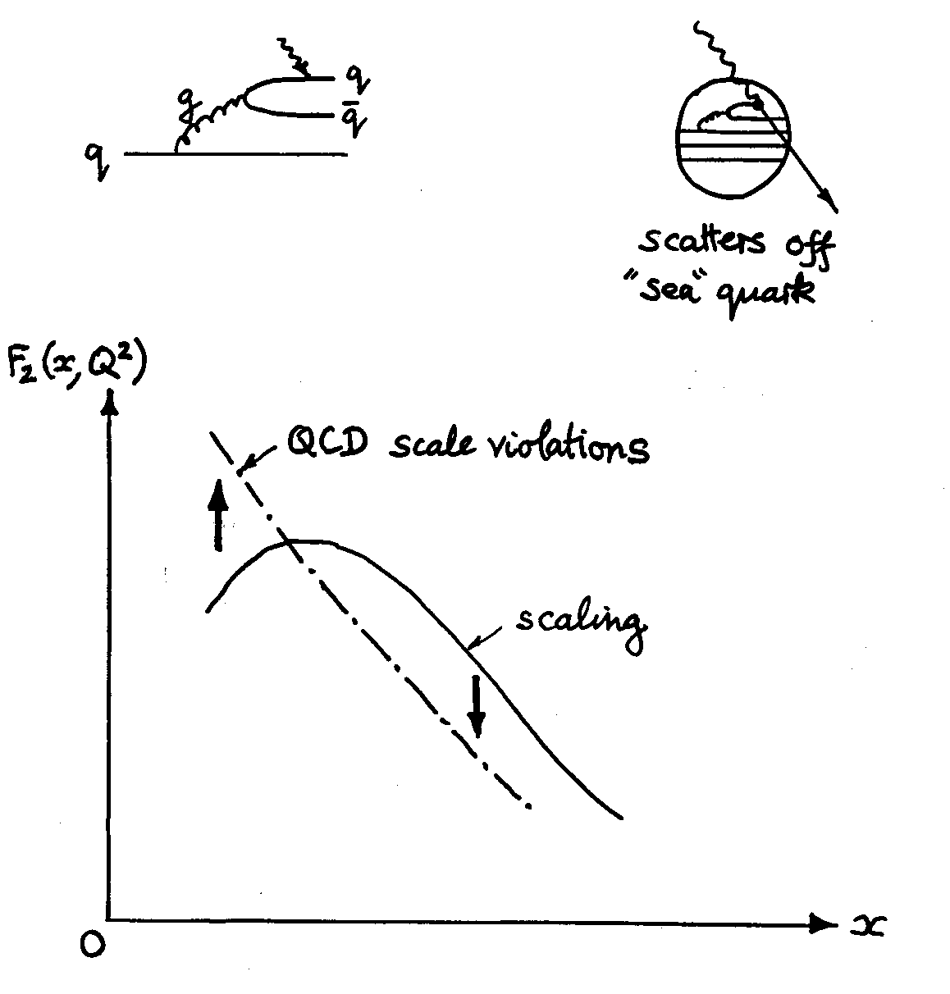
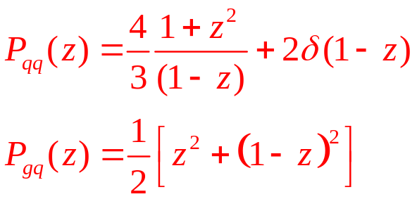
Strong Interactions of Partons
P_{qq}(x/y) = probability of finding a quark with momentum x within a quark with momentum y
P_{gq}(x/y) = probability of finding a q with momentum x within a gluon with momentum y

Slide 25
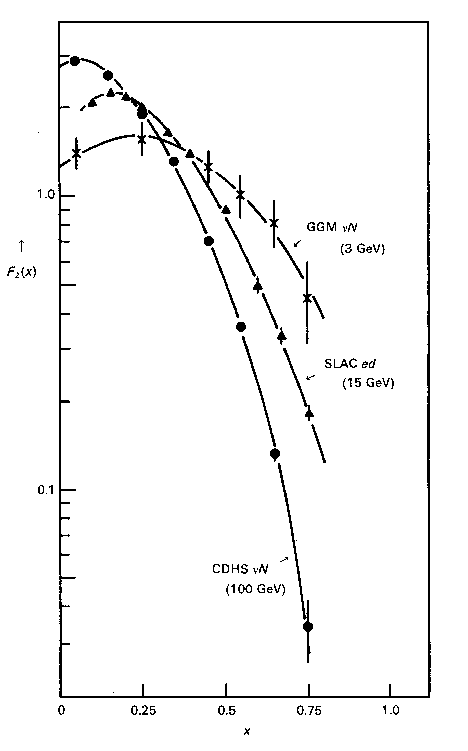
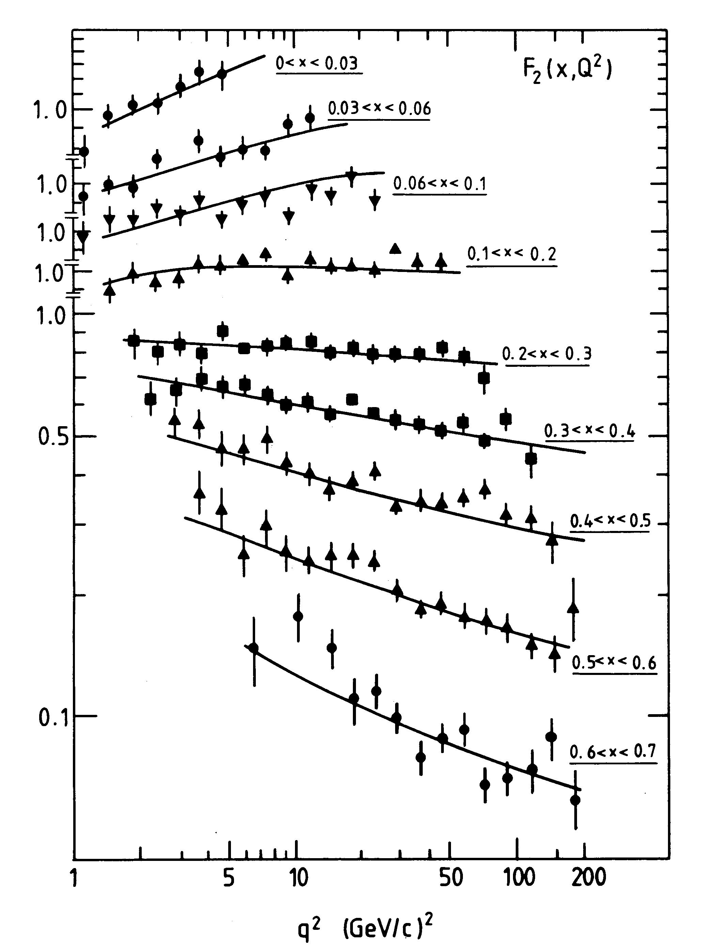
Establishing the QCD
Observed quark distributions vary with Q²
In a quantitative agreement with the QCD predictions
Neutrinos: a tool to establish a theory of strong interactions/ local gauge SU(3) symmetry

Slide 26
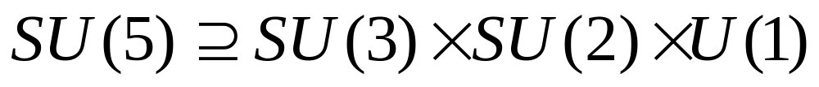
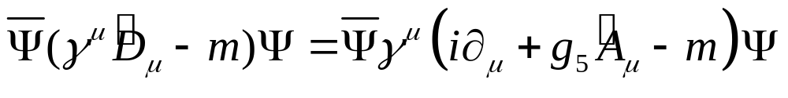
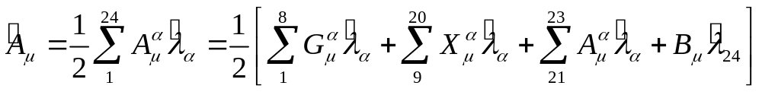
Keep Unifying?
Given the success of electroweak unification: do all forces become one at some high energies? And is this unified force a consequence of a local gauge symmetry? Try :
A single coupling constant , g₅, for all interactions/vector bosons

Slide 27
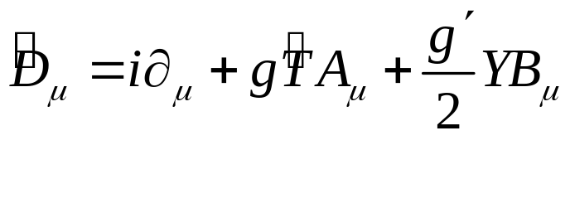
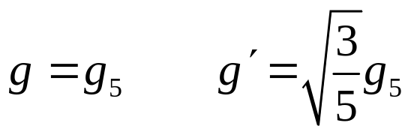
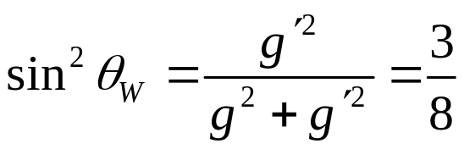
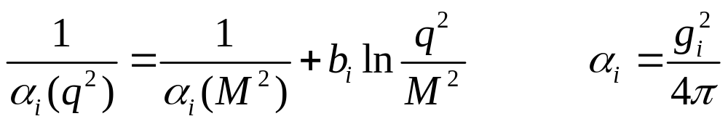
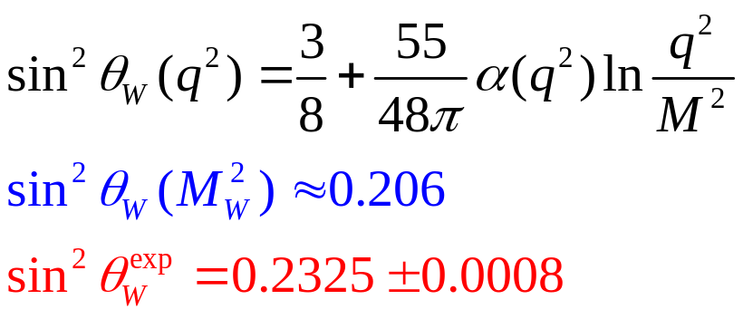
Electroweak sector in SU(5)
with
hence
At the GUT energy scale!
But the coupling constants ‘run’ with energy
Neutrino experiments a severe test for putative Grand Unifications. exclude SU(5) as a GUT

Slide 28

Families
Who ordered them??
Perhaps nobody, but here they are, inviting a number of interesting questions,or trying to tell us something
  What is the origin of quark-lepton relation/symmetry? (Anomalies cancellation: Σq^{i}=0)
  Which quark families relate to which lepton families? (u,d,e,ν_{e}? or perhaps u,d,μ,ν_{μ}? Or perhaps τ? Re: proton decay/stability)
  How many familes?

Slide 29
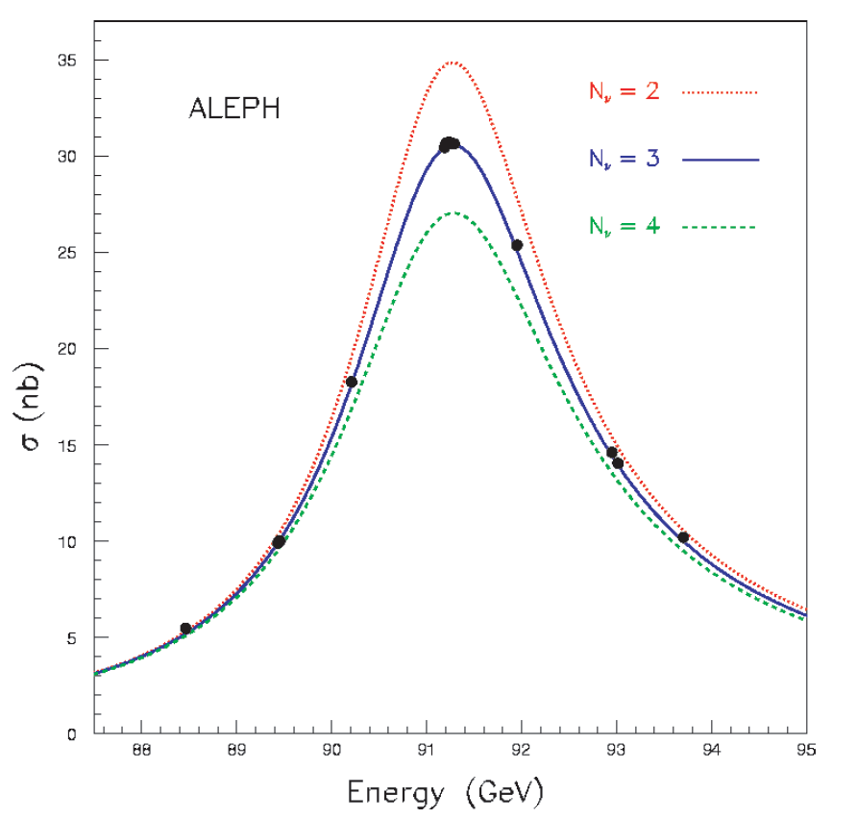
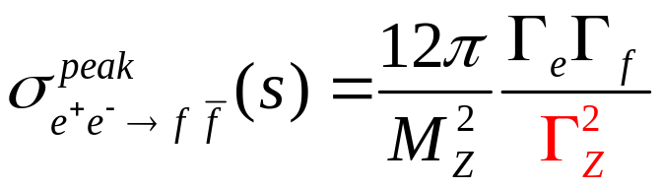
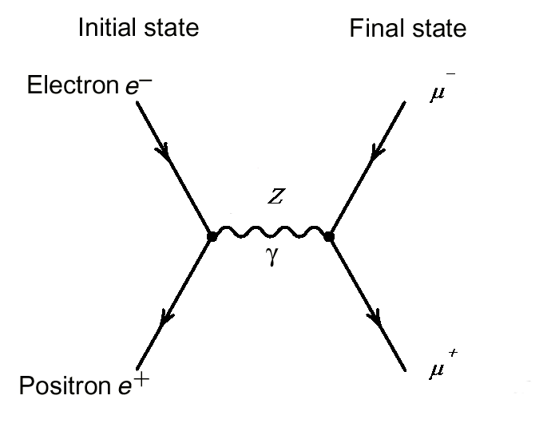
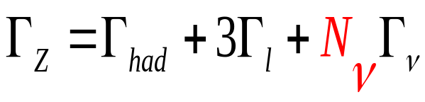
How Many Families?
Neutrinos: families counter

Slide 30
Are Neutrinos Different?
>45 years ago…
  n -> p + e⁻ + ν
  π⁻ -> μ⁻ + ν
Question: are the neutrinos produced in A and B the same? Or different? How can they be different???
Answer: Lederman, Schwartz, Steinberger (Nobel Prize 1987)
μ⁺
ν
μ⁻ only, never e⁻
π⁺

Slide 31
Three Kinds of Neutrinos
Y
e⁺, μ⁺, τ⁺
X
ν_{e},ν_{μ},ν_{τ,}
neutrino born in conjunction with electron, muon, tau is called an electron, muon, tau neutrino.
When it interacts it will produce an electron, muon, tau.
Family lepton number conservation L_{e,}L_{μ},L_{τ} ↔ some new underlying symmetry??

Slide 32

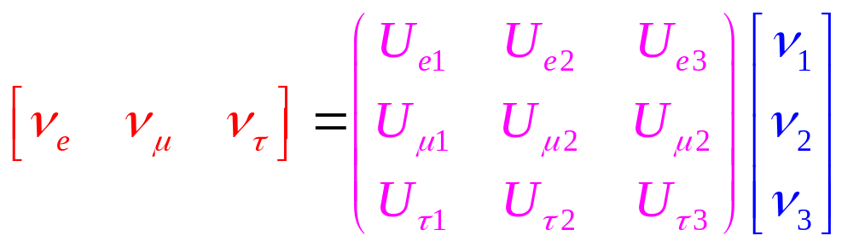
Massive Neutrinos Revolution
Electron (muon,tau) neutrino is not a mass eigenstate
Electron (muon, tau) neutrino is a coherent mixture of mass eigenstates
Y
e⁺
X
ν_{e}

Slide 33
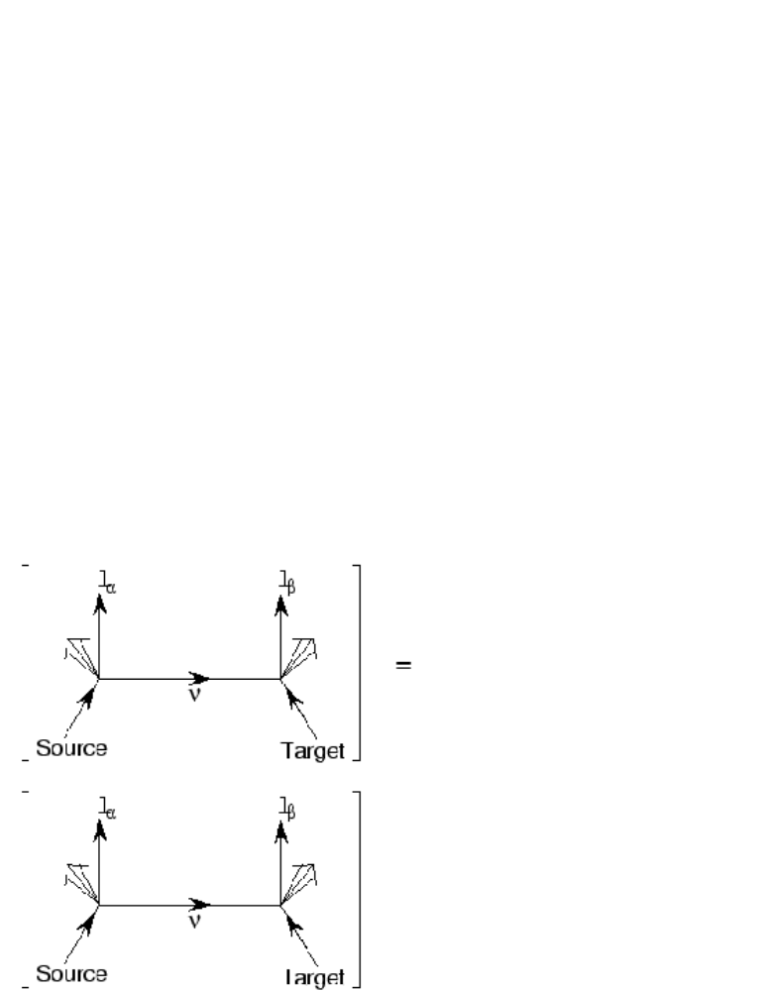
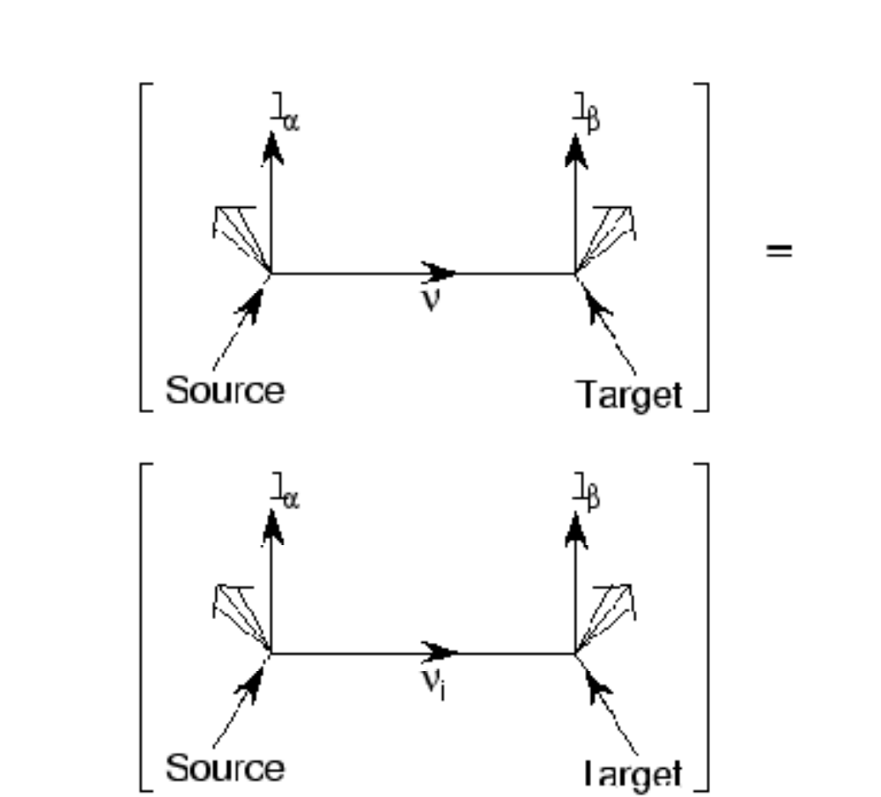
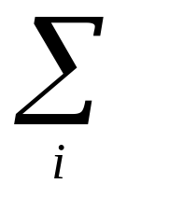
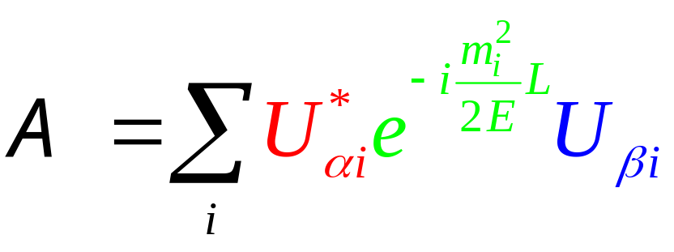
Neutrinos Oscillations
Components of the initial state have different time evolution => Ψ(t) ≠ Ψ(0)
Amplitude
3-slit interference Experiment: mass difference ⬄ difference in optical path length
Amplitude
Notes:
No

Slide 34
Neutrino Oscillations: Lessons and New Questions
No family lepton numbers conservation/symmetry
Neutrinos have mass: right handed neutrinos exist, after all
Downfall of two-component neutrino theory?
New questions
Do neutrinos violate CP? Origin of leptogenesis and baryon number asymmetry of the Universe and our own existemce? Note: CP violation possibly responsible for leptogenesis has nothing to do with the δ_{CP} measured in oscillation experiments.
Is there a lepton number at all? Or are neutrinos Majorana particles?

Slide 35
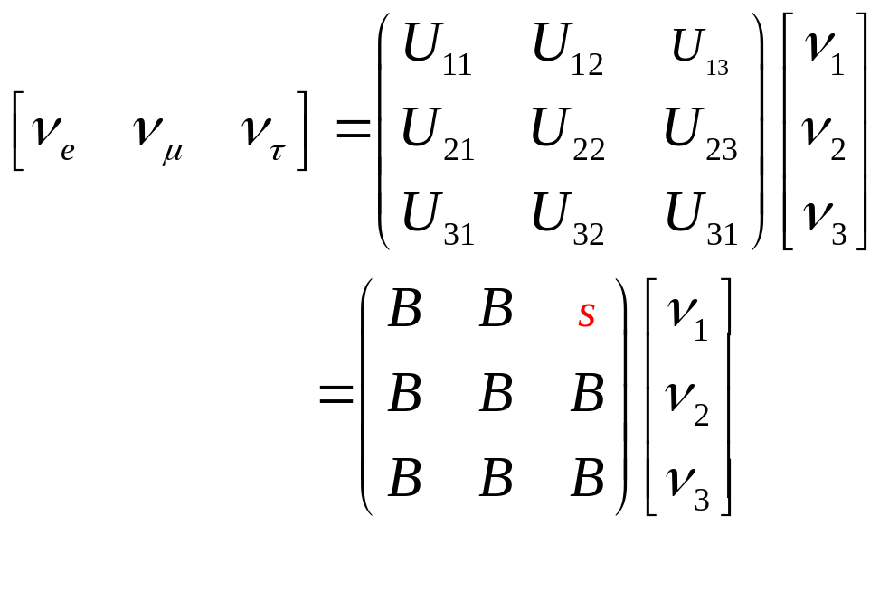
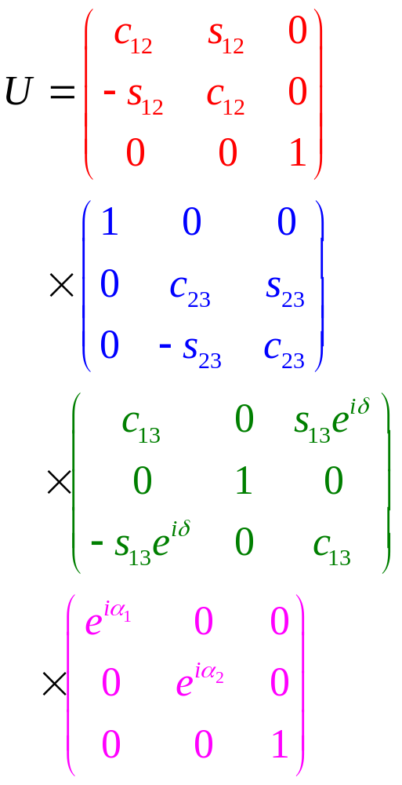
Parameterization of Mixing Matrix
Three mixing angles (like Euler rotation angles
One complex phase (CP violation)
Two Majorana phases

Slide 36
Surprising Pattern of Mixing Angles: New Symmetries of Nature?
Where do mixing angles come from?
Why are they so different (even pattern-wise) from quark mixing angles
sin²2θ₂₃ very close to 1. Is it = 1.00? Maximal mixing ⬅➔ some new symmetry??
Sin²2θ₁₃ small. How small? If tiny, or zero, as opposed to the other mixing angles – why?? Protected by some new symmetry??
Neutrinos as indicators of new symmetries?

Slide 37
Are There any Discrete Symmetries Left?
P, C is violated (maximally) in weak interactions
CP is violated, but
Lorentz invariance + local quantum field theory → CPT invariance
Wait… local quantum field theory?? Aren’t we made of strings? Non-local!
Suppose there is a weak violation (at our energy/distance scale) of CPT communicated to all Standard Model particles. It must be extremely small ~ 10⁻¹⁴ (from Kº_{L}-Kº_{s} mass difference)
But… perhaps the source of the CPT violation is located in the ‘bulk’. The only particle which would be subject to CPT violation is the right-handed neutrino!
CPT violation in the neutrino sector?
  Do neutrinos/antineutrinos oscillate in the same way??
  The same masses?
  The same mixing angles? Limits rather poor so far, but be on lookout (MINOS!)
Neutrinos messengers of CPT violations?

Slide 38
(Kind of) Summary
Symmetries (especially continuous ones) play a very important role in our understanding of our world
We may not know the complete list of symmetries, yet
Neutrinos are a surprisingly powerful tool for learning about symmetries of the Nature

