Slide 1
Direct Photons in PHENIX
Stefan Bathe UC Riverside
for the PHENIX Collaboration
Hot Quarks, May 18, 2006
Notes:
Changed title

Slide 2
Why direct photons?
Hadrons affected by medium created in A+A collision
  Carry information about final state
Photons don’t strongly interact
  Exit medium unscathed
  Carry information about initial state
  Provide calibrated baseline
Leading Particle
Hadrons
frag.
q
g
Direct γ

Slide 3
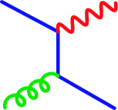
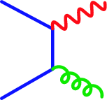


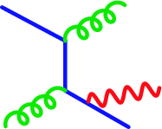
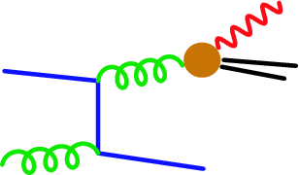
Direct Photons
Compton
Experimenter’s definition
  not from hadronic decays
Elementary processes
  compton:
  annihilation:
  bremsstrahlung = fragmentation
Annihilation
LO
LL
Bremsstrahlung

Slide 4
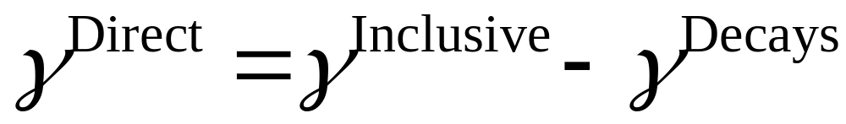
Measurement of Direct Photons
Get clean inclusive-photon sample
  e.g. subtraction of charged particle background
Measure p_{T} spectrum of π⁰ and η mesons with high accuracy
Calculate number of decay photons per π⁰
  Usually with Monte-Carlo
  m_{T} scaling for η’, ω, …
Finally:
Subtract decay background from inclusive photon spectrum

Slide 5
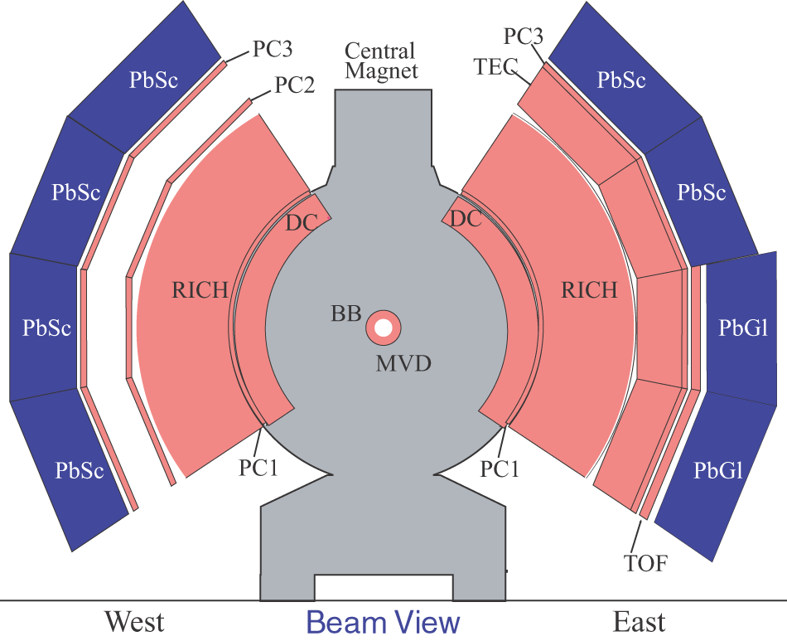
PHENIX Setup
Central spectrometer arms
|η| < 0.35
  γ, π⁰ via π⁰ → γγ:
    EMCal
      Lead scintillator calorimeter (PbSc)
      Lead glass calorimeter (PbGl)
  Charged particles
    DC, PC
  e± ID
    RICH
Muon arms (not shown, forward rapidity)
γ
π⁰
γ

Slide 6
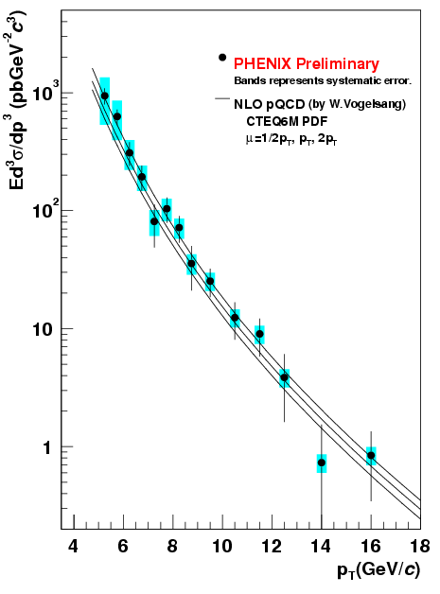

Direct Photons in p+p
q
γ
Compton
g
q
Test of QCD
  direct participant in partonic interaction
  Less dependent on FF than hadron production
Reduce uncertainty on pQCD photons in A+A
good agreement with NLO pQCD
Important baseline for Au+Au
hep-ex/0501066

Slide 7
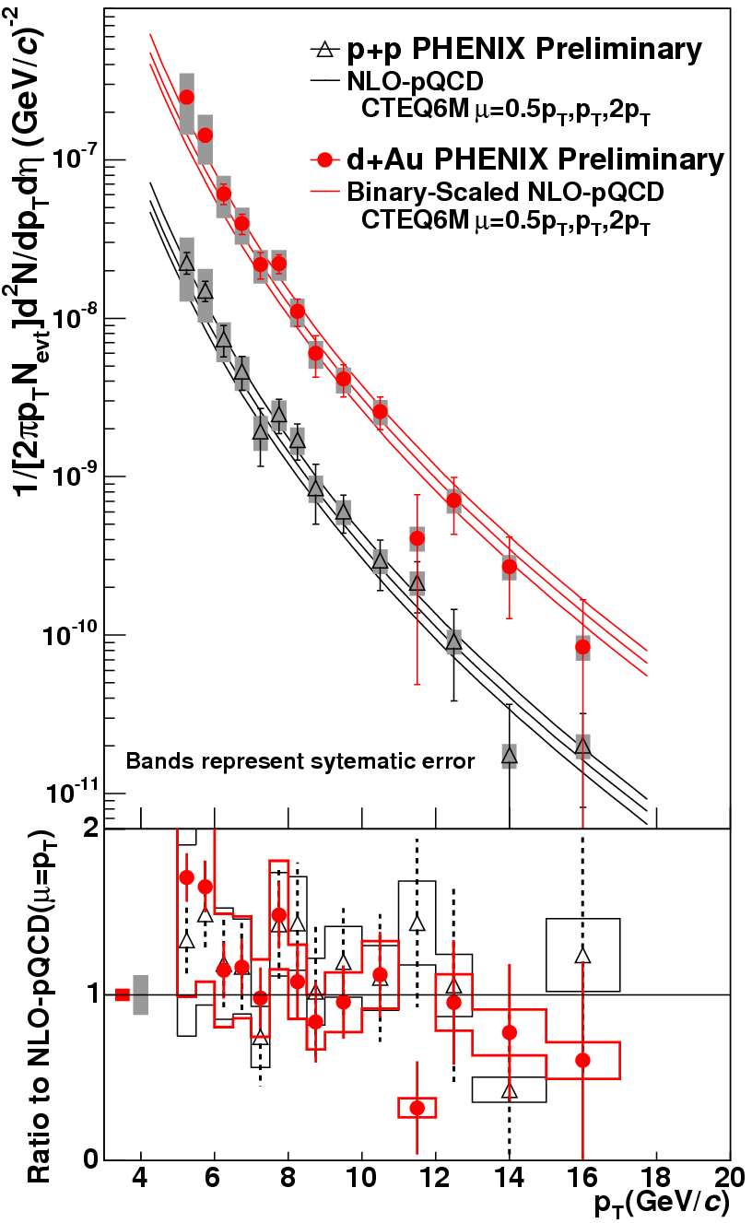
Direct γ in d+Au
d+Au:
  initial-state nuclear effects
  no final-state effects (no medium produced)
  Study initial-state effects
Hisayuki Torii, JPS ’05 (spring)
p+p and d+Au spectra compared to NLO pQCD
2
consistent with 1
No indication for initial-state effects
But large uncertainties
ratio to NLO pQCD

Slide 8
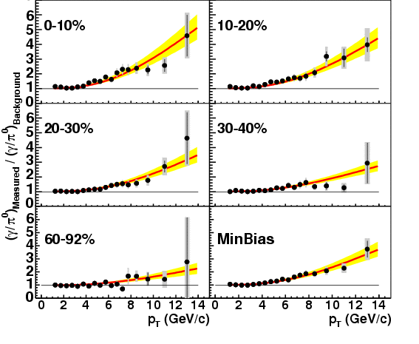

Hard Direct Photons in Au+Au
Large direct photon excess
Photons don’t strongly interact with medium
Allow test of N_{coll} scaling for hard processes
Important for interpretation of observed high-p_{T} hadron suppression
PRL 94, 232301
Expectation for N_{coll} scaling of direct photons
holds for all centrality classes

Slide 9
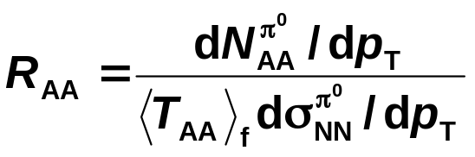
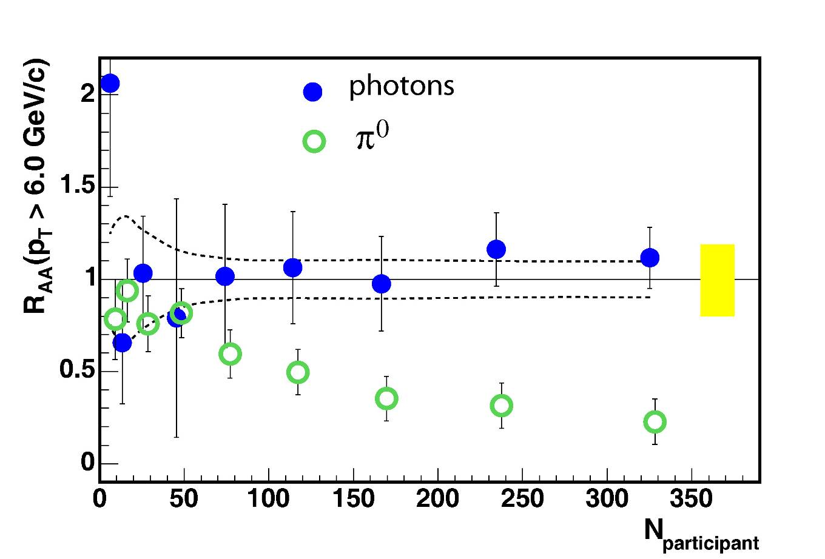
Direct Photon R_{AA}
π⁰ suppression caused by created medium
PRL 94, 232301
direct photons not suppressed
π⁰’s suppressed

Slide 10
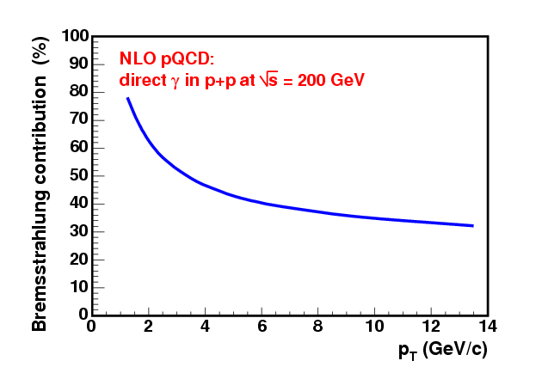
Other Modifications of N_{coll} scaling?
For instance: fragmentation photons?
fragmentation contribution (%)
fragmentation contribution substantial in p+p
parton energy loss in QGP reduces fragmentation contribution in Au+Au
compensated by induced photon bremsstrahlung in QGP
Bremsstrahlung
Effects cancel?
Potentially many more modifications of direct photon production

Slide 11
Going to intermediate p_{T}
Au+Au

Slide 12
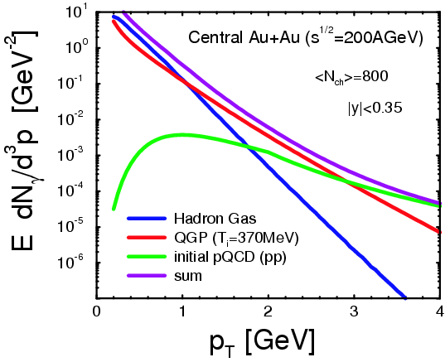
Expected photon sources
Turbide, Rapp, Gale, Phys. Rev. C 69 (014903), 2004
Window for thermal photons from QGP in this calculation:
p_{T} = 1 - 3 GeV/c

Slide 13
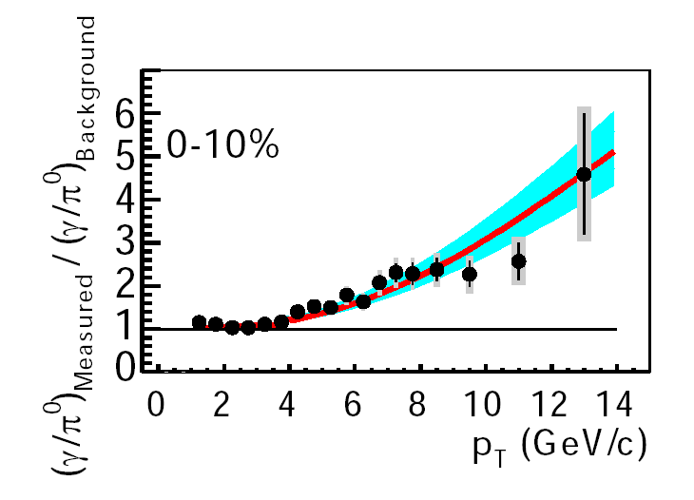
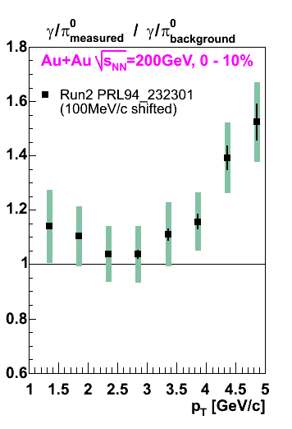
Limitation of Calorimeter Measurement
PRL 94, 232301
No significant excess at low p_{T}

Slide 14
A new technique: opening up the phase space
direct photon analysis
p_{T}
new dilepton analysis
conventional dilepton analysis
0
M_{inv}

Slide 15
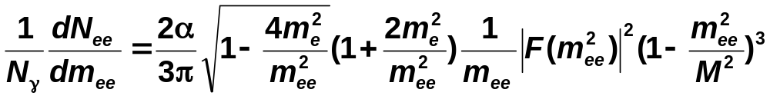
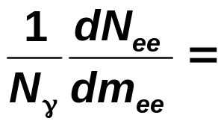
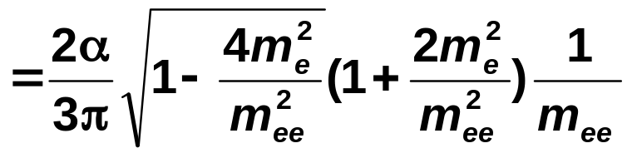
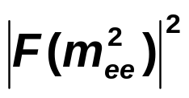
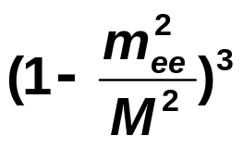
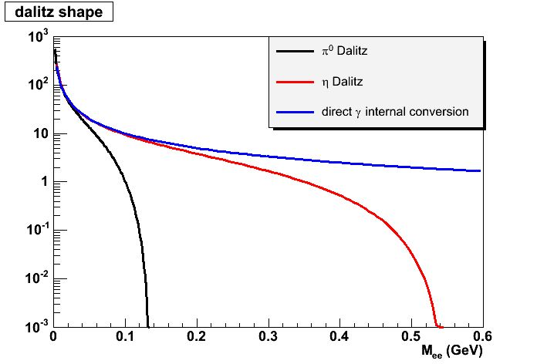
The Idea
e⁺
Compton
Compton
γ∗
γ
e⁻
γ
q
γ
q
π⁰
π⁰
Start from Dalitz decay
Calculate invariant mass distribution of Dalitz pairs
e⁺
γ
γ∗
g
e⁻
g
q
q
invariant mass of Dalitz pair
invariant mass of Dalitz pair
invariant mass of virtual photon
invariant mass of virtual photon
form factor
form factor
phase space factor
phase space factor
Now direct photons
Any source of real γ produces virtual γ with very low mass
Rate and mass distribution given by same formula
  No phase space factor for m_{ee}<< p_{T} ^{photon}
Notes:
What are Feynman graphs for virtual photons?

Slide 16
In Practice
Material conversion pairs removed by analysis cut
Combinatorics removed by mixed events
0-30
90-140
200-300
140-200 MeV
R_{data}
÷
÷
÷
Calculate ratios of various M_{inv} bins to lowest one: R_{data}
If no direct photons: ratios correspond to Dalitz decays
If excess: direct photons

Slide 18
γ
η
π⁰

Slide 19
S/B=~1
γ
γ
η
η
π⁰
π⁰

Slide 20
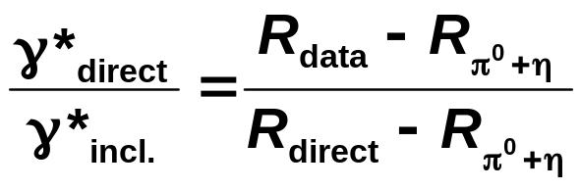
R_{direct}
S/B=~1
γ
γ
η
η
π⁰
R_{η}
calculated from
Dalitz formula
R_{π}0
π⁰
measured
R_{data}
÷

Slide 21
R_{direct}
S/B=~1
γ
γ
η
η
π⁰
R_{η}
calculated from
Dalitz formula
R_{π}0
π⁰
measured
R_{data}
÷

Slide 22
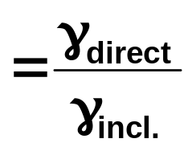
~25 % systematic error :
~20 % from measured η/π⁰ ratio
~10 % from γ inclusive
~5 % acceptance
R_{direct}
S/B=~1
γ
γ
η
η
π⁰
R_{η}
calculated from
Dalitz formula
Here we are…
R_{π}0
π⁰
measured
measured with EMCal
R_{data}
÷

Slide 23
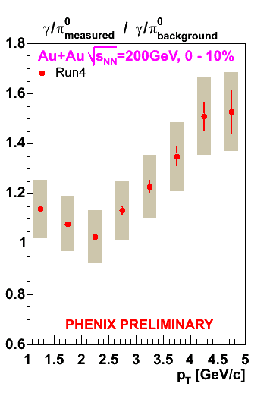
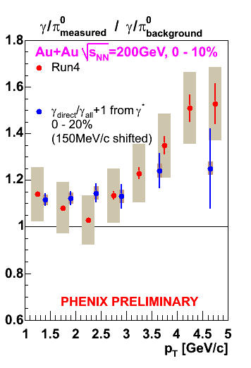
Comparison to Conventional result
( + 1 )

Slide 24
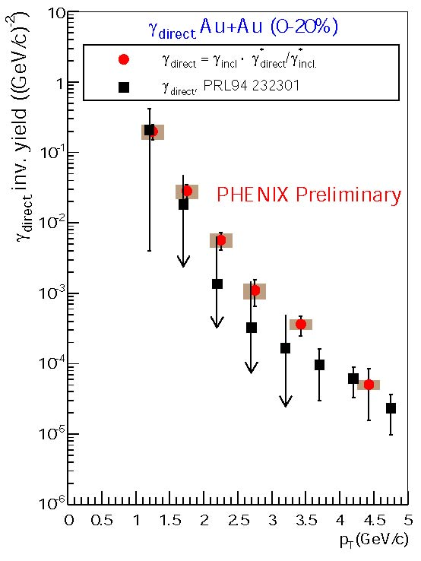
The Spectrum
Compare to published Run2 result: PRL94 232301

Slide 25
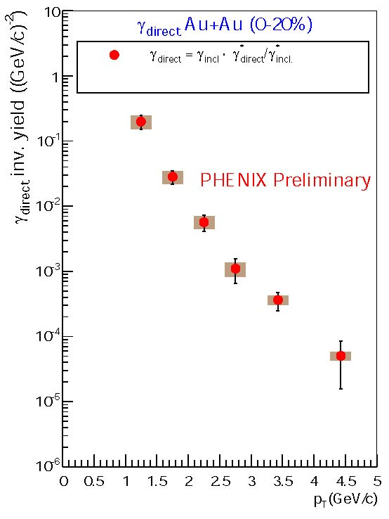
γ_{direct}
preliminary direct photon spectrum at 1-5 GeV/c from γ*

Slide 26
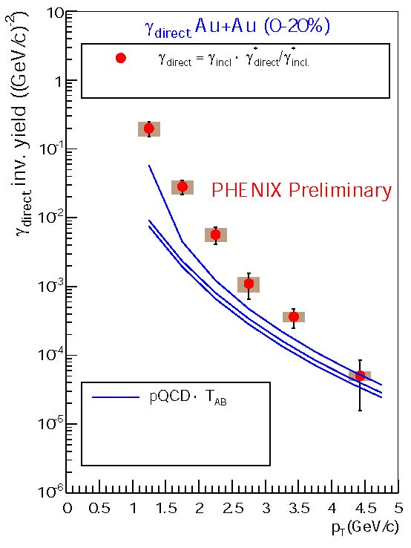
The Spectrum
Compare to NLO pQCD
L.E.Gordon and W. Vogelsang
Phys. Rev. D48, 3136 (1993)
above (questionable) pQCD

Slide 27
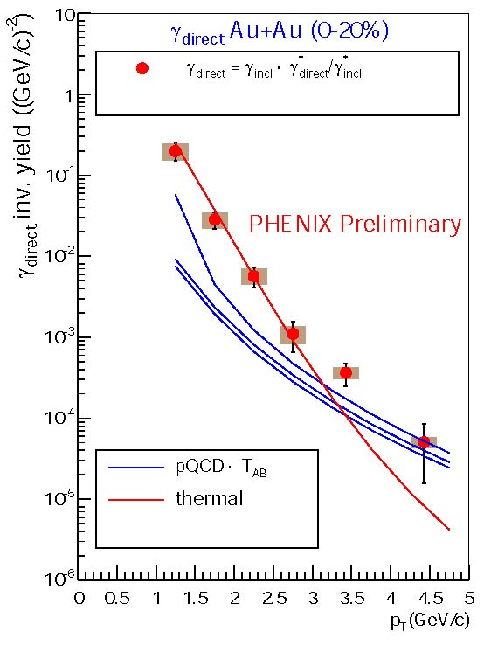
The Spectrum
Compare to NLO pQCD
L.E.Gordon and W. Vogelsang
Phys. Rev. D48, 3136 (1993)
above (questionable) pQCD
Compare to thermal model
D. d’Enterria, D. Perresounko
nucl-th/0503054
2+1 hydro
T₀^{ave}=360 MeV(T₀^{max}=570 MeV)
τ₀=0.15 fm/c
data above thermal at high p_{T}

Slide 28
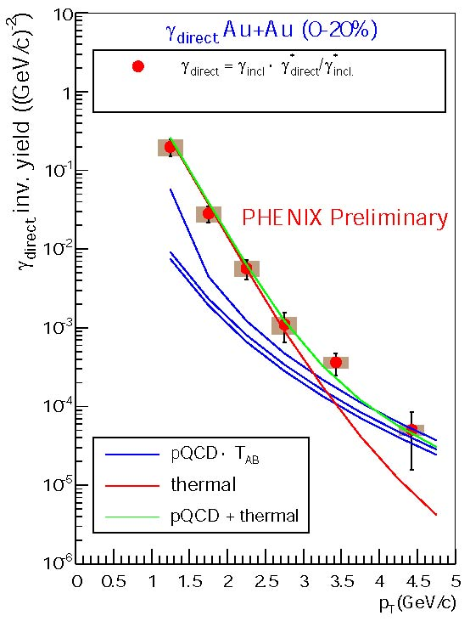
The Spectrum
Compare to NLO pQCD
L.E.Gordon and W. Vogelsang
Phys. Rev. D48, 3136 (1993)
above (questionable) pQCD
Compare to thermal model
D. d’Enterria, D. Perresounko
nucl-th/0503054
2+1 hydro
T₀^{ave}=360 MeV(T₀^{max}=570 MeV)
τ₀=0.15 fm/c
data above thermal at high p_{T}
Compare to thermal + pQCD
data consistent with thermal + pQCD

Slide 29
The Spectrum
Compare to NLO pQCD
L.E.Gordon and W. Vogelsang
Phys. Rev. D48, 3136 (1993)
above (questionable) pQCD
Compare to thermal model
D. d’Enterria, D. Perresounko
nucl-th/0503054
2+1 hydro
T₀^{ave}=360 MeV(T₀^{max}=570 MeV)
τ₀=0.15 fm/c
data above thermal at high p_{T}
Compare to thermal + pQCD
data consistent with thermal + pQCD
Needs confirmation from p+p measurement

Slide 30
Conclusions
p+p
  Established baseline measurement of hard photons
  More precise measurement about to be published
d+Au
  Investigated initial-state effects
  Needs higher-statistics run
Au+Au, high p_{T}
  Confirmed binary scaling of p+p baseline
  Established hadron suppression as medium effect
Au+Au, intermediate p_{T}
  Promising new technique for measuring direct photons in HI collisions through internal conversion
  Excess of direct photons from γ* above decay-photon background
  Data consistent with thermal + pQCD
  However
    pQCD calculations questionable at low p_{T}
    Needs confirmation from p+p measurement with same technique
    Direct photon sources other than thermal might contribute as well

Slide 31
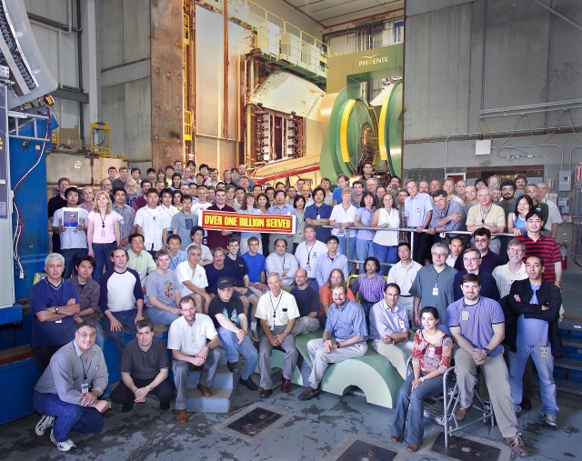

Slide 32
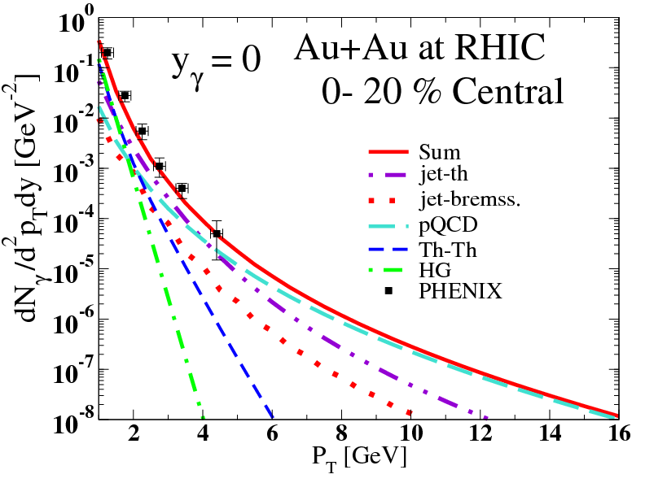
Gale QM05

