Slide 1
Brief report on reactions in Europe to Ray Orbach’s statement
Ray Orbach’s statement created a lot of reactions in Europe
I contacted the chairs of various strategic european committees (CERN SPC, Restricted ECFA, EPS HEPP Board) to present in a factual manner what really was said in the Feb HEPAP session (in May 2007)
Short summary of reactions collected during these discussions

Slide 2
Outline
What is HEPAP?
P5 Roadmap
Status report on the Feb 2007 meeting
Ray Orbach presentation during that meeting and HEPAP reactions
Conclusions

Slide 3
Ray Orbach,very supportive of ILC
(March 2006)
US wants « order of magnitude leadership »
« ITER, template for the future »:
« Snowmass/ Physag/Academy of Science/Lehman review, exemplary process »
« US expresses interest to host ILC in the US »

Slide 4
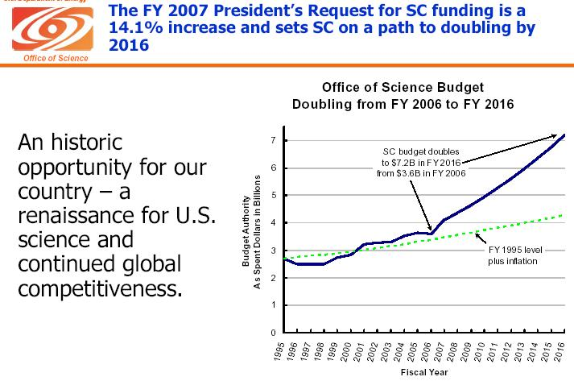

Slide 5
Ray Orbach statement http://www.sc.doe.gov/News_Information/News_Room/2007/hepap/index.htm
Many individuals and many groups already have given considerable thought and effort to the path forward in high-energy physics. The P5 Roadmap in particular articulates a broad set of scientific opportunities and compelling priorities, where the highest priority is to go to the Terascale. Given the high stakes – the risks and the rewards of various paths – I welcome the opportunity to continue this dialogue with HEPAP on the future of this field.
DOE is committed to continuing a vigorous R&D program of accelerator technology. SCRF is a core capability having broad applicability, both to the ILC and to other future accelerator-based facilities as well. Our FY2008 request for ILC R&D and SCRF technology confirms this commitment. We welcome our R&D partnerships with those around the world, in Asia, in Europe, and the Americas. The science is indeed very exciting.
In making our plans for the future, it is important to be conservative and to learn from our experiences. Even assuming a positive decision to build an ILC, the schedules will almost certainly be lengthier than the optimistic projections. Completing the R&D and engineering design, negotiating an international structure, selecting a site, obtaining firm financial commitments, and building the machine could take us well into the mid-2020s, if not later.
Within this context, I would like to re-engage HEPAP in discussion of the future of particle physics. If the ILC were not to turn on until the middle or end of the 2020s, what are the right investment choices to ensure the vitality and continuity of the field during the next two to three decades and to maximize the potential for major discovery during that period?

Slide 6
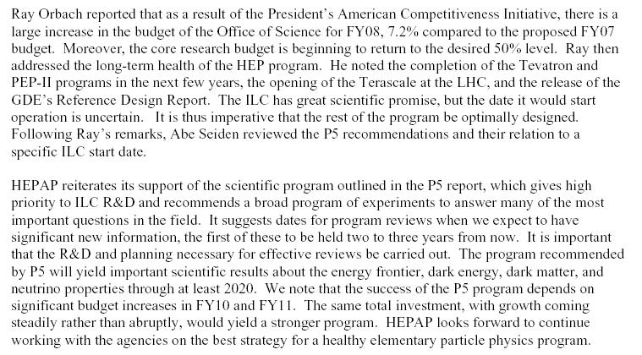
HEPAP summary letter(1)

Slide 7
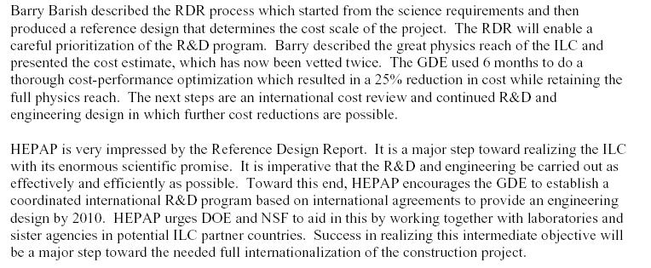
HEPAP summary letter (2)

Slide 8
A statement from M. Shochet, HEPAP chair
"Ray's written statement is unfortunately open to too many interpretations. What he has said to me and others is that he is strongly supportive of vigorously pursuing the ILC R&D and engineering design. On the other hand, based on previous experience (ITER, Spallation Neutron Source, etc.), the time table could be longer than we would like. His message is that we should plan with enough flexibility that we are able to have a strong physics program even if the ILC schedule is stretched out. That is his message, but unfortunately it was not widely understood."

Slide 9
Since then…
No national replanning exercise (to my knowledge)
Fermilab is conducting a medium and long term planning review to examine the lab’s program in the scenario of a delayed ILC
http://www.fnal.gov/directorate/Longrange/Steering_Public/

Slide 10
Conclusions
US is very supportive of the ILC program
  ILC is priority #1 in EPP2010 and P5 roadmap
  Very strong increase in ILC R&D and large absolute value as well (~83 M$ in FY2008, was 19 M$ in 2004)
  Favourable atmosphere due to ACI initiative
R. Orbach is concerned about the health of the US physics program in the event of the ILC delay due to international negociations
  HEPAP/P5 : US HEP program needs the ILC but can cope with some delay. No need now to launch a new initiative that would unavoidably increase this potential delay
  My personal comment: It is up to all involved (GDE, ICFA, FALC, laboratories, funding agencies,..) to make sure that this « international delay » is made as short as possible, by working out the issues beforehand as much as possible. The (LHC upgrade) and ILC FP7 preparatory phase EU projects are good vehicles to start this work.
R. Orbach statement shoud not be over-interpreted: we all share his concerns and he did not retract from ILC. There is no plans of ILC delay. They should not be underestimated either: if we do not work hard, these delays might well occur.
The community needs a clear and strong positive signal : I would really recommand that FALC issues a collective statement expressing its support to the upcoming EDR phase.

Slide 11
Reactions summary
3 typical reactions
US is not a reliable partner
  Unilateral decisions and lack of communication between partners (even I tried to explain that this was mostly a US domestic policy issue)
  Sudden direction changes, while most Europeans rely on the US to push the ILC on the fastest possible track
  « Cold shower » effect after the excitment of the RDR where the cost was presented as affordable (ie similar to the LHC)
The ILC IS indeed delayed (no attention to the potential nature of the delay)
CERN back in the loop!
  2008-2011 : 240 MCHF supplement to CERN budget just approved (LHC consolidation/LHC upgrade/CLIC R&D/ILC participation)
  2012-2015 : LHC upgrade implementation
  2016-.. : Build the new big facility at CERN, ILC or CLIC technology
  (side remark as a semi-joke: CLIC R&D is now performed primarily at SLAC!)
Remark :An ILC delay is not simply getting to the physics a few years later. The whole concept of having or not a balanced worldwide program is at stake

Slide 12
« Damage control »?
Many Europeans see the strong US R&D implication in the ILC but do not automatically conclude that US is still pushing hard for the ILC
  Potential demotivation of the european ILC physicists community
The interpretation of the Fermilab roadmap process outcome will be most likely interpreted with this in mind
CERN feels back in the game in case of a 2016 timescale, for good or for bad and will want to reexamine the technology of choice, which may lead to progress but certainly to even more delay!
Is there a way to transmit more positive messages:
  Clear and strong message from FALC to support the EDR phase
  Play good attention to international communication, even on a priori US domestic issues
  Ambitious and clear plan to work on political issues such as siting process in parallel. If possible, make use of the LHC upgrade discussions to form a ILC-like « political prototype »

