Slide 1

Conformal symmetry breaking in QCD and implications for hot quark-gluon matter
“Heavy quarks”, LBNL, November 1-3, 2007
D. Kharzeev

Slide 2
Bulk viscosity of QCD matter: the tale of
“the least studied transport coefficient”
Based on:
DK, K. Tuchin, arXiv:0705.4280 [hep-ph]
F. Karsch, DK, K. Tuchin, to appear

Slide 3
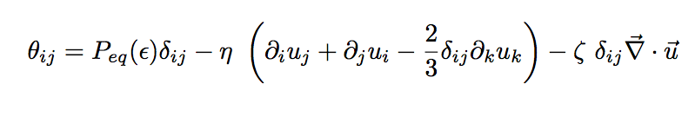
Shear and bulk viscosities: the definitions
The energy-momentum tensor:
shear viscosity
bulk viscosity

Slide 4
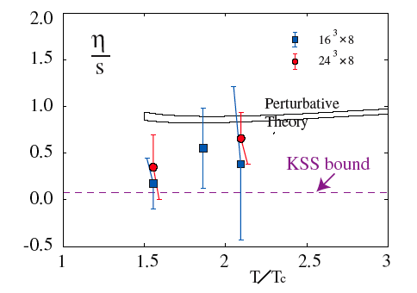
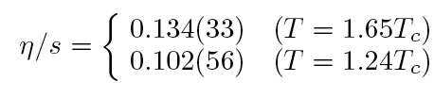
Shear viscosity has attracted a lot of attention:
A.Nakamura and S.Sakai,
hep-lat/0406009;
Recent work:
H.Meyer, 0704.1801
Perfect liquid
Kovtun - Son - Starinets bound:
strongly coupled SUSY QCD = classical supergravity

Slide 5
Kubo’s formula:
Bulk viscosity is defined as the static limit of
the correlation function:

Slide 6
Kubo’s formula for bulk viscosity can be written
down in the form involving Lorentz-invariant operators:
Since θ₀₀’s commute, we get
Bulk viscosity is determined by the correlation function
of the trace of the energy-momentum tensor

Slide 7
Physical picture:
Shear viscosity: how much entropy is produced by
transformation of shape at constant volume
Generated by
translations
Bulk viscosity: how much entropy is produced by
transformation of volume at constant shape
Generated by
dilatations

Slide 8
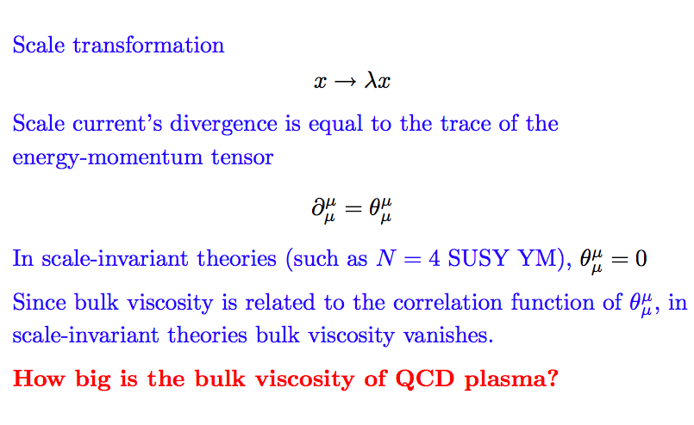

Scale invariance in field theory

Slide 9
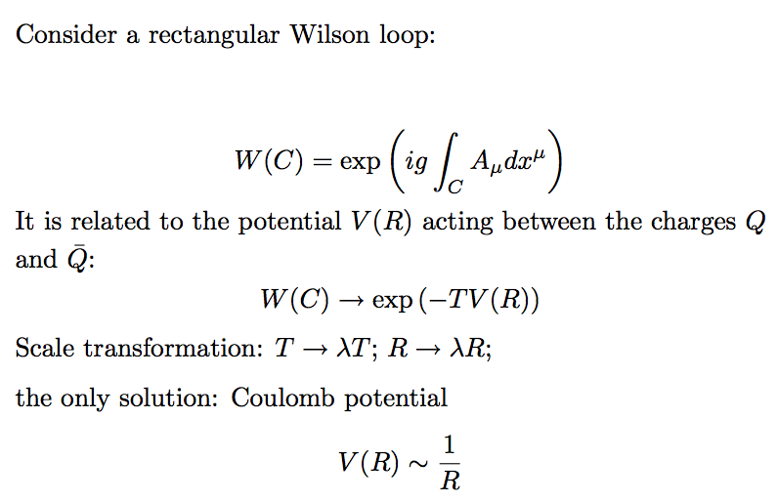
Scale invariance and confinement
R
R
T

Slide 10

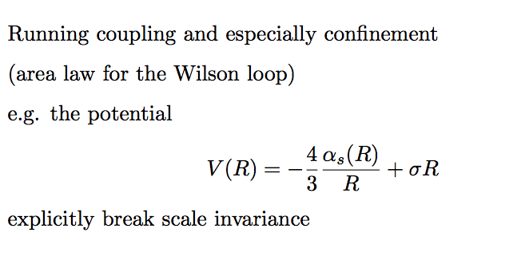
Scale invariance and confinement
R
T

Slide 11


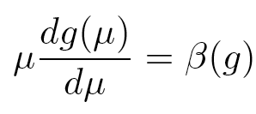
Scale anomaly in QCD
Classical scale invariance is broken by quantum effects:
scale anomaly
trace of the energy-
momentum tensor
“beta-function”; describes the dependence
of coupling on momentum
Hadrons get masses coupling runs with the distance

Slide 12
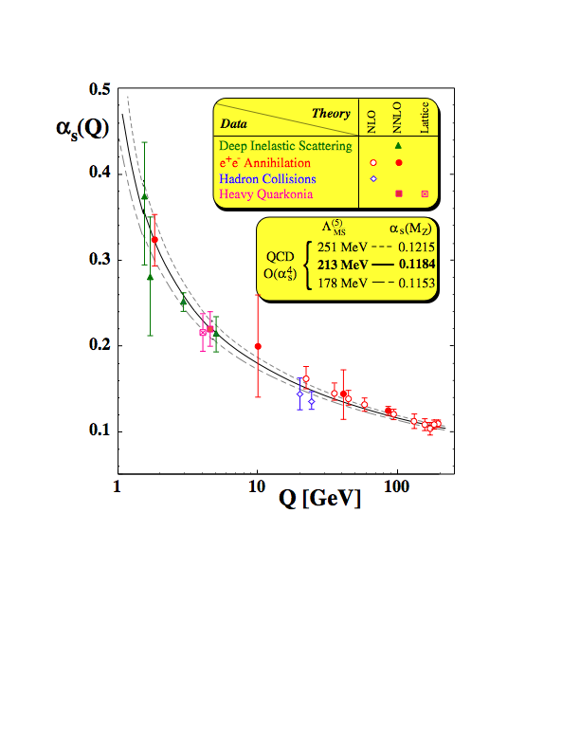


Asymptotic Freedom
At short distances,
the strong force becomes weak
(anti-screening) -
one can access the “asymptotically
free” regime in hard processes
and in super-dense matter
(inter-particle distances ~ 1/T)
number
of flavors
number
of colors

Slide 13
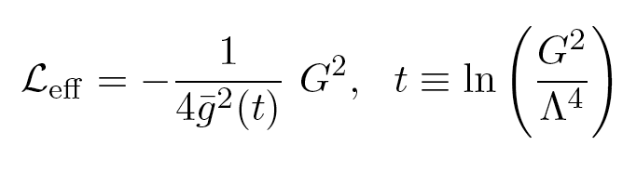
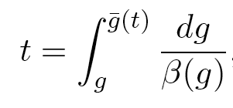
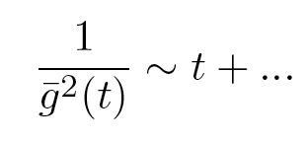
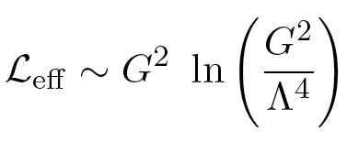
Renormalization group: running with the field strength
RG constraints the form of the effective action:
the coupling is defined through
At large t (strong color field),
and

Slide 14
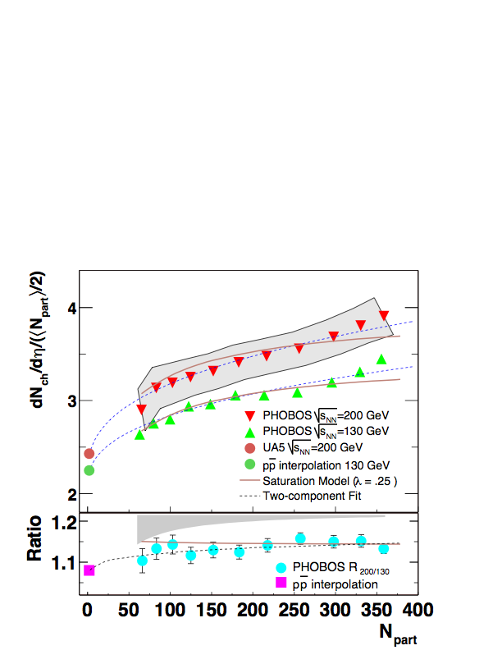

Classical QCD in action
Running coupling
essential for understanding
hadron multiplicities
KLN

Slide 15
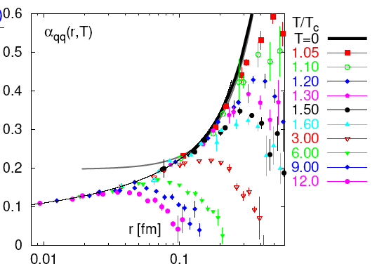
Running coupling in QGP
Strong force is
screened by
the presence of
thermal gluons
and quarks
T-dependence of
the running coupling
develops in
the non-perturbative region
at T < 3 T_{c} ; ΔE/T > 1
- “cold” plasma
F.Karsch et al

Slide 16
Running coupling (and perhaps “remnants
of confinement”) seen in the lattice data
indicate:
Scale invariance in the quark-gluon plasma is at best approximate
What does it mean for bulk viscosity?

Slide 17
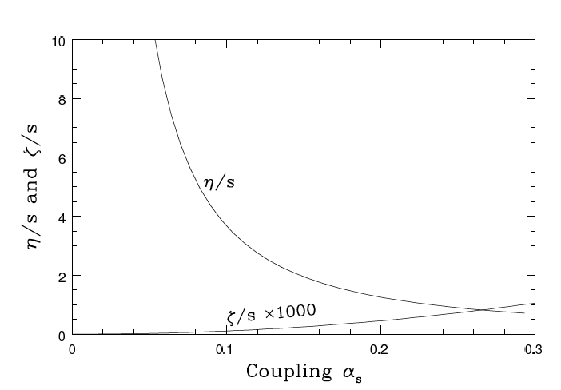

Perturbation theory: bulk viscosity is negligibly small
ζ/η < 10⁻³
P.Arnold, C.Dogan,
G.Moore, hep-ph/0608012

Slide 18


In perturbation theory, shear viscosity is “large”:
and bulk viscosity is “small”:
At strong coupling, η is apparently small;
can ζ get large?

Slide 19

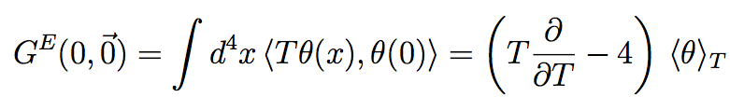
Can we say anything about non-perturbative effects?
At zero temperature, broken scale invariance leads to
a chain of low-energy theorems for the correlation
functions of
Novikov, Shifman,
Vainshtein, Zakharov ‘81
Elegant geometrical interpretation - classical theory
in a curved gravitational background - Migdal, Shifman ‘82;
Einstein-Hilbert action, etc DK, Levin, Tuchin ‘04
These theorems have been generalized to finite T:
Ellis, Kapusta,
Tang ‘98

Slide 20
Sketch of the derivation
Consider an operator with a canonical dimension d:
The dependence of QCD Lagrangian on the coupling:
Write down an expectation value for O as
a functional integral and differentiate w.r.t. 1/4g²:
Repeat n times - get n-point correlation functions

Slide 21
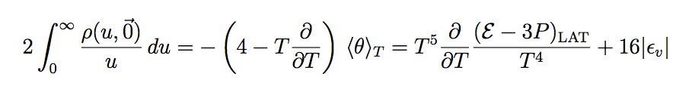
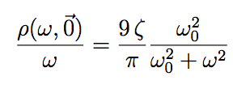
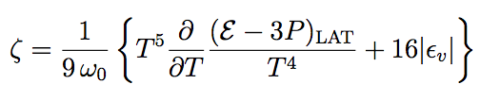
An exact sum rule for bulk viscosity
Basing on LET’s and Kubo’s formula, we derive
an exact sum rule for the spectral density:
Using ansatz we get
DK, K.Tuchin, arXiv:0705.4280 [hep-ph]
0

Slide 22
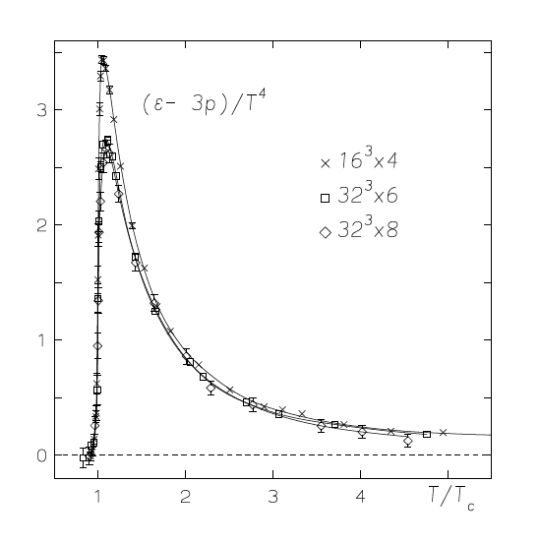
SU(3),
pure gauge
Use the lattice data from G.Boyd, J.Engels, F.Karsch, E.Laermann,
C.Legeland, M.Lutgeimer, B.Petersson, hep-lat/9602007

Slide 23
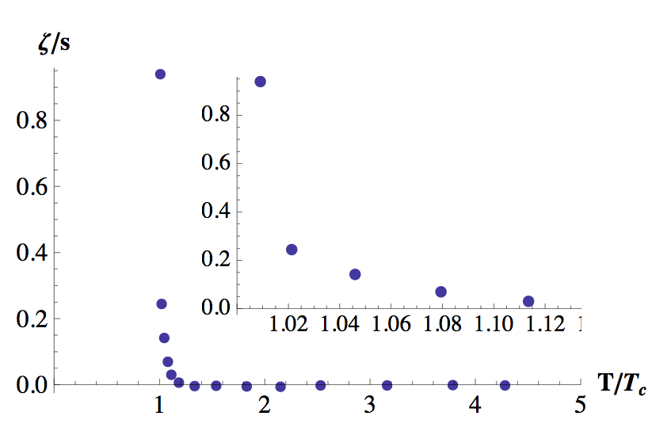
The result
Bulk viscosity is small at high T,
but becomes very large close to T_{c}
DK, K.Tuchin, arXiv:0705.4280 [hep-ph]

Slide 24
Condensed matter analogies?
Example: ³He near the critical point
at (T-T_{c})/T_{c} = 10⁻⁴ on the critical isochore,
shear viscosity is η=17 10⁻⁶ Poise
whereas bulk viscosity is ζ=50 Poise
The ratio ζ/η is in excess of a million

Slide 25
S.Sakai, A.Nakamura, arXiv:0710.3625[hep-lat], Oct 19, 2007

Slide 26
H.Meyer, arXiv:0710.3717[hep-lat], Oct 19, 2007

Slide 27
H.Meyer, arXiv:0710.3717[hep-lat], Oct 19, 2007

Slide 28
Kharzeev-Tuchin
Meyer

Slide 29
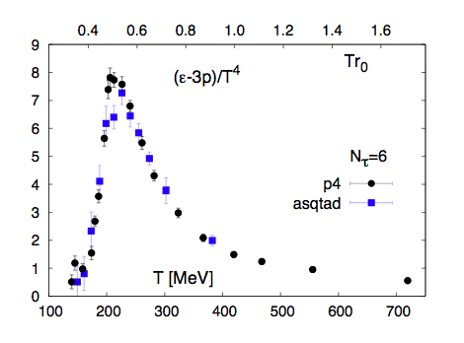
Bulk viscosity in full QCD
Qualitatively similar results:
F.Karsch, DK, K.Tuchin,
to appear
SU(3), pure gauge
QCD, 2+1 quark flavors (pion mass 220 MeV)
BNL-Columbia-RBRC-Bielefeld
arXiv:0710.0354

Slide 30
Universal properties of bulk viscosity near the phase transition
Consider 2 massless (light) quarks and a strange quark:
2nd order phase transition
Sum rule shows that the behavior of bulk viscosity is
driven by the latent heat
F.Karsch, DK, K.Tuchin,
to appear

Slide 31
Universal properties of bulk viscosity near the phase transition
The behavior of latent heat near the phase transition
is driven by the critical exponent:
2+1 flavors, zero baryon density: O(4) universality class:
= -0.19(6): c_{V}= const - t^{0.19} - a spike in bulk viscosity
What happens near the critical point at finite μ?
F.Karsch, DK, K.Tuchin,
to appear

Slide 32
Bulk viscosity near the critical point
Near the tri-critical point: Z(2) universality class
= 0.11 : c_{V} ~ t^{-0.11} bulk viscosity diverges !
Growth of entropy production, large multiplicity,
small transverse momenta

Slide 33
Bulk viscosity and the mechanism of hadronization
Scale transformation
Scale anomaly
What is the meaning of the bulk viscosity growth?

Slide 34
Bulk viscosity and the mechanism of hadronization
Scale transformation
Bulk viscosity:
growth of entropy,
particle production
Bulk viscosity growth = soft statistical hadronization (?)

Slide 35
Bulk viscosity and the mechanism of hadronization
Scale transformation
Not a recombination of pre-existing quarks -
Bulk viscosity saves the 2nd law of thermodynamics
in the process of hadronization

Slide 36
Kharzeev-Tuchin
Meyer
Confinement as seen by the
off-equilibrium thermodynamics

Slide 37
Summary
Bulk viscosity is small away from T_{c} - approximately
scale-invariant dynamics, “perfect liquid”
2. Bulk viscosity grows dramatically (3 orders!) close
to the critical temperature (most likely, a peak at T_{c}):
by far, the dominant viscous effect at this temperature
3. This suggests a new scenario for
soft statistical hadronization
4. Understanding the associated “microscopic”
dynamics is crucial for understanding hadronization
and confinement
Need to devise the methods of experimental study

