Slide 1
Maximizing Discounts
Year 5
Plan Your Strategy
Maximize Discount Rate
Maximize Discounted Services
Transform Priority Two Services
Wide Area Networks
“Do No Harm”

Slide 2
Maximizing Discounts
Year 5
Philosophy of Discount Preparation
Eligible Services - New List
Eligibility Framework - New Guidance
Three Categories of Service
- Some More Equal Than Others
Calculating Discounts

Slide 3
Maximizing Discounts
Year 5
Philosophy of Discount Preparation
STAY IN THE WINDOW!!
- Filing window opens November 5
- Filing window closes January 17
December 20 last day to file 470 online!!

Slide 4
Maximizing Discounts
Year 5
Philosophy of Discount Preparation
Have Form 470 posted for 28 days before
signing a contract or ordering services
Number 1 reason for funding denial...

Slide 5
Maximizing Discounts
Year 5
Eligible Services - A Tale of Two Lists
Applicant List - Guidelines
PIA List - Specific Products and Services
- Will it be made public??

Slide 6
Maximizing Discounts
Year 5
Framework For Eligible Services
New for Year Five - Released 10/19
Better Guidance for Applicants

Slide 7
Maximizing Discounts
Year 5
Framework For Eligible Services
Eligible:
- Telecommunications: Local, LD, Data
- Internet Access: Basic conduit access
- Internal Connections - Service transport

Slide 8
Maximizing Discounts
Year 5
Framework For Eligible Services
Ineligible (usually):
- End user equipment
- Software
- Content
- Filtering/firewall

Slide 9
Maximizing Discounts
Year 5
Framework For Eligible Services
Additional Clarification:
$500,000, 30%, 67% rules
Training
WANs

Slide 10
Maximizing Discounts
Year 5
Eligible Services - Not Black and White
“ The primary purpose of the services for which
support is sought must be the delivery of services
to the classrooms or other places of instruction at
schools and libraries… Support will be limited
to services delivered to the onsite educational
facility or facilities.”
- Eligible Services List 10/19/01

Slide 11
Maximizing Discounts
Year 5
Telecommunications
- Leased, tariffed, contracted, or month-to-
month services used to communicate information
electronically between sites
- Eligible if provided by a “common carrier”
- Supports a wide range of services

Slide 12
Maximizing Discounts
Year 5
Telecommunications
- Can include On-site equipment
67and 30 percent rules apply
- Can include One-time charges
$500,000 rule applies

Slide 13
Maximizing Discounts
Year 5
Internet Access
- Basic conduit access to the Internet
- Priority one service
- Can be provided by any vendor
- Much more limited than Telecommunications

Slide 14
Maximizing Discounts
Year 5
Internet Access
- Can include On-site equipment
67and 30 percent rules apply
- Can include One-time charges
$500,000 rule applies

Slide 15
Maximizing Discounts
Year 5
Internal Connections
- Wiring an other connections that expand
the data network within school or library
- “Transport” not storage
- Does not include end user equipment
- Priority two service

Slide 16
Maximizing Discounts
Year 5
Internal Connections
- Demand may eclipse ALL funding for IC
- $500,000 rule does NOT apply
- Use only for high discount applications
- Most libraries not high enough discount...

Slide 17
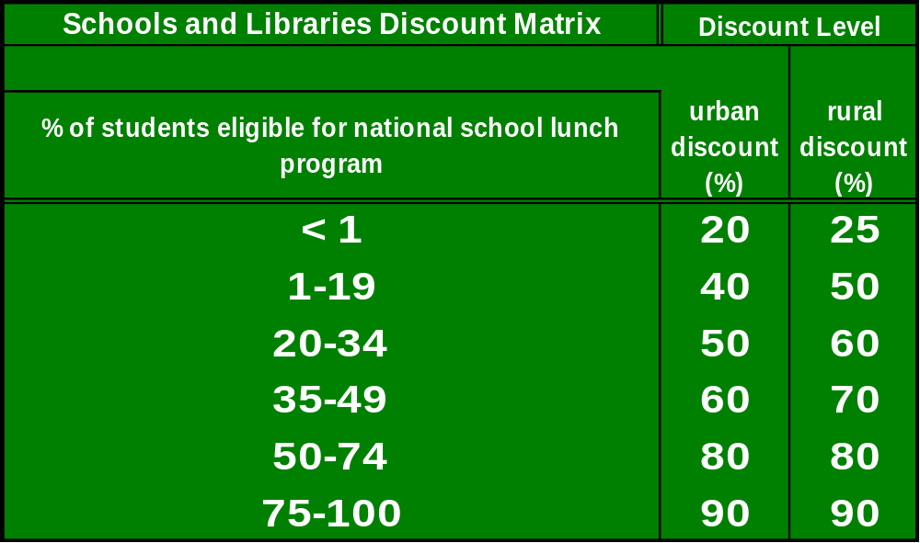
Maximizing Discounts
Year 5
Calculating Discounts

Slide 18
Maximizing Discounts
Year 5
Calculating Discounts
Schools: Simple discount based on NSLP
School District: Weighted average
Consortia: Simple average of members
- Letter of agency from ALL participants
Libraries: School district average

Slide 19
Maximizing Discounts
Year 5
Alternative Calculation Methods:
- Sibling matching
- Survey
- Medicaid
- Food stamps
- Aid to families with dependent children
- 185 percent of local poverty rate
Emphasize schools near threshold rates

Slide 20
Maximizing Discounts
Year 5
When to use Alternatives
Always when discount rate is near 90 percent!
When discount is within five percent of cutoff

Slide 21
Maximizing Discounts
Year 5
Sibling Matching
Free Lunch participation lower in mid and high grades
- Students don’t return forms
- Fear of ridicule
Identify eligible siblings in lower grades
- Must be living in the same household
- Do not use names of students
- Can increase percentage several points

Slide 22
Maximizing Discounts
Year 5
      Survey Requirements
      The survey sent to all families
      The survey must attain a return rate of at least 50%
      The survey must contain the following information:
      Address of family
      Grade level of each child
      Size of the family
      Income level of the parents
      The survey must assure confidentiality

Slide 23
Maximizing Discounts
Year 5
      Last Word on Alternative Calculations
      Share results with state DOE
      Share results with libraries
      Stand firm when questioned by PIA!

Slide 24
Maximizing Discounts
Year 5
On Premise Equipment as Priority One
“In some instances, service providers may install
equipment on the premises…as part of their…eligible
Telecommunications Services or Internet Access
(and not as Internal Connections), if the applicant
demonstrates that it meets all of the following
criteria:”
- Eligible Services List 10/19/01

Slide 25
Maximizing Discounts
Year 5
It will be provided by the same service provider
that provides the service, and ownership will not
transfer in the future.
The relevant contract or lease does not include an
option to purchase the equipment.
The school or library has no contractual right to
exclusive use of the equipment.

Slide 26
Maximizing Discounts
Year 5
Up front, non-recurring charges are less than 67%
of total charges (recurring plus non-recurring).
The equipment will not be used...for any
purpose other other than receipt of the eligible
Telecommunications Services or Internet Access
of which it is a part.
The Local Area Network for data communications...
is functional without dependence on the equipment

Slide 27
Maximizing Discounts
Year 5
Responsibility for maintaining the equipment
rests with the vendor, not school or library.
“The equipment must be directly related to the
end-to-end provision of service by the service
provider. If ANY of these criteria is not met, the
equipment is to be considered Internal Connections.”
- Brought about by the Tennessee Decision

Slide 28
Maximizing Discounts
Year 5
Examples:
PBX in main office. Possibly including lines to
individual classrooms (careful of 67% rule).
Two-way interactive video systems all the way to
the classroom (excluding camera, monitor, computer)
Router or Switch in wiring closet connecting LAN to
outside source.

Slide 29
Maximizing Discounts
Year 5
Key New Provisions:
67 percent rule (less than 67% non-recurring)
- Catch 22 for questionable applications
Non-exclusive right to use equipment
Same service provider owns equipment and
provides service
$500,000 and 30% rules both apply

Slide 30
Maximizing Discounts
Year 5
30 Percent Rule Reminder
If SLD determines that 30 percent or more of a
funding request (a single Block 5) is ineligible for
funding, the entire funding request will be denied
30 Percent Rule, Part II:
If SLD determines that 30 percent or more of a Pri.
One funding request is actually Internal Connections,
the entire funding request will be changed to I. C.

Slide 31
Maximizing Discounts
Year 5
Wide Area Networks
- Fully eligible if leased from common carrier
- Must be used for eligible purpose
- Must serve eligible entities for discount
- Non-common carriers may provide Internet

Slide 32
Maximizing Discounts
Year 5
Wide Area Networks
http://www.sl.universalservice.org/reference/wan.asp
May include vendor-owned on-site equipment
including routers, switches if meet “On-premise” test
Internal Connection becomes WAN when it is
“outside the school or library facility”

Slide 33
Maximizing Discounts
Year 5
Wide Area Networks
The FCC does not allow funding for arrangements between
applicants and service providers that reach essentially the
same result as a prohibited WAN purchase. Factors
evaluated when making this determination include exclusive
access (i.e., the applicant has a contractual right to the full
capacity of the facilities), lease-purchase agreements, and
whether the service provider seeks a substantial payment
for upfront capital costs.
- Eligible Services Framework 10/19/01

Slide 34
Maximizing Discounts
Year 5
Wireless Wide Area Networks
Wireless WAN transmission equipment - antennas,
transmitters, receivers, transmission line outside
building are considered eligible as priority one
Towers that hold antennas are NEVER eligible

Slide 35
Maximizing Discounts
Year 5
Other Service Resources
http://www.e-ratecentral.com
http://www.fundsforlearning.com
http://www.sl.universalservice.org
Call the CSB at your own risk!

Slide 36
Maximizing Discounts
Year 5
Outside Funding Sources
The tale of MasterMind and lessons learned
Grants are acceptable, as long as they are secured
BEFORE filing the 471
Use of previous E-Rate discounts to fund new apps.
A question of “certification”

Slide 37
Maximizing Discounts
Year 5
Administrative Services
Current guidance from SLD:
Telephone service to ONE administration building
LAN eligible only if those internal connections are
essential for the effective transport of information
to an instructional building

Slide 38
Maximizing Discounts
Year 5
T1
School #2
DSL
School #1
School #3
LAN Eligible?
DSL Line?
Telephone Lines?
Admin. Building

Slide 39
Maximizing Discounts
Year 5
T1
School #2
DSL
School #3
Admin Building
LAN Eligible?
DSL Lines?
Telephone Lines?
School #1

Slide 40
Maximizing Discounts
Year 5
One-Time Charges
Brooklyn Library Decision
One-time charges for vendor equipment eligible
If one-time charges exceed $500,000 must
amortize over at least three years
Excellent for high bandwidth projects

Slide 41
Maximizing Discounts
Year 5
One-Time Charges
Usually exempt from 67 percent rule
Must be part of “cost effective solution”
Way for new companies to participate
Same category as installation charges

Slide 42
Maximizing Discounts
Year 5
Last Word on CIPA
File form 486 by TOMORROW (10/26/01)
Billed Entity (B.E.) Files
Administrative Authority submits 479 to B.E.
Could lose funding from 7/1/01 through postmark

Slide 43
Maximizing Discounts
Year 5
Appeals
Appeal ALL denials
Appeal must be submitted within 30 days of the
DATE on the Commitment Letter
Appeal to SLD or FCC, not both at same time

