Slide 1

Application of Ethical Principles
During the Informed Consent Process for Clinical Trials
Barbara E. Barnes, MD, MS
Joanne Russell, MPPM
Maurice Clifton, MD, MSEd
David Barnard, PhD
University of Pittsburgh School of Medicine

Slide 2
Funded by
Human Subject Research
Enhancement Program
S07 RR018239-02
Department of Health and Human Services
National Institutes of Health
National Center for Research Resources

Slide 3
Background
Informed consent is the foundation for ethical research with human subjects
Actual process presents many challenges
  Gulf between scientists and laypeople
  Required language in consent documents
  Psychological situation of patient-subjects
Notes:
Gulf includes literacy levels,
Cultural differences

Slide 4
Goals
Develop communications skills curriculum for informed consent to research for clinical investigators and coordinators
  Demonstrate benchmark standards for ethical consent
  Interactive session to practice their skills
  Utilize their own protocols
  Focused feedback to the workshop participants on their communications skills
  Measure effect and satisfaction

Slide 5
Tools
Background reading
Guidelines for ethical consent
  Behaviorally operationalize guidelines
“Gold standard” video example
Standardized Patient (SPs) cases

Slide 6
Background Reading
Pre-assigned reading material distributed three weeks prior to seminar
  Belmont Report
  Five articles on informed consent for research
  Course handouts

Slide 7
Guidelines for Ethical Consent
Content items and process items
Formed basis for didactic curriculum
Observer checklists (dichotomous)
  Content items
  Communication behaviors
SP checklist (Likert)
  Communication behaviors

Slide 8
Observer Content Checklist
27 items (Yes/No)
Examples:
  Prognosis without treatment
  Review standard treatments, including the no treatment option
  Advantages of standard treatment
  Disadvantages of standard treatment

Slide 9
Observer communication checklist
14 items (Yes/No)
Examples:
  Context: Establishing a mutual understanding of the patient’s current situation
  Describe joint decision making
  Check preferred decision making style (involved or not)
  Check information preference of patient
  Assess medical knowledge

Slide 10
SP communication checklist
14 items (Likert 1-5)
Examples:
  The investigator provided opportunities for me to take an active role in the decision-making process.
  The investigator invited me to make comments about what I was told and invited me to ask him/her questions about things I did not completely understand.
Not at all Some of the time All of the time
1 2 3 4 5

Slide 11
“Gold standard” Video Example
Script written to include all positive behaviors
17 short clips integrated into didactic sessions
  10 seconds – 2 minutes long

Slide 12
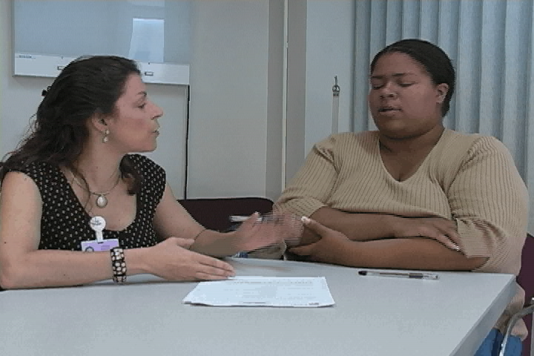

Slide 13
Standardized Patient (SPs) Cases
Based on challenging but common subject types as perceived by the University’s Compliance Auditor
Adapted to meet enrollment criteria of workshop participants’ studies

Slide 14
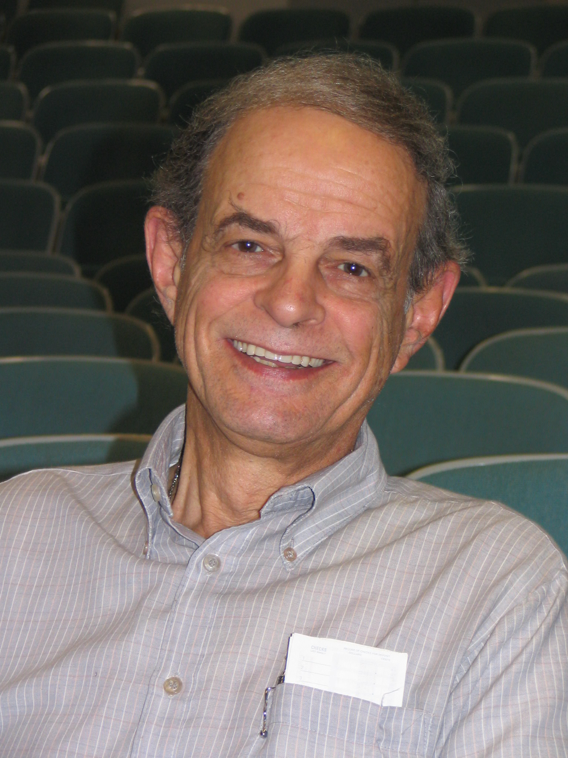
Moderate Dementia
Answers “yes” to all questions
Doesn’t understand protocol

Slide 15
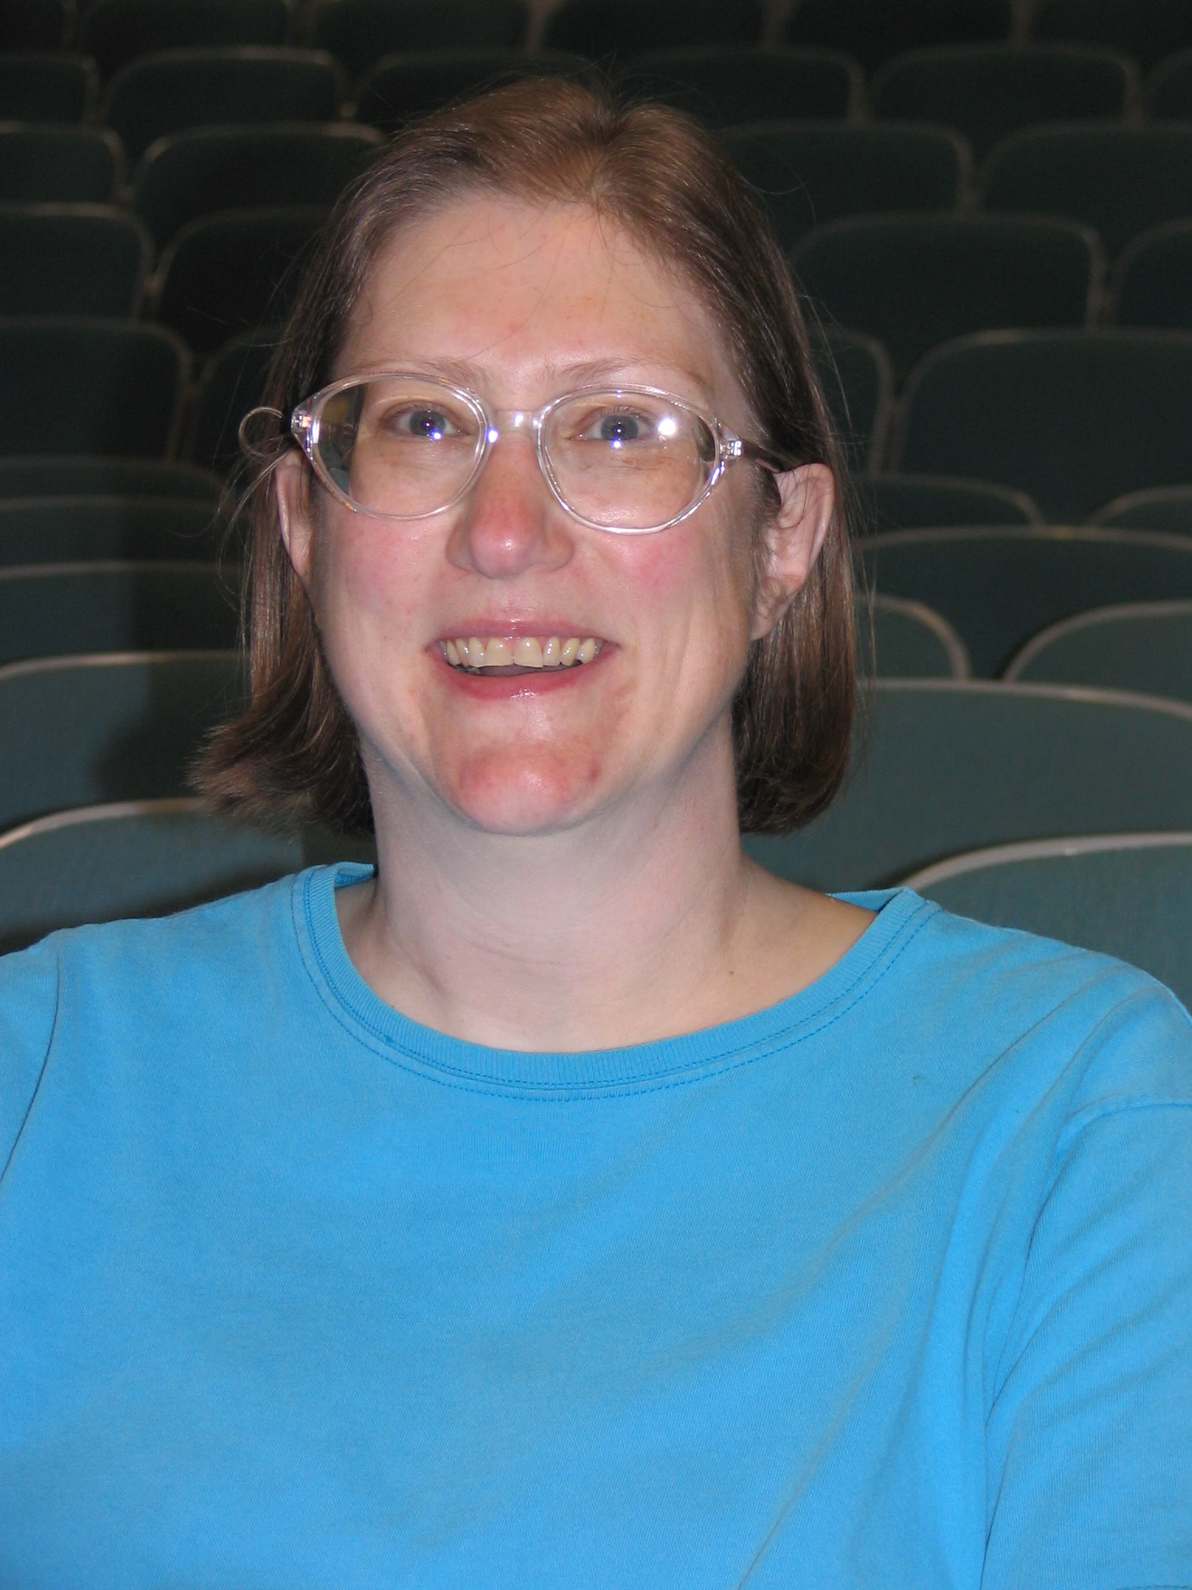
Too Eager
Already signed consent
Medicine is hobby

Slide 16
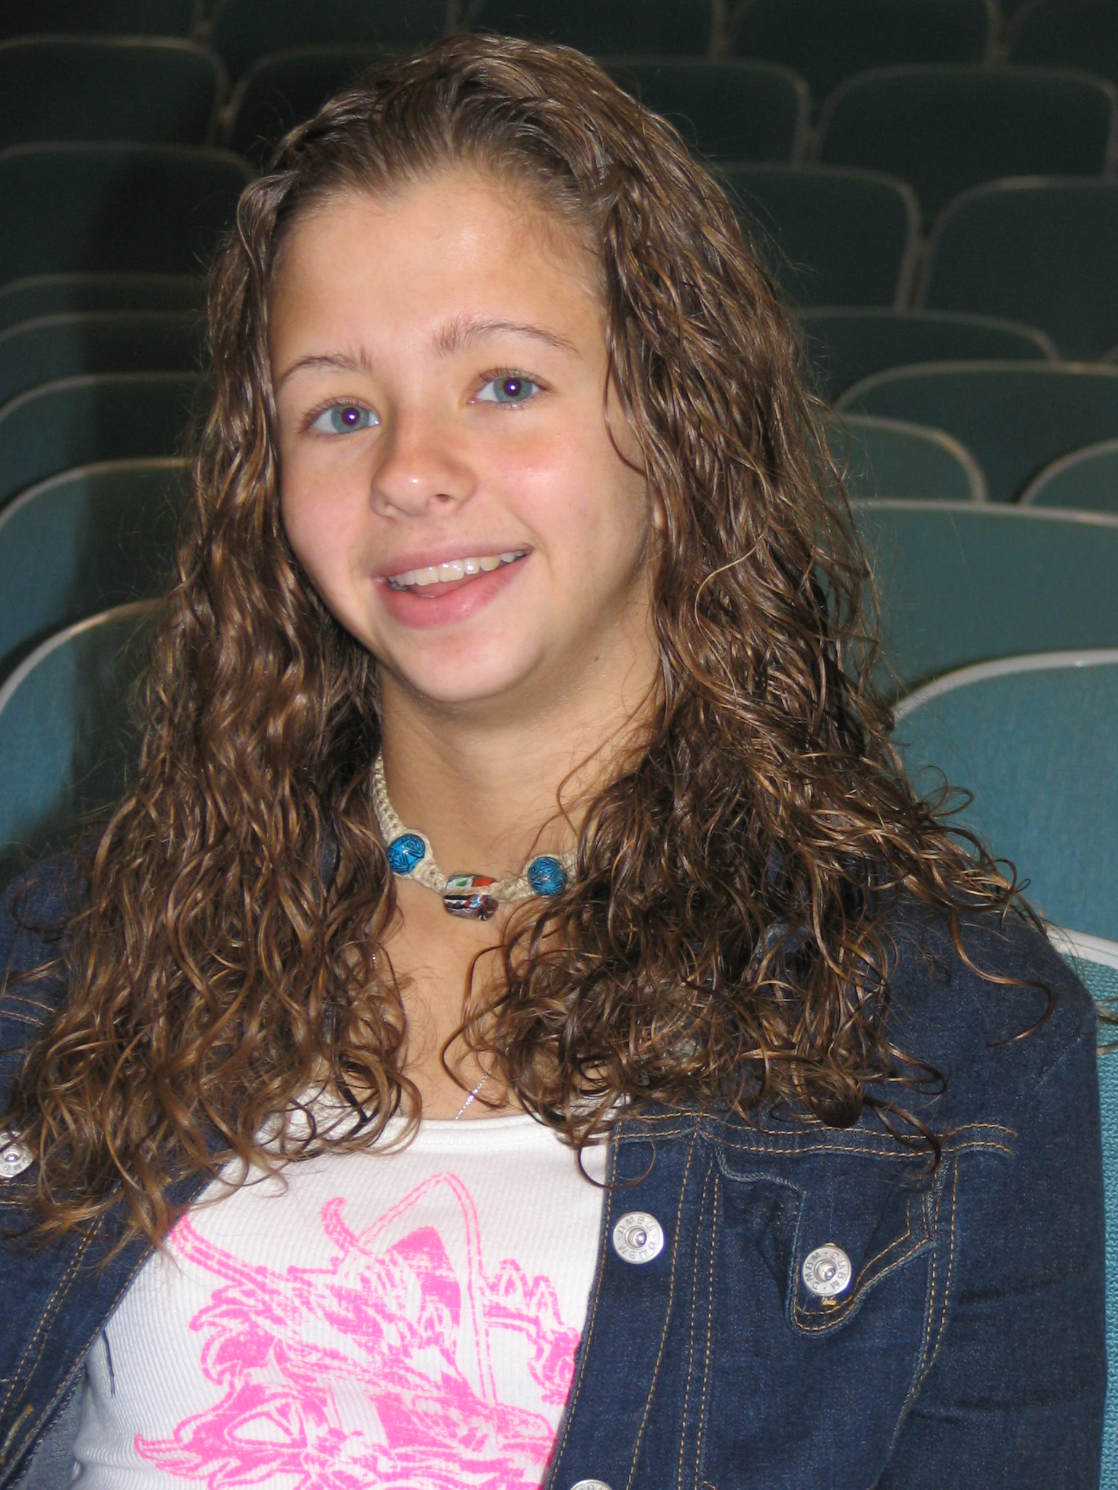
Adolescent
Difficult to engage
Sullen

Slide 17
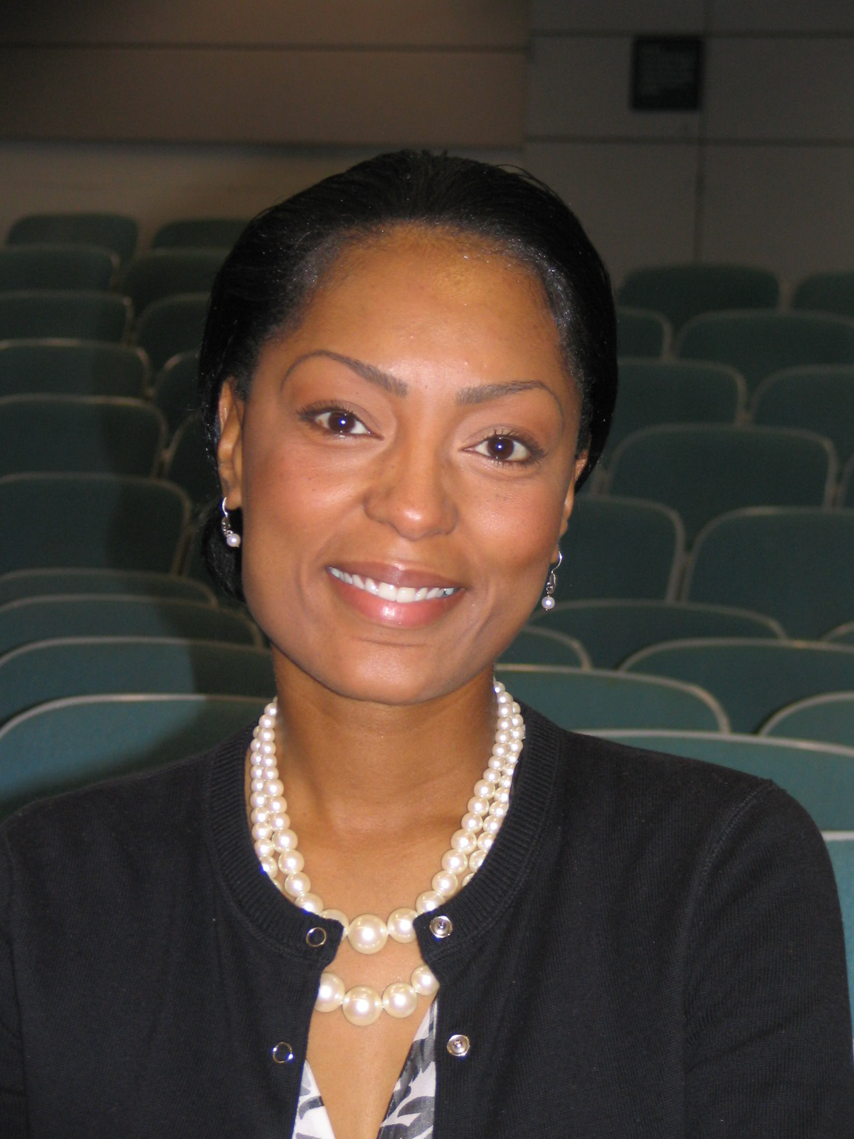
Distrustful
African American
Asks lots of questions

Slide 18
Recruitment
Email survey to faculty and staff on IRB email distribution list for faculty and staff involved in human subject research
200 responses
167 – yes 33 – no
90 registered
16 selected and submitted protocol
(3 replaced)

Slide 19
Participants
Highest Level of Education | Registered | Invited | Participated
PhD | 5 | 2 | 1
MD | 9 | 4 | 3
JD | 1 | 0 | 0
Masters | 33 | 6 | 4
Bachelors | 31 | 7 | 7
Research Role
Investigator | 15 | 6 | 4
Coordinator | 75 | 13 | 11

Slide 20
Workshop Format
8:00 Sign-In, breakfast
8:30 Welcome
8:45 Video/pre-test
9:00 Lecture – Part I
10:00 Break
10:30 Lecture – Part II
11:30 Instructions for SP Session and Lunch
12:45 SP Session
2:45 Break
3:15 Feedback and Discussion
4:30 Video/post-test, Summary and Course Eval.

Slide 21
Interactive Session with Standardized Patients
4 groups of participants
Rotated through SPs so each participant:
  Presented their protocol to one SP of a given type
  Observed the other three present protocols to the other three SPs
  Gave feedback on the observed consents
SPs gave feedback based on their subject type and communications checklist

Slide 22
Results/Evaluation

Slide 23
Pre-Post test
Script written to include positive and negative behaviors
10 minute video consent developed using trained faculty member & SP
Used same actors as “gold standard”
Completed at beginning and end of workshop
1) Describe all the positive behaviors you observe
2) Describe all the behaviors which could be improved

Slide 24
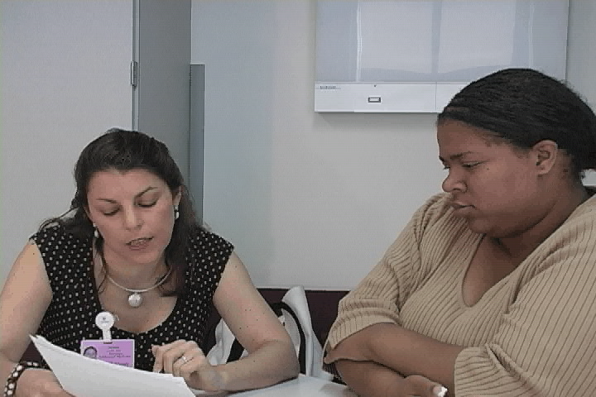

Slide 25
Pre-Post Test
Separated written comments into individual behaviors or ideas
Qualitative methods to analyze comments
26 categories

Slide 26
Participants recognized more behaviors in more categories
 | Pre-test mean (sd) | Post-test mean (sd)
Individual bits | 10.6 (4.2) | 13.0 (4.4)*
Individual concepts | 7.1(2.4) | 8.7 (2.7)**
*p = 0.045
**p = 0.029
Mean number of new categories = 4.1

Slide 27
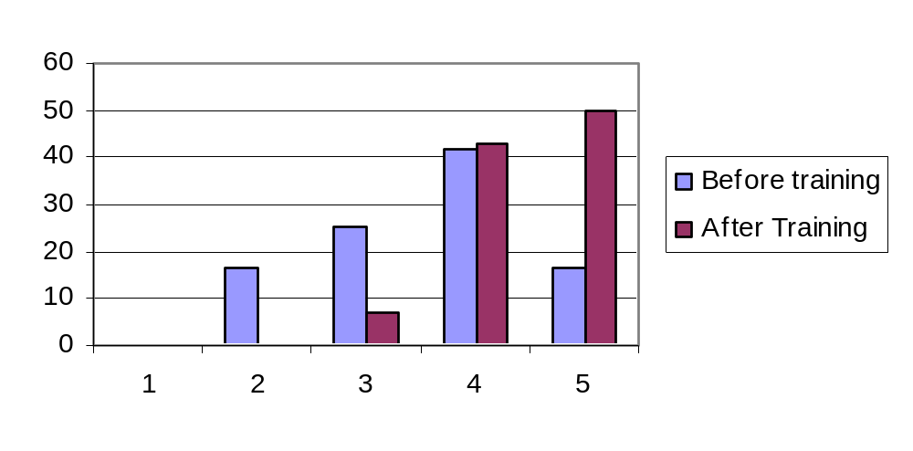
Self-assessed Skills Increased
Rate your overall ability to use the communication skills required for obtaining a valid consent: (Likert 1- 5, 5 = excellent)
%

Slide 28
Self-assessed Skills Stable at Three Months
Rate your overall ability to use the communication skills
required for obtaining a valid consent: (Likert 1- 5, 5 = excellent)
 | Day of training | 3 months later
Before training | 3.6 | 3.7
After training | 4.4* | 4.6**
*p = 0.001
**p = 0.000

Slide 29
Participants Liked the Course
To what degree…
(Likert 1-5, 5=high degree) | Mean
was the material new | 3.36
was the information interesting | 4.21
did the course met expectations | 4.43
will this course make positive difference in practice | 4.50

Slide 30
Satisfaction Did Not Change at Three Months
To what degree do you think this course…
(Likert 1-5, 5=high degree) | Mean at course | Mean at 3 months
met overall expectations | 4.43 | 4.50
will make a positive difference in practice | 4.50 | 4.43

Slide 31
Interactive Components
Rated Higher
To what degree did the following contribute to your overall learning and understanding of the subject matter?
(Likert 1-5, 5=high degree) | Mean at course | Mean at 3 months
Assigned Readings | 3.5 | 3.6
Audiovisuals | 4.2 | 3.4
Lecture | 4.2 | 4.1
Standardized Patients | 4.6 | 4.3
Feedback sessions | 4.1 | 4.1

Slide 32
Conclusions
This innovative curriculum was well received
and effective for teaching communication skills
that facilitate the informed consent process.
a highly interactive program can teach something new even to “experts”
the effect didn't decrease after 3 months
the more interactive parts of the program were evaluated highest

