Slide 1
Climate Forecasts and Reservoir Management : Possibilities and Challenges
Sankar Arumugam
Department of Civil, Construction and Environmental Engineering
North Carolina State University, Raleigh
&
International Research Institute for Climate and Society
Columbia University, Palisades

Slide 2
Acknowledgements
IRI, Columbia University, Palisades
  Upmanu Lall
  Casey Brown
  Neil Ward
FUNCEME, Ceara, North East Brazil
  Assis Filho De Souza
PAGASA, Manila, Philippines
  Susan Espinuvea

Slide 3
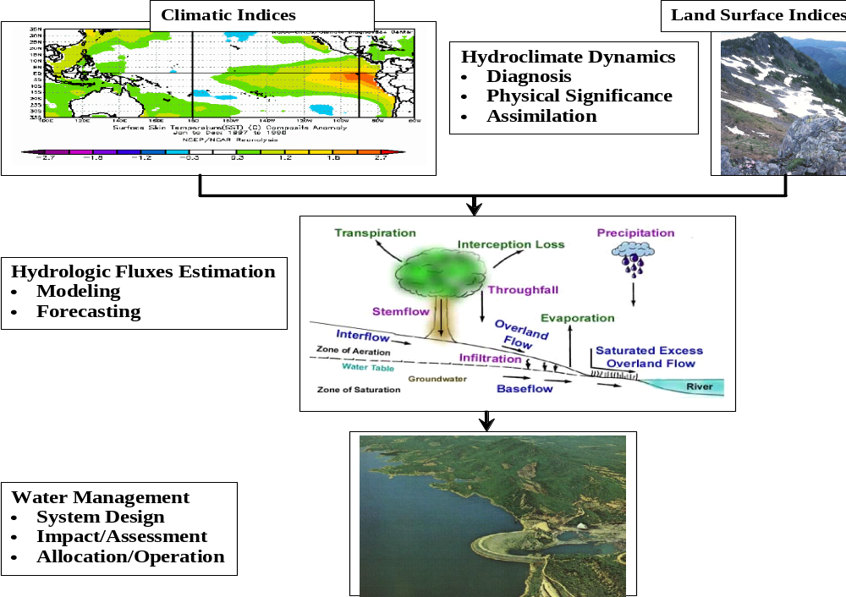
Large Scale Hydroclimatology & Water Management
Understanding & Monitoring of Large Scale Hydroclimatic Systems
Notes:
Hydroclimatic information in the form of both SST anomalies and land surface moisture conditions play an important role in determining the streamflow potential of the basin at seasonal/interannual time scale. For instance, climatic information, in the form of anomalous conditions in sea surface temperature over the tropics, alter the continental storm tracks/ precipitation in the form of teleconnection. Similarly, land surface conditions, like snow pack depth and soil moisture storage influence the streamflow potential of the basin at seasonal time scales. So, identification of these dominant hydroclimatic modes and coupling them with appropriate hydrologic model, one could predict the land surface response, streamflow, well in advance. Such improved prediction at seasonal/interannual l time scale could be exploited for water management like water allocation and reservoir operation. For instance, ….My primary research interest is in these lines; to understand, model and forecast hydrologic fluxes at large spatial scales and effectively utilize them for water management. In this context, I will present my postdoctoral work carried out IRI, Columbia university that focused in developing short-term water management utilizing seasonal/interannual hydroclimatic prediction.

Slide 4
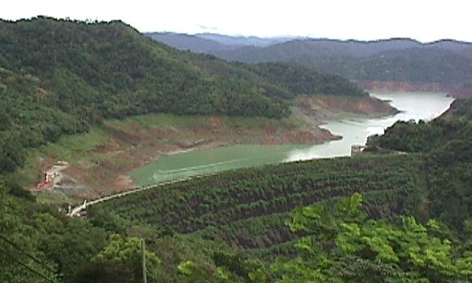
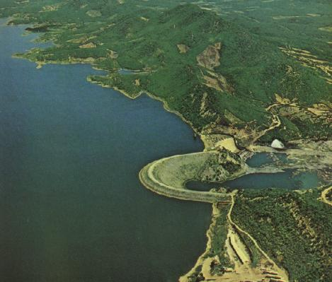
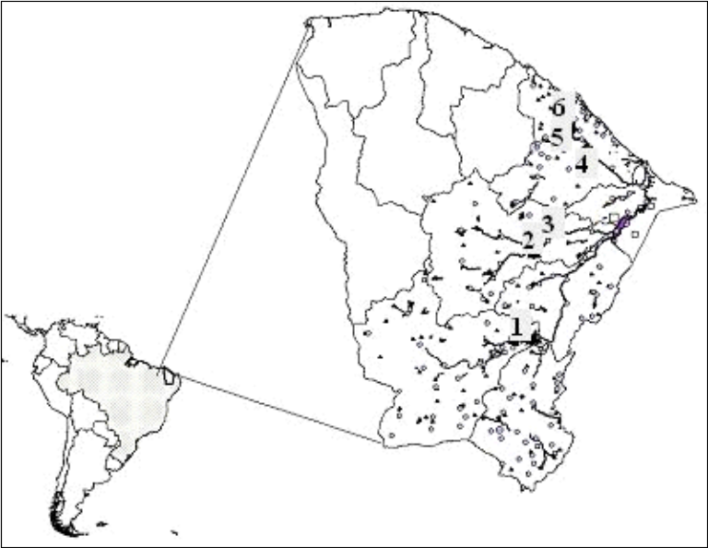
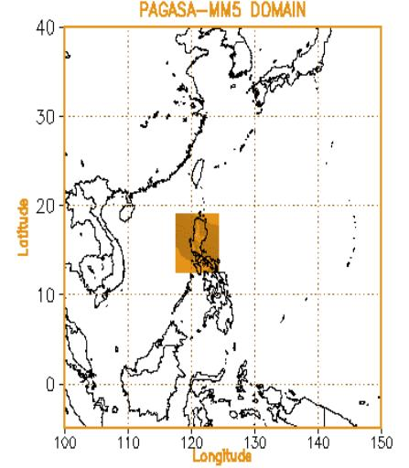
TALE OF TWO RIVER BASINS
Jaguaribe-Metropoilitan
HydroSystem, Ceara, Brazil
Angat Reservoir, Philippines
Angat Reservoir during the 1997-98 El Nino

Slide 5
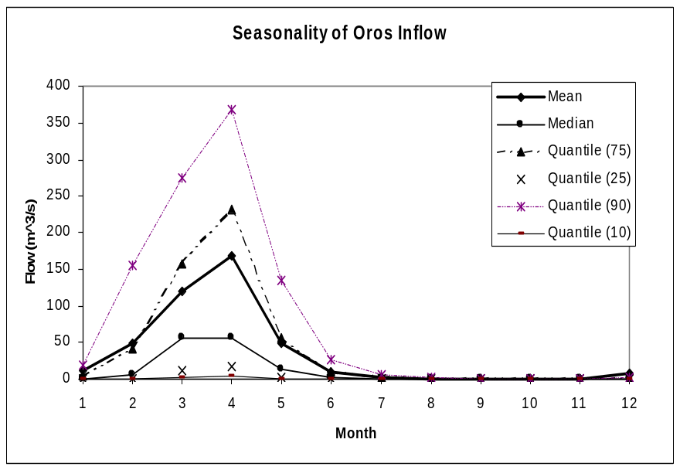
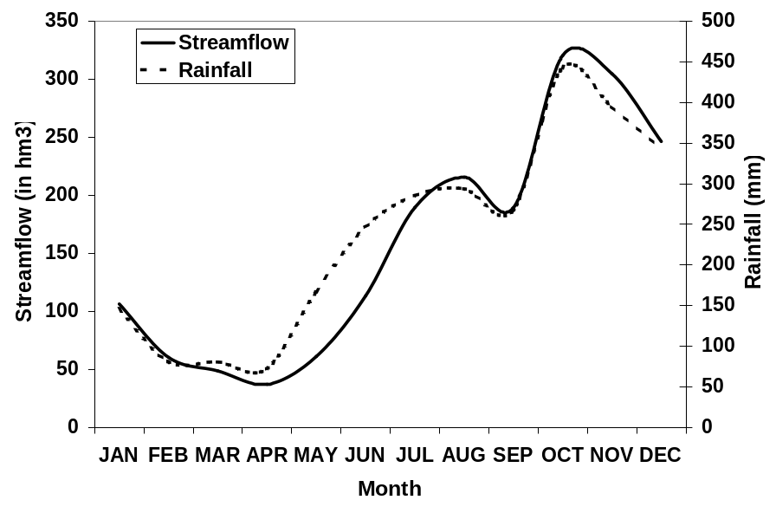
Hydroclimatology of the Basins
JMH, Ceara, NE Brazil
Semi-Arid
One Rainy season, Rest Zero flows
Angat, Philippines
Humid
Two Rainy Seasons (Jun-Sep) & (Oct-Dec)
Seasonality of rain determined by N-S migration of the ITCZ
JJAS – 30%
OND – 46%
Predictors | Correlation
Nino 3.4 Dipole | -0.31 -0.42
3-months lag correlation
ρ(Nino3.4,Q_{JJAS}) = -0.20
ρ(Nino3.4,Q_{OND}) = -0.51

Slide 6
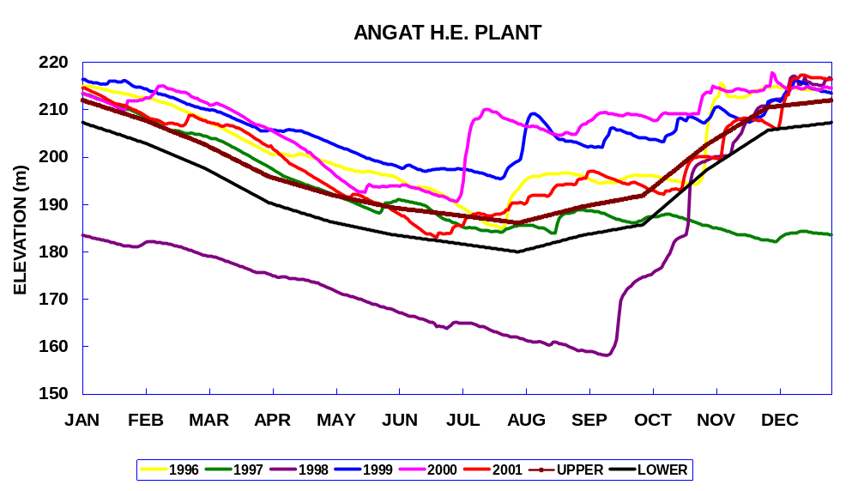
Water Management Context
JMH, Ceara, NE Brazil
Storage/Annual Demand Ratio:
Priority Uses
Municipal
Industrial
Agriculture
Seasonal Variation
Rain/Flow
Agriculture
Municipal and Industrial
July_{t}
Jan_{t+1}
July_{t+1}
Dec_{t+1}
Angat, Philippines
Storage/Annual Demand Ratio:
Priority Uses
Municipal
Industrial
Agriculture
Hydropower

Slide 7
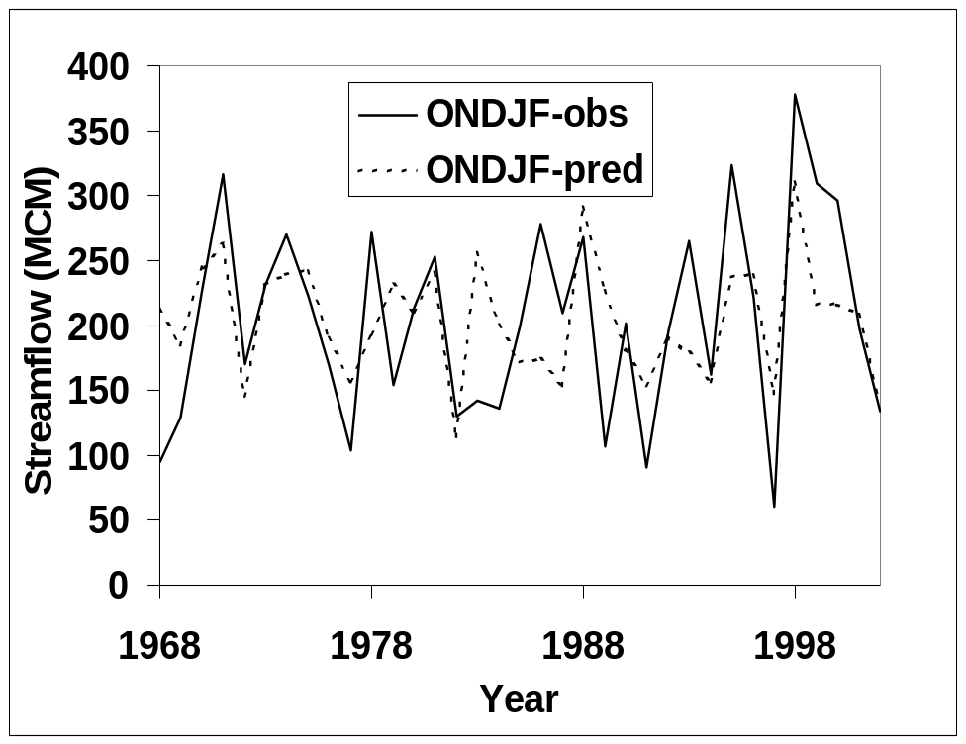
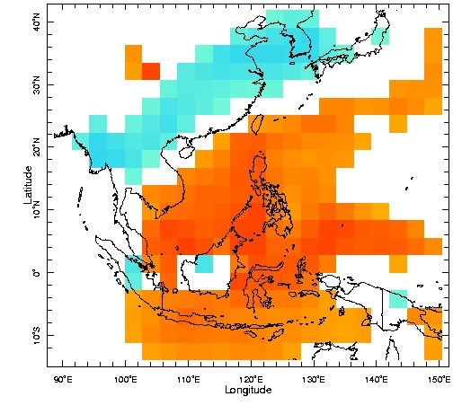
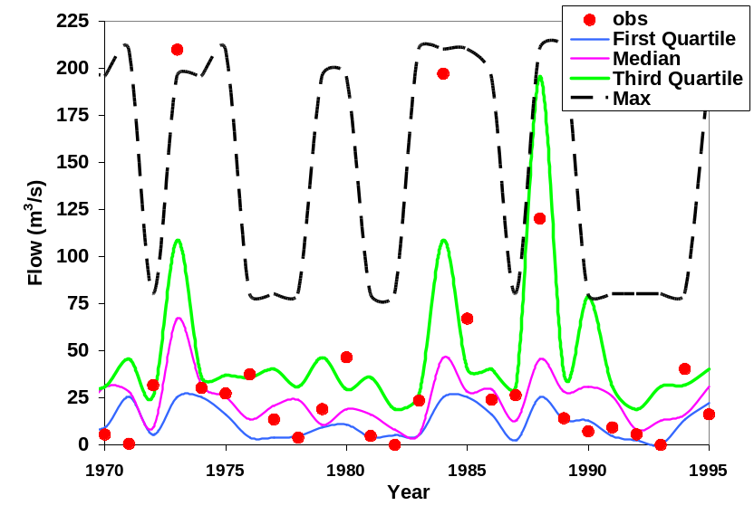
Climate Information based Streamflow Forecasts
JMH, Ceara, NE Brazil
Predictors: Nino3.4 & Atlantic Dipole
Semi-parametric Resampling algorithm
Angat, Philippines
ECHAM 4.5 ONDJF Forecasts in persisted SST mode
Parametric Regression
ρ(Q_{obs},Q_{pred}) = 0.75
ρ(Q_{pred},Q_{obs}):0.58

Slide 8
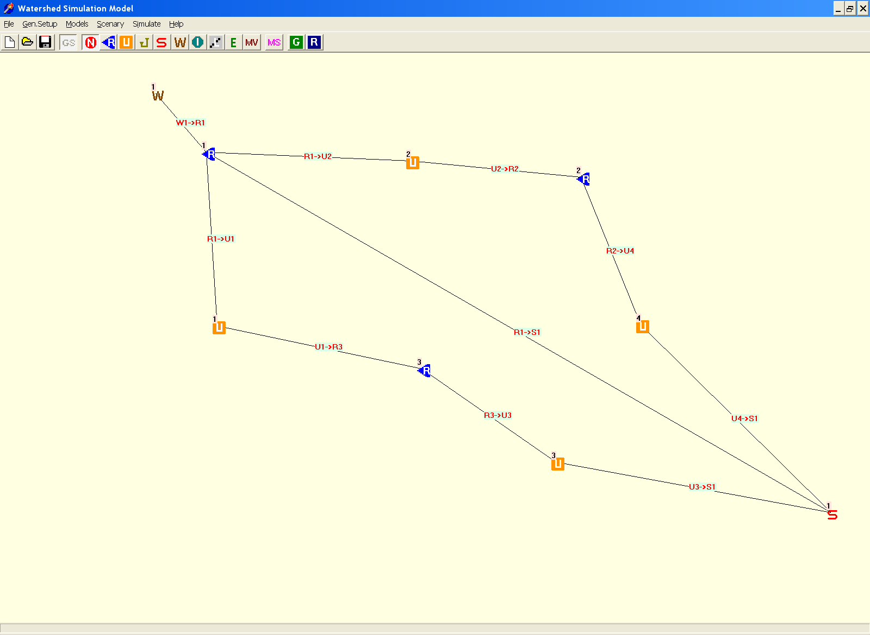
MORAPS (Copyright, IRI)
Angat Watershed
Hydropower (Auxillary) – 48 MW)
La Mesa Dam
Angat Reservoir
Metro Manila (97%)
Hydropower (200 MW)
Bustos Dam
Bulacan Irrigation (31000 ha)
Manila Bay

Slide 9
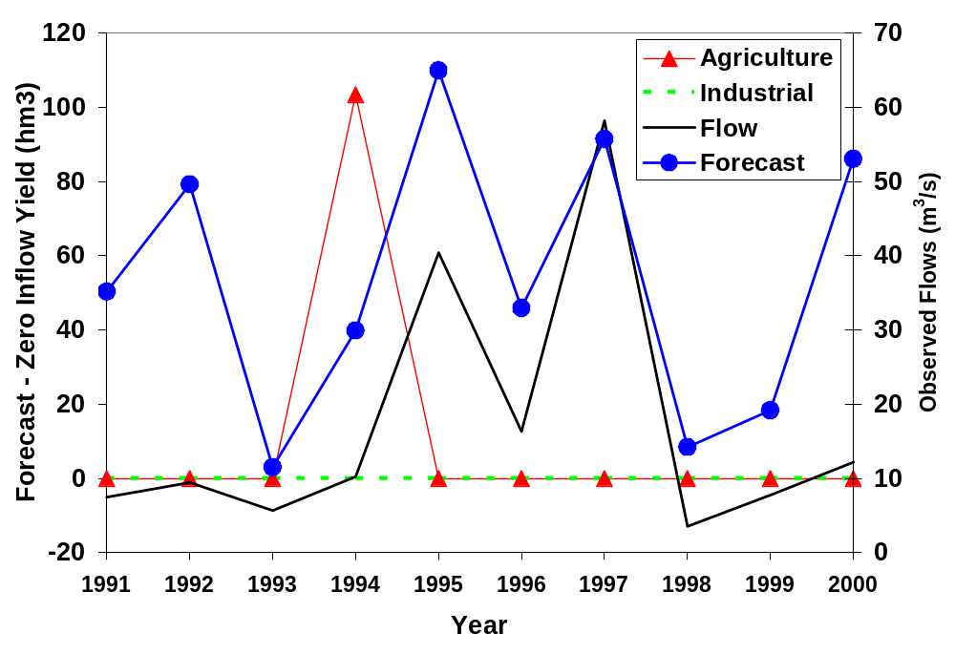
Retrospective Analyses on Water Allocation
JMH, Ceara, NE Brazil:1990 – 2000;Annual Demand

Slide 10
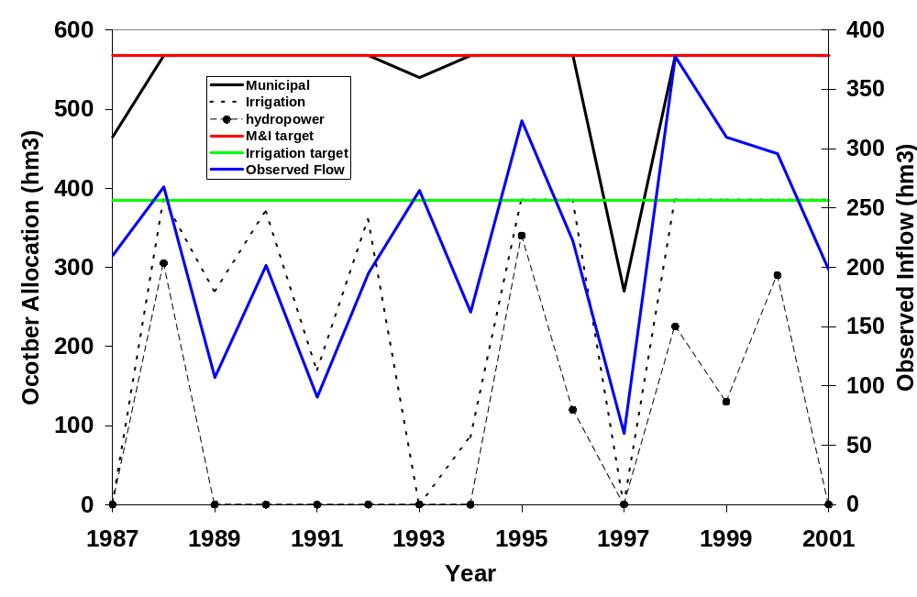
Retrospective Analyses on Water Allocation
Angat, Philippines: 1987-2001 ONDJF Allocation

Slide 11
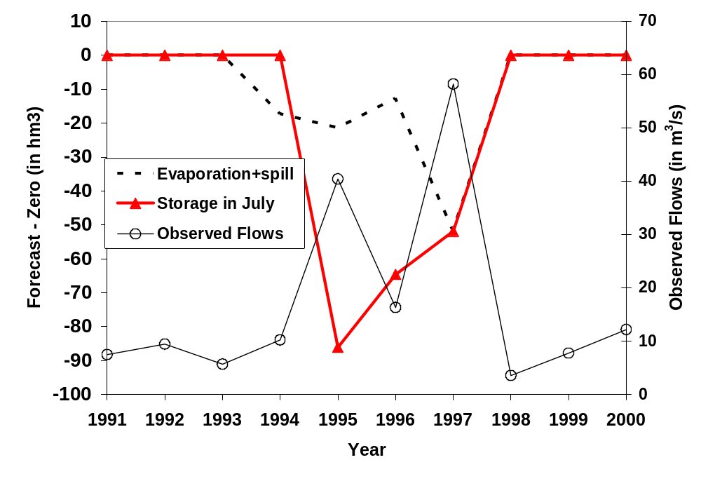
Oros - System Losses

Slide 12
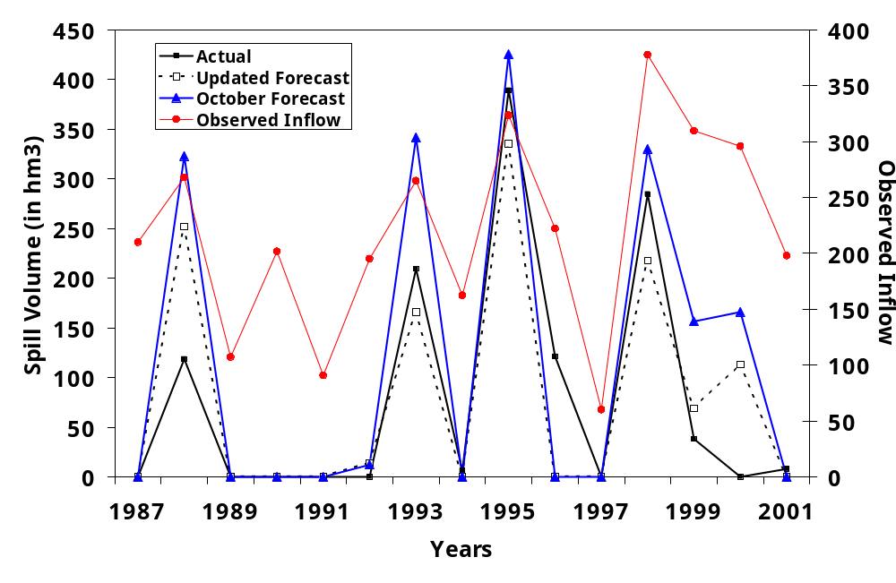
Angat- Spill Volume (Max Hydro)

Slide 13
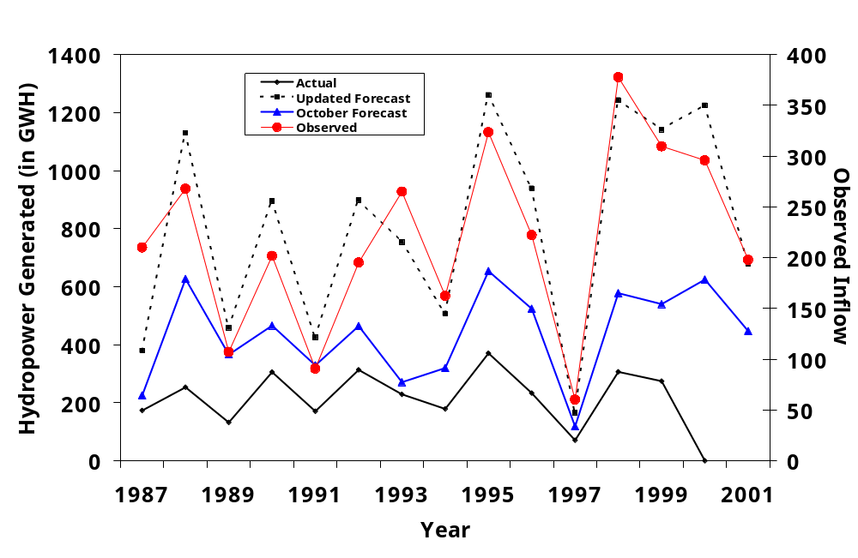
Retrospective Analyses on Water Allocation
Angat, Philippines: 1987-2001 ONDJF Allocation

Slide 14
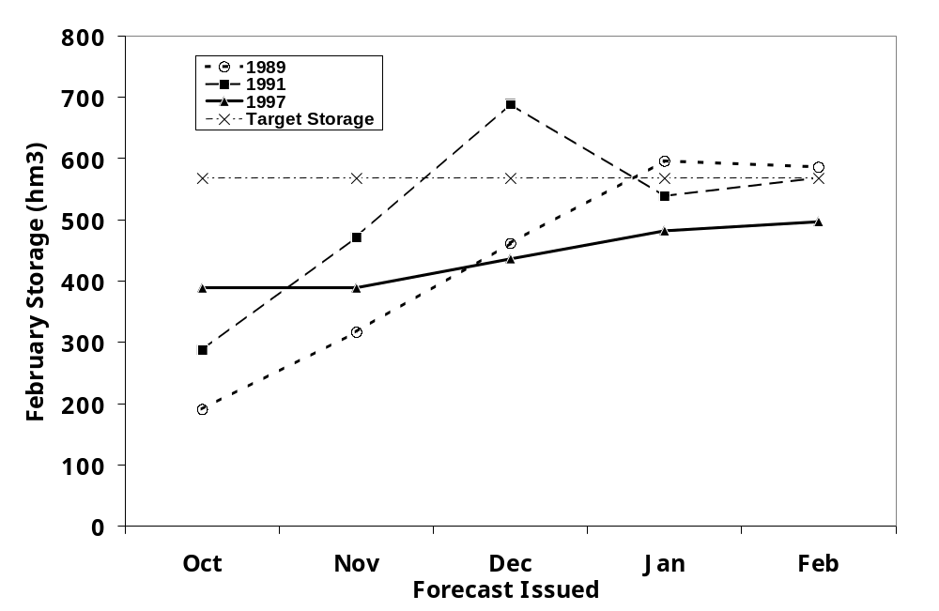
Meeting February Target Storage

Slide 15
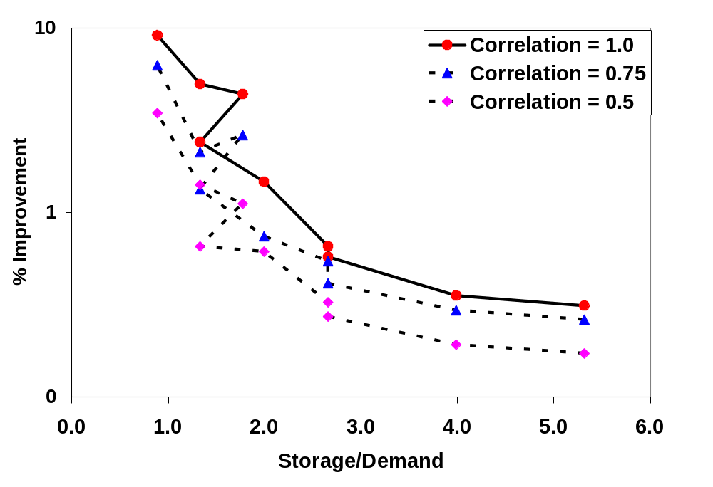
Utility of Forecasts As Storage/Demand
Angat
Oros
Notes:
Dem Stor Stor/Demand
365 1940 5.32
365 1455 3.99
365 970 2.66
730 1940 2.66
730 1455 1.99
730 970 1.33
1095 1940 1.77
1095 1455 1.33
1095 970 0.89

Slide 16
Climate Forecasts – Reservoir Management
Forecast is more useful than climatology
  In reducing System Losses – Spill and Evaporation
  In a system with low Storage/Demand ratio
  In a Seasonal Storage Reservoir than a Over Year System
  In Systems with multiple uses constraining the allocation process
Notes:
Angat Storage – 1011 hm3 – Demand :1870 hm3 Storage/Demand: 0.54; Storage/Inflow : 0.015; Residence time of water – 2.2 months
Ceara : 5.42;

Slide 17
Challenges and Way Forward
S-I Climate Forecasts Applications for Water Management
  Integrating Weather Forecasts (0-7 days outlook) with monthly and seasonal climate outlooks
  Adaptive Management with continuous updating of forecasts
  Community Priorities, Restriction and Compensation Mechanisms
  Application involve Risk based management strategies and water supply reliability specification.

