Slide 1
SOX: What is it, where did it come from, and what is happening now
Washington Tri-Cities Chapter of the IMA
December 12, 2006
Steven Bean
Senior Manager, Protiviti

Slide 2
Agenda
Introduction
Overview of SOX Requirements
Overview of Year 1 Compliance Efforts
Lessons Learned
SOX Methodology Overview (appendix)
Q & A

Slide 3
Who is Protiviti?
Our Vision
To be recognized as the premier global risk consulting and internal audit services company in the world.
Our Mission
To constantly improve how businesses manage risk. We will develop deep competency in people that enhances their value. We will bring unparalleled expertise to clients in risk management.
Our Values
  Professionalism
  Productiviti
  Proactiviti
  Objectiviti
  Creativiti
  Integriti
Protiviti is focused solely on internal audit, technology consulting, business risk consulting and corporate governance.
We currently have over 2,200 professionals worldwide in over 50 offices.
Protiviti owns the intellectual capital – training, methodology and tools – developed by these professionals over the past 16 years.
Our parent company, Robert Half International (RHI), formed Protiviti in May 2002 by hiring over 700 "Big 5" professionals, including over 50 partners, with significant internal audit and risk consulting experience.
Locally, we have an office of 45 professionals, each with SOX, internal audit, and/or technology risk consulting experience.

Slide 4

Overview of SOX Requirements

Slide 5
Why the Legislation?
A quick look at the major headlines during 2001 and 2002 tells the tale of a crisis in the making:
  Nov. 8, 2001 - Enron restates earnings for past five years, reports $586 million in losses
  March 27, 2002 - Adelphia says $2.3 billion borrowed by Rigas family not on books
  June 4, 2002 - Tyco CEO indicted on tax evasion charges
  June 12, 2002 - ImClone CEO Samuel Waksal arrested on insider trading charges
  June 25, 2002 - WorldCom admits to inflating earnings by $3.8 billion
It should come as no surprise that our elected officials and the SEC would aggressively pursue correction of the problem – and pursue it they certainly did!

Slide 6
Sarbanes-Oxley Act of 2002
Section 301: Publicly traded companies are required to establish a procedure for the confidential, anonymous submission by employees of concerns regarding questionable accounting or auditing matters (known as "whistleblower").
Section 302: Management must evaluate the design and operational effectiveness of its disclosure controls and procedures quarterly (disclosure controls include internal controls) [known as "certification"].
Section 404: Management is required to file an internal control report with their annual report, stating:
  Management’s responsibilities to establish and maintain adequate internal controls and procedures for financial reporting
  Management’s conclusion on the effectiveness of these internal controls at year end
  That the company’s public accountant has attested to and reported on management’s evaluation of internal controls over financial reporting
Section 906: Expressly imposes criminal penalties if the information contained in the periodic report does not fairly represent, in all material respects, the financial condition and results of the operations of the issuer.

Slide 7
Sarbanes-Oxley Act of 2002
Some Harsh Realities
  Sarbanes-Oxley requires documentation of all key business processes and primary controls within those business processes
  Sarbanes-Oxley requires testing of these controls – both by management and then again by the external auditor
  This is not going away anytime soon. This is not a “once and done” exercise. The Sarbanes-Oxley program should be performed with a long-term vision in mind.
  “Project” vs. “Process” mentality (will talk about this towards the end of the day)
  This exercise costs a lot of time and money

Slide 8
Overview of Year 1
Compliance Efforts

Slide 9
SOX Year 1 Compliance – Overview
SOX is the most sweeping U.S. securities legislation since the Securities Act of 1933 and the Securities Exchange Act of 1934.
Estimates of the total cost to U.S. companies for SOX compliance in 2004 are in excess of $35 billion.
The legislation is "here to stay" even if modified in the future as a result of current SEC roundtable meetings and other discussions.
As of March 16, 2005, 11% of filers had reported material weaknesses under provisions of the Sarbanes-Oxley Act.
Overall, stocks on filers reporting material weaknesses did decrease slightly, however, only around 2% to 4% (small cap companies were more affected than larger cap).
The following slides are highlights from a study by the Corporate Executive Board, entitled "SOX 404 Triggering Delayed Filings And CFO Turnover," which include some interesting results from Year 1.

Slide 10
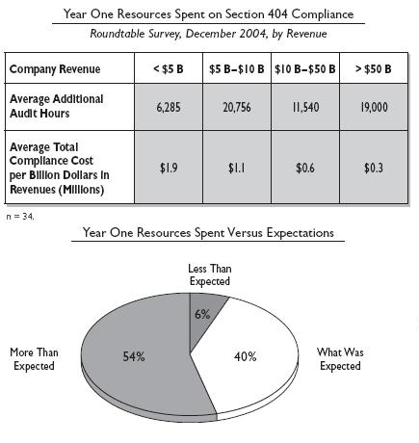
Year 1 Compliance – Overall Cost
The study at left highlights the average Year 1 resources spent on SOX compliance (Section 404).
The analysis suggests for a company with $250 million in Revenues, the cost of Year 1 compliance averaged $475k.

Slide 11
Reporting Deficiencies
_{Significant deficiency:}
    An internal control deficiency that adversely affects the company’s ability to initiate, record, process or report external financial data reliably in accordance with GAAP.
    Could be a single deficiency or a combination of deficiencies that results in more than a remote likelihood that a misstatement of the annual or interim financial statements that is more than inconsequential in amount will not be prevented or detected.
_{Material weakness:}
    A significant deficiency that, by itself, or in combination with other significant deficiencies, results in more than a remote likelihood that a material misstatement of the annual or interim financial statements will not be prevented or detected.
    Material Weakness = Adverse Opinion

Slide 12
Reporting Deficiencies
A sample framework for classifying deficiencies using the “likelihood” and “magnitude” factors:
LIKELIHOOD
REMOTE
(A “slight” chance or a
less than a 5% to 10% chance))
MORE THAN REMOTE
(More than a
5% to 10% chance)
MATERIAL AMOUNT
(GREATER than
4% to 5% of pre-tax income)
Control Deficiency,
but not Significant Deficiency
Material Weakness
MORE THAN
INCONSEQUENTIAL
(i.e., More Than Clearly
Immaterial), But Less
Than Material Amount
(GREATER than .5 to 1% of
pre-tax income but LESS than 4%)
Control Deficiency
but not Significant Deficiency
Significant Deficiency
but not Material Weakness
MAGNITUDE
INCONSEQUENTIAL
AMOUNT
(i.e., Clearly Immaterial)
(LESS than .5% to 1%
of pre-tax income)
Control Deficiency
but not Significant Deficiency
Control Deficiency
but not Significant Deficiency

Slide 13
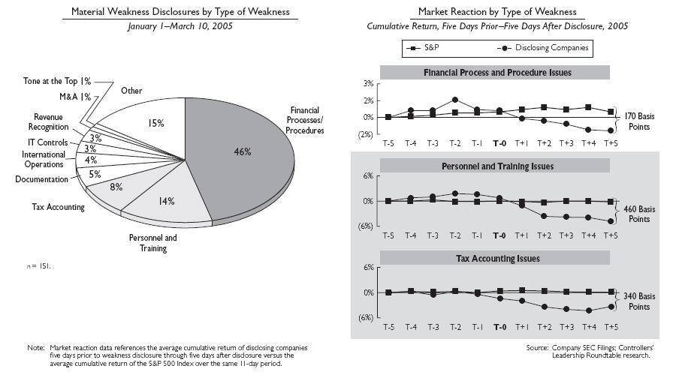
Filers Reporting Material Weaknesses
11% of accelerated filers to date (March 16, 2005) have disclosed a material weakness in internal controls.
While the largest number of weaknesses are in financial processes and procedures, market reaction is more pronounced for disclosures related to personnel and tax accounting issues.
As of April 2005, the number of companies receiving “adverse opinions” or disclaimers was 9.8%.

Slide 14
Compliance Week –
April 2005 Overview
Based on 2005 disclosures, the following areas were commonly cited as having known deficiencies:
  Lease Accounting
  Accounting Policies and Practices
  Inexperienced Staff or Lack Thereof
  Taxes
  GAAP Calculations and Policies
  Revenue Recognition
  Monitoring
  Third-Party Relationship (e.g., strategic supplier relationship, etc.)
  International and Merger and Acquisitions
  Control Environment (e.g., integrity, ethical values, compliance with Code of Ethics, etc.)

Slide 15
Compliance Week –
April 2005 Overview
The top five industries with the highest failure rate (at least 20 filings) included:
  Retail (21.5%)
  Consumer Products (20%)
  Metals and Mining (17.2%)
  Business Services (14.4%)
  Consumer Products Manufacturers (13.7%)

Slide 16
Lessons Learned

Slide 17
Management Best Practices
Top management support is vital; the project can’t succeed without it
Budget for it and commit – be serious and set the tone:
  Don’t ignore the clock – this is a BIG effort
  FEI studies report an under-estimation of overall effort
  Start as early as you can
Take charge – some common pitfalls to avoid:
  Project is managed at too low a level within the organization
  Project team gets lost in irrelevant details
  Key scoping decisions remain unaddressed too long
Walk through the major processes yourself
Insist on status reports
Obtain sub-certification by others
Communicate up, down and across the organization
Establish a Steering Committee to maintain senior management sponsorship

Slide 18
Potential Obstacles / "Nightmares"
Company or external auditor testing of remediated controls prove they are not working
"New scope" items created by external auditor
No time left to remediate issues
Fraud occurs, not contemplated by existing controls
Key fourth quarter or annual controls do not work
Large financial statement adjustment NOT detected by management
Large financial statement adjustment detected by management but affecting prior quarters
Audit Committee is deemed ineffective
Fraud programs and controls not thoroughly documented
Issues in general IT control environment
Sample sizes not large enough
Deficiency / material weaknesses definition disagreements
SAS 70 issues

Slide 19
Where are we trying to go?
H
Enterprise Risk Management
Protect and Enhance Enterprise Value
H
Business Process Improvement
Improve Quality, Cost and Time
Value to the Business
Effective Monitoring Process
and Testing Strategy
Sustainability of the Control Structure
Self Assessment by Accountable Process Owners
Implement Ongoing Compliance Structure
Assess
Internal
Controls
Comply with302 and 404
L
L
Time

Slide 20
SOX Methodology Overview (appendix)

Slide 21
Detailed Project Steps
Set Foundation
Organize project Develop project plan Agree on approach / reporting requirements
PHASE I: Assess Current State and Identify Relevant Processes
Perform entity-level controls assessment Select financial statement elements, processes and locations Agree on documentation standards – level of depth, assertions and control objectives Inventory existing control documentation
PHASE II: Document Design and Evaluate Critical Processes and Controls
Document processes Source risks (what can go wrong?) Document controls Assess design Develop testing approach Validate operation
PHASE III: Design Solutions for Control Gaps
Evaluate nature of identified deficiencies Determine deficiencies requiring correction Design and document improvements
PHASE IV: Implement Solutions for Control Gaps
Build improvements Implement improvements Test improvements Update policies and procedures Provide training Measure performance
Report
Formulate conclusions with respect to internal controls over reliability of financial reporting Provide results and documentation to External Auditors for attestation process Conclude attestation process Generate internal controls report
Checkpoint with External Auditors

Slide 22
Type / Depth of Documentation
Process Categorization Framework
High
Information Technology
Security / Controls
Litigation
and Other
Contingencies
Framework Interpretation:
  Detail LEVEL 3 or LEVEL 2 process documentation and assessment for all control activities
  LEVEL 2 or LEVEL 1 process documentation and assessment of key control and monitoring activities related to relevant control objectives
  LEVEL 1 or no process documentation and assessment of key control and monitoring activities
Treasury / Cash
Management
Financial
Reporting
Supply
Chain
Accounts
Receivable /
Collections
Red
Inventory
Management
Revenue
Recognition
Customer
Billing
Payroll
Materials
Management
Importance to business
Budgeting /
Forecasting
Yellow
Purchasing /
Accounts
Payable
SAMPLE
Capital Assets
Contracts
Management
Intangible
Assets
Green
Travel &
Entertainment
Marketing
Medium
Deferred
Charges
Medium
Likelihood of control / process issues
High

Slide 23
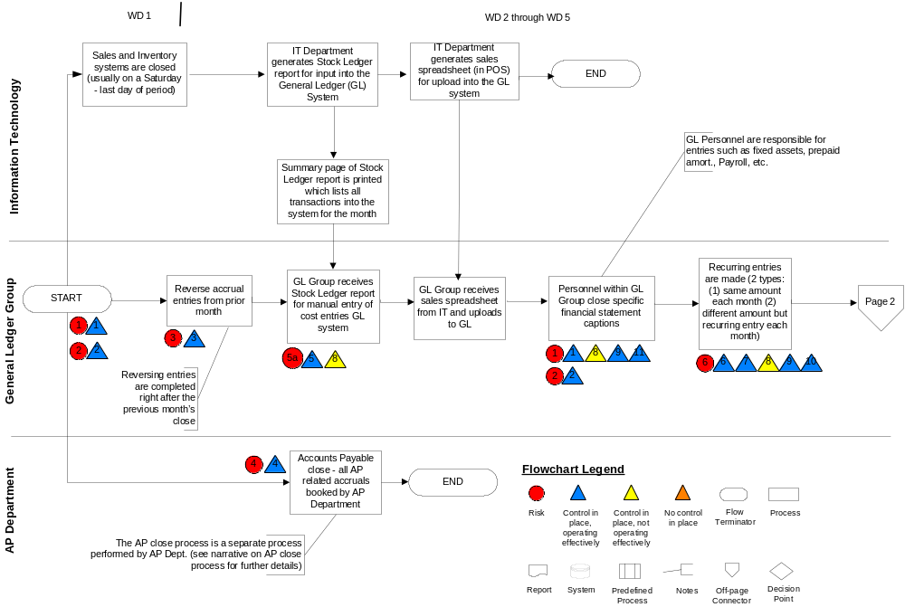
Sample Documentation
Level 3 – Process Map
SAMPLE

Slide 24
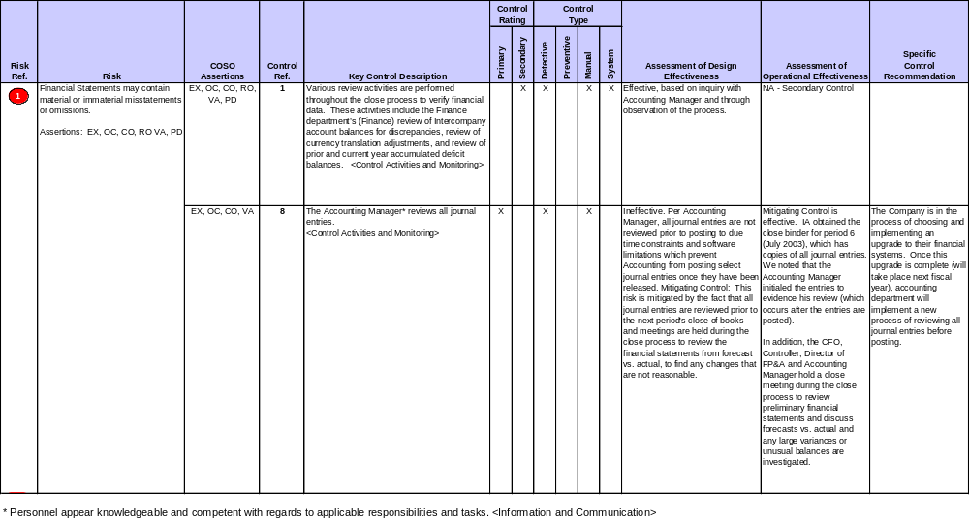
Sample Risk / Control Matrix
COSO Assertions:
Existence (EX) - Assets, liabilities, and ownership interests exist as a point in time.
Occurrence (OC) - Recorded transactions represent economic events that actually occurred during a stated period of time.
Completeness (CO) - All transactions and other events and circumstances that occurred during a specified period, and should have been recognized in that period,
have, in fact, been recorded. Therefore, there are no unrecorded assets, liabilities, or transactions and no omitted disclosures.
Rights and Obligations (RO) - Assets and liabilities reported on the balance sheet are bona fide rights and obligations of the entity as of that point in time.
Valuation or Allocation (VA) - Assets, liabilities, revenues, and expenses are recorded at appropriate amounts in accordance with relevant accounting principles.
Presentation and Disclosure (PD) - Items in the statements are properly described and classified as well as fairly presented.
SAMPLE
Process: Close the books
COSO Objective: Integrity of financial reporting
Financial Reporting Element: All financial reporting elements

