Slide 1
Virginia Department of Education
Foreign Language Standards of Learning
Cultural
Perspectives, Practices and Products
Notes:
4th strand in the VaSOL for Foreign Languages
Integral to the understanding of fl
Interrelated and difficult to separate; each has an impact on the other
If our students have a good feel for the 3 P’s, then they have a good chance of ……
(next slide)

Slide 2

You may want to have a copy of the Foreign Language Standards of Learning available for reference as we discuss them throughout this broadcast.

Slide 3
Successful Communication:
Knowing how,
when,
and why
to say what
to whom.

Slide 4
Culture Is the Context Within Which Communication Occurs
Development of cultural understanding includes developing an awareness of other people’s world views, of their unique way of life, and of the patterns of behavior that order their world.

Slide 5

The human mind, once stretched to a new idea, never returns to its former dimension.
Oliver Wendell Holmes

Slide 6
Organizing Strands
The Communication Strands
Person-to-Person Communication
Listening and Reading for Understanding
Oral and Written Presentation
Reading for Understanding
Using Oral and Written Language for Understanding
Cultural Perspectives, Practices, and Products
Making Connections through Language
Cultural and Linguistic Comparisons
Communication across Communities

Slide 7
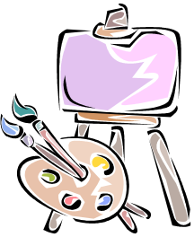
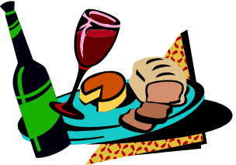
What is Culture?
“Big C” Culture
  Formal Culture
  Requires knowledge of social, political, and economic institutions, great figures of history, literary and artistic works
“little c” culture
  aspects of daily living
  housing, clothing, food, patterns of
  daily behavior

Slide 8

Which is more important?
Both formal and informal culture are inextricably interwoven into the language of those who live the culture.
Understanding and involvement with both formal and informal culture are vitally important to students in learning to communicate.
Formal and informal culture are inseparable.

Slide 9
Consider the
Three P’s of Culture:
Perspectives, Practices, and Products
Notes:
AVOIDING CULTURAL MISUNDERSTANDINGS:
-- Remember a time when you embarrassed yourself. It was probably because you did not understand at least one cultural convention, meaning, or use of something.
FORMAL ARTIFACTS OF CULTURE:
--contact with art, music, literature, architecture that reflect the history and culture of a people.
--enables a conversational framework
--our students will understand conversational references to such things if they are introduced to them in our classes.
--our students will have topics about which to talk that demonstrate a certain level of knowledge
INFORMAL ASPECTS OF DAILY LIFE
--this includes behaviors in a social setting, as well as knowing when stores are open, when business may be conducted.
SAME LANGUAGE DOES NOT MEAN SAME CULTURE
--knowing all of the vocabulary and having exact grammar does not guarantee understanding and comprehension.

Slide 10


What are the
PRODUCTS of a culture?
Concrete aspects of daily life
  Tools, foods, laws, games, etc.
Tangible and intangible
  Paintings, monuments, work of
  literature
  An oral tale, a sacred ritual, a system
  of education
Notes:
Products of a culture are the elements that form the unique nature of that culture.
TANGIBLE AND INTANGIBLE
tangible: any artifact that may be touched that gives a sense of the people who create and/or use it. Foods, clothing, houses, etc. fall into this category.
Intangible: Encompasses ideas, ideals, etc. Democracy is an intangible product of the Greek City States and those concepts were used to form the United States. Another example is the definition of beauty: certainly the Renaissance painters had a different concept of beauty than Americans today.
INVENTIONS AND INNOVATIONS:
the car is an example of American ingenuity, technical knowhow, need for efficiency.
CONCRETE ASPECTS OF DAILY LIFE:
--vocabulary (# of words for snow for Inuit vs for equatorial
--tell us about tools
AESTHETIC EXPRESSIONS:
--music, art, literature of the people. A Gothic cathedral is a product of its place, time, beliefs, and technology.
SOCIO-CULTURAL MORES:
reverence for elderly. Socially defined roles according to age, sex, etc.

Slide 11



What are the
PRODUCTS of a culture?
Inventions and innovations
  foods, gadgets, forms of transportation,
  processes, etc.
Aesthetic expressions
  music, literature, art, etc.
Notes:
Products of a culture are the elements that form the unique nature of that culture.
TANGIBLE AND INTANGIBLE
tangible: any artifact that may be touched that gives a sense of the people who create and/or use it. Foods, clothing, houses, etc. fall into this category.
Intangible: Encompasses ideas, ideals, etc. Democracy is an intangible product of the Greek City States and those concepts were used to form theUnited States. Another example is the definition of beauty: certainly the Renaissance painters had a different concept of beauty than Americans today.
INVENTIONS AND INNOVATIONS:
the car is an example of American ingenuity, technical knowhow, need for efficiency.
CONCRETE ASPECTS OF DAILY LIFE:
--vocabulary (# of words for snow for Inuit vs for equitorial
--tell us about tools
AESTHETIC EXPRESSIONS:
--music, art, literature of the people. A Gothic cathedral is a product of its place, time, beliefs, and technology.
SOCIO-CULTURAL MORES:
reverence for eldery. Socially defined roles according to age, sex, etc.

Slide 12
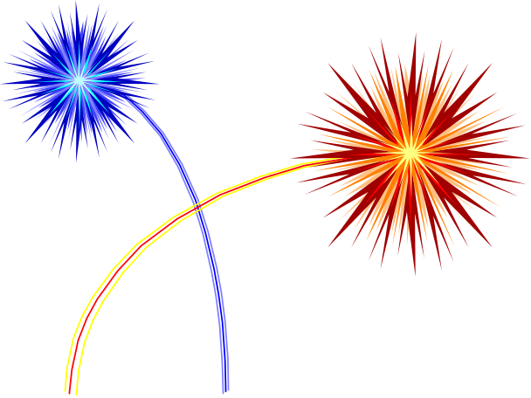


What are the PRACTICES of a culture?
Patterns of behavior accepted by society
Social interaction in a specific cultural context
Personal, small group, or societal
What to do when and where
How to interact
Notes:
Practices are defined by the society at large and are often unconscious. That is until somebody “violates” one of them. This is when those embarrassing moments take place.
Govern social action. May be a subset of the whole population (youth, business, family, etc.) The “youth culture” has its own words and behaviors that are acceptable.
Interaction among and between people. It is necessary to understand the social pecking order, the rites of passage, personal space, gestures and conversational conventions. This includes, touching, kissing, embracing, hand shaking, etc. For ASL it especially encompasses facial gestures.
Accepted behavior within the particular social context is not noticed. Only when a “violation” takes place does one become aware of the infraction. These are the moments when one says “I can’t believe he said/did that.”
How does one interact? This not only includes the greeting/farewell behaviors, but also such things as eye contact.

Slide 13
What are the PRACTICES of a culture?
They may be things such as
  rites of passage
  the use of formal and informal language
  the social “pecking order”
  the use of personal space
  when to embrace or shake hands
Notes:
Practices are defined by the society at large and are often unconscious. That is until somebody “violates” one of them. This is when those embarrassing moments take place.
Govern social action. May be a subset of the whole population (youth, business, family, etc.) The “youth culture” has its own words and behaviors that are acceptable.
Interaction among and between people. It is necessary to understand the social pecking order, the rites of passage, personal space, gestures and conversational conventions. This includes, touching, kissing, embracing, hand shaking, etc. For ASL it especially encompasses facial gestures.
Accepted behavior within the particular social context is not noticed. Only when a “violation” takes place does one become aware of the infraction. These are the moments when one says “I can’t believe he said/did that.”
How does one interact? This not only includes the greeting/farewell behaviors, but also such things as eye contact.

Slide 14
What are the
PERSPECTIVES of a culture?
Traditional ideas, attitudes, and values
Underlying beliefs or values that justify a product or practice
What individuals think or do from their own particular points of view
World view, belief system
Notes:
Perspectives are burried deep beneath the products and practices of a people. They are strong and exert heavy influence although we are not aware of them.
Traditional ideas, attitudes and values are the guiding principles of the whole group.
They determine the boundaries for individualizing.
The way the world is seen and understood is governed by the perspectives of a people.
The teachable moment for the teacher is when a student asks “Why do they do it that way?” or “Why don’t they just do it like us? It would be so much simpler.”
Just because “our way” works for us does not mean that is works for someone else. Circumstances of geography, history, economics, climate, etc. will define the way in which each group of people solves the problems of living each day.

Slide 15

What are the
PERSPECTIVES of a culture?
The perspectives of a culture are often difficult to articulate for one’s own culture
They are even more difficult to articulate for another culture
Notes:
Perspectives are burried deep beneath the products and practices of a people. They are strong and exert heavy influence although we are not aware of them.
Traditional ideas, attitudes and values are the guiding principles of the whole group.
They determine the boundaries for individualizing.
The way the world is seen and understood is governed by the perspectives of a people.
The teachable moment for the teacher is when a student asks “Why do they do it that way?” or “Why don’t they just do it like us? It would be so much simpler.”
Just because “our way” works for us does not mean that is works for someone else. Circumstances of geography, history, economics, climate, etc. will define the way in which each group of people solves the problems of living each day.

Slide 16
EXAMPLES
Let’s choose a language specific culture
Identify a set of the 3 P’s (perspectives, practices, products) specific to that culture
Describe how these are separate, yet related, concepts.
Notes:
This is a good place to stop and come up with some specific examples of these 3 P’s as relate to each of the languages being taught. An example from the US:
Perspective: youth is valued in the US
Practices: exercise, makeup, hair dye, diet, fashion,
Products: --spa memberships, exercise machines,
--multimillion companies in cosmetics
--for both men and women
--Healthy Choice, Weight Watchers
--Clothing that makes us “look young”
**Note that this exercise sometimes works best when starting with products and moving through practices to perspectives. Other times it will work better going from the perspective through practice to product.
**Note: This particular strand was the one that gave the writing committee the most difficulty, partly because it is so difficult to distinguish the three one from the other. This is also an area that is heavily value-laden, so when writing a curriculum, be aware of this.

Slide 17

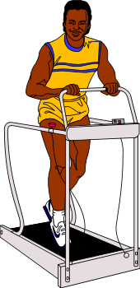
EXAMPLES
U.S. Culture
Perspective - how much youth is valued
Products that prolong youth and vitality
  face creams, healthy foods, exercise equipment
Practices that are perceived as prolonging youth and health
  jogging, spa membership, crash diets
  exercise clothing, running shoes, etc.
Describe how these are separate, yet related, concepts.
Notes:
This is a good place to stop and come up with some specific examples of these 3 P’s as relate to each of the languages being taught. An example from the US:
Perspective: youth is valued in the US
Practices: exercise, makeup, hair dye, diet, fashion,
Products: --spa memberships, exercise machines,
--multimillion companies in cosmetics
--for both men and women
--Healthy Choice, Weight Watchers
--Clothing that makes us “look young”
**Note that this exercise sometimes works best when starting with products and moving through practices to perspectives. Other times it will work better going from the perspective through practice to product.
**Note: This particular strand was the one that gave the writing committee the most difficulty, partly because it is so difficult to distinguish the three one from the other. This is also an area that is heavily value-laden, so when writing a curriculum, be aware of this.

Slide 18

Why are the Three P’s so important?
They enable us to:
  Avoid cultural misunderstandings
  Articulate what culture is
  See formal artifacts of a culture
  Understand informal aspects of daily life
  Recognize that the same language does not necessarily mean the same culture
  Help students to expect differences

Slide 19

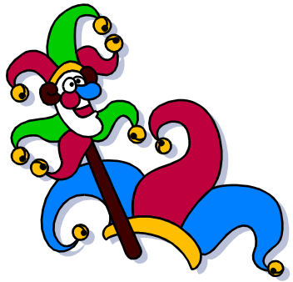
Cultural Perspective, Practices, and Products
How do the cultural standards progress from concrete to more analytical?
Level I
  identify viewpoints, customs and traditions, individuals, products
  recognize interrelationships
Level II
  participate in events
  identify and discuss patterns
  examine the influence of geography

Slide 20


Cultural Perspective, Practices, and Products
Level III
  examine how and why products reflect practices and perspectives
  discuss how viewpoints are reflected in practices and products
Level IV
  discuss evidence of viewpoints, patterns of behavior, and products in the culture
  engage in situations that demonstrate an understanding of culturally appropriate practices

Slide 21



TECHNOLOGY
Opportunity to interact with native speakers
Access to authentic materials
Access to research materials
Creation of documents
Notes:
Technology is everywhere in the standards rather than handled as a separate item.
Interact w/native speakers using e-mail, pc webcams, chat rooms. This depends on school district policies.
Authentic, up to the minute materials are available through the Internet. What are the movies the teens will be watching this weekend? Maps and newspapers are immediately available, as are some soundbits of music.
A wider range of research materials become available through the Internet, not to mention more in the foreign language.
Document creation becomes easier: range from word processing, through the creation of databases and charts to be used for posters and class presentations, as well as PowerPoint presentations.
The key is to learn from the students.

Slide 22
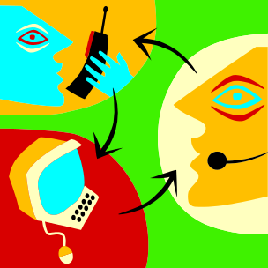
REMEMBER...
Linguistic fluency alone does not guarantee successful cultural interaction.
Cultural perspectives are critical for developing communication skills that allow students to exchange information effectively, accurately, and appropriately with native speakers.
Notes:
Our students will become members of a global cosmopolitan community in which they will need to function in a positive manner.
Without losing their own cultural identities, perspectives, practices, and products, they will need to be aware of the importance of…..
(go to next slide)

Slide 23
Perspectives
(Meanings, attitudes, values, ideas)
CULTURE
Practices
(Patterns of social interaction)
Products
(Books, tools, foods, laws,
music, games)

Slide 24

The true content of the foreign language course is not the grammar and the vocabulary of the language, but the cultures expressed through the language.

Slide 25
Successful Communication:
Knowing how,
when,
and why
to say what
to whom.

Slide 26
August 2000
This presentation was prepared by Sheila W. Cockey
King George High School
King George County, VA
and edited by
Dr. Linda Wallinger
Associate Director for Foreign Languages and ESL
Virginia Department of Education
(804) 225-2593
lwalling@pen.k12.va.us
http://www.pen.k12.va.us/VDOE/Instruction/Language
Notes:
4th strand in the VaSOL for Foreign Languages
Integral to the understanding of fl
Interrelated and difficult to separate; each has an impact on the other
If our students have a good feel for the 3 P’s, then they have a good chance of ……
(next slide)

