Slide 1
Solving the Emerging Disease Crisis: Finding Them Before They Find Us
Daniel R. Brooks
Department of Ecology & Evolutionary Biology
University of Toronto

Slide 2
Evolution of Human Pattern Recognition
The fragility of early hominids placed a premium on accurately perceiving and generalizing the complexity of their surroundings
Underestimate it and you are lunch
Overestimate it and you starve

Slide 3
How Well Did Evolution Work?
We have an excellent ability to perceive complex patterns – in fact, we do that better than computers
Object-oriented programming helps computers emulate human pattern recognition

Slide 4
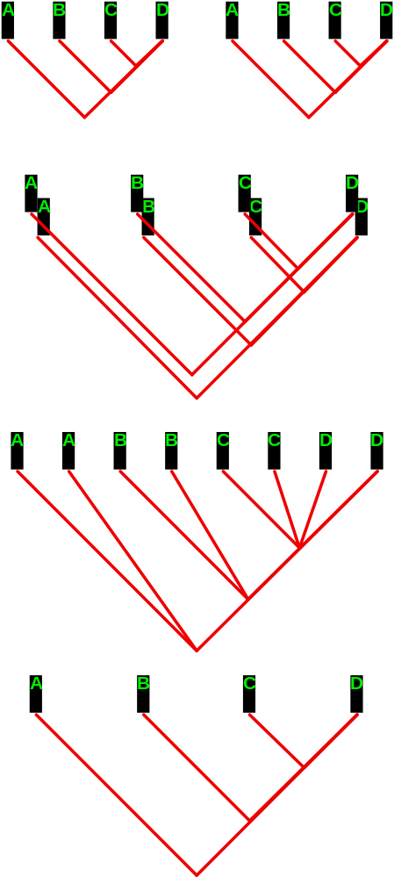

Slide 5
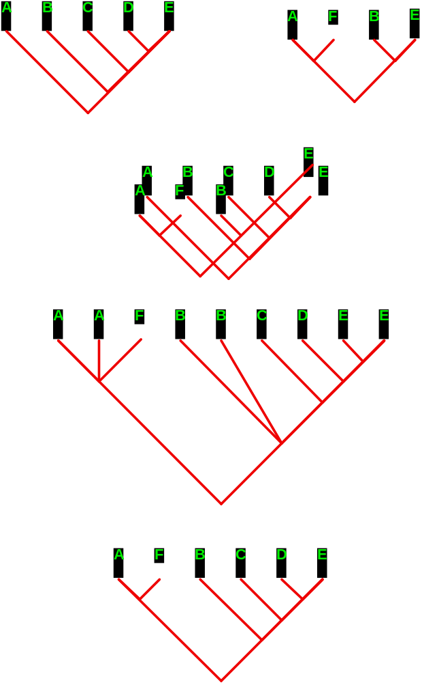

Slide 6
Why Do We Fear Complexity?
Successful generalizing gave us a sense of security, so we trusted it – good became synonymous with generalization, evil with contingency, the complexity that cannot be generalized, that frightens us and does us harm.
We distrust complexity because that’s where the sabertooths, cave bears and boogeymen are.

Slide 7
Fear and Loathing Before the Enlightenment
We thanked supernatural forces for the generalities, then began to use them to manipulate and control our surroundings
then
We thanked supernatural forces for giving us the ability to control our surroundings

Slide 8
Fear and Loathing in the Enlightenment
We discarded the supernatural and decided to thank our own cleverness for the ability to control our surroundings.
The Newtonian Revolution
The world ought to be simple, therefore it is simple. The appearance of complexity is due to incomplete knowledge.

Slide 9
Kant’s Angst
When reason and experience conflict, which do we choose?
There is no easy answer, leading to tension between theory and data. This can be a good thing if it stimulates us to cooperative efforts.

Slide 10
Kant’s Angst Today
When data and models conflict, do we reason the data into agreement with the model or modify the models to fit the data?
In reality, we need to do some of each; remember that over-simplification is the surest way to get eaten.

Slide 11
What About Parsimony?
Explanations that are as simple as the data allow (William of Occam)
NOT
Explanations that are as simple as we can imagine (Aristotle)

Slide 12
A Tale of Two Traditions
Host-Centered Studies:
The host species IS the critical resource
Parasite Centered Studies:
The host species HAS the critical resource

Slide 13
Both Traditions Agree on One Thing
Parasites are Ecological Specialists
Microhabitat preferences
Transmission dynamics

Slide 14
The Host-Centered View: Simple and Intuitive
Parasites become more strictly adapted to their hosts through time
Pathogenic strains can only survive by switching hosts
Climate change creates more mutations, hence more switches and pathogenic strains

Slide 15
The Parasite-Centered View: Complex and Non-intuitive
Increased specialization on a particular host at a particular place and time may enhance the ability to switch hosts and cause pathology without increased rates of mutation
How can this be?

Slide 16
A Thought Experiment
How can extreme resource specialists host switch readily?

Slide 17
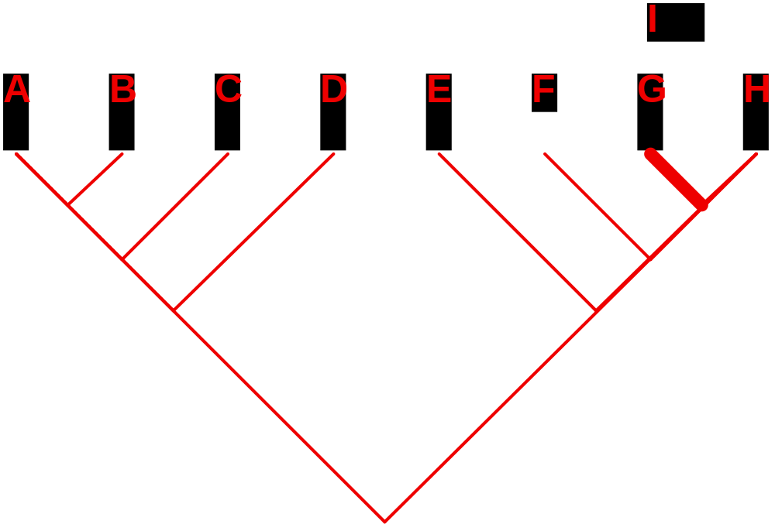

Slide 18
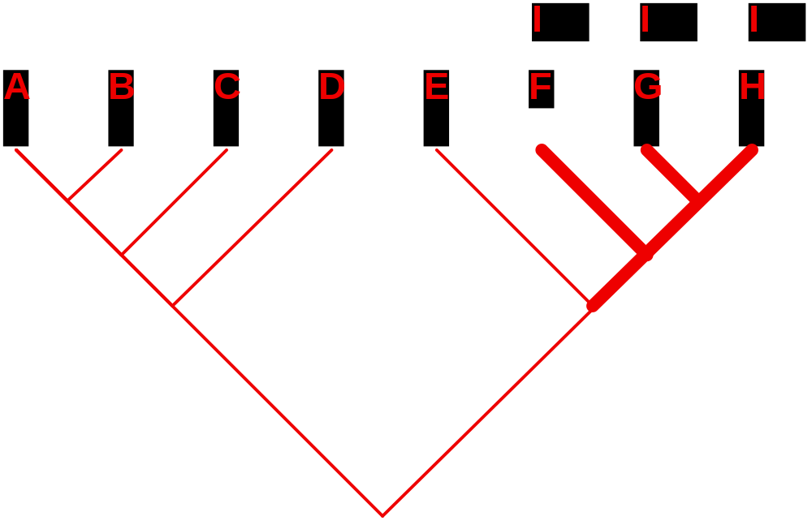

Slide 19
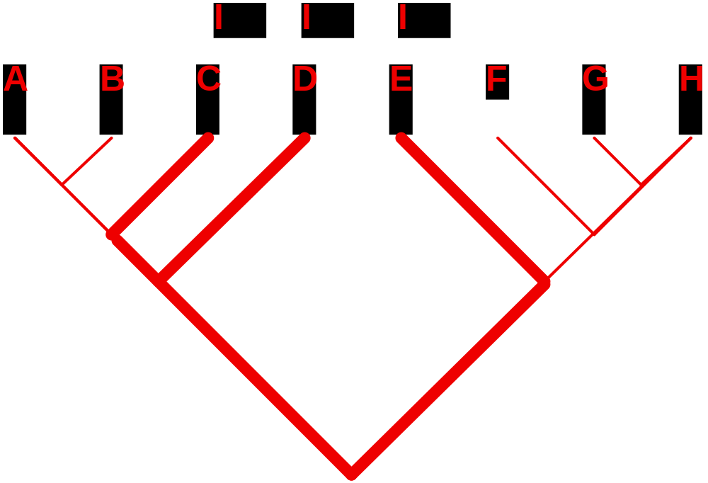

Slide 20
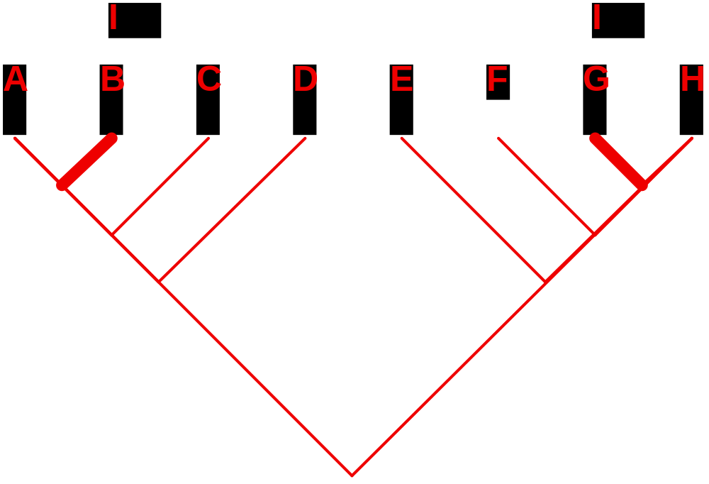

Slide 21
Specialists and Host Switching:
The Parasite-Centered View
Phylogenetic conservatism in host resource evolution and geographic distribution results in a geographic mosaic of infected uninfected, yet susceptible, hosts, even when the parasites are extreme resource specialists.
This is called Ecological Fitting

Slide 22
An Exemplar:
Brooks & Ferrao (2005)
Most species of parasites infecting humans have been acquired as a result of anthropogenic changes in trophic structure associated with the evolution of agriculture, domesticated livestock, and urbanization
Pinworms (Enterobius) and Hookworms (Oesophagostomum) infecting humans have been seen as exemplars of cospeciation

Slide 23
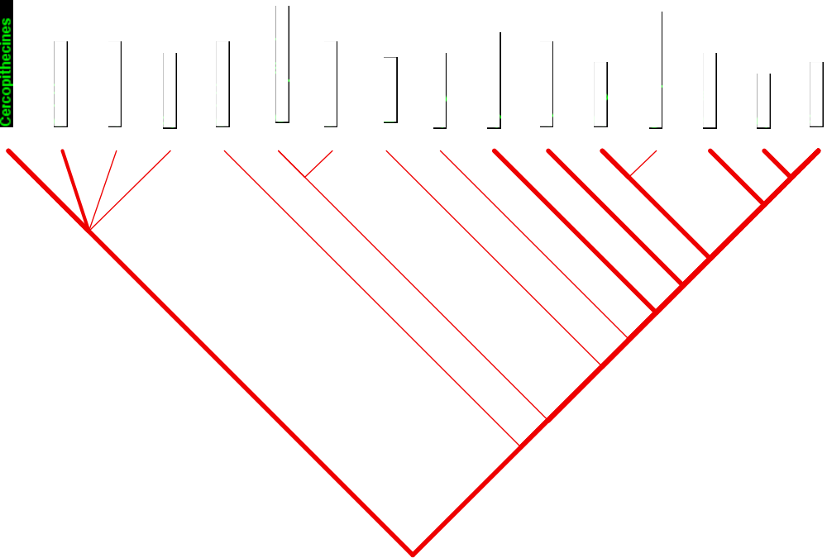
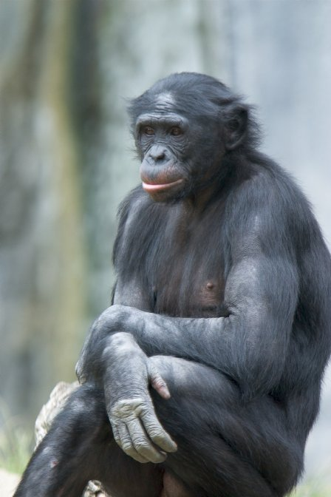
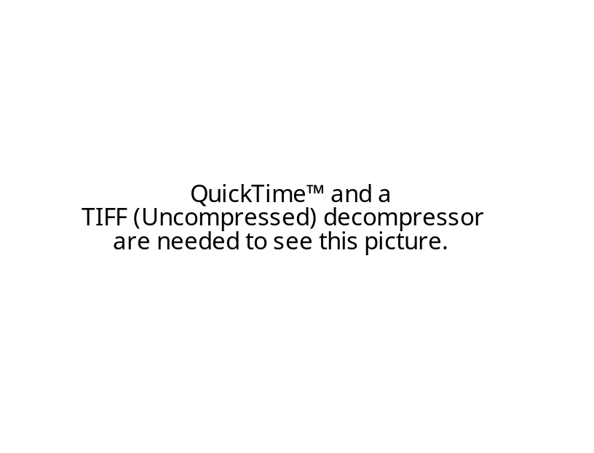

Slide 24
Overview of Host Switching for Pinworms and Hookworms
All but one host switch involved Great Apes and Cercopithecoids, thus likely to be due to ecological fitting. One case involved a switch from primates to rodents, likely due to the evolution of novel host utilization capabilities.

Slide 25
What Drives Ecological Fitting?
Phylogenetic conservatism in host resource evolution and geographic isolation results in uninfected susceptible hosts
Changes in geographic range and/or trophic interactions bring the parasites into contact with those susceptible hosts

Slide 26
A Prediction:
Host Switching is Mostly Episodic, not Stochastic
All host switches resulting from ecological fitting were associated with episodes of climate change and biotic expansion.

Slide 27
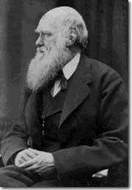
Historical Biogeography
In considering the geographic
distribution of organic beings
over the face of the globe...
[w]e see...some deep organic
bond, through space and time,
over the same areas of land and
water,independently of physical
conditions. The naturalist must
be dull who is not led to
enquire what this bond is.

Slide 28
NOW We Look at the Hosts
Hominoids, Hynaenids and Proboscideans since the Miocene

Slide 29
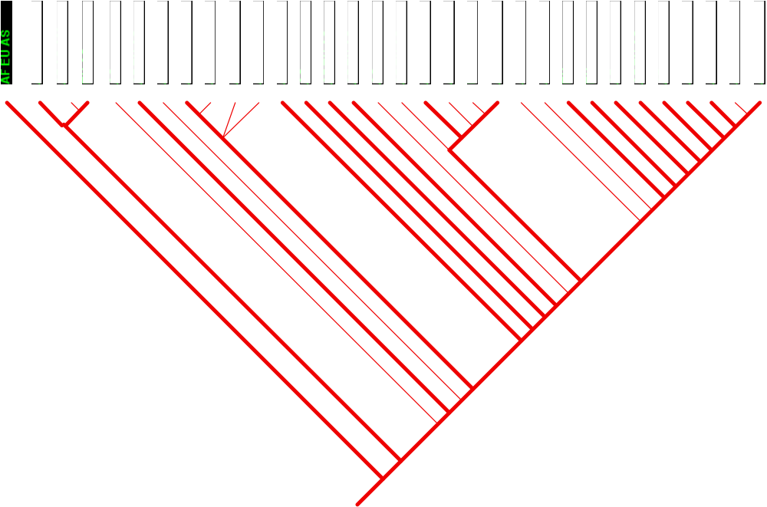
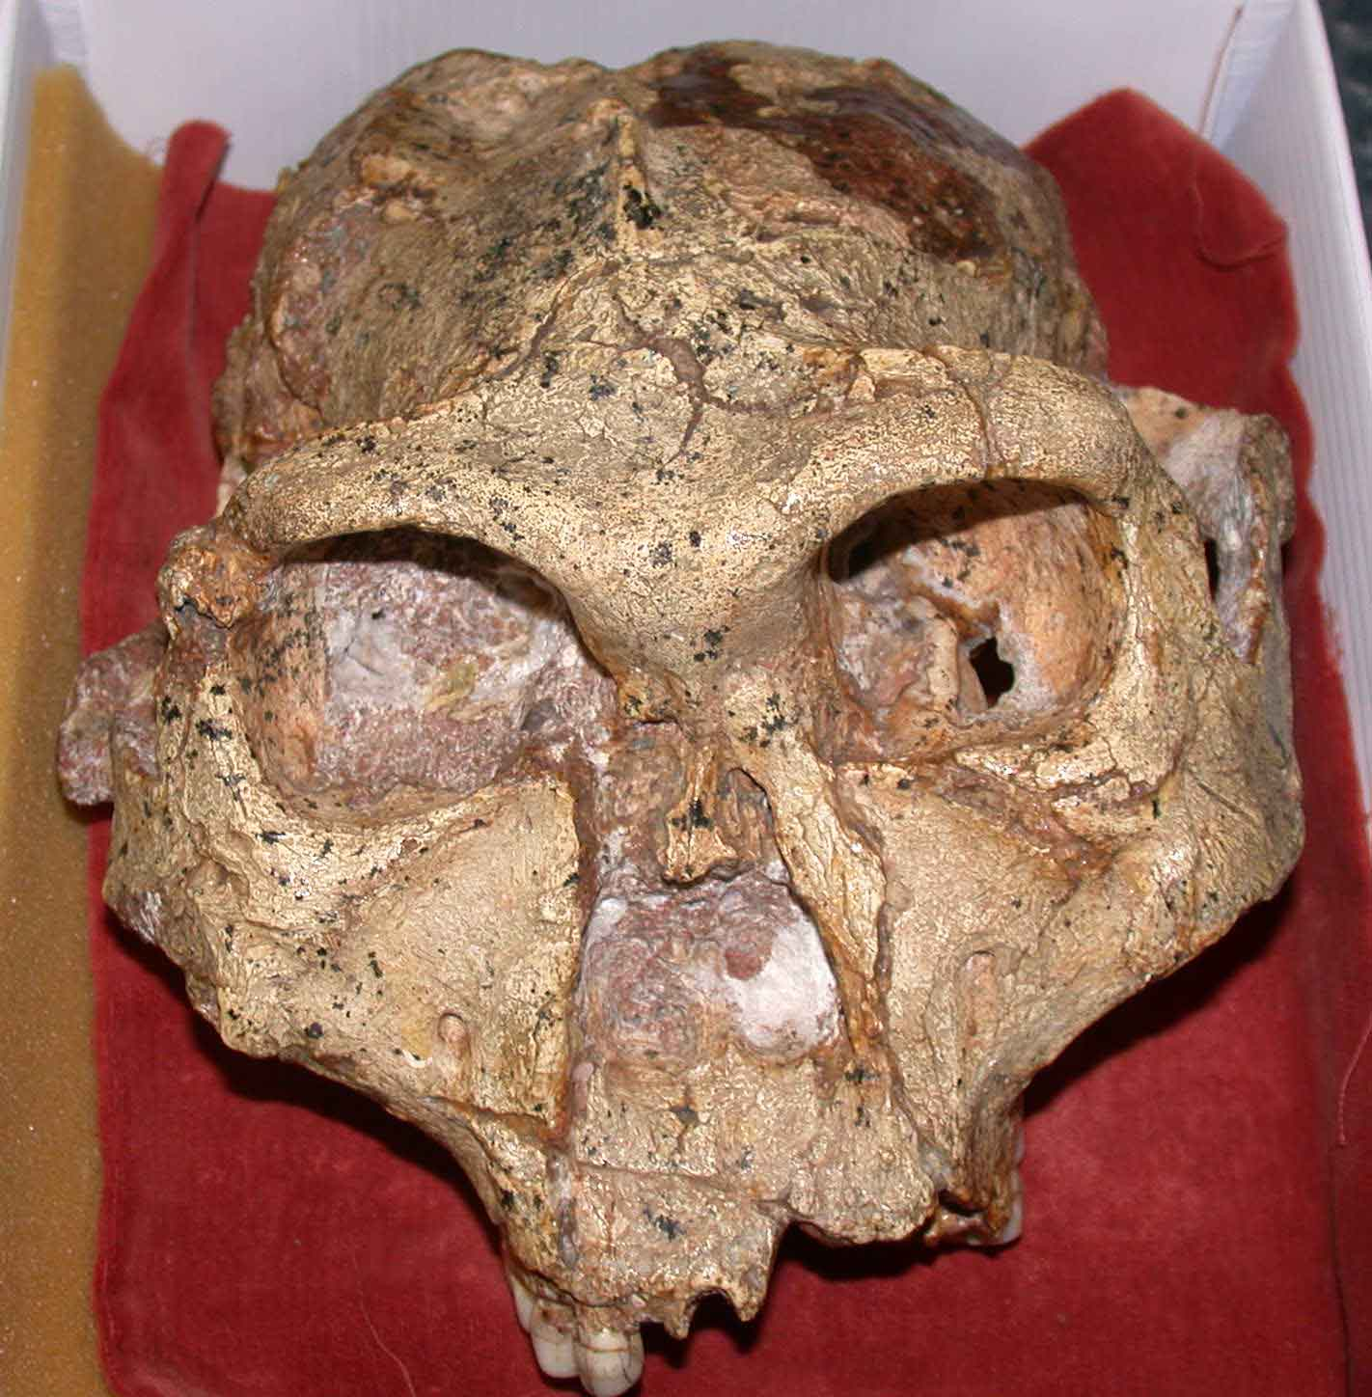
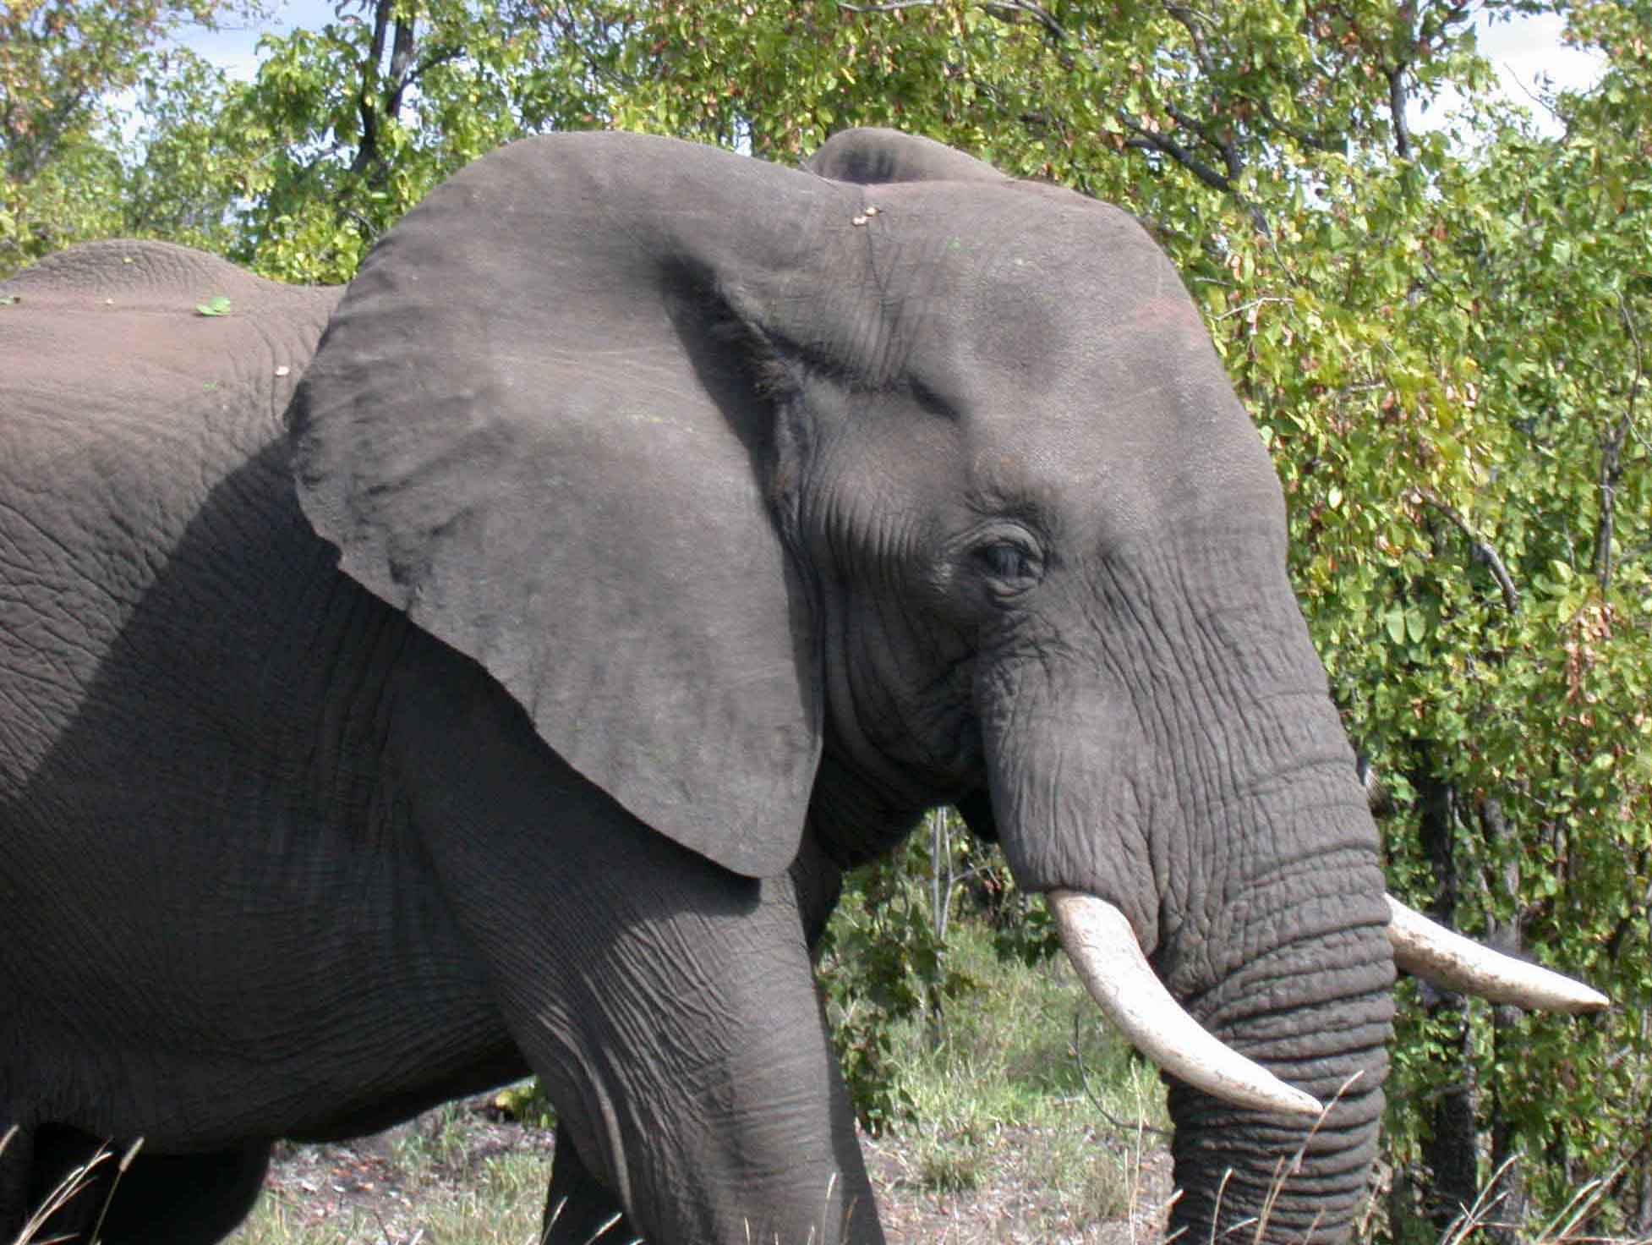
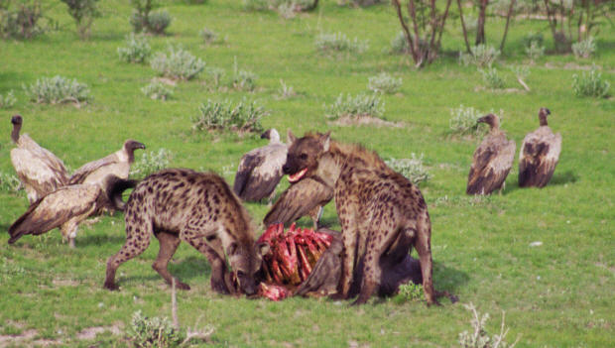

Slide 30
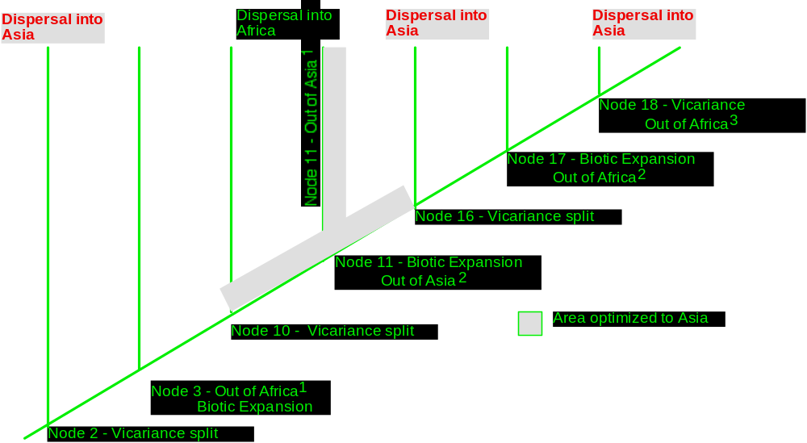
The Taxon Pulse

Slide 31
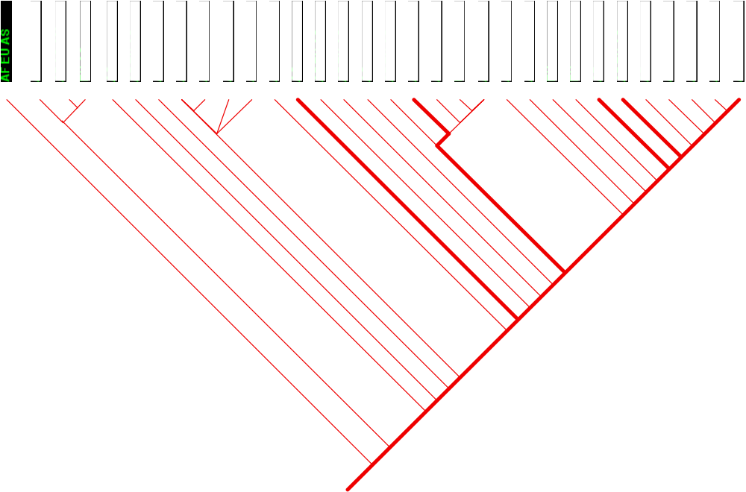
Back to The Parasites

Slide 32
How “New” is this View?
Parasites…are simultaneously the product of an immediate environment and of a long ancestry reflecting associations of millions of years. The messages they carry are thus always bilingual and usually garbled. Eventually there may be enough pieces to form a meaningful language which could be called parascript - the language of parasites which tells of themselves and their hosts both of today and yesteryear. -- Manter, 1966

Slide 33
How New is Parascript?
… there are two factors: namely, the nature of the organism and the nature of the conditions. The former seems to be much more the important … nearly similar variations … arise … under dissimilar conditions; and … dissimilar variations arise under conditions which appear to be nearly uniform. -Darwin, 1872

Slide 34
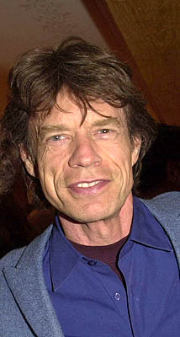
The Jagger Principle
You can’t always get what you want, but if you try sometimes, you just might find you get what you need

Slide 35
Why is it Hard to Let Go of the Simple View?
The neocortex allows us to accurately assess the complexity of our surroundings. (The simplicity view is dead)
The brainstem keeps us from believing the bad news. (It’s simpler to believe the simplicity view is alive)
Incomplete integration of the brain produces denial. (The simplicity view is not dead, it’s pining for the fjords)

Slide 36
Does Any of This Matter?
If the host HAS the critical resource, the resource is a trait or trait set
If the trait or trait set is widespread and phylogenetically conservative, host switching will occur whenever allopatry and/or trophic structure break down
Such as global climate change or species introductions

Slide 37
EIDs are Evolutionary Accidents Waiting to Happen
The host associations for Enterobius and Oesophagostomum that arose through host switching associated with geographic dispersal were all emerging infectious diseases at the time the switches occurred

Slide 38
Global Climate Change:
A Double-Edged Sword
Species that disperse well and species with large geographic ranges survive mass extinctions
Species that are most successful at surviving mass extinctions will be the primary source of EIDs.

Slide 39
Bad News for Bio-Control and Bio-Containment
Extreme resource specialists may be able to host switch even when there are no “closely related” hosts available
Host range in the native ecosystem is a poor indicator of potential host range
The phylogenetic basis of host specificity must be taken into account when considering the introduction of species as bio-control agents

Slide 40
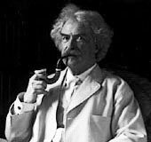
There is something fascinating about science. One gets such wholesale returns of conjecture out of such a trifling investment of fact. - Mark Twain

Slide 41
The Scope of our Ignorance
We have named <10% of the species on this planet, analyzed <1% of those phylogenetically, and analyzed <5% of those in terms of coevolution and biogeography, mostly using anachronistic methods

Slide 42
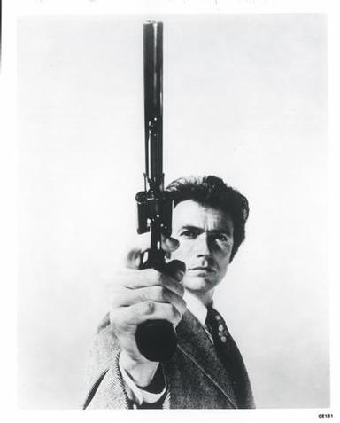
The Dirty Harry Criterion
Our ignorance of such
potentially important
aspects of the
world’s biodiversity
calls for massive
discovery efforts,
and extreme
skepticism about
existing models

Slide 43
Why Are We in This State of Affairs?
Taking advantage of the human capacity for denial is good business and good politics

Slide 44
Two Corollaries of Denial: Fear and Despair
When we’re afraid and when we feel we have no control, we retreat into familiar patterns and avoid innovation.
We do not attempt bold actions to solve problems, we settle for managing them along, hoping things will get better by themselves.

Slide 45
The Medical-Industrial Complex’s Two Most Hated Words
Prevention and Cure
Managing disease is more profitable than curing it. Responding to a crisis is always less cost- and time-effective than anticipating it.
Keep people afraid and in crisis response mode, and they won’t think to ask for prevention and cure.

Slide 46
The False Comfort of Models:
More Denial
“You rationalize…You defend. You reject unpalatable truths, and if you can't reject them outright you trivialize them.…evidence is never enough for you. Temperatures rise, glaciers melt— species die—and you blame sunspots and volcanoes…You turn incomprehension into mathematics…”
"It served me well enough."
- Peter Watts, Blindsight (2006)

Slide 47
“Well Enough” is not
Good Enough
[Women know that] ‘Be reasonable’ means ‘lower your expectations.’
- Ursula Le Guin
Do not lower your expectations - challenge the models, get more data

Slide 48
If There was Ever a Time to Think Outside the Box…
If the climate change biodiversity and EID crises are real, time is critical
We can’t afford business as usual. We must transcend our biological heritage, and cooperate outside our kin groups.

Slide 49
A Religious Principle
Then the Lord said to Cain, “Where is Abel your brother?” And he said, “I do not know. Am I my brother’s keeper?”- Genesis 4: 9

Slide 50
A Literary Principle
Moving from
Pride & Prejudice
to
Sense & Sensibility
It is time for ecologists and evolutionary biologists to join forces with biomedical and biotech specialists in a spirit of enlightened mutual self-interest

Slide 51
A Sports Principle
Never change a winning game
Always change a losing game

Slide 52
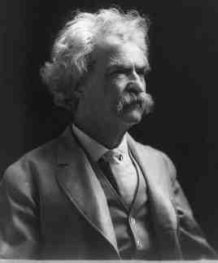
A Socio-Political Principle
Do the right thing. It will gratify some people and astonish the rest.
-Mark Twain

Slide 53
What’s going to Happen?
There is a certain inevitability about inaction. - Voltaire

Slide 54
Will We Make It?
The most altruistic and sustainable philosophies fail before the brute brainstem imperative of self-interest.
- Peter Watts, Blindsight (2006)

