Slide 1
YouTube:
EXPANDING YOUR AUDIENCE THROUGH Social Media
Kyle E. Carothers
NOAA Ocean Service
Special Projects Division
Technical Information Services Branch
Washington, D.C.

Slide 2
YouTube 101
Founded in February 2005, YouTube received funding in November and was officially launched that December. Within a year of its launch, YouTube was purchased by Google Inc in November 2006.
YouTube is considered the leader in online video, and the premier destination to watch and share original videos worldwide.
The YouTube user base is 18-55, spanning all geographies, offering something for everyone.
YouTube is a new method to reach existing and potential audiences with content they select.

Slide 3
Publishing Content On YouTube
Using YouTube you are able to publish content to a worldwide audience of 20 million unique users watching more than 100 million videos each day.
YouTube video programs should highlight the science and research being conducted at the agency and follow an established editorial review process.
Video’s should be informative, interesting and entertaining.
Modern browsers and broadband allow for video content to finally be viable.

Slide 4
NOAA, Ocean Explorer
YouTube Channel
The first NOAA YouTube channel was published on Dec. 11, 2006, with eight video clips from various NOAA-OE explorations.
NOAA-OE YouTube videos run 3-to-8 minutes and are tied to the http://oceanexploer.noaa.gov web site.
They feature video content from Ocean Explorer newsmakers and exploration natural events.

Slide 5
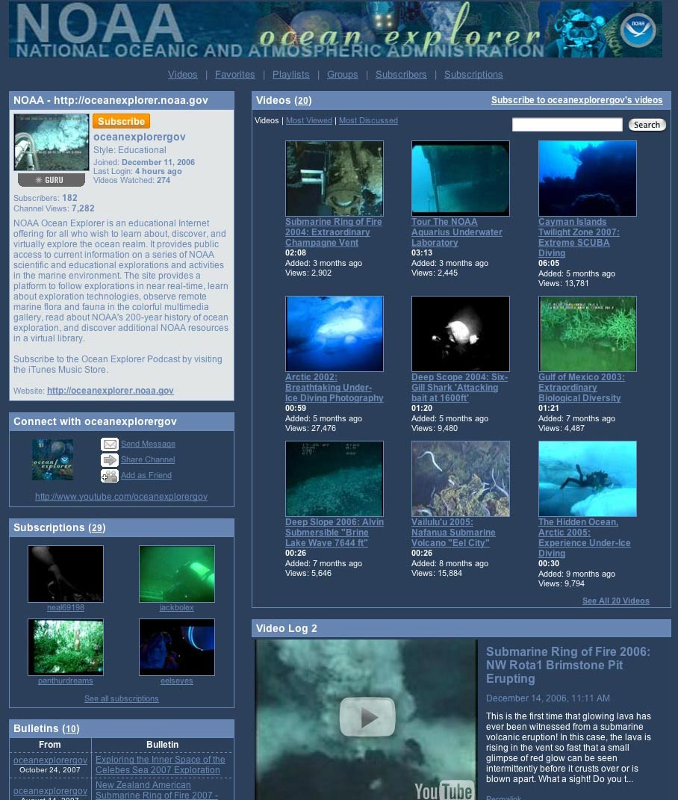
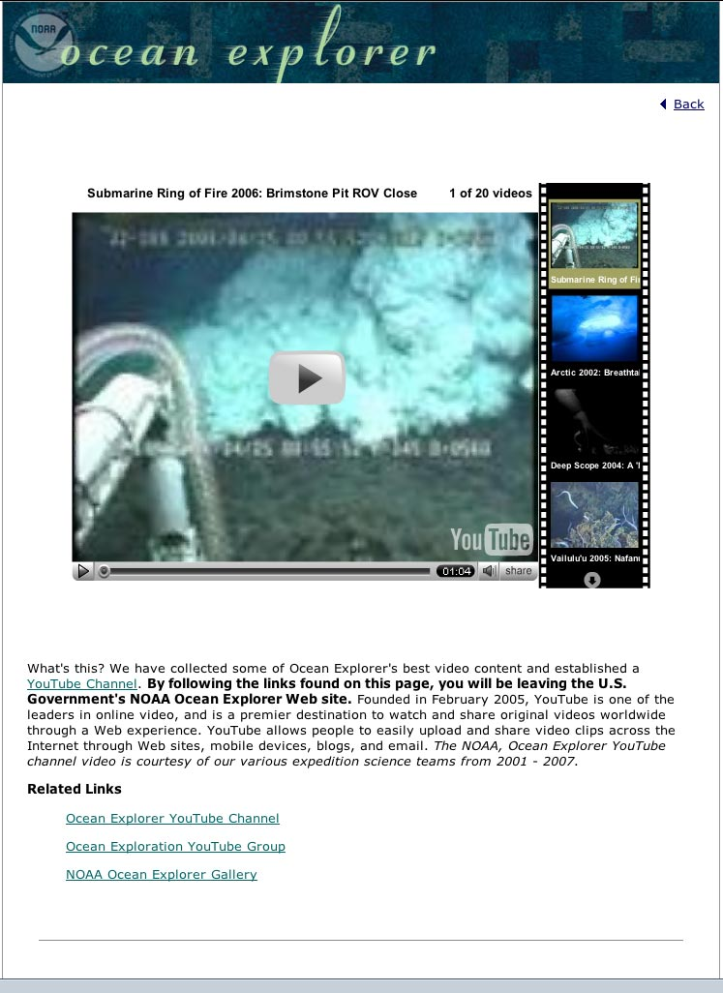
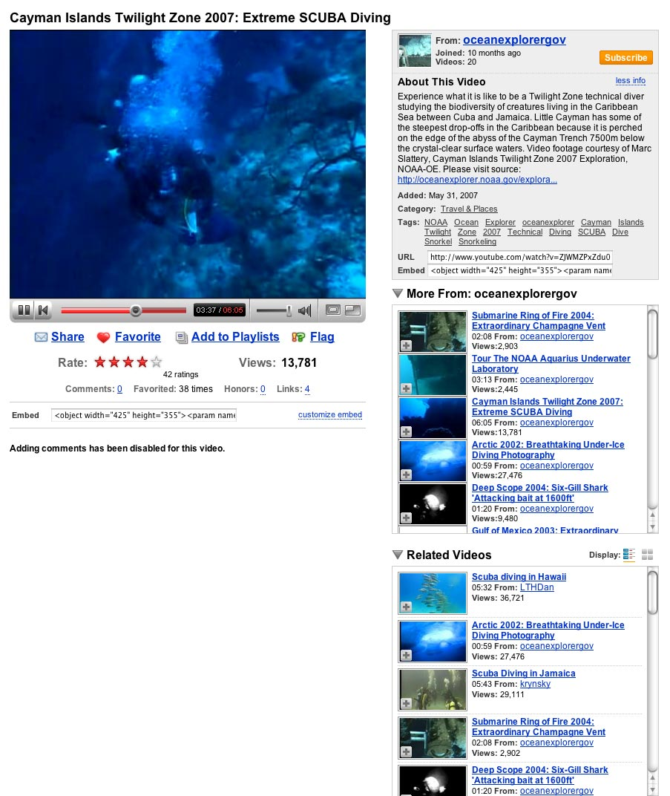
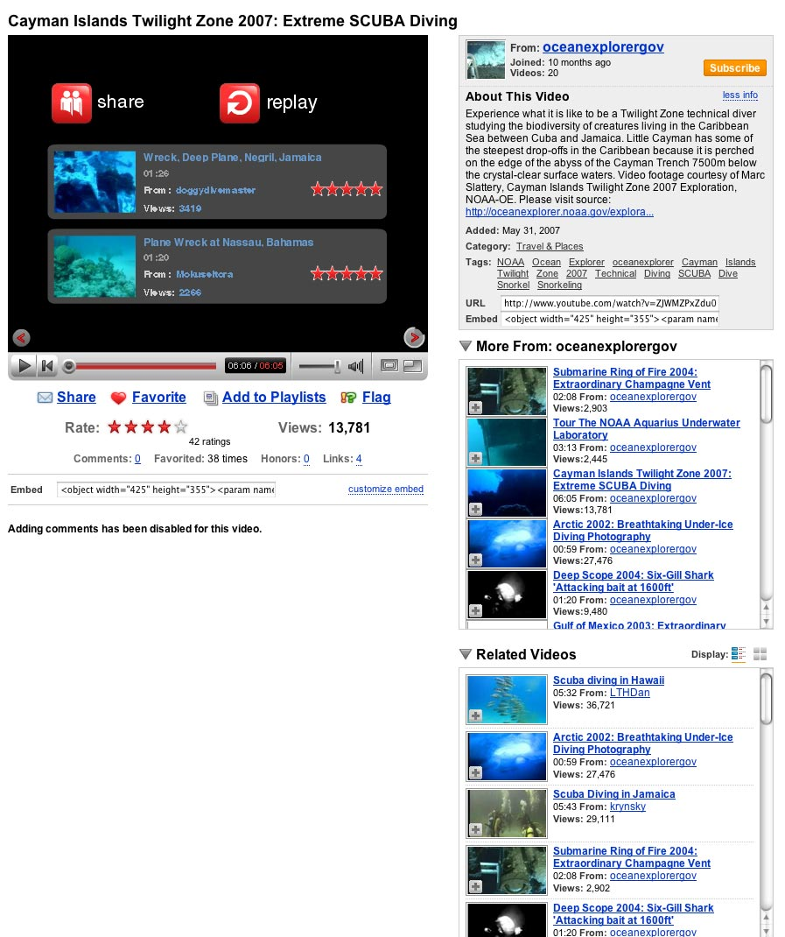
NOAA, Ocean Explorer Channel
How To Develop A Channel It’s Free! It’s Easy!

Slide 6
YouTube Channel Production
Having web standards to produce your channel is essential for design continuity and content relevance.
NOAA, Ocean Explorer YouTube Best Practices
• Have a consistent way to name video content:
Cayman Islands Twilight Zone 2007: Extreme SCUBA Diving
• Turn comments off
• Make relevant keywords for your content:
NOAA Ocean Explorer, oceanexplorer, Deep Scope 2004, Six-Gill Shark, Gulf of Mexico, deepwater, hexanchus, griseus, underwater, eye-in-the-sea
• Please visit source: http://oceanexplorer.noaa.gov/explorations/04deepscope/logs/aug17/media/eye3_video.html

Slide 7
Benefits of YouTube
Makes Stories Come Alive.
It’s Content On-the-Go.
Expand the Audience.
Better search engine results for video content.

Slide 8
NOAA-OE YouTube Stats 2007

Slide 9
YouTube Stats Roundup
From December 11, 2006 through November 14, 2007
21 NOAA-OE YouTube video clips have been watched 161,727 times.
The NOAA, Ocean Explorer YouTube Channel http://youtube.com/oceanexplorergov has been visited 7,635 times with 191 subscribers.

Slide 10
The Numbers Tell the Tale
What can be deduced from the Web statistics?
The consistent higher stats for the YouTube channel and video clips indicates our YouTube audience is looking for more video content.
Traffic from the YouTube channel to the http://oceanexplorer.noaa.gov is accomplishing the initial goal of reaching new audiences.

Slide 11
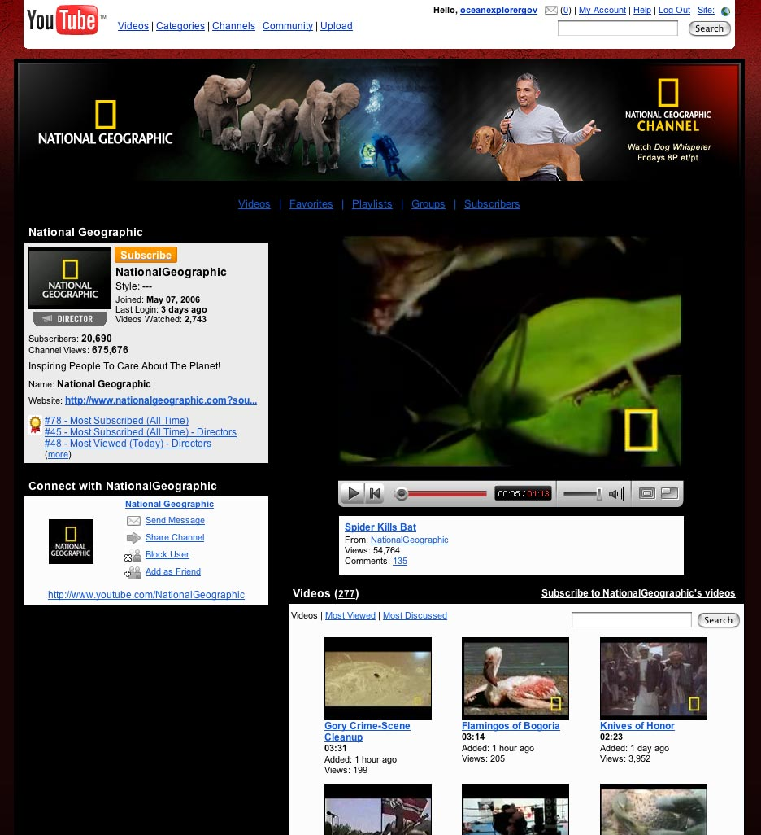
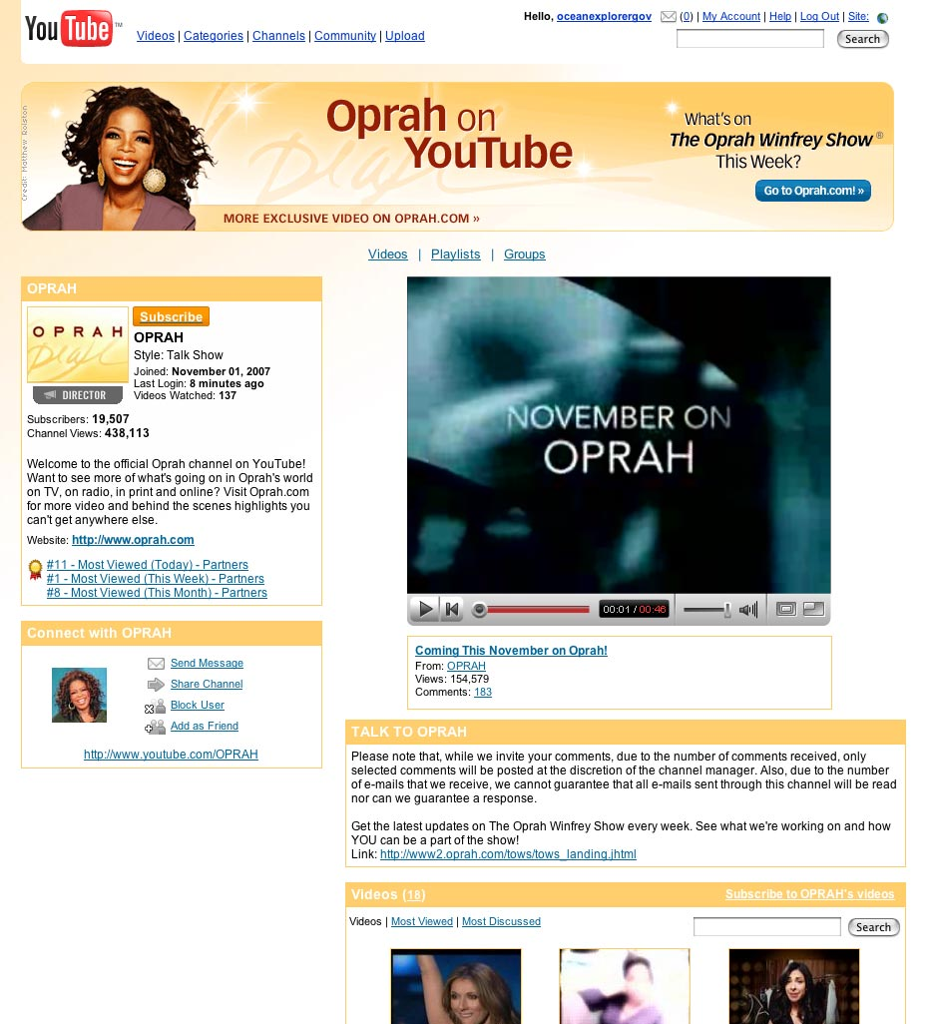
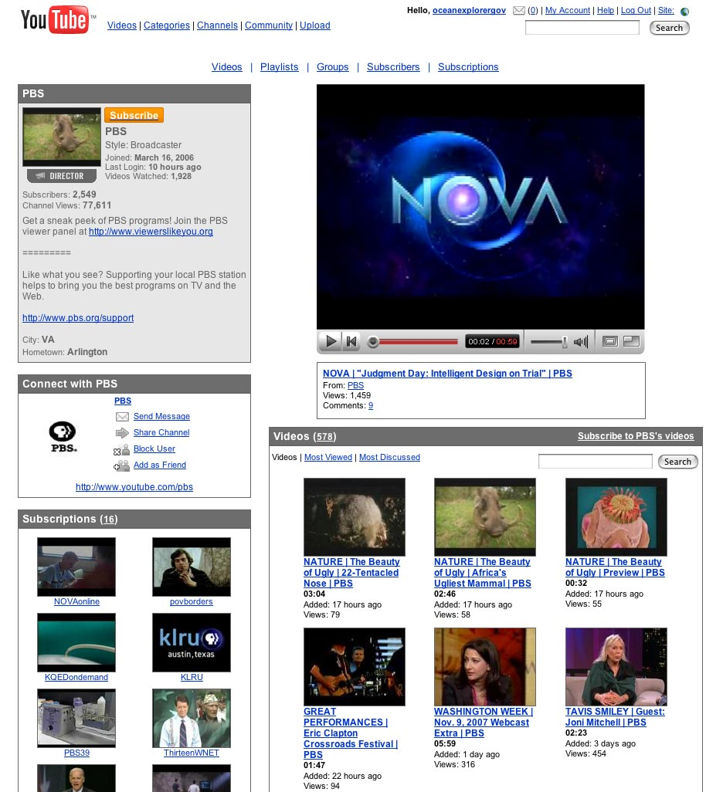
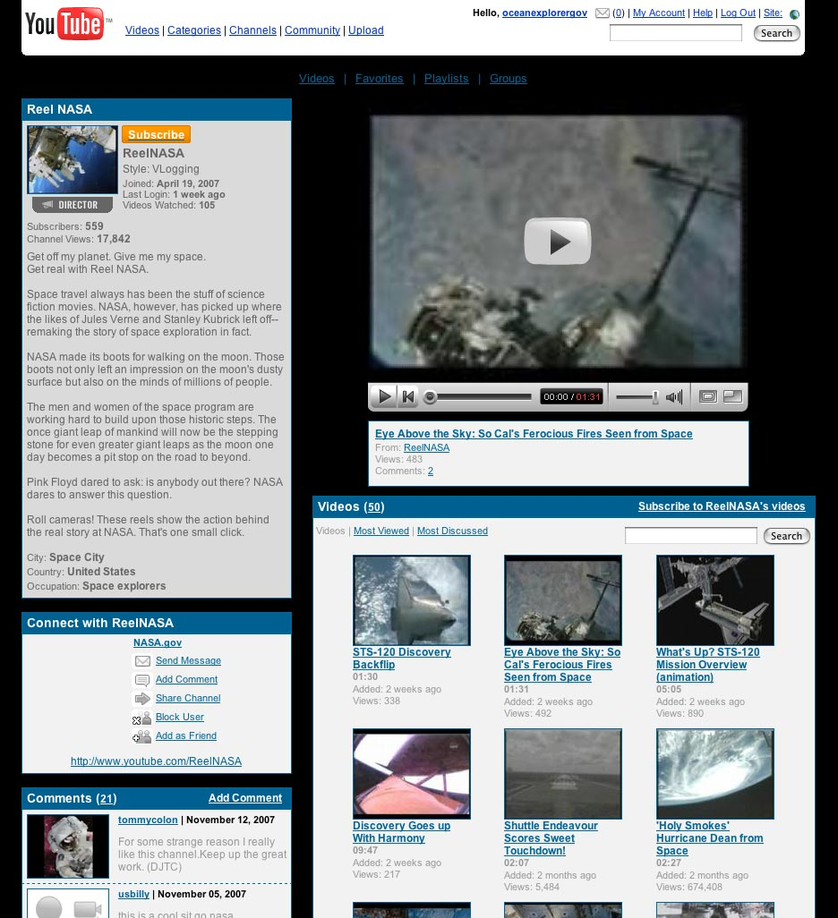
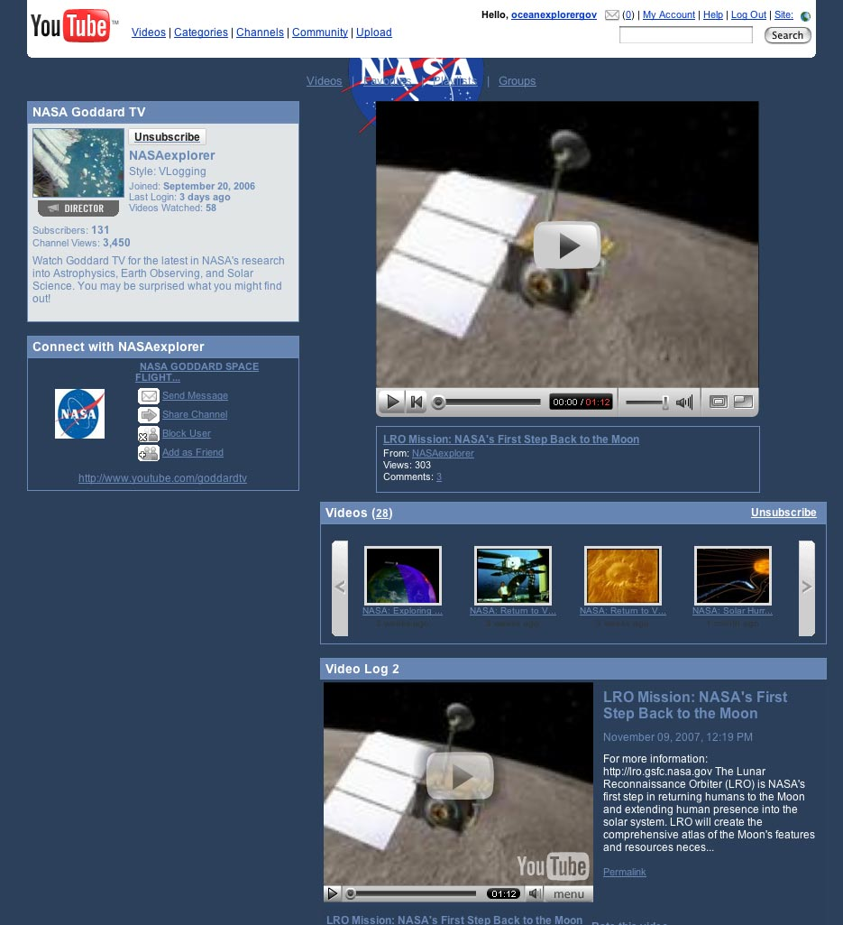
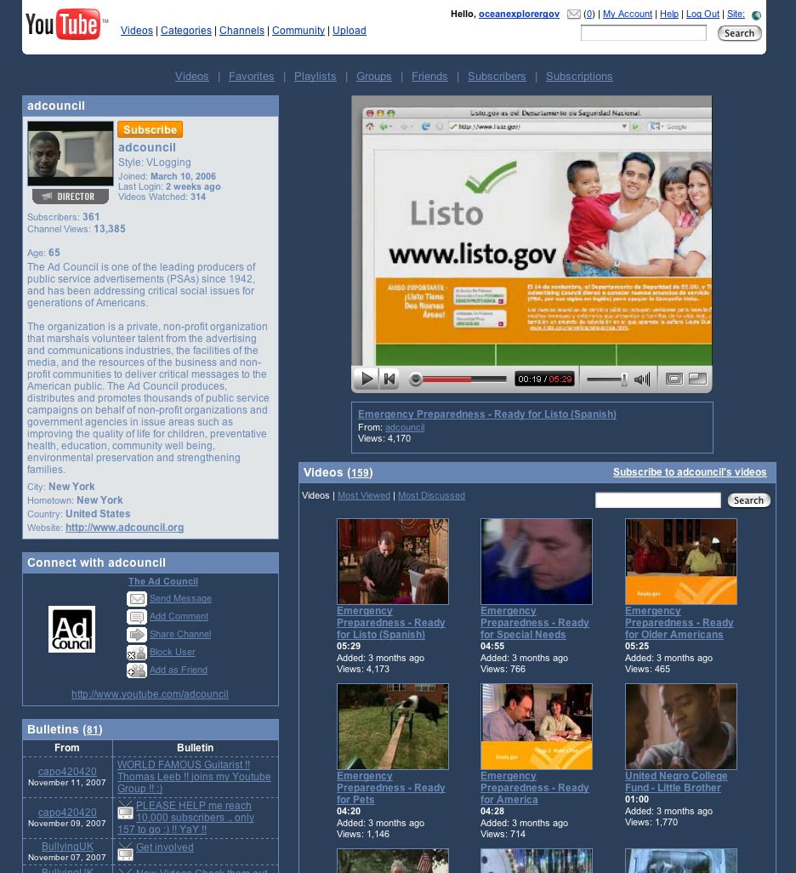
Who Is YouTubeing?

Slide 12

Read All About It
YouTube For Dummies
by Doug Sahlin &
Chris Botello

Slide 13
Contact Information
E-mail: Kyle.Carothers@noaa.gov
Office: (301) 713-3000 ext.209
Please feel free to call me or e-mail me.

