Slide 1

Meeting the
Educational Needs of Children and Youth Experiencing Homelessness
Policy Academy on Homeless Families with Children
Diana Bowman
National Center for Homeless Education
Margie Milenkiewicz
State Homeless Contact, Colorado

Slide 2

How many children and youth experience homelessness in a year?
1.35 million children
10% of all children living in poverty
733,000-1.3 million youths

Slide 3
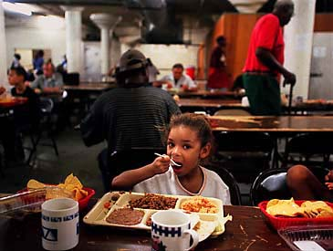
Who is homeless?
Students who lack a fixed, regular, and adequate nighttime residence
Living in shelters, hotels, motels, camping grounds
Living in cars, parks, public spaces, abandoned buildings, substandard housing
Awaiting foster care placement, abandoned in hospitals
Sharing housing (doubled up) due to loss of housing or economic hardship
Migratory children who qualify as homeless

Slide 4

What challenges do homeless children and youth face?
At least 20% do not attend school
Within a year, 41% will attend 2 different schools; 28% will attend 3 or more
With each change of schools, a student is set back academically on average 4-6 months

Slide 5
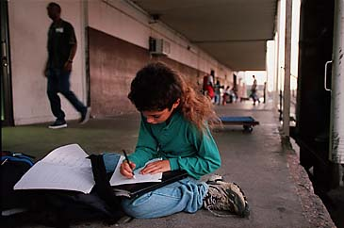
What are the educational needs of homeless children and youth?
School stability and education continuity
Assistance with basic needs
School supplies
Appropriate study environment outside of school
Mental and physical health services
Academic support
Support of a caring adult

Slide 6
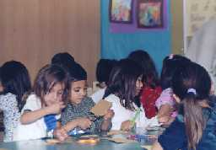
Reported Educational Barriers
Immediate enrollment (required documents, records, residency requirements)
Transportation
Access to programs
Lack of preschool
programs
Guardianship requirements
Report to Congress 2000

Slide 7
McKinney-Vento Homeless Education Assistance Act of 2001
Reauthorized in 2002 as part of the No Child Left Behind Act (NCLB Act)
Addresses problems that homeless children and youth face in enrolling, attending, and succeeding in school
Ensures a free, appropriate public education, including public preschool, as other children and youth
Ensures access to educational and other services to help meet State student achievement standards
States and districts required to revise laws, practices, and policies that act as barriers

Slide 8
What rights are guaranteed by the McKinney-Vento Act?
Immediate enrollment and full participation in classes
Attendance in the school of origin
Transportation to the school of origin
Comparable services
Attending school with nonhomeless children and youth

Slide 9
How are these rights enacted?
U.S. Department of Education Homeless Education Program
State Coordinator for homeless education
Local liaison in every school district
Title I serves at-risk students (homeless automatically included)
Collaboration among school programs
Collaboration among community agencies and resources

Slide 10

What can collaboration accomplish?
Common definition of homelessness
Congruent and complementary policies
Coordinated approach to addressing needs
Mutual understanding of goals and cultures of agencies
Effective use of resources

Slide 11
How is Colorado making Stone Soup?
“Stone Soup,” a folk tale, illustrates how a lack of understanding and trust can turn into a fruitful partnership when all players win due to the sharing of resources and building of relationships.
Definition of Collaboration: All who come to the table feel safe and get their needs met.– Margie Grimsley: The Federation of Families for Children’s Mental Health, CO Chapter

Slide 12
How many homeless students are there in Colorado?
178 school districts
750,000 students
7,105 or 1% of students were identified as homeless in 2003-04
95% in urban areas, 5% in rural areas
$405,878 in education funding to 22 school districts

Slide 13
How does Title X of the NCLB Act drive our State homeless education plan?
Sec. 722(f)(5)
Coordinate & collaborate with educators AND providers of services and those groups that represent homeless children, youth, and families

Slide 14
What are the education support systems?
Federal initiatives (Title I, Title III, Title IV, Migrant Education, Special Education, 21st CCLC)
Nutrition & Transportation
Student Health Services
Research and Evaluation
Student Assessment

Slide 15
How do we work with school districts?
Awareness training
TA for compliance with Federal and State laws
Grant Awards
Resource development
Professional development and local research opportunities

Slide 16
Who are our partners related to housing issues?
Colorado Coalition for the Homeless
Local homeless service providers
Homeless Continuum of Care Associations
Housing Justice*
Colorado Children’s Campaign*
*Published CO issue briefs connecting issues

Slide 17
What other resources do we bring to the table?
AmeriCorps: VISTA, AmeriCorps Direct, NCCC
74 members total, 15 communities
$360,055 in inkind donations & grants
Recruited 657 community members for 14,398 service hours to serve in shelters, schools, and faith- and community-based agencies

Slide 18
Who are major non-government partners?
Foundation Support of $100,000
Private: Center for Research Strategies &
Nonprofit: National Center for School Engagement
(for data collection, professional development, advocacy of participatory action research to promote local solutions to education issues/barriers/problems)

Slide 19
What is the Colorado Interagency Council on Homelessness?
Started as Policy Academy, changed name in 2002
31 members participate in quarterly meetings
Homeless Families with Children and Unaccompanied Youth Committee, 18 members
Year 2 focus is advocacy: policy & public awareness
“The squeaky wheel” at the table includes the needs and issues of homeless children and their families and unaccompanied youth

Slide 20
What are we learning about our collaborations?
Assess and refocus (in Title X program and in all partnerships)
Work smarter; look for duplication & gaps
Be realistic; remain hopeful
Make Stone Soup together with flavor and abundance

