Slide 1

U of Warwick: Sep 15, 2005
Phenomenology of Rayleigh-Taylor Turbulence
Boussinesq appr. (At<<1,miscible)
Immiscible => effects of surface tension
Misha Chertkov (Theory Division, Los Alamos)
Igor Kolokolov (Landau Institute, Moscow)
Vladimir Lebedev (Landau Institute, Moscow)
MC Phys.Rev.Lett 91, 115001 (2003)
MC,IK,VL Phys.Rev.E 71, 055301 (2005)

Slide 2
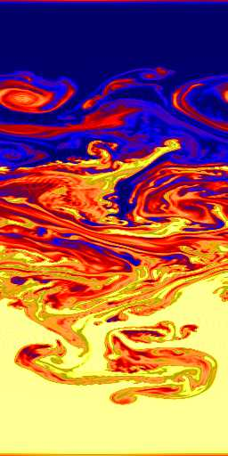
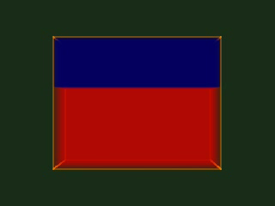
Condition:
The developed (mixing) regime of
Rayleigh-Taylor instability (turbulence)
*
Question:
Explain/understand spatio-temporal hierarchy of scales in velocity and density (temperature) fluctuations inside the mixing zone.

Slide 3
Menu
Cascade picture (phenomenology)
Navier-Stokes Turbulence (Kolmogorov,Obukhov’41)
Passive Scalar Turbulence (Obukhov’48, Corrsin’51)
3d
2d
Rayleigh-Taylor turbulence phenomenology
2d
vs
3d
Low Atwood number
incompressible Boussinesq
vs Rayleigh-Benard
Immiscible, incompressible
[effects of surface tension] *
Plans:
Immiscible, steady turbulence
Richtmyer-Meshkov + decay turb.
Chemical reactions
Anisotropy
Intermittency
Mixing

Slide 4

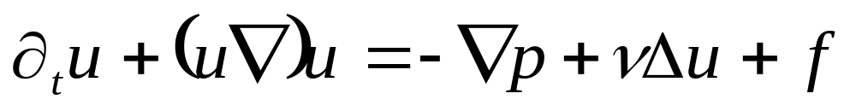

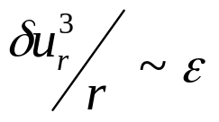
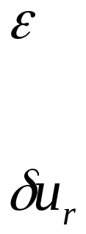
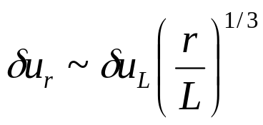
Navier-Stokes Turbulence (steady 3d)
viscous
(Kolmogorov)
scale
cascade
integral
(pumping)
scale
kinetic energy flux
scale independent !!!
time independent !!!
Kolmogorov ’41
Obukhov ‘41
typical velocity fluctuation on scale “r”
Menu

Slide 5
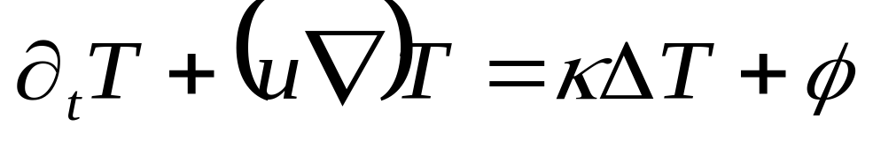
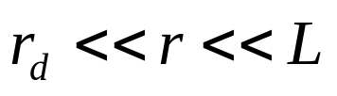
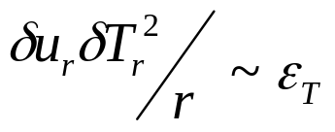
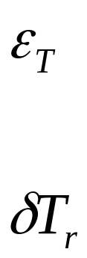
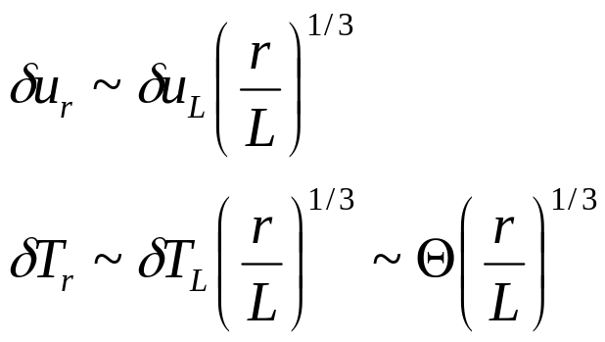
Passive scalar turbulence (steady)
cascade
integral
(pumping)
scale
dissipation
scale
scalar flux
scale independent !!!
time independent !!!
Obukhov ’48
Corrsin ‘51
typical temperature fluctuations on scale “r”
Menu

Slide 6

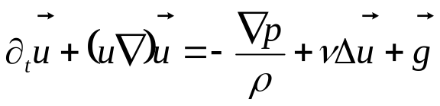
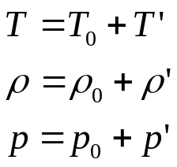

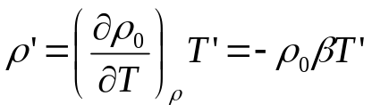

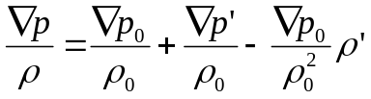
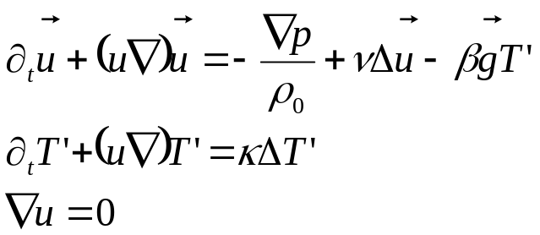

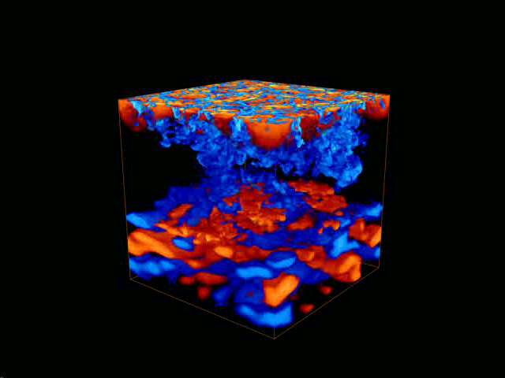
Low Atwood number, Boussinesq approximation
Free convection (one fluid)
e.g. Landau-Lifshitz
``Hydrodynamics”
Navier-Stokes
unstable
Oberbeck 1879
Lord Rayleigh 1883
J. Boussinesq 1903
G.I. Taylor ‘1950
Chandrasekhar ‘1961
…
Rayleigh-Taylor vs Rayleigh-Benard
(different initial/boundary conditions)
Menu

Slide 7

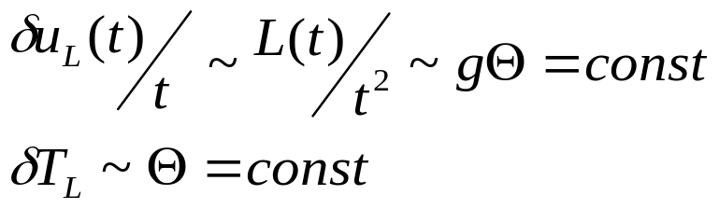


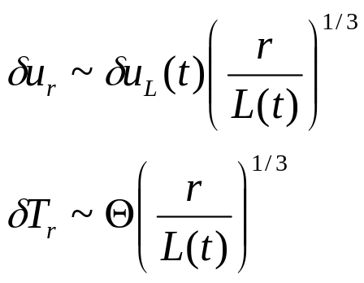
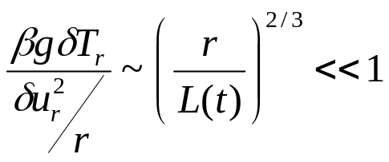
Rayleigh-Taylor turbulence. Boussinesq. 3d
L(t) ~ turbulent (mixing) zone width
also energy-containing scale
Adiabatic picture:
decreases with r
Sharp-Wheeler ’61 +
Review: Sharp ‘84
Generalized Kolmogorov-Obukhov
(Shraiman-Siggia ’90 in Rayleigh-Benard) scenario:
The turbulence is driven by large scale fluctuations of
the scalar while the small-scale fluctuations of the scalar
(temperature) remain passive!!
Checking:
consistent with existing experimental
and numerical observations, e.g.
Dalziel, Linden, Youngs ’99
Young, Tufo, Dubey, Rosner ’01
Wilson, Andrews ‘01
Menu

Slide 8
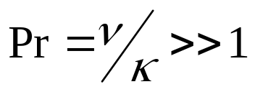
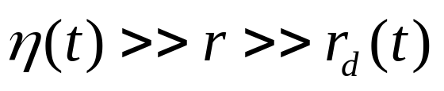
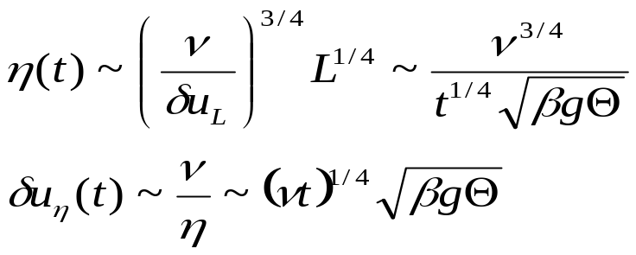
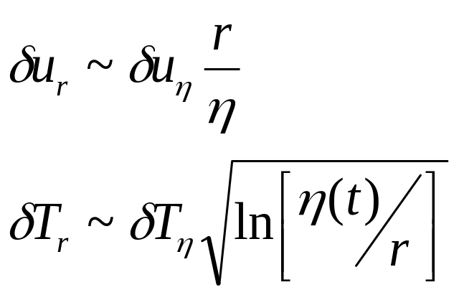
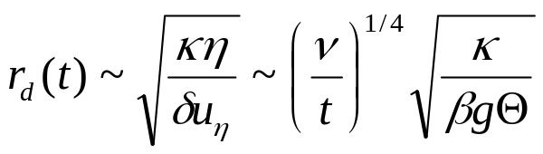
Rayleigh-Taylor turbulence. Boussinesq.
3d smallish scales
viscous scale
velocity is smooth
passive scalar adveciton is
``Batchelor”
consistent with
Clark,Ristorcelli ‘03
dissipative scale
Menu

Slide 9
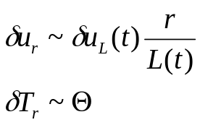
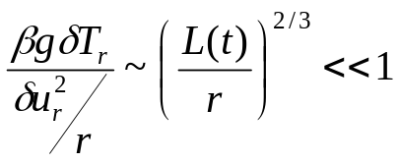
Rayleigh-Taylor turbulence. Boussinesq. 2d
L(t) ~ turbulent (mixing) zone width
also energy-containing scale
so far the same as in 3d
Two false attempts
Two cascades ?
Nope!!
Does not work because inverse (energy) cascade
is not catching up/developing !!!!
Passive scenario
(simple vorticity cascade) ?
Nope!!
It is not self-consistent:
Menu

Slide 10
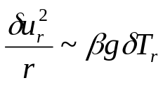
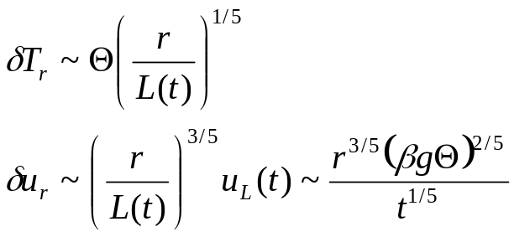
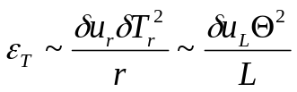
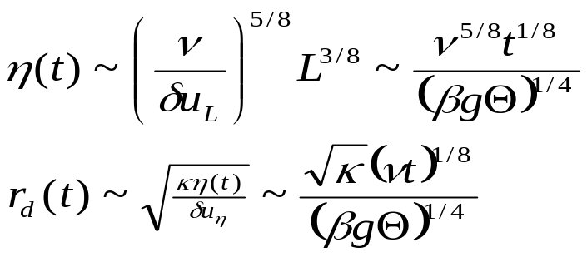
Rayleigh-Taylor turbulence. Boussinesq. 2d active scalar regime
Bolgiano ‘59-Obukhov ‘59
(Rayleigh-Bernard turb scenario)
balance each other at all the ``inertial” range scales
Self-advection
Buoyancy
+ nonlinear cascade of scalar (temperature)
to small scales
Even smaller scales
consistent with RB numerics
Celani,Matsumoto,
Mazzino,Vergassola ‘02
Menu

Slide 11
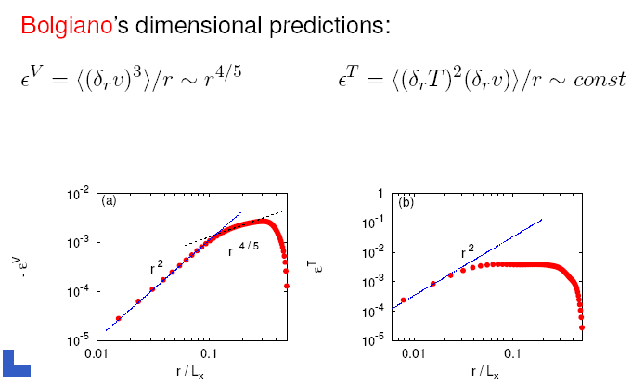
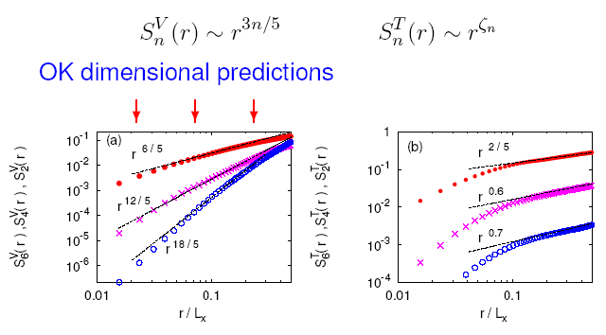
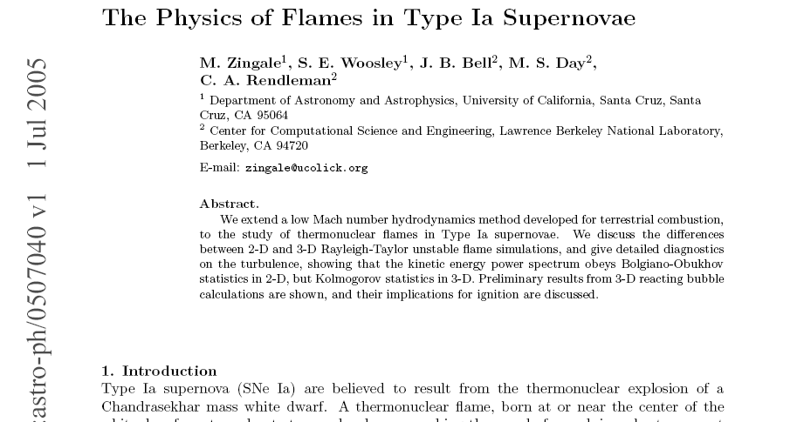
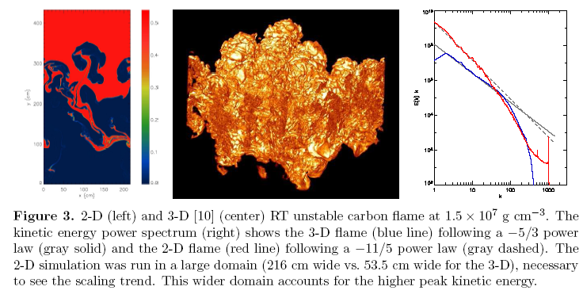
New numerical confirmations of the Bolgiano-Obukhov spectra
A. Mazzino, A. Celani, L. Vozella - Castel Gandolfo Sep 1-4, 2005
Menu *

Slide 12


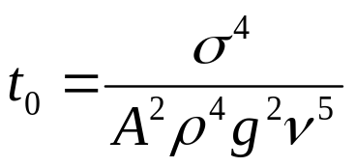
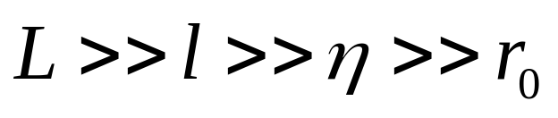


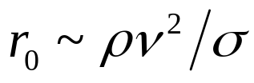

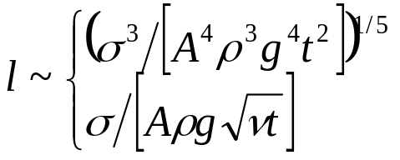
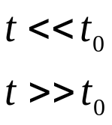





surface tension
coefficient
RTT. Immiscible case (effects of surface tension) d=3.
Wave turb.(interfaces)
Late stage
Kolmogorov turb.(bulk)
Early stage
viscous scale
capillary scale
wave turbulence range *
density fluctuations *
Menu

Slide 13

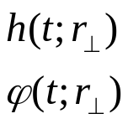

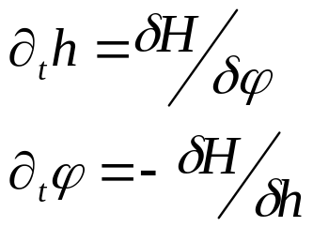
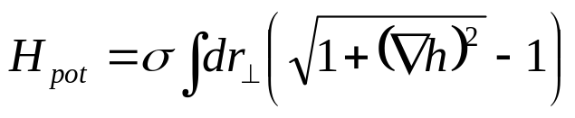

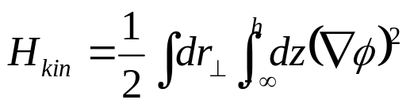


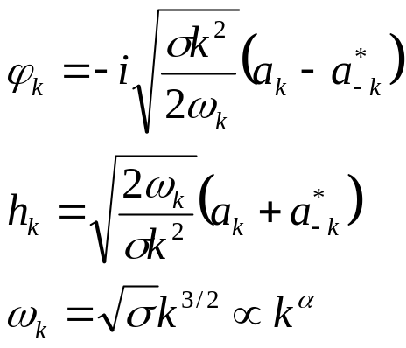
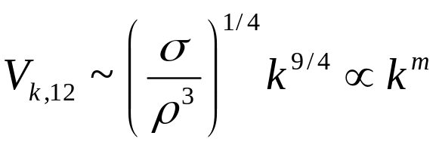
Zakharov, Filonenko ’66
Zakharov,Pushkarev ’96,’00
At=1 (water-air)
Surface/capillary wave dynamics
Potential, incompresible flow
surface elevation
velocity potential
Menu
3-wave interaction

Slide 14
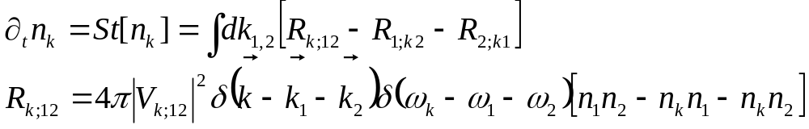

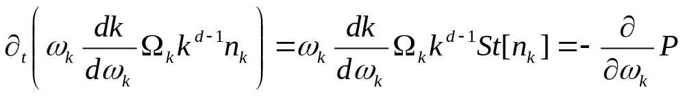
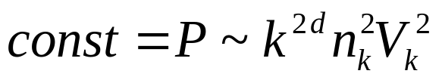
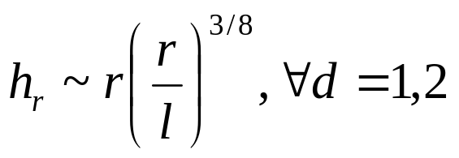





Surface/capillary wave turbulence
Zakharov and coll. ’66--
Kolmogorov-Zakharov
flux solution
locality is ok
asymptotically weak
injection scale, l
dissipation scale,
wave energy cascade
Menu

Slide 15



Cascades at the early stages of immiscible RTT
KZ (interfaces)
K41
wave dissipation
scale,
K41 (bulk)
Injection scale, L =
mixing zone width
Capillary scale, l
viscous scale,
Surface turb. is decoupled from
fluctuations in the bulk
Bulk (K41) turb. is not affected
by fluctuations on the surface(s)
[capilary fluct. of the scale r decay
distance r away from an interface]
Immis.
Menu

Slide 16



Density fluctuations. Immiscible. 3d.
passive scalar
Obukhov-Corrsin
Immis.
Menu

Slide 17






RTT. Immiscible. 2d
KZ (1d !!)
BO
wave dissipation
scale,
BO (bulk)
Injection scale, L =
mixing zone width
Capillary scale, l
viscous scale,
Contact lines turb. is decoupled
from fluctuations in the bulk
Bulk (BO) turb. is not affected
by fluctuations on the line(s)
[capilary fluct. of the scale r decay
distance r away from an interface]
Immis.
Menu

Slide 18
2003 Dirac Medal
On the occasion of the birthday of P.A.M. Dirac
the Dirac Medal Selection Committee takes pleasure in announcing that
the 2003 Dirac Medal and Prize
will be awarded to:
Robert H. Kraichnan
(Santa Fe, New Mexico)
and
Vladimir E. Zakharov
(Landau Institute for Theoretical Physics)
The 2003 Dirac Medal and Prize is awarded to Robert H. Kraichnan and Vladimir E. Zakharov for their distinct contributions to the theory of turbulence, particularly the exact results and the prediction of inverse cascades, and for identifying classes of turbulence problems for which in-depth understanding has been achieved.
Kraichnan’s most profound contribution has been his pioneering work on field-theoretic approaches to turbulence and other non-equilibrium systems; one of his profound physical ideas is that of the inverse cascade for two-dimensional turbulence. Zakharov’s achievements have consisted of putting the theory of wave turbulence on a firm mathematical ground by finding turbulence spectra as exact solutions and solving the stability problem, and in introducing the notion of inverse and dual cascades in wave turbulence.
8 August 2003
2d Boussinesq
SurfaceWaves *
Menu

Slide 19










Miscible case
density of the mixture
mass fraction of (second) fluid
compatibility
condition
Menu

