Slide 1

Phenomenology of Rayleigh-Taylor Turbulence
Misha Chertkov (T-13, Theory Division, Los Alamos)
Thanks: David Sharp (LANL)
Brad Plohr (LANL)
Vladimir Lebedev (Landau Inst)
Tim Clark (LANL)
Ray Ristorcelli (LANL)
Phys.Rev.Lett 91, 115001 (2003)

Slide 2
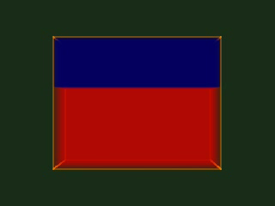
Condition:
The developed (mixing) regime of
Rayleigh-Taylor instability (turbulence)
Question:
Explain/understand hierarchy of spatial/temporal scales of velocity and density (temperature) fluctuations, deep inside the mixing zone.

Slide 3
Menu
Cascade picture (phenomenology)
Navier-Stokes Turbulence (Kolmogorov,Obukhov’41)
Passive Scalar Turbulence (Obukhov’48, Corrsin’51)
3d
2d
Rayleigh-Taylor turbulence phenomenology
2d
vs
3d
Small Atwood number, Boussinesq
vs Rayleigh-Benard
Plans:
Lagrangian
phenomenology
Miscible, incompressible
Immiscible, incompressible
Richtmyer-Meshkov + decay turb.
Anisotropy
Intermittency
Mixing
Chemical reactions *
*
Anomalous
scaling
*

Slide 4

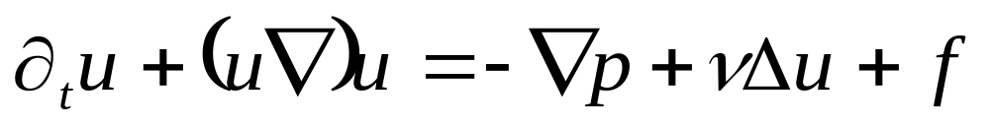

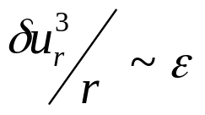
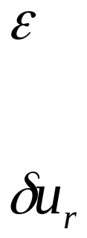
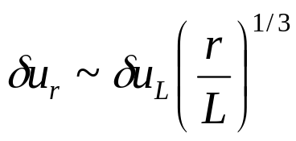
Navier-Stokes Turbulence (steady 3d)
viscous
(Kolmogorov)
scale
cascade
integral
(pumping)
scale
kinetic energy flux
scale independent !!!
time independent !!!
Kolmogorov ’41
Obukhov ‘41
typical velocity fluctuation on scale “r”
Menu

Slide 5
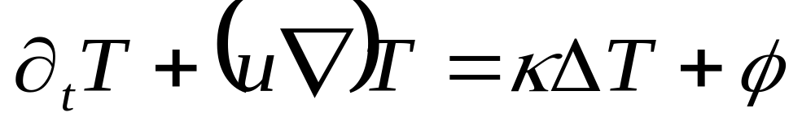
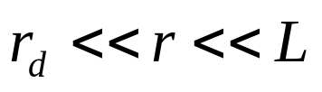
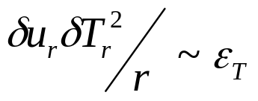
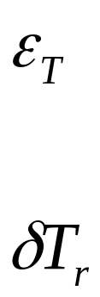
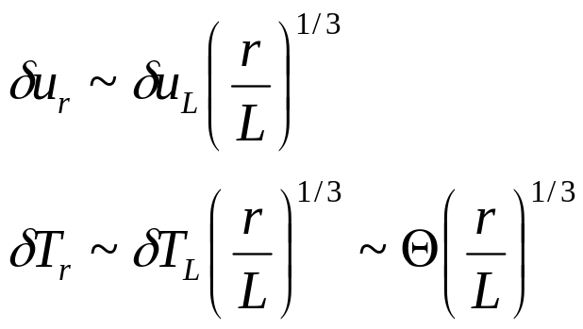
Passive scalar turbulence (steady)
cascade
integral
(pumping)
scale
dissipation
scale
scalar flux
scale independent !!!
time independent !!!
Obukhov ’48
Corrsin ‘51
typical temperature fluctuations on scale “r”
Menu

Slide 6

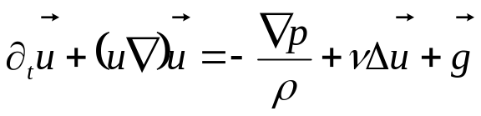
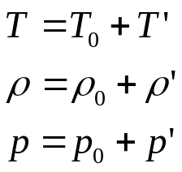

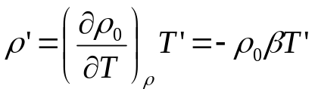

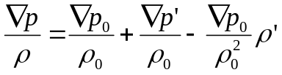
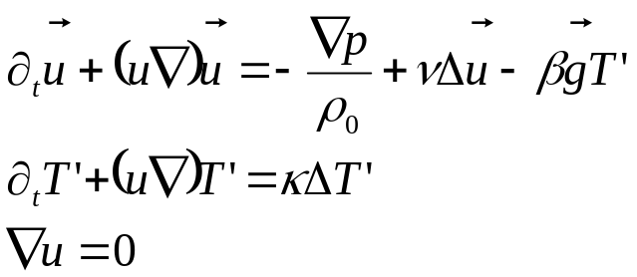

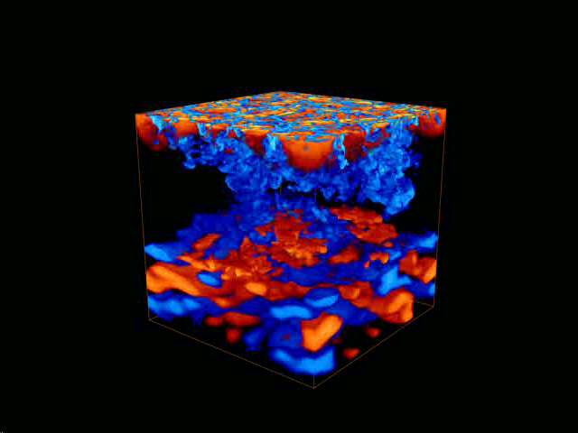
Low Atwood number, Boussinesq approximation
Free convection (one fluid)
e.g. Landau-Lifshitz
``Hydrodynamics”
Navier-Stokes
unstable
Oberbeck 1879
Lord Rayleigh 1883
J. Boussinesq 1903
G.I. Taylor ‘1950
Chandrasekhar ‘1961
…
Rayleigh-Taylor vs Rayleigh-Benard
(different initial/boundary conditions)
Menu

Slide 7

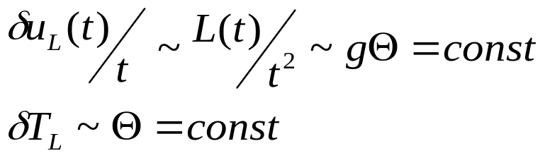


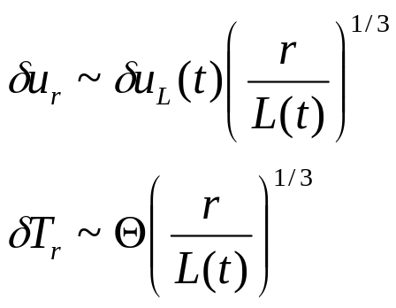
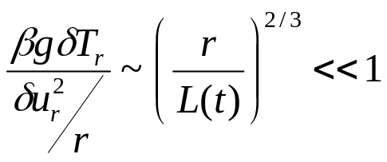
Rayleigh-Taylor turbulence 3d
L(t) ~ turbulent (mixing) zone width
also energy-containing scale
Adiabatic picture:
decreases with r
Sharp-Wheeler ’61 +
Review: Sharp ‘84
Generalized Kolmogorov-Obukhov
(Shraiman-Siggia ’90 in Rayleigh-Benard) scenario:
The turbulence is driven by large scale fluctuations of
the scalar while the small-scale fluctuations of the scalar
(temperature) remain passive!!
Checking:
consistent with existing experimental
and numerical observations, e.g.
Dalziel, Linden, Youngs ’99
Young, Tufo, Dubey, Rosner ‘01
Menu

Slide 8
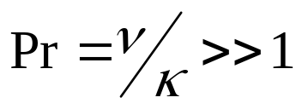
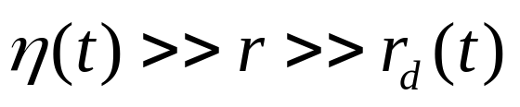
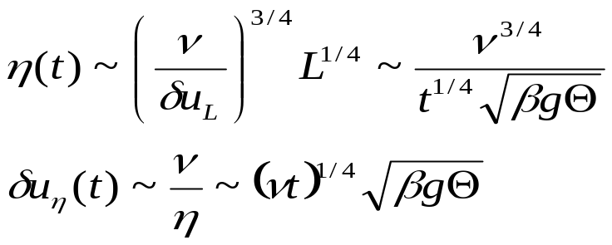
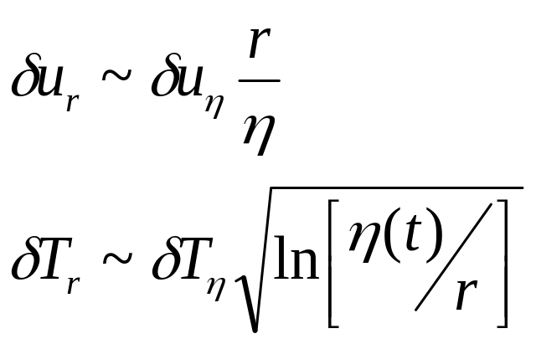
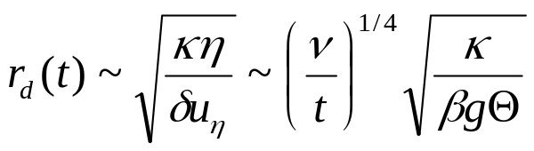
Rayleigh-Taylor turbulence 3d
smallish scales
viscous scale
velocity is smooth
passive scalar adveciton is
``Batchelor”
consistent with
Clark,Ristorcelli ‘03
dissipative scale
Menu

Slide 9
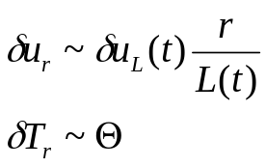
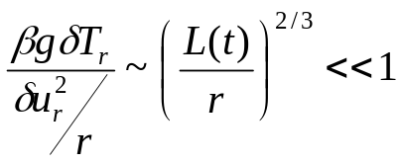
Rayleigh-Taylor turbulence 2d
L(t) ~ turbulent (mixing) zone width
also energy-containing scale
so far the same as in 3d
Two false attempts
Two cascades ? *
Nope!!
Does not work because inverse (energy) cascade
is not catching up/developing !!!!
Passive scenario
(simple vorticity cascade) ?
Nope!!
It is not self-consistent:
Menu

Slide 10
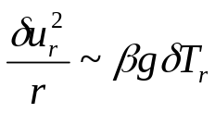
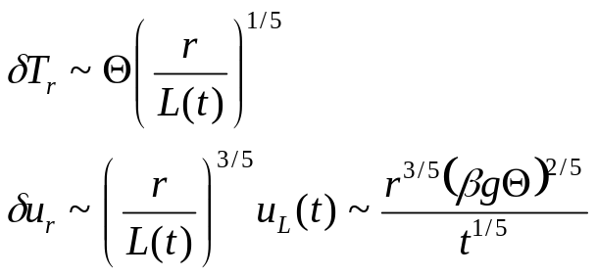
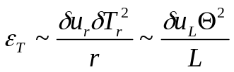
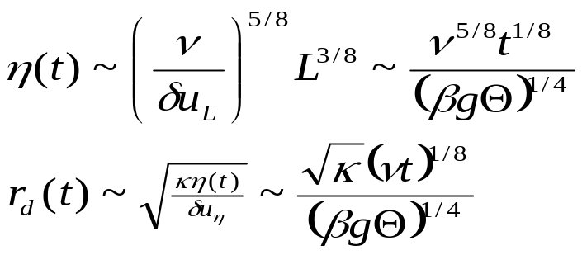
Rayleigh-Taylor turbulence 2d active scalar regime
Bolgiano ‘59-Obukhov ‘59
(Rayleigh-Bernard turb scenario)
balance each other at all the ``inertial” range scales
Self-advection
Buoancy
+ nonlinear cascade of scalar (temperature)
to small scales
Even smaller scales
consistent with RB numerics
Celani,Matsumoto,
Mazzino,Vergassola ‘02
Menu

Slide 11

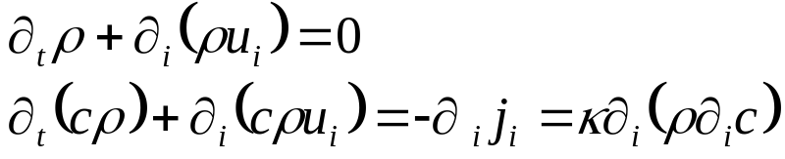

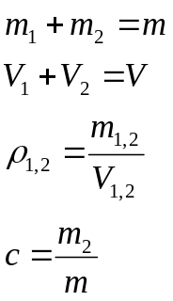
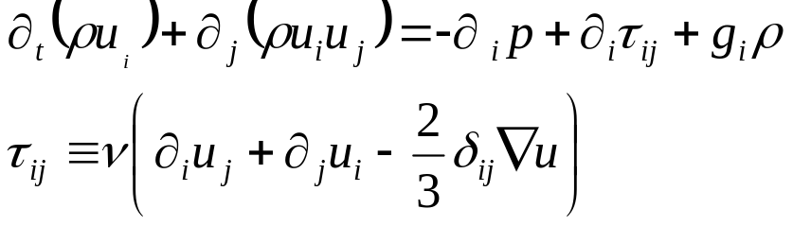
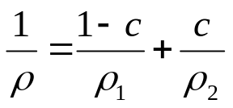

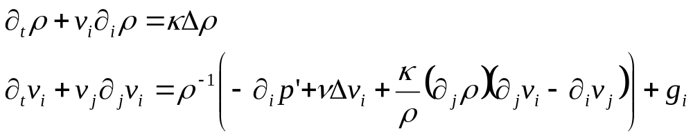

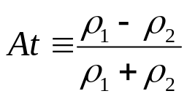
Miscible case
density of the mixture
mass fraction of (second) fluid
compatibility
condition
Menu

Slide 12
2003 Dirac Medal
On the occasion of the birthday of P.A.M. Dirac
the Dirac Medal Selection Committee takes pleasure in announcing that
the 2003 Dirac Medal and Prize
will be awarded to:
Robert H. Kraichnan
(Santa Fe, New Mexico)
and
Vladimir E. Zakharov
(Landau Institute for Theoretical Physics)
The 2003 Dirac Medal and Prize is awarded to Robert H. Kraichnan and Vladimir E. Zakharov for their distinct contributions to the theory of turbulence, particularly the exact results and the prediction of inverse cascades, and for identifying classes of turbulence problems for which in-depth understanding has been achieved.
Kraichnan’s most profound contribution has been his pioneering work on field-theoretic approaches to turbulence and other non-equilibrium systems; one of his profound physical ideas is that of the inverse cascade for two-dimensional turbulence. Zakharov’s achievements have consisted of putting the theory of wave turbulence on a firm mathematical ground by finding turbulence spectra as exact solutions and solving the stability problem, and in introducing the notion of inverse and dual cascades in wave turbulence.
8 August 2003
2d *
Menu *

Slide 13
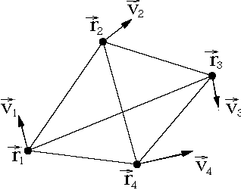
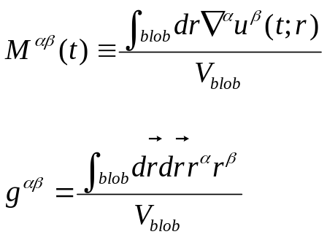
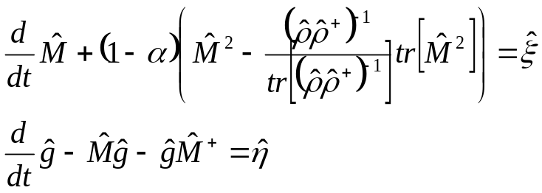
Lagrangian phenomenology of Turbulence
velocity gradient tensor
coarse-grained over the blob
tensor of inertia of the blob
Stochastic minimal model verified against DNS
Chertkov, Pumir, Shraiman
Phys.Fluids. 99, Phys.Rev.Lett. 02
Steady, isotropic Navier-Stokes turbulence
Challenge !!! To extend the Lagrangian phenomenology (capable of describing small
scale anisotropy and intermittency) to non-stationary world, e.g. of
Rayleigh-Taylor Turbulence
Menu *

Slide 14
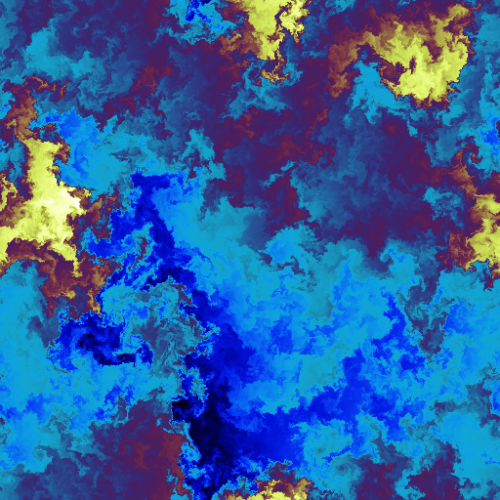

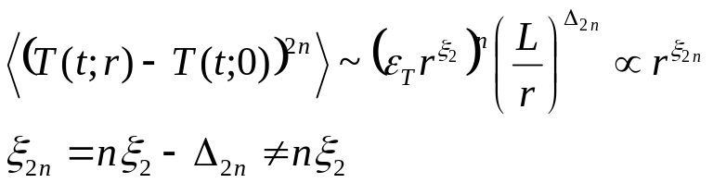

Intermittency (anomalous scaling) of density fluctuations
Small scale fluctuations of passive scalar shows intermittency
(and anisotropy) even in a self-similar velocity field !!!!
Kraichnan model:
1/d-expansion Chertkov, Falkovich, Kolokolov,Lebedev ‘95
``almost diffusive” limit Gawedzki, Kupianen ‘95
``almost smooth” limit Shraiman, Siggia ’95
exponent saturation (large n) Chertkov ’97; Balkovsky, Lebedev ‘98
Challenge !!!
To extend the passive scalar steady turbulence intermittency description
to non-stationary cases, e.g. to explain density filed intermittency
and mixing in the 3d Rayleigh-Taylor Turbulence.
Menu *

Slide 15
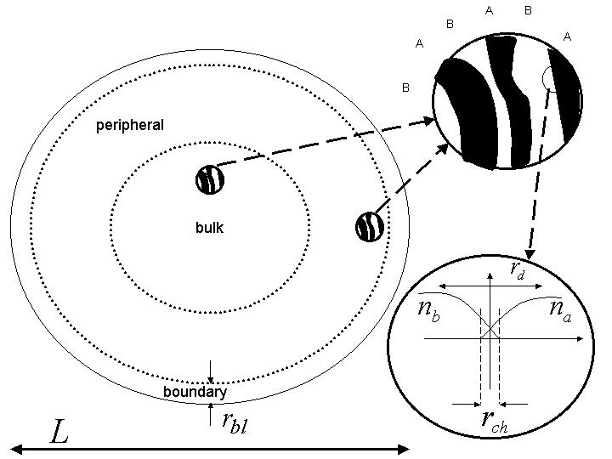


Acceleration of chemical reactions by turbulence
Chertkov, Lebedev Phys. Rev. Lett. 90, 034501 (2003)
Phys. Rev. Lett. 90, 134501 (2003)
Explanation of the chemical concentration
(and its fluctuations) decay in time in
stationary (isotropic or bounded)
chaotic/turbulent flow
Challenge !!!
To extend the chemical reaction description to the case of non-stationary
advection, e.g. by Rayleigh-Taylor Turbulence.
Menu *

