Slide 1
Buried Interfaces
Mark Schlossman
University of Illinois at Chicago
Interface scattering between solids and liquids: S/S, S/L, L/L
A few examples of studies of liquid/liquid interfaces
High energies required to pass x-rays through bulk phases (7 to 10 cm)
Absorption lengths (approximate values):
15 keV: Light oil 2 cm (hexane)
Water 5 mm
30 keV: Water 3 cm
Polar Oil ~5 mm (dichloroethane)
Also studies of thin films: µm thick water film/solid interfaces electrochemistry of solid surfaces, supported bilayers,
hydrated biomaterials surfaces, mineral/water interfaces
15 to 20 keV often used.
Small beams and precise mechanical motions required for liquid/liquid,
Total reflection Q_{c} ~ 0.007Å⁻¹ to 0.012Å⁻¹
Notes:
Early in their education, electrochemists learn about the electrical double layer, the distribution of ions in an electrolyte solution in contact with a charged planar solid electrode surface. The Gouy-Chapman theory is often used to describe the diffuse double layer, orsimilarly the Debye-Huckel theory is used to describe the diffuse ion cloud around an ion in solution. These ion distributions are important because they mediate or screen the electrostatic interactions between charged particles, or between the particles and a charge surface. As a student, we learn that the Gouy-Chapman theory is limited to describing solutions of point-like ions in a uniform, continuum solvent. Of course, we know that the situation is much more complex, the ions and solvents are not point-like, they occupy volume and have interactions that determine the structure of the electrolyte solution. In spite of a large theoretical effort to understand the influence of the liquid structure on ion distributions, most experimentalists just use the Gouy-Chapman or Debye-Huckel theories. This is partially due to the great complexity of these liquid state theories of ion distributions. It may also be partially due to an intuition that these effects can be neglected.

Slide 2
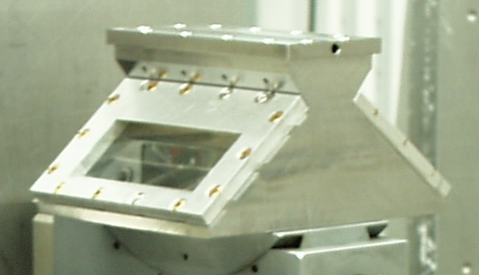
Some Examples of Liquid/Liquid Interface Studies
At the light oil/water interface:
Surfactant ordering and conformations at liquid-liquid interfaces.
Monolayer and multilayer phases
and phase transitions.
Interactions with the aqueous subphase.
Nanoparticle/colloid organization.
Techniques:
Reflectivity, off-specular diffuse scattering
GISAXS, GID (for very strong scatterers)
resonant anomalous reflectivity

Slide 3
Electrified Liquid/Liquid Interfaces between Two Immiscible Electrolyte Solutions
Liquid-liquid interfaces useful for investigating:
Molecular reactions across the interface
+
Ion pairing
Some Applications:
Separation membranes
Extraction processes
Phase transfer catalysis
Sensor design (microfluidics)
Drug transport
Biomolecular processes
driven by electrostatic
interactions
–
Rate of assisted ion transfer depends upon
distance of approach of ion and ionophore
+
+

Slide 4
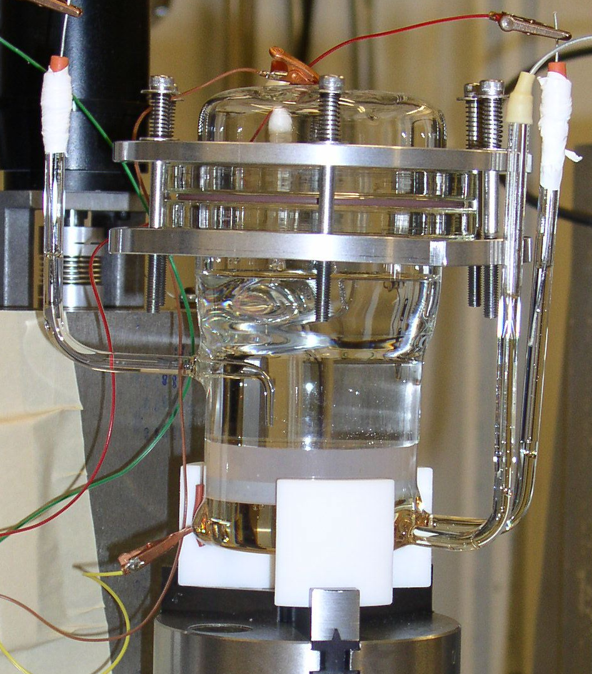

Control of Electrical Potential Across the Interface
Interfacial Electrical Potential can be used to
Alter concentration and species of ions at interface
Change physical properties of interface
Control molecular transport through interface
Investigate electrostatically controlled interfacial processes
water with electrolytes
X-rays
polar oil with electrolytes
Voltage
Requires an interface between two polar liquids - small potential (~0.1 V) yields large electric field across interface ~10⁸ V/m

