Slide 1
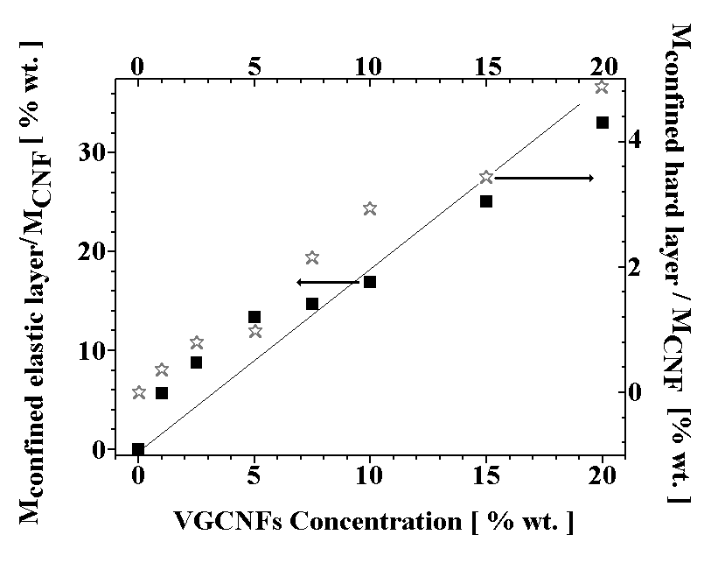
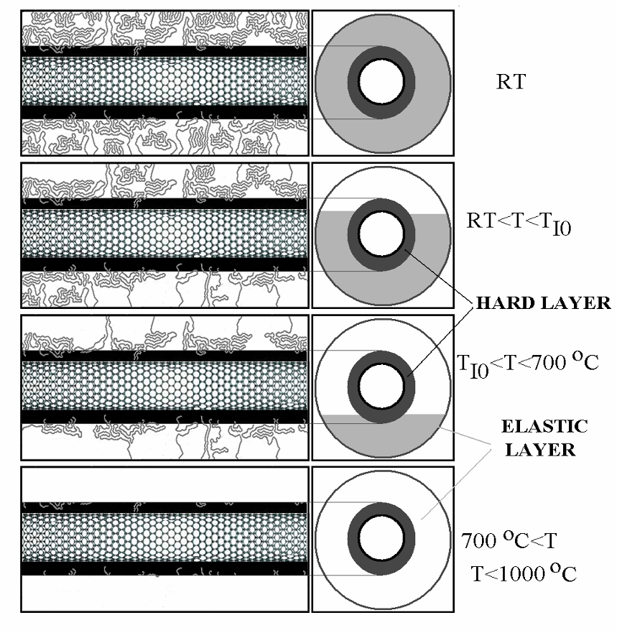
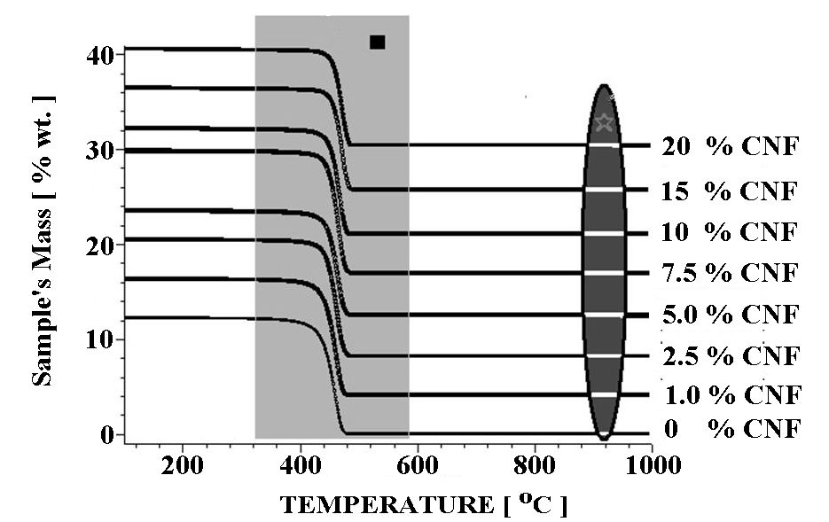
Nano-Micro Morphological Understanding of Nanofiber-Nanotube Reinforced Polymer Composites
Karen Lozano, University of Texas Pan American, DMR 0606224
Research: The proposed experiment-based study focuses on the interplay between the nano- and micro-morphology of nanofiber and nanotube reinforced polymer composites. Studies are being conducted to elucidate how the interactions between the NF or NT and polymer matrix account for morphological changes therefore affecting specific macro- properties.
2 inter-
faces
CNF
TGA on PP-VGCNFs (nitrogen)
Model of PP-VGCNFs interface
An estimation of the interface of PP/NF composites was obtained using simple TGA analysis. The external layer (soft layer), of
t ≈ 200 nm confines most PP molecules in interaction with the NFs. This interaction is responsible for the increased thermal stability,
and is represented by the wrapping of macromolecular chains around NFs. The core layer is rigid and has a t ≈10 nm.

Slide 2
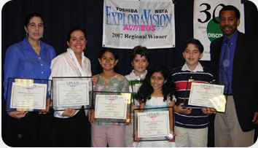
Nano-Micro Morphological Understanding of Nanofiber-Nanotube Reinforced Polymer Composites
Karen Lozano, University of Texas Pan American, DMR 0606224
Education: Dr. Magdalena Chipara (Post Doc), Rogelio Benites (MS student), Ana Hernandez (MS Student) and several UG students (Wasiela Salinas, Joshua Wilkins, Eugenio de Hoyos, and Elsa Garcia) are carrying out projects related to the grant. Our group consist of six MS students and 20 UG students (80% Hispanics). Three Junior Professors, Horacio Vasquez, Jose Juan Gutierrez and S. Ahn have been receiving help to launch their research careers at UTPA.
Outreach: Dr. Lozano established Sci & Tech Apprentices to expose children (4-18 yrs of age) to engineering at an early age. To this end, more than 200 students have benefited from the hands-on engineering activities (>85% Hispanics). In addition, Dr. Lozano mentored a group of four 4th graders (all Hispanics) in their project presented to the Toshiba/NSTA Exploravision Award Competition, these kids won first place competing among 17,000 students from USA and Canada. They won a $10,000 savings bonds (one for each one) and an all expense trip to Washington DC for the award ceremony for them and their families.
D.A.P.E.S. (Diabetes Assistance and Prevention E-System)
Implants a nanosensor in a tooth to analyze harmful food intake for adolescent diabetics. The nanosensor continuously monitors and provides information such as sugar levels to a portable electronic system via wireless communication and warns or rewards children according to their consumption patterns.
View winning web site
Discovery School, Edinburg, TX. Back row, left to right: Karen Lozano (Mentor), Raquel Duberney-Guerrero (Coach), Isabella Soto (Student), Adam Tabak (Student); Front row, left to right: Bianca Mujica (Student), Jorge Vidal (Student), Mark Fowler (Toshiba)

