Slide 1
Comments on
EPA’s Proposed Validation Plan for the
Mammalian Two Generation Test
Richard A. Becker, Ph.D., DABT
American Chemistry Council
June 5, 2003

Slide 2
Overview of Two - Generation
Reproduction Study in Rats
Current guideline protocol considered the definitive mammalian reproduction study for human health risk assessment
Guideline was recently revised -- extensively -- to increase sensitivity to detect effects mediated by the endocrine system
  sperm parameters, estrous cycling, developmental markers, more extensive parental histopathology, brain, spleen and thymus weights of weanlings, oocyte counting
5 to 8 years to revise and harmonize internationally
  1998: U.S. EPA
  2001: OECD, Japan
A globally harmonized protocol is critical:
  Animals – Mutual Acceptance of Data
  Resources – Avoid ambiguous status

Slide 3
Changes to Protocol Are Premature
Before changing the study design requirements
EPA has a responsibility to demonstrate that risk assessments based on the study will be substantially improved
    Demonstrate that lower NOAELs/LOAELs will be identified
    Demonstrate that important new target organs will be identified
EPA has a responsibility to demonstrate that increasing the number of pups from F1 retained to adulthood will add value to the study
  The additional value of each proposed endpoint should be validated experimentally before requirements are changed
    Side-by-side comparisons using compounds that have been evaluated by a recent (post-1998) protocol guideline

Slide 4
Morphological Changes are Detectable by the Current Guideline Protocol
Example: Pre-1998 guideline studies for linuron were able to detect morphological changes in male reproductive tract - the current protocol would be at least as sensitive
Gross necropsy at weaning pnd 21 can detect morphological alterations (with focused & skilled evaluation)
    Hypospadias see RTI study page 39
    Retained nipples / areolas see RTI study page 38
    Missing epididymis see RTI study page 39
    Altered AGD (measured on pnd 1) see RTI study page 38

Slide 5
Increases in Animal Numbers May
Impact a Guideline Study
Additions which increase complexity and logistics can influence results
Animal room capacities can be exceeded easily
  e.g., RTI protocol would require:
    ~ 400 additional cages to house the F1 males for 10 weeks (above the 240 currently needed to breed F1 to F2)
    Using more than one animal room for each study ?
Multiple teams of technicians may be required to measure all required endpoints
Measurement variation may increase due to numbers of technicians required to generate data

Slide 6
Question 1: Status of Proposed Endpoints a) AGD in all animals in both F1 and F2 at birth
Endpoint is part of OPPTS 870.3800
Is extremely sensitive and may occur without other morphological effects that affect function
Lacks specificity: can be altered by factors not specific to exogenous agents, e.g., prenatal uterine position, stress, altered arachidonic acid cascade, factors that affect pup body weight such as maternal or neonatal toxicity, litter size, etc. (Gallavan et al. 1999)
AGD – rec. consider as a triggered endpoint -- ensure linked to changes in other other endocrine-mediated endpoints

Slide 7
Question 1: Status of Proposed Endpoints
b) retained nipples / areolas
Traditional endpoints -- more sensitive endpoints for detecting altered endocrine status (at least in some cases).
In some studies, nipple retention was not permanent.
Rigorous validation would be necessary before including this endpoint.
Reference | Compound and doses | Lowest dose showing retained areolas/nipples | Other altered endocrine/reproductive endpoints
McIntyre et al., 2000 | Linuron: 12.5, 25, 50 mg/kg/day | 50 mg/kg/day | At 50 mg/kg/day: decreased pup survival to weaning; At >25 mg/kg/day: testicular hypoplasia; epididymal hypoplasia; altered testicular histology (some minimal indications of these effects at 12.5 mg/kg/day)
Turner et al., 2002 | Fenitrothion: 5, 10, 15, 20, 25 mg/kg/day | 25 mg/kg/day; transient effect | At 20 and 25 mg/kg/day: Maternal toxicity; increased fetal death; At 25 mg/kg/day: decreased AGD (transient effect)

Slide 8
Question 1: Status of Proposed Endpoints c) TSH, T4, thyroid weight & histology, all at necropsy
Useful addition to the 1998 Guideline study to enhance ability to detect thyroid-active agents. Appropriate not to require measurement of T3
However, thyroid measurements should be made in adult animals, not at pnd 21
  T4 levels peak at pnd 15, decline until pnd 27; then rise again. In male rats, there is also a marked increase from pnd 33 to 50
  T4 levels may also vary during the estrous cycle in female rats
Male rats are more sensitive to thyroid perturbations; EPA should consider whether thyroid measurements in females are necessary.
See published results of Intact Male assay

Slide 9
Question 2: Does the Tier 2 Multigeneration Rat Reproduction Study Provide Adequate Data?
The existing multigenerational study is sensitive and effectively detects potential endocrine mediated adverse effects, including those that occur by estrogenic, androgenic, and thyroidogenic mechanisms, even those that occur at relatively low incidence.
Recall that this is a multi-dose study (3 doses + control) and that the guidelines require the highest dose tested to induce some reproductive and/or systemic toxicity but not death or severe suffering
Apical endpoints, adverse effects and dose response from Tier 2 are used for risk assessment
  Tier1 assays do not evaluate adversity
  Tier 2 results supersede Tier 1

Slide 10
Question 3: Should additional procedures and endpoints in Table 2 be listed explicitly?
The endpoints listed in EPA’s Table 2 are not all specifically evaluated in the current guideline study (OPPTS 870.3800)
A number of the additional endpoints appear to be unnecessarily redundant
If considered, each new measurement should be demonstrated to add value by increasing sensitivity, specificity, or reliability.

Slide 11
Question 4: Validation of Additional Endpoints
The existing multigeneration study is sensitive and effectively detects potential endocrine mediated adverse effects, including those that occur by estrogenic, androgenic, and thyroidogenic mechanisms, even those that occur at relatively low frequency.
EPA needs to expressly consider relevance & reliability for the endpoint and the overall test -- if major modifications to existing design are contemplated
Additions to a complex and intensive study design can influence intra & inter-laboratory performance & reproducibility

Slide 12
Question 5: PND 95 vs PND 21
“..does the 1-Gen extension study show increased sensitivity & provide greater precision .. [to warrant inclusion in 2-Gen design]?
RTI study cannot answer the question posed re: sensitivity in ref to the existing 2-gen study design because the RTI study was not designed for this purpose
The RTI F1 extension design focused only on hazard ident. Lacked complete dose-response necessary to address whether or not F1 retention to adulthood enhanced sensitivity for adverse effects. Not designed to determine the number of pups needed to be retained, the optimal age for retention, optimal housing of retaining offspring (a considerable logistical concern) and whether or not necessary to retain females.
To address this question need a side-by-side comparison of the current 2-Gen protocol vs. an otherwise identical protocol except for pup retention

Slide 13

What do the Data Indicate?
The RTI study does show pnd 95 is not always more sensitive than pnd 21
All effects observed at pnd 95 also observed pnd 21

Slide 14
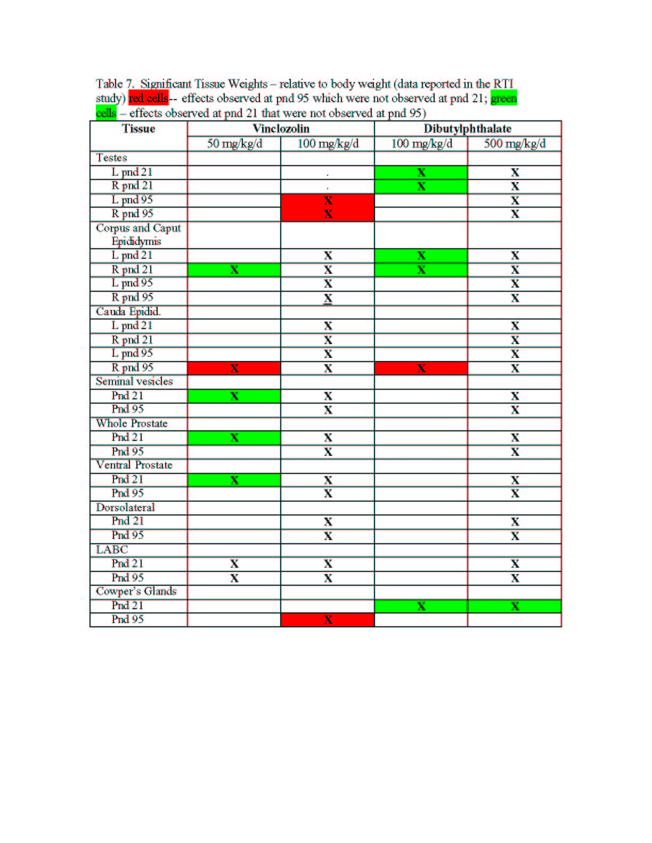

Slide 15
Conclusions
Rat Multigeneration Study Design
Some proposed endpoints appear justified and useful -- particularly addition of thyroid endpoints if done in adult animals.
Many proposed endpoints appear redundant – endocrine mediated changes occur across a number of tissues – pattern of effects - associated with a mode of action. It is not necessary to evaluate all, but instead focus on the most sensitive adverse effects in the Tier 2 test
If additional endpoints are considered, each should be subjected to experimental validation and should be required to enhance sensitivity, specificity, or reliability for detecting adverse effects.
Furthermore, a significant impact on risk assessment should be evident and verified

Slide 16
