Slide 1

Identification, Mefenoxam Sensitivity, and Mating Type of Phytophthora spp. attacking Floriculture Crops in North Carolina
Jaesoon Hwang and D. M. Benson

Slide 2
Floriculture crops production in North Carolina
Wholesale value of $161.4 million in 2001 (8th in the nation)
335 growers, 17.9 million square feet of covered area
Phytophthora diseases - one of the major problems, potential movement within state/among states, 21% of growers using mefenoxam

Slide 3
Objectives of project
Identify Phytophthora spp. causing blight, crown rot, and root rot on floricuture crops
Characterize isolates for sensitivity to mefenoxam
Determine mating type of isolates

Slide 4
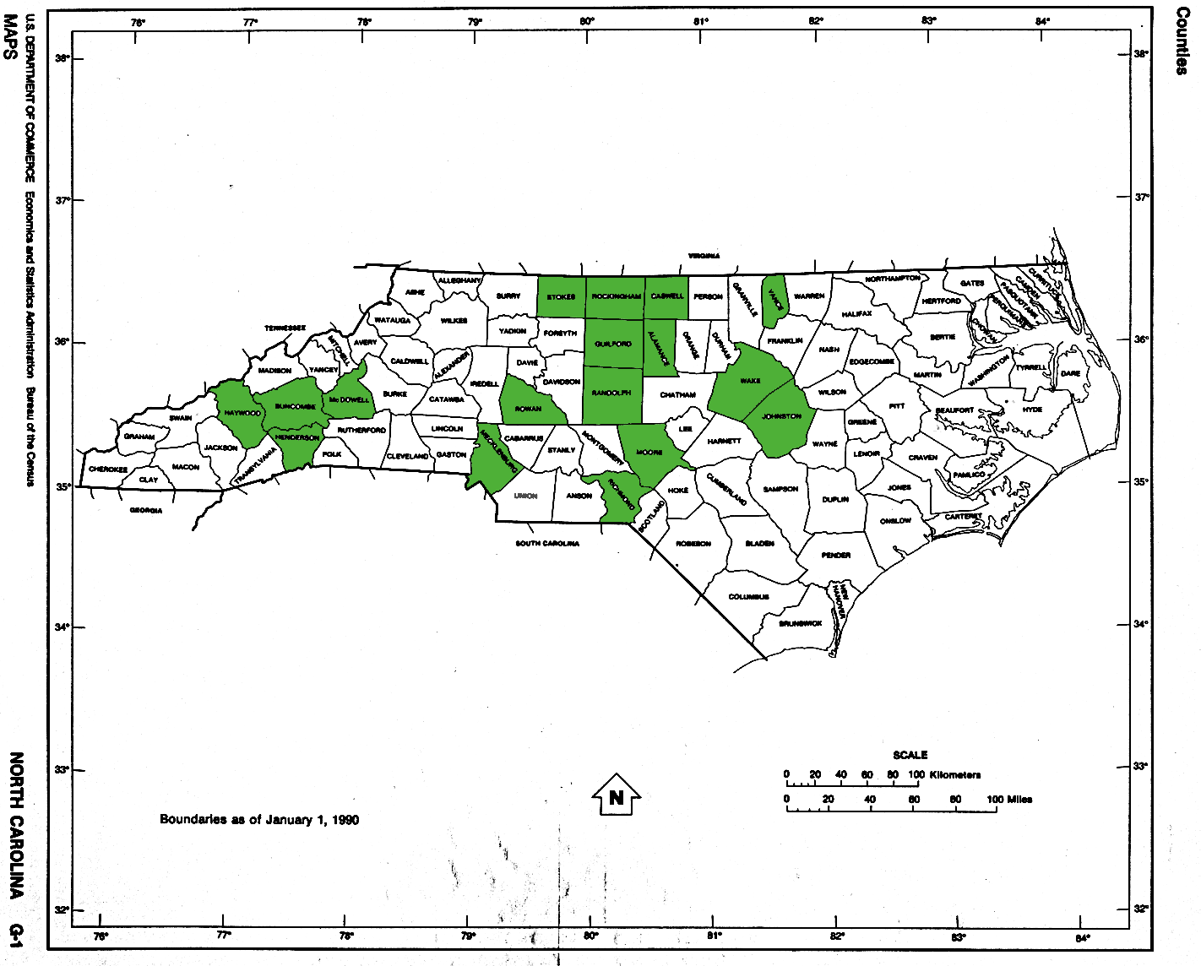
Isolate collection
61 wholesale growers listed in NCCFGA
-29 operations visited (>1/4 to 65 acres)

Slide 5
Isolate collection
46 plant species sampled
African violet, artemisia, begonia, campanula, carnation, chrysanthemum, cladium, cyclamen, dahlia, Dusty Miller, English ivy, fuchsia, gardenia, garden sage, geranium, gerber, gloxinia, impatiens, lamb’s ear, lantana, lavender, lusianthus, marigold, miniature rose, New Guinea impatiens, oregano, pansy, pentas, petunia, plectranthus, poinsettia, portulaca, pothos, rhodochiton, rosemary, salvia, Scotch moss, snapdragon, syngonium, verbena, vinca, viola,

Slide 6
Isolate collection
Direct isolation from leaf, crown, and root using PAR/Hymexazol
14 groups, 486 isolates collected
Isolate ; Phytophthora isolated from an individual plant
Group ; Isolates collected from the same host at a given location

Slide 7
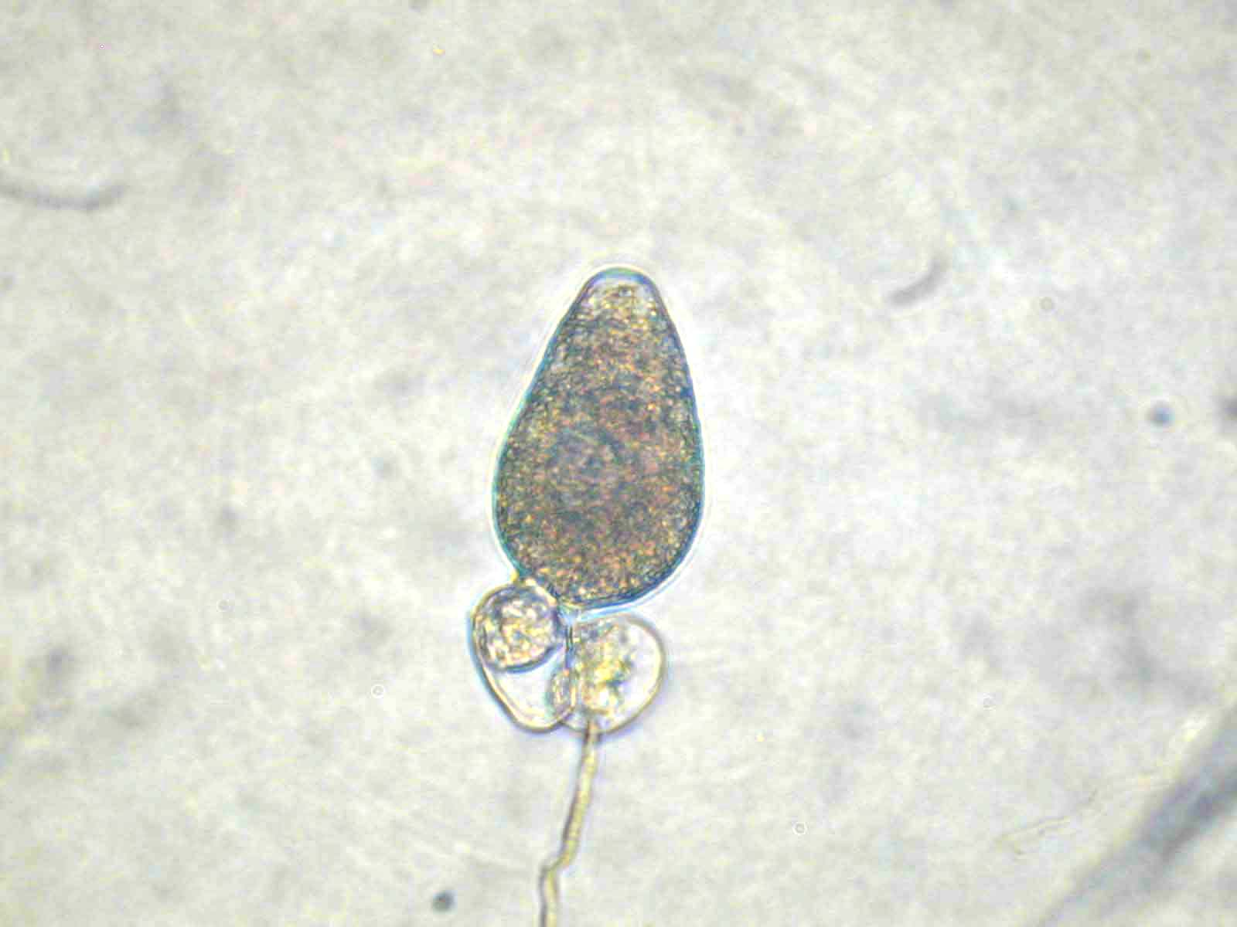
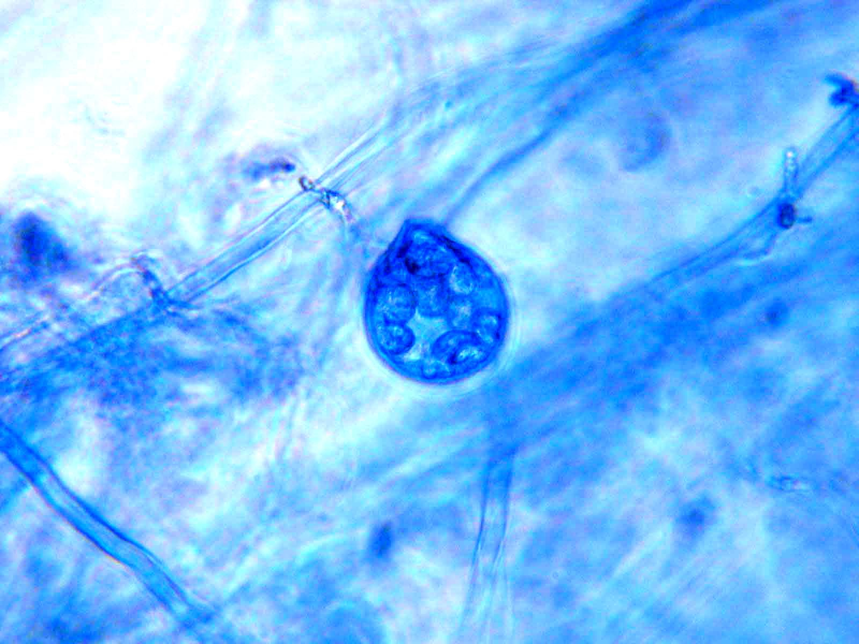
Species identification
Morphological & physiological characteristics
Ho et al. 1995
Waterhouse 1970

Slide 8
Species identification
PCR using ITS 4 and 5 primers & digestion with RsaI, MspI, HaeIII
Ristaino et al. 1998

Slide 9
PCR: Species identification
P. palmivora
P. nicotianae
P. palmivora
Cut with RsaI

Slide 10
PCR: Species identification
P. cryptogea
P. drechsleri
Cut with HaeIII

Slide 11
Species identified by morphological & molecular (PCR) characteristics

Slide 12
A potential new Phytophthora species
Isolated from English ivy at two locations
Koch’s postulate completed
Closely related to P. tropicalis
- morphological characteristics
- DNA sequence analysis

Slide 13
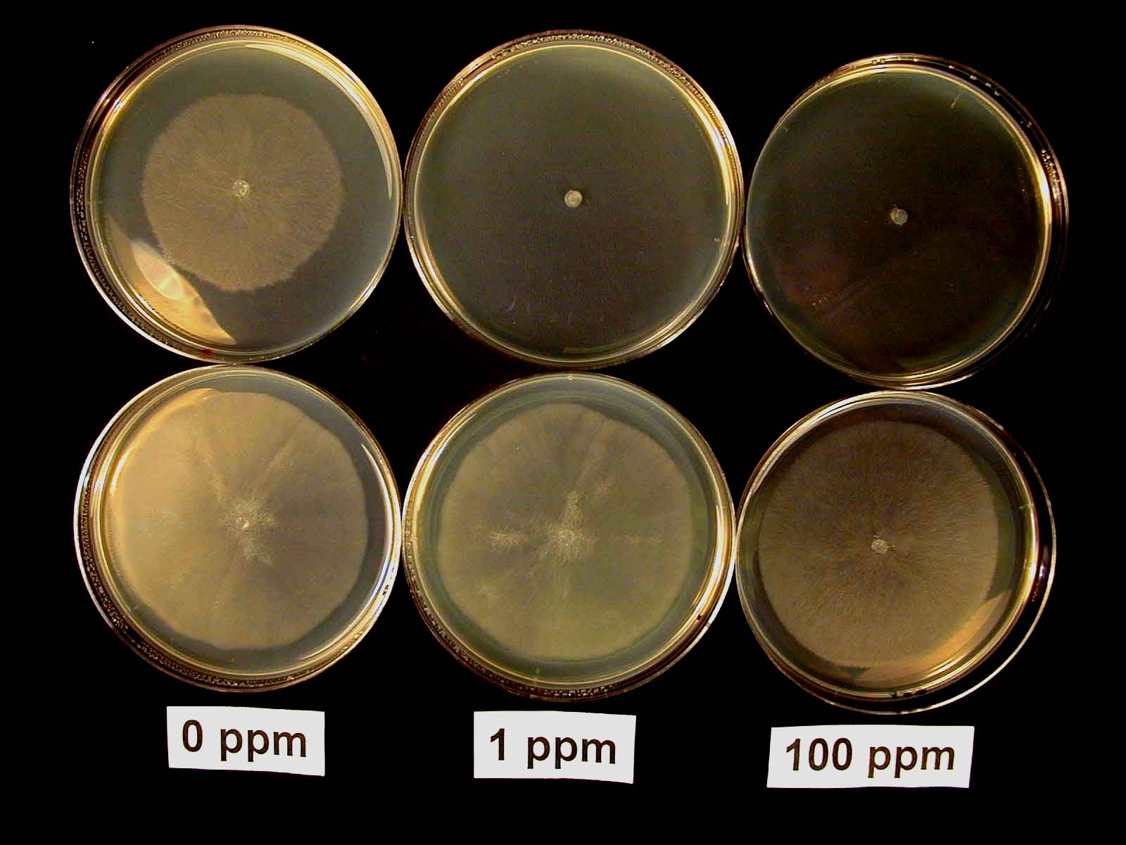
Mefenoxam sensitivity
0, 1, 100 ppm (Subdue Maxx a.i.) corn meal agar plates
- ; No growth
+; 1-24%
++; 25-49%
+++; 50-74%
++++; 75-100%

Slide 14
Mefenoxam sensitivity

Slide 15
Mefenoxam sensitivity at 100ppm
P. cryptogea
- sensitive (-); 8%
- intermediate (+~+++); 19%
- resistant (++++); 73%
P. nicotianae
- sensitive (-); 80%
- resistant (++++); 20%
P. palmivora
- sensitive (-); 100%

Slide 16
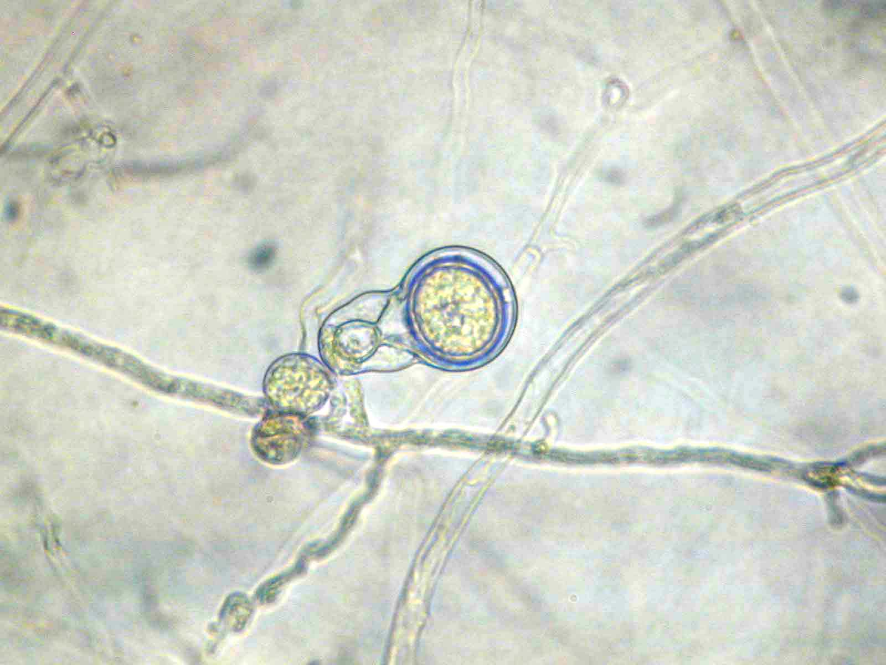
Mating type determination
Tester isolates
P. capsici
OP97 (A1)
SP98 (A2)
P. nicotianae
MLPT (A2)
FBPS (A1)

Slide 17
Host/species/mating type
UD ; Undetermined

Slide 18
A1, A2 coexist in NC
P. nicotianae
Potential spread & long-term survival of mefenoxam resistant isolates

Slide 19
Homogeneity within a group
12 of 14 groups (host by location combinations)
- Within a group, all isolates showed same level of sensitivity to mefenoxam
- Within a group, all isolates were same mating type
- Originated from one source?

Slide 20
Variations of mefenoxam sensitivity within a group
P. cryptogea from Dusty miller
P. cryptogea from gerber

Slide 21
2001 vs 2002
P. nicotianae from African violet collected at same location
Homogeneous mating type and mefenoxam sensitivity over year
- originated from same source?

Slide 22
2001 vs 2002
P. cryptogea from Dusty miller collected at same location
Increased sensitivity to mefenoxam over year
- originated from different source?
- shift the other way?

Slide 23
Comparison of Phytophthora in NC & MI (K. Lamour & M. Hausbeck)
North Carolina
Prevalent species
P. nicotianae
Overall mefenoxam resistant isolates
35%
A1, A2 mating type
coexist for P. nicotianae
Homogeneity within a group
Yes (for 12 of 14 groups)
Michigan
P. nicotianae
8%
coexist for P. nicotianae
Yes (for all groups)

Slide 24
Summary
P. cryptogea, nicotianae, palmivora isolated
35% of isolates were resistant to mefenoxam
Homogeneity within a group
- same origin
Variations within a group / among groups
- shift in progress
- different origin
Both mating type coexist for P.nicotianae
A potential new species from English ivy

Slide 25
Significance to the industry
Diversity of Phytophthora spp. recovered
- appropriate control strategies based on the biology of each species
Multiple Phytophthora spp. may present in an operation
- significance of population monitoring & chracterization

Slide 26
Significance to the industry
High percentage of mefenoxam resistant isolates
- could result in fungicide failure
- need to develop fungicide resistance management program
new fungicides
rotation of multiple fungicides
evaluating cross-resistance with other fungicides

Slide 27
Special thanks to
Growers in North Carolina
Luis Gomez
Dr. Seong-Hwan Kim
Dr. Kurt Lamour
Dr. Jean B. Ristaino
Dr. Brian E. Whipker
NCSU Plant Disease & Insect Clinic

