Slide 1

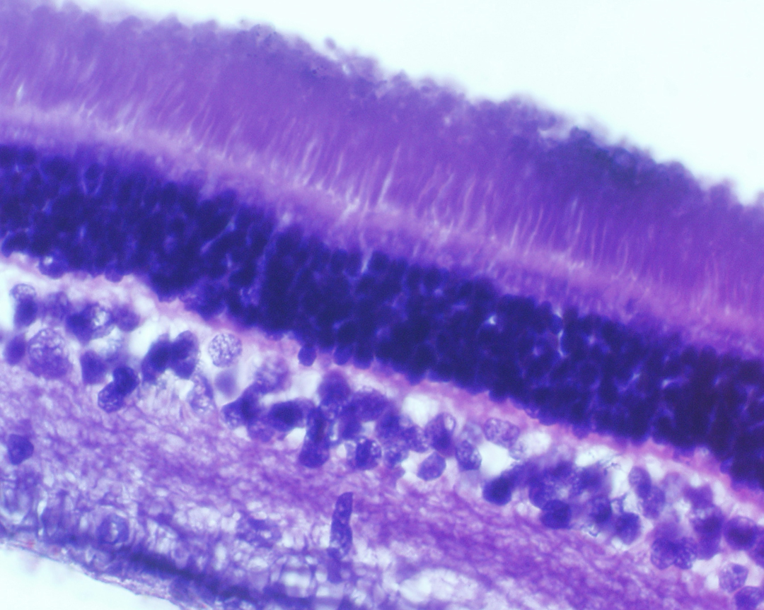
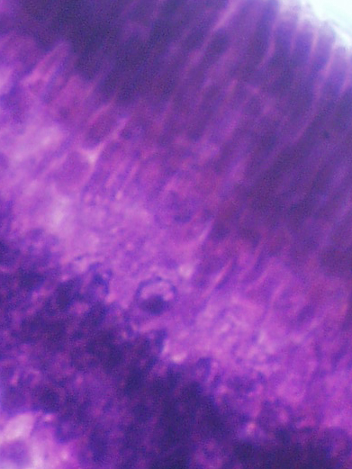
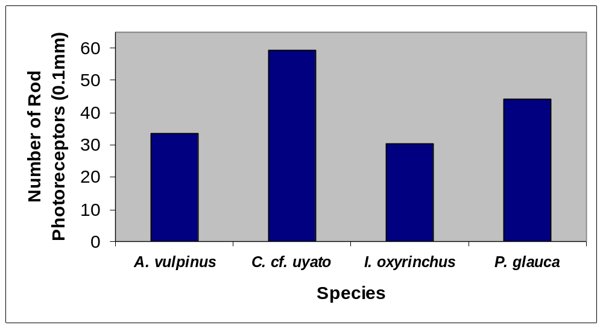
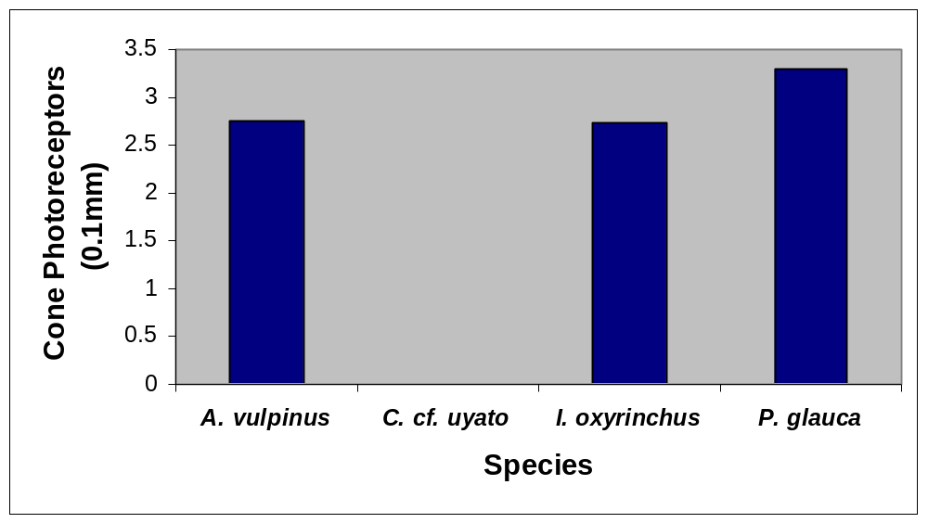
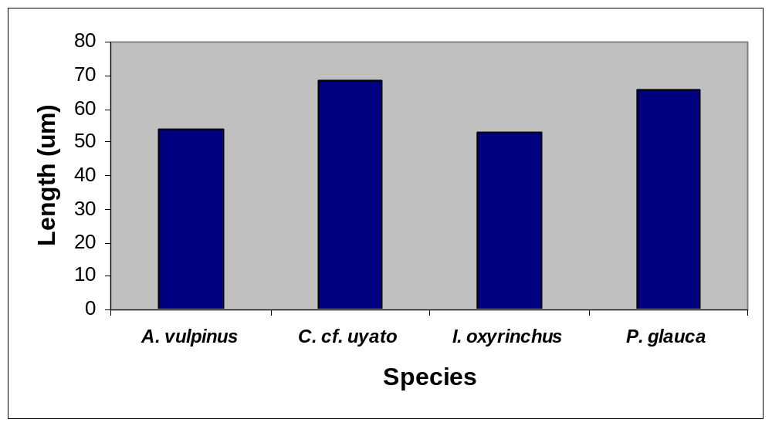
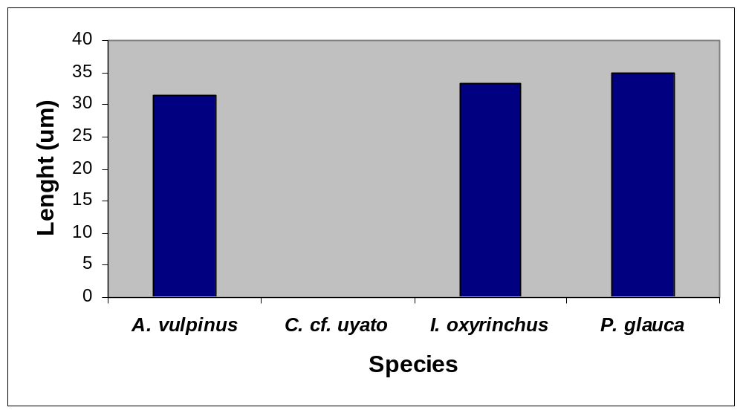
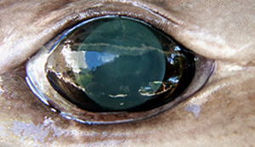
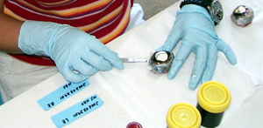
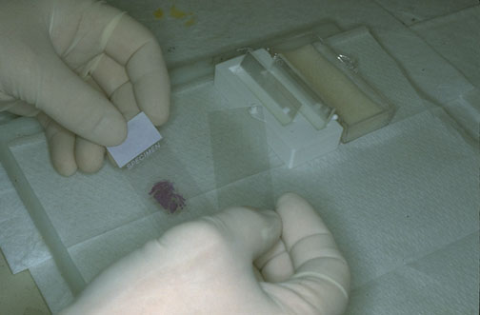

Histological Comparison of the Retinal Structure of Deep-Water and Epipelagic Sharks
Jill A. Olin* and John F. Morrissey
Department of Biology, Hofstra University, Hempstead, NY 11549
Abstract
Morphological characteristics of the retina of a deep-water shark of the order Squaliformes were compared to three epipelagic sharks (one carcharhinoid and two lamnoids) to investigate visual adaptations in elasmobranchs living at different depths. The three epipelagic species (Alopias vulpinus, Isurus oxyrinchus, and Prionace glauca) have well-developed eyes, with retinas composed of both rod and cone photoreceptors in ratios of 13:1, 12:1, and 14:1, respectively, whereas Centrophorus cf. uyato, a mesobenthic species found at depths greater than 400 m, has a retina composed solely of rods. The rod-rich, relatively cone-poor retinas of these four elasmobranchs yield low visual acuity and rather high sensitivity, enabling them to detect an object against contrasting background in dim light. Further histologic investigations into eight different regions of the retinas, four central and four peripheral, exhibited no indication of intraretinal variation within each species in terms of photoreceptor abundance, distribution, outer-segment length, inner-segment length, or width, suggesting that there is no specific area of increased visual acuity or sensitivity in the retinas of these species. As expected, interspecific variation in these characteristics was observed between the deep-water squaloid and the three epipelagic sharks, whereas little variation was observed between the ecologically and taxonomically related A. vulpinus and I. oxyrinchus. These variations in retinal structure are discussed in terms of the ecologic and taxonomic relationships of these sharks.
Results
The retina of C. cf. uyato contained only rod photoreceptors in abundance of
6,000/mm, measuring approximately 68µm (Figure 1).
The retinas of A. vulpinus, I. oxyrinchus and P. glauca contained both rod and
cone photoreceptors in ratios of 13:1, 12:1, and 14:1 measuring approximately
54µm and 31µm, 53µm and 33µm, and 65µm and 22µm, respectively (Figure
2).
No differences were observed within species between the eight regions of the
retina.
Significant differences were observed between the species in photoreceptor
composition, abundance and dimensions (Figures 3, 4, 5 and 6).
The retinas of the two lamnoid species exhibited significantly similar
characteristics, for photoreceptor abundance, as well as rod and cone outer and
inner segment.
The retina of P. glauca was observed to be the median between the lamnoids and
centrophoroid species containing significant similarities to both.
Conclusions
These findings indicate clear variation in retinal compositions between mesobenthic (400-900m) and pelagic (0-400m) habitats .
The lack of differences within the retinas indicate that there are no adaptations associated with areas of high photoreceptor concentrations, as seen in other elasmobranch species (Hueter 1991).
As anticipated the retina of the centrophoroid species indicates an adaptation for scotopic vision with high sensitivity.
The retinas of the two lamnoid species exhibit similarities and indicate adaptations for both scotopic and photopic vision. These data represent similarities resulting from both taxonomic relations and habitat use.
The similarities of the carcharhinoid species to the other three species indicate a retina adapted for both photopic and scotopic vision with high sensitivity.
Literature Cited
Bozzano, A., R. Murgia, S. Vallerga, J. Hirano, and S. Archer. 2001. The
photoreceptor system in the retinae of two dogfishes, Scyliorhinus canicula
and Galeus melastomus: Possible relationship with depth distribution and
predatory lifestyle. J. Fish Bio. 59: 1258 – 1278.
Gruber, S.H., D.H. Hamasaki, and C.D.B. Bridges. 1963. Cones in the retina of
the lemon shark (Negaprion brevirostris). Vis. Res. 3: 397-399.
Gruber, S.H., R.L. Gulley, J. Brandon. 1975. Duplex retina in seven
elasmobranch species. Bull. Mar. Sci. (25) 3: 353-358.
Gruber, S.H. and J.L. Cohen. 1985. Visual system of the white shark,
Carcharodon carcharias, with emphasis on retinal structure. Memoir #9
S. California Academy of Science. 9: 61-72.
Hamasaki, D.I. and S.H. Gruber. 1965. The photoreceptors of the nurse shark,
Ginglymostoma cirratum and the sting ray, Dasyatis sayi. Bull. Mar. Sci. 15
(4): 1051-1059.
Hueter, R.E. 1991. Adaptations for spatial vision in sharks. J. Exp. Zool. Suppl.
5: 130 -141.
Kohbara, J., H. Niwa, and M. Oguri. 1987. Comparative light microscopic
studies on the retina of some elasmobranch fishes. Nipp. Suis. Gakka. 53
(12): 2117- 2125.
Sillman, A.J., G.A. Letsinger, S. Patel, E.R. Loew, and A.P. Klimley. 1996.
Visual pigments and photoreceptors in two species of shark, Triakis
semifasciata and Mustelus henlei. J. Exp. Zool. 276: 1-10.
Stell, W.K. 1972. The structure and morphologic relations of rods and cones
in the retina of the Spiny Dogfish, Squalus. Comp. Biochem. Physiol. 42A:
141-151.
Yew, D.T., Y.W. Chan, M. Lee, and S. Lam. 1984. A biophysical,
morphological and morphometrical survey of the eye of the small shark
(Hemiscyllium plagiosum). Anat. Anz. 155: 355-363.
Introduction
Fishes inhabit more diverse light environments than any other group of vertebrates. These different light environments present broadly different visual problems to their inhabitants. A relatively large amount of information on elasmobranch retinal structure has been collected, however the emphasis has been placed on coastal and pelagic species (Gruber et al. 1963, 1975, 1985; Hamasaki and Gruber 1965; Sillman et al. 1996; Yew et al. 1984) with modest attention paid to deep-sea forms (Bozzano et al. 2001; Kohbara et al. 1987; Stell and Witkovsky 1972, 1973). The deep sea, defined as the area that lies below the level of effective light penetration, makes for a biologically unique environment and the elasmobranchs living there practical research materials to investigate retinal adaptations in comparison with pelagic and coastal elasmobranchs.
Cone
Rod
5 µm
5 µm
Figure 1: Cross section of the retina of
C. cf uyato depicting an all rod retina.
Figure 2: Rod and cone photoreceptors
of I. oxyrinchus.
B
B
B
C
A
A
A
A
C
Methods
Species used (N = 3): Centrophorus cf. uyato were obtained with horizontal longline
gear at depths ranging from 400-913 meters from the Cayman Trench, Jamaica, West
Indies; Alopias vulpinus, Isurus oxyrinchus and Prionace glauca were obtained from
specimens collected by rod and reel off of the south shore of Long Island, NY.
Retinas were divided into eight regions: dorsal-central, dorsal-peripheral, posterior –
central, posterior-peripheral, ventral-central, ventral-peripheral, anterior-central or
anterior-peripheral.
Retinas were fixed in 10% neutral buffered formalin at pH 7.2, dehydrated through a
graded series of ethanol (80%, 95% & 100%) and embedded in paraffin wax.
Embedded specimens were sectioned between 4μm and 6μm.
Measurements and counts were collected from digital photographs at 200x and 400x.
The within species and between species differences were determined using one-way
repeated measures analysis of variance (ANOVA) and the Student-Newman-Keuls post
hoc test.
A
A
Figure 3: Average Number of Rod Photoreceptors (0.1mm).
Figure 4: Average Number of Cone Photoreceptors (0.1mm).
A
B
A
C
A
A
A
Acknowledgements
The authors acknowledge Hofstra University for providing partial funding for this research. Special thanks to all of the fellow graduate students, faculty, researchers and volunteers who donated their time to the success of this project.
Figure 5: Average Length of Rod Photoreceptors.
Figure 6: Average Length of Cone Photoreceptors.

