Slide 1

Effects of non-hermeticity in space-relevant III-V devices
Rosa Leon, James O. Okuno, Ronald Ruiz, Robert Gauldin, Suzanne Martin, Tracy Lee, Michael C. Gaidis and R. Peter Smith
Jet Propulsion Laboratory, California Institute of Technology, 4800 Oak Grove Drive, Pasadena, CA 91109
*This research was sponsored by the Jet Propulsion Laboratory, under a contract with the National Aeronautics and Space Administration.

Slide 2
ABSTRACT
High humidity and temperature tests (known as 85/85 tests) were performed on various III-V devices and structures to determine environmental effects in non-hermetically packaged GaAs membrane mixer diodes. Results are shown for:
1. Conventional recessed Au/Ge/Ni/Ag/Au ohmic contact test structures.
2. Thin films of AlGaAs.
3. Anode-less and operational 2.5 Terahertz mixer diodes.
Performance and morphological degradation were determined by using four point probe measurements (transmission line method) for ohmic contacts, by Scanning Electron Microscopy examination and by measuring the DC voltage current (I-V) characteristics in the membrane diodes. The 85/85 humidity test caused a slight degradation in the contact resistance of the ohmic contact test structures and an increase in the scatter in measurements between similar test contact structures. Blistering in various regions of the GaAs membrane diodes and complete consumption of epitaxial AlGaAs test films were also found. However, the I-V characteristics of the 2.5 Thz membrane-diode mixers did not degrade after 500 hours at 85°C and 85% relative humidity.

Slide 3
Background/Motivation
Some of the far infrared sensing applications for III-V devices are incompatible with hermetic enclosure of the sensing device due to the unavailability of non-absorbing window materials. The effects of humidity on semiconductor devices have shown detrimental effects in the past, from failures due to large increases in threshold current in InP-based lasers [1] to mechanical stresses due to polymeric layers volume expansion in micro-mechanical devices [2]. Humidity in Ag based metallization in microelectronic interconnects has caused metal corrosion and dendrites due to migration [3].
This study was undertaken with the 2.5 THz GaAs monolithic membrane-diode mixers (fabricated at the Jet Propulsion Laboratory) to be used on the Earth Observing System Microwave Limb Sounder instrument [4,5]. These devices will be used to measure and differentiate the emission from O₂ at 2502 GHz and OH at 2510 and 2514 GHz (119.820, 119.438 and 119.248 microns respectively). The tests were done to assess any possible effects from moisture during the pre-launch time period.

Slide 4
ΔF = e^{[E/kT]} e^{[A(RH)2]} e^{[B(V)]}
1
E = - 0.42eV, A = - 4.6 x 10⁻⁴, and B = - 6.7 x 10⁻²/V
Constants experimentally determined for InP planar PIN photodiodes in:
J. W. Osenbach, T. L. Evanosky, N. Chand, R. B. Comizzoli, and H. W. Krautter,
“Temperature-humidity bias behavior and acceleration factors for nonhermetic
uncooled InP-based lasers” Journal of Lightwave Technology, Vol 15, 861 (1997)
Assuming these are similar for GaAs, Survival of 1000 hours at 85°C/85RH means that the device will survive at least:
14 years at 50% RH and 45°C (113F)
3.2 years at 80% RH and 45°C

Slide 5
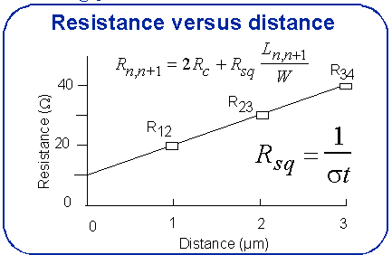
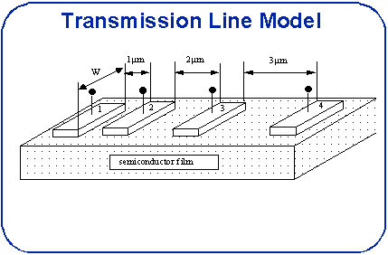

Slide 6
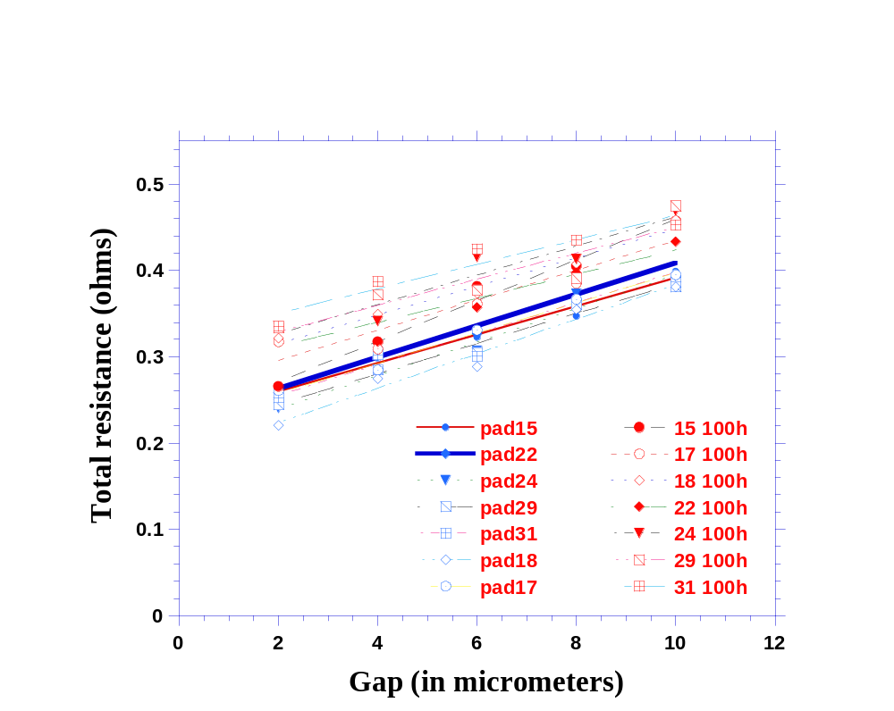
Degradation in contact resistance after 100 hours in an 85% humidity environment and 85 degrees. The test structures consisted of a pad of equal area with varying separation between metallization in GaAs ohmic contacts. This data is relevant to both the 640 Ghz and 2.5 Thz mixer diodes. The contact resistance for these structures degraded from an average of 5.16 x 10⁻⁶ Ω cm² to an average of 6.44 x 10⁻⁶ Ω cm², roughly 20%. Second set of data shows more scatter in values but still shows a statistically significant degradation.

Slide 7
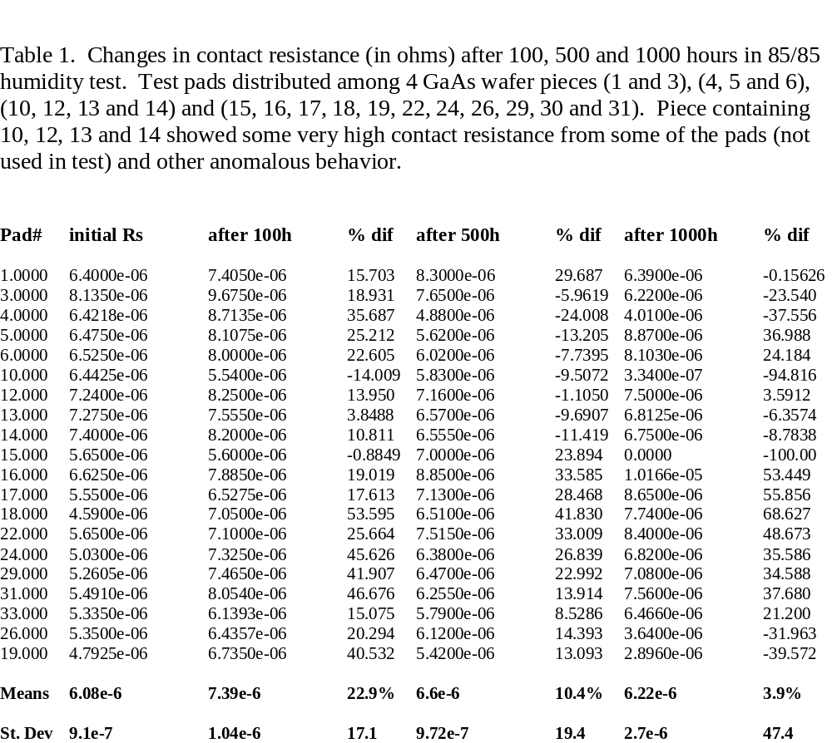

Slide 8
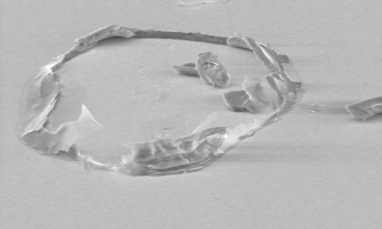
SEM micrograph shows “crater” formed in 1.5 micrometers Al_{0.98}Ga_{0.02}As film capped with a 30 nm GaAs film. Severe film deterioration occurred after 1000 hours in ambient conditions (25 C, ~ 50% relative humidity). The films that were subjected to 85/85 testing were totally detached from the GaAs substrates and consumed by the resulting oxidation. Crater is ~ 40 micrometers in diameter.

Slide 9
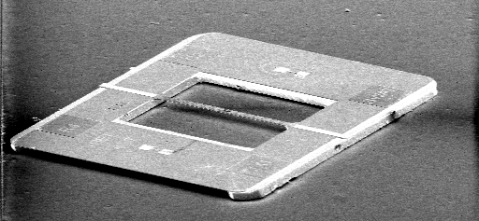
Scanning electron micrograph of
2.5 THz GaAs membrane diodes and
frame prior to humidity testing.
Membranes are 3 microns thick.

Slide 10
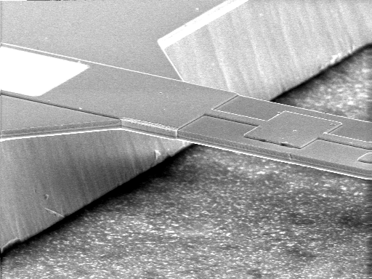
Enlarged view of membrane
without humidity testing.

Slide 11
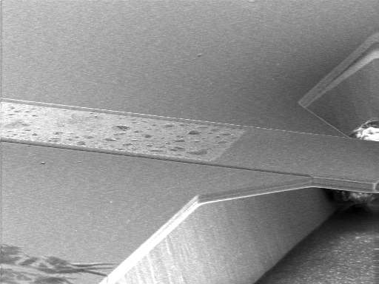
“Blistering” in unprotected metallization in
GaAs mixer diodes after 1000 hours at 85 C and
85 % RH.

Slide 12
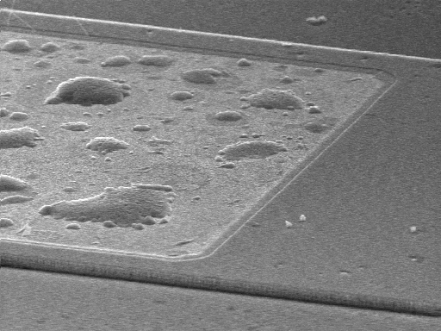
Enlarged view of blistered area.

Slide 13
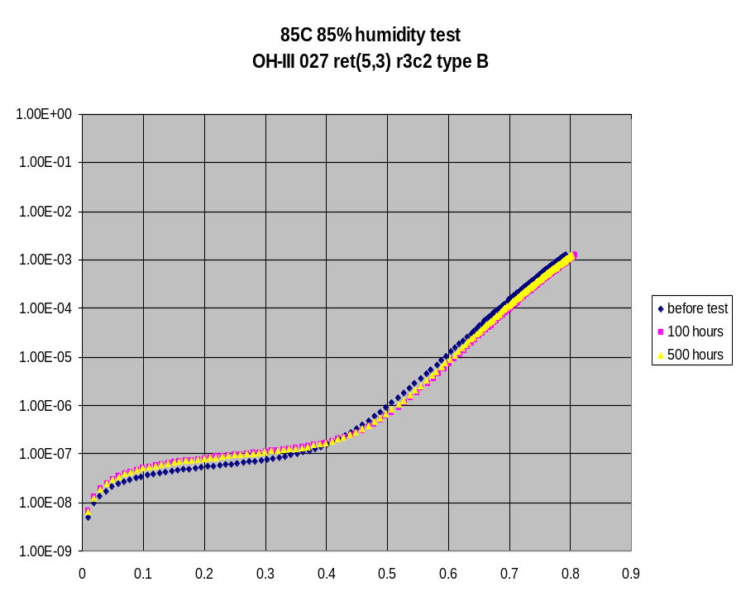
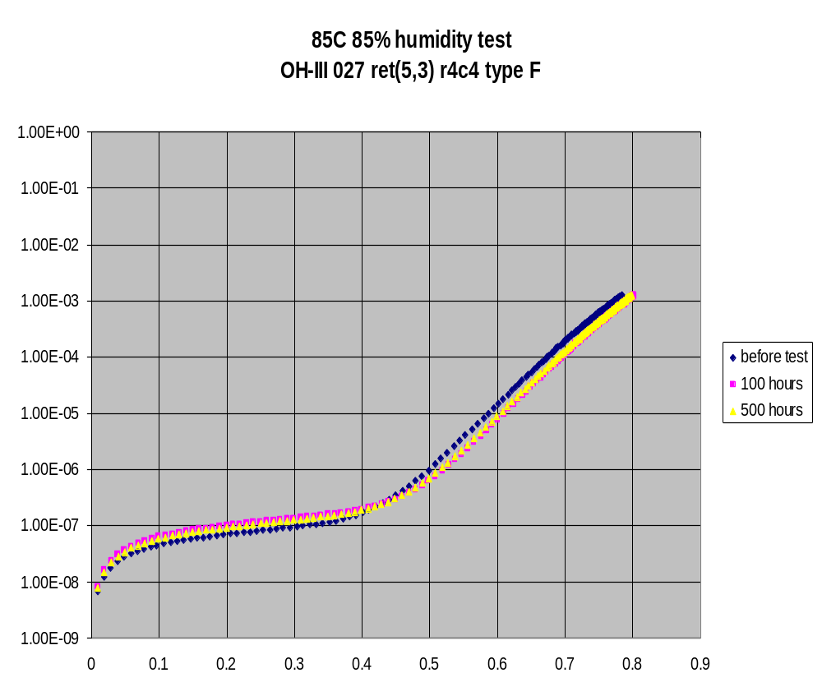

Slide 14
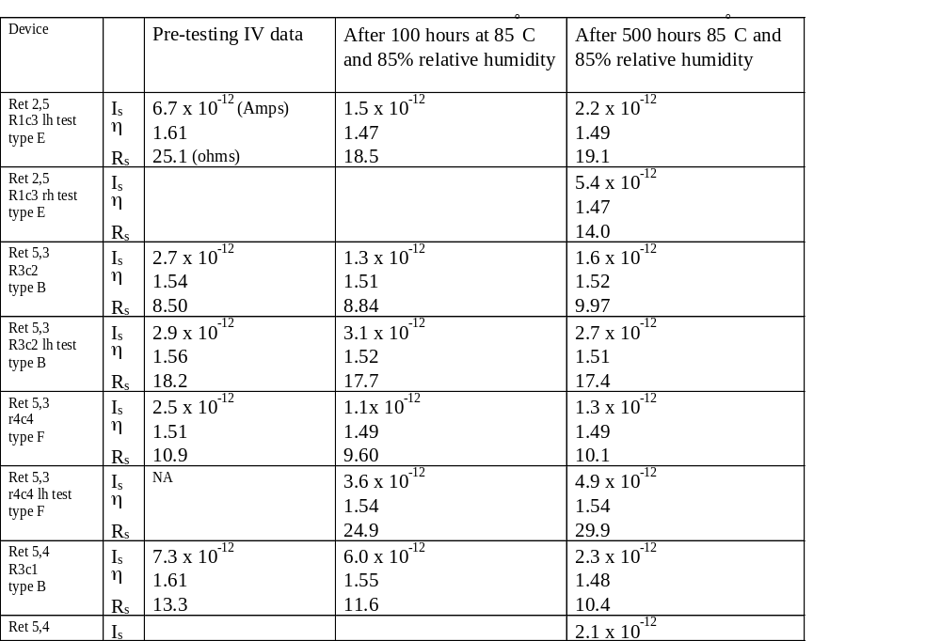

Slide 15
Conclusions
AlGaAs is unsuitable for nonhermetic device applications even with a 30 nm GaAs cap. The effectiveness of other standard passivating films still remains to be investigated.
2.5 THz GaAs membrane mixer diodes (with unpassivated membrane backs) do not show degradation in their DC I-V characteristics after 500 hours of 85/85 testing.
Process residues can cause morphological changes (“blistering”) in exposed areas of GaAs devices subject to humidity testing.
Unpassivated standard recessed Au/Ge/Ni/Ag/Au ohmic contacts on GaAs suffer a slight degradation in contact resitance (R_{s}). Values for R_{s} from different test pads show much greater variance after the 85/85 tests. Identifying the cause for this variance will require more detailed structural characterization like transmission electron microscopy or scanning probe microscopy analysis.

Slide 16
    References
    1. J. W. Osenbach, T. L. Evanosky, N. Chand, R. B. Comizzoli, and H. W. Krautter, “Temperature-humidity bias behavior and acceleration factors for nonhermetic uncooled InP-based lasers” Journal of Lightwave Technology, Vol 15, 861 (1997)
    2. Buchhold R, Nakladal A, Gerlach G, Sahre K, Eichhorn KJ, Muller M, “Reduction of mechanical stress in micromachined components caused by humidity-induced volume expansion of polymer layers”, MICROSYSTEM TECHNOLOGIES Vol 5, 3 (1998)
    3. R. Manepalli, F. Stepaniak, SA Bidstrup-Allen, and PA Kohl, “Silver metallization for advanced interconnects”, IEEE Trans. on Adv. Packaging, Vol 22, 4 (1999)
    4. Waters JW et al., “The UARS and EOS microwave limb sounder (MLS) experiments”, J. of the Atmosph. Sci., Vol 56, 194 (1999).
    5. Siegel PH, Smith RP, Gaidis MC, Martin SC, “2.5-THz GaAs monolithic membrane-diode mixer” IEEE Trans. on Microwave Theory and Techniques, vol 47, 596 (1999).
    6. O. Hallberg and P.S. Peck, “Recent humidity accelerations, a base for testing standards”, Qual. Reliab. Eng. Int. Vol 7, 169 (1991).

