Slide 1

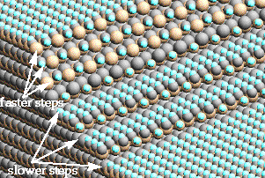
Small
Business
Innovation
Research
MICROSCOPIC AND MACROSCOPIC MODELING OF LAYER
GROWTH KINETICS AND MORPHOLOGY IN VAPOR
DEPOSITION PROCESSING
CFD Research Corporation
Huntsville, Alabama
INNOVATION
Simulation tool (CFD-FILM) to enable development of new materials for semiconductor and opto-electronic applications, as well as for structural and thermal barrier coatings
ACCOMPLISHMENTS
Developed a Monte Carlo microscopic model to simulate specific morphological characteristics of film growth such as step bunching, thermal roughening, polytype growth, growth uniformity, defect formation, etc.
Created a commercial software, CFD-FILM, to analyze morphology of growing films
Validated the microscopic model against experimental data for materials such as Si, diamond and SiC
Coupled CFD-FILM with a general purpose macroscopic transport/chemistry software, CFD-ACE
COMMERCIALIZATION
Contributed to increased sales of CFD-ACE to leading semi- conductor equipment vendors and process designers (~$500K/year)
CFD-FILM is marketable as a stand-alone module, as well as an add-on module with CFD-ACE
Application projects from industry and research projects from government agencies
Simulation of Step Bunching in SiC Growth
(using CFD-FILM)
GOVERNMENT/SCIENCE APPLICATIONS
Provides an enabling technology for advanced materials such as GaN, GaAs, InP, and SiC
Provides a base technology for extension to plasma- substrate interactions in low pressure etch processes
Lewis Research Center
Instrumentation & Controls
3-005
1992 Phase II, NAS3-27287, SS-, 2/6/98
NASA Contact - Arnon Chait or Maria Kuczmarski
Company Contact - Dr. Anantha Krishnan

