Slide 1
Summary of Yellowtail Snapper Life History Characteristics with Emphasis on the Caribbean
Nancie Cummings
NOAA, NMFS, SEFSC, Sustainable Fisheries Division
Miami, Florida
Nancie.cummings@noaa.gov

Slide 2
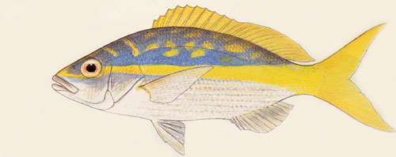
Yellowtail snapper,
Ocyurus chrysurus

Slide 3
Taxonomy
Recognized as member of genus Ocyrurus
Larvae pelagic - rare in icthyoplankton collections
At sizes <5mm Yellowtail snapper share a number of similar meristic and morphological characters as the red snapper, gray snapper, and vermillion
In addition, characterized by the ability to hybridize with several other snappers

Slide 4
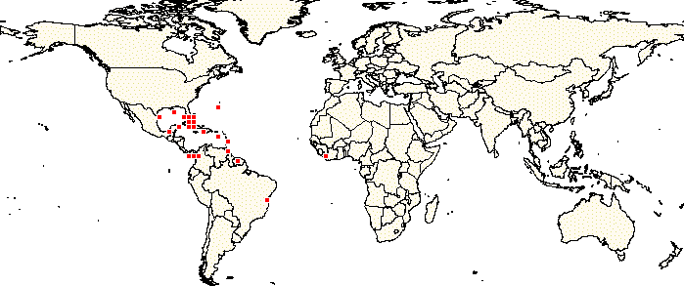
Broad Distribution
Throughout tropical and subtropical western Atlantic shelf and coastal waters.
Carolinas south to Brazil, primarily South Florida, the Bahamas and the Caribbean.

Slide 5
Habitat and Diet
Thought to spawn offshore, settle out after 30-45 days into the near shore environment.
Subadults/adults utilize multiple habitats during the early growth phase (seagrass, mangrove/prop root habitat).
Diet and habitat needs are thought to change according to ontogenetic growth from planktonic feeding to more piscivory feeding individuals.

Slide 6
Stock structure
Limited information is available to quantify stock structure, however the Caribbean populations are thought to be separate from Florida populations (Hoffman 2003).
Stock structure information from tagging studies is extremely limited (temporally and spatially).
Lindholm (2004-South Florida) and Randall (1962, 1963-USVI) showed movement of adult yellowtail to be restricted spatially (short distances).

Slide 7
Stock Structure
Watson, et. al. (2002-BVI) showed that newly settled recruits rarely moved more than 20 cm from settlement site.
Some possibility of larval exchange between local regions exist. However, based on a larval duration of one month time and information on surface currents, the probability of upstream recruitment from other locals in the Caribbean does not seem high (see Watson and Munro (2004). Larval exchange between populations on the Puerto Rico platform seems likely (Puerto Rico, St. Thomas, St. John and the BVI)

Slide 8
Sex Ratio, Maturation Timing and Fecundity
Maturation studies are somewhat limited for the Caribbean populations.
Figuerola, et. al. (1998) evaluated maturation off of Puerto Rico from commercial samples
The remaining studies considered populations in Cuba, Jamaica and the Florida Keys.

Slide 9
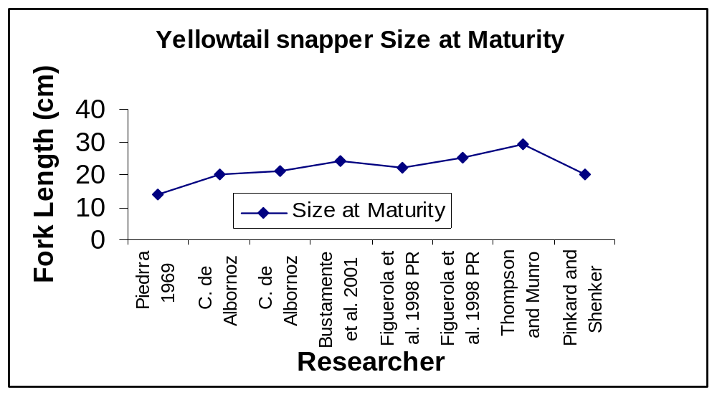
Sex Ratio, Maturation Timing and Fecundity

Slide 10
Sex Ratio, Maturation Timing and Fecundity
Seasonality
  Spawning is year round
  Florida Continental – one main pulse
  Caribbean – two pulses, early spring and again in fall
Size at Maturation
  Sex identification is as early as 10-11 cm.
  Maturation variable by area, but 20-25 cm generally
  Seems to be later for individuals offshore of Jamaica (26-29 cm).

Slide 11
Growth Estimates
Growth information exists from the continental stocks and the Caribbean.
The only hard parts study from the study region was from Manooch and Drennon (1987).
Other studies from the Caribbean were from Cuba, Mexico and Jamaica.
All studies indicate that a great deal of variability and observed length at age exists in this species making the use of hardparts questionable to determine age.

Slide 12
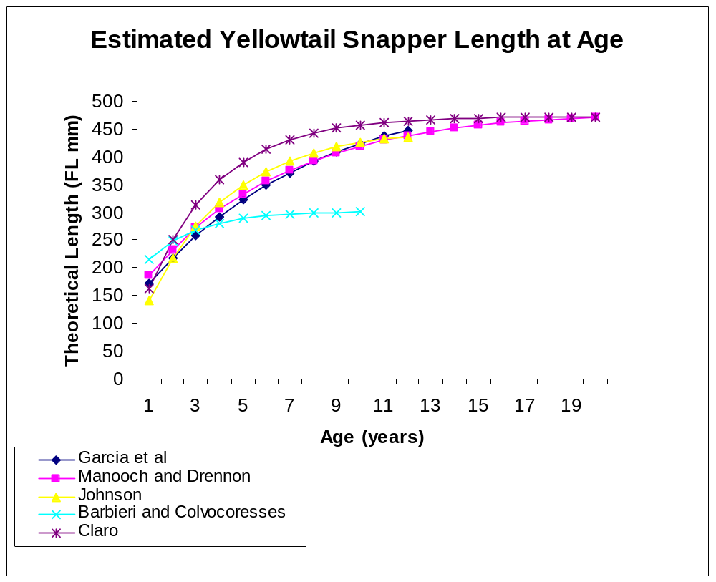
Estimated von Bertallanffy Length at Age from Hardpart Studies

Slide 13
Other Growth Analysis
Very limited growth information exists from adult tagging studies (USVI)
Estimates of growth parameters exist from length frequency analyses (Cuba, Mexico, Jamaica).
Growth and Natural Mortality Summary
Rapid growth first two to three years, slowing down by age seven or eight.
Maximum sizes observed around 56 cm (Cuba, Jamaica, PR, USVI, S. Florida)
Mortality estimates using the methods of Pauly and Hoening and growth information yielded estimates of 0.15 – 0.6.

