Slide 1

The Department of Laboratory Medicine
Angkor Hospital for Children
A Role Model in Quality Laboratory Management
presented at the workshop
“Building Laboratory Quality Systems: A Route to Reliable Laboratory Data”
by
Robyn Devenish and Sarin Eng

Slide 2
The Department of Laboratory Medicine
Angkor Hospital for Children
Is a role model for full integration of quality laboratory services to provide –
■ Accurate and timely diagnostic test results for the clinicians
■ Accurate monitoring of patient results who have long term or chronic diseases
■ Safe and reliable blood products for the support of patient care.
Serology
Clinical chemistry
Clinical microbiology
Haematology and Coagulation
Blood Transfusion Medicine

Slide 3
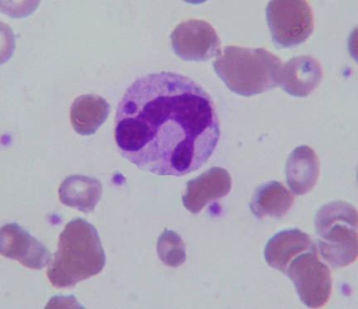
The integrated role of the laboratory in the management of a patient with
H.I.V.
MayGrunwald/Geimsa x 1000
Diagnosis Monitoring Support

Slide 4
The integrated role of the laboratory in the management of a patient with
H.I.V.
MayGrunwald/Geimsa x 1000
HIV can cause bone marrow dysfunction. These abnormal neutrophil inclusions are an indication of bone marrow dysplasia in AIDS patients.

Slide 5
The integrated role of the laboratory in the management of a patient with
H.I.V.
MayGrunwald/Geimsa x 1000
Presence of dohle bodies indicates severe sepsis.

Slide 6
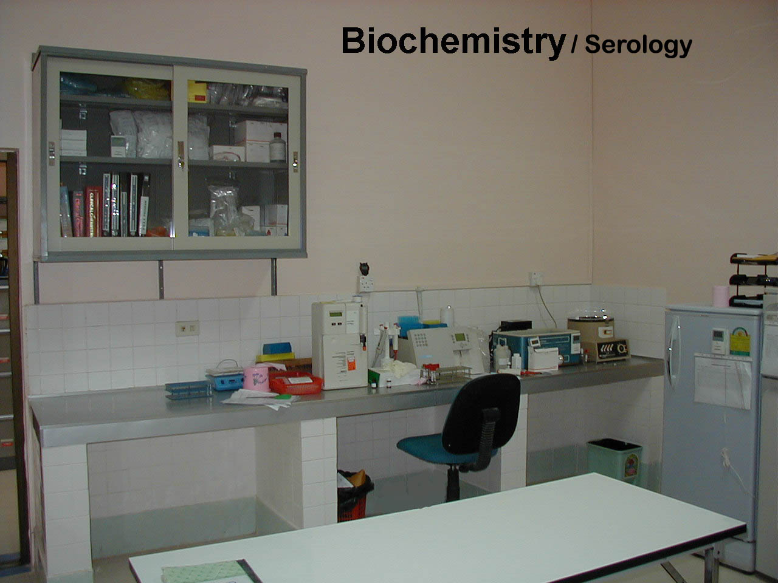
DIAGNOSIS: Serology department
HIV Screening test – Positive
Confirmatory HIV Test - Positive
Maintenance manuals
Method manual
Text books
Calibration
Controls
Temperature monitor

Slide 7
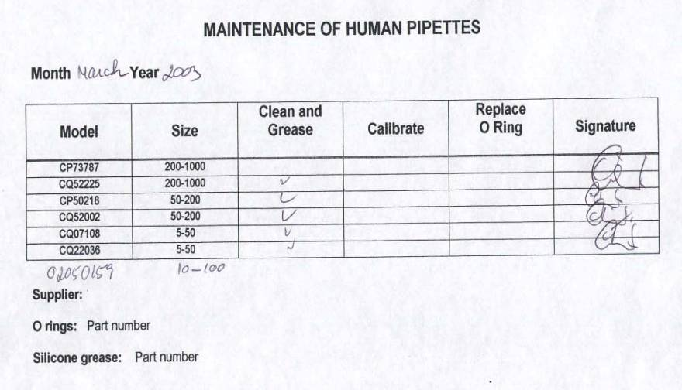
Quality Laboratory Management
Maintenance of equipment

Slide 8
DIAGNOSIS of other infections in HIV patient: Serology department
Hepatitis B
Hepatitis C
Syphilis
Maintenance manuals
Method manual
Text books
Calibration
Controls
Temperature monitor

Slide 9
Monitoring of patient with HIV: Biochemistry department
Liver function tests e.g. ALT
Renal function tests e.g. Creatinine
Diabetes - glucose
Maintenance manuals
Method manual
Text books
Calibration
Controls
Temperature monitor

Slide 10
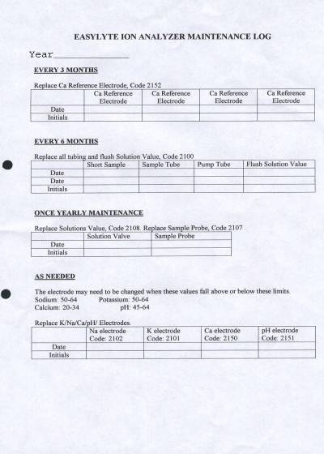
Quality Laboratory Management
Maintenance of equipment

Slide 11
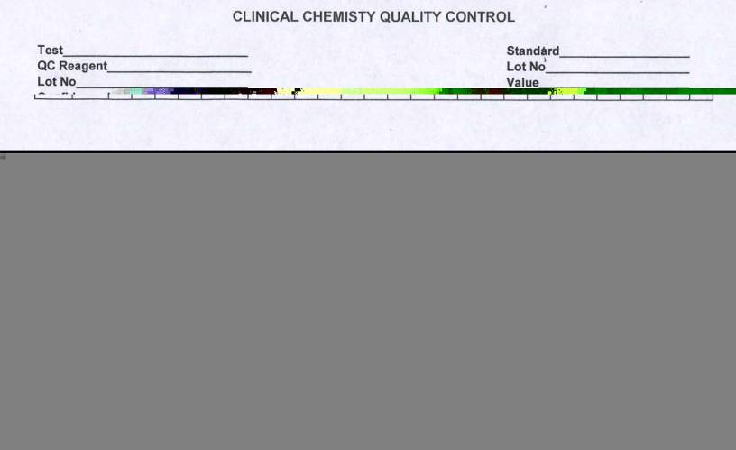
Quality Laboratory Management
Internal Quality Control

Slide 12
External Quality Assessent
Quality Laboratory Management

Slide 13
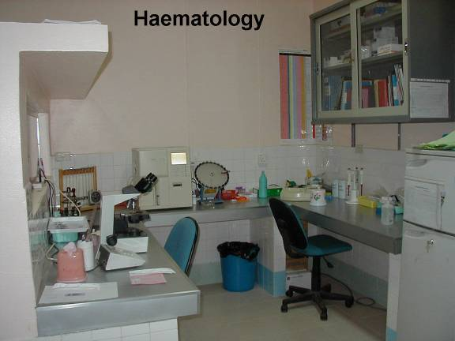
Monitoring of HIV patient: Haematology department
Full blood count – Anaemia, leucopenia, thrombocytopenia
Blood film – Morphological changes in erythrocytes, neutrophils, lymphocytes
CD4 count – To monitor the number of T4 lymphocytes “helper cells”
Coagulation – Prothombin time (INR) in patients with liver dysfunction
Maintenance manuals
Calibration
Method manual
Text books
Controls
Temperature monitor

Slide 14
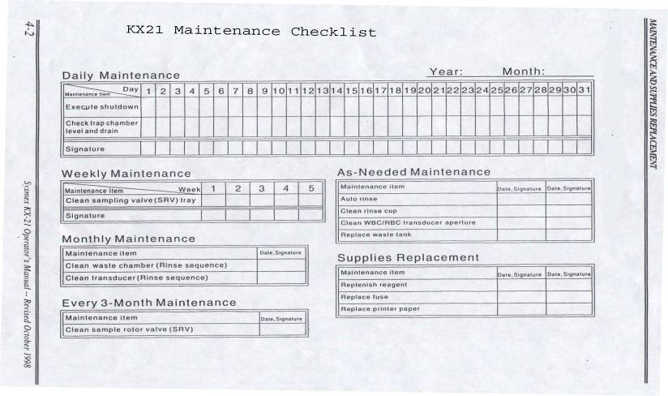
Quality Laboratory Management
Maintenance of equipment

Slide 15
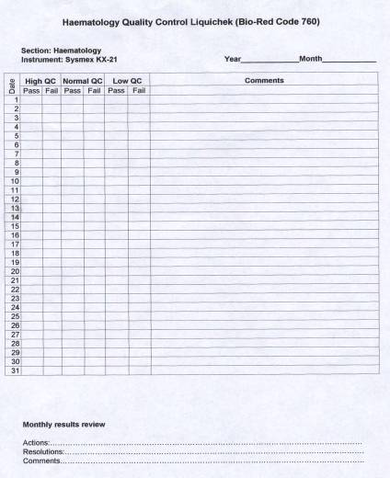
Quality Laboratory Management
Internal Quality Control

Slide 16
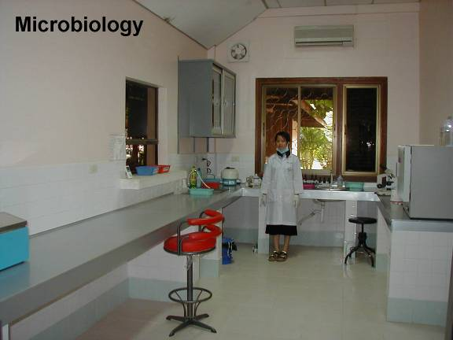
Monitoring of HIV patient: Microbiology department
Examination of Stool – Parasitic infections
Examination of Sputum – TB infections
Examination of CSF, blood etc. – Other opportunistic infections
Diagnosis of other sexually transmitted diseases – e.g. Gonorrhoea
Method manual
Text books
Temperature monitor
Smooth bench tops

Slide 17
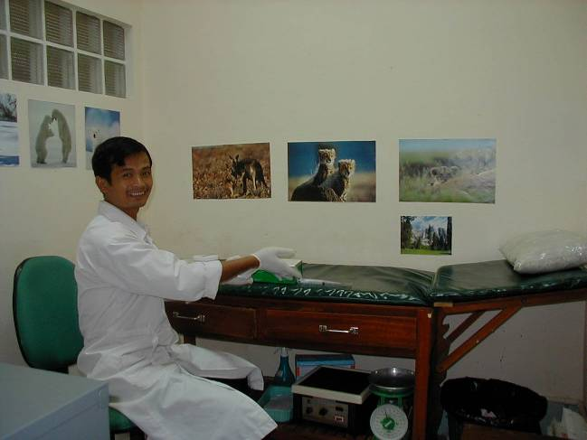
Support of HIV patient: Blood Transfusion department
Collection of blood donors – Blood grouping
Full blood count
Serology testing (EQA by PBTC)

Slide 18
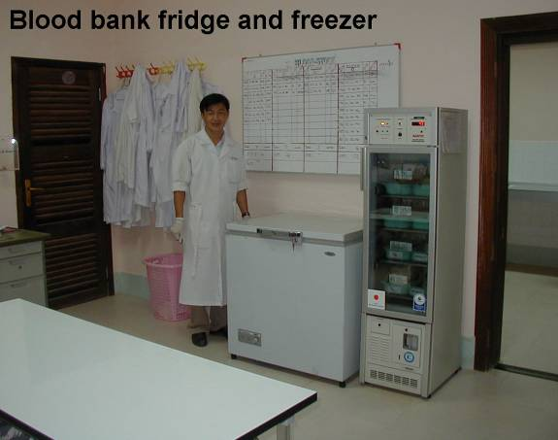
Support of HIV patient: Blood Transfusion department
Crossmatching of blood products – whole blood,
packed cells
fresh frozen plasma
Temperature monitor
Fridge alarm
Back up generator

Slide 19
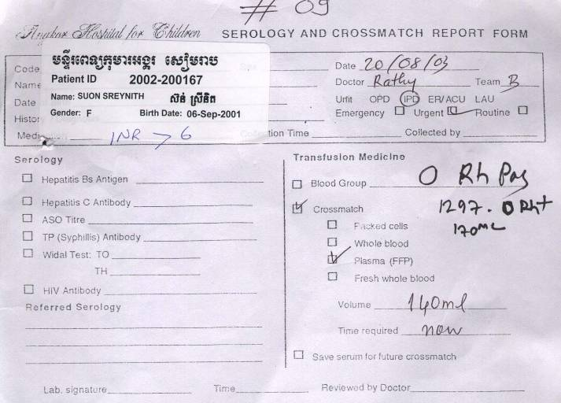
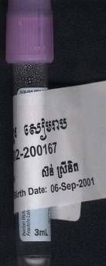

Specimen Identification
Quality Laboratory Management

Slide 20
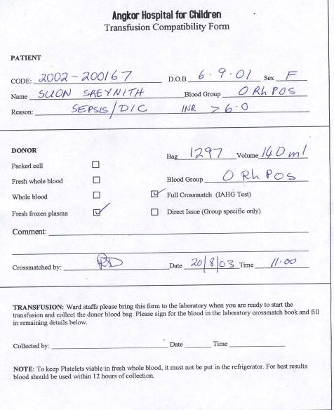
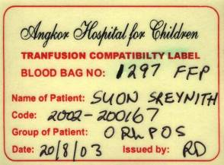
Reporting Results
Quality Laboratory Management
Label for blood bag

Slide 21
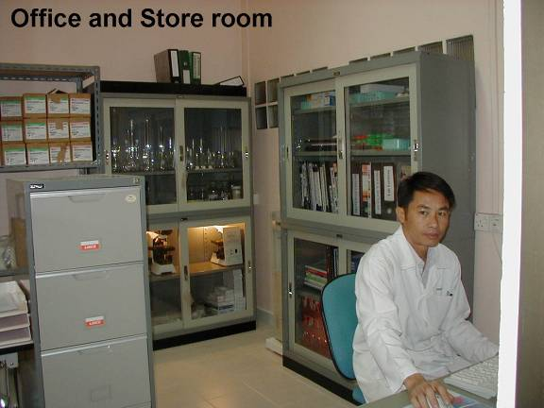
Quality Laboratory Management
Stock control –
Consumables
Reagents
Controls
Stationery
Equipment
Glassware
Furniture
Equipment manuals
Lecture notes
Journal articles

Slide 22
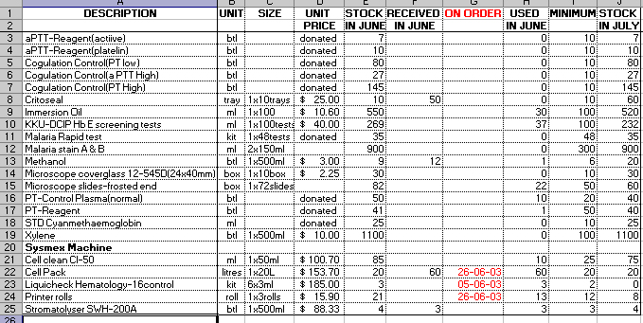
Quality Laboratory Management
Stock Control

Slide 23
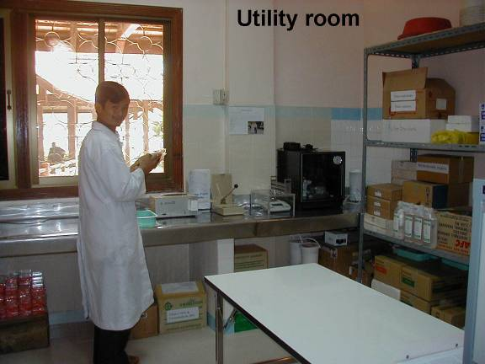
Quality Laboratory Management
An infectious free utility and storage room

Slide 24
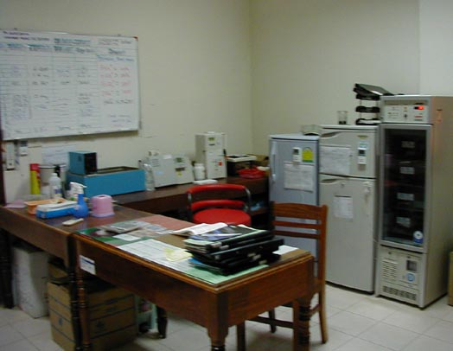
Quality Laboratory Management
From handwritten notes to a
Computer Laboratory Information Management System

Slide 25
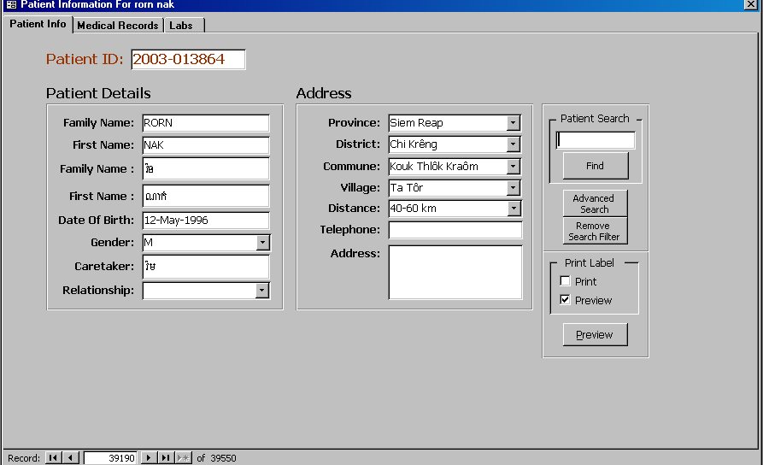
Quality Laboratory Management
Computer Laboratory Information Management System

Slide 26
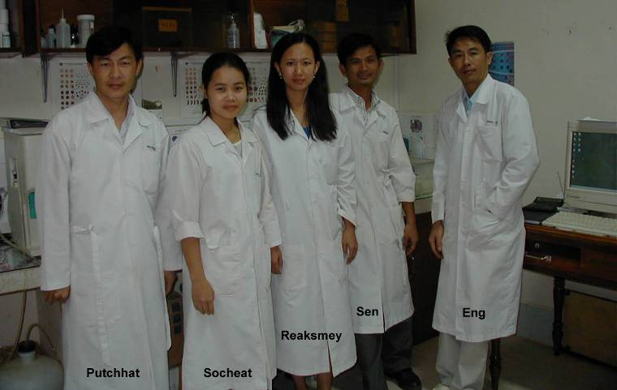
Thank you to
Angkor Hospital for Children
and the laboratory staff

