Slide 1
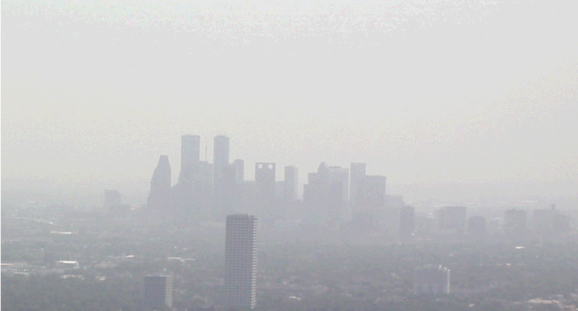
Guest Speakers
Speaking on: Forum Outcomes
Dr Elbert W. (Joe) Friday
WeatherNews, Professor of Meteorology and
Founding Director of Sasaki Applied
Meteorology Research Institute, University of Oklahoma
Dr Paul D. Try
Senior Vice President, Science
and Technology Corporation

Slide 2

Searching For a System Solution
1.
What are the problems we are trying to solve?
2.
What is the whole system?
3.
How do we optimize the solution?

Slide 3
How do we optimize the solution?
Objective function: Minimize adverse effects of accidents and terrorism events
Constraints: Irreducible uncertainties
- Meteorological dispersion parameters
- Hazardous materials releases
Issues
- Model development
- Measurement data quality
- Urban test beds

Slide 4
Consistent Message for a Complex Problem
Consistent Message:
-- Simplify Message to Funding Agencies
(better define “Urban Meteorology”– new term?)
-- Focus on End-to-End System
-- Emphasize Impact to Society (Cost-Benefit Terms)
-- Improve Collaboration and Facilitate Partnerships
-- Develop an Integrated/Coordinated Program (Plan)

Slide 5
Complex Problem – Many Components & Issues
-- Conference Identified Many Issues
within this Complex Problem
-- Data, Databases, Instruments, Siting, 4DDA, Models,
Comm, Formats, Applications, Users, Demos, etc.,
_____________________________________
-- Tractable and Manageable
with Focus and Coordinated Planning
-- Integrated Concept/Strategic Plan can help define:
a) Urban Met Observation Strategy
b) Outreach and Societal Response

Slide 6
Issues for consideration
Policy issues
  Who’s in charge; agency responsibilities
  How much do you tell the public?
  Incentives for good behavior
Information and data needs
  Consistent, reliable
  User centric
  Preloaded

Slide 7
More things to consider
Communications issues
  Science coordination mechanism
  User/producer linkage; met advisor
  Appropriateness – enough info, but not too much
Ecosystem approach
  Humans are a part of the ecosystem
  Ecosystem is dynamic

Slide 8
Urban Met Observation Strategy
(Conceptual/Proposed)
Response to Collective Requirements/Applications
(5 focus areas/ Wx, HS, AQ, WQ, & Climate)
-- High Resolution a) Urban Area, and b) Incident (on-site) Response
(vs obs strategy for each requirement application/user)
Urban Area:
-- Add Instruments for Urban Perimeter Sfc/BL BCs
(Couple to Broader Synoptic/Mesoscale Flow)
-- Utilize Existing Urban Network Data (e.g., WxBug, etc.,)
-- Facilitate National Urban Morphological Database
-- Establish High Resolution Demo/Test Bed Projects (user feedback)
to provide data for improved Canyon-scale models & UserOutput
-- Use Synoptic/Mesoscale Flow & Perimeter BCs
to drive urban canyon-scale model for high res output for users

Slide 9
Urban Met Observation Strategy
(Conceptual/Proposed)
Incident (on-site) Response (1st Responders):
-- Use Urban Area output as 1st guess
-- Add Instrumentation to Mobile EM Response CP
for on-site & BL Data
(e.g., cost effective scanning lidar, sodar, rass, profiler, etc.,?)
-- Adapt Models to use updated on-site BL & area scan data.
Collective Requirement to Better Define Uncertainties/Errors
for Both Observational Data and Model Output
Remote sensing including the potential URBSAT

Slide 10
Outreach and Societal Response
-- Must focus on, fund and develop improved methods
to communicate results of new, more complex urban met
higher resolution, probability based output to all Societal sectors as well as governmental decision makers.
-- Focus on handling uncertainty as well as on improving current methods and terminology (e.g., watch/warning, cones of error, ensemble results, etc.,)
-- Response and educational issues to be included

Slide 11
Conclusion
Greater Collaboration, Strategic Planning and Outreach
Should Facilitate Development of Improved
End-to-End System Urban Meteorological Support System

