Slide 1
Sputum Smear Examination by Fluorescence Microscopy
C.N. PARAMASIVAN
Tuberculosis Research Centre
Indian Council of Medical Research
Chennai

Slide 2
Fluorescence Microscopy
More than 50 smears examined/day
Continuous availability of power
More sensitive. where small No. of bacilli are present
Majority of FM +ve samples are also +ve by culture
Does not yield more false positive than ZN
Doubtful smears to be re examined by ZN

Slide 3
Reagents for staining
Auramine-phenol solution
    Auramine O 25 g
    Ethanol 3000 ml
    Phenol 250 g
    Distilled water 5300 ml
Suspend 25 g auramine-O in 3000 ml of ethanol in a 5-litre conical flask. Add a magnet and place on a magnetic stirrer until solution is complete.
Dissolve 250 g phenol in 5300 ml of distilled water.
Mix the phenol solution with alcoholic auramine solution.
Store in an amber colored bottle at room temp. for up to 3 mths.
Filter before use.

Slide 4
Reagents for staining
Acid-alcohol for decolorization
Sodium chloride 20 g
Hydrochloric acid, A.R. 20 ml
Distilled water 500 ml
Ethanol 1500 ml
Dissolve sodium chloride in distilled water
Add conc. hydrochloric acid, mix thoroughly.
Add alcohol
Can be stored at room temperature for 3 months.

Slide 5
Reagents for staining
Counter stain
Potassium permanganate 1 gm
Distilled water 1000 ml
Dissolve and store in an amber colored bottle
Stays at room temperature for up to 3 months.

Slide 6
Staining procedure
Place the slides on a staining rack, with the smeared side facing up, the slides not touching each other
Flood the slides with freshly filtered auramine-phenol. Let stand for 7-10 min.
Wash well with running water
Decolorize with acid-alcohol for 1-2 min.
Wash as before with water and slope the slides to air dry
Counter stain with 0.1% KMNO₄ for 30 seconds

Slide 7
Staining procedure - Precautions
Avoid under-decolorization. AFBs are difficult to over-decolorize since the decolorization procedure with acid-alcohol is relatively milder than the 25% H₂SO₄ used in Z-N.
Thick smears: Interfere with decolorization, and counter stain. Mask the presence of AFB and tendency to flake, resulting in loss of smear material and possible transfer of material to other slides
Strong counter stain: May mask the presence of AFB
Re Staining : Smears examined by FM may be restained by Z-N to confirm findings. However, Z-N stained smears cannot be used for FM
Fading: Stained smears may fade on exposure to light. To be stored wrapped in brown or black paper and kept away from light

Slide 8
EXAMINATION PROCEDURE
The mercury vapor lamp : It takes about 10 min. to reach full intensity
Examination: Using the low power objective (100-150x) first examine a known pos. slide to ensure that the microscope is correctly set up
Appearance: Bacilli appear as slender bright yellow fluorescent rods, standing out clearly against a dark background
Positive: Minimum of 4 AFB in the entire smear.
Negative: Less than 4 bacilli ( No.of bacilli to be recorded)
Morphological Confirmation: With a high power objective (400-600x) - To be done with all doubtful smears as well as scanty positives.
Examination: At least three horizontal sweeps on the entire smear.
Gradation: Grade positive smears into three degrees of positivity using the high power objective

Slide 9
QUANTIFICATION OF FLUOROCHROME SMEAR RESULTS
ZN 1000x | REPORT | FM Magnification
 |  | 250x | 450x | 630x
0 | NO.AFB | 0 | 0 | 0
1-9/100FIELD | EXACT NO | DIVIDE by 10 by 4 by 2
10-99/FIELD | 1+
1-10/FIELD | 2+
>10/FIELD | 3+

Slide 10
FM Grading
No. of bacilli per HPF | Grade
Less than 6 per field | 1+
6-100 bacilli per field | 2+
More than 100 per field or large clumps | 3+

Slide 11
SMEAR AND CULTURE RESULTS OF 1480 SPUTUM SPECIMENS
CULTURE POSITIVE | SMEAR |  | SPECIMENS
 | FM | ZN | No. | %
 | POS | POS | 600 | 40.5
 | POS | NEG | 160 | 10.5
 | NEG | POS | 18 | 1.2
 | NEG | NEG | 174 | 11.8
SUBTOTAL |  |  | 952 | 64.2
CULTURE NEGATIVE | POS | POS | 10 | 0.7
 | POS | NEG | 12 | 0.8
 | NEG | POS | 6 | 0.4
 | NEG | NEG | 500 | 33.8
SUB TOTAL |  |  | 528 | 35.7
TOTAL |  |  | 1480 | 100
W. Githui et al 1993 East Afr Med J pp293

Slide 12
COMPARISON OF FM & ZN WITH CULTURE
 | FM |  |  | ZN
 | + | - | TOTAL | + | - | TOTAL
CULTURE + - TOTAL | 441 | 214 | 655 | 433 | 222 | 655
 | 15 | 713 | 728 | 14 | 714 | 728
 | 456 | 927 | 1383 | 447 | 936 | 1383

Slide 13
RELATIONSHIP OF STAINING METHOD TO QUANTIFIED SPUTUM SMEAR RESULTS
Smear Quantity | Fluorescence |  | ZN
 | Number | % | Number | %
Scanty (+) | 180 | 23.7 | 50 | 8.1
Moderate (++) | 250 | 32.9 | 249 | 39.3
Heavy (+++) | 330 | 43.4 | 325 | 52.6
Total | 760 | 100 | 618 | 100
Scanty p< 0.001

Slide 14
FM & ZN comparison in culture positive cases
Examined by | Specimens pos.
FM ZN | No. %
+ + + - - + - - | 405 62 36 6 28 4 186 28
Total Culture positive
655
100

Slide 15
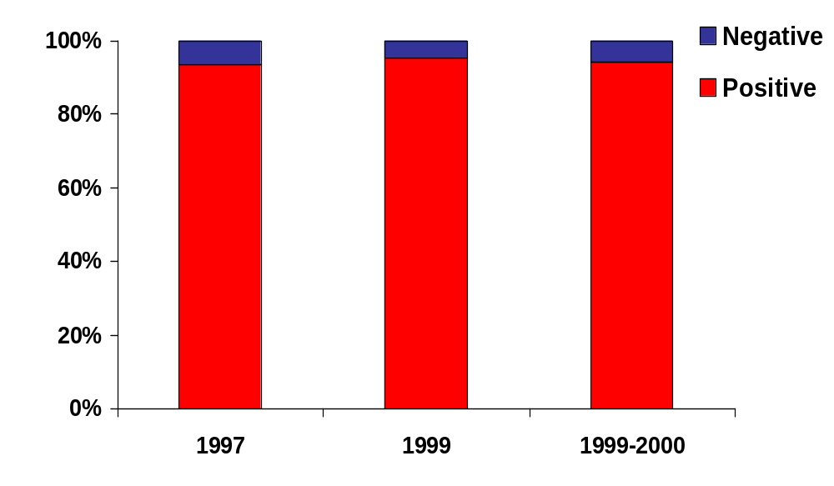
Consistency of smear results in duplicate specimens from ZN +ve pts examined by FM
N=1375
N=635
N=617
Tamil Nadu
North Arcot
Raichur

Slide 16
Spot & collection specimens: smear & culture results of various combinations
Type of specimen(s) | Positive by
 | Smear % | Culture %
1 spot 1 collection 2 spot 1 spot + 1 collection 2 collection 2 spot + 1 collection 1 spot + 2 collection 2 spot + 2 collection | 66 77 76 81 83 84 84 85 | 91 93 94 97 97 98 99 95

Slide 17
Fluorescence Microscopy
Advantages:
Usage of low power objective
Size with a 25x objective : 0.34 mm²
Oil Immersion : 0.02 mm²
Covers15 times as many fields compared to ZN
Same area can be covered at a shorter time
No. of slides that can be examined per day : about 100
Examination of slides for 1 min. by FM equivalent to 4 min.by ZN

Slide 18
Fluorescence Microscopy
Advantages
Covers an increased area of smear field
An increased contrast between stained bacilli & background
Heating not required
Immersion oil not needed
May be appropriate in the diag. of HIV + assoc.TB
With low bacillary content
Early diagnosis of pulm.TB - Low bacillary content

Slide 19
Fluorescence Microscopy
Disadvantages
Handling & maintenance of optical equipment require advanced skill
Periodic replacement of bulbs
Continuous supply of power.
High cost of Microscope and maintenance

Slide 20
Fluorescence Microscopy
Cost Effectiveness:
 | Light Microscope | FM
Equipment | $ 4000x3 | $10000
Tech. Salary | $1200x3 | $ 1200
Total | $15600 | $11200

Slide 21
Fluorescence Microscopy
Definitive role to play in a high-volume laboratory

