Slide 1


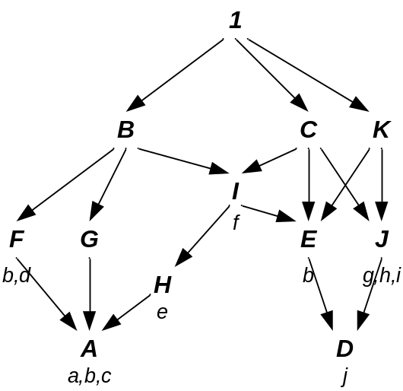
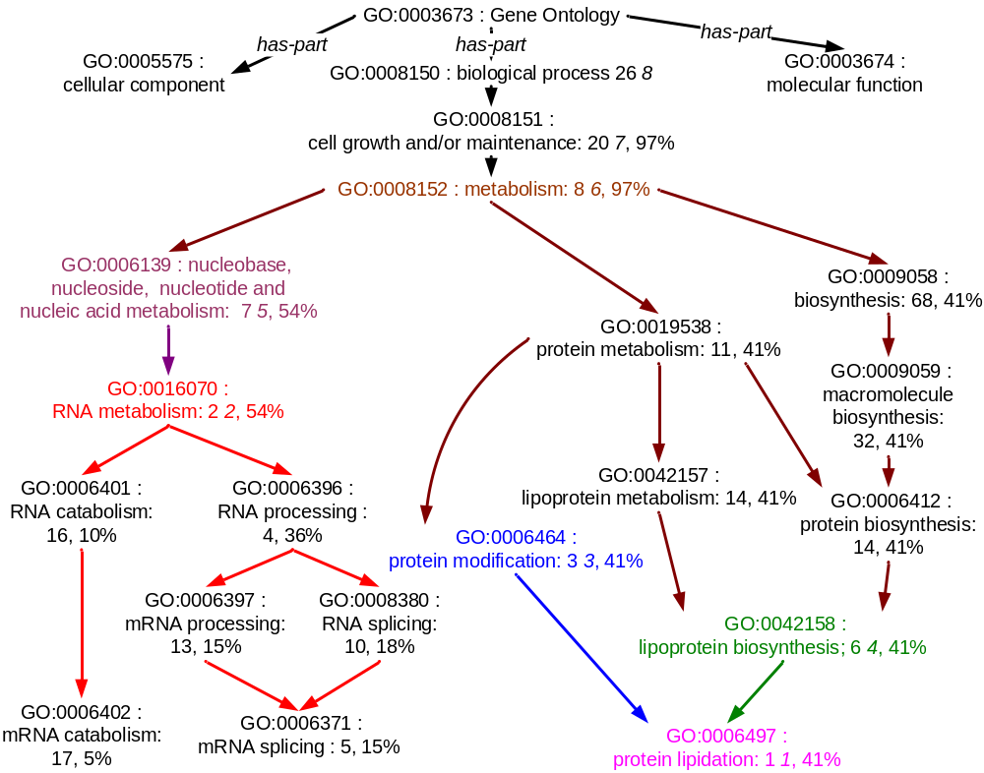
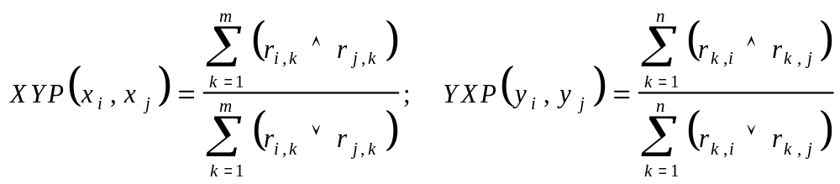
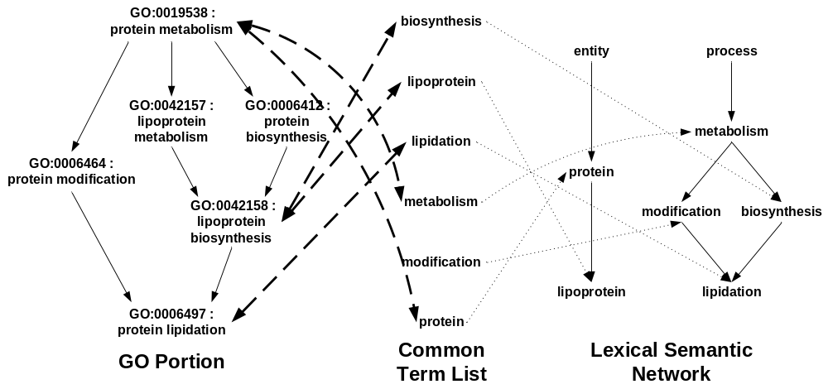
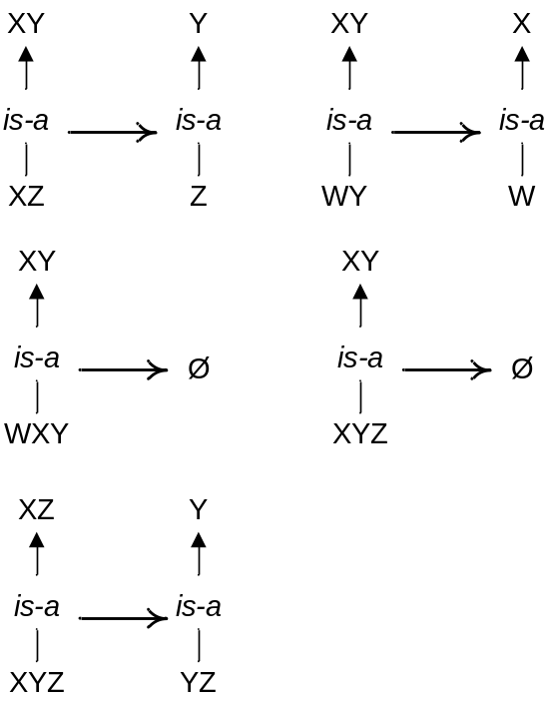
TEXT MINING FOR BIOINFORMATICS
Karin Verspoor
Computer and Computational Sciences Division
Los Alamos National Laboratory
Motivation
There has been an explosion of publications in the Biological domain. We wish to explore the application of natural language processing (NLP) techniques to texts in the biological domain in order to facilitate analysis and extraction of the wealth of information conveyed by those texts.
BioCreAtIvE 2003
(Critical Assessment of Information Extraction Systems in Biology)
With Andy Fulmer, Cliff Joslyn, Sue Mniszewski,
Andreas Rechtsteiner, Luis Rocha,Tiago Simas
Goals: [A] Automatic assignment of a given protein to a node in the Gene Ontology (GO) based on the information conveyed in a selected publication, utilizing the full text of the publication (not just abstracts).
[B] Retrieval of text from the document justifying the assigned annotation.
Strategy: Application of a categorization methodology which utilizes the structure of the Gene Ontology to find the best covering nodes given a set of node “hits”. The node hits are determined through term overlaps between node labels in the GO and selected text in the selected publication.
Extraction of gene-protein interactions
With George Papcun and Kari Sentz
Goal: Identification of relations between genes and proteins as expressed in biological literature.
Intended uses: inputs to pathway modeling; research into gene behavior modification
Strategy: framework based on Construction Grammar, which claims that languages consist of a set of constructions, at varying levels of abstraction from morphemes to words to idioms to abstract syntactic patterns:
  C is a construction iff C is a form-meaning pair <Fi, Sj>, such that some aspect of Fi (form) or some aspect of Sj (semantics) is not strictly predicted from C’s component parts or from other previously established constructions.
Constructions are defined to schematize ways in which information can be expressed, and to directly associate interpretations with those schemas.
TEXT
Sentence
Recognizer
Ontology-based categorization: Given inputs (c,e,i…), what nodes (e.g. C,1,H) are best to pay attention to? Answer is based on pseudo-distances between comparable nodes, measured according to the structure of the ontology, with rank ordering of nodes balancing coverage – covering as many inputs as possible – and specificity – covering the inputs at the lowest level possible.
Inputs are clustered based on comparable high-score nodes.
Factor
List
Word Identifier
Gene
Relation
List
Construction
Identifier
Protein
Construction
definitions
The figure below shows an actual query result for a set of inputs consisting of genes annotated to GO nodes. The first number after each node label is the rank of the node. It can be seen that the inputs cluster into roughly two groups: under protein lipidation and RNA metabolism.
Linguistic
information
Conceptual
Mapper
relations
For our BioCreAtIvE system, we explored using this ontology-based categorization methodology with respect to the Gene Ontology (called the GO Categorizer, or GOC) by attempting to cluster terms rather than genes.
Terms are collected through analysis of the sentential context of the given protein.
The terms are processed to remove morphological endings such as verb endings or plurals.
These terms are weighted using a normalized TFIDF (term frequency inverse document frequency) value generated based on statistical analysis of our training documents. The weights represent the “contentfulness” of each term.
Knowledge
Base
Factor phrase
chunker
expression of arix
the nr0b2 promotor
Architecture: Cascading finite state machines; each machine recognizes increasingly abstract linguistic patterns, building on the output of the previous machine(s).
EXAMPLE: PASSIVE CONSTRUCTION
Constructions in which the patient is expressed as the subject and the agent is expressed as the object of the preposition “by”
Verb group
chunker
was found to potently transactivate
could have been regulating
Sentential
patterns
<factor phrase> <verb group> <factor phrase>
original text “camk1 is activated by camkk”
descriptive explanation
camk1 | is activated | by | camkk
FACTOR | PASSIVE VERB COMPOUND | “BY” FUNCTIONAL WORD | FACTOR
  From the word order and knowledge of the passive construction, we know that camk1 is the patient and camkk is the agent. Consequently, we can harvest the following relationship:
camkk | activate | camk1
AGENT FACTOR | ACTION | PATIENT FACTOR
REFERENCES
Croft, W. Radical Construction Grammar. New York: Oxford University Press, 2001.
Langacker, R. Foundations of Cognitive Grammar, Vol. 1: Theoretical Prerequisites. Stanford University Press, 1987.
Papcun, G., K. Sentz, A. Fulmer, J. Xu, O. Lubeck, M. Wolinsky. 2003. A Construction Grammar Approach to Extracting Regulatory Relationships from Biological Literature. Pacific Symposium on Biocomputing 2003 Kauai, Hawaii.
Verspoor, C., G. Papcun, and K. Sentz. 2003. A Theoretical Motivation for Patterns in Information Extraction. Los Alamos Unclassified Report 03-1504.
Internally, GOC looks for overlaps between the input term set and (morphologically normalized) terms associated with each individual node in the Gene Ontology. A match between an input term and a term associated with a GO node counts as a “hit” on that node. The strength of that hit is determined by the weight of the term in the input set.
Associated terms: Terms are associated with GO nodes via one of three mechanisms:
Direct: the term occurs in the node label of GO node
Definitional: the term occurs in the definition text associated with GO node
Proximity: using the measure described at right, built from co-occurrences of GO node ids and key terms in documents mapped to the GO node id in the training data, additional terms are identified as closely related to the GO node
Direct and indirect associations are counted as distinct “hits” on a node and can be weighted differently.
The Gene Ontology as a source of lexical semantic data
With Cliff Joslyn and George Papcun
Goal: Development of knowledge resources specific to the biology domain, in order to support semantic abstraction in extraction construction definitions and word sense disambiguation.
Strategy: Exploit the existing structure of the Gene Ontology, applying rules to infer lexical relations from the phrasal relations existing between nodes in the GO.
Proximity: Given a binary relation R between sets X and Y (e.g. GO node identifiers and key terms) we extract two proximity relations: XYP(x_{i}, x_{j}) is the probability that both x_{i} and x_{j} co-occur with the same element y ∊ Y. Conversely, YXP(y_{i}, y_{j}) is the probability that both y_{i} and y_{j} co-occur with the same element x ∊ X. (Rocha 2003)
After transforming the input query into a set of node hits, GOC traverses the structure of the Gene Ontology, percolating hits upwards, and calculating scores for GO nodes (see Joslyn et al 2003 for details of the scoring function).
GOC returns a set of GO nodes representing cluster heads for the weighted term input set, as well as data on which of the input terms contributed to the selection of each cluster head. This information is used to select the evidence text for the GO assignment associated with the cluster head. To address this, we again bring in proximity measurement – in this case, the proximity of terms to individual paragraphs in the document. The set of terms which contributes to an annotation is judged to be close to one or more paragraphs in the document; the closest match is selected as the evidence.
RULE APPLICATION: from phrasal relations to lexical relations
Parallel rule: “lipoprotein metabolism is-a protein metabolism” ⇒ “lipoprotein is-a protein”
Captures the structural parallelism of two phrases
cf. “maternal behavior is-a reproductive behavior” ⇒? “maternal is-a reproductive”
The system as described above can function as part of a larger system which integrates information retrieval of relevant documents with the annotation component. This was also addressed as part of our BioCreAtIvE work, by incorporating an initial processing step which selects documents relevant to the annotation of the given protein based on an automatically retrieved mapping of GO ids and MeSH terms. This mapping and MEDLINE's MeSH term annotations of articles about a given protein
were used to associate these documents and the proteins with GO ids. Details on this will appear in future papers.
Finally, we expect professional evaluation of our results in the BioCreAtIvE competition by Swiss-Prot annotators to be available in March 2004.
protein
Document selection
for each
Modifier rule: “positive gravitactic behavior is-a gravitactic behavior” ⇒Ø
Pre- and post-modifiers normally modify entire phrases; inference lexically invalid
document selected
Insertion rule: “adult feeding behavior is-a adult behavior” ⇒ “feeding behavior is-a behavior”
Heuristic for right-grouping based on right-branching structure of English
cf. “adult male behavior is-a adult behavior” ⇒? “male behavior is-a adult behavior”
context term selection
morphological normalization
TFIDF-based term weighting
GOxW proximity matrix
SAMPLE RULE INFERENCES (with number of times inferred from GO)
GO Categorizer
GO node predictions
581 | biosynthesis is-a metabolism
577 | catabolism is-a metabolism
44 | receptor is-a binding
38 | deoxyribonucleoside is-a nucleoside
15 | oxidation is-a metabolism
14 | Inhibitor is-a regulator
14 | tRNA is-a RNA
10 | rRNA is-a RNA
8 | modification is-a metabolism
Evidence text selection
PxW proximity matrix
{Protein, GO ID annotation, Evidence Text}
REFERENCES
Verspoor, C., C. Joslyn and G. Papcun (2003). "Interactions Between the Gene Ontology and a Domain Corpus for a Biological NaturalLanguage Processing Application". In Proceedings of the Sixth Annual Bio-Ontologies Meeting (Bio-Ontologies 2003), Brisbane, Australia, June 28, 2003.
Verspoor, C., C. Joslyn and G. Papcun (2003). "The Gene Ontology as a Source of Lexical Semantic Knowledge for a Biological Natural Language Processing Application". In Proceedings of the SIGIR'03 Workshop on Text Analysis and Search for Bioinformatics,Toronto, CA, August 1, 2003.
REFERENCES
Joslyn, C., S. Mniszewski, A. Fulmer, G. Heaton (2003). “Structural Classification in the Gene Ontology”. In Proceedings of the Sixth Annual Bio-Ontologies Meeting (Bio-Ontologies 2003), Brisbane, Australia, June 28, 2003.
Rocha, Luis M. (2003). "Semi-metric Behavior in Document Networks and its Application to Recommendation Systems". In: Soft Computing Agents: A New Perspective for Dynamic Information Systems. V. Loia (Ed.) International Series Frontiers in Artificial Intelligence and Applications. IOS Press, pp.137-163.

