Slide 1
Linking Pollution to Water Body Integrity
- First Year of Research
Vladimir Novotny
CDM Chair Professor
Northeastern University

Slide 2
STAR WATERSHED PROJECT FUNDED BY USEPA 2003-2007
Development of Risk Propagation Model for Estimating Ecological Response of Streams to Anthropogenic Stresses and Stream Modification
Project Team
  PI - Vladimir Novotny, NEU Center for Urban Environmental Studies
  Co-PI’s NEU CUER
    Elias Manolakos
    Ferdinand Hellweger
    Ramanitharan Kandiah
  Co-PI Univ. of Wisconsin Milwaukee
    Timothy Ehlinger
  Co-PI Marquette University
    Neal O’Reilly
  Co-PI Illinois State Water Survey
    Alena Bartosova
  5 graduate students

Slide 3
Project objectives
A model that will include stresses such as
    Pollutant inputs
    Watershed and water body modification
      Land use changes
      Chanelization and impoundments
      Riparian corridor modifications
Development of a quantitative layered risk propagation from basic landscape and watershed stressors to the biotic IBI endpoints
Study the possibility of mitigating the stresses that would have the most beneficial impact on the biotic endpoints
Apply the model to another geographic region

Slide 4
NUMERIC INDICES OF BIOTIC INTEGRITY
Fish
Benthic macroinvertebrates
Physical - Habitat

Slide 5
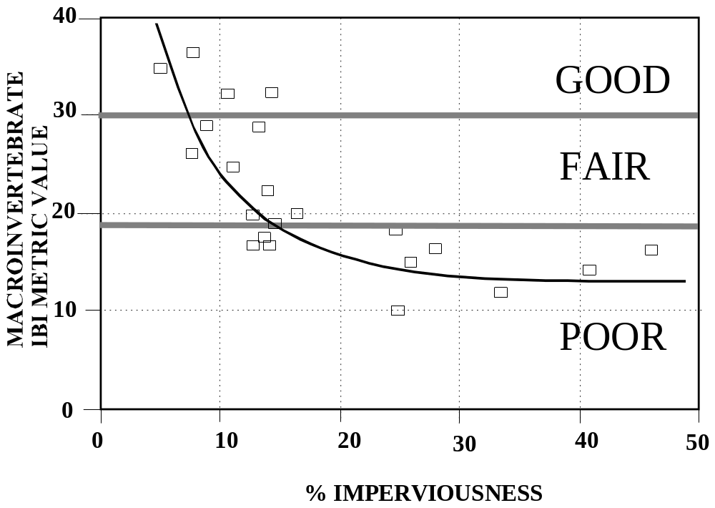
SIMPLISTIC RELATIONSHIPS

Slide 6
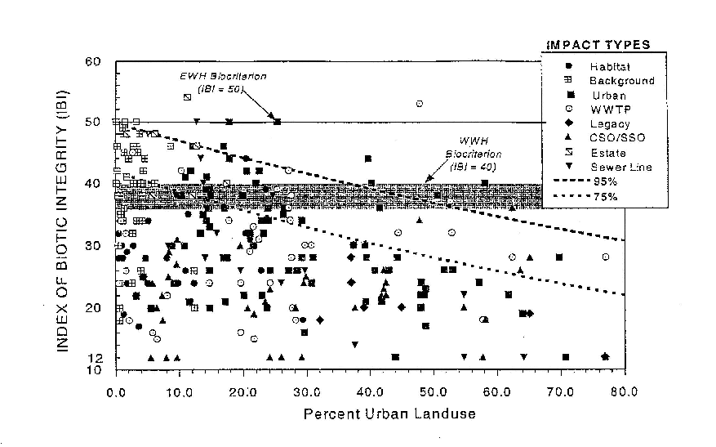
A more realistic relationship of IBI to a single stressor Yoder

Slide 7
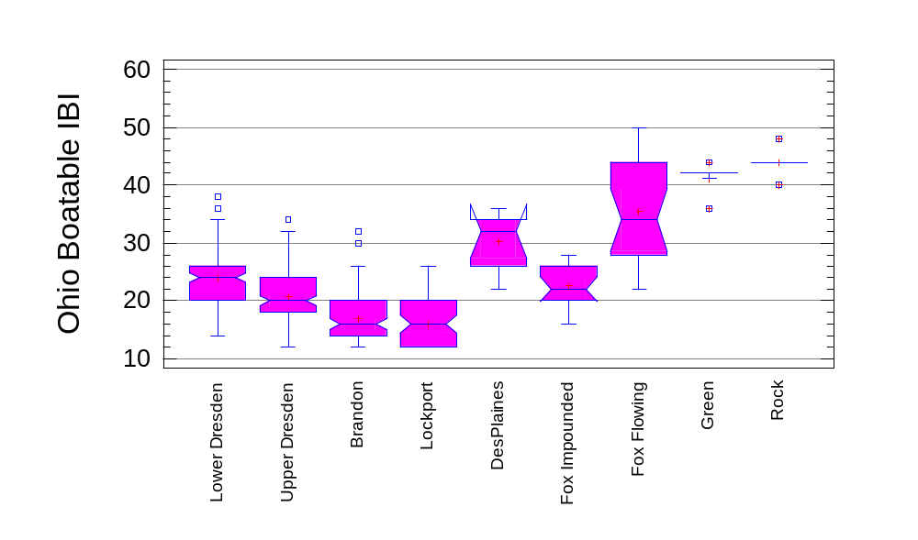
Impact of pollutants and channel modification
Northeast Illinois Rivers
Reference impounded streams
Navigable impounded
Des Plaines R. CSSC

Slide 8
Model Development
Analyze individual risks of stressors
Assemble a large data base
  Midwest (Illinois, Wisconsin, Ohio)
Define structural and functional components of the model
Develop a layered hierarchical model
Assemble a data base for testing and transferability of the model (e.g., Charles River)
Test the model and its a priori predictability

Slide 9
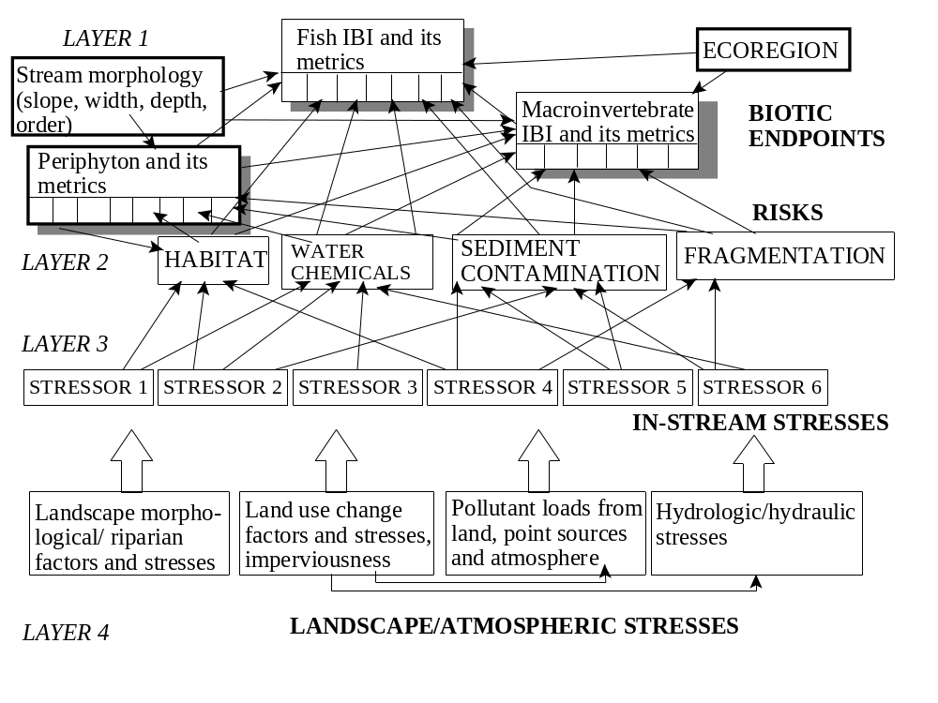
STRUCTURAL AND FUNCTIONAL MAZE

Slide 10
RISKS
Pollutant (chemical) risks, acute and chronic, in the water column
  Key metrics: Priority (toxic) pollutants, dissolved oxygen, turbidity (suspended sediment), temperature, pH.
  Variability: flow , DO, temperature
Pollutant risk (primarily chronic) in sediment
  Key metrics: Priority pollutants, ammonium, dissolved oxygen in the interstitial layer (anoxic/anaerobic or aerobic), organic and clay content
Habitat degradation risk
  Key metrics: Texture of the sediment, clay and organic contents, embeddedness, pools and riffle structure, bank stability, riparian zone quality, channelization and other stream modifications
Fragmentation risk
    Longitudinal - presence of dams, drop steps, impassable culverts
    Lateral - Lining, embankments, loss of riparian habitat (included in the habitat evaluation), reduction or elimination of refugia
    Vertical - lack of stream - groundwater interchange, bottom scouring by barge traffic, thermal stratification/heated discharges, bottom lined channel

Slide 11
Fragmentation Risk
Fragmentation can result from any factor (biotic or abiotic) that causes decrease in the ability of species to move/migrate among sub-populations or between portions of their habitat necessary for different stages of their life (e.g spawning migrations) and it can be both physical (e.g., biologically impassable culverts, dams, waterfalls, road crossings and bridges) and caused by pollutants (e.g., localized fish kills or a polluted mixing zone without a zone of passage or a thermal plume or stratification).

Slide 12
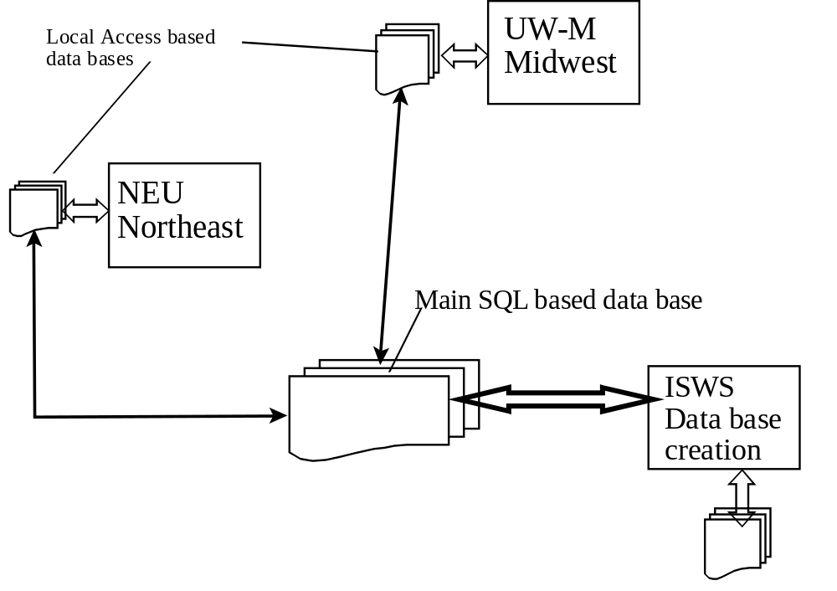
DATA BASE
Data base keeper
FOX RIVER DATA BASE

Slide 13
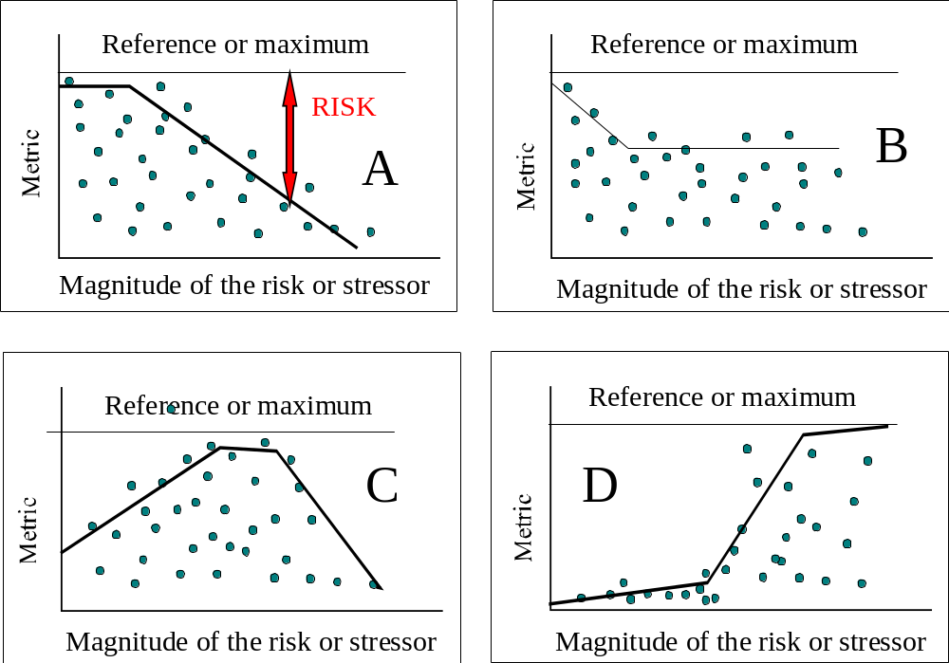
Functional components
Maximum Species Richness

Slide 14
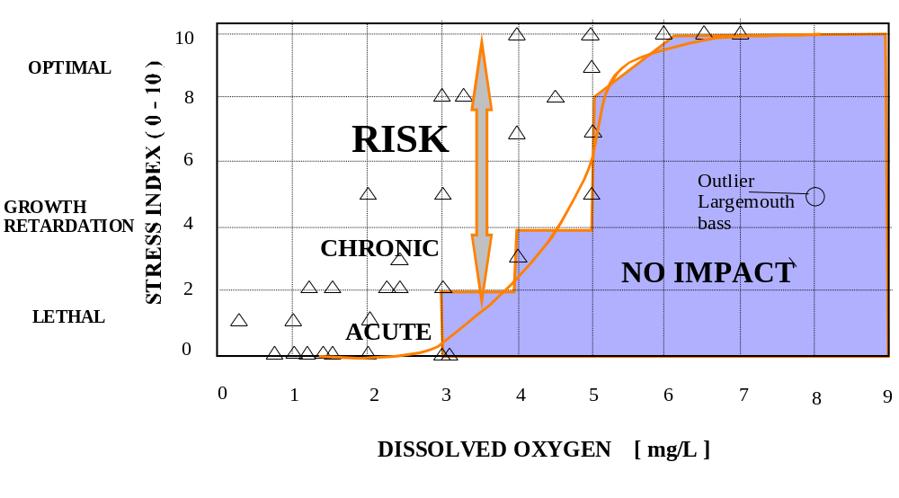
Stressor – Endpoint Relationships
Fish vs. Dissolved Oxygen

Slide 15
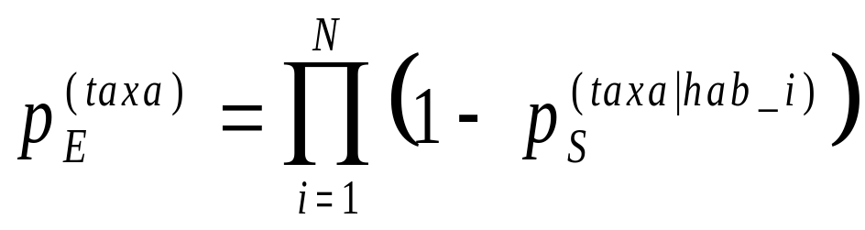
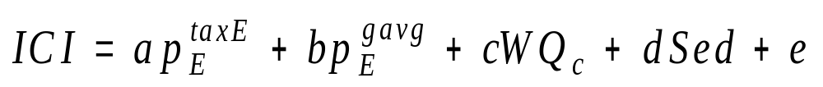
Example of simple risk model
Probability of taxa survival
where p_{E} ^{(taxa)} is the joint probability of taxa extinction, pS(taxa|hab_i) is the probability of taxa survival due to habitat condition I and N is the total number of habitat characteristics influencing the taxa.

Slide 16
The Model (additive risks)
ICI = index of biotic integrity (macroinvertebrate)
p_{E}^{taxE} and p_{E}^{gavg} = respective risks due to habitat impairment to mayfly taxa and a geometric mean of all habitat risk components respectively
WQ_{c} = the summation of chronic risks due to water column contamination
Sed =is the summation of the chronic risks due to contamination of sediments

Slide 17
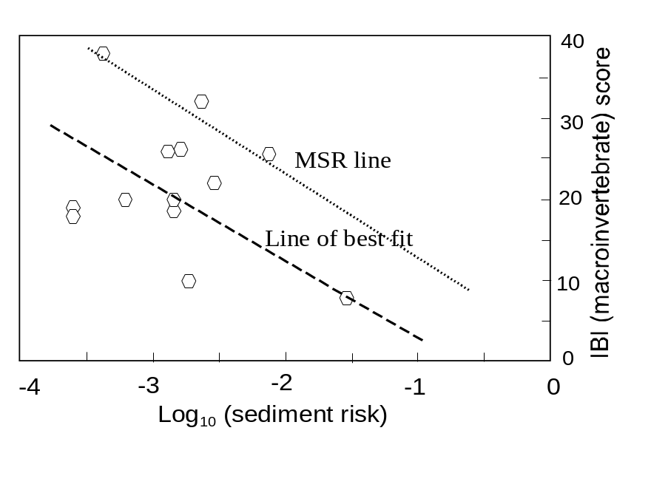
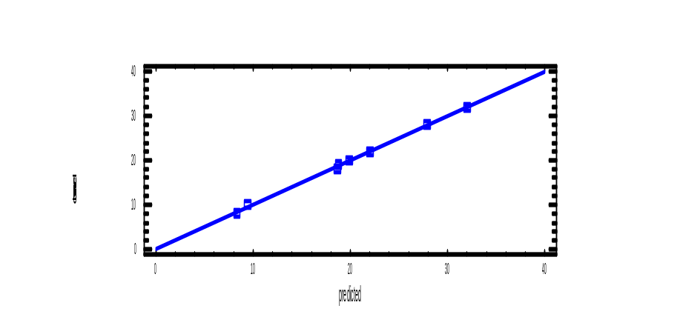
Single vs. multiple stressor/IBI relationship
Multivariate model – predicted and calculated from observed metrics – Regional data – Southeastern Wisconsin
Single stressor effect

Slide 18
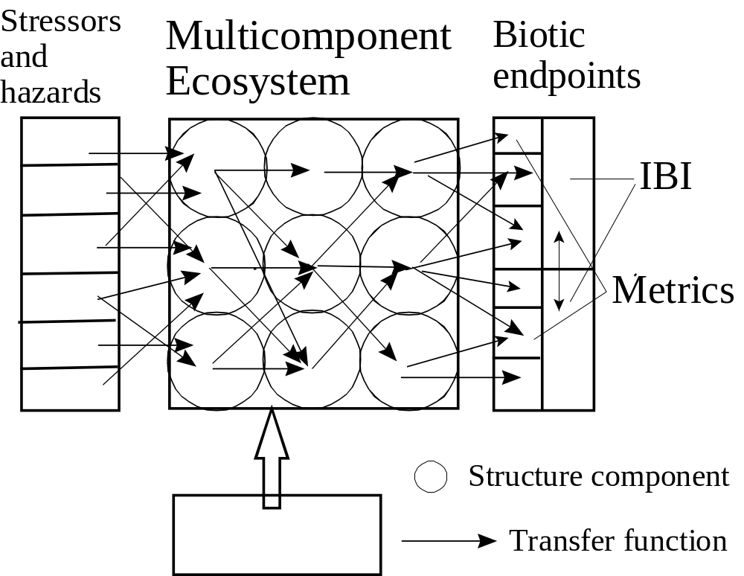
Artificial (Feed forward/backward) Neural Nets or More Advance Learning Models
Network based schemes which can flag the formation of parameter patterns that start affecting severely metrics that contribute to IBI
Randomness (white noise)

Slide 19

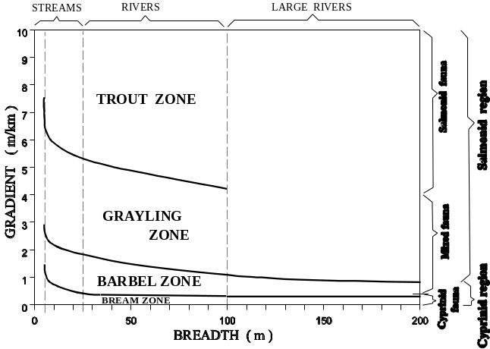
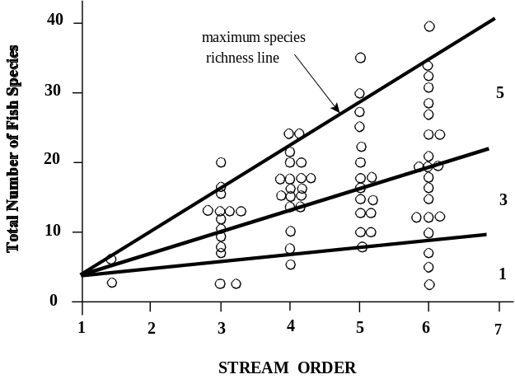
CATEGORIZATION OF STRESS
Stream Classification
  Rosgen morphological
  Stream order
Ecoregional
  Reference water bodies
Hydraulic modification
  Natural
  Impounded
  Channelized
  Navigation
Chemical risks
  Water
  Sediment
Etc.
Linked to the Habitat risk and IBI metrics

Slide 20
USE OF THE MODEL
Watershed and water/body vulnerability classification (another project)
Assist watershed manager with selection of priority watersheds
Development of watershed wide best management practices
Watershed mapping based on vulnerability
TMDL

Slide 21
Northeastern University established Center for Urban Environmental Studies
www.coe.neu/environment
novotny@coe.neu.edu

Slide 22


First year accomplishments
Interdisciplinary team was formed
    Northeastern University
    University of Wisconsin/Marquette University
    Illinois Water Survey
Two Technical Review Reports
Methodology was developed
Data Base development
Four review publications submitted

