Slide 1
Session V
Workshop on Multiscale Atmospheric Dispersion Modeling within the Federal Community
Dr. Darryl Randerson
Director, Special Operations and Research Division,
Air Resources Laboratory, NOAA
Chairman, Joint Action Group for
Atmospheric Transport and Diffusion
June 8, 2000

Slide 2
Overview
Review of Technical Barriers Panel Session
Reports on Breakout Sessions
  Methods for VV&A of Models
  Establishing Subsets of Models to Meet Dispersion Applications
Wrap-Up and Closing Remarks - Federal Coordinator

Slide 3
Technical Barriers Panel
Moderator: Ronald Cionco, Army Research Lab
Rapporteur: Robert Lawson, EPA
Panel Members:
Dr. Ray Hosker, Director, ATDD, ARL
Paul Bryant, FEMA
Jim Bowers, Dugway Proving Ground
Jocelyn Mitchell, NRC
Alan Cimorelli, EPA
Dr. Jerome Fast, Pacific Northwest National Lab

Slide 4
Summary of
Technical Barriers Panel
Questions:
  What are the knowledge gaps which limit the performance of models?
  What is impeding your research or restricting progress on model development
Anticipated Results:
  Do you accept this as a barrier?
  How do we satisfy this deficiency?
  Identify which agencies are clearly addressing this barrier.

Slide 5
Summary of
Technical Barriers Panel(2)
Turbulence and the Stable Boundary Layer: Barrier? YES
Need simultaneous met measurements and dispersion data; need higher resolution measurements - scales of a few meters (being addressed by the Army and DOE laboratories)
The SBL in coastal areas (in addition to urban and forested areas) also needs more attention due to location of power plants and cities near coasts
It’s important to link chemistry and meteorology in the SBL

Slide 6
Summary of
Technical Barriers Panel(3)
This slide added after original presentation
Turbulence and the Stable Boundary Layer: Barrier? YES
Need to be observers before we can be modelers
There are minimal observations available to verify and improve SBL parameterizations
Need information on the vertical structure of the SBL, no just surface-based measurements
Need to probe the SBL with multiple radars or sounders to establish the structure of the SBL. Need to combine technologies to get better obs capability

Slide 7
Summary of
Technical Barriers Panel(4)
This slide added after original presentation
Turbulence and the Stable Boundary Layer: Barrier? YES
How do we distinguish true dispersion from low frequency meandering?
What is the limit to vertical mixing in the SBL?
Should consider empirically correlated local phenomena with larger-scale phenomena
Should examine non-Gaussian models for the SBL
Pacific Northwest Lab is planning a field study in Salt Lake City to examine SBL in an urban environment
Agencies: DOE, NOAA, ARL, DOD

Slide 8
Summary of
Technical Barriers Panel(5)
Air-Surface Exchange: Barrier? YES
This is the most important driving mechanism for models because this represents the lower boundary condition
There is a lack of data and observations on which to base parameterizations
There is a need for higher spatial resolution measurements of sensible and latent heat fluxes which appear to be the key to driving mesoscale models

Slide 9
Summary of
Technical Barriers Panel(6)
This slide added after original presentation
Air-Surface Exchange: Barrier? YES
Pollutant characterization is complicated by chemical and biological effects and their relation to micrometeorology
Need to consider the effects of precipitation - tends to move materials to lowest areas
Need for better understanding of acid deposition and nitrogen deposition to estuaries - multimedia processes
Need for deposition velocities and solubilities for toxic pollutants as well as better data for dry deposition in general
Agencies: DOD, EPA, NOAA

Slide 10
Summary of
Technical Barriers Panel(7)
Probabilistic Modeling: Barrier? YES and NO
Probabilistic modeling requires educating the decision makers - “let the user know the consequences”
To achieve probabilistic results requires that the models perform to a higher level than required for deterministic models

Slide 11
Summary of
Technical Barriers Panel(8)
This slide added after original presentation
Probabilistic Modeling: Barrier? YES and NO
Probabilistic modeling techniques need to be applied to chemistry as well as meteorology
These models are difficult to evaluate
Approaches:
  Conventional model with variance
  2-particle Lagrangian stochastic models
  SCIPUFF-type model
  Ensemble of runs with conventional models
Agencies: NRC, FEMA, DOD

Slide 12
Summary of
Technical Barriers Panel(9)
Mesoscale and Surface Layer Transport: Barrier? YES
Important to recognize that the microscale process drives the mesoscale processes
Knowledge gaps exist because we don’t have measurements at the scale needed to parameterize the process (being addressed by Army Research Lab)
Current understanding of canopy models (urban and vegetative) has not been transferred to mesoscale models (being addressed by Army Research Lab)

Slide 13
Summary of
Technical Barriers Panel(10)
This slide added after original presentation
Mesoscale and Surface Layer Transport: Barrier? YES
New instruments may show promise
  Special-purpose aircraft
  Remote automated weather stations
Coupling/decoupling of meso/micro scale models is not well understood. The mesoscale parameterization of the surface layer is problematic
Current model resolution is not adequate for surface layer phenomena

Slide 14
Summary of
Technical Barriers Panel(11)
This slide added after original presentation
Mesoscale and Surface Layer Transport: Barrier? YES
Need better understanding of energy budgets and spatial variability of sensible and latent heat fluxes
As the vertical resolution is improved, may require different closure schemes for models
Agencies: DOE, DOD, NOAA

Slide 15
Summary of
Technical Barriers Panel(12)
Neighborhood-Scale Processes: Barrier? YES
New instrumentation techniques and standards promise to provide very high resolution measurements of near-surface properties
Characterization of the morphological features of urban areas at high resolution is in progress by FEMA and Army Research Lab
CFD models for flow around buildings is improving, but still need wind tunnel modeling as well as field studies with greater data density
DOE’s CBNP has upcoming field studies to address scales down to building scale - VTMX experiment in Salt Lake City; long term goal is to do full-scale urban experiment (2002)

Slide 16
Summary of
Technical Barriers Panel(13)
This slide added after original presentation
Neighborhood-Scale Processes: Barrier? YES
Need to include interstate highways as a large line source - may not be properly included in current models
Does the urban heat island effect need to be included?
Models must resolve problems with local sources of particulates and with fenceline issues for toxics
Agencies: DOE, EPA, FEMA, DOD

Slide 17
Summary of
Technical Barriers Panel(14)
Recommendations:
  Follow-up with scientific meeting
  Invite more hands-on scientists
  Probe deeper into these problems
  Begin coordination in regard to future field studies
  Explore sharing modeling products

Slide 18
VV&A Breakout Session
Co-Chairs:
William Peterson, EPA
Tim Bauer, Naval Surface Warfare Center
Rapporteur:
Marcia Carpentier, EPA

Slide 19
Summary of
VV&A Breakout Session
Model Evaluation = Verification and Validation
Elements:
  Operational testing or sensitivity analysis
  Independent methodology evaluation or peer review
  Comparison against measured data
Approval involves sponsor/user concluding that model should be used for a specified range of applications

Slide 20
Summary of
VV&A Breakout Session(2)
Current Procedures
  DOE: self-imposed; no formal process
  DOD: being developed; formal acquisition procedure for EMIS/D2PC and MIDAS-AT
  EPA: formal regulatory approval process including public review and comment
  NOAA: comparison of new against existing as continuous process
  FEMA: same as NOAA

Slide 21
Summary of
VV&A Breakout Session(3)
More on EPA process
  Defined regulatory “niches”
  One guideline model for each niche but many models submitted
  1980 solicitation for new models to allow technological advances
  Modeling clearinghouse established to evaluate model applications and use
  Potential problem with inertia (slow process)

Slide 22
Summary of
VV&A Breakout Session(4)
ASTM Standard Guide for Evaluation of Dispersion Models
  ASTM develops widely varying standards
  Several federal organizations represented in D-22 subgroup (meteorologists)
  Covers basic procedures but not specifics such as statistics (general philosophy)

Slide 23
Summary of
VV&A Breakout Session(5)
Issues
  Difficulty in decoupling evaluation from acceptance (model must meet user’s needs)
  Evaluation process quite expensive
  Woods Hole: too many statistics
  Who is the audience for the evaluation?
  Lack of database or data exchange - need lots of data to determine model accuracy
  Models predict means, we measure observations

Slide 24
Summary of
VV&A Breakout Session(6)
Summary and Recommendations
  Model evaluation seems impossible but still gets done (Hanna dense gas models)
  Recommend staying involved with ASTM subgroup - may adopt guidelines
  Facilitate data sharing between organizations

Slide 25
Subsets Breakout Session
Co-Chairs:
Dr. K. S. Rao, ARL, NOAA
LTC Todd Hann, DTRA
Rapporteur:
Ron Meris, DTRA

Slide 26
Summary of
Subsets Breakout Session
This slide added after original presentation
Many model characteristics to be considered (see box)
Established a framework to identify types of models appropriate to various applications
Concentrated on time and space scales to get started
Much more detail needed to fill in the framework
Model Characteristics
  Time and space scales
  Frame of Reference (Eulerian or Lagrangian)
  Steady state or time dependent
  Pollutant properties (gas/particle) and chemical reactions
  Plume behavior (buoyant/ dense; downwash)
  Turbulence parameterization
  Topography and removal processes
  Treatment of uncertainty
  Numerical solution method

Slide 27
Summary of
Subsets Breakout Session(2)
Space scale: inside a building
Time scale: few minutes to 1 hour
Model types:
  CFD - good for low speed, auditorium type
  Multizonal good for energetic flow with multiple rooms
Production time (within 1 hour of “cold start”) - multizonal only
Agencies with capability: DOE, EPA, DOD, NIST

Slide 28
Summary of
Subsets Breakout Session(3)
Space scale: single building - 10m x 100m
Time scale: few minutes
Model types:
  CFD
  Parameterized Gaussian
  Physical modeling
Production time: planning tool only, no model for immediate response
Agencies with capability: DOE, DOD, EPA, NOAA

Slide 29
Summary of
Subsets Breakout Session(4)
Space scale: neighborhood, 2 x 5 km horizontal, sfc - 100m vertical
Time scale: 30 minutes to days
Model types:
  Particle (near field)
  CFD (mixed, large eddy simulation [LES])
  Modified Gaussian
  Puff trajectory with mass consistent winds
Production time: 20 min for modified Gaussian, puff
Agencies with capability: DOE, DOD, EPA, NOAA, ...

Slide 30
Summary of
Subsets Breakout Session(5)
Space scale: micro scale, 20 x 20 km horizontal, sfc to BL vertical
Time scale: convective 10-15 mins, advective 1 hr
Model types:
  Trajectory
  Gaussian Plume or Puff
  CFD particle
Production time: within 20 min, all Gaussian and CFD particle and trajectory; requires more fine scale met, meet regulatory considerations
Agencies with capability: ALL

Slide 31
Summary of
Subsets Breakout Session(6)
Space scale: mesoscale, 50 x 1000 km horizontal, sfc to BL vertical
Time scale: Hours to 24 hours
Model types:
  Gaussian Puff or Particle
  Eulerian
  Hybrid Eulerian and Lagrangian
Production time: within 20 min, all of above
Agencies with capability: DOD, DOE, NOAA, EPA, NASA

Slide 32
Summary of
Subsets Breakout Session(7)
Space scale: continental, 3000 x 4000 km
Time scale: several days
Model types:
  Lagrangian puff
  Transport key, not diffusion
Production time: within 20 min, all of above
Agencies with capability: NOAA, DOE, DOD, NSF, EPA, NASA

Slide 33
Summary of
Subsets Breakout Session(8)
Space scale: global
Time scale: weeks
Model types:
  NWP is key
  Lagrangian particle trajectory
Production time: within 20 min, all of above
Agencies with capability: DOD, DOE, NSF, NASA, NOAA

Slide 34
Summary of
Subsets Breakout Session(9)
Recommended Actions:
  Follow-up meeting
  Scientific reviews/discussion

Slide 36
Closing Remarks
Workshop on Multiscale Atmospheric Dispersion Modeling within the Federal Community
Samuel P. Williamson
Federal Coordinator
Office of the Federal Coordinator
for Meteorological Services and Supporting Research
June 8, 2000

Slide 37
Overview
Workshop Goal
Expected Outcomes
How did we do?
Next steps

Slide 38
Workshop Goal
Improve agency coordination in the development and operational use of dispersion models.

Slide 39
Expected Outcomes
Requirements
Capabilities
?
Barriers
Session 1
Session 2
Session 3

Slide 40
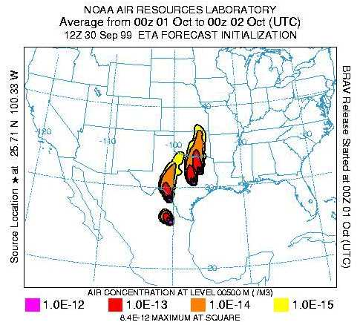
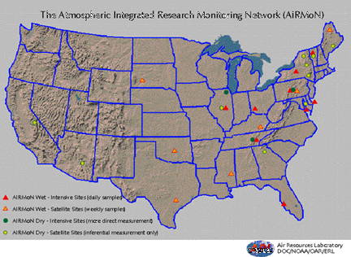
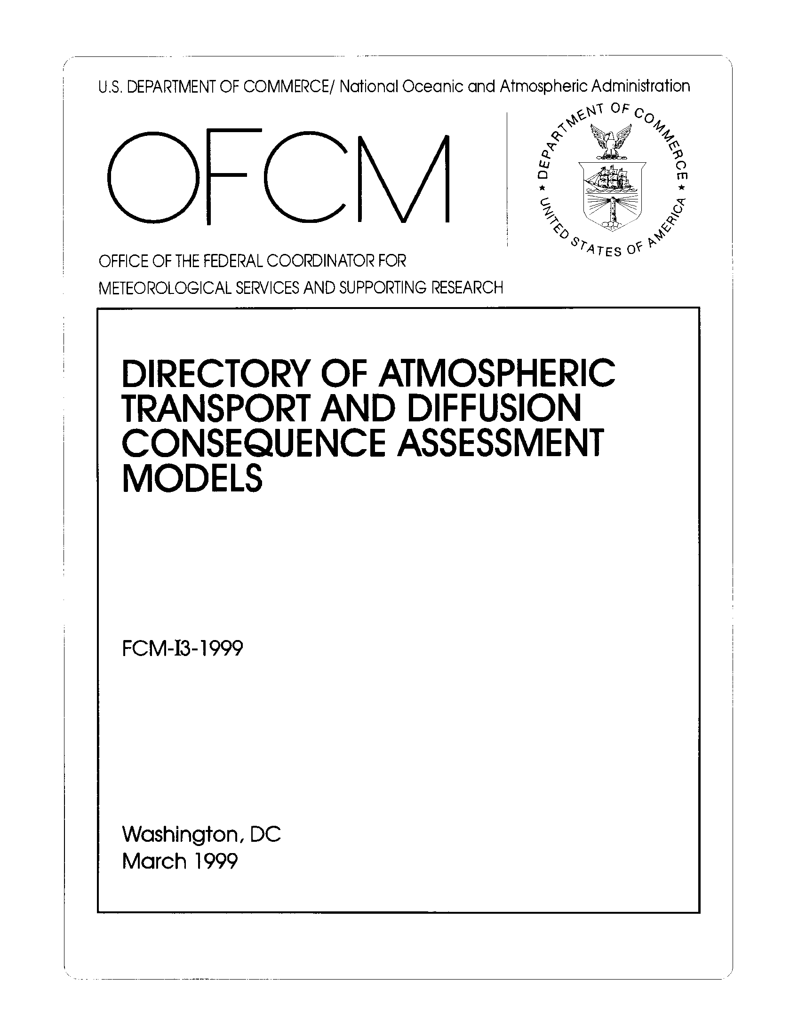
Expected Outcomes
Verification, Validation, and Approval Methods
Session 4
Selecting subsets to meet applications needs

Slide 41
Workshop Objectives
How did we do?
State current modeling requirements and capabilities
Specify new requirements/unmet needs
Describe existing methods for validation, verification, and approval of current models and future needs
Describe a process for establishing model subsets for specific applications
Find solutions to agency-identified technical barriers
Identify opportunities for leveraging model development and model validation, verification, and approval
Started!

Slide 42
Cross-cutting issues/concerns
Need for improved temporal and spatial resolution
Need for improved urban modeling capability!
Probabilistic approach - cannot eliminate uncertainty
Need improved source term estimates
Need improved handling of lower boundary condition - complex problem, data lacking
User training - creating the sophisticated user, probabilistic model interpretation
Tailored VV&A, choosing the right model for the application, developing model use strategies

Slide 43
Cross-cutting issues/concerns
Structured approach to approval process
Technology transition, leveraging, avoiding duplication
Interdisciplinary approaches required
Exploit opportunities for collaboration
Scope: spectrum of applications from immediate response to planning and design, individual rooms to global scale - no near-term “universal model”
Process for systematic crossfeed of agency activities and progress

Slide 44
Next Steps
Summary slides on OFCM web site next week
  http://www.ofcm.gov/
Workshop Proceedings/Action Plan - out in 2-3 months
JAG/ATD actions
  Report to CESORN (parent committee)
  Report to ICMSSR
Follow-on Workshop

Slide 45
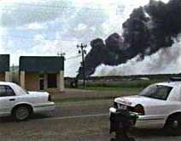
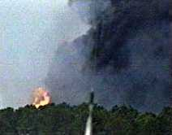
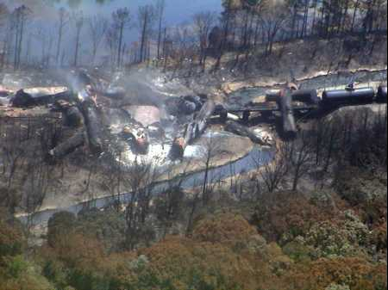
Why are we here?
CNN/KATC-TV photo
CNN/KATC-TV photo
Eunice, LA. (Reuters) - Hazardous-chemical specialists plan to put out fires still burning in two tank cars of plastics Tuesday and then begin moving some of 30 freight cars that derailed Saturday in southwest Louisiana, forcing 2,500 people from their homes.
Residents were ordered to flee from a 2-1/2-mile radius around the site within minutes....
Dense smoke poured from the scene for almost 24 hours, police said.
... dichloropropane, acrylic acid, methyl chloride, toluene, diisocyanate, sodium hydroxide, hexane, and phenol.
AP Photo/Civil Air Patrol - Rock Palermo
May 27, 2000 - Eunice, Louisiana

Slide 46
Thank You!
Darryl Randerson and Tom Fraim
Session chairs, panel moderators, and rapporteurs
Joint Action Group for Atmospheric Transport and Diffusion
OFCM Staff
Workshop Attendees!
Thank you for coming and have a safe trip home!

