Slide 1
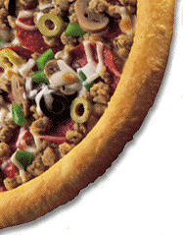
The Thermodynamics of Pizza
ES Institute July 2001
©Oklahoma Climatological Survey

Slide 2
That “entopy-nerial” spirit!
What is thermodynamics?
The movement of heat! (or more properly, energy!)
There are 3 Laws of Thermodynamics:
These laws may seem remote to most people, but they can be applied to every aspect of science, from astrophysics to meteorology, to zoology, to pizza!
The First Law says energy is conserved;
The Second Law says everything moves toward equilibrium because of something called entropy;
The Third Law says that there is a lowest temperature, called absolute zero, where this entropy stuff is zero.
Now, for the details…

Slide 3
First Law of Thermodynamics
The First Law is usually referred to as the Law of Conservation of Energy.
1. If the state of a system is changed by applying work or heat (or both) then the change in the energy of the system must equal the amount of energy applied.
2. If the system is doing work, then the system cannot do this work without losing energy in the amount equal to the work.
YOU EXPERIENCE THIS DAILY!
IF YOU ARE DOING WORK, YOU LOSE ENERGY!
ALSO, HOW MANY TIMES HAVE YOU SAID
“YOU ONLY GET OUT OF IT WHAT YOU PUT INTO IT!”, OR
“YOU GET WHAT YOU PAY FOR!”
See! You already knew the First Law!
Essentially, the First Law states that energy cannot be created or destroyed. In other words, energy is transferred, or, “there’s no free lunch!”!

Slide 4
Second Law of Thermodynamics
Let’s start this one with an example:
If you take two bottles. Fill one with a gas and make the other a vacuum, and then connect the bottles. The gas will quickly reach a state of equilibrium where it fills both bottles with equal pressure and temperature, both values lower than those in the first bottle.
Since the First Law states that the energy of the system is the same after the expansion as it was before the expansion, then there must be a new value, we call it entropy, which increased with the loss of heat.
Why was there a heat loss?
The gas expanded! When a gas expands, there are less molecular collisions. This is why aerosols are cool when you spray them. This is why the nozzle of a fire extinguisher gets cold when in use.
And…
This is why air in the atmosphere that rises, cools. Less air molecules in the upper parts of the atmosphere means less pressure. Less pressure means expansion. Expansion means cooling.

Slide 5
Second Law of Thermodynamics
Entropy is defined as the "capacity for change" of a system. If the state of a system is changed but the entropy is not changed, then the process is called reversible (able to be changed back to the original state without any more added energy).
Wouldn’t you like to take back something you did or said as a youth? Or maybe as an adult? Unfortunately, taking back something usually requires A LOT of extra energy on our part!
Meaning, most processes in nature are irreversible!
It is said that universal entropy is always increasing - since entropy is the driving force behind equilibrium, this means that the universe is constantly moving toward a less dynamic state.
Simply put, our universe, our atmosphere, etc. are always trying to reach equilibrium!
Let’s think about this for a second…
Will it ever happen?
What would have to happen for the atmosphere to reach equilibrium?

Slide 6
Second Law of Thermodynamics
You would have to stop transferring energy from a certain external object (sun).
That would be a cold proposition!
The formal statement of the Second Law is:
It is impossible to move heat, by a cyclical process, from something at lower temperature to something at higher temperature unless work is added to the system.
Since any two objects at different temperatures brought together will come to equilibrium at the same temperature, with increased entropy for the spontaneous change, to force the heat to move in the opposite direction requires some external source of energy (work) to make up for the change in entropy.
A good example is the refrigerator: if you leave the door to your refrigerator open (don't try this with perishables on the shelves), what happens to the temperature in the kitchen?

Slide 7
Third Law of Thermodynamics
At lower temperatures, the change in entropy for spontaneous reaction decreases. This observation lead to the postulate, that as the temperature of a pure substance approached some lower limit (called absolute zero) the entropy for would approach zero.
After plotting the temperatures and energy changes for several spontaneous reactions, it is possible to work backwards to find the value of absolute zero, which is -273C (about -460F). The Kelvin scale places 0K at absolute zero and then uses Celsius for increment size, so that water freezes at 273K and boils at 373K.
With further math, the nature of absolute zero was defined as the Third Law:
If the entropy of each element at absolute zero can be taken as zero, then all elements above absolute zero must have a finite, positive entropy. However, because entropy cannot be reduced to zero (as per the Second Law), no system can reach absolute zero.

Slide 8
Summary of Thermodynamics
Energy is transferred;
Our systems always tend towards an equilibrium;
And we likely won’t ever get there.

Slide 9
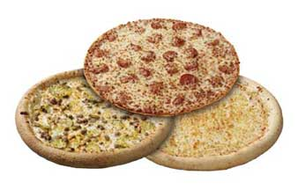
Let’s now look at pizza!
To a first approximation, the pizza is composed of three cylindrical disks or layers.
The lowest layer is made of yeast-flour dough, the middle layer is made largely of tomato paste, and the top layer is cheese. Trace materials such as oregano, basil and pepper are also present in small quantities. For now, we will ignore any toppings.

Slide 10
Are the ingredients by themselves sufficient to be called a pizza?
In order to have a “pizza”, you must first apply some energy!
But how much?
You have three very different types of ingredients (or constituents) in this layered configuration. Each will likely behave differently when energy is added.
What are some outcomes in nature when energy is added to a system?

Slide 11
Outcomes when energy is added…
The First Law says the system will either heat up or do work.
The Second Law says the system will tend toward an equilibrium, but that some irreversible changes are likely to occur.
Let’s look at the 1st Law:
How will the system heat up when energy is added?
Energy is transferred via:
CONDUCTION
CONVECTION
RADIATION

Slide 12
Heat Transfer
Conduction
Occurs in materials when heat flows from the hot part of the substance to the colder part. There is no net movement of matter involved.
Radiation
This is electromagnetic radiation emitted by a body due only to its temperature. This radiation spans a range of wavelengths and the intensity of the energy for a particular wavelength depends on the temperature of the emitting body.
Convection
Movement of molecules of a fluid due to a change in density when heated.

Slide 13
Effects of Heat Transfer
Temperature Change
Motion
Phase Change
Now, let’s apply these changes to our three layered system, the pizza!
Three things occur as the stacked disk structure
equilibrates with the high temperature oven.
(533K, 160K higher than water’s boiling point.)

Slide 14
The Crust
The dough bakes into bread, a low-water content material with a large number of non-connecting air spaces.
The crust becomes an excellent insulator because of the unconnected air spaces throughout.
Ever burn a piece of bread on the inside?
Try it in a toaster sometime!

Slide 15
The Sauce
The tomato paste dehydrates.
Tomato paste has a high heat capacity and a low conductance.
It serves as a buffer between the insulating crust and the cheese.

Slide 16
The Cheese
The cheese undergoes a complex series of transitions involving protein de-naturation and lipid rearrangement from liquid crystals to more disordered states. (In other words, it melts!)
The transitions result in a high heat capacity for the melted cheese.

Slide 17
The Cheese
Because of the insulating dough and the high heat capacity paste, the cheese layer is well insulated from below. Meaning, most of the energy (heat) loss will be through the top of the cheese.
When you eat pizza hot out of the oven, do you burn your tongue?
Or the roof of your mouth?

Slide 18
The Ensemble
Conduction, convection and radiation will be at work transferring energy through the top of the pizza.
To eliminate the energy loss through the top, place an insulating layer over it.
Air is a great insulator! Just like in our atmosphere! But, to keep the air in place (limit energy loss due to convection), use a “pizza box”. These boxes also tend to have non-connecting air spaces, just like the crust (corrugated).

Slide 19
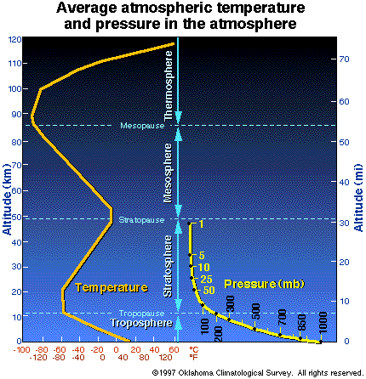

Slide 20
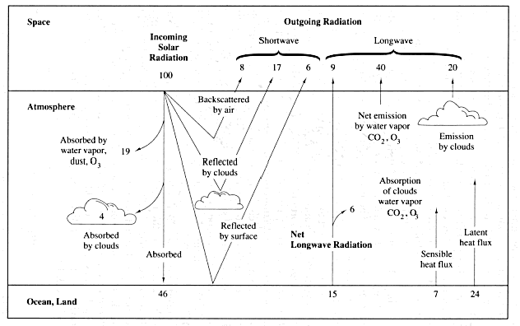
100 units of energy on the wall...

Slide 21
Greenhouse Effect….A Bad Andy
How do you keep the atmosphere from losing energy?
_x0008_A giant insulating pizza box?
Carbon Dioxide, Water, Methane, Ozone and other greenhouse gases do not physically “block” energy transfer from occurring (like a greenhouse or pizza box).
These gases absorb radiation, thus heating up, then, reradiate that energy (The atmosphere reaches a new equilibrium with the new chemical composition.)

Slide 22
Review!
The Laws of Thermodynamics govern energy (heat) transfer.
Energy (heat) transfer can result in temperature changes, phase changes, and motion.
Phase changes are governed by molecular structure and require heat/work/energy to occur.
Layers composed of different chemical constituents react differently to the same amount of incoming energy, and then impact adjacent layers.
The atmosphere is not a greenhouse!
Let’s Eat!
©Oklahoma Climatological Survey

