Slide 1



CUMULATIVE IMPACTS
FHWA 2008 ENVIRONMENTAL CONFERENCE
LAWRENCE (LANCE) HANF,
SENIOR AGENCY COUNSEL, HCC-WE

Slide 2

No analysis;
No Deference –
Good area to sue

Slide 3

Introduction
Let’s start at the beginning:
Scope of the NEPA document looks at
3 Types of actions (Conn., Cum., Similar)
3 Types of alts. (no Build, reasonable, Mitigation)
3 Types of impacts (Direct, In-dir, Cum.)

Slide 4

Overview
Cumulative Impacts (40 CFR 1508.7)
Cumulative Actions (40 CFR 1508.25(a)(2)
Connected Actions (40 CFR 1508.25(a)(1)
Similar Actions [40 CFR 1508.25(a)(3)]

Slide 5

Similar Actions
When an agency is proposing (is reasonably foreseeable) another action in the same area or at the same time, an agency may WISH to look at the impacts in one document.

Slide 6

Connected Actions
(See FHWA’s segmentation regulation & three part test).
Automatically trigger other actions.
Cannot or will not proceed without the other.
Interdependent parts of larger action.

Slide 7
Cumulative Actions
Agency Actions with other Proposed agency action that have cumulatively significant impacts should be discussed in one document.
A proposal is a stage where there is an agency goal and an active NEPA action – it is not a reasonably foreseeable action.

Slide 8

Cumulative impacts

Slide 9
THE IMPACT ON THE ENVIRONMENT WHICH RESULTS FROM THE INCREMENTAL IMPACT OF THE ACTION WHEN ADDED TO OTHER PAST, PRESENT, AND REASONABLY FORESEEABLE FUTURE
ACTIONS REGARDLESS OF WHAT AGENCY (FEDERAL OR NON-FEDERAL) OR PERSON UNDERTAKES
SUCH OTHER ACTIONS.

Slide 10
Continued
Cumulative impacts can result from individually minor, but collectively significant actions taking place over a period of time.
Query: Why use the term actions?

Slide 11
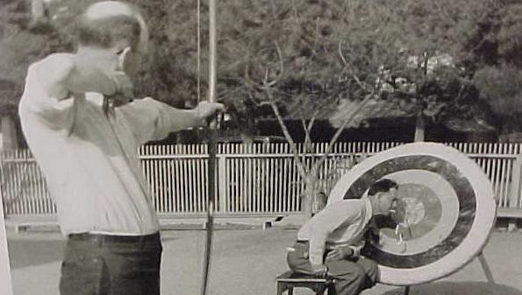
CASE LAW

Slide 12
Kleppe v. Sierra Club,
427 U.S. 390 (1976).
Pre-CEQ regs. (A cumulative action case)
DOI Programmatic EIS on Coal permits and leasing program over 4 states.
Court: Scope of EIS is only for proposed projects not all future coal projects – no regional coal EIS required.
Agency must take a hard look at environmental impacts.

Slide 13

Fritiofson v. Alexander, 772 F2d. 1225
(5th Cir. 1985)
COE permit for 475-unit development on 145-acre
Tract in Galveston Island, Texas.
Lots of other past, present and
future developments in this area.
Told sensitive area by NMFS & USF&W & concerned
with cumulative impacts.
COE In the absence of any study concerning Galveston Island, the cumulative effects of this and similar projects cannot be estimated with any degree of success.

Slide 14
Court: 5-step cumulative-effects study:
Area where effects will be
felt from project.
Impacts that are expected
from project.
3. Id. other past, present and reasonably foreseeable actions with similar impacts and this area.
4. What those impacts are.
5. Overall impact if the individual impacts accumulate.

Slide 15
Save the Yak v. Block, 840 F2d. 714 (9th Cir. 1988)
Five sections of road w/ four E.A.s, one with none,
all to primarily serve salvage timber sales.
Court: If substantial Q’s raised regarding a signif. effect decision not to prepare & EIS is unreasonable.
Agency decision not prepare an EIS is unreasonable unless it has a convincing statement why potential effects are insignificant.
Defer to agency’s decision only if informed and well considered.
e. Unconnected & unrelated action, but reasonable foreseeable future actions may result in cum. actions.

Slide 16
Legal Issues in Cumulative Impact Analysis:
How far in the future is still reasonably foreseeable. How much certainty?
What is the geographic area that we look at? More than one?
What if there is no baseline information?
on resources or past project impacts?
How far back in time do you go?
How do you figure out synergistic effect?

Slide 17

Other adverse cases
Muckleshoot Indian Tribe v. U.S.F.S, 177 F.3d 800 (9th Cir. 2001) (Details on cumulative impacts of project and other proposed projects is required).
City of Carmel v. U.S. DOT, 123 F.2d 1142 (9th Cir. 1997) (EIS must have enough detail to be useful to the decision-maker).

Slide 18
Lands Council v. Powell, 395 F.3d 1019 (9th Cir. 2005)
Timber sale to raise funds to mitigate past timber sale impacts.
Project in headwaters of the Coeur d’Alene River involving 14 watersheds. 12 of which are not functioning or are at risk.
As for the past actions document only showed maps of timber sales.

Slide 19
Cont. Lands Council v. Powell
NEPA requires a cataloguing of past projects with time, type, place, scale,
AND how those projects effected the environment. Test: sufficient detail to inform.
As for a future timber sale, it was in another watershed and did not need eval.
Westslope Cutthroat Trout – 6 year old study too stale.

Slide 20
Texas Comm. on Nat. Resources v. Van Winkle, 197 F.Supp 2d (N.D. Texas 2002)
COE flood control project – Dallas Floodway Extension, Trinity River.
7 counts – won all but cumulative impacts
Nice distinction between cumulative actions and cumulative impacts.
Court: other COE, highway and County actions on resource had not reached level of a proposal.
But these actions were foreseeable and needed a cumulative impact analysis.

Slide 21
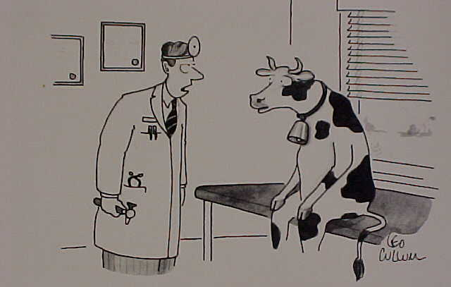
“That ringing in your ears - - I think I can help.” We can be our own worst enemies.

Slide 22
Legal Issues in Cumulative Impact Analysis:
How far in the future is still reasonably foreseeable. How much certainty?
What is the geographic area that we look at? More than one?
What if there is no baseline information on resources or past project impacts?
How far back in time do you go?
How do you figure out synergistic effect?

Slide 23

Do we look at indirect impacts when we do our cumulative impact evaluation?
What responsibility do we have to mitigate other’s impact?
Lists of projects do not satisfy the test. Need to focus on the resource.
Do we need to show a trend?

Slide 24

Focus on Issues
Area of effect – varies for each resource.
Resource focused -- individually.
Based on both indirect & direct effects.
Separate sections for cumulative and indirect effects.

Slide 25



Federal Highway Administration
Western Legal Services
San Francisco, California

