Slide 1

Rescue POD Safety System
Welcome !
Gamma Services is a Safety and Production
Assistance Company.

Slide 2
Why a Rescue POD
Loss of our fallen colleagues.
Modern technology is being pursued by the mining community as a result of the recent loss of lives.
Seal-In-Bratticing has often been a last ditch effort to save your life when all other options have been exhausted to exit the mine, with very few successful attempts.
Miners are among the most independent and self-reliant people in the world.
Naturally, miners prefer self-rescue than to rely on a rescue party to reach them from the surface. Building a trust between the miners and the equipment.

Slide 3
Key Components
Rescue POD is a fully deployed rugged steel enclosure to help shelter miners from secondary explosions and roof falls while providing breathable oxygen. A POD typically stays with a mining unit although additional POD’s can be located out-by the working sections.
The standard size Rescue POD is designed to support life for 16 people for 96+ hours in a compact size: (16 feet long X 5.7 feet wide X 3.7 feet high).
Incorporate Through-The-Earth, battery powered, Geosteering TG MinerTracker , while inside and/or near the Rescue POD.

Slide 4
Key Components (Cont.)
Mine atmosphere with as little as 4% oxygen can be used as an oxygen source.
Temperature reduction support system.
CO, C_{H}4, CO₂, N₂, Ar, scrubber and H₂O dehumidifier inside the Rescue POD.
Portable self contained breathing units adds to interior oxygen supply.
Interior and Exterior monitoring C_{H}4 and CO₂ levels

Slide 5
Key Components (Cont.)
Nutrition and hydrating supplies for miners.
Canister toilet with privacy curtain.
Chem.-stick Lighting
Introducing a Nitrogen foaming fire fighting technique while miners are down stream of the fire, regardless of the limited gas levels.

Slide 6
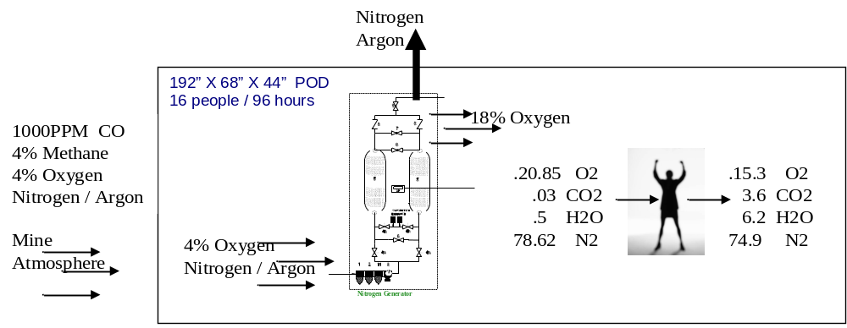
Oxygen Transfer
CO Scrubber
Dehumidifier

Slide 7

Oxygen Transfer
N2 Purge
Pressure Relief Valve
Personal O2 Concentrator
O2
Analyzer
O2, CO2, CO, Ch4
O2
O2
Personal O2 Concentrator
O2
Air In Air Out
20.85% O2 15.30%
.03% CO2 3.60%
.50% H2O 6.20%
78.62% N2 74.90%
CO Scrubber
Dehumidifier
CO2
H2O
CO 1000 PPM
CH4 4%
O2 4%
Nitrogen
55deg F
65 deg
Heat Exchanger
Mine Atmosphere
CO
CH4
Filter
CO 10 PPM
CH4 1%
O2 4%
Nitrogen
Batteries
85 deg

Slide 8
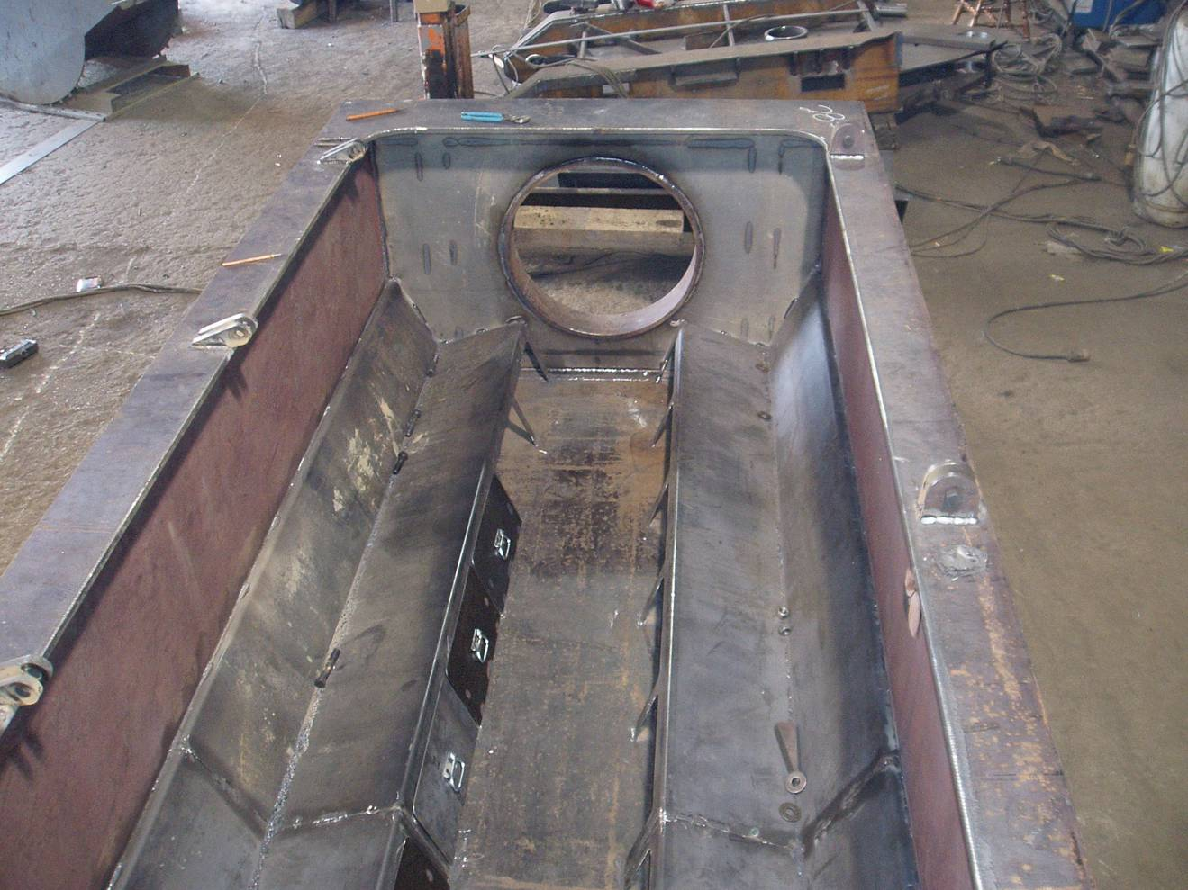
Rescue POD construction

Slide 9
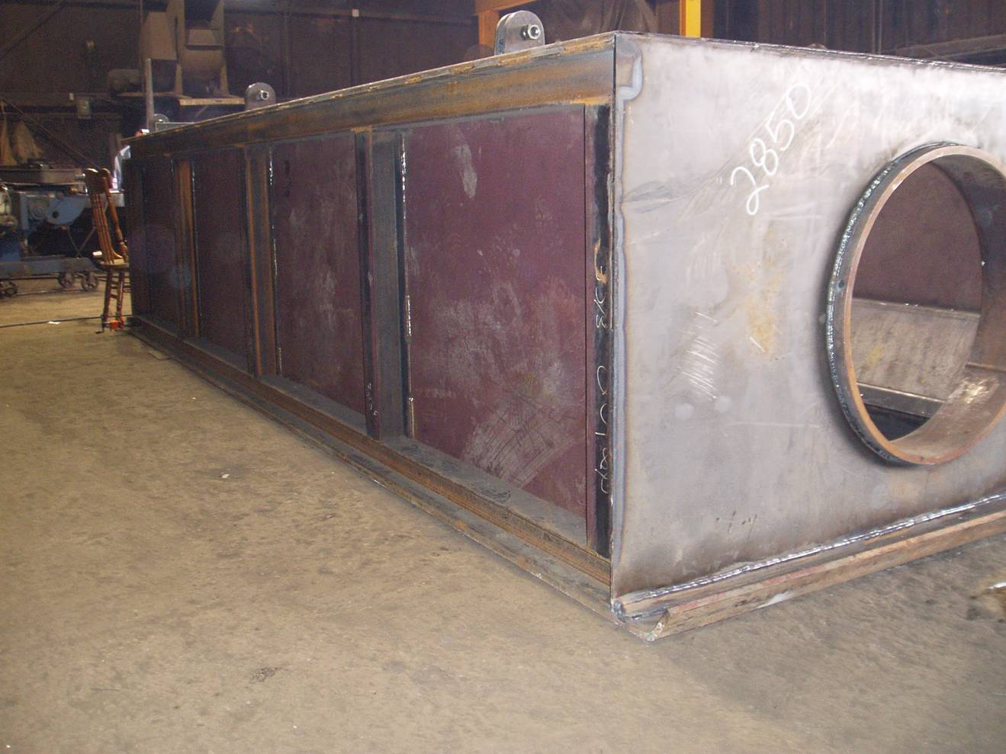
Rescue POD construction

Slide 10
Conclusion
Utilization of rescue PODs for each mining unit could be a useful method of saving lives during mining disasters.
Gamma Services along with all the supporting companies believes our approach is one of the answer’s to saving lives right now.
However if new ideas or guidance arises in the future, we will change our direction to expedite the deployment for life saving devices to the mining community.

Slide 11
Thank You

