Slide 1

Statistical Process Control
A way of:
  presenting data on a chart
  determining if you have a trend
  determining if you are stable
  determining the capability of your process
  It is also a way of thinking
  http://www.hanford.gov/safety/vpp/spc.htm

Slide 2
What is a “Trend”?
Many procedures and policies call for “trending” to be performed, for “trends” to be identified.
Webster’s Dictionary:
  to extend in a general direction,
  a general movement,
  to veer in a new direction,
  to show a tendency,
  to become deflected
For our purposes: a changing condition

Slide 3
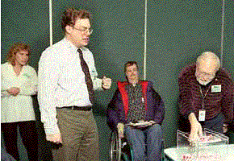
Lessons of the Red Bead Experiment
In the Red Bead Experiment, we reacted to the random noise from result to result.
Rewards, punishments, ranking of the workers, feedback to the workers had no effect on the results of the process.
The process was stable and needed to be changed!

Slide 4
Importance of Trending
Actions taken to improve a process are different, depending on whether or not the process is “stable”.
Attempting to explain or correct for individual datum point changes in a stable process will not improve performance. This is a “Type I” error.
  You will be making a mountain out of a molehill.
Missing initial indication of a change (and missing the opportunity to determine the cause of the change). This is a “Type II” error.
  You will allow the molehill to grow into a mountain.

Slide 5
Management Theory:
The Theory of Variation
SPECIAL CAUSE VARIATION
If a statistically significant trend occurs, find the special cause of this trend. Use this information to correct or reinforce these special causes.
COMMON CAUSE VARIATION
If no trends exist, you must look at the long run performance of the process and fundamentally change the process in order to improve the process.

Slide 6
Implications
No amount of explanation of, corrective action to, or causal analysis of an event will fix a broken stable process
  What if we did a root cause analysis of why Red Bead #298 fell in hole #19 of the paddle?
  What about “Find it Fix it”?

Slide 7
Implications
What if we miss an emerging trend?
  Bad parts sent to customers
  Increase in injuries
  Increase in costs
  Impact on Employee morale

Slide 8
The Losses
Misinterpretation of Performance Results can lead to:
  Missed Opportunities
  Incorrect Actions
  Frustration and Bewilderment
  Let’s take an example:

Slide 9
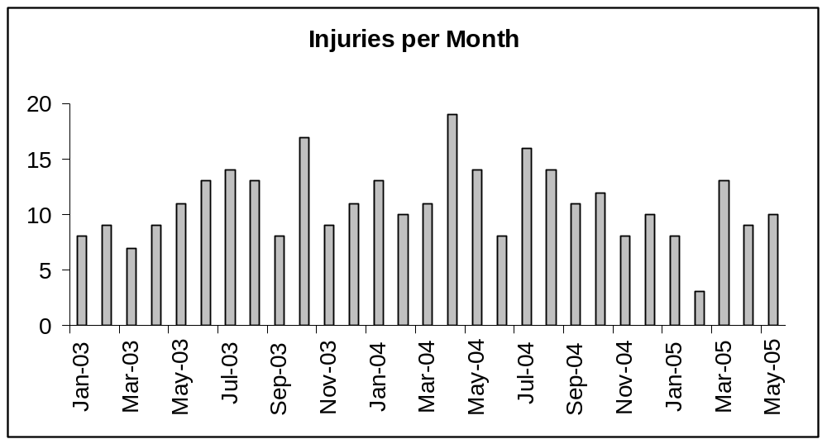
Great improvement from July 2004 – February 2005 !!!
Alas, something obviously has gone wrong in March. We jumped from 3 injuries to 13. The injury rate increased more than 400%! April and May have recovered somewhat, but not by much.

Slide 10
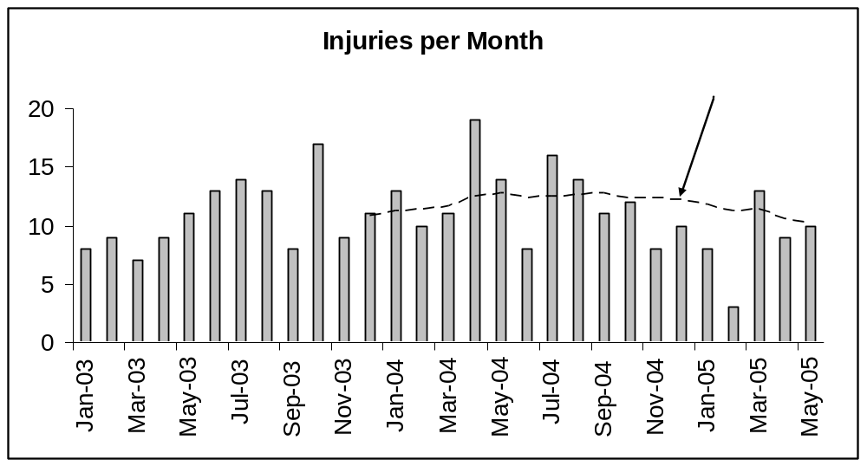
Addition of a 12 month moving average shows us we are actually improving!
Or are we?

Slide 11
The Hazards of Moving Averages
A moving average simply compares the new datum point to the oldest. If the new point is higher, the moving average moves up; if lower, the moving average moves down.
There is no criteria for when to declare a trend, when to sound the alarm

Slide 12
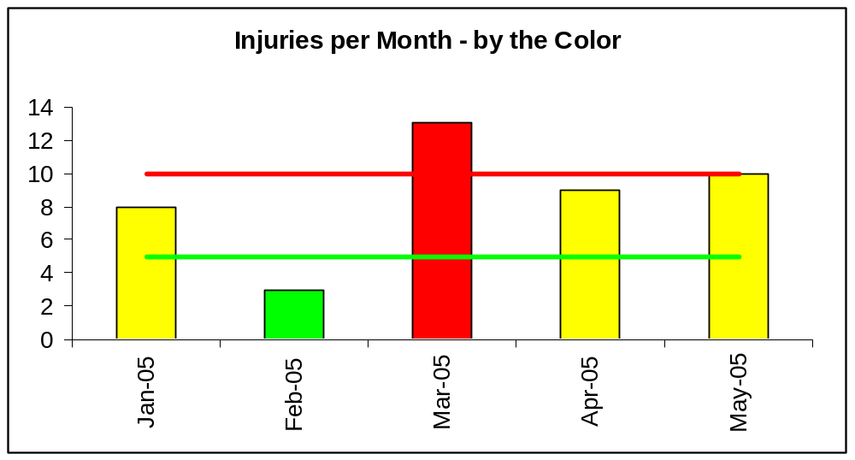
Adding color and cutting back to the current year certainly eliminates confusion . . .
Oh, really?

Slide 13
The Hazards of Rainbow Charts
The traditional color coded charts against numerical targets add to the reaction to random noise
Although we now have an alarm threshold, there is a high rate of false alarms against arbitrary thresholds

Slide 14
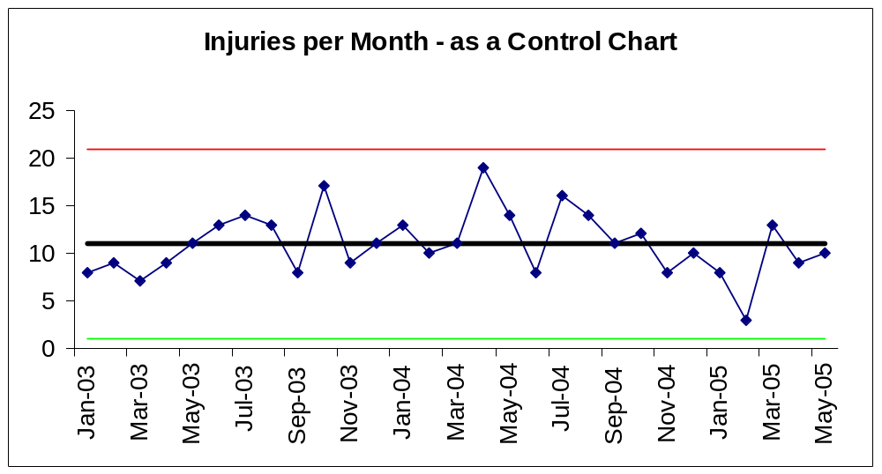
The control chart allows us to see that this is a stable, but random process
Yes, Really – it was random numbers

Slide 15
Construction of the Control Chart
Plot the actual data by month (or whatever time interval you are using)
Plot at least 25 points (when available)
Calculate a baseline average rate
Add 3 standard deviation control limits
Incorporate a set of trend rules
Adjust the baseline only when there is a significant trend

Slide 16
Why use the Control Chart?
Provides a formal method to detect trends
Provides credibility and rigor at minimum cost
Balances false alarms and failures to detect
  (Type I and II Errors)
Accepted industry standard with long history
Control Charts are analogous to the circuitry in your home’s smoke detector.

Slide 17

Statistical Process Control – A Lens
Control Charting provides knowledge of variation. This knowledge is a lens, and provides a different way of viewing the world.
The Control Chart will give you a significantly different view of what is happening than will other methods.

Slide 18
Why Three Standard Deviations ?
Many courses incorrectly teach that the control limits cover 99.7% of the normal distribution
Not all data are normal, “real data” can cause the rate to be as low as 95% (Dr. Wheeler)
The Tchebychev Inequality states up to 11% can be outside three standard deviations
We use a suite of rules, and we want to avoid too many false alarms

Slide 19

Why Three Standard Deviations (2)
Dr. Shewhart established 3 standard deviations as an economic balance between failure to detect and false alarms.
If you don’t believe this, go home and make your smoke detector more sensitive. Is your house now more safe?

Slide 20
Definition of a Trend
One point outside the control limits
Two out of Three points two standard deviations above/below average
Four out of Five points one standard deviation above/below average
Seven points in a row all above/below average
Ten out of Eleven points in a row all above/below average
Seven points in a row all increasing/decreasing

Slide 21
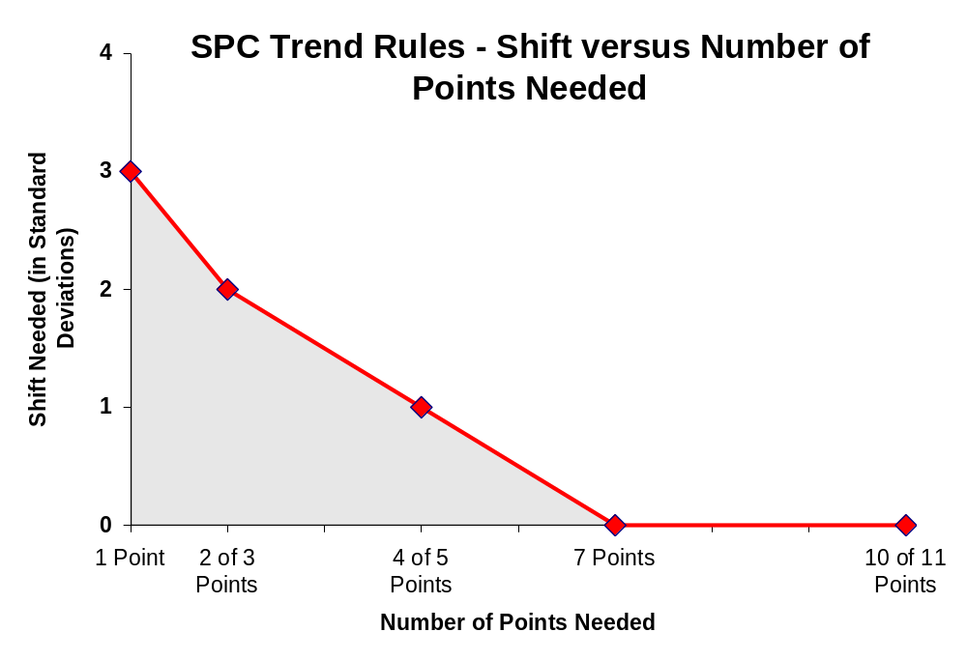
Definition of a Trend

Slide 22
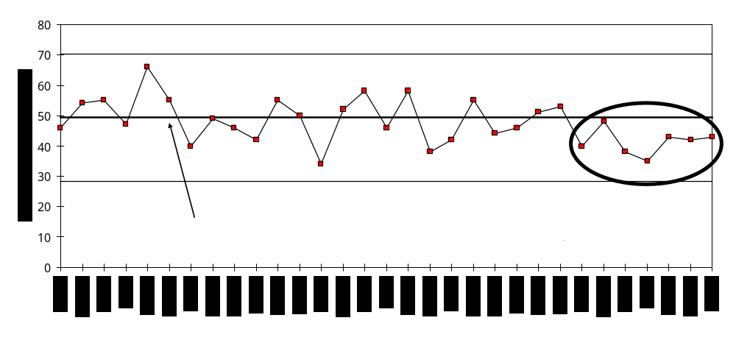
Example of a Trend
We should also determine the cause for the trend. In this case, it was a change in reporting requirements.

Slide 23
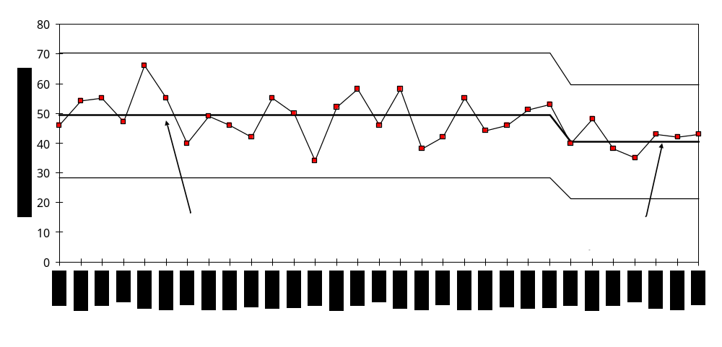
Re-baselining
After the data stabilize, consider adding a new baseline average

Slide 24
A set of data that is EITHER circled or has a shifted average line is still a Significant Trend.
The only purpose to establishing a new average is to detect further significant trends after this trend plays itself out, and the data stabilizes.
The existing average and control limits should NOT be changed unless a significant trend is detected.
In rare cases, when fewer than 25 points were used in the average and control limits, the addition of new data into the existing average and control limits will “eliminate” the trend.

Slide 25
What Has SPC Done for Hanford?
Minimized knee-jerk reactions to the latest events
Detected changing conditions
Allowed focus upon the system, the underlying processes
Saved time and money, both in the act of chart making, and in management actions

Slide 26
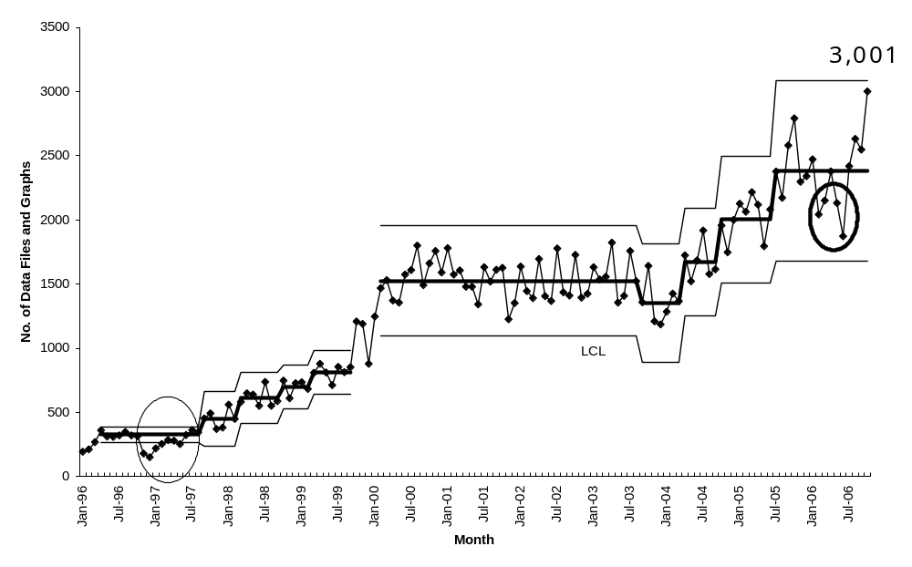
Use of SPC – Charts and Files per Month

Slide 27
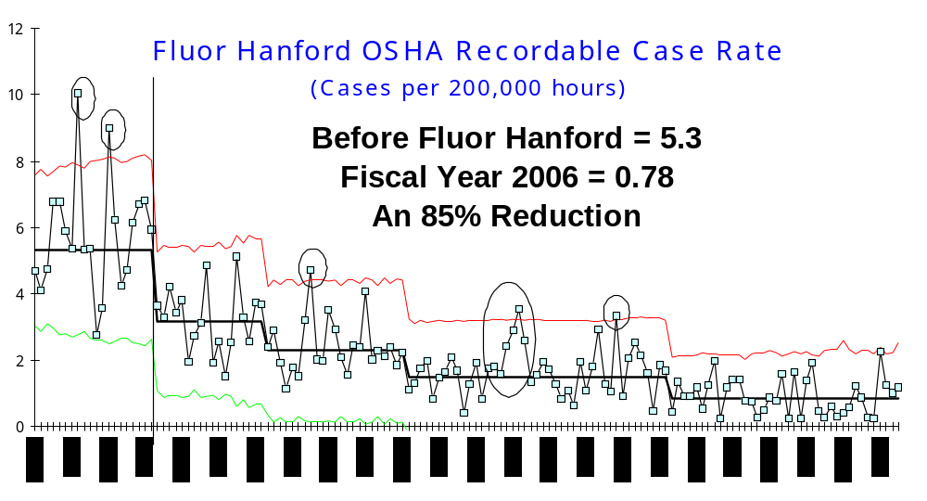
Impact on Safety

Slide 28
More Fun with Numbers
Boston Herald (Dec 23, 1996): "Murders Sink To 30-Year Low "
"....major crime such as homicide is down. Over the last two years there has been a 52% reduction in shootings..... that's a dramatic difference....Police Commissioner Paul Evans has succeeded where others have fell [sic] short...."

Slide 29
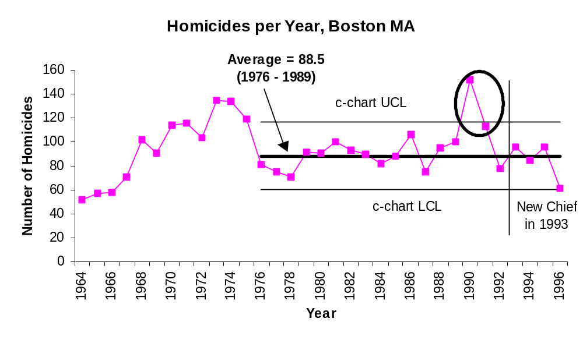
More Fun with Numbers 2

Slide 30
“Murder rate rises in Boston”
BOSTON (AP) — The number of murders in Boston rose in 2000 after years of steady decline, partially due to an alarmingly violent first six months.
The final tally was 37 — up from 31 last year.
[Police Commissioner] Evans noted that there were no homicides in October or November
For 2001, AP reported a 67% increase

Slide 31
Data Sanity
We can either react to numbers, with explanations of every percent change, with the inherent frustrations, fear, and failure
Or
We can understand our data, put it to good use, and apply valid management principles
The choice is ours.

Slide 32
What’s Next
Dr. Deming’s System of Profound Knowledge
Four elements, you have been exposed to one so far
Hands-on training making charts, including the Red Bead results from today
“Life Cycle of a Trend” to fit this in with an improvement methodology

Slide 33
Resources
Hanford Trending Primer http://www.hanford.gov/safety/vpp/trend.htm
HNF-GD-10677 Statistical Process Control
Monthly Hanford PI Forum Materials
Hands on training tomorrow
American Society for Quality
http://www.asq.org
The Elsmar Cove Discussion Board http://elsmar.com/Forums/index.php

Slide 34
Conclusion
Statistical Process Control is not just a charting technique
SPC is a way of doing business
SPC approach saves money
SPC has proven very successful at Hanford, allowing the workforce to make significant improvements

