Slide 1
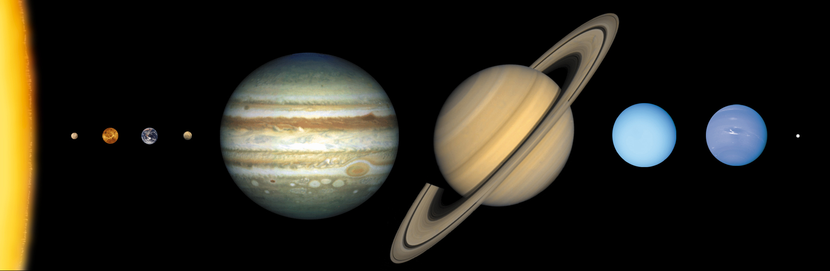
Planetary Magnetic Fields

Slide 2
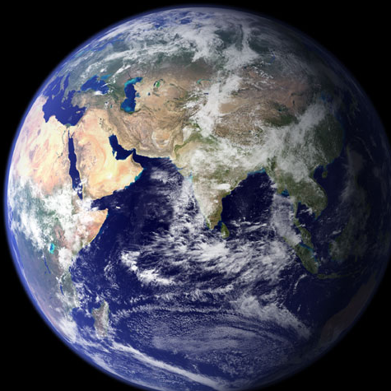
Like many Planets in our Solar System the Earth has a Magnetic Field

Slide 3
The Earth behaves as if there was a magnet in its interior.
S
N

Slide 4
The North Pole of the Earth has a “south” polarity
S
N

Slide 5
As a result a compass will always point towards the North
S
N

Slide 6
A compass is a Magnetized piece of metal that can spin.
S
N
S
N

Slide 7
A compass is a Magnetized piece of metal that can spin.
S
N
North attracts South
S
The north tip of the compass always points towards the North Pole of the Earth
N

Slide 8
A Magnetic Field also protects us from the Solar Wind

Slide 9
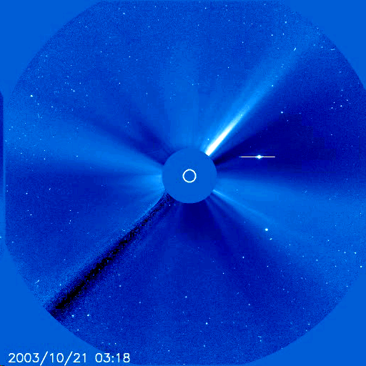
The Sun produces a stream of charged particles that spread throughout the solar system.

Slide 10
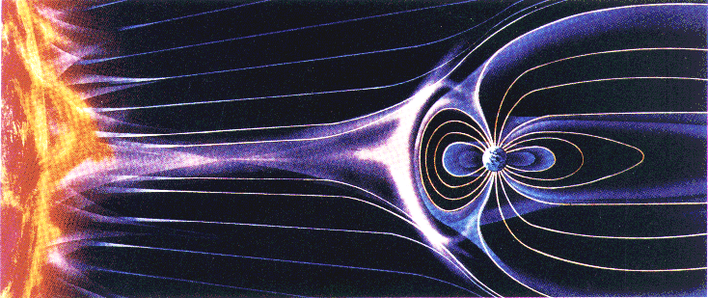
These particles are deflected by the Earth’s Magnetic Field

Slide 11
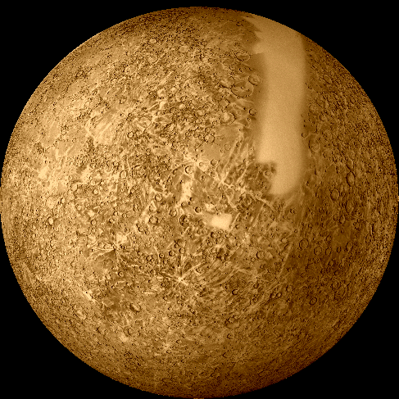
What causes a Planet’s Magnetic Field?

Slide 12

The Earth’s Magnetic Field is created in the same way you make an electromagnet

Slide 13
In an electromagnet the electrons move around an iron nail
+
-

Slide 14
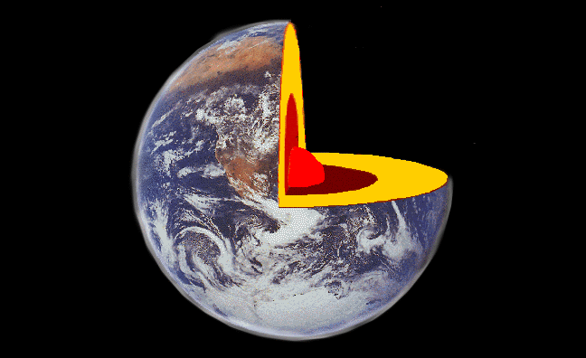
The Earth is made of four layers

Slide 15
The Crust:
A Thin Rock Material

Slide 16
The Crust:
A Thin Rock Material
The Mantle:
A Dense and Mostly Solid Rock Material

Slide 17
The Crust:
A Thin Rock Material
The Mantle:
A Dense and Mostly Solid Rock Material
The Outer Core:
Liquid Iron and Nickel

Slide 18
The Crust:
A Thin Rock Material
The Mantle:
A Dense and Mostly Solid Rock Material
The Outer Core:
Liquid Iron and Nickel
The Inner Core:
Solid Iron and Nickel

Slide 19
The Iron Core of the Earth is an Electromagnet

Slide 20
The Iron Core of the Earth is an electromagnet
The core is surrounded by liquid Iron and Nickel

Slide 21
The Iron Core of the Earth is an electromagnet
The core is surrounded by liquid Iron and Nickel
As electrons flow around the core the magnetic field is produced

Slide 22
The Iron Core of the Earth is an electromagnet
The core is surrounded by liquid Iron and Nickel
As electrons flow around the core the magnetic field is produced
The Earth’s rotation makes the electrons flow at very high speeds

Slide 23
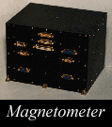
A planet’s magnetic field is measured using an instrument called a Magnetometer

Slide 24
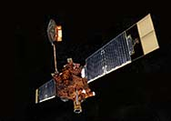
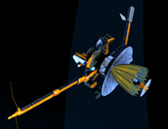
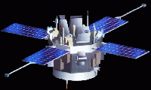
Many spacecraft carry Magnetometers to measure the Magnetic Field.
Advanced Composition Explorer
Galileo
Mars Global Surveyor

Slide 25
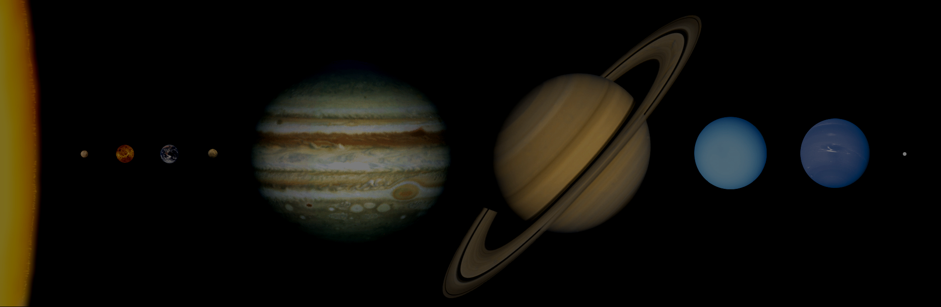
Other Planets in our Solar System have Magnetic Fields
Planet
Magnetic Field
Mercury
100 times weaker than Earth
Venus
25,000 times weaker than Earth
Earth
30,000 – 60,000 nT
Mars
5000 times weaker than Earth
Jupiter
20,000 times greater than Earth
Saturn
540 times greater than Earth
Uranus
40 times greater than Earth
Neptune
¼ that of Earth
Pluto
None that we know of

Slide 26
Mercury
Mercury has a weak magnetic field.

Slide 27
Mercury
Mercury has a weak magnetic field.
This suggests Mercury has an iron core with liquid interior.

Slide 28
Mercury
Mercury has a weak magnetic field.
This suggests Mercury has an iron core with liquid interior.
The weak magnetic field could be the result of the slow rotation period.

Slide 29
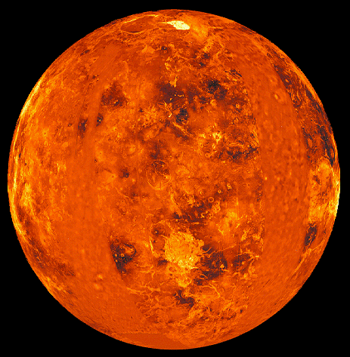
Venus
Venus has a very weak magnetic field.
(About 25,000 times weaker than Earth’s)

Slide 30
Venus
Venus has a very weak magnetic field.
(About 25,000 times weaker than Earth’s)
Venus appears to lack the necessary ingredients to generate a magnetic field
(no liquid core?)

Slide 31
Venus
Venus has a very weak magnetic field.
(About 100,000 times weaker than Earth’s)
Venus appears to lack the necessary ingredients to generate a magnetic field
(no liquid core?)
Venus also has very slow rotation.

Slide 32
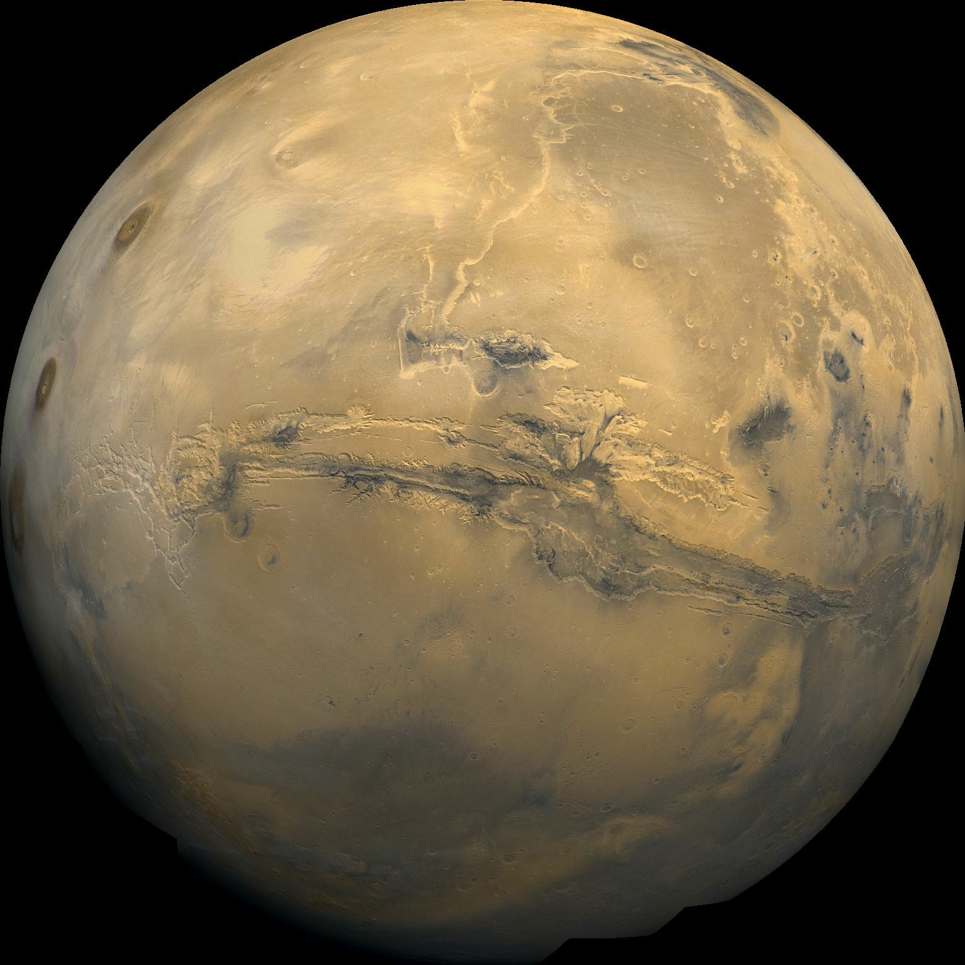
Mars
Mars also has a very weak magnetic field.
(About 5,000 times weaker than Earth’s)
The interior of Mars appears to have cooled so much that it is no longer liquid.

Slide 33
Mars
Mars also has a very weak magnetic field.
(About 5,000 times weaker than Earth’s)
The interior of Mars appears to have cooled so much that it is no longer liquid.
The volcanoes in Mars are no longer active

Slide 34
Mars
Mars also has a very weak magnetic field.
(About 5,000 times weaker than Earth’s)
The interior of Mars appears to have cooled so much that it is no longer liquid.
The volcanoes in Mars are no longer active
There is no Earthquake activity on Mars

Slide 35
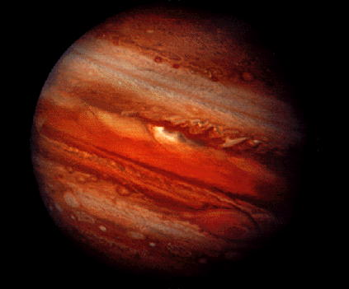
Jupiter
Jupiter has a strong magnetic field.
(About 20,000 times stronger than Earth’s)

Slide 36
Jupiter
Jupiter has a strong magnetic field.
(About 20,000 times stronger than Earth’s)
The Terrestrial planets generate magnetic fields from iron at the center.
But Jupiter has almost no iron core.

Slide 37
Jupiter
Jupiter has a strong magnetic field.
(About 20,000 times stronger than Earth’s)
The Terrestrial planets generate magnetic fields from iron at the center.
But Jupiter has almost no iron core.
The magnetic field of Jupiter is produced by the motion of liquefied metallic hydrogen found beneath the surface.

Slide 38
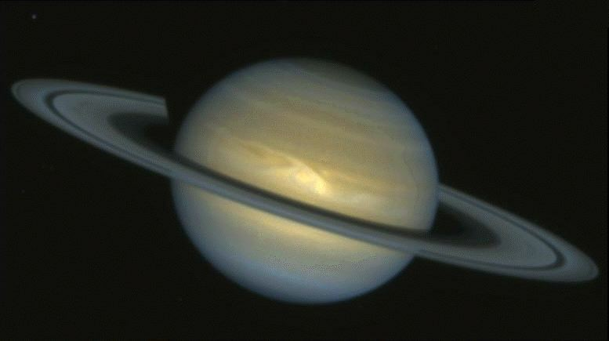
Saturn
Saturn also has a strong magnetic field.
(About 540 times stronger than Earth’s)

Slide 39
Saturn
Saturn also has a strong magnetic field.
(About 540 times stronger than Earth’s)
Saturn’s magnetic field is produced in the same way Jupiter’s is.

Slide 40
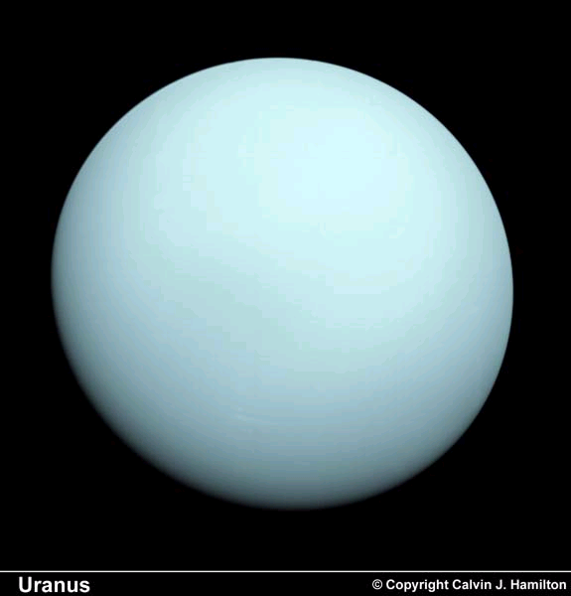
Uranus
The magnetic field in Uranus is about 40 times stronger than Earth’s

Slide 41
Uranus
The magnetic field in Uranus is about 40 times stronger than Earth’s
It is probably created in the core of the planet, with ice, rather than with iron.

Slide 42
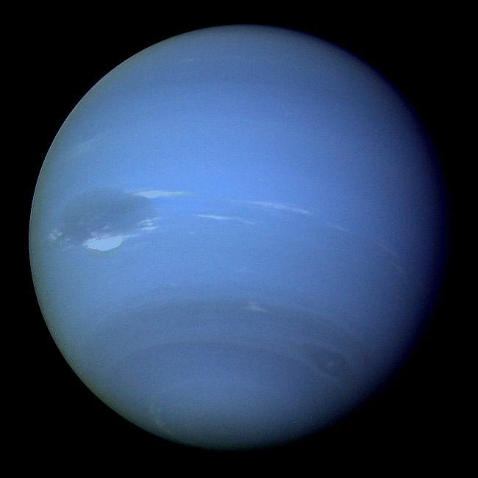
Neptune
The magnetic field in Uranus is about 1/4 times as strong as Earth’s

Slide 43
Neptune
The magnetic field in Uranus is about 1/4 times as strong as Earth’s
It is probably created in the same way as Uranus

Slide 44
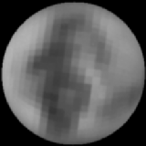
Pluto
We do not know if Pluto has a magnetic field.

Slide 45
Pluto
We do not know if Pluto has a magnetic field.
Because Pluto has a small size and a slow rotation rate (1 day in Pluto = 6.4 Earth days), it does not seem likely that Pluto has a magnetic field.

Slide 46
end

