Slide 1



Slide 2
Cardima, Inc.’s
Revelation® Tx Microcatheter with NavAblator™ RF Ablation System
FDA Circulatory System Devices Panel Meeting
P020039
May 29, 2003

Slide 3
Overview of Presentation
FDA Review Team
History of FDA Interactions with Cardima
Non-clinical Evaluation
Clinical & Statistical Evaluation
Conclusions
Panel Questions

Slide 4
PMA Review Team
Cindy Demian, MSBE, Lead Reviewer
Lesley Ewing, MD, Clinical Review
Heng Li, PhD, Statistical Review
Nick Jensen, DVM, MS, Animal Review
James Cheng, MSEE, Electrical Engineering Review
Lisa Kennell, Sterilization Review
Barbara Crowl, Bioresearch Monitoring Review

Slide 5
Proposed Indications for Use
"The Cardima® Inc., REVELATION® Tx Microcatheter with
NavAblator™ RF Ablation System is indicated for treatment of Atrial
Fibrillation in patients with drug refractory paroxysmal atrial
fibrillation by mapping, pacing, and ablating with a compatible
radiofrequency generator, creating a set of continuous linear
lesions along the lateral and septal walls and along the isthmus in
the right atrium.
The REVELATION® Tx is intended for the creation of continuous
linear lesions for the purpose of interrupting arrhythmia pathways.
The NavAblator™ is intended for the creation of lesions at the
isthmus for the purpose of interrupting arrhythmia pathways when
the REVELATION® Tx is not used to complete the isthmus region."

Slide 6
Proposed Indications for Use
"The Cardima® Inc, REVELATION® Tx
Microcatheter Ablation System is indicated for
treatment of Atrial Fibrillation in patients
with drug refractory paroxysmal atrial fibrillation
by mapping, pacing, and ablating with a set of
continuous linear lesions in the right atrium.”

Slide 7
Brief History of
FDA Interactions with Cardima
December 1997
Feasibility study approved
  10 patients
July 1998
FDA Advisory Committee makes recommendations for atrial fibrillation clinical study designs
  Single arm, patient serves as own control
  Reduction (75%) or cure as clinically significant endpoints

Slide 8
History (cont’d)
August 1998
First progress report (n=5)
  Problems with creating isthmus line with Revelation Tx
    Sponsor opted to design standard 4mm catheter (which was necessary to complete the procedure)
    Agency informed Cardima that use of non-investigational device would be considered
    a failure in terms of the clinical trial
December 1998
Progress report on next 5 patients (total n=10)
  Still widespread (7/10) use of non-investigational catheters

Slide 9
History (cont’d)
May 2000
Approval to begin the pivotal trial, Phase III
Addition of NavAblator (4mm) Catheter
  Sample Size (n=80) for Phase III
  Sample Size was based on confidence
  interval width
FDA continues to state that use of non-investigational catheters were considered failures

Slide 10
History (cont’d)
June 2000
Cardima states that feasibility patients will not be pooled with the pivotal patients
May 2001
Progress report on Phase IIb patients
  FDA concerns for conduct of pivotal trial based on feasibility study results
    Patient non-compliance with transtelephonic monitoring (TTM)
    Varying definitions of acute success

Slide 11
System Components
Catheters
  Revelation™ Tx Micro Ablation Catheter (3.7 F)
  NavAblator™ (4mm) Ablation Catheter (8F)
Accessories
  Naviport™ Guiding Catheter
  Revelation™ Tx Select Switch Box
  Revelation™ Tx Cables
No Generator
  RF Generator Compatibility

Slide 12
Revelation® Tx Microcatheter
3.7 French single use catheter, steerable, non-deflectable with an atraumatic distal tip coil, flexible, non-electrically active tip
8 electrodes & 8 thermocouples temperatures sensors on distal end of the catheter
Ablation electrodes - 6mm long 90%Pt/ 10% Ir tip
RF is applied to each individual electrode to produce thin linear radiofrequency ablation lines
Used with a deflectable guiding catheter (Naviport) to properly position the distal tip

Slide 13
NavAblator™ Catheter
8 French (4mm) Ablation catheter, single use, deflectable with an electrically active tip
4 electrodes, including one embedded in its tip just proximal to a thermocouple
Intended to create spot lesions
Used without a guiding catheter
Control mechanism in handle that activates a pull wire to steer and deflect the tip

Slide 14
Naviport™ Guiding Catheter
Aids in the positioning of the Revelation™ Tx
Sterile, single use only, dual lumen (a device lumen and closed pull wire lumen)
Cleared through 510(k)
Deflecting mechanism allows tip to be straightened while being inserted into & deflected while in the heart
Friction-locking mechanism permits the distal tip to retain its deflected shape once the catheter is in position for ablation

Slide 15
FDA Preclinical Review Goals
Safety
  ensure that the device has been appropriately designed and tested, and that safety features have been qualified
  for use
Reliability
  – ensure that the device design and
  manufacture provides assurance of consistency with performance specifications

Slide 16
Catheter
Preclinical Qualification
Biocompatibility of catheter materials
Reliability of catheter design
Mechanical testing of catheter performance
Electrical testing of catheter performance
Qualification of sterilization procedures

Slide 17
Preclinical Testing Conclusions
Preclinical testing performed by the sponsor is designed appropriately and met the pre-specified pass/fail criteria
Testing shows that the device can be reliably manufactured to meet the product specifications

Slide 18
Device Failures-
Observed in Clinical Trial
Revelation Tx
Electrical Failure
Complaints-
  Thermocouples never registered temperature
  Electrodes did not ablate
  Noisy ECG Signals
  Electrode noise or
  Cross talk
Coagulum | 5
Delamination of THV coating on catheter shaft | 7
Electrical Failures* | 21
[Customer Experience Reports]

Slide 19
Clinical Summary
Lesley Ewing, M.D.

Slide 20
Proposed Indications for Use
The Cardima® Inc, REVELATION® Tx Microcatheter with NavAblator™ RF Ablation System is indicated for treatment of Atrial Fibrillation in patients with drug refractory paroxysmal atrial fibrillation by mapping, pacing, and ablating with a compatible radiofrequency generator, creating a set of continuous linear lesions along the lateral and septal walls and
along the isthmus in the right atrium.

Slide 21
Proposed Indications for Use
The REVELATION® Tx is intended for the creation of continuous linear lesions for the purpose of interrupting arrhythmia pathways.
The NavAblator™ is intended for the creation of lesions at the isthmus for the purpose of interrupting arrhythmia pathways when the REVELATION® Tx is not used to complete the isthmus region"

Slide 22
Study Design
Single arm, non-randomized,
multi-center study which began in 1997
Three study phases
PMA data from phases IIb & III

Slide 23
Inclusion Criteria
Symptomatic paroxysmal atrial fibrillation (PAF) refractory to at least two antiarrhythmic drugs (AAD) or one if amiodarone
Three or more episodes during the
30 day baseline period
21 to 80 years
Normal sinus rhythm at eps or can be converted

Slide 24
Exclusion Criteria
  Prior acute ablation failure within 2 months
  AMI within 6 weeks
  Contraindication or unable to comply with long-term anticoagulation
  Valvular disease, aneurysm or LVH with NYHA class III or IV
  Coagulopathy or bleeding diathesis
  CVA or TIA within 6 months
  Intra-cardiac thrombus
  Echocardiographic PFO or ASD
  LA dimension > 5cm

Slide 25
Baseline Pre-Ablation Procedure
30 day baseline screening period with minimum of 3 episodes of PAF to be eligible for ablation
Patients were aware than a minimum number of episodes were required
Re-screening allowed
Re-screening total time period was 90 days with a total of 9 episodes required

Slide 26
Ablation Procedure
Three linear lesions specified in protocol
  Posterolateral
  Posteroseptal
  Tricuspid Isthmus
Anterior lesion optional
All lesions to be attempted first with the REVELATION Tx and if tricuspid isthmus lesion was not successful then NavAblator catheter to be used

Slide 27
Follow-up
Assessments at 1, 3, 6, 12 & 24 months
QOL questionnaires at 3 & 6 months
Transtelephonic monitor (TTM) up
to 6 months
Weekly TTM “compulsory” during the 1st, 3rd, 6th month post ablation even without symptoms

Slide 28
Primary
Effectiveness Endpoint
Reduction in frequency of symptomatic episodes during the 6th month post ablation procedure compared to the baseline period while on same medication/s or reduced dosage
  50% less if at baseline 5 or greater episodes
  75% less if at baseline 3 or 4 episodes
Episodes to be documented by transtelephonic monitoring (TTM)

Slide 29
Secondary
Effectiveness Endpoint
Improvement in the quality of life assessed by SF-36 and Atrial Fibrillation Severity Scale (AFSS) compared to baseline

Slide 30
Procedural Success
Demonstration of one of the following at the lines of ablation during sinus rhythm:
    Reduction in the amplitude, fragmentation or widening of local electrograms
    Split potentials
    Increase in pacing threshold
      Requirement to measure deleted from phase III protocol

Slide 31
Safety Endpoint
Incidence of complications-
major complications in the first 7 days post ablation and adverse events in the
24 months follow-up period

Slide 32
Study Results
120 patients have had the linear ablation procedure, 116 with verified data
89/116 male (76.6%)
Mean age of all patients 56.9 ± 10.9 years
72.4% had other heart disease
8 patients with pre-existing pacemaker
33/116 had had a prior ablation

Slide 33
Ablation Procedure
Mean procedure time 250 ± 123 minutes,
range 100 to 755 minutes
Mean fluoroscopy time 47 ± 46 minutes,
range 2 to 265 minutes

Slide 34
Linear ablation procedure
n=120
Verified data
Safety cohort
N=116
Unverified data
N=4
Unambiguous baseline episodes
N=111
Ambiguous baseline episodes
N=5
Less than 6 months f/u
n=21
Lost to f/u
N=2
Effectiveness cohort
N=88

Slide 35
Study Results
Safety cohort = 116 patients
Effectiveness cohort = 88 patients

Slide 36
AF Episodes at Baseline
excluding 5 patients with disputed baseline numbers
 | # of patients | % of total
≤5 | 41 | 38.7
6-10 | 38 | 35.9
11-15 | 11 | 10.4
16-20 | 7 | 6.6
21-25 | 2 | 1.9
>26 | 7 | 6.6

Slide 37
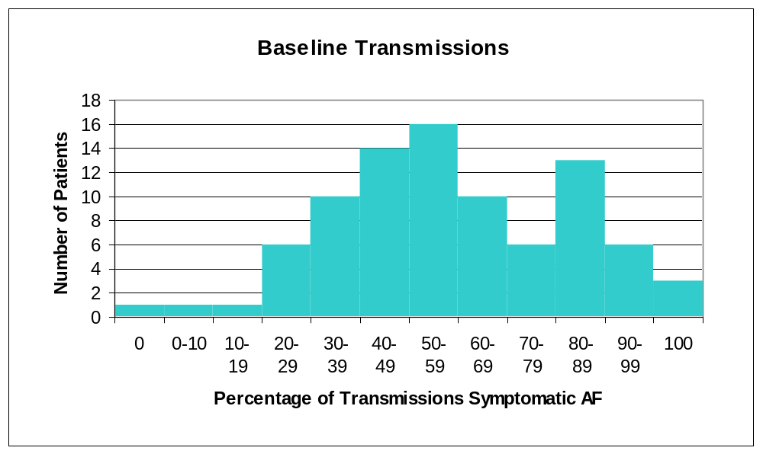
% of All Transmissions that were Diagnosed to be Atrial Fibrillation

Slide 38
Baseline AF Episodes
Percent of symptomatic transmissions that were diagnosed to be AF ranged from 12.9% to 100%
Unknown whether each transmission represents a discrete AF episode

Slide 39
Ablation Procedure Performed
Patients did not all have the same lesion set performed
Revelation Tx catheter used for all septal and lateral linear lesions
Some patients had only a non-investigational catheter used for the tricuspid isthmus lesion
The non-investigational catheters used were from 5 different manufacturers and included a cooled tip catheter

Slide 40
Ablation Lesions Performed
A=lateral, B=septal, C=isthmus, D=anterior
Lesion lines | Number of patients | %
ABC (protocol) | 95 | 82.6
AB | 7 | 6.1
ACD | 6 | 5.2
AC | 2 | 1.7
ABCD | 3 | 2.56
BC | 1 | 0.8
BCD | 1 | 10.8
Total | 115 | 100

Slide 41
Devices used to create tricuspid isthmus lesion
Catheters | Number of patients (%)
 | Phase IIb n=33 | Phase III n=75 | Total N=108
Revelation Tx only | 14 (42.4) | 7 (9.3) | 21 (19.4)
Revelation Tx, other | 7 (21.2) | 1 (1.3) | 8 (7.4)
Revelation Tx, NavAblator | n/a | 2 (2.7) | 2 (1.9)
NavAblator only | n/a | 47 (62.7) | 47 (43.5)
NavAblator, other | n/a | 10 (13.3) | 10 (9.3)
Other only | 12 (36.4) | 8 (10.7) | 20 (18.5)

Slide 42
NavAblator Use
Per protocol to be used if REVELATION Tx unsuccessful at the tricuspid isthmus
Used in 59/116 patients (51%)
57/59 was first catheter used at isthmus
10/59 a non-investigational catheter was also required
Successful bidirectional conduction block at tricuspid isthmus in 42/59 (71%)
  Non-investigational catheters used alone at tricuspid isthmus 19/19 (100%) successful bidirectional conduction block

Slide 43
Procedural Success
“Sufficient data to demonstrate either
success or failure for the procedural
endpoint are not available”
[page 48, Clinical Summary]

Slide 44
TTM in the 6th
Month Post Procedure
Data submitted on 83 patients
22 patients with no TTM
31 patients had 1-3 TTM
53/83 (63.9%) poor compliance with TTM in the 6th month

Slide 45
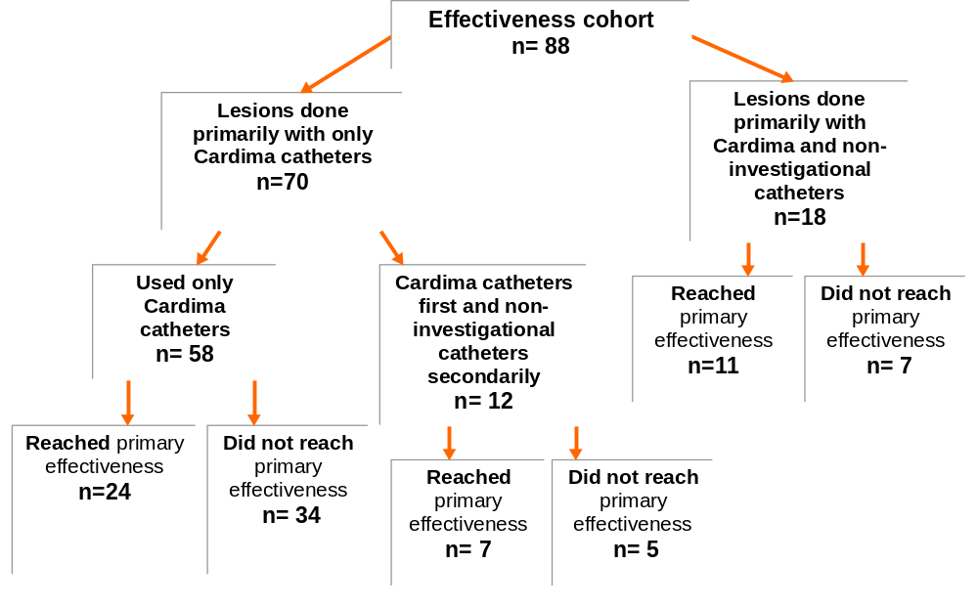
Primary Effectiveness Endpoint
[From Figure 1
FDA clinical review]

Slide 46
Investigational Device System Success
Reduction in of symptomatic episodes during the 6th month post ablation compared to baseline while on same medication/s or reduced dosage
42/88 (47.7%) patients
reached primary effectiveness endpoint
24 patients with successful investigational device system evaluation
18 patients required a non-investigational catheter to complete the ablation procedure
7 patients investigational catheter unable to complete isthmus lesion and non-investigational catheter required
11 patients with only
non-investigational catheters used for isthmus lesion

Slide 47
Patients that
Failed Primary Endpoint
8 had AV node ablation prior to the 6th month
5 had pacer prior to the 6th month
1 withdrew due to failure to improve
9 did not have sufficient episode reduction
21 did have episode reduction but with new AAD or increased dose (includes 2 patients with a pacemaker implantation)
2 had both increase in AAD and an insufficient reduction in episodes

Slide 48
Patients with No
AF Events in the 6th Month
43/88 reported/transmitted no events in this month
2/43 have had an AV node ablation,
one prior to the 6th month and one after
1/43 had a surgical MAZE after the 6th month
1/43 had an atrial defibrillator after the 6th month
7/43 had had amiodarone added prior
to the 6th month

Slide 49
AAD in the 6th Month
Data on 82/88 available
14 patients on no AAD or no Class I or III 6/14 unchanged from baseline
26 patients had increase in AAD
Amiodarone added in 6 & removed in 10

Slide 50
AV Node Ablation & Surgical MAZE Post Ablation Procedure
10/88 patients had an AV node ablation procedure after the linear percutaneous ablation procedure
2/88 patients had a surgical MAZE procedure after the linear percutaneous ablation procedure

Slide 51
Secondary
Effectiveness Endpoint
Improvement in the quality of life assessed by SF-36 and Atrial Fibrillation Severity Scale compared to baseline

Slide 52
Clinically Significant Improvement Quality of Life Scores
Measurement Scale | Total (freq/n, (%))
SF-36
Physical Functioning | 29/76 (38.2)
Role Physical | 35/80 (43.8)
Role Emotional | 26/78 (33.3)
Bodily Pain | 37/81 (45.7)
General Health | 28/79 (35.4)
Vitality | 45/80 (56.3)
Social Functioning | 39/80 (48.8)
Mental Health | 23/80 (28.8)
AFSS
Episode Frequency | 42/68 (61.8)
Episode Duration | 27/66 (40.9)
Episode Severity | 45/75 (60.0)
AFSS Total | 35/64 (54.7)

Slide 53
Major Complications
Patient ID
III 606 | Sinus node damage, pacing required
III 514 | Tamponade requiring pericardial window
III 1702 | AV fistula requiring surgical repair
IIb 508 | Sinus node dysfunction requiring urgent temporary pacing and implant within 3 days of procedure
IIb | Embolic stroke in patient with protein C deficiency
Three other patients required a pacemaker within two weeks of the procedure:
two for bradycardia and one for an abnormal SNRT

Slide 54
Safety
5/116 or 4.3% (1.7%, 9.4%) patients had one or more major complication
Possible safety concern:
  20 patients had pacemaker implanted
  1 day to 1.5 years after ablation,
  9 of these had AV node ablation also
  7/88 (8%) had pacemakers implanted within 6 months of the ablation procedure without AV node ablation

Slide 55
Statistical Summary
Heng Li, Ph.D.
Division of Biostatistics

Slide 56
Study Design
Single arm, non-randomized, multi-
center, with subjects serving as their
own controls, i.e., with treatment effect
evaluated by comparing post
treatment measurements with the
corresponding pre-treatment
measurements

Slide 57
Investigational Protocol
Absence of a proposed rule that
specifies what the study results have
to be in order for the investigational
device to be approved

Slide 58
General Pitfalls
History
Maturation
Placebo Effect
Selection

Slide 59
Pitfall: Placebo Effect
The secondary effectiveness endpoints
are subjective self evaluations and are
therefore particularly vulnerable to
Placebo effect.

Slide 60
Pitfall: Maturation
The motivation to record AF episodes
and the ability to avoid multiple
recording of single episode may
change over time, affecting the
evaluation of the primary effectiveness
endpoint

Slide 61
Pitfall: Selection
Patients with overall AF frequency
lower than 3 per 30 day period may be
selected, and those patients may
experience ‘regression to the mean’

Slide 62
A Unique Issue:
Non-Investigational Devices
Study procedures were performed
using non-investigational devices on a
number of study subjects who are not
randomly selected

Slide 63
A Unique Issue:
Non-Investigational Devices
The patients who are treated only with
investigational devices do not form a
random subgroup of all the study
subjects

Slide 64
Clinical & Statistical Summation
Lesley Ewing, M.D.

Slide 65
The ablation procedure (lesions made and catheters used) was not the same for all patients in the study.
    There were a variety of investigational and non-investigational catheters used for one of the lesions.
    A small number (38/116 or 33%) of patients had the ablation procedure performed using the investigational device system as specified by the protocol.
    Some patients did not have the lesion set performed as specified by the protocol.

Slide 66
As a result of the unblinded study design there could be bias toward reporting AF episodes at baseline and against reporting in the 6th month.
Acute procedural success can not be assessed for the procedures in the study due to incomplete reporting of the various acute procedural endpoints.
Some patients had further procedures to treat PAF after the linear ablation procedure.

Slide 67
20 patients had a pacemaker implanted 1 day to 1.5 years post procedure.
There was poor compliance with “compulsory” TTM during the 6th month.
More than 50% of patients had clinically significant improvement in two AFSS domains. The QOL results include data from patients with ambiguous number of baseline episodes and some patients who had an AV node ablation procedure.

Slide 68
Conclusion
From the clinical and statistical
perspective, it is not clear if the data can
support any conclusion about the safety
and effectiveness of the investigational
device system.

Slide 70
Baseline TTM
Detailed information submitted on 89 patients
62/89 transmitted multiple times per day on at least one day of the 30 days
5 patients with AF transmission twice within 5 minutes
7 patients with AF transmission at least twice within 30 minutes
26 patients with AF transmission twice between one and three hours

