Slide 1
Gravitational lensing of the CMB
Richard Lieu
Jonathan Mittaz
University of Alabama in Huntsville
Tom Kibble
Blackett Laboratory, Imperial College London

Slide 2
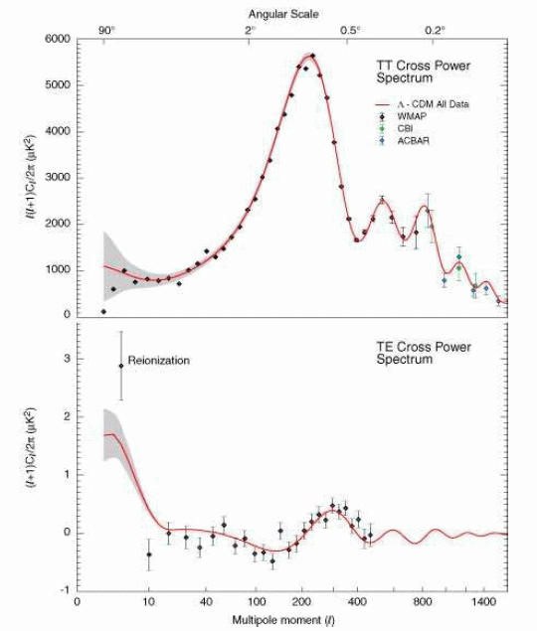

Slide 3
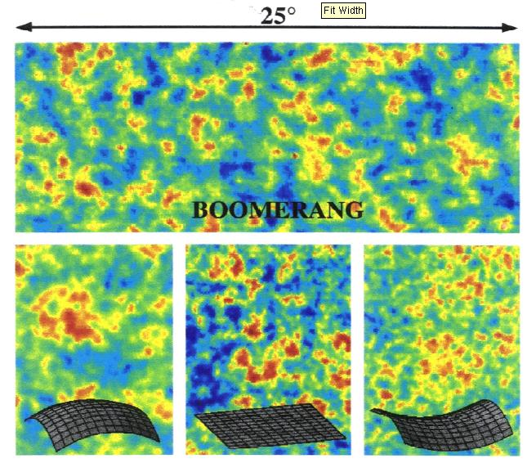
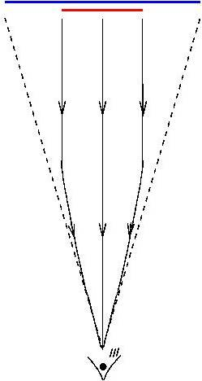
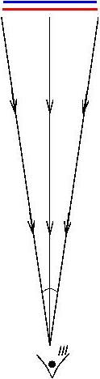
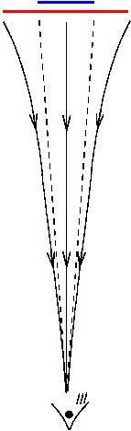
+ve curvature
Flat
-ve curvature

Slide 4
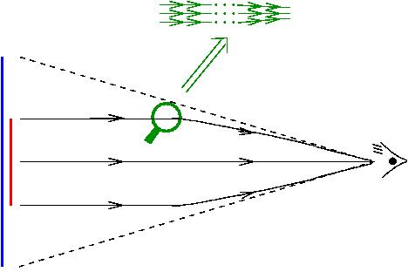
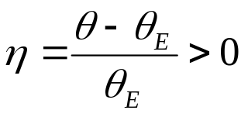
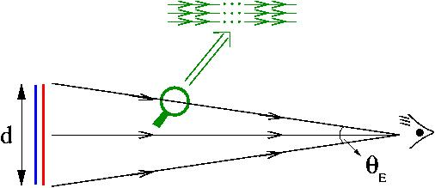
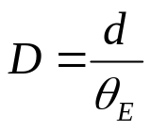
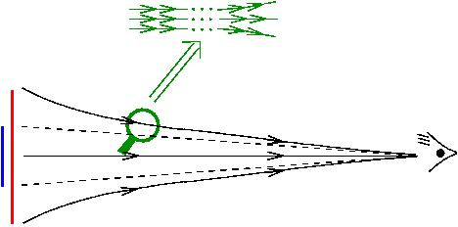
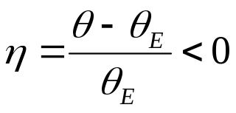

Positive curvature: parallel rays converge, sources
appear `larger’.
Source distance (or angular size distance D) is
`smaller’
Zero curvature: parallel rays stay parallel, sources
have `same’ size
Angular size distance has Euclidean value
Negative curvature: parallel rays diverge, sources
appear `smaller’.
Angular size distance D is `larger’
Angular magnification

Slide 5
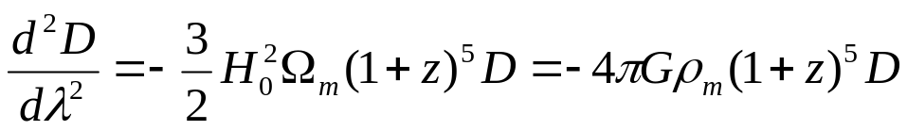
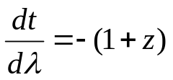

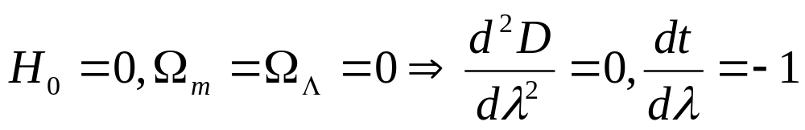
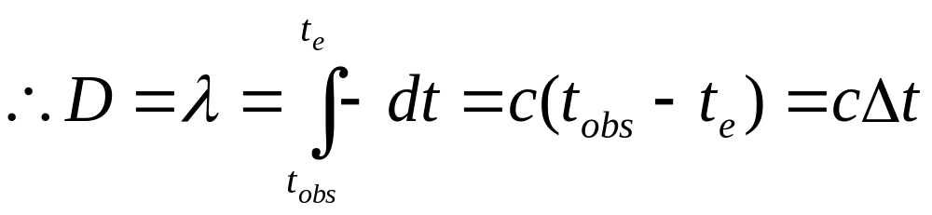

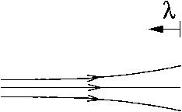
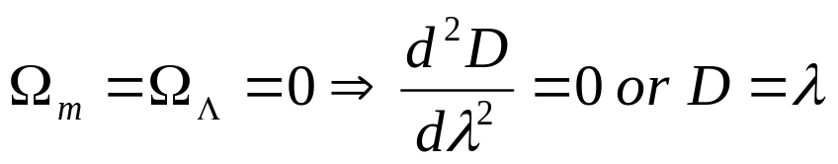

EXAMPLES TO ILLUSTRATE THE BEHAVIOR OF PROPAGATING LIGHT
The general equation is
where
Non-expanding empty Universe
Parallel rays stay parallel
Expanding empty Universe
Parallel rays diverge;

Slide 6
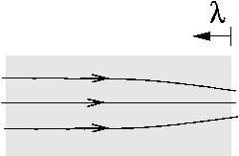
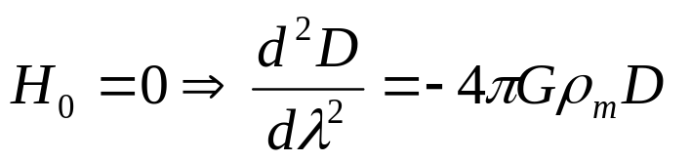

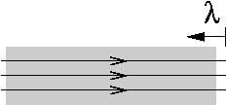
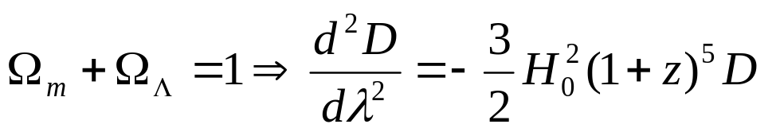
The general equation is
where
Non-expanding Universe with some matter
Parallel rays diverge;
Expanding Universe with matter and energy at critical density
Parallel rays stay parallel;

Slide 7

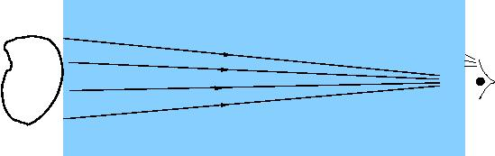

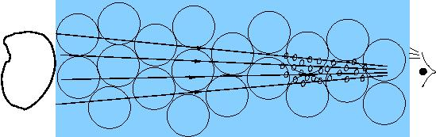
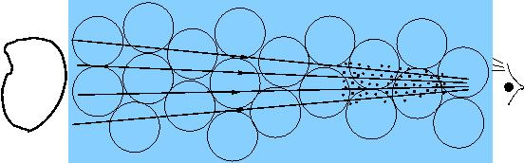
PROPAGATION THROUGH THE REAL UNIVERSE
We know the real universe is clumped. There are three possibilities
Smooth medium all along, with
WMAP papers assumed this
scenario
At low z smooth medium has
CLUMPS are small and rare
Hardly visited by light rays

Slide 8
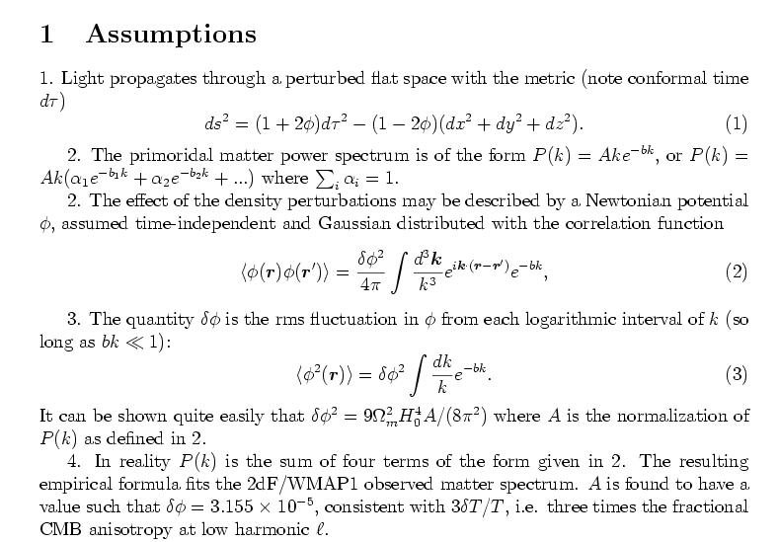
CMB lensing by primordial matter

Slide 9
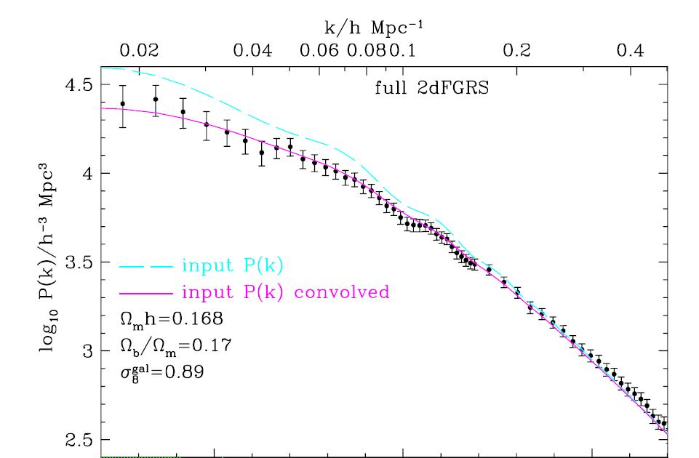
2dF/WMAP1 matter spectrum (Cole et al 2005)

Slide 10
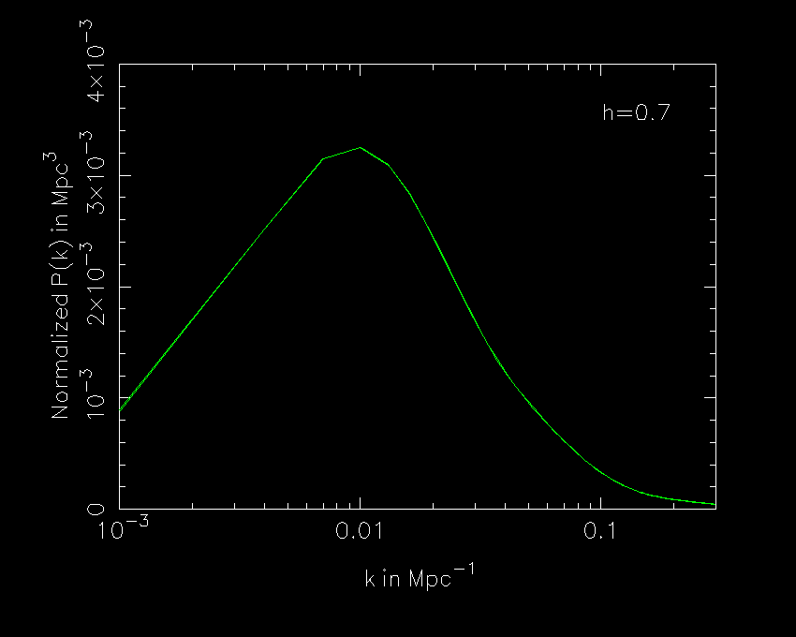

Slide 11
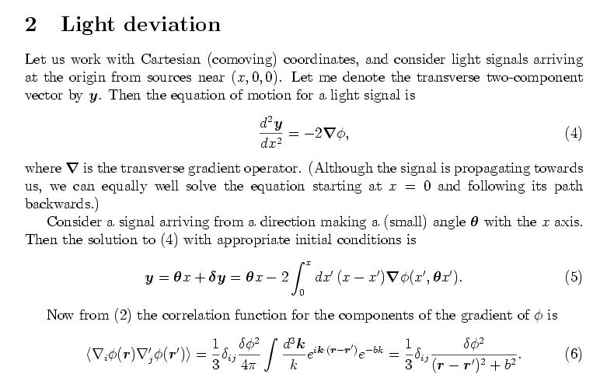

Slide 12
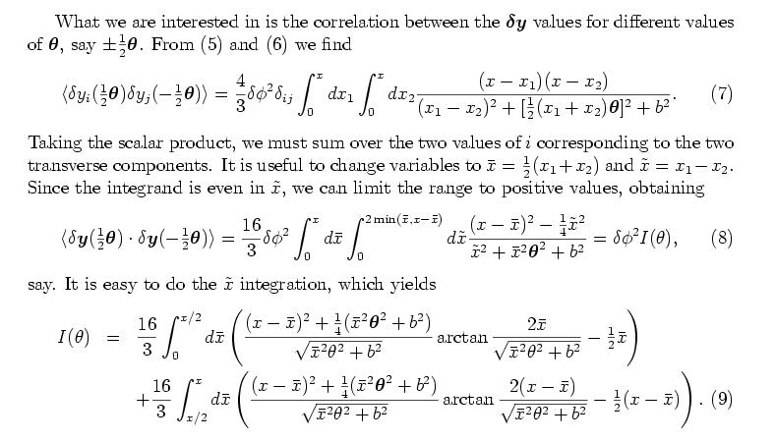

Slide 13
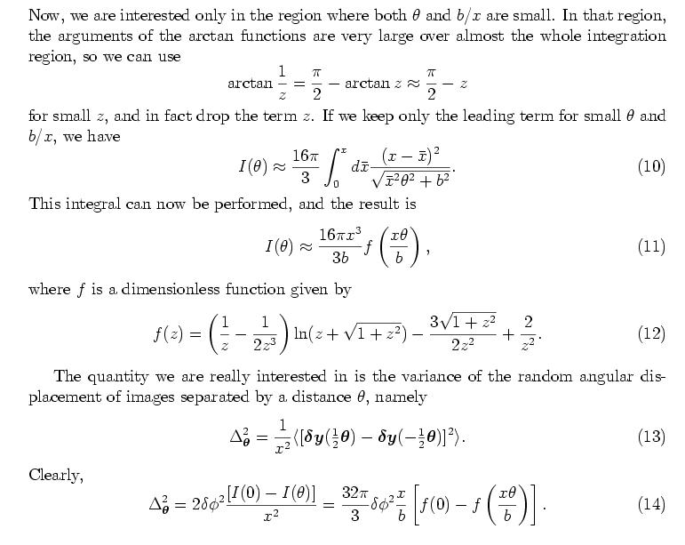

Slide 14
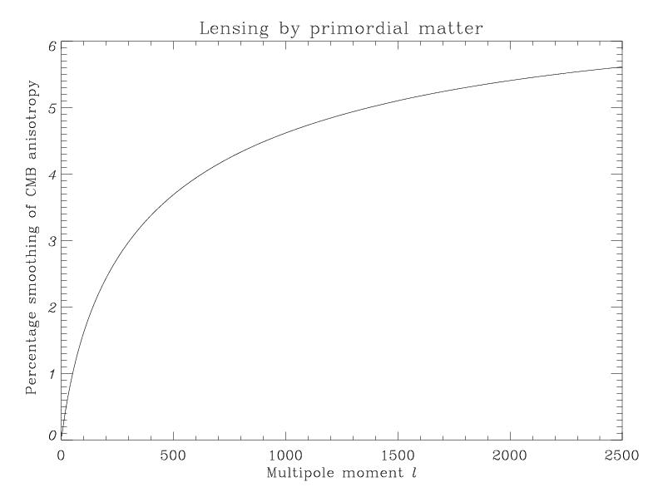

Slide 15
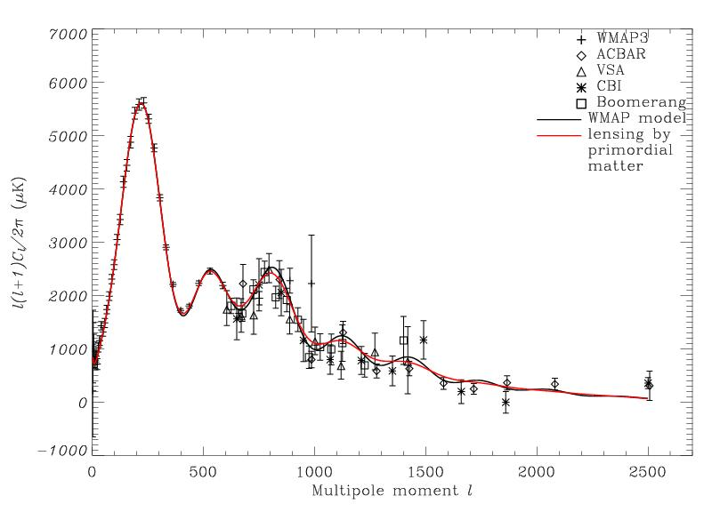

Slide 16
PROPAGATION THROUGH THE REAL UNIVERSE
We know the real universe is clumped. There are three possibilities
Smooth medium all along, with
WMAP papers assumed this
scenario
Smooth medium has
CLUMPS are small and rare
Hardly visited by light rays

Slide 17
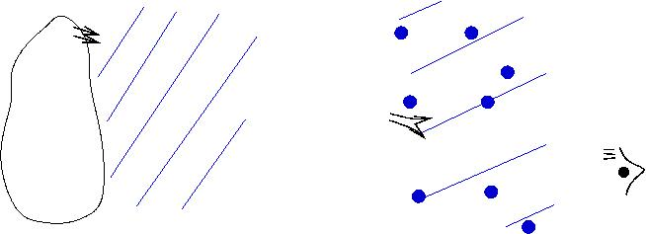

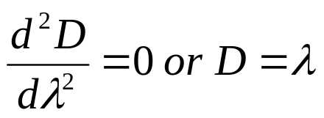
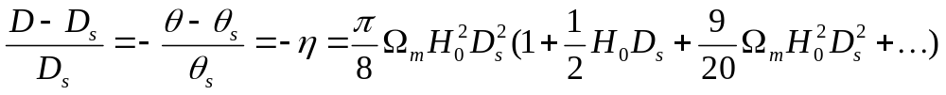


z=z_{s}
z=0
If a small bundle of rays misses all the clumps, it will map back to a demagnified region
Let us suppose that all the matter in is clumped i.e. the voids are matter free
The percentage increase in D is given by
where c=1 and & are the Euclidean angular size and angular size distance of the source
This is known as the Dyer-Roeder empty beam

Slide 18
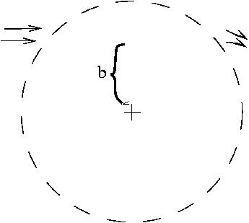
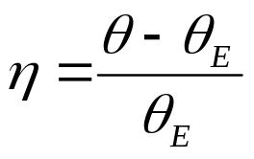
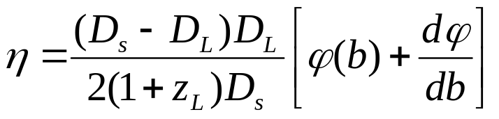
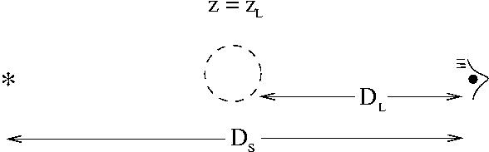
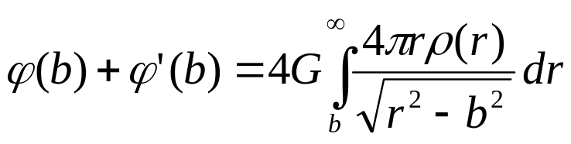

What happens if the bundle encounters a gravitational lens
where the meanings of the D’s is
assuming Euclidean distances since mean density is ~ critical. Also the deflection angle effect
is
We can use this to calculate the average

Slide 19

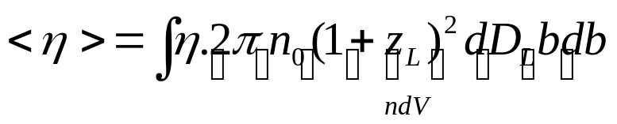
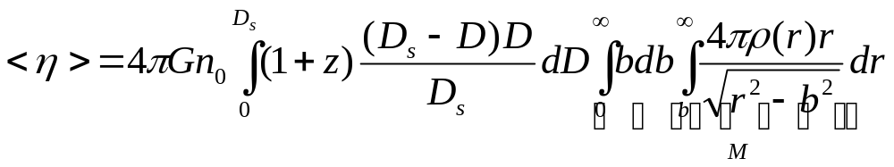
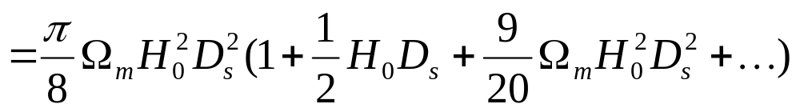
Consider a tube of non-evolving randomly placed lenses
Thus
The magnification by the lenses and demagnification at the voids exactly
compensate each other.
The average beam is Euclidean if the mean density is critical.

Slide 20
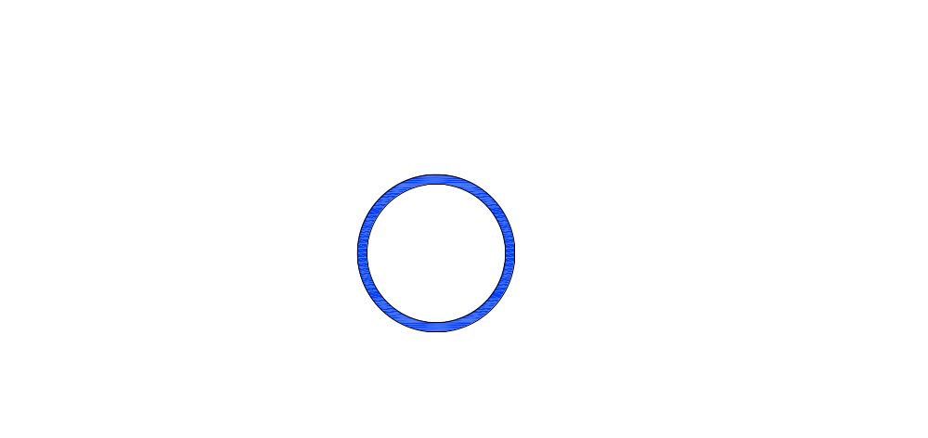
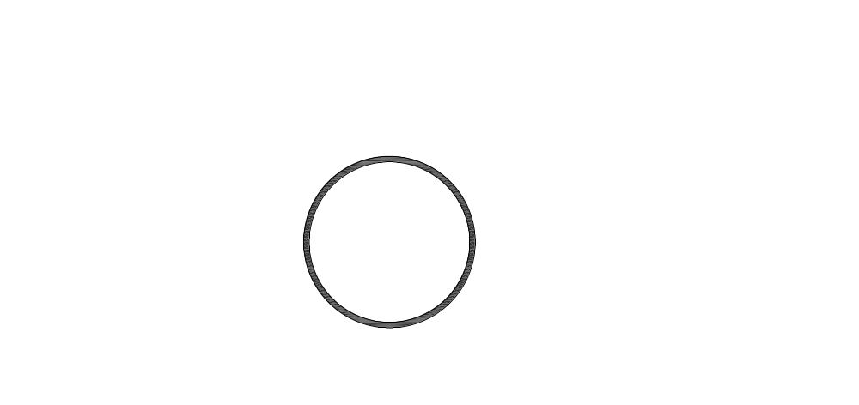

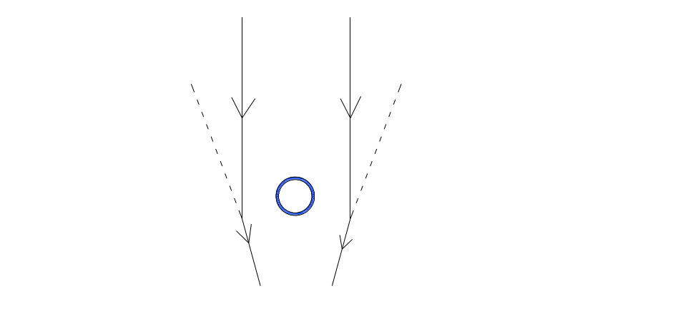
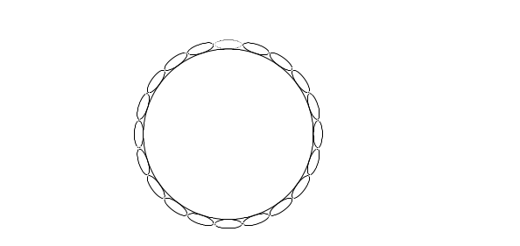
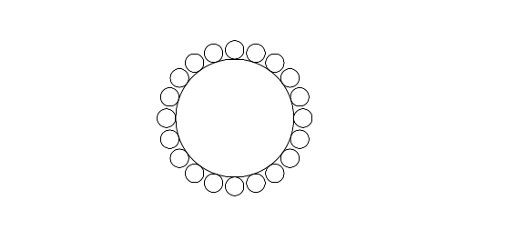
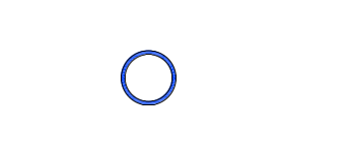
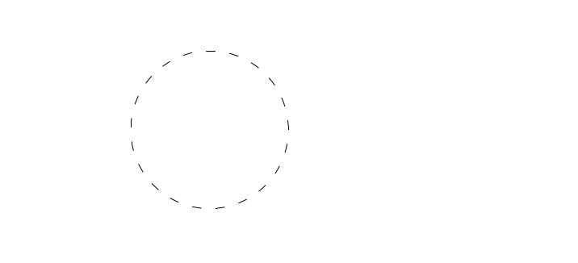


How does gravitational lensing conserve surface brightness?
Unlike ordinary magnifying glass, gravitational lens magnifies a central pixel and tangentially shear an outside pixel.
Only rays passing through the gravitational lens are magnified
The rest of the rays are deflected outwards to make room for the central magnification (tangential shearing)
Before Lensing
After Lensing
Gravitational lensing of
a large source
When lens is "inside"
source is magnified
When lens is "outside" the
source is distorted but not magnified

Slide 21


If there is a Poisson distribution of foreground
clumps extending from the observer's neighborhood
to a furthest distance D
δ θ ≈ π² GM √nD
o
Source size
Fluctuation
Number density
of clumps
Mass of
One clump
In the limit of infrequent lensing,
this is >> magnification fluctuation
due to the deflection of boundary ray
by boundary clumps, viz.
δ θ ≈ 2π² n GMRD
o
Radius of lens

Slide 22







Returning to the three possibilities
Homogeneous
Source Size
Inhomogeneous at
low z
Source Size
Clumps are missed
by most rays
Source Size

Slide 23




WHY THE PRIMORDIAL P(k) SPECTRUM DOES NOT ACCOUNT FOR
LENSING BY NON-LINEAR GROWTHS AT Z < 1
Homogeneous
Universe
Mass Compensation
(swiss cheese)
Poisson Limit

Slide 24





While the percentage angular magnification has an average of
Its variance is given by
For a large source (like CMB cold spots), this means the average angular size
can fluctuate by the amount
where

Slide 25

Cluster CMB lensing parameters

Slide 26


