Slide 1
This presentation is for illustrative and general educational purposes only and is not intended to substitute for the official MSHA Investigation Report analysis nor is it intended to provide the sole foundation, if any, for any related citations issued.

Slide 2
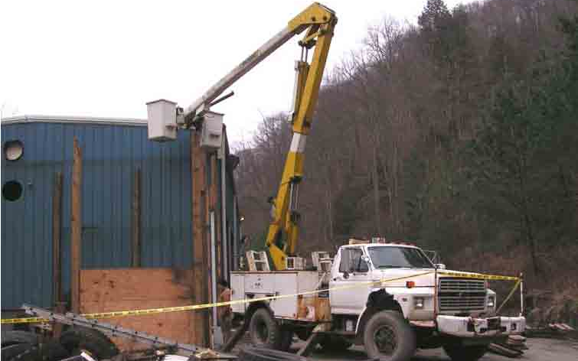
Coal Mine Fatal Accident 2004-03
GENERAL INFORMATION
Operator: Blue Diamond Coal Company, Inc.
Contractors: Chas Coal, Inc.
Tyco Trucking Company, Inc. Calvary Coal Company, Inc.
Mine: Calvary No. 80
Date: February 3, 2004
Classification: Machinery
Location: District 7, Leslie Co., Kentucky
Mine Type: Underground
Production Non-producing status

Slide 3
Prior to the accident, Calvary Coal Company, Inc. (Calvary) had operated this mine under a lease agreement with Leeco, Inc., an affiliate to Blue Diamond Coal Company (Blue Diamond).
Calvary had recently terminated its lease on the property and the mine reverted back to Blue Diamond.
At the time of the accident, Blue Diamond was in the process of reopening the mine and installing their equipment.
The sole stockholder of Calvary, and part owner of Chas Coal, Inc. (Chas), still had equipment, parts, and supplies on the mine property.
Employees of Chas, including the victim, were present on a regular basis and were in the process of moving equipment to other mines in which Calvary’s stockholder had interest.
The victim was a salaried employee for Chas, whose job duties included general maintenance and installation of major electrical systems for the mines under Calvary’s stockholder’s control; as well as the removal of the equipment and materials from this mine.
The victim last hauled equipment and supplies from this mine to Free Dome Coal, a contract operator for Chas. A truck and trailer owned by Tyco Trucking Company (Tyco) was used for this purpose.
GENERAL INFORMATION

Slide 4
A maintenance shop was constructed at the mine when it was operated by Calvary. Attached to this shop was a metal bay, built and used by Silverado Trucking, Inc. (Silverado), who had hauled coal for Calvary.
In 2003, the president of Tyco leased Silverado's trucks and took over hauling coal for Calvary. He attempted to obtain a contract with Blue Diamond to haul coal from this mine but was unsuccessful.
The victim was aware of the addition to the shop and spoke with Tyco’s president on several occasions seeking consent to remove the structure.
The victim intended to dismantle the structure and reassemble it on his neighbor’s property for private use. When Tyco’s president was unable to secure the coal haul contract, he told the victim he could have the structure.
The victim’s neighbor agreed to move the structure and share its use. The neighbor was not employed by any of the entities involved in the accident
GENERAL INFORMATION

Slide 5
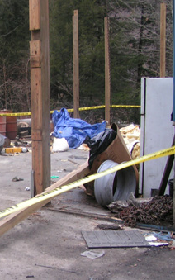
  On Saturday, January 24, 2004, the victim and his neighbor traveled to the mine to examine the structure.
  On Wednesday, January 28, 2004, the neighbor returned alone with his personal pickup truck and trailer and began dismantling the structure; and again on January 30, 2004
  On Tuesday, February 3, 2004, the neighbor returned to the site at around 10:00 a.m. and removed rafters and other materials until only the metal roll-up garage door and vertical wooden support posts remained. He was about to leave when he received a call from the victim who told him that he and his son were coming to help remove the wooden posts.
ACCIDENT DETAILS
  The posts could not be moved by hand as the concrete floor had been poured around the posts.

Slide 6
  The victim’s son helped remove equipment from the site.
  When they arrived at the mine at 4:10 p.m., they spoke with the mine superintendent. The victim asked if the dual aerial bucket truck was operational, and the superintendent told them there was nothing wrong with it.
  The superintendent also showed them where the second Power Take-Off (PTO) control was located and explained the use of the control.
  The victim checked the controls on the outriggers and then drove the bucket truck to the location where his neighbor was dismantling the structure. His son followed, driving his father's pick-up truck.
  The victim entered the left bucket of the truck while his neighbor placed a ¼" diameter chain loosely around the center shaft of the jib crane rope drum.
  The victim raised the bucket of the truck and positioned it over the elevated garage door and loaded it onto the trailer. He was not wearing a safety harness.
ACCIDENT DETAILS

Slide 7
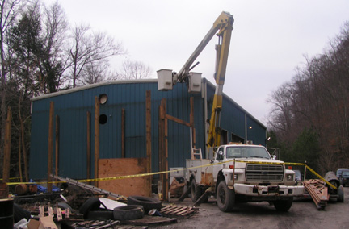
ACCIDENT DETAILS
  After confirming that one of the posts was loose in the concrete, the victim successfully hoisted it out of the concrete floor and onto the trailer using the bucket truck.
  At approximately 4:30 p.m., they attempted to remove a second post. The victim pulled upward and wiggled the post back and forth with the aerial bucket trying to free it from the concrete.
  The post suddenly came loose from the concrete, causing the boom to catapult upward, throwing the victim from the bucket. He fell onto the concrete floor and received fatal injuries.

Slide 8
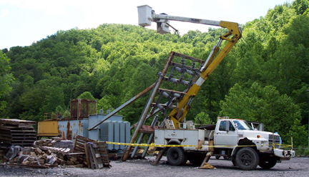
PREVIOUS ACCIDENT
  The victim was aware of a similar fatal accident occurred at this mine on June 9, 2003, when the mine manager was thrown from this same aerial bucket truck (Report of Investigation, CAI-2003-14). The victim attempted to lift excessive weight with the boom of the truck when the nylon rope on the jib crane winch failed, causing him to be thrown from the bucket. He was also not wearing a safety belt or harness.
  Calvary, who operated the mine at that time, took steps to prevent a similar occurrence, including instructing miners never to lift anything with the aerial bucket truck and to use the safety harness.

Slide 9
  The aerial device had two-man baskets at the end of the top boom arm, with a jib crane between them.
  The maximum lifting capacity of the jib crane was 2000 pounds. Controls to operate the boom and the jib crane were located on the left basket when looking toward the rear of the boom truck.
  The jib crane was not designed to lift heavy loads, but was designed to be an implement crane.
  The upper boom arm on the aerial bucket truck was made out of fiberglass, causing it to deflect under the large force that was applied to the upper boom. When the force was released suddenly, the boom arm moved rapidly in the direction of the force being applied.
  The manufacturer makes boom lifting attachments for the lower boom arm, which was made of steel and can be used to lift loads heavier than the loads recommended for the upper jib crane.
  The operator's manual stated no one should be in the bucket when heavy loads are being lifted. The operator's manual also stated that the lower controls, operated from the bed of the truck, should be used to operate the boom when the lower boom arm lifting devices are being used.
BUCKET TRUCK

Slide 10
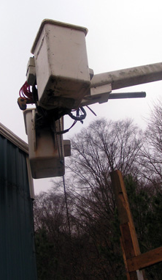
  Considering the angles of the boom arms, maximum load for the jib crane was 1,300 lbs.
  Since the chain was attached to a concrete embedded post, an undetermined amount of force was applied to the chain.
  The fiberglass boom was deflected approximately 27" down and to the right when the post came loose.
  No defects were found in the operation of the hydraulic functions.
  At the time of the accident, a safety harness was on the cab seat of the truck.
BUCKET TRUCK

Slide 11
ROOT CAUSE ANALYSIS
Causal Factor: Written procedures for safe operation of boom truck were not being followed. The operator’s manual stated: no one should be in the bucket when heavy loads are being lifted; and the lower controls, located in the bed of the truck, should be used to operate the boom when the lower boom arm lifting devices are being used.
Corrective Action: Mine management should establish and enforce a policy that equipment be used only in a manner consistent with the manufacturer’s suggested recommendations.

Slide 12
ROOT CAUSE ANALYSIS
Causal Factor: The available safety harness was not used while operating the aerial bucket.
Corrective Action: Mine management should establish and enforce policies and procedures to ensure that employees use safety equipment.

Slide 13
CONCLUSION
The fatal accident occurred because the aerial bucket truck was used improperly to lift a load. Failure to wear a safety belt or safety harness when working from a location where there was a danger of falling contributed to the severity of the accident.

Slide 14
ENFORCEMENT ACTIONS
Violations of 30 CFR 77.404(a): The Simon-Telelect aerial bucket, S/N T4000-1006CY, was used in a manner that created an unsafe operating condition. The maintenance supervisor, an employee of Chas Coal, Inc. used the upper boom to lift wooden posts out of the concrete floor while riding in the attached aerial bucket. The maintenance supervisor was pulling up and rotating the boom left and right to loosen and remove a post that was embedded in concrete. When the post came loose, the boom moved rapidly away from the post, throwing him out of the bucket. As a result, the victim fell to his death.
Calvary – 104(a) Citation, Moderate Negligence - The operator had established safety precautions and procedures for the safe use of this bucket that no loads shall be lifted with the boom. The rope had been removed from the JIB crane in an attempt to stop the use of the boom to lift loads.
Blue Diamond – 104(d)(1) Citation, High Negligence - The Superintendent of Calvary No. 80 Mine had knowledge of the victim’s use of the truck and failed to ensure that the aerial bucket was used properly.
Chas – 104(d)(1) Citation, High Negligence - As a management employee of Chas Coal, Inc., he was responsible for the safe operation of the aerial bucket truck.
Tyco – 104(a) Citation, Moderate Negligence - The president of Tyco Trucking Company authorized the dismantling of the structure, but was not present at the site during any of the activities.

Slide 15
ENFORCEMENT ACTIONS
Violations of 30 CFR 77.1710(g): On February 3, 2004, a maintenance supervisor employed by Chas Coal, Inc., failed to wear a safety belt or harness when he was working in the Simon-Telelect aerial bucket, S/N T4000-1006CY, while it was elevated 22 feet above the ground. The maintenance supervisor was thrown from the bucket when the concrete imbedded wooden post he was pulling with the aerial boom, which was attached to the bucket, suddenly came out of the concrete floor and released the deflected aerial boom. As a result, the victim fell to his death.
Calvary – 104(a) Citation, Moderate Negligence - A previous, similar accident involving this truck, which also resulted in fatal injuries to the bucket operator, demonstrated that using the truck in this manner posed a danger of falling.
Blue Diamond – 104(a) Citation, Moderate Negligence - The Superintendent of Calvary No. 80 Mine had knowledge of the victim’s use of the truck, but was not present at the worksite to ensure proper use of the safety harness.
Chas – 104(d)(1) Order, High Negligence - As a management employee of Chas Coal, Inc., he was responsible to ensure that safety harnesses are used.
Tyco – 104(a) Citation, Moderate Negligence - The president of Tyco Trucking Company authorized the dismantling of the structure, but was not present at the site during any of the activities.

Slide 16
BEST PRACTICES
Use equipment only for its intended purpose. Man-lifts are not cranes!
Wear safety belts and lines where there is a danger of falling. All persons in man-lift type buckets should be tied off using a short lanyard regardless of the activity they are performing.
Routinely monitor work habits and strictly enforce compliance with established safe work procedures to ensure that personal protective equipment is used.
Ensure that equipment operators are properly trained and know the rated capacity, limitations, and appropriate use of the equipment.

