Slide 1
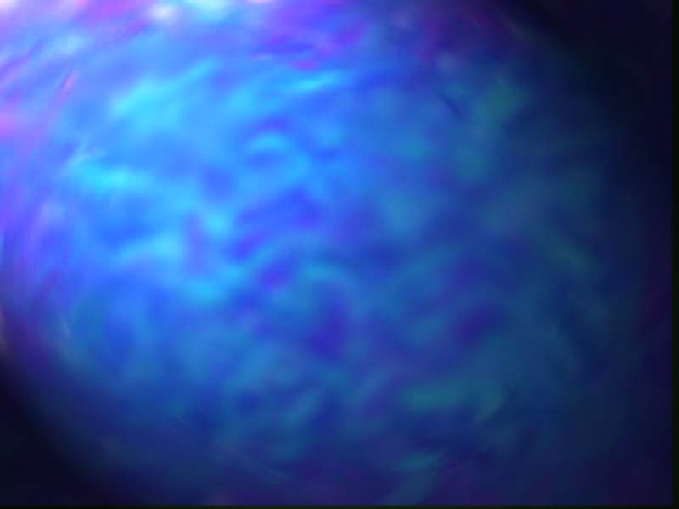
OCEANIC CURRENTS
UPDATED: 24 Feb 2000

Slide 2
TOPICS
Atmospheric Circulation
Role of Wind in Ocean Circulation
Ocean Heat Transfer
Surface Currents
Ocean Currents
Specific Currents
Ekman Spiral
Eddies
Drifting Bouy
Notes:
We will be discussing the following topics.

Slide 3
Atmospheric Circulation
We can gain an understanding of how global circulation works by developing a graphical model of processes that produce this system.
    The global reception of solar insolation and loss of longwave radiation cause a temperature gradient of hotter air at the equator and colder air at the poles.
Surface air flow is from the poles to the equator. The air reaches the equator is then lifted vertically by the processes of convection and convergence. When it reaches the top of the troposphere it begins to once again flow horizontally. However, the direction of flow is now from the equator to the poles. At the poles the air in the upper atmosphere then descends to the earth's surface to complete the cycle of flow.
Planetary rotation causes the development of three circulation cells in each hemisphere rather than one. These three circulation cells are known as the: Hadley cell; Ferrel cell; and Polar cell.
Notes:
The primary cause of ocean currents is the wind. In order to understand how the currents form, you must understand how the wind is generated.
Since the equatorial sections of the earth receive the most incoming solar radiation, they are normally the warmest parts of the planet. Consequently, the air in the equatorial region is quite warm, and rises as a result of heating. Due to this rising air, low pressure belts form near the equator.
Where does all this air go? In order to remain in equilibrium, the air that has risen over the equator has to descend as it moves toward the poles. Once it reaches the poles, it is now cool and dense and moves back towards the equator where it’s journey began.
However, we must add another force to the equation, that force being Coriolis. Coriolis force is the apparent force imparted to a moving object by the rotation of the earth. This force tends to deflect moving objects to the right in the northern hemisphere and to the left in the southern. This results in three cells of air circulation, the Hadley, Ferrel and Polar cells.

Slide 4
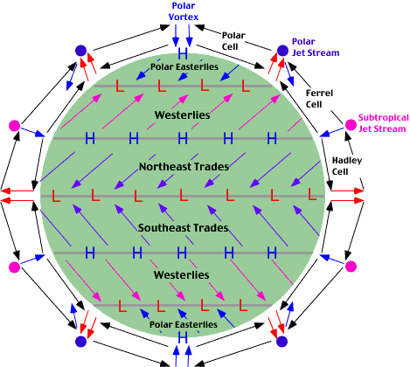
Notes:
This slide graphically depicts a simplified diagram of the earth’s atmospheric circulation.

Slide 5
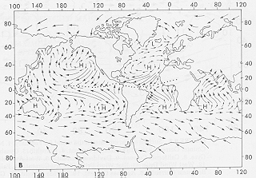
GENERALIZED SURFACE WIND PATTERN
Notes:
Which results in the surface winds we see on a daily basis.

Slide 6
CURRENTS
AS THE WIND BLOWS OVER THE OCEANS, IT CAUSES THE SURFACE WATER TO DRIFT ALONG WITH IT. THE MOVING WATER GRADUALLY PILES UP, CREATING PRESSURE DIFFERENCES WITHIN THE WATER ITSELF. THIS LEADS TO FURTHER MOTION SEVERAL HUNDRED
METERS DOWN INTO THE WATER. IN THIS MANNER, THE GENERAL WIND FLOW AROUND THE GLOBE STARTS THE MAJOR SURFACE OCEAN CURRENTS MOVING.

Slide 7
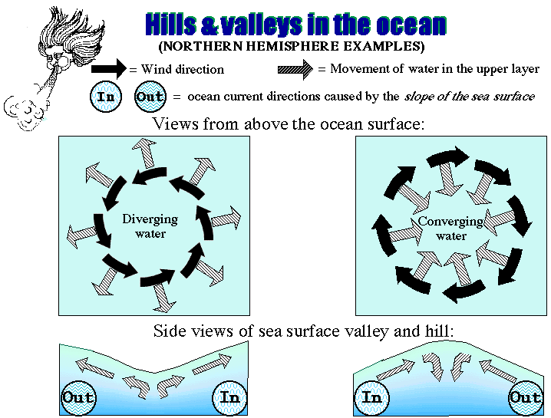
Notes:
Besides wind, friction and Coriolis, there is another factor that must be taken into account when discussing ocean currents. That is the Sea Surface Topography (And what does SS Topo mean??)
In simplified terms, it is hills and valleys in the ocean, caused by density differences between water masses. The sea surface contains many hills and valleys, especially near the central portions of the ocean basins. A primary example is the Sargasso Sea (anyone know where that is?), where a hill of warm, light water is surrounded by colder, heavier water. Keep in mind that these hills and valleys are only several centimeters in height and depth, and are measured via satellite altimeters.
In the end assesment, currents will tend to flow around hills of lighter water or around valleys of denser water.

Slide 8
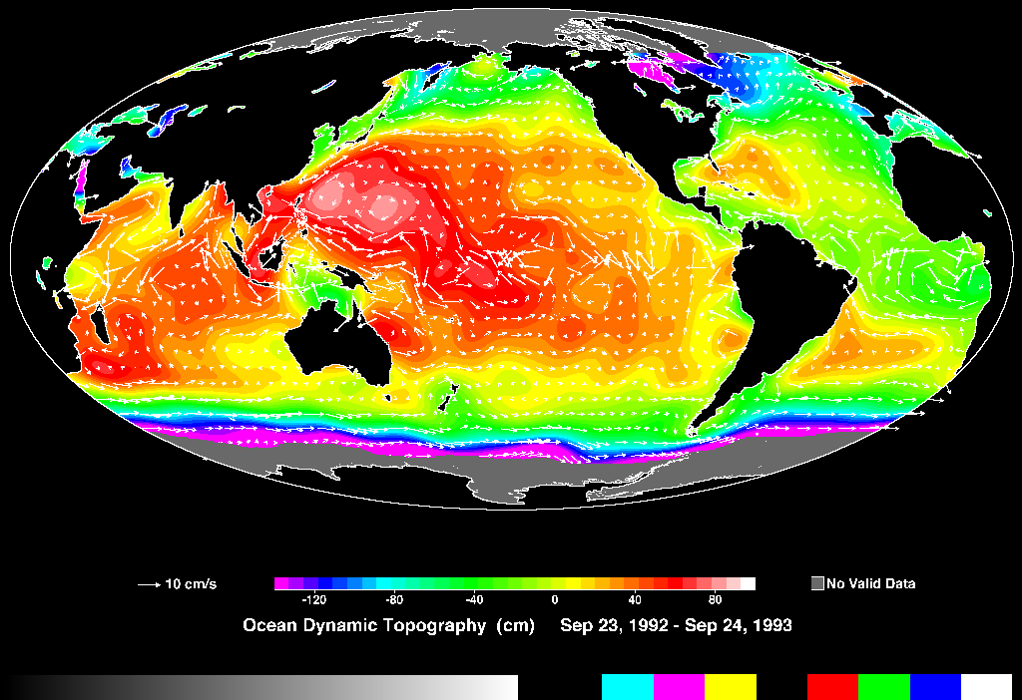
BELOW AVERAGE
OCEAN HEIGHT
ABOVE AVERAGE
OCEAN HEIGHT

Slide 9
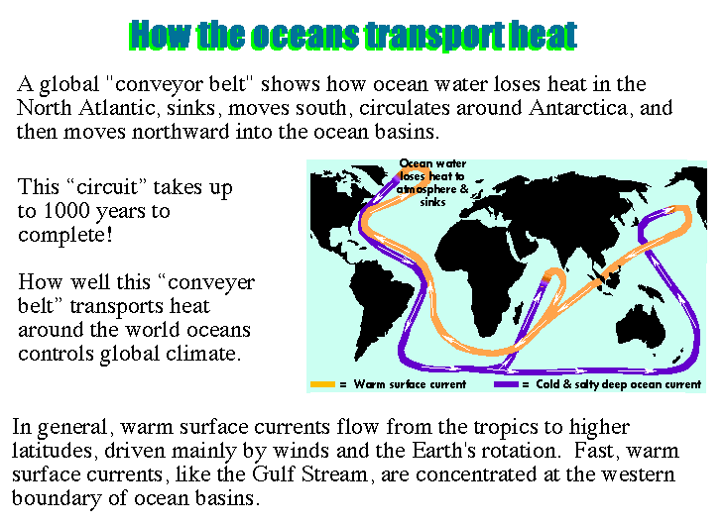
Notes:
A new concept in oceanography has been discovered recently, that being the global deepwater current heat conveyor. This conveyor belt of water, is the earth’s primary means of transporting heat around the planet. Warm surface waters primarily in the northern hem sink and then travel to the southern hem and then back, taking up a thousand years to complete the circuit. .

Slide 10
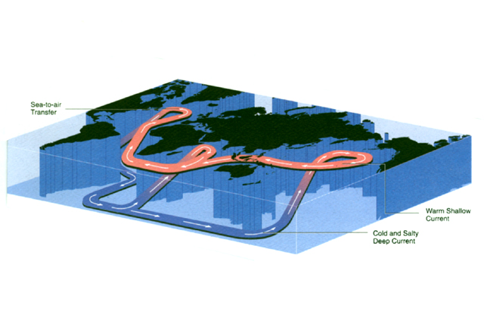
3-D VIEW OF THE GLOBAL CONVEYOR BELT

Slide 11
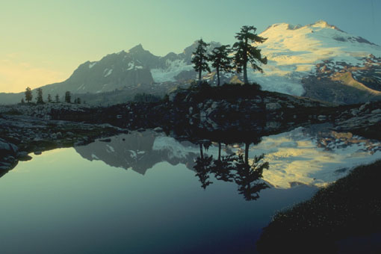
IN THE NORTH ATLANTIC, THE PREVAILING WINDS
BLOW CLOCKWISE AND OUTWARD FROM THE
SUBTROPICAL HIGH, WHILE THE OCEAN CURRENTS
MOVE IN A MORE OR LESS CIRCULAR , BUT STILL
CLOCKWISE PATTERN.

Slide 12
GENERALIZED SURFACE WIND PATTERN FROM SEMIPERMINENT HIGHS
H
H
H
H
H
H
Notes:
Which results in the surface winds we see on a daily basis.

Slide 13
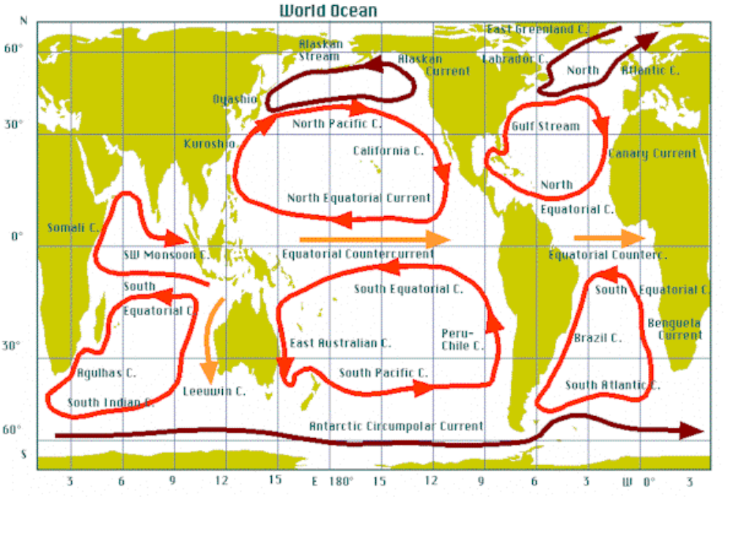
SURFACE OCEAN CURRENTS AROUND SEMIPERMANENT HIGH
ALASKAN
STREAM
EAST GREENLAND C.
ALASKAN
LABRADOR C.
NORTH
ATLANTIC C.
CURRENT
OYASHIO C.
NORTH PACIFIC C..
GULF STREAM
KUROSHIO C.
CALIFORNIA C.
H
H
CANARY CURRENT
NORTH
NORTH EQUATORIAL CURRENT
EQUATORIAL C.
SOMALI C.
SW MONSOON C.
EQUATORIAL COUNTER CURRENT
EQUATORIAL COUNTER C.
SOUTH
EQUATORIAL
CURRENT
SOUTH EQUATORIAL C.
H
H
SOUTH
EQUATORIAL
CURRENT
H
PERU
CHILE C.
BENGUELA
CURRENT
H
EAST AUSTRALIAN C.
BRAZIL C.
SOUTH PACIFIC C.
SOUTH ATLANTIC
CURRENT
AGULHAS C.
SOUTH INDIAN C.
ANTARTIC CIRCUMPOLAR CURRENT
(WEST WIND CURRENT)

Slide 14
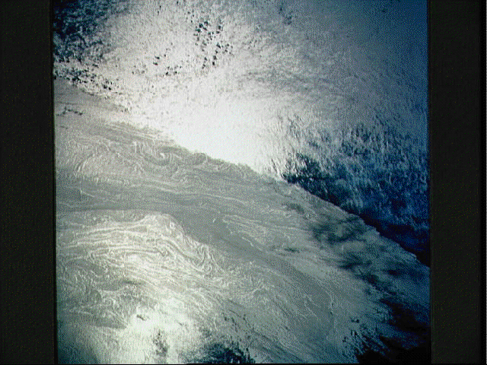

Slide 15
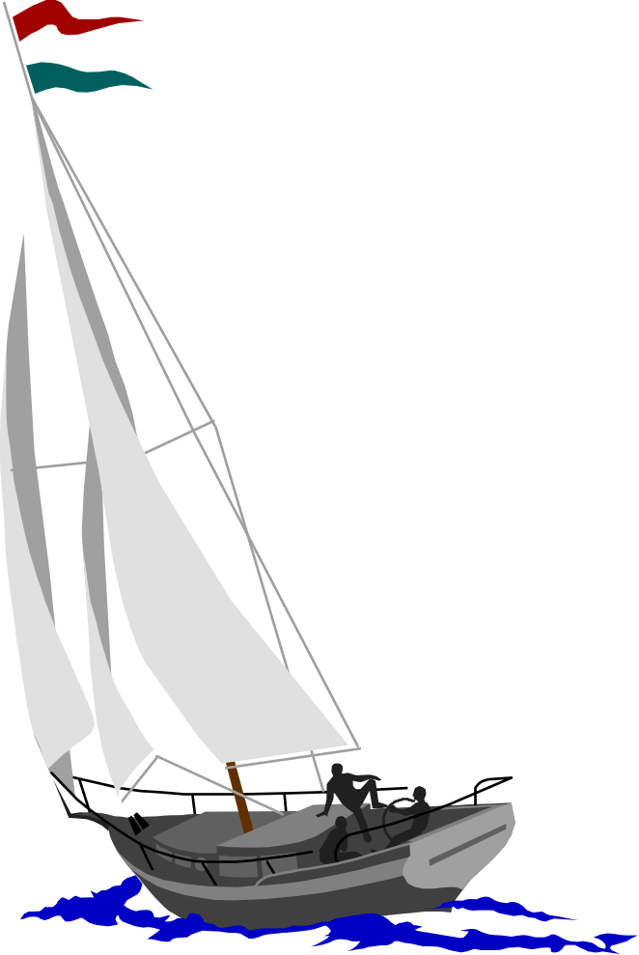
MAJOR OCEAN CURRENTS DO NOT FOLLOW
THE WIND PATTERN EXACTLY; RATHER, THEY
SPIRAL IN SEMICLOSED CIRCULAR WHIRLS
CALLED GYRES.

Slide 16
SURFACE CURRENTS
SHIPS’ COURSES ARE DEFLECTED BY SURFACE
CURRENTS; THIS DEFLECTION CAUSES A
DISCREPANCY BETWEEN A SHIP’S INTENDED
POSITION AND ITS ACTUAL POSITION AFTER IT
HAS TRAVELED FOR A PERIOD. THUS THE DIRECTION
AND SPEED OF THE LOCAL CURRENT CAN BE DEDUCED
FROM A SHIP’S ACTUAL POSITION AFTER IT HAS BEEN
STEERED ON A GIVEN COURSE.

Slide 17
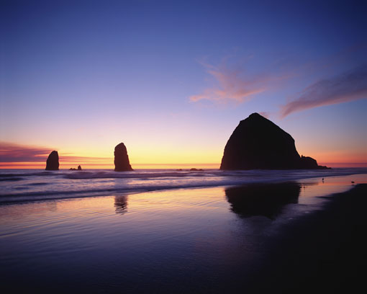
BECAUSE OF THE LARGER FRICTIONAL DRAG IN WATER,
OCEAN CURRENTS MOVE MORE SLOWLY THAN THE
PREVAILING WIND.
TYPICALLY, THESE
CURRENTS RANGE
IN SPEED FROM SEVERAL
KILOMETERS PER DAY TO
SEVERAL KILOMETERS PER HOUR.

Slide 18
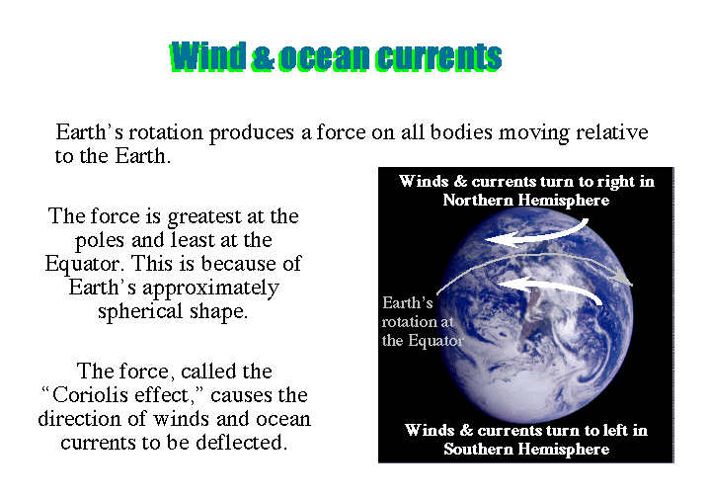

Slide 19
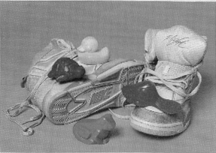
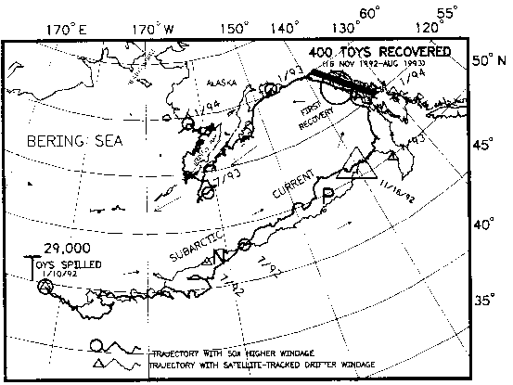
In 1990, a container vessel lost five containers overboard in a storm,releasing 61,000 Nike running shoes into the Pacific Ocean. These shoes float, and several months later, hundreds of them began to wash ashore along the coast of North America from Alaska to Oregon.
Scientists tapped into the information network of beachcombers, and the points of landfall of at least1600 Nike shoes were recorded exactly. By the time the data were plotted, the drift of the North Pacific was recorded in finer detail than ever. Years later, far-floating Nike shoes from the spill are still being recovered as far away as Hawaii, because the surviving floaters were turned southward into the main Pacific clockwise circulation.
It was with even greater delight that oceanographers learned of the fate of 29,000 Chinese plastic bath toys during their voyage from Hong Kong to Tacoma, Washington. In a severe storm on January 10, 1992, thousands of blue plastic turtles, yellow plastic duckies, red plastic beavers, and green plastic frogs began their great adventure.
Ten months later, the first waves of plastic toys hit the beaches of Sitka, Alaska. Advertisements in newspapers and letters to lighthouse keepers brought in reports of landings, all of them on the Alaskan coast. This time, the higher-floating plastic toys were more affected by the wind than the low-floating Nikes, and their main trajectory took them north, out of the gyre circulation. Those that did not reach shore quickly were swept northeast, and by the winter of 1993-94, the survivors would have been frozen into sea ice in the Bering Sea. Some may now be heading back into the North Pacific, others may be on their way round the Arctic Ocean, neastward along the north coast of Siberia, heading for the North Atlantic.

Slide 20
Ocean Circulation
Vertical- Primarily driven by regional differences in density, salinity, temperature, sediment content
Horizontal- “Wind-driven”
  mean flow is perpendicular to wind direction
  Ekman Spiral- Surface current(Northern Hemisphere)
Notes:
Now that we have a basic understanding of atmospheric circulation, lets move on to Ocean circulations. There are two different types of ocean circulations, vertical and horizontal. For the purposes of today’s lecture, we will focus on the horizontal circulation.
Vertical circulations are driven by differences in density brought on by differences in temperature, salinity, or sediment content. Vertical circulation is important in coastal areas or near closed seas such as the Med.
Horizontal currents however are primarily wind-driven. But contrary to what you might expect, the currents do not directly follow the wind direction. This is due to the Ekman transport effect, which we will discuss on the next slide.

Slide 21
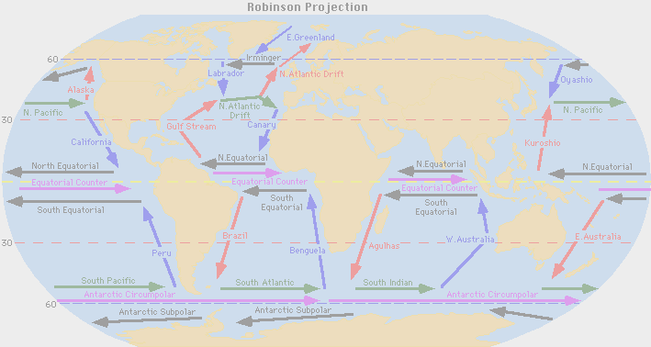
OCEAN CURRENTS

Slide 22
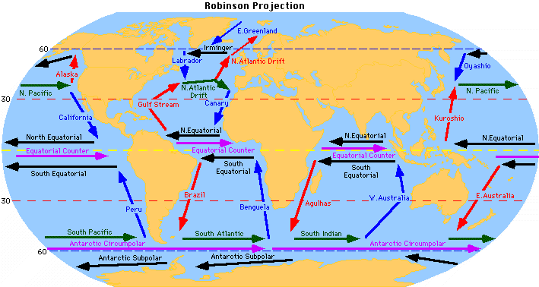

Slide 23
SURFACE OCEAN CURRENTS AROUND SEMIPERMANENT HIGH
ALASKAN
STREAM
EAST GREENLAND C.
ALASKAN
LABRADOR C.
NORTH
ATLANTIC C.
CURRENT
OYASHIO C.
NORTH PACIFIC C..
GULF STREAM
KUROSHIO C.
CALIFORNIA C.
H
H
CANARY CURRENT
NORTH
NORTH EQUATORIAL CURRENT
EQUATORIAL C.
SOMALI C.
SW MONSOON C.
EQUATORIAL COUNTER CURRENT
EQUATORIAL COUNTER C.
SOUTH
EQUATORIAL
CURRENT
SOUTH EQUATORIAL C.
H
H
SOUTH
EQUATORIAL
CURRENT
H
PERU
CHILE C.
BENGUELA
CURRENT
H
EAST AUSTRALIAN C.
BRAZIL C.
SOUTH PACIFIC C.
SOUTH ATLANTIC
CURRENT
AGULHAS C.
SOUTH INDIAN C.
ANTARTIC CIRCUMPOLAR CURRENT
(WEST WIND CURRENT)

Slide 25
NORTH PACIFIC CURRENTS
THE CURRENTS OF THE NORTH PACIFIC OCEAN
ARE VERY SIMILAR TO THE CURRENTS OF THE
NORTH ATLANTIC OCEAN. EVEN SO, THERE ARE
SOME DISTINCT DIFFERENCES. THESE DIFFERENCES
ARE DUE MAINLY TO LARGE AMOUNTS OF
SUBARTIC WATER IN THE NORTH PACIFIC,
COMPARED WITH THE SMALL AMOUNT IN THE
NORTH ATLANTIC.

Slide 26
The Kuroshio Current
The next slide depicts an image of the Northwest Pacific near Japan. Blue and purple represent cold water while red and yellow represent warmer waters. This north-south gradient is seen clearly in the image. This image also shows a current that brings warm water from the south up to the north. It is one of the strongest currents in the ocean with an average velocity of 1 m/s (3 ft/s).

Slide 27
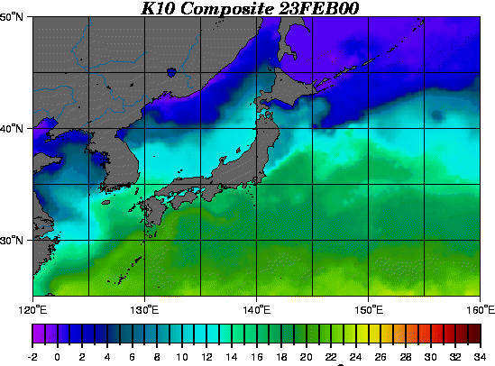
KUROSHIO CURRENT

Slide 28
NORTH PACIFIC CURRENTS
NORTH EQUATORIAL CURRENT - STARTS NEAR
THE WESTERN COAST OF CENTRAL AMERICA.
CROMWELL CURRENT - A NARROW, SWIFT
SUBSURFACE CURRENT CENTERED ON THE EQUATOR
BETWEEN 2 deg N and 2 deg S.
KUROSHIO SYSTEM - BEGINS WHERE THE NORTH
EQUATORIAL CURRENT LEAVES OFF. IT FLOWS PAST
FORMOSA AND PROCEEDS NORTHEASTWARD IN THE
DEEP OCEAN AREA BETWEEN THE CHINA SEA AND
THE RYUKYU ISLANDS.
*COMPOSED OF KUROSHIO CURRENT, KUROSHIO
EXTENSION AND NORTH PACIFIC CURRENT.

Slide 29
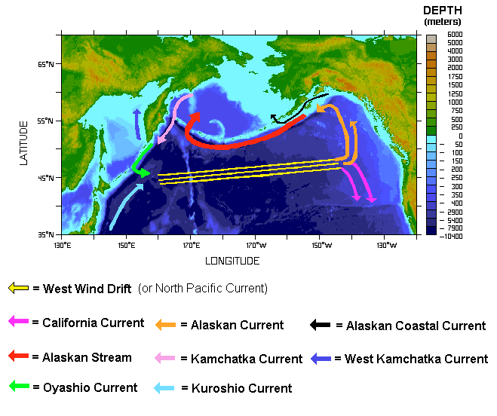

Slide 30
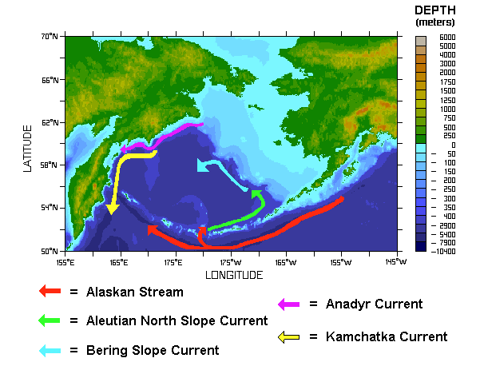

Slide 31
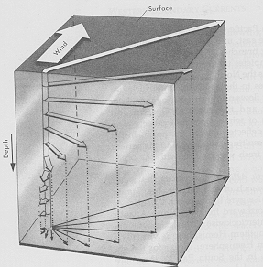
The Ekman spiral is one of the oldest results in dynamical oceanography. It was first proposed (conceptually) by the great Norwegian explorer Fridtjof Nansen. As part of a polar expedition in the late 1890s, Nansen froze his ship Fram into the ice north of Spitzbergen Island and allowed it to drift for more than two years.
During the expedition he noticed that the drift of the boat was generally to the right of the wind. Nansen proposed that this motion was the result of the Coriolis force, which causes objects to veer to the right in the northern hemisphere and to the left in the southern hemisphere. He supposed further that as the ice pushed on the water immediately below it, that water would move still further to the right of the wind, though a little more slowly. Extended down through the water column, the result would be a spiral structure.
EKMAN SPIRAL
Notes:
When a wind blows over the ocean surface, the water particles near the surface tend to move in the same direction as the wind. Once this motion is set initiated, Coriolis force begins to act, deflecting the particles to the right in the northern hem and to the left in the southern hem. The motion of a thin layer of surface water will be about 45deg to the right of the wind. The wind energy, however is transmitted even below the surface layer. Because of friction, the water at the surface tends to pull the underlying water with it but at a slower speed. Coriolis force further deflects this deeper water. This reaction continues to some depth at which the frictional forces and the water movement due to this process become negligible. The vertical pattern of moving water forms a sort of spiral called the Ekman Spiral. The water at some depth may even be moving at opposite to the wind at the surface. The overall effect is that a surface layer of water, up to several tens of meters, will have a net motion of 90 deg to the wind.

Slide 32
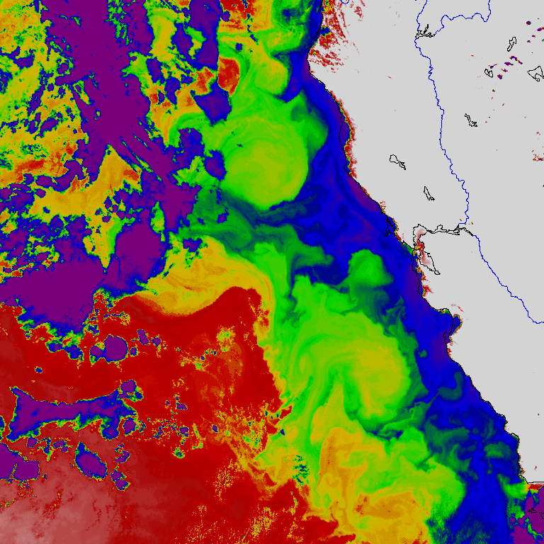
Ekman Transport,
The California Current and Coastal Upwelling
Areas of Upwelling
Notes:
A prime example of Ekman Transport and it’s effect is the California current,which flows southward along the California coast. Assume that a wind is blowing parralel to the coast, (which is normally the case along the cali coast). With the coast to the left of the wind, the net movement of water, 90deg to the right of the wind, is away from the coast. Deeper, colder water must move up to replace the surface water that has moved offshore. This is known as upwelling, and may transport water from as deep as 400 meters to the surface. The cold deep water is generally rich in nutrients and will increase surface productivity.
What are some of the other effectst that upwelling has along the coast?
How does it affect the weather?
What other areas of the world experience significant upwelling?
What happens if upwelling stops?
What is the connection between upwelling and El Nino?

Slide 33
NORTH ATLANTIC CURRENTS
NORTH EQUATORIAL CURRENT - LOCATED IN THE
TRADE WIND BELT OF THE NORTH ATLANTIC OCEAN.
THE CHIEF SOURCES OF FLOW ARE THE
NORTHEASTERLY CURRENTS OFF THE WEST COAST
OF NORTHWESTERN AFRICA.
GULF STREAM SYSTEM - BEGINS IN THE FLORIDA
STRAITS AND FLOWS NORTHWARD AND EASTWARD
ALONG THE EAST COAST OF THE UNITED STATES.
*COMPOSED OF THE FLORIDA CURRENT,
GULF STREAM & NORTH ATLANTIC CURRENT.

Slide 34
The Gulf Stream
Here is an image of the North Atlantic from June of 1984. Blue and purple represent cold water while green represents warmer water. This north-south gradient is seen clearly in the image. This image also shows a current that brings warm water from the south up to the north. It is one of the strongest currents in the ocean with an average velocity of 1 m/s (3 ft/s). This image also shows that the Gulf Stream does not follow a straight path. It has many twists and turns called meanders. If a meander becomes really sharp, it may pinch off and form what is called a ring. This is much like the formation of an oxbow lake by a river. Rings can be formed either to the north or to the south of the stream.

Slide 35
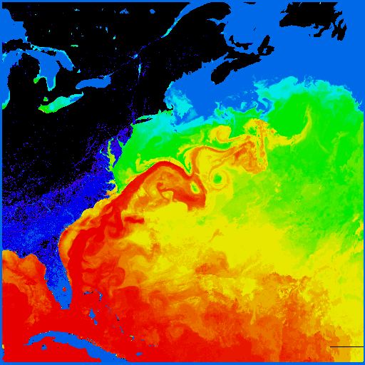

Slide 36
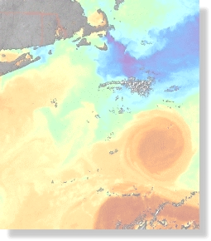
EDDIES
Notes:
Eddies are pockets of either colder or warmer water cutoff from there parent current. Eddies are common along both sides of the gulf stream and the kuroshio currents.

Slide 37
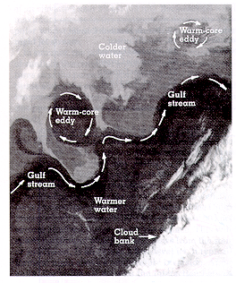
SATELLITE PICTURES REVEAL
THAT DISTINCT TEMPERATURE
GRADIENTS EXIST ALONG THE
BOUNDARIES OF SURFACE
OCEAN CURRENTS.
THE BOUNDARY SEPERATING
THE TWO MASSES OF WATER
WITH CONTRASTING
TEMPERATURES AND DENSITIES
IS CALLED AN OCEANIC FRONT.
ALONG THIS FRONTAL
BOUNDARY, A PORTION OF THE
MEANDERING GULF STREAM
OCASSIONALLY BREAKS AWAY
AND DEVELOPS INTO A CLOSED
CIRCULATION OF EITHER COLD
OR WARM WATER - A WHIRLING
EDDY.

Slide 38
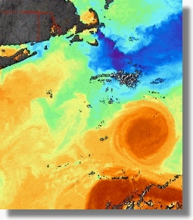
WARM EDDY
Notes:
Warm eddies are those that have their warmest temperatures at the center, surrounded by cooler water. They occur on the north side of a warm water current such as the gulf stream and generally rotate counterclockwise. Theyare generally shallow in depth, rarely extending below 100 meters, due to the warmer water being less dense. They generally are large in areal area and last only short periods of time. Warm eddies are good for submarines to hide in due to the fact that sound travels upward toward the surface in warm water. This allows the submarine to “hide” in the warm eddie because it’s sound does not eminate outside the eddy.

Slide 39
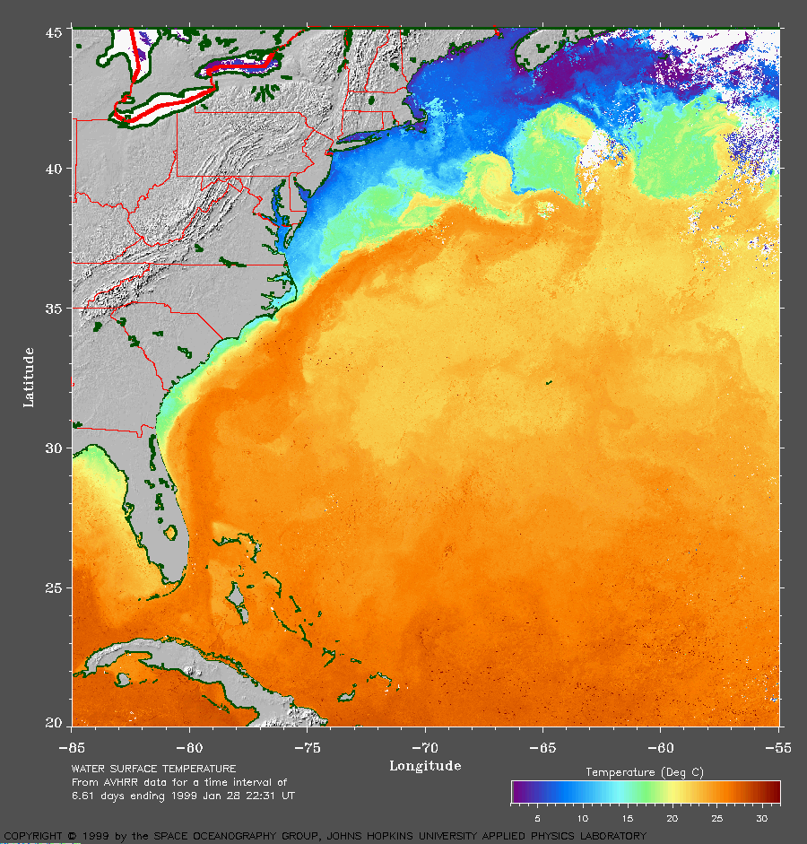
COLD EDDIES
Notes:
Cold eddies are those with the coldest temperatures at their center surrounded by warmer water. They normally form on the southern side of warm water currents and rotate clockwise. They generally form near the surface but extend to very deep depths due to the denseness of the water. They last for long periods of time, but may or may not be reflected at the surface due to sinking. Cold eddies are prime areas to place sonar sensors to detect submarines due to coupling with the Deep Sound Channel.

Slide 40
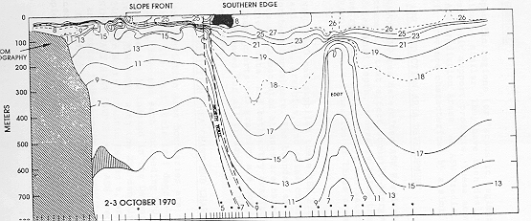
EDDY STRUCTURE
EDDY
Notes:
This slide depicts the vertical structure of a cold core eddy. Note that the eddy does not reflect at the surface.

Slide 41
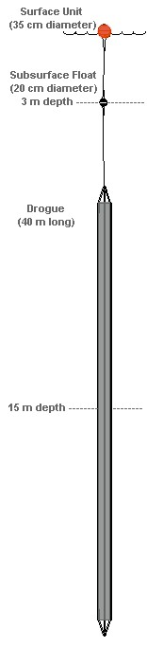
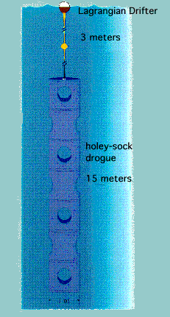
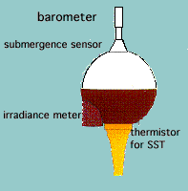
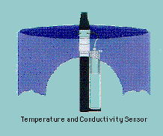
LAGRANGIAN DRIFTERS
These drifters measure the location, sea surface temperature, upwelling radiance, and downwelling irradiance.
Measurements are made every 90 seconds and averaged over a one hour period. The most
recent set of hourly data is then transmitted to the user, via the ARGOS satellite system, every 90
seconds for an hour. The typical lifetime for these drifters was 3 - 7 months, although some
failed immediately upon or shortly after deployment, and one lasted for 10 months.

