Slide 1

The Beam-Based Adaptive Alignment of the Focusing Elements of Linear Collider.
Presented by
V.Alexandrov
Branch of the Institute of Nuclear Physics,
Protvino, Russia.

Slide 2
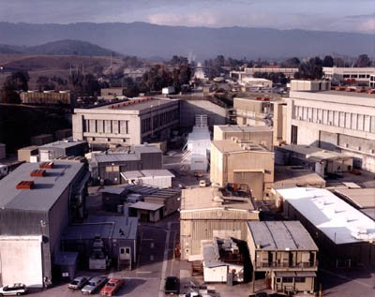

General view of the FFTB facility
(SLAC, Stanford, USA)
The designed parameters
Nominal beam energy | 46.6 | GeV
Invariant emittance | 2 · 10⁻⁶ | m · rad
Beam population | 6.5 · 10⁹ | e⁺ per pulse
Vertical beam size at focal point | 50 ÷ 70 | nm

Slide 3
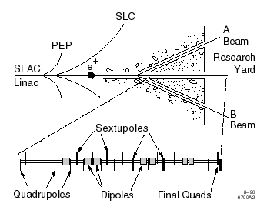
Location of the FFTB at the end of the SLAC 50-GeV linac
The FFTB contains five optical sections.
One section that controls the launch of the beam into the FFTB.
Two sections that contain sextupole magnets allow the chromaticity of the lattice to be tuned separately in the horizontal and vertical planes.
Geometric aberrations are controlled with pairs of sextupoles placed at points of equal dispersion.
The lattice includes a “P-exchanger” to match the optics from one chromatic correction section to the other. This section contains an intermediate focal point at which the vertical beam height is reduced to 1 micron.

Slide 4
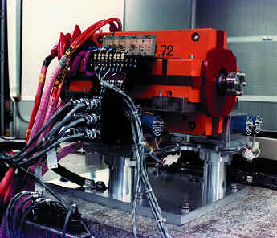
The “standard” quadrupole magnet
The FFTB beam line contains:
7 discrete dipole,
28 “standard” quadrupole,
3 “final” quadrupole,
4 sextupole
magnetic elements.

Slide 5
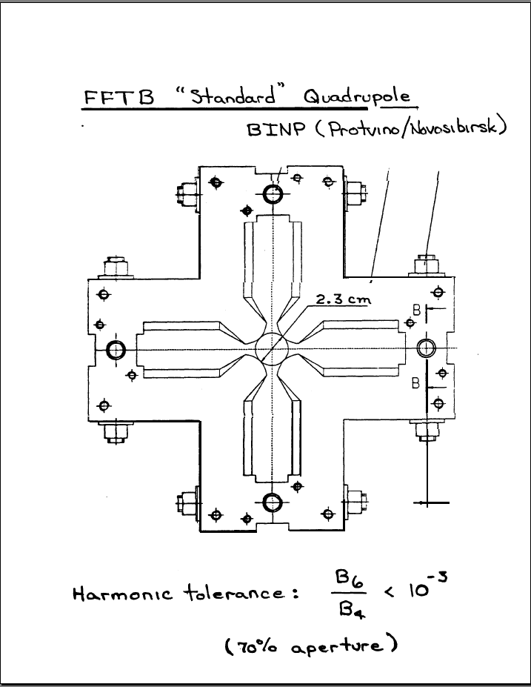
~250 mm ( 10” )

Slide 6
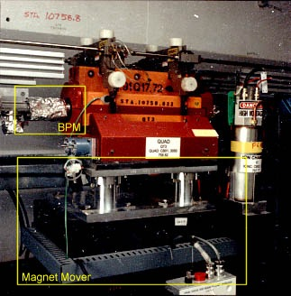
Each of the FFTB quads has a BPM and mover, what makes this facility very suitable for the Adaptive Alignment testing.
The BPM resolution: ~ 1 mkm
The mover’s step: ~ 0.3 mkm

Slide 7
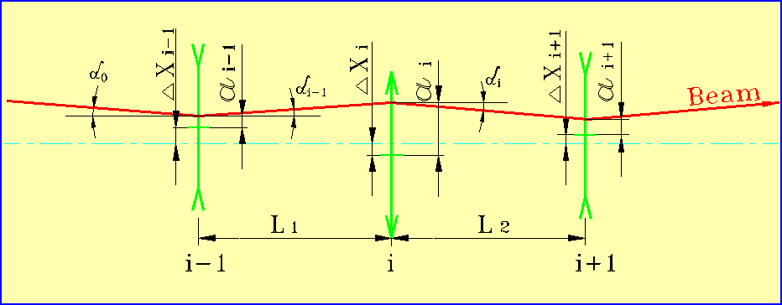
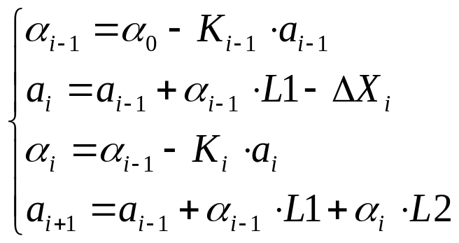
The main principle of the method
The Adaptive Alignment is a “local” method.
The data from the BPMs of only 3 neighboring quads are using to determine the necessary shifting of the quad.
Where: ΔXi – quad displacement relative to reference line;
ai – beam position relative to quad’s center (BPM reading);
The position of the quad number i relative to it neighbors can be determined by simple formulas:

Slide 8
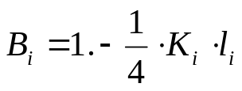
Solving the previous equations one can get the base formula of the Adaptive Alignment:
Where:
dE/E - beam energy spread,
ai - data from BPM of the quad number i;
L1 - distance to the previous quad;
L2 - distance to the next quad;
li - length of the quad number i;
Ki - reverse focusing distance of the quad with number i;
Bi - coefficient, which takes into account the differences
of the real optics from the thin lens approximation.
  Adaptive Alignment is an iterative process.
  The suggested shifts for each quad should be calculated by above formula in each iteration.

Slide 9
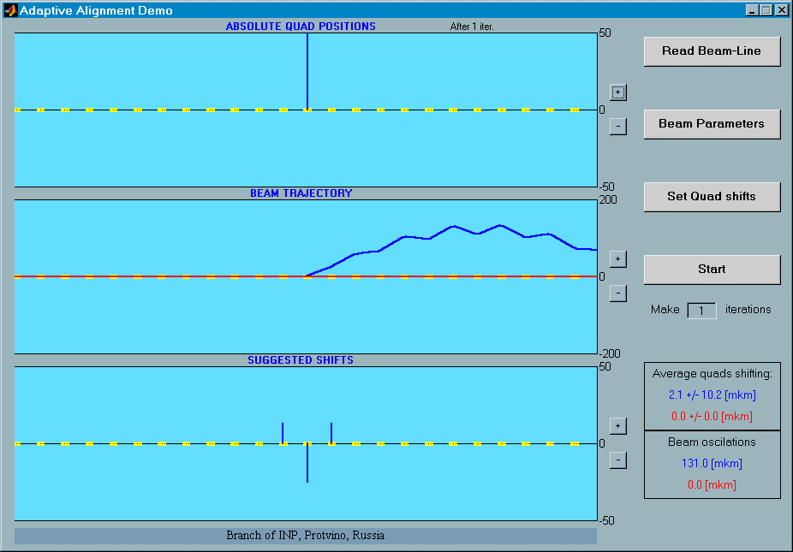
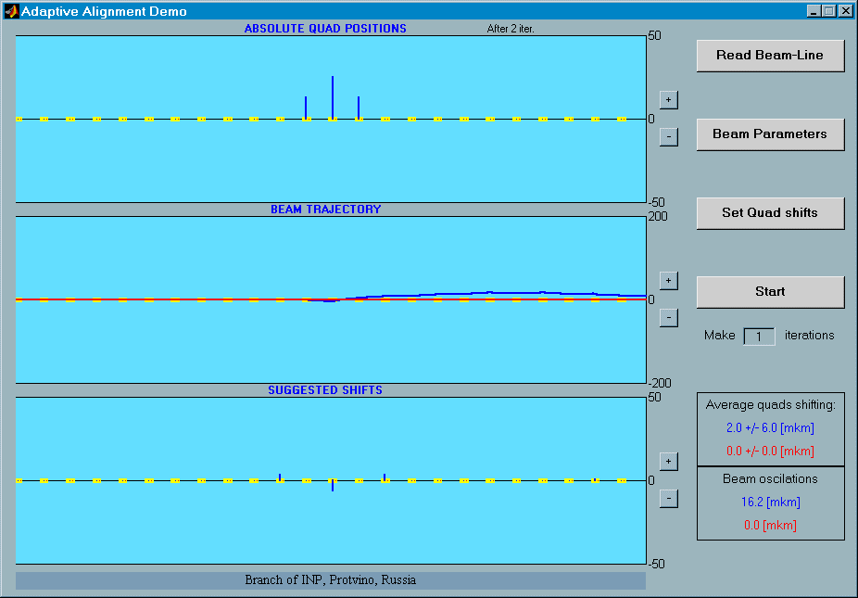
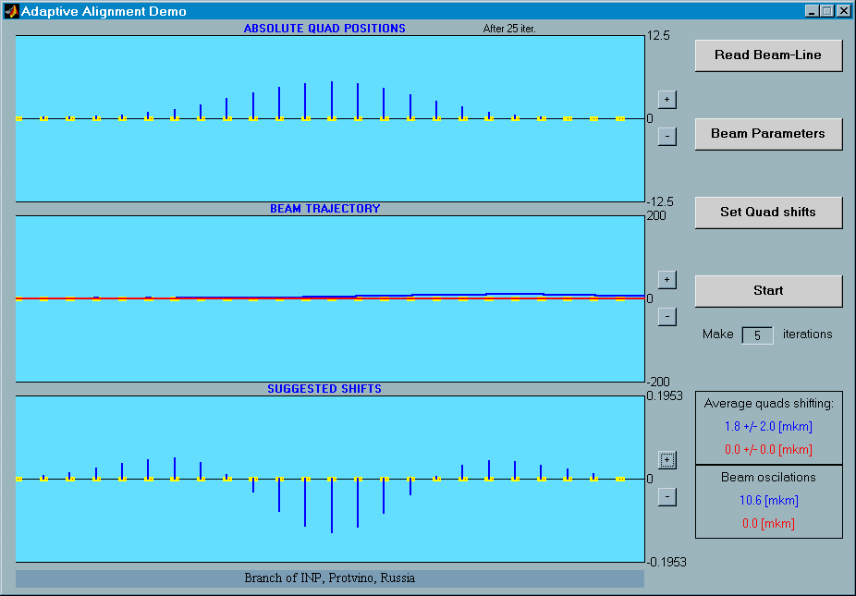
The simple example.
(Computer simulation)
The single quad is displaced on 50 mkm
The necessary shifting, calculated by the Adaptive Alignment method
New quads positions after the 1-st iteration
Quads positions after 25 iterations
(in enlarged scale)
Suggested shifts after 25 iterations
(in very enlarged scale)

Slide 10
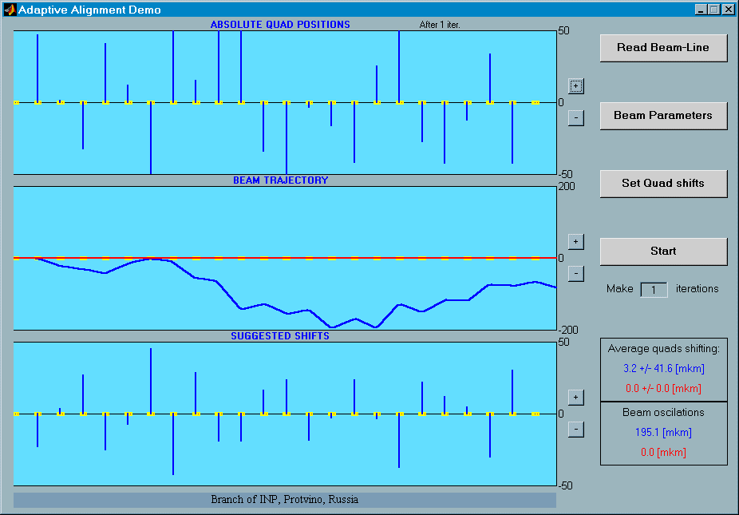
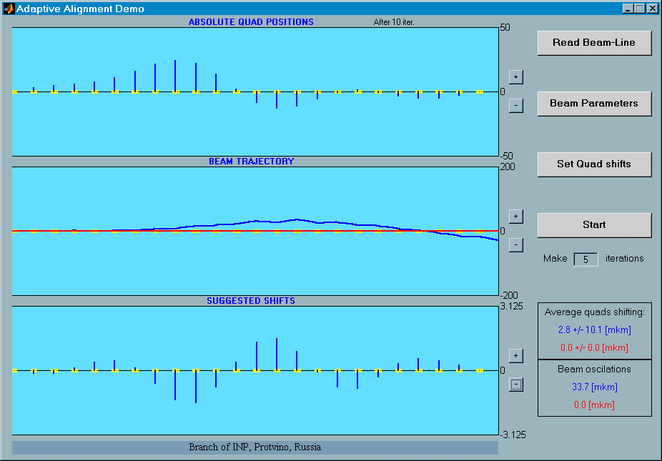
The more complex case.
All quads are displaced randomly with rms 50 mkm
The necessary shifting, calculated by the Adaptive Alignment method
New quads positions after the 10 iterations

Slide 11
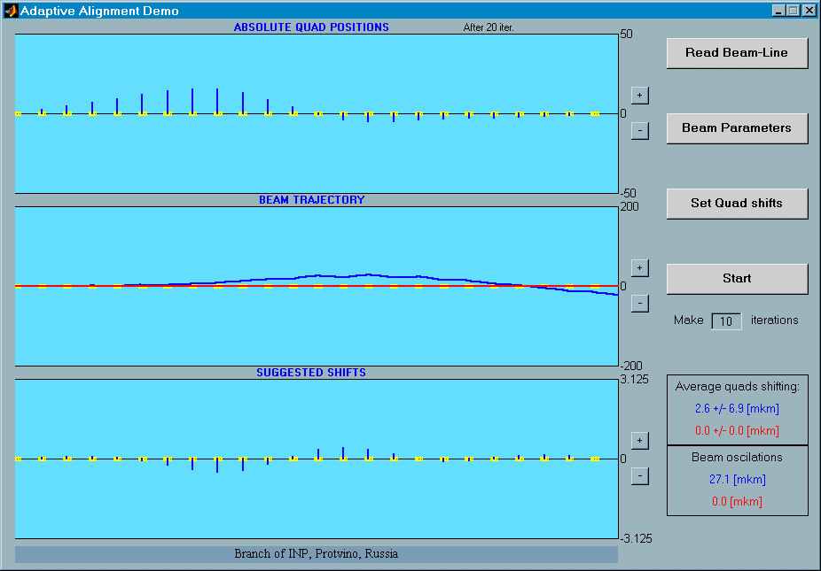

Quads positions after 20 and 50 iterations

Slide 12
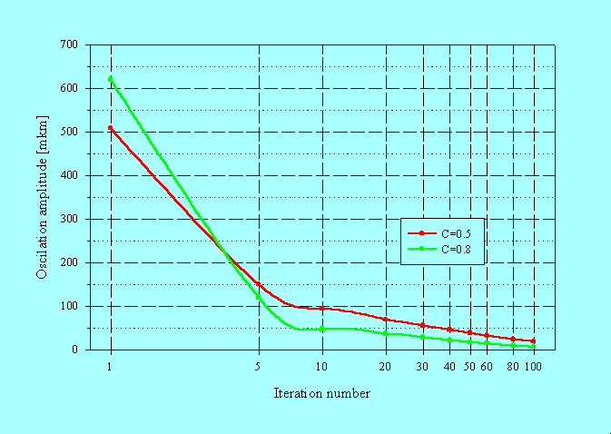
The decreasing of the beam oscillation during the Adaptive Alignment
(Computer simulation)
The initial conditions:
24 quads are displaced randomly with σ = 50 mkm.

Slide 13
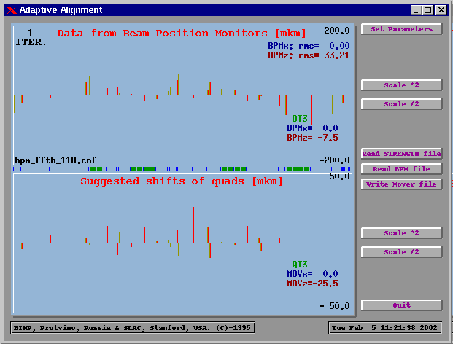
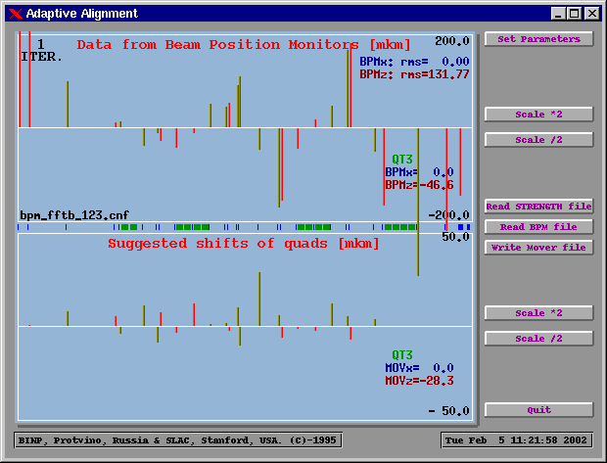
The testing of the method on the Stanford Linear Collider, (SLAC , USA)
Usual beam oscillations
The necessary shiftings, calculated by the Adaptive Alignment method
The beam is deflected forcedly at the entrance of FFTB line
The necessary shiftings are the same as for the undeflected beam
  The Adaptive Alignment method is depends on the real quads displacements only, not on the beam oscillations!

Slide 14
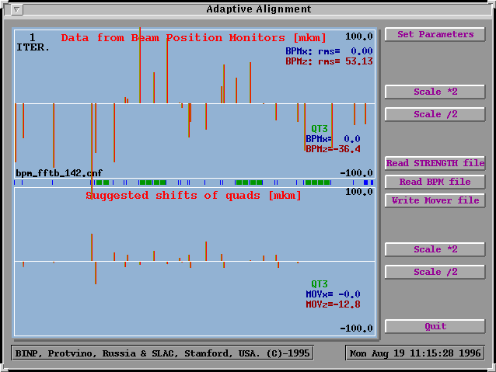
  The Adaptive Alignment in action.
Vertical component of the beam oscillations (upper part of the picture)
and suggested shifts for quads (lower part of the picture)
before the Adaptive Alignment procedure.

Slide 15
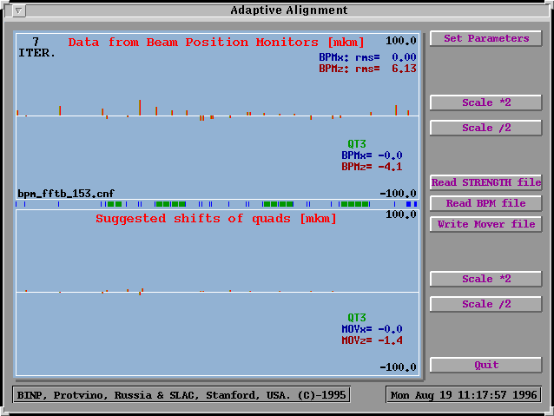
Vertical component of the beam oscillations (upper part of the picture)
and suggested shifts for quads (lower part of the picture)
after 7 iterations of the Adaptive Alignment procedure.

Slide 16
Conclusion
  It was experimentally confirmed that the method of Adaptive Alignment works enough fast and properly and can be applied to compensate any sharp or smooth technical displacements of quads as well as the seismic vibrations of the ground right during the operation of the Linac.

