Slide 1
Detector Monte-Carlo
Goal: Develop software tools to:
  Model detector performance
  Study background issues
  Calculate event rates
  Determine feasibility of interesting experiments

Slide 2
Monte Carlo
Main components:
  Flexible interactive framework
    GEANT++ (version 3.21) to track particles through a model of a detector and surrounding matter, simulating additional interactions of particles and detector's response
    FLUKA for hadronic interactions
  Simple detector model
  Sophisticated neutrino event generator
    NEUGEN (from MINOS) embedded in GEANT
    Beam flux model

Slide 3
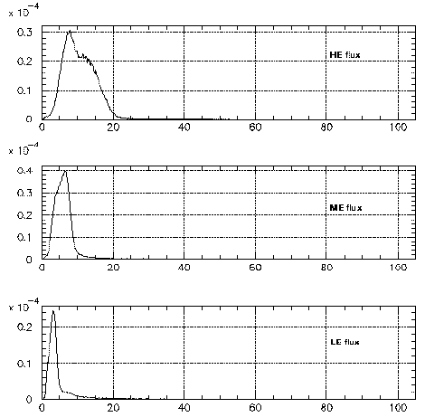
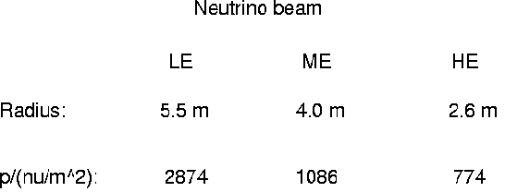
Neutrino beam model

Slide 4
MC algorithm
Choose incident particle
  Can specify everything (type, position, momentum)
  Can choose neutrino (any type) randomly from beam model or with specified position, momentum.
Let GEANT track particle, including secondaries
  Energy loss in scintillators is converted to light output
  Neutrinos don't interact, but sample matter distribution to calculate vertex distribution density along path.
  Choose neutrino vertex position, struck atom, and let NEUGEN generate interaction. (Can cut on final state.)
  Final state particles tracked by GEANT.
  Normalization book-keeping for rate calculations.

Slide 5
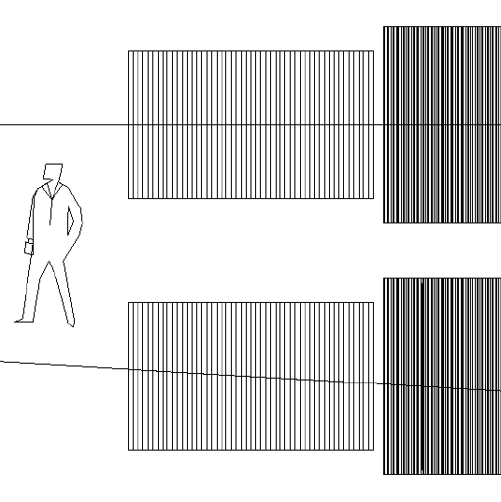
Target/detector + near detector
Near
Tgt/det
Beam center
Top View
Side View
1.5 m
2.5 m (50 modules)

Slide 6
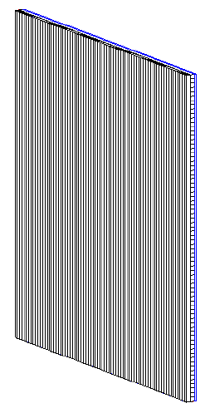
Detector module
Polystyrene strips
  2cm x 2cm x 1.5m
Stacked into planes
  1.5m x 1.5m square
  2 planes with orthogonal alignment (X, Y axes)
Air gap of 1cm (room for additional target material)
Total thickness: 5 cm
1.5m
1.5m

Slide 7
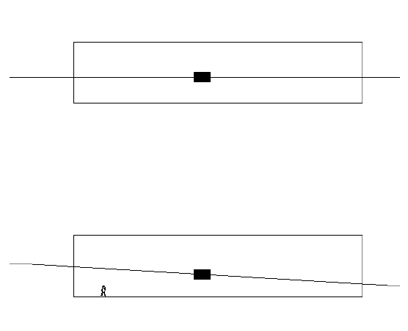
Target/detector in cave
Cave
5.5m
Beam
center
Top
Tgt
4m
9.6m
Side
20 m
25m

Slide 8
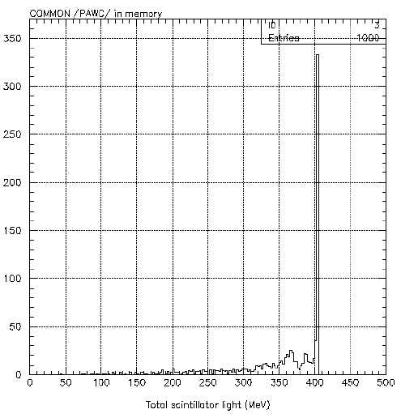
(Idealized) Detector Response
For each scintillator strip:
  Energy loss --> light output
  Perfect light collection for now (no loss or attenuation)
Light from all strips is summed together (calorimeter mode) and normalized to minimum ionizing protons for an energy scale.
Plot is for protons of momentum 1 GeV/c entering the detector. (fully contained when no secondaries produced.)

Slide 9
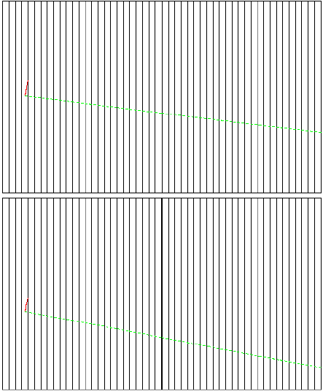
Good charged-current event
Proton
Top view
Muon
Proton
Side view
Muon

Slide 10
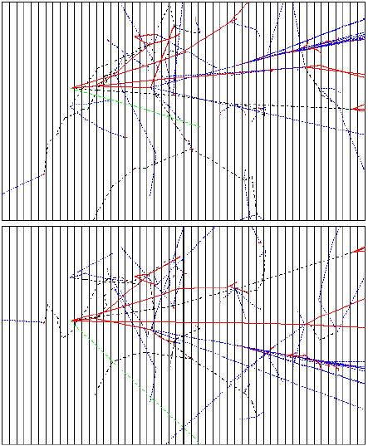
Complex event
Top view
Side view

Slide 11
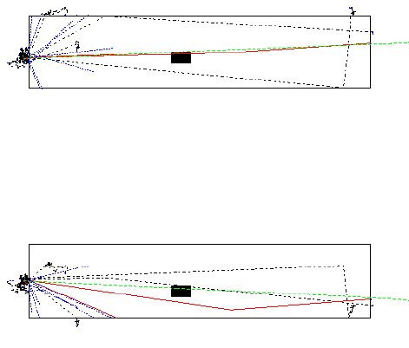
Upstream background event
Muon goes through detector
Several charged particles enter the cave
  Could be vetoed by an upstream detector

Slide 12
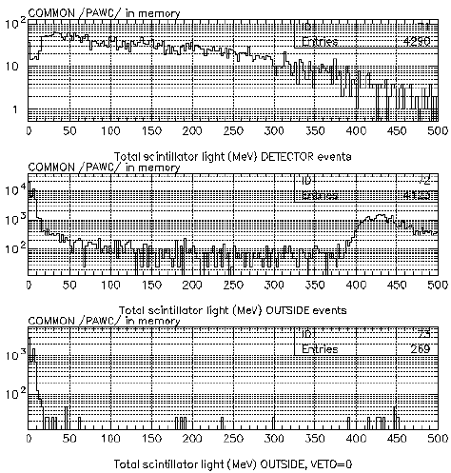
Veto of upstream background
ME tune, NC elastic events in detector
Any event in upstream rock
Any event in upstream rock, vetoed by a
scintillator lining upstream wall

Slide 13
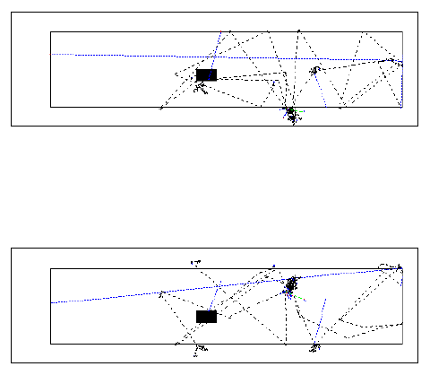
Background from walls
LE beam overlaps walls
Neutrons can bounce into detector and scatter, simulating a NC event
Difficult to veto

Slide 14
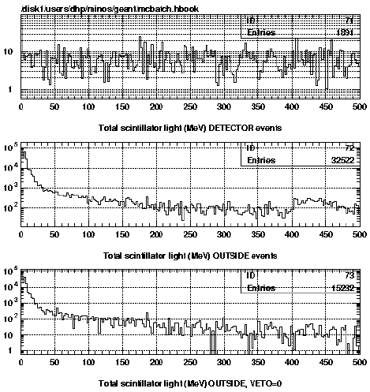
Background from walls
LE tune, CC + NC events in detector
Detector signal from CC+NC events
anywhere in the rock
Rock events above, vetoed by a
scintillator detector lining upstream wall

Slide 15
Neutron background
Neutron events can look like N.C. Scattering
May be a large background from scattering in walls of cave, especially for LE tune.
Caveat: GEANT/FLUKA might not be very good for neutron interactions...
Needs further investigation. (Track reconstruction may help)

Slide 16
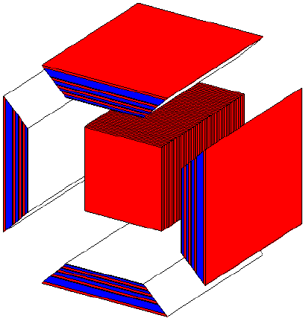
Muon side-detectors (exploded view)
4 layers magnetized Fe (4, 4, 6, 12.5 cm thick)
2 planes of plastic scintillator strips (like main detector) after each Fe layer.
3 configurations for magnetic field: axial, toroidal, quadrupole.

Slide 17
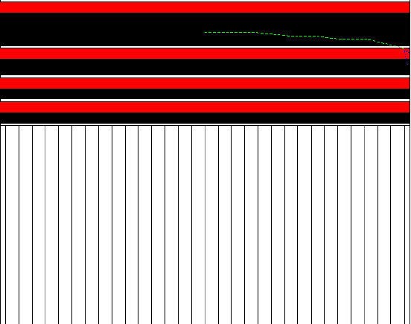
Permanently magnetized iron
Toroidal field, max is 3.8 kG inside special alloy.
Field is parallel to direction of view.
Fe is black, scint is red.
Muon of p = 1 GeV/c introduced in Fe.
Should be deflected up by field, but multiple scattering is larger effect (downwards in this event.)

Slide 18
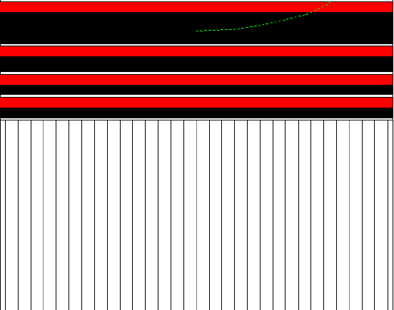
Fe magnetized with coils
Toroidal field, 20 kG in Fe.
Field is parallel to direction of view.
Fe is black, scint is red.
Muon of p = 1 GeV/c introduced in Fe.
Deflection by field dominant over multiple scattering.

Slide 19
Conclusions
Reasonable starting point for detector simulations
Lots of room for improvement:
  More sophisticated detector model (light collection)
  Track reconstruction from hits in scintillator
  Newer version of NEUGEN?
  Better hadronic interaction package, especially neutrons
IMPORTANT: Needs new leader

