Slide 1
Expected signal strength, detection schemes.
A.Aleksandrov.

Slide 2
Basic assumptions
Cross-section is well known therefore stripping efficiency calculation is a matter of algebraic manipulation (tech. notes)
Range of beam parameters:
  SCL energy: 186MeV-1000MeV
  Current: 20mA-38mA
  Pulse length: 50us-1000us
  Beam size: 1.5mm- 2mm- 2.5mm :nom.emm.
  2.0mm-2.8mm-3.5mm :2 x nom.emm.

Slide 3
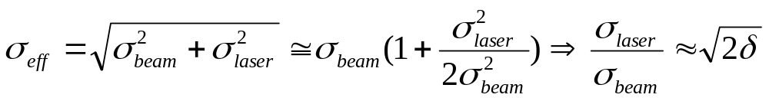


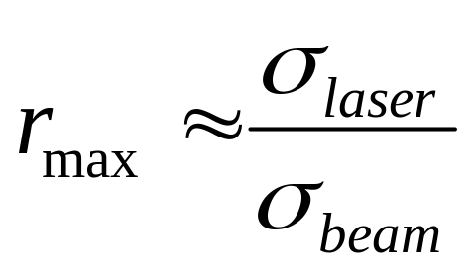
Laser parameters:
  NdYAG pulsed; 1064nm; 12ns; 200mJ;
  Focal spot size is defined by allowed broadening :
  For δ=5% and minimum beam size of
  Note: much more powerful laser are available: ex. 3J NdYAG
    Higher risk of window damage, more expensive optics, etc.
    No significant gain in stripping efficiency due to geometrical limitation:

Slide 4
Calculated stripping efficiency r [%]
 |  | 1.5 x 2.5 mm | 2 x 2 mm | 2.5 x 1.5 mm | 2 x 3.5 mm | 2.8 x 2.8 mm | 3.5 x 2 mm
200 mJ | 300MeV | 19% | 23% | 30% | 14% | 17% | 23%
 | 1GeV | 13% | 16% | 21% | 9% | 12% | 16%
∞ | - | 20% | 25% | 33% | 15% | 18% | 25%
Nominal emittance
2 x Nominal emittance
It is safe to assume stripping efficiency of 15%
I_{beam}
% of I_{beam}
12ns

Slide 5
Signal strength and noise estimation
Assuming 15% stripping efficiency, 20mA beam current, 20:1 transformer ratio, 50 Ohm load we have 12 ns pulse of 7.5mV amplitude. (laser wire at beam center)
S/N estimation (M.Kesselman): ~35dB
  Optimized filter (gaussian, 40MHz BW)
  Thermal noise + amplifier noise (4 x 50ohm resistor)
  allows measurement down to ~ 3 sigma
  No beam noise (can be dominant factor)
Differential measurements to mitigate beam noise effect:
  2 BCMs hundreds meters apart + long cables + beam energy variations ( commissioning) make it difficult

Slide 6
Signal strength (number of electrons x 10⁸) for 20mA beam
 |  | 1.5 x 2.5 mm | 2 x 2 mm | 2.5 x 1.5 mm | 2 x 3.5 mm | 2.8 x 2.8 mm | 3.5 x 2 mm
200 mJ | 300MeV | 2.8 | 3.5 | 4.5 | 2.1 | 2.5 | 3.5
 | 1GeV | 1.9 | 2.4 | 3 | 1.4 | 1.7 | 2.3
Nominal emittance
2 x Nominal emittance
It is safe to assume number of released electrons of 2·10⁸
U = 2e8*1.6e-19/12e-9*50 = 133mV on 50 Ohm load (laser at beam center)
Bending magnet
Laser beam
Electron collector

Slide 7
Detection of released electrons
Advantages:
  large number of electrons
  charge integrating amplifier similar to BLM
  Energy of electrons is well defined
  Electron beam is well collimated
Drawbacks
  External magnets are required
  In vacuum collectors are required
  Might suffer from beam loss background
} good S/N
} easy to collect

Slide 8
Background charge
Sources of background are
  Stripping on residual gas
    38mA; 200MeV; 1e-9 torr nitrogen; 1ms: 3.3e6 electrons/m
      10⁻³ background in 10cm detector
    20mA; 200MeV; 1e-9 torr nitrogen; 50us: 8.7e4 electrons/m
      < 10⁻⁴ background in 10cm detector
  Beam losses
    1W/m -> Ne = 2e6 for 10cm^2 collector area at 200MeV
    Ne = 4e5 for 10cm^2 collector area at 1000MeV
    Can be major source of background (~1e-2)
      Time gating can help
      Experience from other machines? (PSR, etc.)

Slide 9
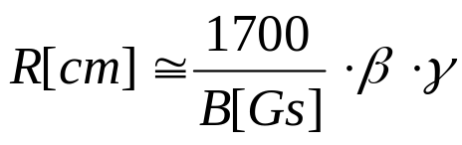
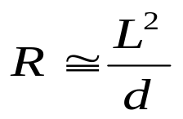
Magnet requirements
Electrons released in the process of photo-detachment have well defined velocity along the beam. They can be easily deflected by magnetic field and collected. Bending radius for electrons in a uniform magnetic field is
Reasonable choice for bending radius is
where L is available longitudinal space between laser beam and electron detector, d is diameter of the vacuum chamber. For current warm section design L=12cm, d=7cm therefore R=20cm is a reasonable choice for estimation of required magnetic field strength.

Slide 10
Calculated values of the magnetic field for each warm section of the SCL
E[MeV] | 186 | 204 | 223 | 241 | 259 | 277 | 296 | 314 | 332 | 351 | 369 | 387
B[Gs] | 70 | 74 | 77 | 80 | 84 | 87 | 90 | 94 | 97 | 100 | 103 | 105
E[MeV] | 438 | 489 | 540 | 591 | 642 | 694 | 745 | 796 | 847 | 898 | 949 | 1000
B[Gs] | 113 | 121 | 128 | 136 | 143 | 150 | 157 | 163 | 170 | 177 | 183 | 190
Required magnetic field spans from 70Gs at lowest energy to 190Gs at the linac exit. As beam energy can deviate from design values during commissioning/operation it is desirable to have magnets with variable field.
Optimal solution might be hybrid PM/EM design where 130Gs are generated by permanent magnet and EM coils generate ±60Gs.
Note that electron detector been discussed is not an imaging device therefore high quality of the field is not required.
Deflection of the ion beam is negligibly small an can be corrected by baseline steering correctors therefore no compensating magnet is required.

Slide 11
Signal strength (number of electrons x 10⁸) for 20mA beam mode locked laser
 |  | 1.5 x 2.5 mm | 2 x 2 mm | 2.5 x 1.5 mm | 2 x 3.5 mm | 2.8 x 2.8 mm | 3.5 x 2 mm
200 mJ | 300MeV | 150 | 200 | 240 | 110 | 130 | 170
 | 1GeV | 70 | 90 | 110 | 50 | 60 | 80
Nominal emittance
2 x Nominal emittance
It is safe to assume number of released electrons of 1·10¹⁰
U = 1e10*1.6e-19/12e-9*50 = 6.7V on 50 Ohm load (laser at beam center)
NdYAG
beam
Mode locked

Slide 12
conclusions
One can expect about 15% neutralization yield at beam center for realistic commissioning beam parameters
Expected S/N ratio is about 35db but beam noise can be major limiting factor
Electron collection option might extend dynamic range considerably while not preventing from using BCM
Electron collection allows use of mode-locked laser as an attractive option

