Slide 1
Ultra-High Energy Cosmic Radiation
and what it teaches us about astro- and fundamental physics
General facts and the experimental situation
Acceleration (“bottom-up” scenario)
Cosmic magnetic fields and their role in cosmic ray physics
New interactions and new particles
Günter Sigl
GReCO, Institut d’Astrophysique de Paris, CNRS
http://www.iap.fr/users/sigl/homepage.html

Slide 2
Further reading:
short review: Science 291 (2001) 73
long review: Physics Reports 327 (2000) 109
review collection: Lecture Notes in Physics 576 (2001) (eds.: M.Lemoine, G.Sigl)

Slide 3
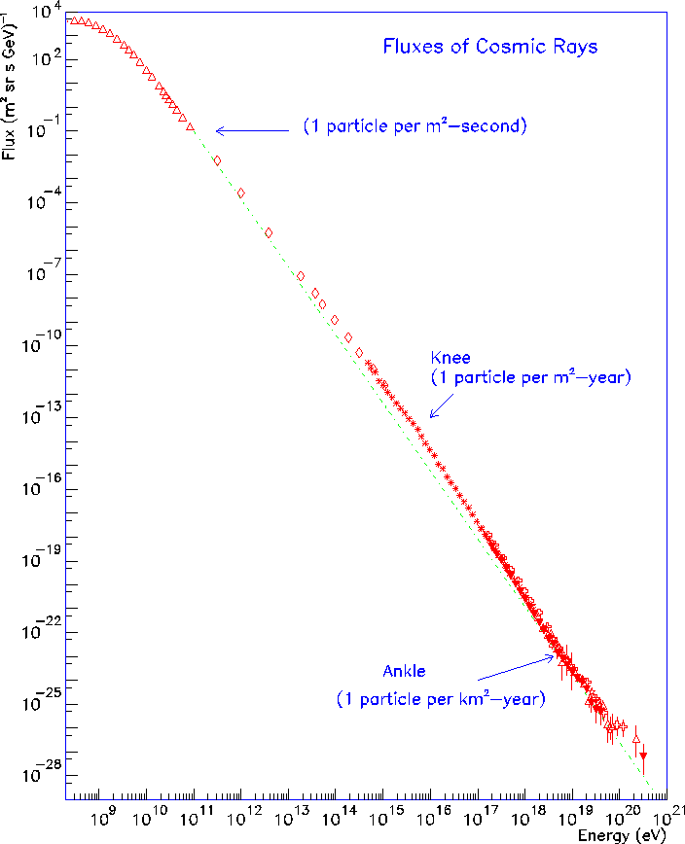
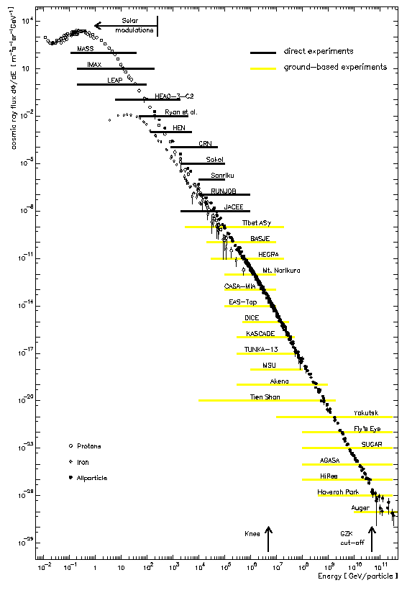
The cosmic ray spectrum stretches over some 12 orders of magnitude in energy
and some 30 orders of magnitude in differential flux:
many Joules in one particle!

Slide 4
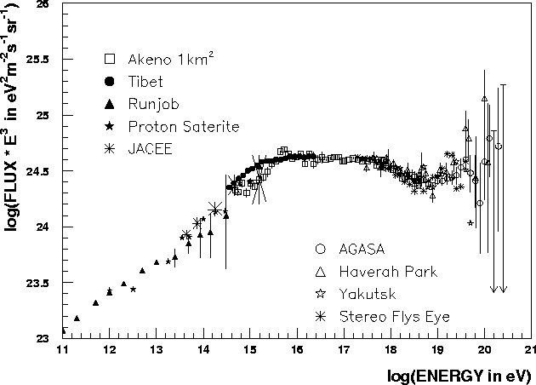
The structure of the spectrum and scenarios of its origin
supernova remnants
pulsars, galactic wind
AGN, top-down ??
knee
ankle
toe ?

Slide 5
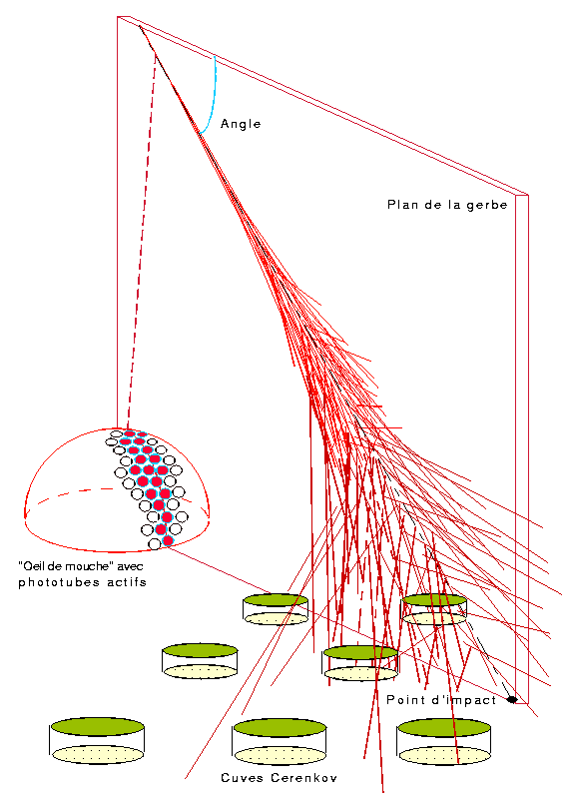
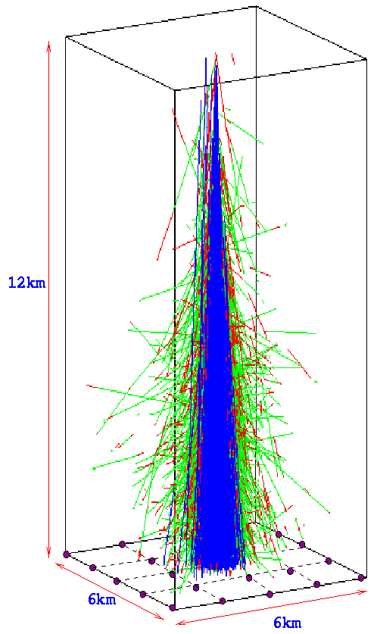
Atmospheric Showers and their Detection
Fly’s Eye technique measures
fluorescence emission
The shower maximum is given by
X_{max} ~ X₀ + X₁ log E_{p}
where X₀ depends on primary type
for given energy E_{p}
electrons
-rays
muons
Ground array measures lateral distribution
Primary energy proportional to density 600m from shower core

Slide 6
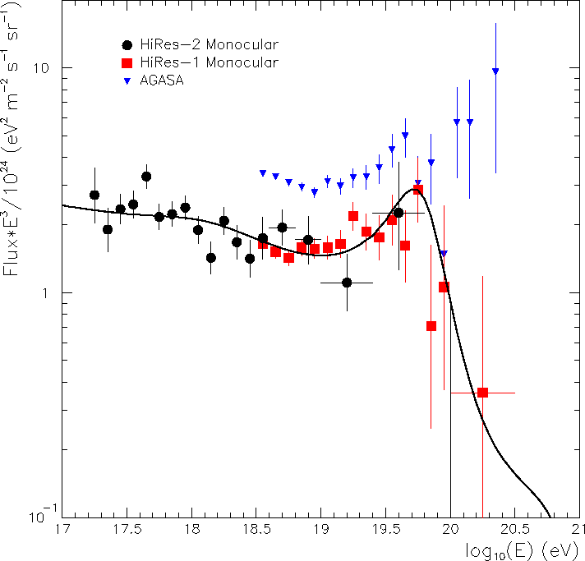
A Tension between the Newest Fluorescence Data (HiRes)
and Ground Array Results?
Or: Is there a Cut-Off after all?

Slide 7
Next-Generation Ultra-High Energy Cosmic Ray Experiments
compare to AGASA acceptance ~ 230 km²sr
Experiments | starting date | acceptance in km²sr | angular resolution | energy resolution
High – Res Fly’s Eye | since 1999 | 350-1000 | few degrees | ~40% mono ~10% stereo
Telescope Array | maybe with Auger North | 1700-5000 | ~1º ? | ~20% ?
Auger ground | full size in about 2004 | >7000 | < 2º | ~15%
Auger hybrid | ~2004 | >700 | ~0.25º | ~8%
EUSO/OWL space-based | >2010 | ~10⁵ ? | ~1º ? | <30% ?
radio detection | ??? | >1000 ? | few degrees ? | ???

Slide 8
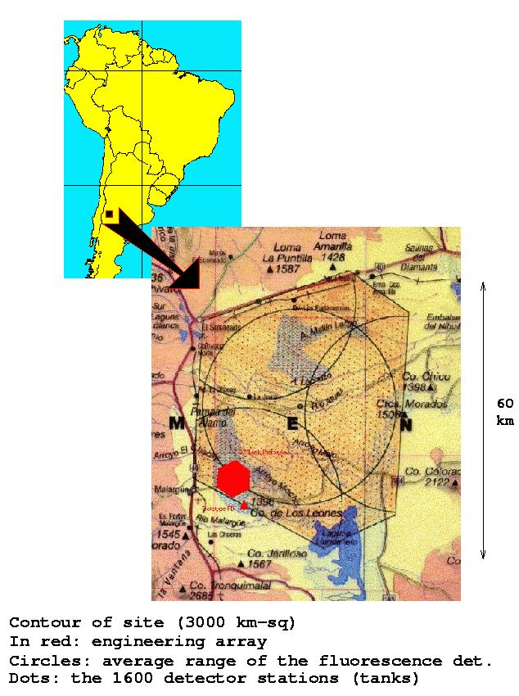
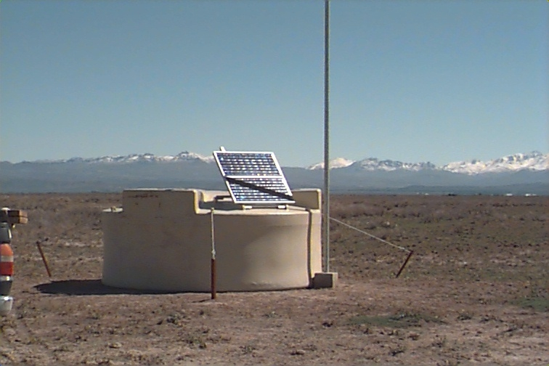
The southern Auger site is under
construction.

Slide 9
The Ultra-High Energy Cosmic Ray Mystery consists of
(at least) Three Interrelated Challenges
1.) electromagnetically or strongly interacting particles above
10²⁰ eV loose energy within less than about 50 Mpc.
2.) in most conventional scenarios exceptionally powerful
acceleration sources within that distance are needed.
3.) The observed distribution seems to be very isotropic
(except for a possible interesting small scale clustering)

Slide 10
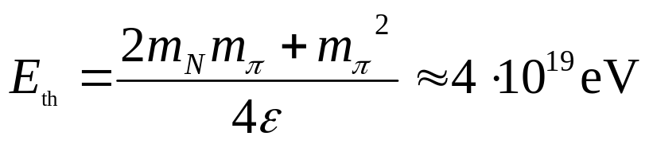
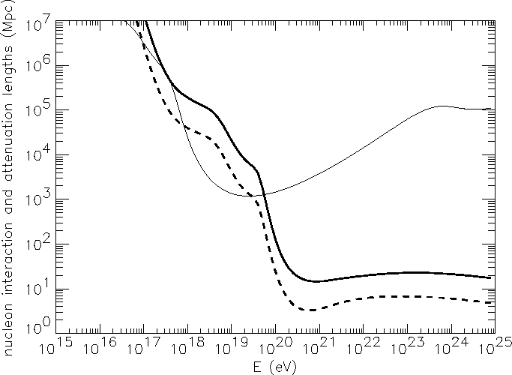
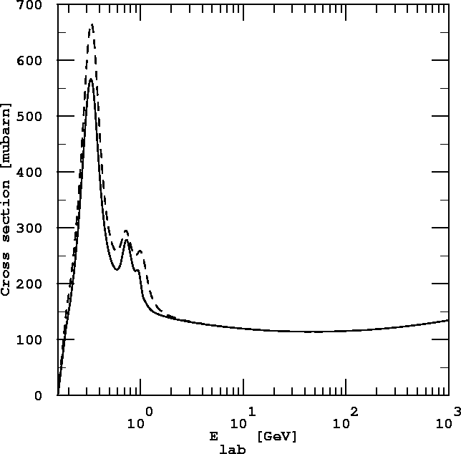
The Greisen-Zatsepin-Kuzmin (GZK) effect
Nucleons can produce pions on the cosmic microwave background
nucleon
γ
pair production energy loss
Δ-resonance
pion production energy loss
multi-pion production
pion production rate
sources must be in cosmological backyard
Only Lorentz symmetry breaking at Г>10¹¹
could avoid this conclusion.

Slide 11
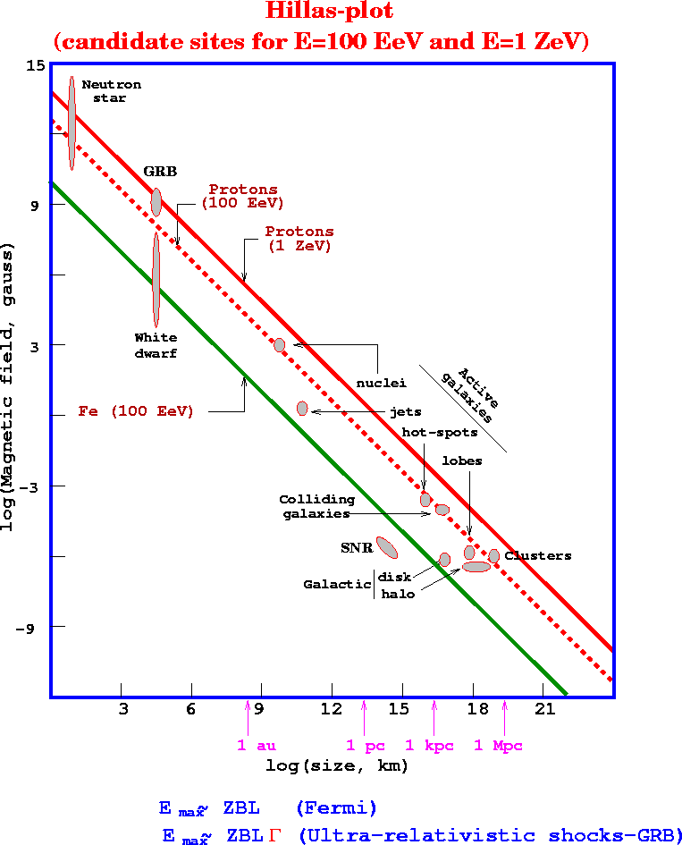
First Order Fermi Shock
Acceleration
M.Boratav
u₁
u₂
The ball hit by the racket in
random directions:
leads to spectrum E^{-q}, q ≥ 2.
As for man-made accelerators the
maximal energy is limited by the
gyroradius staying below the shock
size,

Slide 12
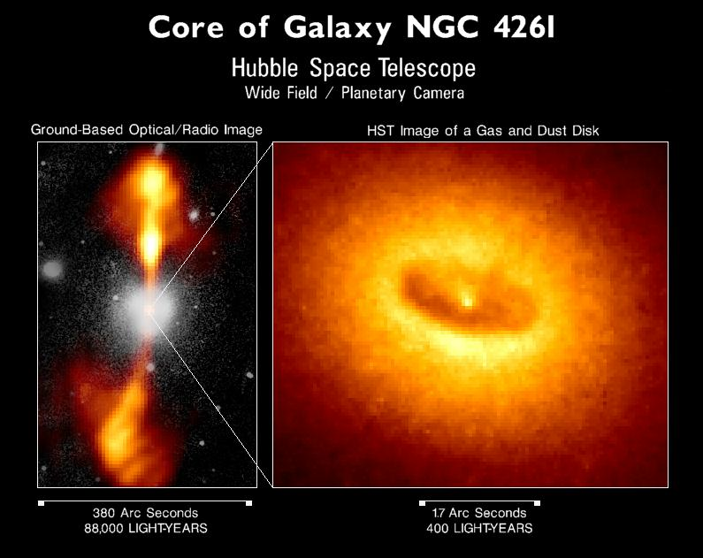
A possible acceleration site associated with shocks in hot spots of active galaxies

Slide 13
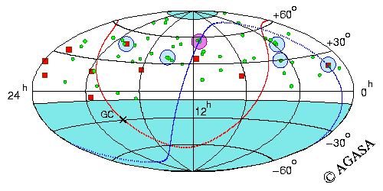
Arrival Directions of Cosmic Rays above 4x10¹⁹ eV
galactic plane
supergalactic plane
Akeno 20 km², 17/02/1990 – 31/07/2001, zenith angle < 45º
Red squares : events above 10²⁰ eV, green circles : events of (4 – 10)x10¹⁹ eV
Shaded circles = clustering within 2.5º.
Chance probability of clustering from isotropic distribution is < 1%.

Slide 14
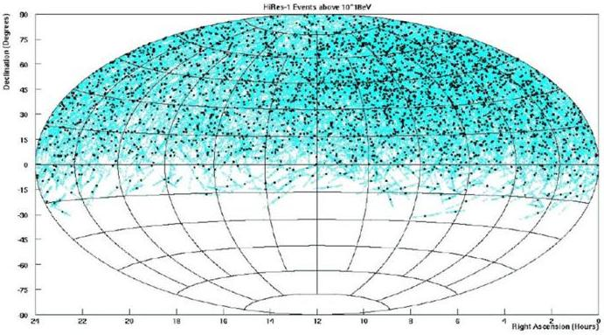
HiRes sees no significant anisotropy above 10¹⁸ eV

Slide 15
Cosmic Magnetic Fields and their Role in Cosmic Ray Physics
Cosmic rays above ~10¹⁹ eV are probably extragalactic and
may be deflected mostly by extragalactic fields B_{XG} rather
than by galactic fields.
However, very little is known about about B_{XG}:
It could be as small as 10⁻²⁰ G (primordial seeds, Biermann
battery) or up to fractions of micro Gauss if concentrated
in the local Supercluster (equipartition with plasma).

Slide 16
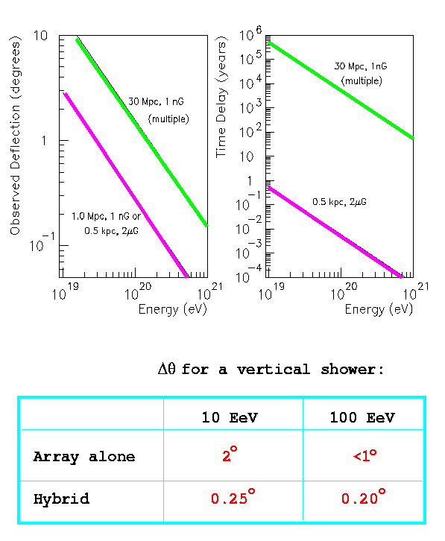
Deflection and Angular Resolution

Slide 17
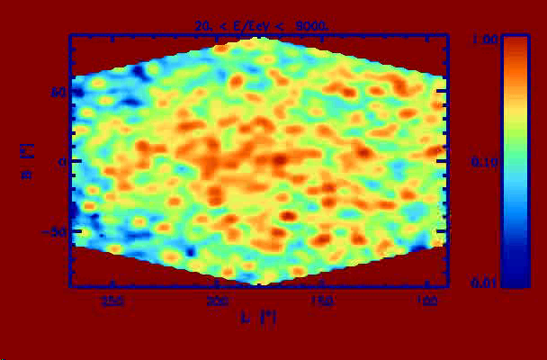
Strong fields in our Supergalactic Neighbourhood: Numerical simulations
A source at 3.4 Mpc distance injecting protons with spectrum E^{-2.4} up to 10²² eV
A uniform Kolmogorov magnetic field of strength 0.3 micro Gauss and largest
turbulent eddy size of 1 Mpc.
10⁵ trajectories,
251 images between
20 and 300 EeV,
2.5º angular resolution
Isola, Lemoine, Sigl
Conclusions:
1.) Isotropy inconsistent with only one source.
2.) Strong fields produce interesting lensing (clustering) effects.

Slide 18
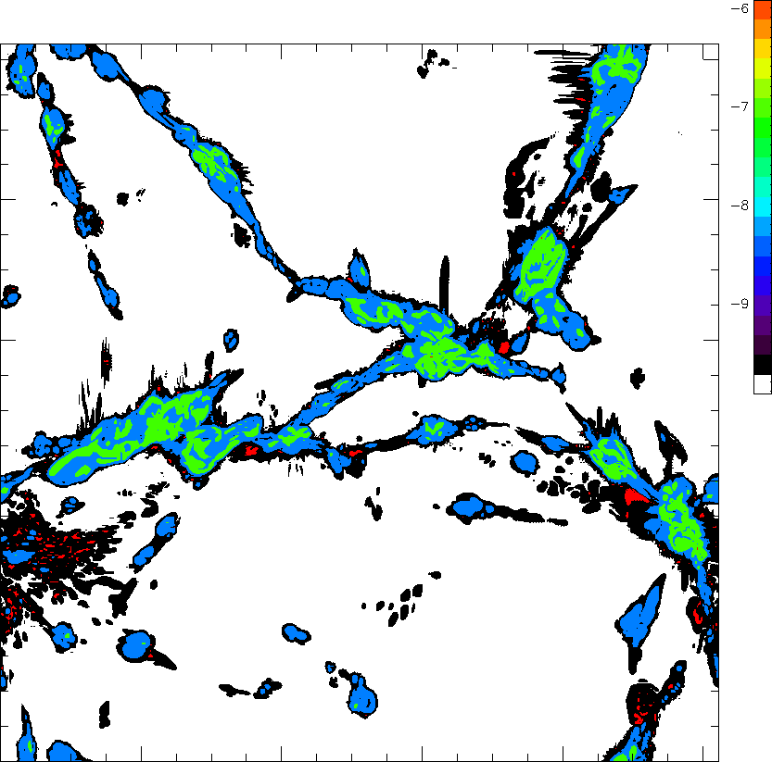
Supergalactic Neighbourhood and Magnetic Fields are strongly structured
baryon density-cut
through 50Mpc³ box

Slide 19
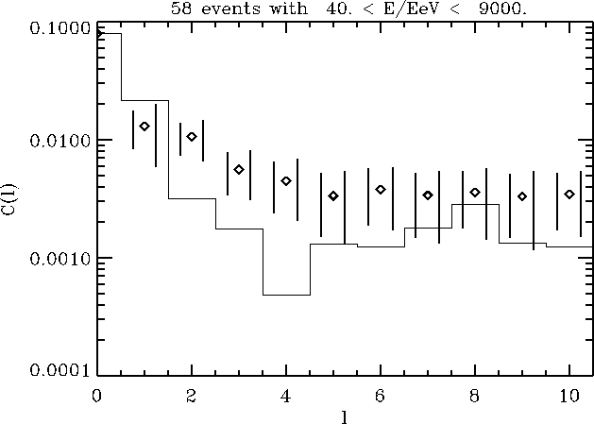
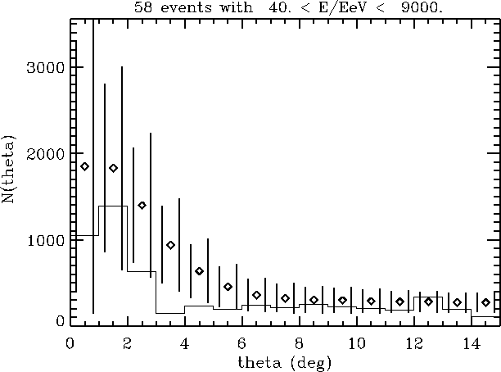
How many sources in a strongly structured and magnitezed environment?
Assume source density follows baryon density, field is stochastic and uniform
with a Kolmogorov spectrum up to largest eddy scale of 1 Mpc.
Current (AGASA) data can be fit with 10-100 sources if observer is surrounded
by fields ≥ 0.1 micro Gauss:
power spectrum
auto-correlation function
CL=63%
CL=17%
Diamonds=simulations; statistical and total (including cosmic variance) error bars
Histogram=AGASA data.
Isola, Sigl, astro-ph/0203273, Miniati, Ensslin, Sigl, in preparation

Slide 20
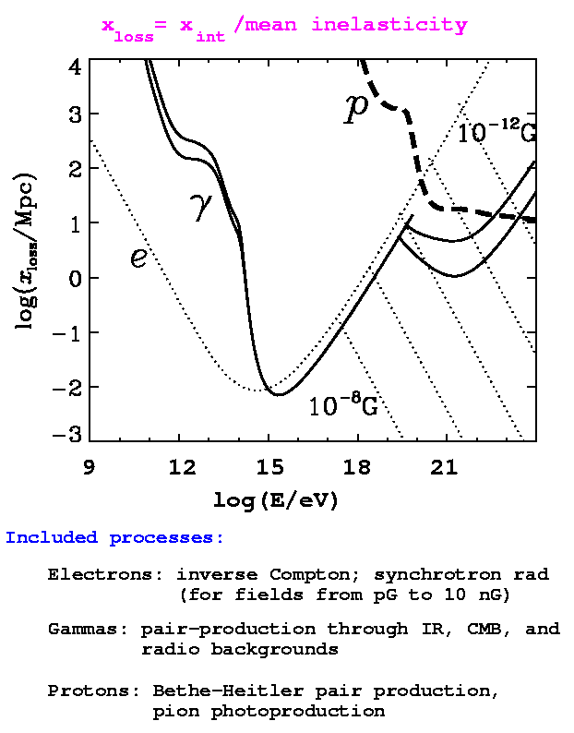
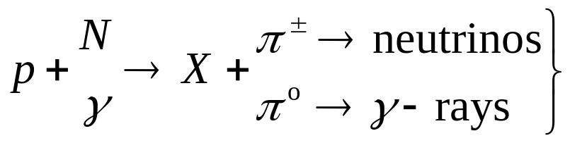
Ultra-High Energy Cosmic Rays and the Connection to
γ-ray and Neutrino Astrophysics
accelerated protons interact:
=> energy fluences in γ-rays and
neutrinos are comparable due to
isospin symmetry.
The neutrino spectrum is unmodified,
whereas γ-rays pile up below the pair
production threshold on the CMB at a
few 10¹⁴ eV.
The Universe acts as a calorimeter for
the total injected electromagnetic
energy above the pair threshold. This
constrains the neutrino fluxes.

Slide 21
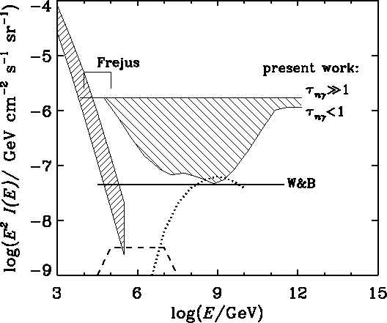
The total injected electromagnetic energy is constrained by the diffuse γ-ray
flux measured by EGRET in the MeV – 100 GeV regime
Neutrino flux upper limit
for opaque sources
determined by EGRET
bound
EGRET
Neutrino flux upper limit
for transparent sources
more strongly constrained
by primary cosmic ray
flux at 10¹⁸ – 10¹⁹ eV
(Waxman-Bahcall)
Mannheim, Protheroe, Rachen

Slide 22
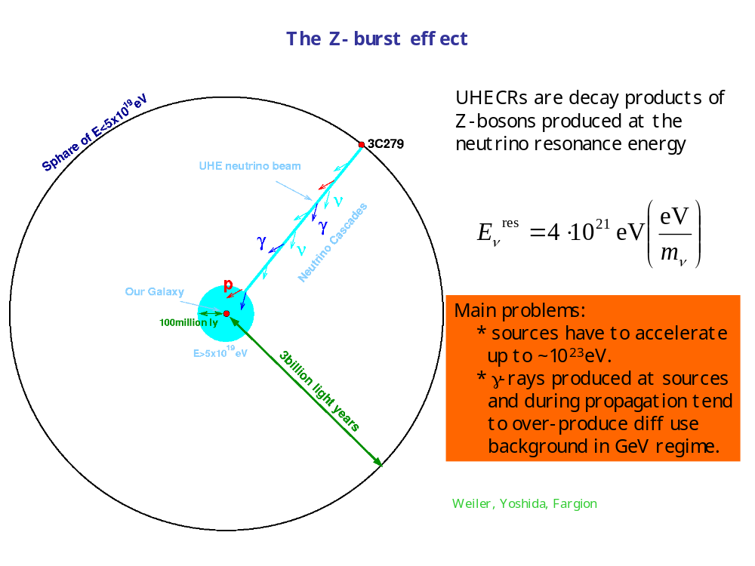
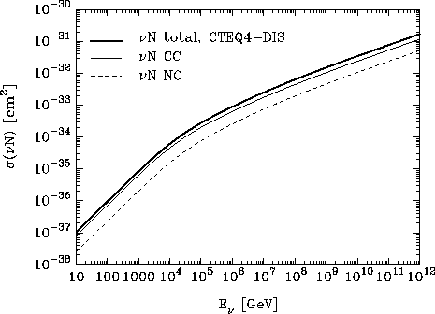
New Particles and New Interactions
Motivated by possible correlations with high redshift objects:
Farrar, Biermann | radio-load quasars | ~1%
Virmani et al. | radio-load quasars | ~0.1%
Tinyakov, Tkachev | BL-Lac objects | ~10⁻⁵
G.S. et al. | radio-load quasars | ~10%
If this is confirmed, one can only think of 3 possibilities:
1.) Neutrino primaries
but Standard Model interaction probability in atmosphere is ~10⁻⁵.
resonant (Z0) secondary production on massive relic neutrinos:
needs extreme parameters and huge neutrino fluxes.
strong interactions above ~1TeV: only moderate neutrino fluxes required.
2.) New heavy neutral (SUSY) hadron X₀: m(X⁰) > m_{N} increases GZK threshold.
but basically ruled out by constraints from accelerator experiments.
3.) New weakly interacting light (keV-MeV) neutral particle
electromagnetic coupling small enough to avoid GZK effect; hadronic coupling
large enough to allow normal air showers: very tough to do.
In all cases: more potential sources, BUT charged primary to be accelerated to
even higher energies.

Slide 23
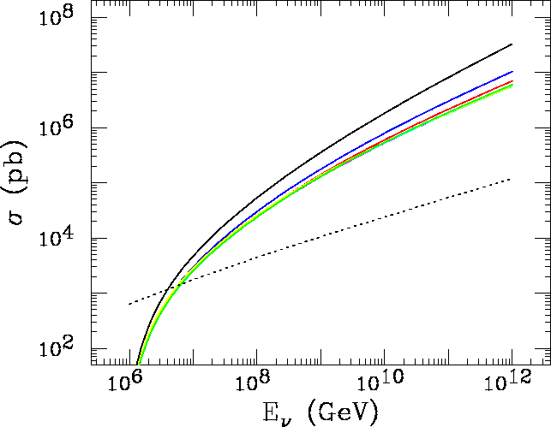
Probes of Neutrino Interactions beyond the Standard Model
Note: For primary energies around 10²⁰ eV:
Center of mass energies for collisions with relic backgrounds
~100 MeV – 100 GeV ―> physics well understood
Center of mass energies for collisions with nucleons in the atmosphere
~100 TeV – 1 PeV ―> probes physics beyond reach of accelerators
Example: microscopic black hole production in scenarios with a TeV string scale:
For neutrino-nucleon scattering with
n=1,…,7 extra dimensions,
from top to bottom
Feng, Shapere, hep-ph/0109106
This increase is not sufficient
to explain the highest energy
cosmic rays, but can be probed
with deeply penetrating showers.
Standard Model cross section

Slide 24
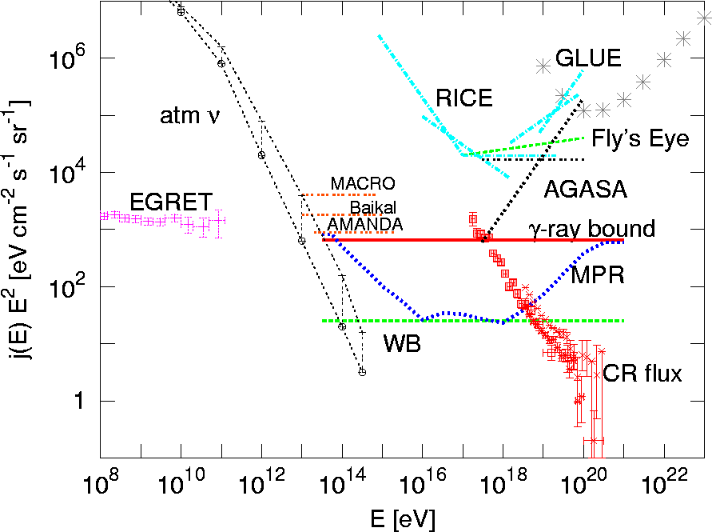
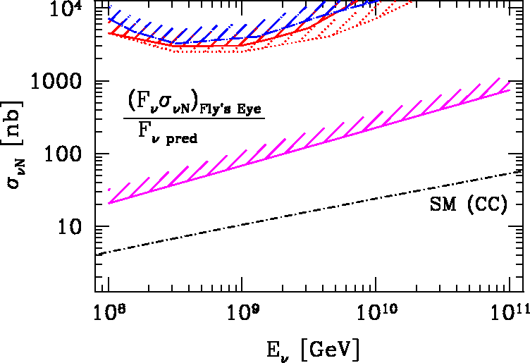
However, the neutrino flux from pion-production of extra-galactic trans-GZK
cosmic rays allows to put limits on the neutrino-nucleon cross section:
Ringwald, Tu, PLB 525 (2002) 135
Comparison of this Nγ- (“cosmogenic”) flux with the non-observation of
horizontal air showers results in the present upper limit about 10³ above the
Standard Model cross section.
Future experiments will either close the window down to the Standard Model
cross section, discover higher cross sections, or find sources beyond the
cosmogenic flux. How to disentangle new sources and new cross sections?

Slide 25
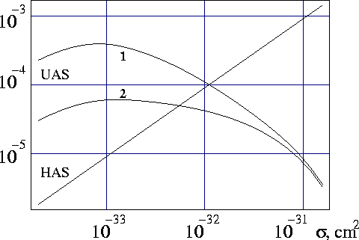
Earth-skimming τ-neutrinos
Air-shower probability per τ-neutrino at 10²⁰ eV for 10¹⁸ eV (1)
and 10¹⁹ eV (2) threshold energy for space-based detection.
Comparison of earth-skimming and horizontal shower rates allows to
measure the neutrino-nucleon cross section in the 100 TeV range.
Kusenko, Weiler, PRL 88 (2002) 121104

Slide 26
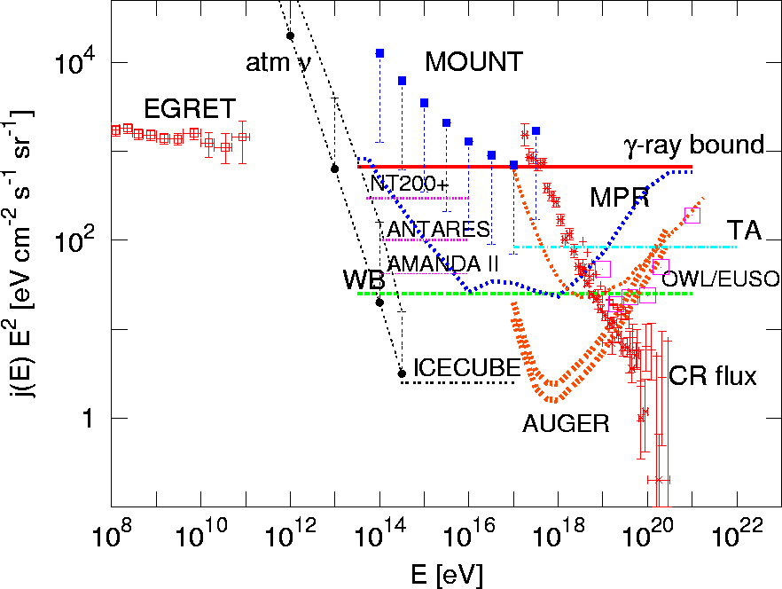
Future neutrino flux sensitivities
Kalashev, Kuzmin, Semikoz, Sigl, hep-ph/0205050

Slide 27

Ultra-High Energy Neutrino Detection: Traditional and New Ideas
Mostly uses the charged-current reactions:
1.) detect Cherenkov radiation from muons in deep sea or ice
AMANDA, ANTARES, BAIKAL, NESTOR
aims at 1 km³ for E> 100 GeV to 1 TeV
2.) horizontal air showers for electron and τ-neutrinos
PIERRE AUGER, MOUNT
for E> 10¹⁸ eV, increased efficiency for τ-neutrinos if surrounded by
mountains on 100 km scale which is decay length of produced taus.
3.) detection of inclined showers from space for E>10²⁰ eV
EUSO, OWL
4.) acoustic detection in water: hydrophonic arrays
5.) detection of radio emission from negative charge excess of showers
produced in air, water, ice, or in skimming rock.
RICE (in South-pole ice), GLUE (radio-telescope observing the moons rim)
6.) Earth-skimming events in ground arrays or fluorescence detectors.

Slide 28
Conclusions
1.) The origin of very high energy cosmic rays is one of the fundamental
unsolved questions of astroparticle physics.
This is especially true at the highest energies, but even the origin of
Galactic cosmic rays is not resolved beyond doubt.
2.) Pion-production establishes a very important link between the physics
of high energy cosmic rays on the one hand, and γ-ray and neutrino
astrophysics on the other hand. All three of these fields should be
considered together.
3.) Acceleration and sky distribution of cosmic rays are strongly linked to the
in part poorly known strength and distribution of cosmic magnetic fields.
4.) At energies above ~10¹⁸ eV, the center-of mass energies are above
a TeV and thus beyond the reach of accelerator experiments. Especially
in the neutrino sector, where Standard Model cross sections are small,
this probes potentially new physics beyond the electroweak scale.
5.) The coming 3-5 years promise an about 100-fold increase of ultra-high
energy cosmic ray data due to experiments that are under either
construction or in the proposal stage.
6.) Many new ideas on a modest cost scale, especially for ultra-high energy
neutrino detection, are currently under discussion.

