Slide 1

Advancement Training
Earth-Sun Relationship (Unit 1-Lesson2)
Operations Department Training

Slide 2
Earth-Sun Relationship
Introduction
The Sun is a thermonuclear reactor about 93 million miles from the earth.
The Sun is important in meteorology because all natural phenomena can be traced, directly or indirectly, to the energy received from it.

Slide 3
Earth-Sun Relationship
Learning Objective
Describe how radiation and insolation are affected by the Earth-Sun relationship.

Slide 4
Earth-Sun Relationship
The Sun
Core temperature: 15,000,000 K
Surface temperature: 6,000 K (10,300 F)
The Sun radiates electromagnetic energy in all directions. However, Earth intercepts only a small fraction of this energy.
Most of the electromagnetic energy is in the form of light waves, with only a tiny fraction in the form of heat waves.

Slide 5
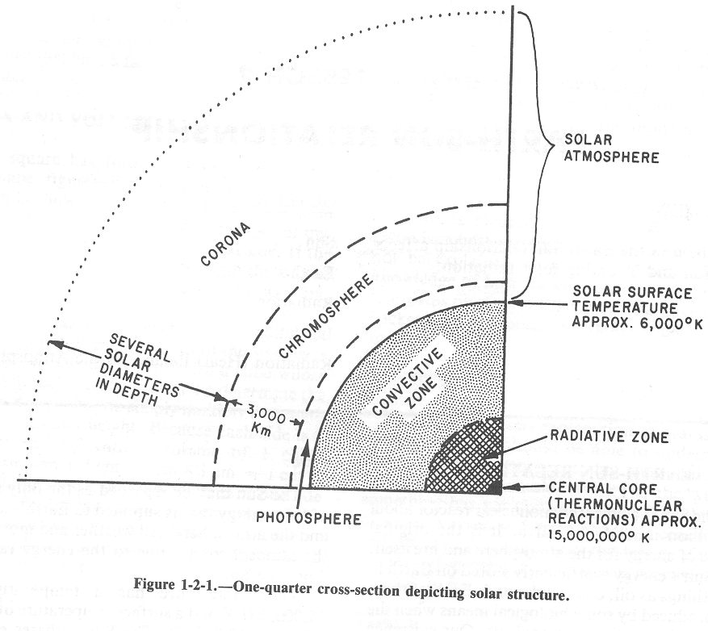
Earth-Sun Relationship
Solar Composition
*Radiation emissions consisting of gamma rays through x-rays, ultraviolet, visible and radio waves, originate in the corona.
The Sun

Slide 6
Earth-Sun Relationship
Solar Prominences/Filaments
*Solar prominences/filaments are injections of gases from the chromosphere into the corona.
*A filament appears as a long dark ribbon.
*A prominence is a long bright ribbon.

Slide 7
Earth-Sun Relationship
Sunspots
*Regions of strong localized magnetic field and indicate relatively cool areas in the photosphere.
Appear darker than surroundings.
*Sunspots begin as small dark areas known as pores.

Slide 8
Earth-Sun Relationship
Plages
Large irregular bright patches that surround sunspot groups.
They are features of the lower chromosphere and often completely or partially obscure and underlying sunspot.

Slide 9
Earth-Sun Relationship
Flares
The most spectacular of the eruptive features.
*Flares are classified according to size and brightness.
Activity, solar winds are emitted and often intercept Earth.
*Geomagnetic disturbances like the aurora borealis and aurora australis result primarily from the motion of electrically charged particles within the ionosphere.

Slide 10
Earth-Sun Relationship
Earth
Of the nine planets in our solar system Earth is the third nearest to (or from) the Sun.
Earth varies in distance from the Sun during the year: 94 million miles in summer and 91 million miles in winter.

Slide 11
Earth-Sun Relationship
Earth
Earth is subject to four motions in its movement through space:
*Rotation* about its axis
*Revolution* around the Sun
Wobble of the axis
Solar motion (movement of solar system with space)
Only the above highlighted two are of any importance to meteorology.

Slide 12
Earth-Sun Relationship
Rotation
Earth rotates on its axis once every 24 hours.
One-half of Earth’s surface is therefore facing the Sun at all times.
Rotation about Earth’s axis take place in an eastward direction. (sun rise east, set west)

Slide 13
Earth-Sun Relationship
Revolution
The revolution around the Sun and the tilt of Earth on its axis are responsible for our seasons.
Earth makes one complete revolution in approximately 365 1/4 days.
Earth’s axis is at an angle of 23 1/2 degrees to its plane of rotation and points in a nearly fixed direction in space towards the North Star (Polaris).

Slide 14
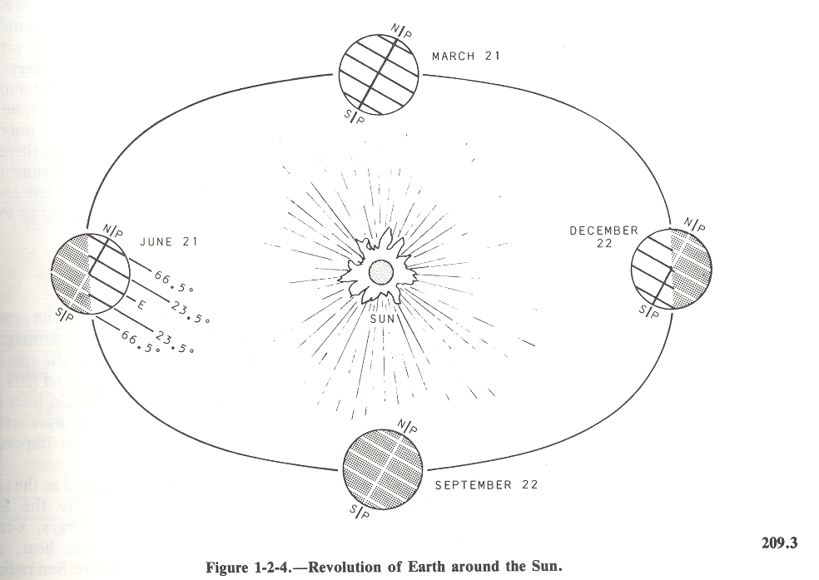
Earth-Sun Relationship
Solstices and Equinoxes

Slide 15
Earth-Sun Relationship
Solstices and Equinoxes
Polar Zone - Frigid Zone
66 1/2 N - Arctic Circle
Temperate Zone
23 1/2 N - Tropic of Cancer
Torrid Zone - Equatorial Zone - Tropical Zone
23 1/2 S - Tropic of Capricorn
Temperate Zone
66 1/2 S - Antarctic Circle
Polar Zone - Frigid Zone

Slide 16
Earth-Sun Relationship
Radiation
Radiation - the process by which electromagnetic energy is propagated through space. It moves at the speed of light, which is 186,000 miles per second, and travels in straight lines in a vacuum.
*IT IS THE MOST IMPORTANT MEANS OF HEAT TRANSFER.

Slide 17
Earth-Sun Relationship
Solar Radiation
Defined as total EM energy emitted by the Sun.
Energy radiates from a body by wavelengths which vary inversely with the temperature of that body.
SUN EMITS SHORTWAVE RADIATION.
EARTH RERADIATES THE SUN’S ENERGY WITH LONGWAVE RADIATION.

Slide 18
Earth-Sun Relationship
Depletion of Solar Radiation
Dispersion - Due to the tilt of the earth, the sun’s rays hit the earth at different angles. Rays that are not perpendicular to the earth are dispersed or spread out over a greater area.
Scattering - solar radiation passes through the air and some of the wavelengths are deflected in all directions by molecules of gases, suspended particles, and water vapor.
Reflection - process whereby a surface turns a portion of the incident radiation back into the medium through which the radiation came. *Albedo is the percent of reflectivity of all wavelengths on a surface.
Absorption - Earth and its atmosphere absorb about 64% of the insolation. Land and water surfaces of Earth absorb 51% percent of this insolation. The remaining 13% is directly absorbed by ozone, carbon dioxide, and water vapor.

Slide 19
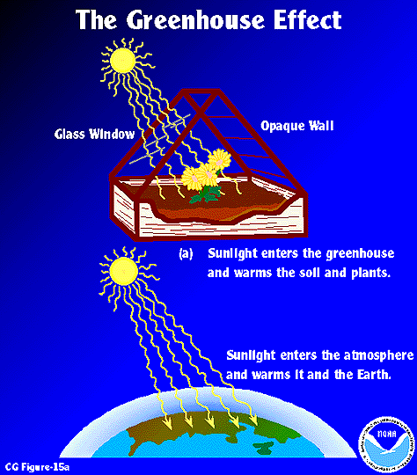

Slide 20
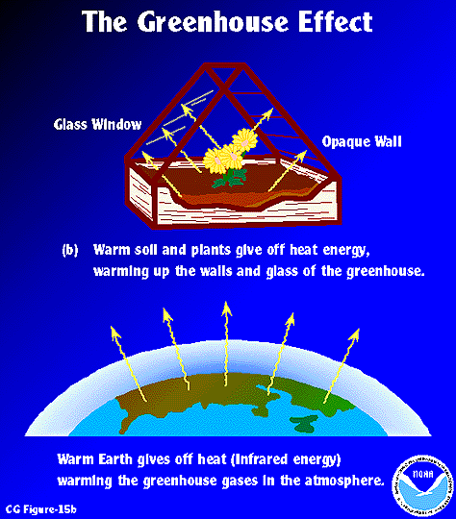

Slide 21
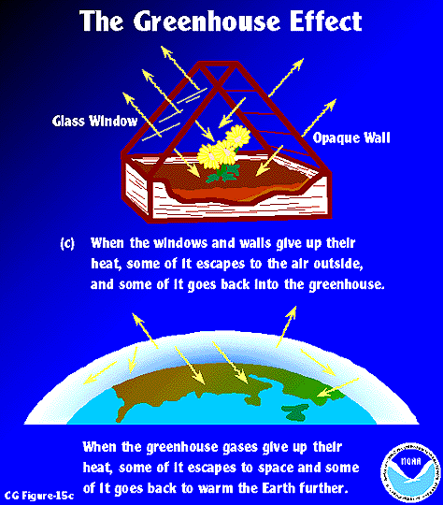

Slide 22
