Slide 1

Nonlinear Thermal/Structural Analysis of Hypersonic Vehicle Hot Structures
NASA Workshop on Innovative
Finite Element Solutions to Challenging Problems
May 18, 2000
Michael C. Lindell and Ruth M. Amundsen
Structural & Thermal Analysis Branch
NASA Langley Research Center
Hampton, Virginia

Slide 2
Outline
Hyper-X Introduction
Analysis Challenges
Aero-Thermo-Structural Analysis Process
Thermal Analysis Methods & Results
Structural Analysis Methods & Results
Conclusions

Slide 3
Hyper-X Introduction
Goal: To validate, in flight, propulsion and related technologies for air-breathing hypersonic aircraft.
Product: Two vehicles capable of Mach 7 and one vehicle capable of Mach 10.
Schedule: First Mach 7 flight in late 2000.
Payoff: Increased payload capacities and reduced costs for future vehicles by eliminating on-board oxygen fuel requirements.

Slide 4


Slide 5
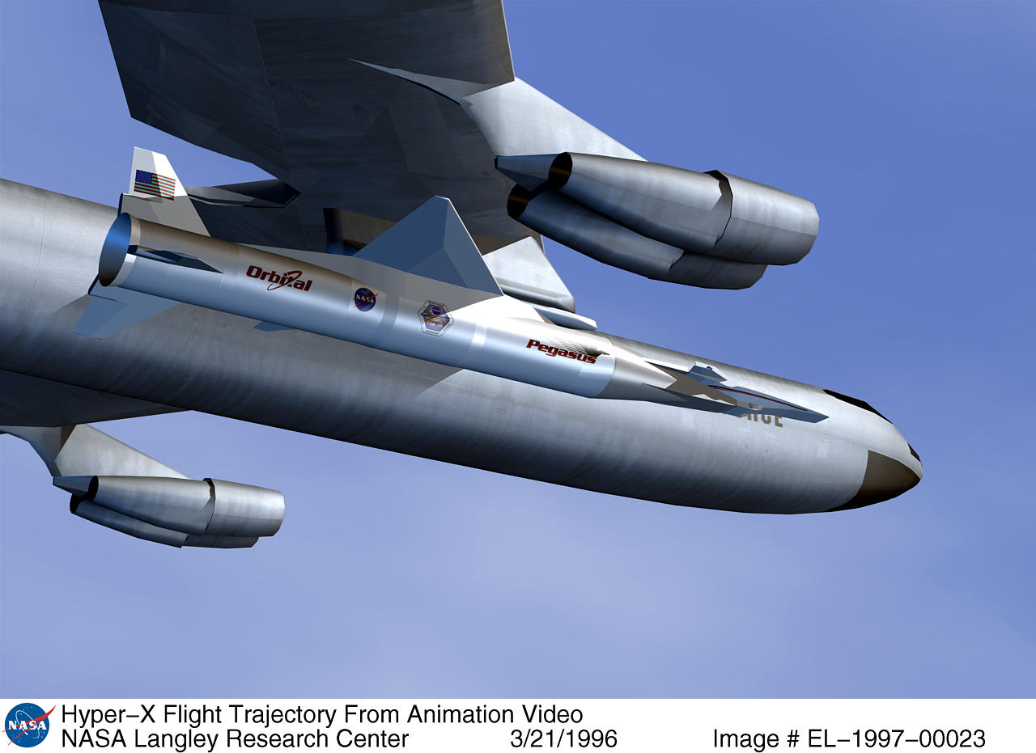
Hyper-X Vehicle and Booster on B-52

Slide 6
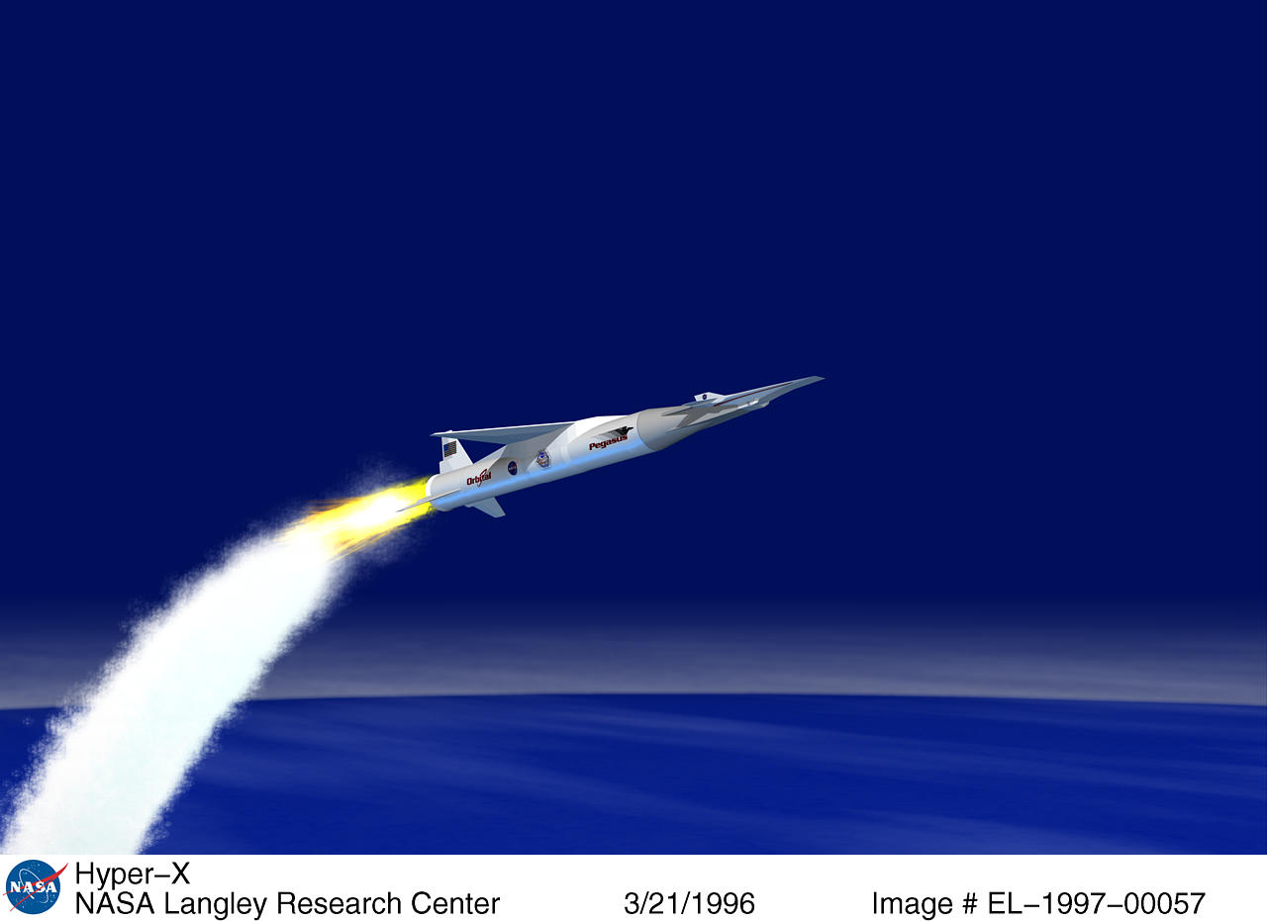
Hyper-X During Pegasus Boost

Slide 7
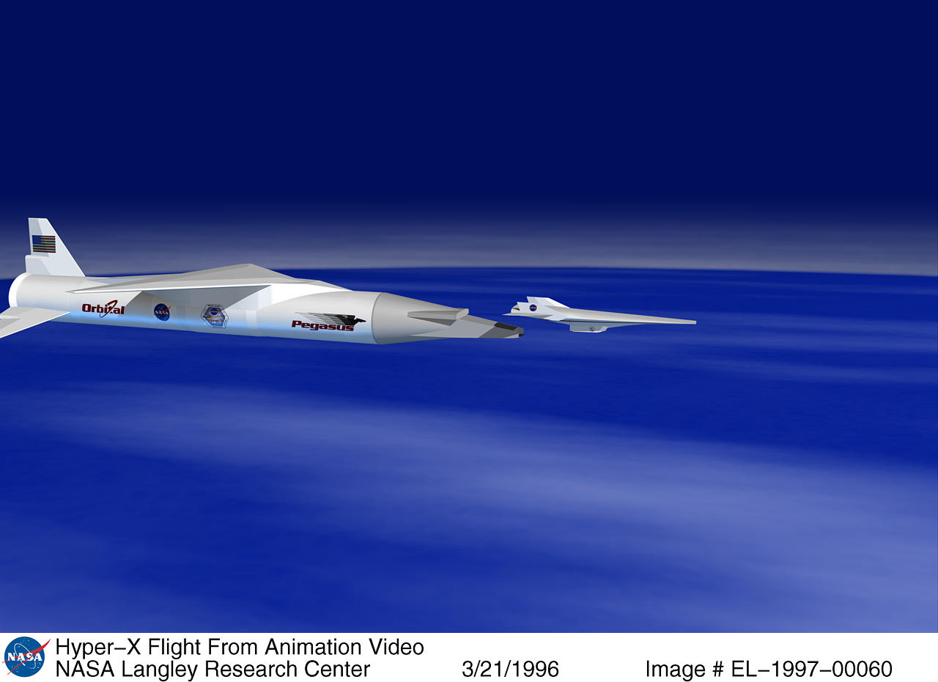
Hyper-X Separating for Free Flight

Slide 8
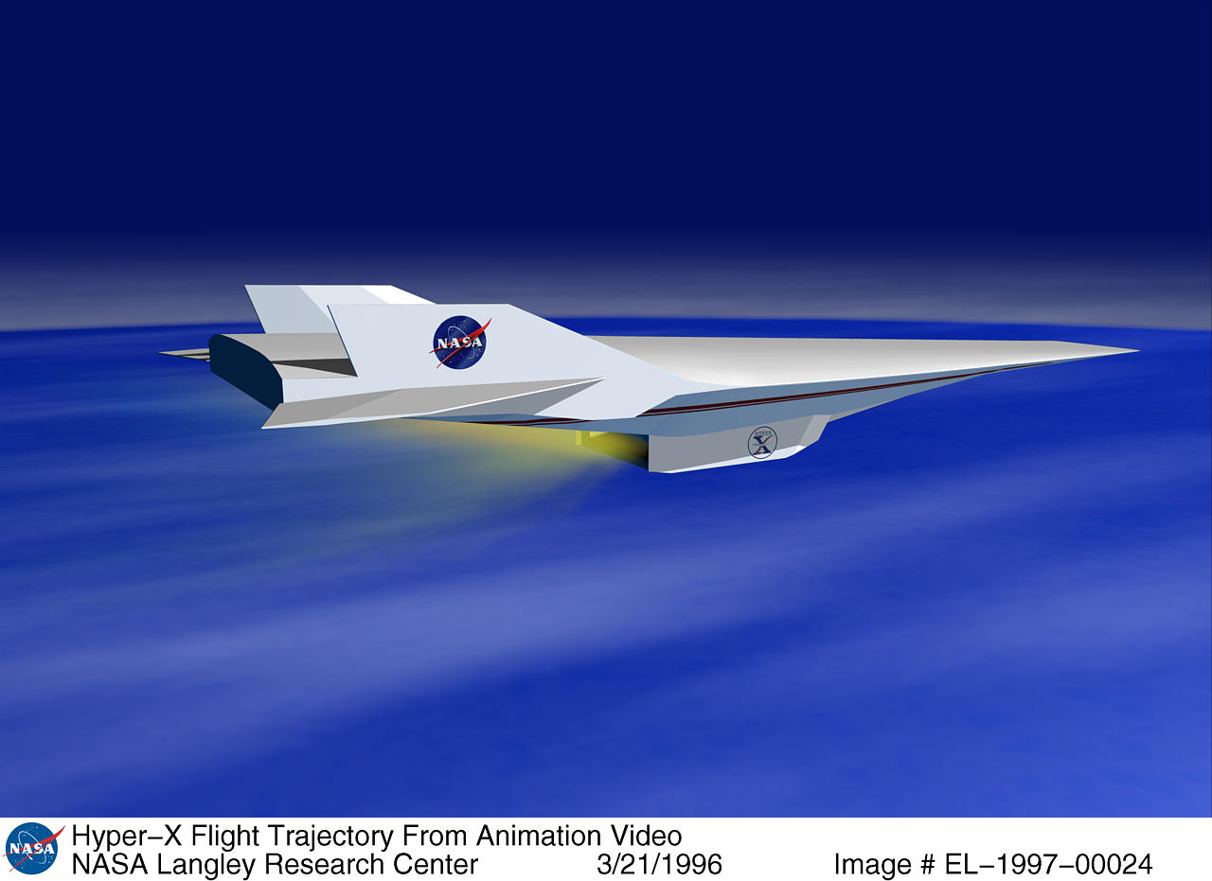
Hyper-X Engine Test

Slide 9
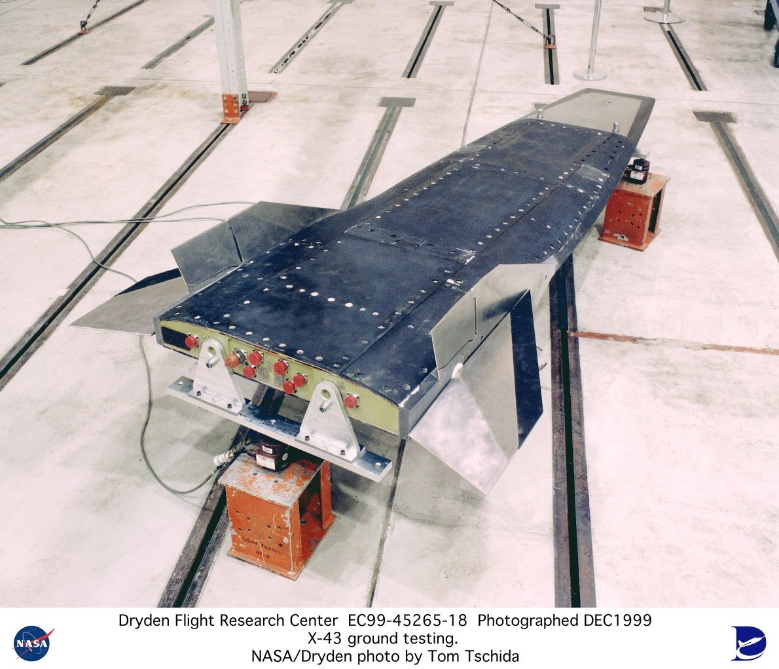
Hyper-X Flight Hardware

Slide 10
Hyper-X Analysis Challenges
Hypersonic flight introduces extreme heat loads into vehicle leading edges (wings, tails, and nose).
High temperature materials and coatings are required to distribute heat and carry resulting loads.
Accurate generation and incorporation of heat loads requires tight integration between aeroheating analysis, thermal analysis, and structural analysis.
Loading conditions require nonlinear analysis with temperature-dependent material properties.

Slide 11
Aero-Thermo-Structural Analysis Process
trajectory
information
Pro/Engineer
design geometry
SHABP
aeroheating
Fay-Riddell
aeroheating
iteration
Q
T
Q
T
MSC/PATRAN
modeling
PATRAN Thermal
thermal analysis
T
MSC/NASTRAN
structural analysis

Slide 12
Aero-Thermo-Structural Analysis Process
Design in Pro/Engineer
Aeroheating analysis in SHABP from IGES geometry
Import Pro/E model directly to MSC/PATRAN
Thermal analysis in MSC/PATRAN Thermal
  Less manual model development due to geometry import
  Include aerodynamic heating and pressure loads from SHABP
    Different aeroheating and thermal meshes can be utilized
    Extensive FORTRAN in PATRAN Thermal to interpolate aeroheating over both time and 3D space
  Stagnation point heating done using Fay-Riddell
  Iteration between thermal and aeroheating to capture skin temperature
Structural analysis in MSC/NASTRAN
  Less manual model building due to sharing with thermal analyst
  Different thermal and structural meshes can be utilized
  Uses temperatures interpolated directly from thermal model
  Nonlinear static analysis performed at discrete trajectory points under thermal and mechanical loads

Slide 13
Thermal Analysis Methods
Properties
  All properties done as temperature-dependent
  3D orthotropic where needed (on C-C)
Aeroheating fluxes
  On surfaces, aerodynamic heating from SHABP
    dependent on Mach, altitude, skin temperature, geometry
  Interpolated in time and space onto PATRAN model
  On leading edges from Fay-Riddell
    dependent on Mach, altitude, skin temperature, geometry
  Factors applied for gap heating, cove heating, etc.
  Iteration between Q and T to come to closure
  Uncertainty factor F(time) applied to flux after closure
Other boundary conditions
  Radiation to atmosphere (changing temperature with descent)
  Contact resistance between parts and across welds
  Radiation within cavities
  All boundary conditions done on geometry to facilitate remesh

Slide 14
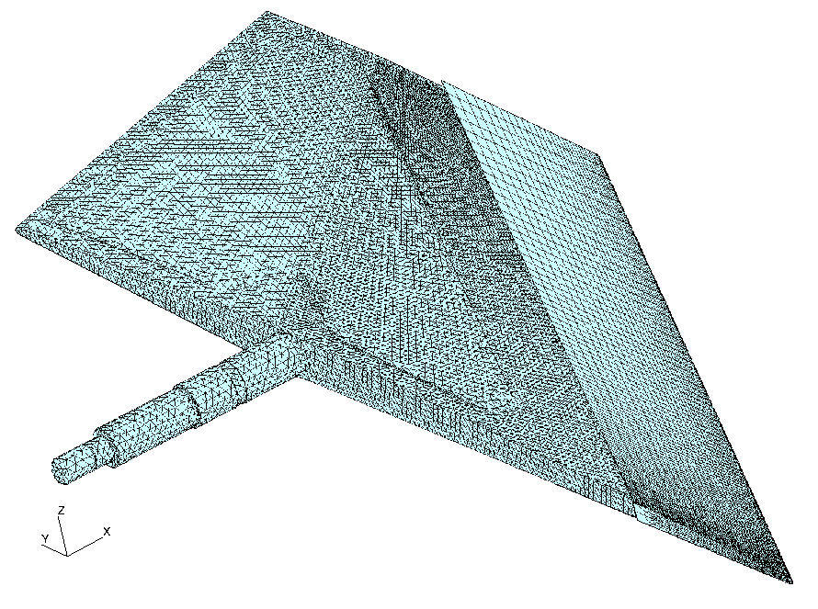
Thermal Analysis Model
C-C leading edge
Wing body
66,000 nodes
Brick and tet elements
Mesh density at LE 0.1” x 0.1”

Slide 15
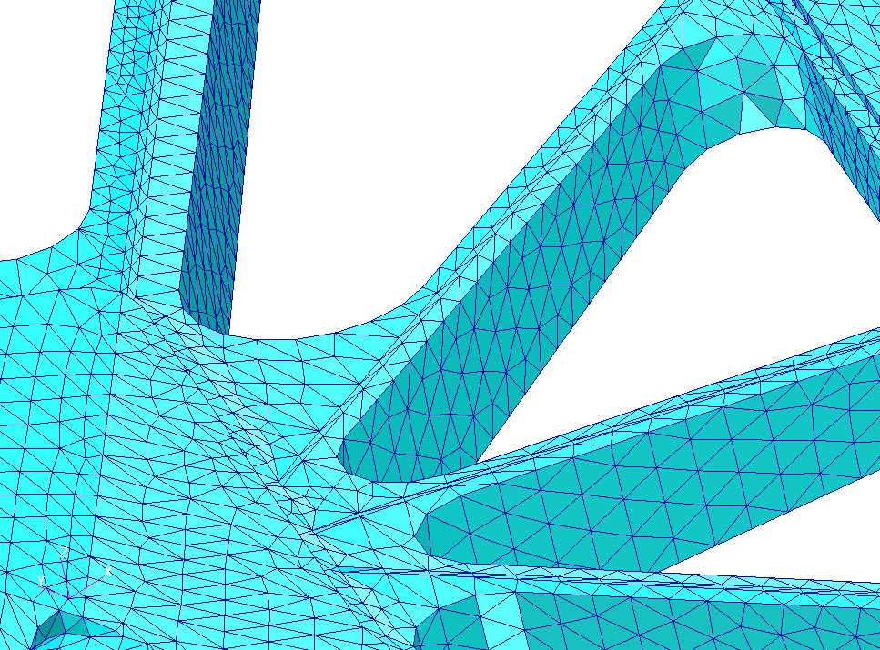
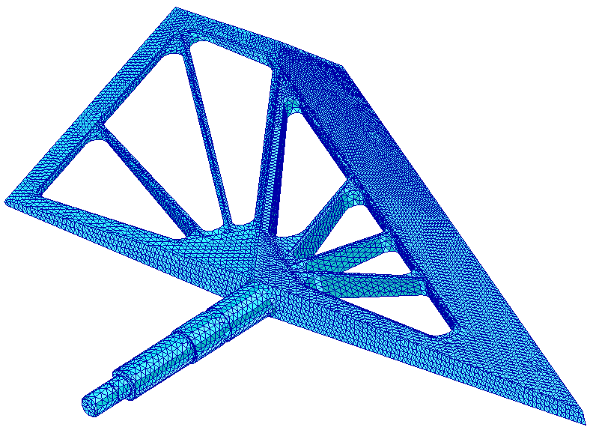
Thermal Analysis Model Details
Weld detail
Internal body structure

Slide 16
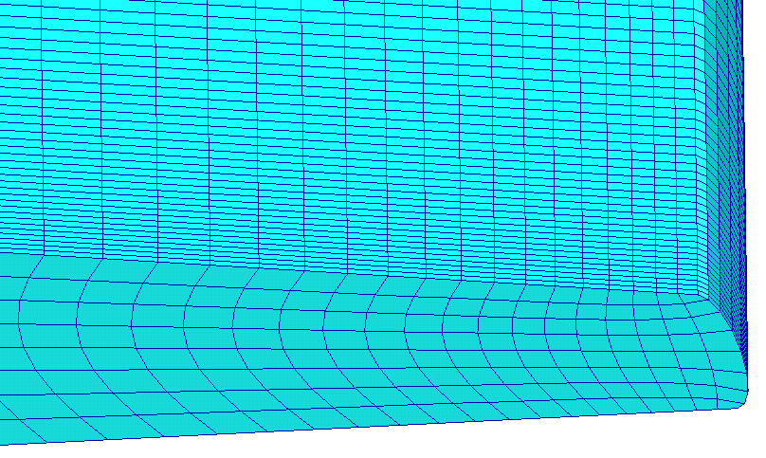
Thermal Analysis Model Details
Detail of leading edge mesh

Slide 17
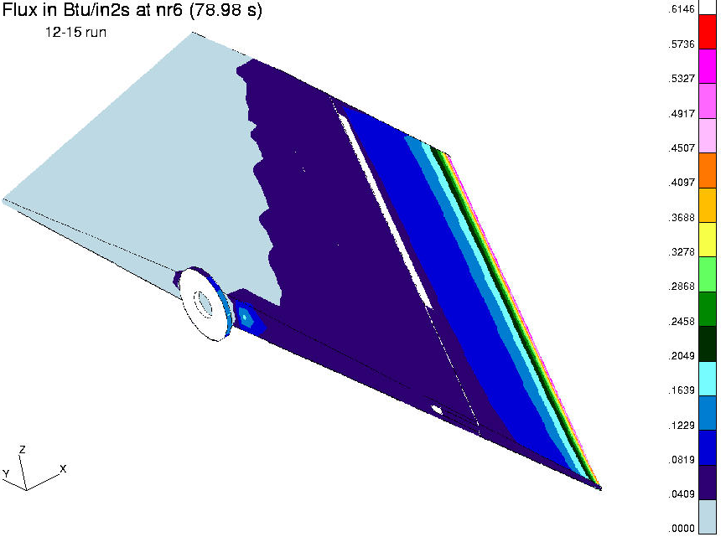
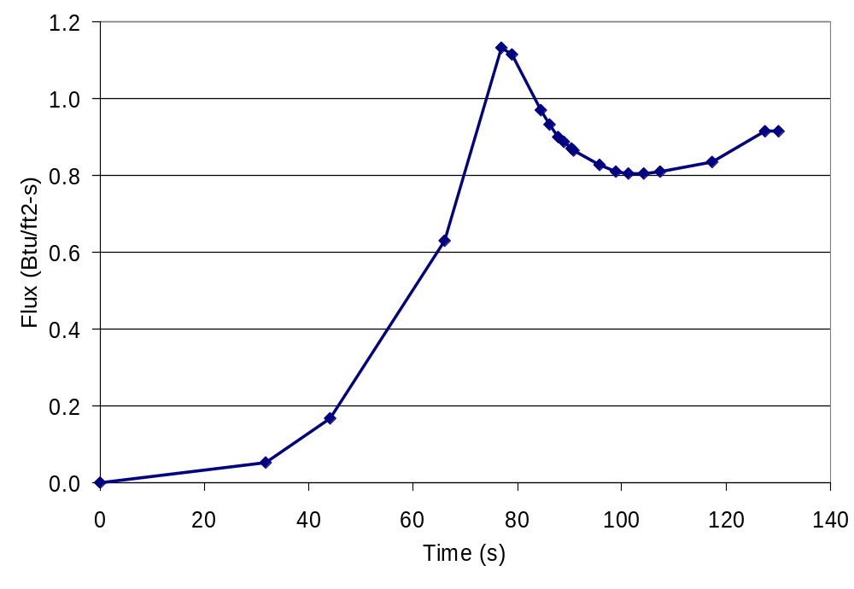
Aeroheating Flux Details
Flux change across surface
At each of 18 trajectory points, the flux across the surface varies
These effects must be combined in the thermal solver
Flux change with time

Slide 18
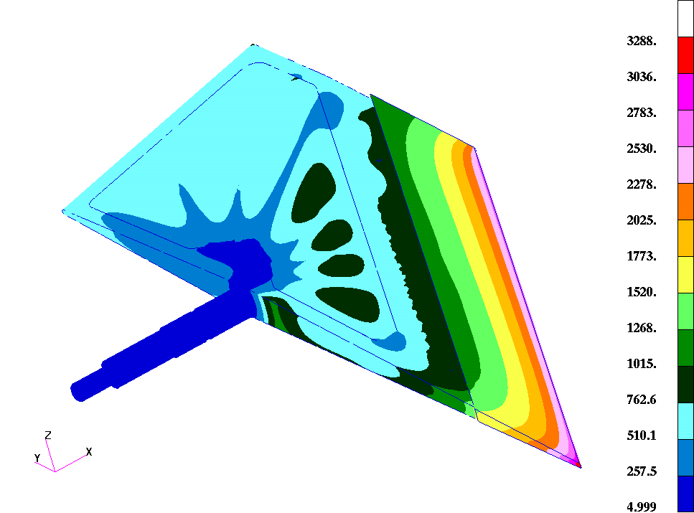
Thermal Analysis Results
Results in °F at 127 s

Slide 19
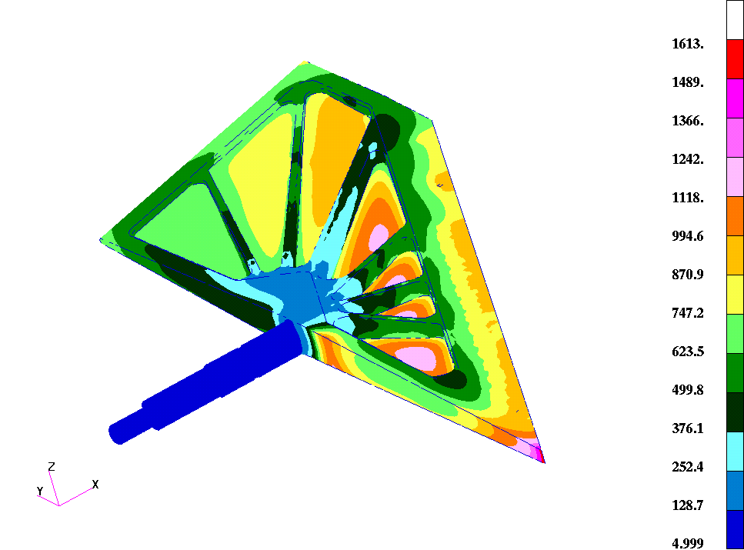
Thermal Analysis Results
Results on body in °F at 127 s

Slide 20
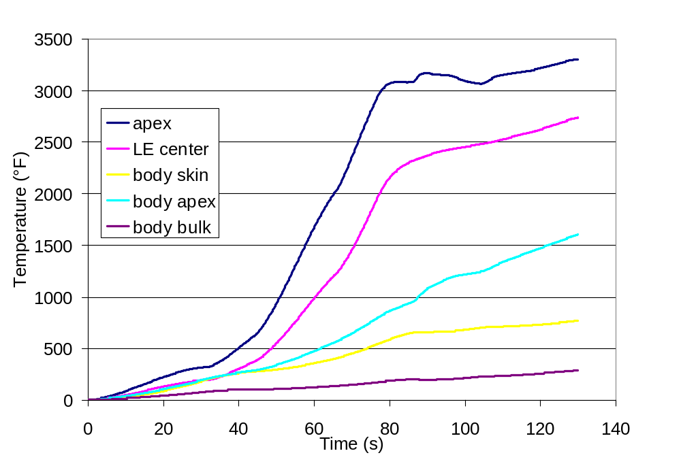
Thermal Predicted Transient

Slide 21
Thermal Analysis Results
Two outer emissivities run on body with little difference
  painted ε = 0.8
  unpainted ε = 0.3
Contact resistance of leading edge varied
  5E-4 to 5E-3 Btu/in²-s-°F with little effect
Contact resistance at weld varied
  0.1 to 1.0 Btu/in²-s-°F with little effect

Slide 22
Structural Analysis Methods
Temperatures from thermal analysis interpolated through MSC/Patran onto structural finite element mesh.
Analysis performed using MSC/Nastran v70.5.
Initial linear analysis run for yield assessment.
Nonlinear analysis performed using temperature-dependent material properties (elastic modulii and coefficients of thermal expansion).
Temperature-dependent stress/strain curves used in nonlinear solutions for materials experiencing yield.
Discrete trajectory points analyzed to determine worst case loads for strain and deflection (not always the hottest case).
Strain results evaluated in light of short duration, single use conditions.
Deflection results used to specify initial cold clearances.

Slide 23
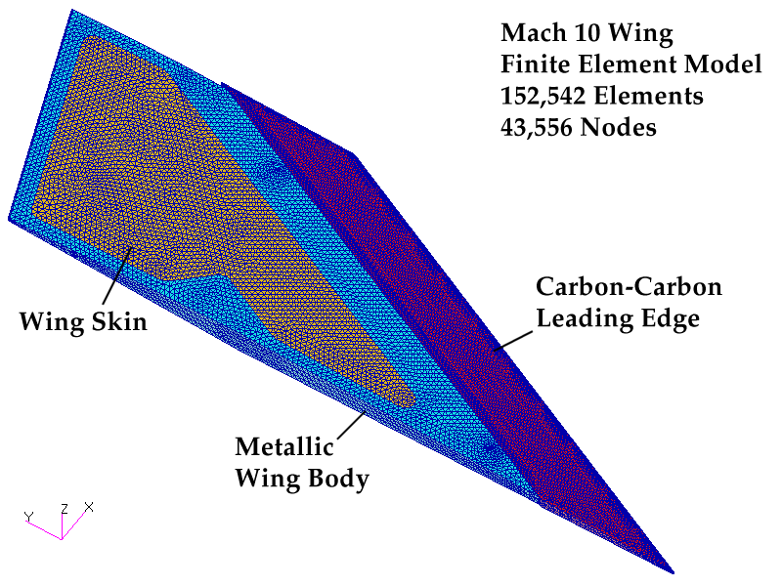
Mach 10 Wing Finite Element Model

Slide 24
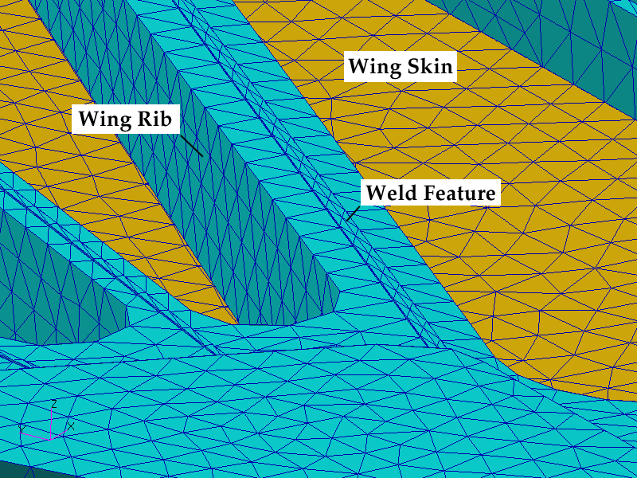
Mach 10 Wing Internals

Slide 25
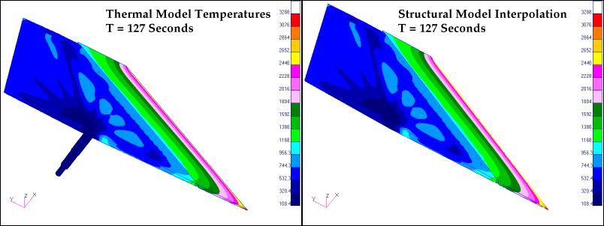
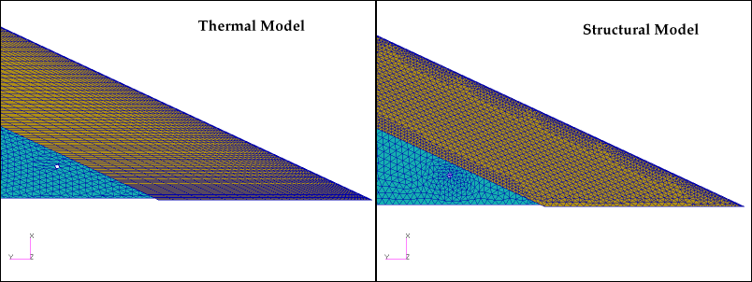
Thermal/Structural Load Interpolation

Slide 26
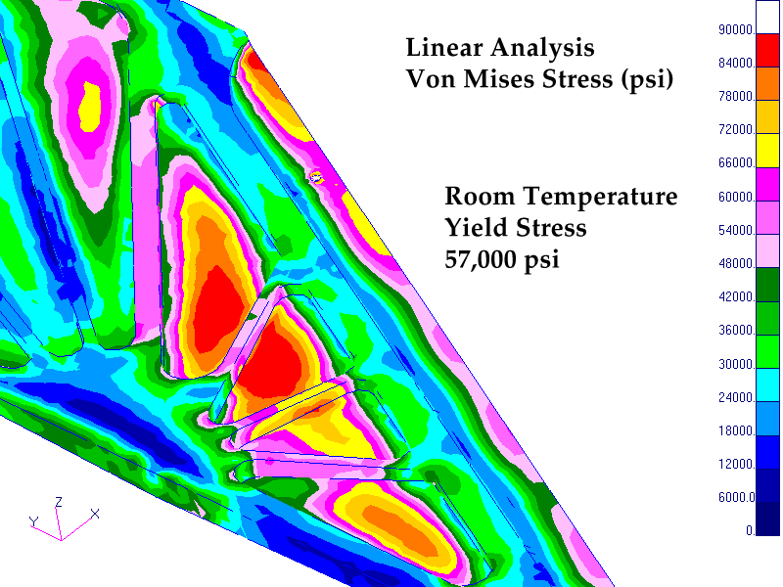
Mach 10 Wing Linear Analysis

Slide 27
Yield Assessment
Problem: How extensive is the yielding? Yield stress is a function of temperature and therefore also a function of position throughout the wing.
Determine an approximate relationship between temperature and yield stress (e.g., piecewise linear), σ_{Y}(T).
Using model temperatures for a given trajectory point, compute the temperature-dependent yield stress at each node using σ_{Y}(T).
Compute the linear Von Mises stress at each node.
Compute the ratio of Von Mises stress to the temperature-dependent yield stress at each node.
Generate a contour plot of the yield stress ratio.

Slide 28
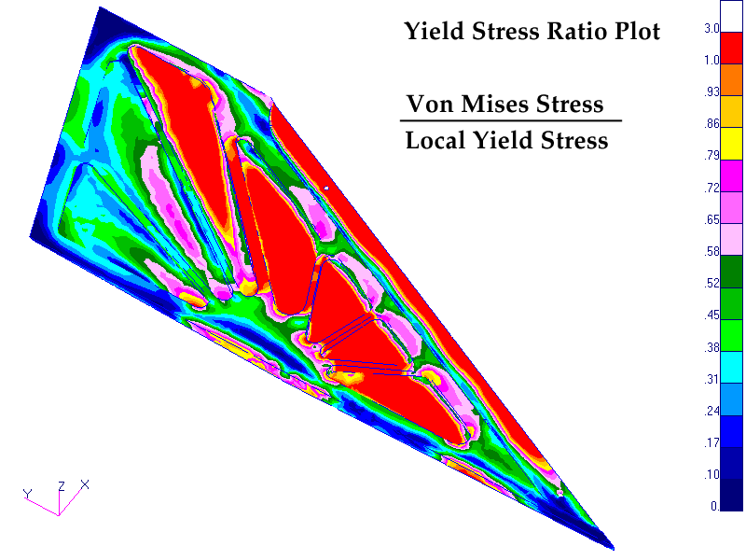
Mach 10 Wing Yield Assessment

Slide 29
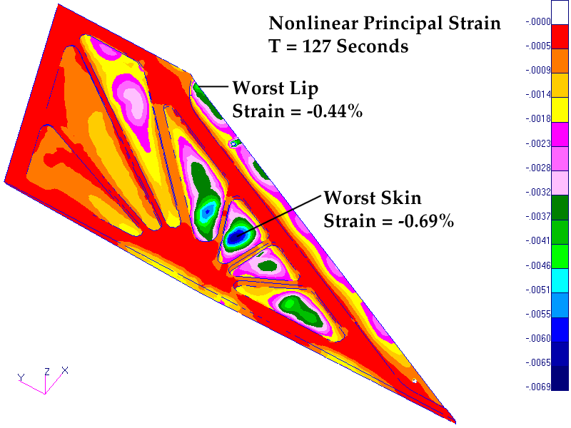
Mach 10 Wing Nonlinear Analysis

Slide 30
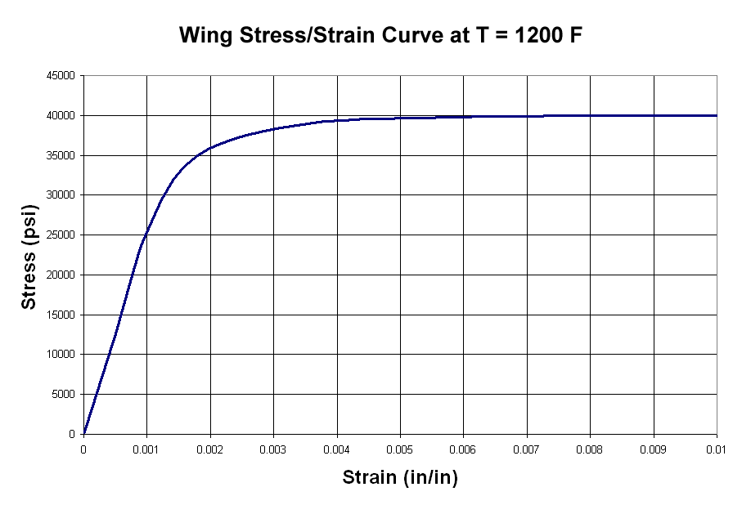
Typical Stress/Strain Curve for Wing

Slide 31
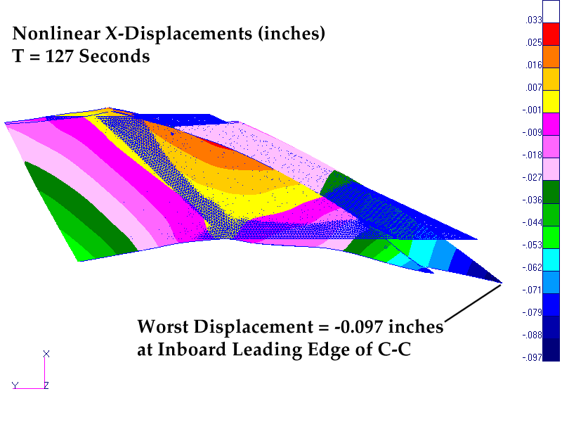
Mach 10 Wing Nonlinear Analysis

Slide 32
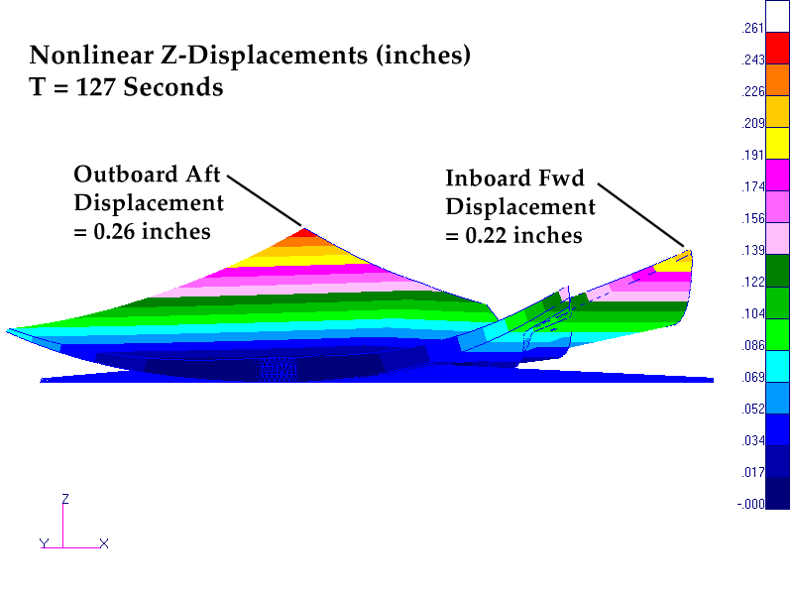
Mach 10 Wing Nonlinear Analysis

Slide 33
Conclusions
Tight integration of aeroheating, thermal, and structural analyses, each based on full 3-D geometry, was worthwhile and efficient.
3-D analysis captured effects that simpler 2-D analysis would have missed.
Deflected shape from structural analysis can be fed back into aeroheating analysis to assess impact of deformation on flow and heating characteristics.

