Slide 1
X-ray Continuum Sources
Astrophysical origins of high-energy electromagnetic radiation

Slide 2
Prepared by: Profs. A. Eskandarian, L.C. Maximon, W.C. Parke

Slide 3
General Outline
I. Introduction and the basics of electrodynamics
II. Continuous Radiative Processes
- Thermal Radiation
- Thomson & Compton/Inverse Compton Scattering
- Pair Creation and Annihilation
- Bremsstrahlung
- Cyclotron and Synchrotron radiation
III. Exotic Phenomena
- Radiation from Magnetic Compact Objects
- - Magnetars
- Cosmic Background Radiation Effects

Slide 4
Introduction
The observational information we obtain about our immediate surroundings (the solar system, the milky way galaxy, etc.), distant stars and galaxies, clusters of galaxies, and the far corners of the universe as visible light, radio waves, x-ray and γ-ray radiation; is primarily due to manifestations of the interaction among charged particles that are abundantly available as matter (or parts of matter) in and around astronomical objects of interest.
We now know that an ever present microwave background radiation left over from the Big Bang era permeates the universe, making its interaction with charges and other radiation essential to our understanding of astrophysical phenomena.

Slide 5
Introduction II
A surprising number of observations may be adequately described through the theory of Classical Electrodynamics and its associated language of charges, fields, and waves, which already embodies Einstein’s theory and the principle of relativity.
Yet for a thorough understanding of astrophysical phenomena, we need to rely on a more accurate description of nature through a highly successful description of electromagnetic interactions codified in the theory of Quantum Electrodynamics with its associated language of charged particles and quantized fields that behave as particles. This sophisticated theory combines Einstein’s theory of relativity with the principles of quantum physics.

Slide 6
Introduction III
Richard Feynman’s diagrammatic representation of quantum electrodynamics processes and calculations provides a convenient language for describing radiative processes in astrophysics. It is not necessary to know all the details of the theory to appreciate the utility of this mode of describing nature.
One of the most important features of the theory of quantized fields is the creation and annihilation of particles under certain circumstances in accordance with the important conservation laws of nature.
We shall utilize this diagrammatic method as a unified language for discussing radiative processes (such as Compton Scattering, Bremsstrahlung, Synchrotron radiation, etc.) all in the framework of interactions among charged particles (electrons, protons, etc.) and quantized field particles (photons)
After a brief presentation of the basics of electrodynamics, we will consider radiative processes in some detail, and will end with the discussion of some exotic phenomena such as the behavior of matter and radiation near strong electromagnetic fields (magnetars).

Slide 7
Basics
Electric (and possibly magnetic) charge is that locally conserved quantity which determines the strength of non-gravitational long-range interactions between particles
Interactions with a charge can be described by local fields created by other charges
ALL electromagnetic radiation comes from the far-field of accelerated charges

Slide 8
Electrodynamics
Quantum electrodynamics
  Maxwell’s equations ( for photon states )
  Wave equation ( Dirac for electron states )
h → 0 :
Classical electrodynamics
  Maxwell’s equations ( for EM fields F )
  Newton-Einstein with Lorentz force:
..
m u = q F . u

Slide 9
QED in a nutshell
μ
μ
μ
A = 4π e ψ γ ψ
A = 0
μ
`Gauge Condition’
μ
( γ ( p – e A ) – m ) ψ = 0
μ
μ
(Maxwell and Dirac Equations combined)
(units with h = 1 , c = 1 )
A and ψ are the photon and electron fields. (Feynman: ψ represents both electron and positron states as the positive and negative energy components.)
This is a non-linear system. Because α = e ² / h c << 1, and because of gauge symmetry, a perturbation ‘renormalized’ series in α works very accurately to explain processes involving only a few number of photon exchanges.

Slide 10
Making Photons I
Basic Feynman diagram:
Photon: γ
Electron: e⁻
t
Electron: e⁻
x
Lines and vertices corresponds to specific factors in a transition amplitude for the process

Slide 11
Making Photons II
Bound particles have quantized energies E_{i}. Transitions of charges from excited states to lower-energy bound states makes photons with energies peaked at ΔE = E*_{i} - E_{j}. X-rays and gamma rays possible from
  Atomic transitions for tightly-bound electrons
  Nuclear photo-transitions
  Spin flip in strong B fields
  Landau level changes in strong B fields
“Unbound particles” have a “continuum” of possible energies; Acceleration of these can produce a continuum of photon energies.

Slide 12
Making Photons in the “Continuum”
Thermal emissions
Compton Scattering &
“Inverse” Compton Scattering
Pair annihilation
Bremsstrahlung
Synchrotron Radiation
Vacuum polarization effects
E
B
E, B

Slide 13
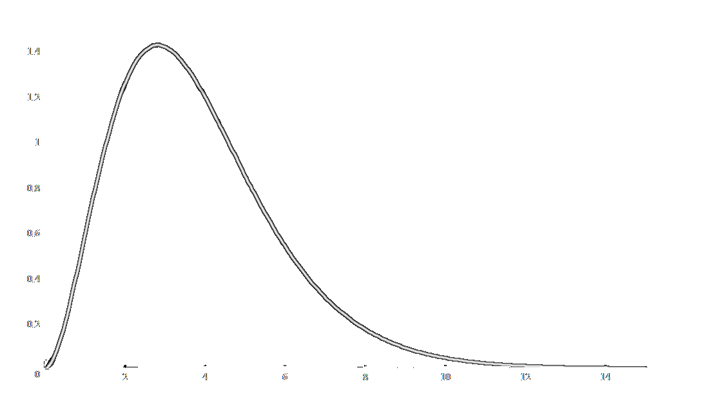
Thermal Emissions
Thermal vibrations of matter (containing charges) makes radiation
Max Planck predicted:
d I
8π h ν ³
=
d ν
c ² e^{h ν / kT}-1
h ν / kT
Intensity peaks at
h ν = 2.4313 eV T₄
1 keV X-rays: → T ~ 4 million degrees Kelvin
X-rays: 10⁶ to 10⁹K
γ-rays: >10⁹K

Slide 14
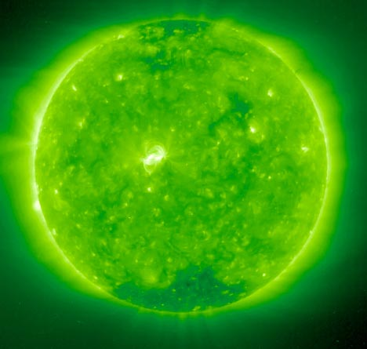
X-ray image of our Sun
Soft: Thermal bremsstrahlung
(k T ~ 40 keV)
Hard: Non-thermal (power-law) bremsstrahlung; fluctuates with flares
Electrons, accelerated from surface by turbulent magnetic plasma, hit ions above

Slide 15
Radiation from accelerated charges
Dipole radiation power, non-relativistic :
  dP/dΩ = q²|a|²sin²θ /(4π c³)
  Electric field polarized in the plane of a and propagation vector; power strongest in direction perpendicular to acceleration.
Over all angles,
P = (2/3) q²|a|² /c³
(Larmor’s Formula)

Slide 16
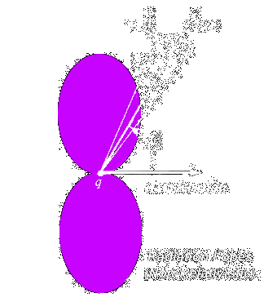
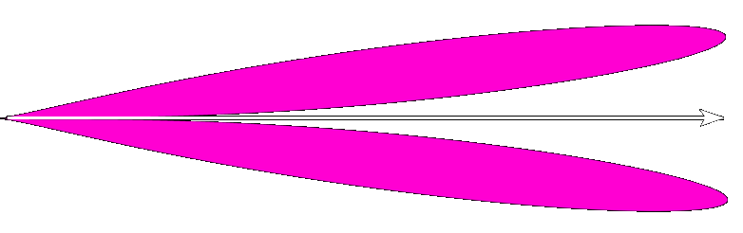
Dipole radiation from accelerating charges
Non-Relativistic
Relativistic
Notes:
For the relativistic case the max. angle is of the order of 1/(gamma) approximately the ration of the rest energy to the total energy of the particle

Slide 17
Photon-Electron Scattering
This process is often called Compton scattering (Inverse Compton Scattering) when kinematical and dynamical quantum effects are significant, and Thomson scattering when the classical approximation yields accurate results.
In this particular case, it is instructive to go through the details of calculations to see how the classical and quantum descriptions differ. We start with Thomson Scattering and find the scattering cross section.

Slide 18
Thomson Scattering
Plane wave of monochromatic electromagnetic radiation incident on a free electron (charge e, mass m)
Consider an incident wave of propagation vector and polarization vector
The electron will accelerate in response to the oscillating electric field of the incident radiation
$\vec{k_{0}}$
$\vec{ϵ_{0}}$
$\vec{E}\left(\vec{r},t\right)=\vec{ϵ_{0}}E_{0}e^{i\vec{k_{0}}.\vec{r}−iωt}$
$m\overset{˙}{\vec{v}}=e\vec{E}\left(\vec{r},t\right)$

Slide 19
Thomson Scattering
$\overset{˙}{\vec{v}}=\vec{ϵ_{0}}\frac{eE_{0}}{m}e^{i\vec{k_{0}}.\vec{r}−iωt}$
The instantaneous power radiated in a polarization state (which could be complex, e.g., circular polarization) by a particle of charge “e” in non-relativistic motion is (the average is performed over one cycle):
$\vec{ϵ}$
$\begin{aligned}\frac{dP}{dΩ}=\frac{e^{2}}{4πc^{3}}{\left|\vec{ϵ}⋅\overset{˙}{\vec{v}}\right|}^{2} \\ \left\langle \frac{dP}{dΩ}\right\rangle =\frac{c}{8π}{\left|E_{0}\right|}^{2}{\left(\frac{e^{2}}{mc^{2}}\right)}^{2}{\left|\vec{ϵ}⋅\vec{ϵ_{0}}\right|}^{2}\end{aligned}$
Notes:
Assuming that the charge moves a negligible part of a wavelength during one cycle of oscillation the time average of the absolute-value-acceleration-squared is ½ of the Re( acceleration . conjugate of acceleration)

Slide 20
Thomson Scattering
This process can be viewed simply as a scattering process with a scattering cross section given by
The above formula gives the contribution to differential scattering cross section from a particular initial state of polarization into a definite final polarization state.
$\begin{aligned}\frac{dσ}{dΩ}=\frac{Energy{radiated}/{unit}{time}/{unit}solidangle}{Incidentenergyflux\left({energy}/{unit}{area}/{unit}time\right)} \\ \frac{dσ}{dΩ}={\left(\frac{e^{2}}{mc^{2}}\right)}^{2}{\left|\vec{ϵ}⋅\vec{ϵ_{0}}\right|}^{2}\end{aligned}$

Slide 21
Thomson Scattering
In the classical domain, each polarization state contributes separately (incoherently) to the cross section, and when unpolarized incident waves are considered the average of those individual contributions to the cross section are taken.
is in the plane of n & k₀ and
Perpendicular to n.
is perpendicular to both
& n.
$\vec{ϵ_{1}}=cosθ\left(\vec{e_{x}}cosϕ+\vec{e_{y}}sinϕ\right)−\vec{e_{z}}sinθ$
z
n
$\vec{ϵ_{2}}=−\vec{e_{x}}sinϕ+\vec{e_{y}}cosϕ$
k₀
θ
$\vec{ϵ_{1}}$
ε₂
y
φ
$\vec{ϵ_{1}}$
ε₁
x
$\vec{ϵ_{1}}$

Slide 22
Thomson Scattering
If the incident wave is polarized along the x-axis, after summing over the final polarization states, one obtains:
$For\vec{ϵ_{0}}=\vec{e_{x}}$
$\begin{aligned}{\left(\frac{dσ}{dΩ}\right)}_{\vec{e_{x}}}={\left(\frac{e^{2}}{mc^{2}}\right)}^{2}{\left|\vec{ϵ_{1}}.\vec{ϵ_{0}}\right|}^{2}+{\left(\frac{e^{2}}{mc^{2}}\right)}^{2}{\left|\vec{ϵ_{2}}.\vec{ϵ_{0}}\right|}^{2} \\ ={\left(\frac{e^{2}}{mc^{2}}\right)}^{2}\left[{\left(cosθ\right)}^{2}{\left(cosϕ\right)}^{2}+{\left(sinϕ\right)}^{2}\right]\end{aligned}$

Slide 23

Thomson Scattering
If the initial polarization of the incident wave is along the y-axis, the following cross section is obtained.
For unpolarized incident waves, the average of these two differential cross sections should be calculated.
$For\vec{ϵ_{0}}=\vec{e_{y}}$
${\left(\frac{dσ}{dΩ}\right)}_{\vec{e_{y}}}={\left(\frac{e^{2}}{mc^{2}}\right)}^{2}\left[{\left(cosθ\right)}^{2}{\left(sinϕ\right)}^{2}+{\left(cosϕ\right)}^{2}\right]$

Slide 24

Compton Scattering
Thomson formula for scattering of radiation by a free charged particle is appropriate for the scattering of x-rays from electrons or gamma rays by protons. The total cross section is
When the incident radiation is of low frequency, its momentum can be ignored, but when the recoil of the charged particle is not ignored, relativistic kinematics shows that the ratio of the outgoing to the incident wave numbers is given by
$σ_{T}=\frac{8π}{3}{\left(\frac{e^{2}}{mc^{2}}\right)}^{2}withσ_{T}=0.665×{10}^{−24}{cm}^{2}forelectrons$
$\frac{e^{2}}{{mc}^{2}}=2.82×{10}^{−13}cmiscalledtheclassicalelectronradius$

Slide 25
Photon-Electron Scattering
ν’
Compton Scattering
Relativistic expression for cross section:
Klein-Nishina formula:
When h ν / c << m c (photon ‘kick’ negligible): Thomson scattering:
“Inverse” Compton Scattering: Moving electron scattered by light
ν’ / ν = 1 + (hν / mc²) (1 - cosθ)
ν
dσ e ⁴ ν’ ² ν ν’
= + - sin²θ
dΩ 2 m ² c ⁴ ν ν’ ν
(Incident electron at rest; averaged over photon polarization)
dσ _{T} e ⁴
= 1 + cos²θ
dΩ 2 m ² c ⁴
  “Comptonized photons”: Light rescattered in a plasma

Slide 26
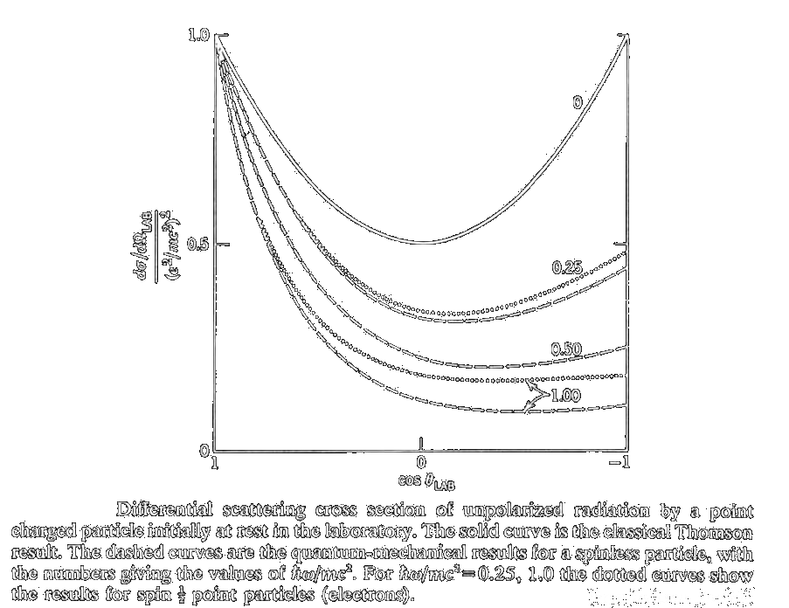
Thomson/Compton Scattering
Differential cross section for the classical (Thomson) and quantum- mechanical (Compton) photon-electron scattering.

Slide 27
Inverse Compton Scattering
Comptonization: If the evolution of the spectrum of the source is determined through Compton scattering primarily → plasma must be rarefied so that other radiation processes such as Bremsstrahlung do not add photons to the system
Whenever a moving electron has sufficient kinetic energy compared to the photon, net energy may be transferred from the electron to the photon, hence, Inverse Compton Scattering.
Converts a low-energy photon to a high-energy photon by a factor of γ² !
Notes:
Imagine the electron in its rest frame, then the process looks like Thomson Scattering, and factors of gamma come in the reference frame transformation

Slide 28
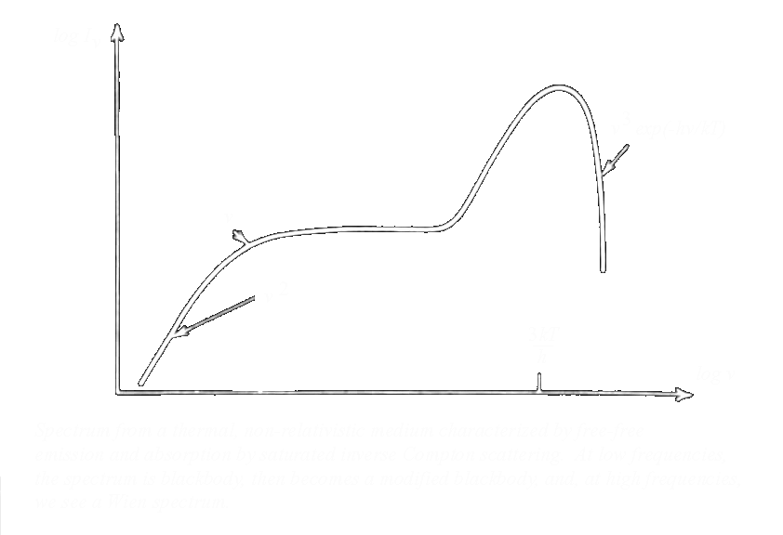
Inverse Compton Scattering

Slide 29
Pair Creation and Annihilation
γ + X → e⁺ + e⁻
e⁺ + e⁻ → γ + γ
X
Examples:
Pair creation from matter exposed to gamma rays
Pair creation in strong electric and magnetic fields
Pair creation near horizon of small black holes

Slide 30
Pair Creation and Annihilation
Ultrahigh energy photons (E₂ >10⁸ eV) in collisions with microwave background radiation (6 x 10⁻⁴ eV), Starlight (2 eV), and X-rays (10³ eV) produce electron-positron pairs
In ultrarelativistic limit:
σ = (π r_{e}² m_{e}² c⁴/Ε₁Ε₂)[ 2 ln (2ω/m_{e}c²) – 1], with ω=(Ε₁Ε₂)^{1/2}
In the classical regime for ω →m_{e}c²:
σ → (π r_{e}²) [1 – (m_{e}² c⁴/ ω²)]^{1/2}

Slide 31
Pair Creation and Annihilation
Energy loss mechanism for electrons through the annihilation process
Positively charged pions created in collisions of cosmic ray protons and nuclei are sources of positrons, as well as the decay of long-lived radioactive isotopes created by explosive nucleosynthesis in supernova explosions (β⁺ decay of ²⁶Al with a mean half-life of 1.1 x 10⁶ years)
In the extreme relativistic limit:
σ = (π r_{e}²/ γ ) [ ln 2γ – 1 ]
For thermal electrons and positrons one gets:
σ → (π r_{e}² ) / (v/c)

Slide 32
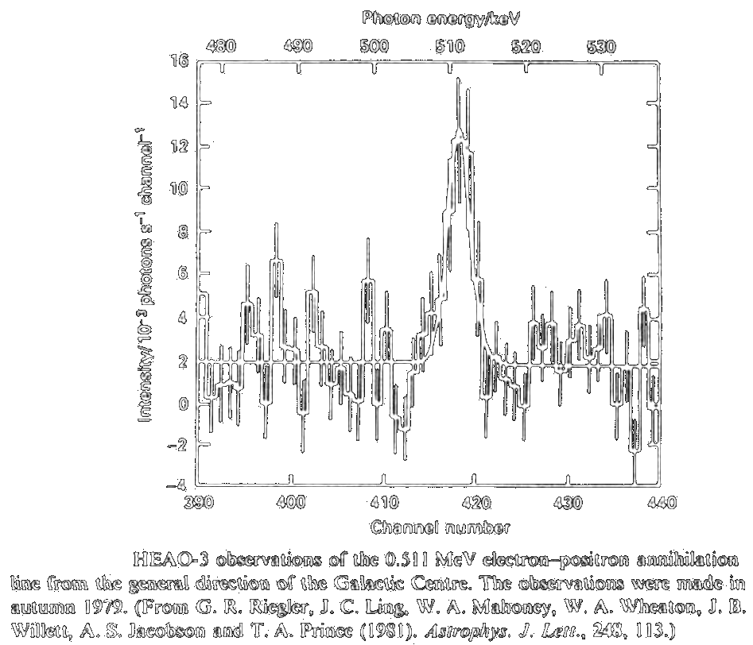
Observation of Pair Annihilation

Slide 33
Bremsstrahlung
‘Braking’ radiation from charged particles deflected by an impulse from another charge. Dominant mode of energy loss for relativistic electrons in a hot plasma.
E

Slide 34
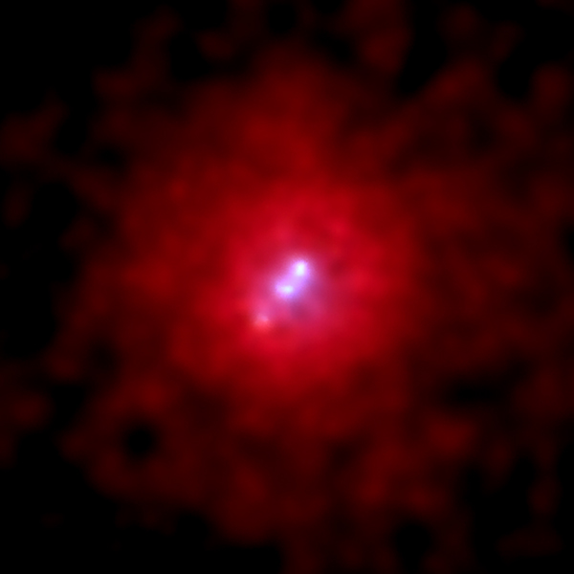
Bremsstrahlung Observed
3c295 galactic cluster in X-ray showing thermal bremsstrahlung emission in the center
Note: Earth’s aurora produced by bremsstrahlung!

Slide 35
Bremsstrahlung Calculation
Strategy:
1. Find power spectrum from single encounter of electron and ion with given impact parameter
2. Integrate over all possible impact parameters
3. Integrate over distribution of electron velocities (e.g. thermal)
γ

Slide 36
Bremsstrahlung Energy Loss
e
-
b
θ
x
z
Z e
z
Impulse = F_{x} d t
= (Z e ²sinθ / r ² ) d z / v = (Ze ²b /v) (b ²+z ²)^{-3/2}dz = 2Ze ²/bv
Electron kinetic energy loss
E = p ²/(2m_{e})=2 (Z e ²)² / (m_{e} b ² v ²)
Sum over many electrons (with range of impact parameters b):
δE / δz = N_{e} 2πb db E = 4πN_{e}((k Z e ²)²/ (m_{e}v ²)) ln (b_{max}/b_{min})
With a full quantum theory calculation, the log factor becomes the ‘Gaunt factor’.

Slide 37
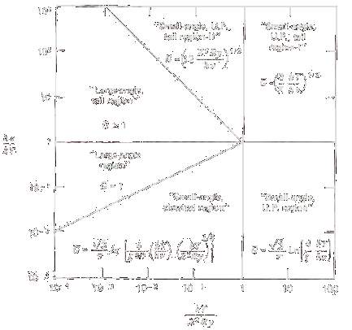
Bremsstrahlung Gaunt Factor
Approximate analytic formulae for <g_{ff}>
From Rybicki & Lightman Fig 5.2 (corrected) -- originally from Novikov and Thorne (1973)
Notes:
Note that at hnu/kt <<1 G only depends on the log of frequency-- (small variation).
X-ray == g(nu, T) = sqrt(3)/pi ln(kt/hnu)

Slide 38
Bremsstrahlung Radiation
Relativistic Electrons
Use dipole radiation formula for the electron in its rest frame, kicked by a ion rapidly passing by, causing acceleration of the electron given by:
a’_{x} = eE_{x}/m_{e} = ( Ze²/ m_{e}) b / ( b²+(γvt )²)^{3/2}
so
a’_{z} = eE_{z}/m_{e} = ( Ze²/ m_{e}) γ v t / ( b²+(γvt )²)^{3/2}
Now the relativistic power radiated in the frame (S’) of the electron is the same as that in the frame of the ion, because the energy differences and time intervals both transform with a gamma factor:
dE /dt = dE ’/dt ’
Lorentz transforming the acceleration from the frame of the electron to that of the ion gives
a’ ² = γ⁴ ( a² + γ² (v .a / c)²)

Slide 39
Bremsstrahlung Spectrum
The electromagnetic pulse emitted from a jiggled charge gives a spectrum of frequencies.
The power per unit frequency is
d P
2e ²
| a’ (ω) | ²
=
d ω
3c ³
d P
4πe ²
γ⁴ ( a² + γ² (v .a / c) ² )
=
d ν
3c ³
I(ω) → [ (1/γ²) K₀²(ωb/γv) + K₁² (ωb/γv) ],
with K₀ and K₁, modified Bessel functions

Slide 40
Bremsstrahlung Spectrum
At High frequencies, exponential cut-off:
I(ω) → exp (- 2ωb/γv)
At low frequencies, flat:
I(ω) → constant
For a quantum treatment, note that the emitted photon energy is limited to the maximum electron kinetic energy (Bethe-Heitler treatment)

Slide 41
Astrophysical Magnetic Fields
Galaxy
Molecular cloud
Earth
Massive star
Sun spot
Jupiter
White dwarf
Neutron star
Magnetar
10⁻⁶ Gauss
10⁻³ Gauss
1 Gauss
10² Gauss
10³ Gauss
10³ Gauss
10⁶ Gauss
10¹² Gauss
10¹⁴ Gauss
( B Field next to proton ~ 10¹⁶ Gauss )
( 1 Tesla = 10⁴ Gauss )

Slide 42
Origin of Astrophysical Magnetic Fields
Magnetic fields created by currents and by changing electric fields.
  Dynamo effect: Differential motion of charged matter can create currents.
  Magnetic field can sustain currents (Faraday’s Law).

Slide 43
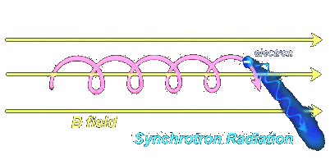
Radiation from charges accelerated in a magnetic field
( Non-relativistic: Cyclotron radiation )

Slide 44
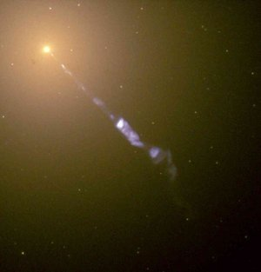
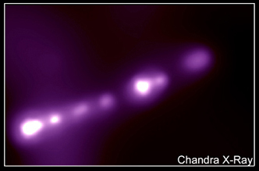
Synchrotron Radiation Examples
Image of M87 Synchrotron X-ray Radiation Glow and Jet
Hubble image
(50 MLy from us in Vergo)
Jet about 5000 LY long

Slide 45
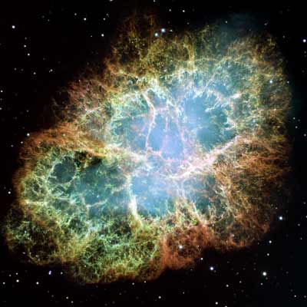
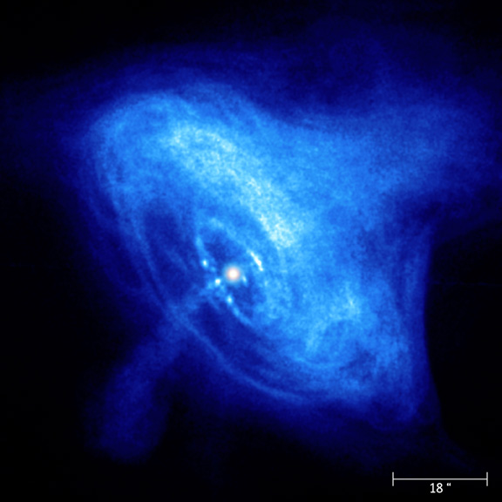
Synchrotron radiation-lit nebulae
Crab Nebula
Supernova in 1054 AD
X-ray close-up of Crab pulsar

Slide 46
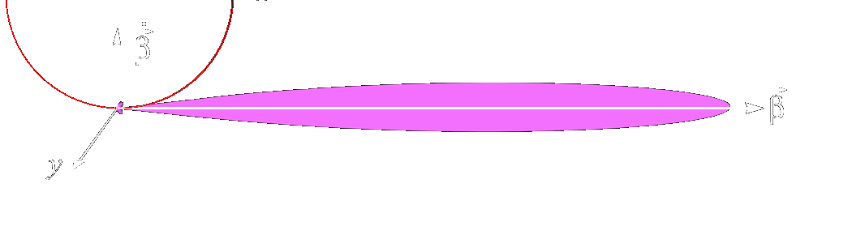
Synchrotron Radiation Theory
Radiation by magnetic deflection of relativistic particles
x
φ
θ ∼ 1/γ
Polarized radiation!
Relativistic radiation lobe
Notes:
Synchrotron radiation formula comes from Jackson 3rd (14.44).

Slide 47
Synchrotron Radiation Theory II
Power radiated per unit solid angle:
.
dP k e² β ² sin²θ cos²φ
=
1 -
dΩ 4πc³ (1-βcosθ)³ γ²(1-βcosθ)²
( Jackson )
β = v / c
Larmor ‘gyration’ frequency
ω_{L} = e B / m_{e}c = 2.8 MHz B_{1G}
ω_{B} = γ⁻¹ω_{L}
γ = 1 / 1 – v ² / c ²
.
β² = ω² β²
Power radiated over all angles:
P = (2 / 3) ( k e² / c³ ) ω_{L}² β² γ²

Slide 48
Synchrotron Radiation Theory III
Power radiated per unit solid angle per unit frequency interval:
Low frequency end:
d P / d Ω d ν / ν ^{2/3}
High frequency end:
d P / d Ω d ν / γ² ν exp( - ν / ν_{c} )
ν_{c} = ( 3 / 2 ) γ² ω_{L}
Now integrate over angle and supposed electron density at each electron energy to get expected intensity per unit light frequency!
( General result in Jackson )

Slide 49
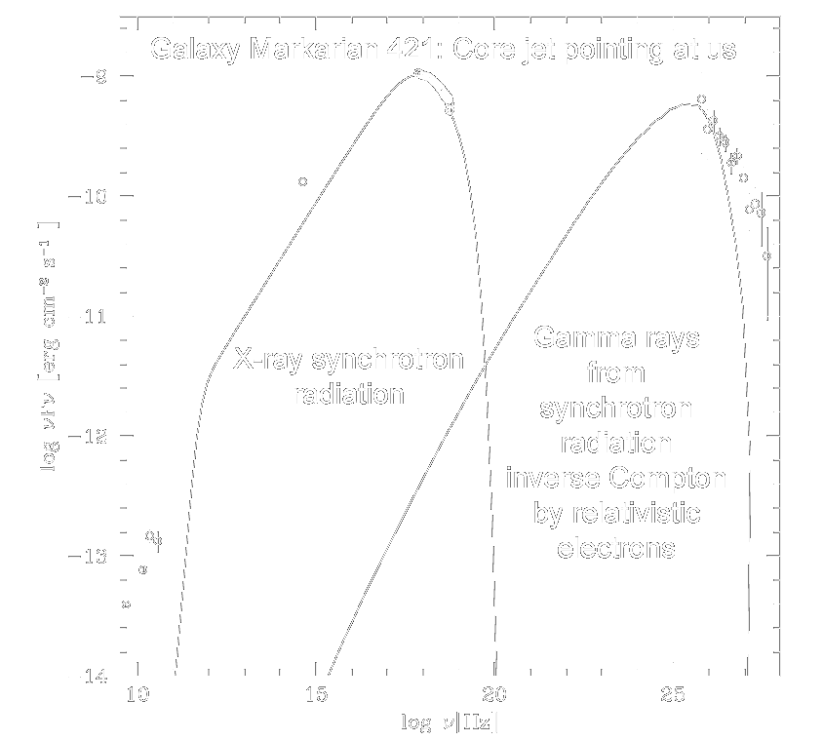
Synchrotron Radiation Theory IV

Slide 50
Plasma Physics near Compact Objects
E & M (Maxwell)
QED (Dirac)
General Relativity (Einstein)
  Relativistic Plasma Physics

Slide 51
X-Ray Radiation from Exotic
Astrophysical Phenomena
Extreme Electric and Magnetic Fields: Magnetars
Extreme Gravitational Effects: Black Holes

Slide 52
High-Energy Radiation from Magnetic Compact Objects
Thermal radiation from surface of compact object or hot plasma; bremsstrahlung radiation
Radiation from star quakes and magnetic reconnections
Radiation from infalling plasma
Thermonuclear explosions from accreted matter
Synchrotron radiation near a neutron star or black hole
Inverse synchrotron radiation and e⁺e⁻ cascading in jets
Curvature radiation

Slide 53
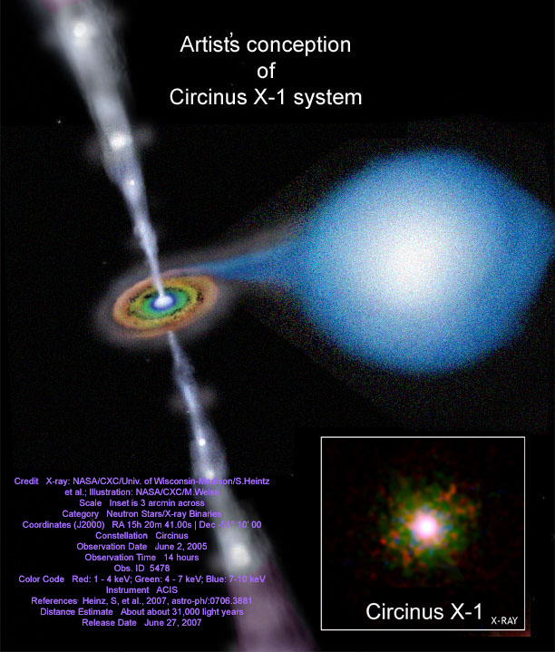
Recent observation of jets from a neutron star in a binary system
(Report:
June 27, 2007)

Slide 54
Magnetars
Created by stellar collapse with quasi-magnetic flux conservation plus dynamo effect for fast rotation and high turbulence
Cowling’s Theorem (Dynamo effect requires asymmetry)
‘Fast’ spin-down due to magnetic field-crust interaction (Magnetic dipole radiation dominates spin energy loss in ordinary pulsars)
Proton Landau transitions (Quantized orbits in B field)
Strong Curvature Radiation (electrons radiate in direction of curving B)
Atomic Orbit Distortion (‘Cigar’-shaped orbitals)
Photon splitting (QED: Photons connect to vacuum bubble)
Pair Creation in strong B field
Limits to E² and B² (B near proton, B near magnetar)
(P = - B² R⁶ Ω⁴ sin² α / (6c³))
ν = γ³ v / ( 2 π R_{c} )
B

Slide 55
Fields near a Magnetar
Neutron star acts as an almost perfect conducting sphere surrounded, to first approximation, by a magnetic dipole field:
B_{r} = 2μ cosθ / r ³ B_{θ} = μ sinθ / r ³
μ = B₀R ³
Charges on the rotating surface experience a Lorentz q (v / c) x B .
The charges separate until the created electric force tangent to the surface cancels the tangential Lorentz force. The corresponding electric field will be
E_{θ} = - ( 2 μ Ω / ( c R ² ) ) sinθ cosθ
(quadrupole)
Using Gauss’ law and that the tangential component of E must be continuous, there will be a radial component outside the star given by
E_{r} = - ( μ Ω R ² / c ) ( 3 cos² θ − 1 ) / r ⁴
|E.B| > 0 on surface

Slide 56
Fields near a Magnetar II
The corresponding electric potential is
Spin Axis
-
V = (μ R ² Ω / ( 3 c ) ) ( 3 cos²θ – 1 ) / r ³
Fields of the order of 10¹⁰ volts per centimeter are typical. Charges on the neutron star will be ripped from the surface, filling the magnetosphere with a plasma. An electric field in the plasma will accelerate the charges, creating plasma currents and trapping magnetic flux. The currents will intersect the magnetic poles.
+
-
-
-
-
+
Radius of “light cylinder”

Slide 57
Critical Magnetic and Electric Fields
B_{Q} = m_{e}² c ³ / ( h e )
B_{M} = m_{m}² c ³ / ( h e )
B_{G} = c ⁷ / ( h G ² )
1.3x10¹⁶ V / cm
4.3x10¹³ G
electron-pair creation
(Schwinger pair production)
X
>10¹⁸ G
monopole-pair creation
~ 10⁵⁶ G
graviton creation

Slide 58
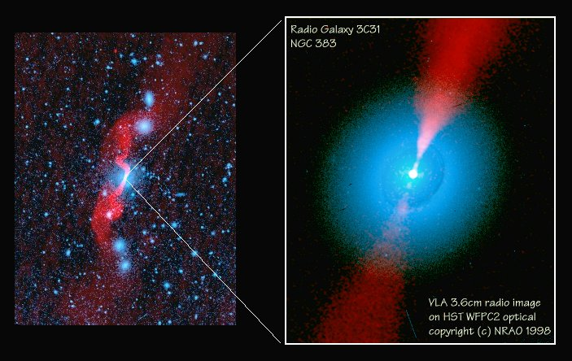
Black Holes
There are massive energetic compact objects at center of large galaxies

Slide 59
Black hole Gravitohydromagnetic object
Externally, similar to magnetar!
Wind zone
zone of closed field lines
zone of closed field lines
-
charged circulating current at
10 Rs
+
charged rotating black hole
(Ref.: B. Punsly, 2001)
Wind zone

Slide 60
END
(Except for encore)

Slide 61
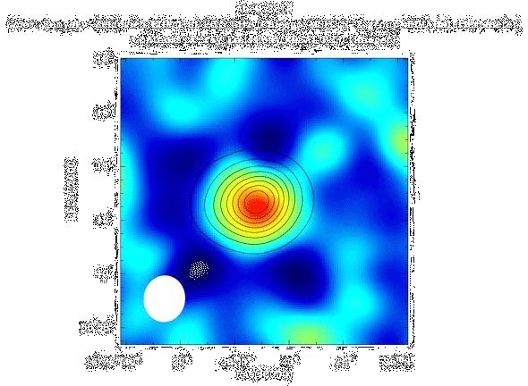
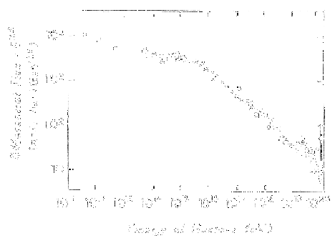
Cosmic Microwave Background Radiation Effects
The Sunyaev-Zel'dovich effect:
Greisen-Zatsepin-Kuzmin effect:
Frequency distribution of cosmic background photons shifts by scattering through plasmas near galactic clusters
Upper limit to cosmic ray energy due to scattering by CMBR
( Also limits space craft speeds ! )

