Slide 1
High p_{T} group update
Kirill Filimonov
Denes Molnar
Saskia Mioduszewski
11 November 2005

Slide 2
Recall main questions from first RHICII Meeting
#1 What is the nature of the phase transition between nuclear matter and quark matter(…)? How does hadronization work? Is there evidence for deconfinement?
#2 How does the clearly evident thermodynamic character of a high-energy heavy-ion collision evolve ...? How does the collision thermalize so quickly?
#3 What are the properties of the strongly-coupled quark-gluon plasma? …
#4 Is chiral symmetry restored? …
…
High-pT measurements relate to #1-3, perhaps #4
Case for RHIC II based on:
- What is unique when at T~2T_{c} ?
- Heavy flavor measurements and more correlation studies to understand energy loss
- Excitation Function

Slide 3
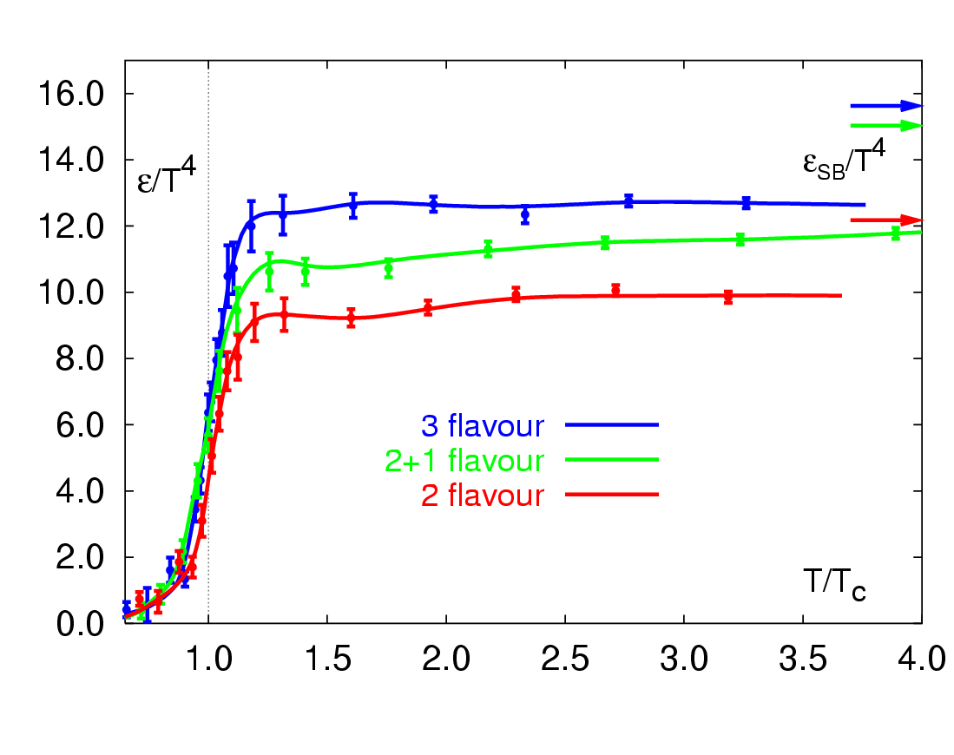
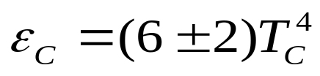
Lattice QCD at Finite Temperature
Ideal gas (Stefan-Boltzmann limit)
(μ_{B}=0)
F. Karsch, hep-ph/010314
Deconfinement:
Critical energy density:
T_{C} ~ 175 MeV
⇒ ε_{C} ~ 0.7 GeV/fm³

Slide 4
Observations at RHIC
Large (factor 5) suppression of high p_{T} hadrons in central Au+Au collisions
Absence of such a suppression in d+Au collisions
Excess of p/π ratio in central Au+Au collisions
Large v₂ saturating at p_{T}~2 GeV/c and > 10% up to higher p_{T}
Constituent quark scaling of v₂
Suppression of heavy-flavor (c+b decays), significant v₂ of heavy-flavor
Is there a consistent picture?
Consistent picture is crucial in understanding the matter created at RHIC

Slide 5
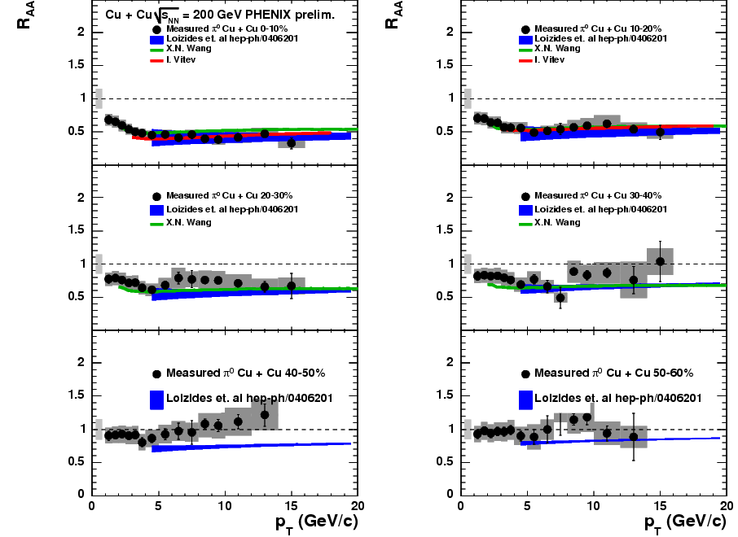
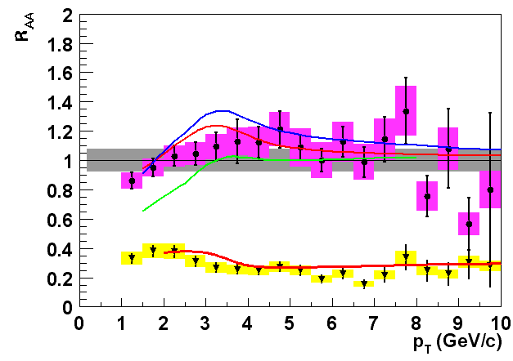
Theoretical Understanding?
Both
  Au-Au suppression (I. Vitev and M. Gyulassy, hep-ph/0208108)
  d-Au enhancement (I. Vitev, nucl-th/0302002 )
understood in an approach that combines multiple scattering with absorption in a dense partonic medium (15 GeV/fm³ ~100 x normal nuclear matter)
Our high p_{T} probes
have been calibrated
and are now being used to explore the
precise properties
of the medium
d-Au
Au-Au

Slide 6
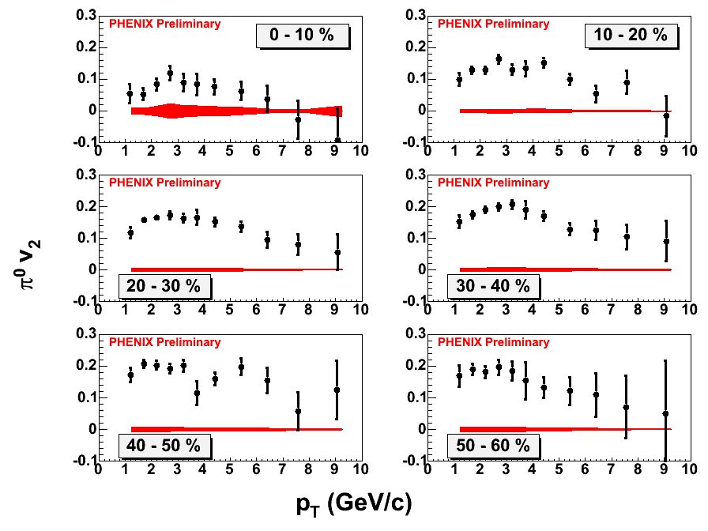
π⁰ v₂
Large v₂ at high p_{T}!
Red: Sys. error (abs)

Slide 7
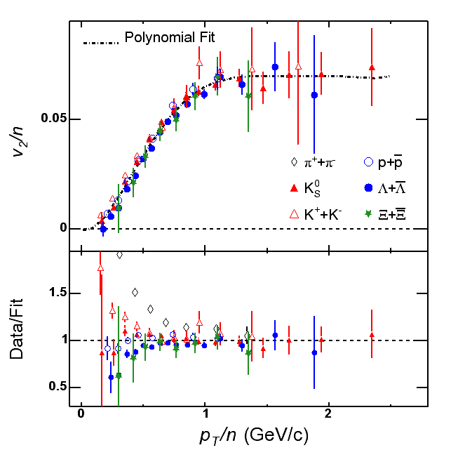
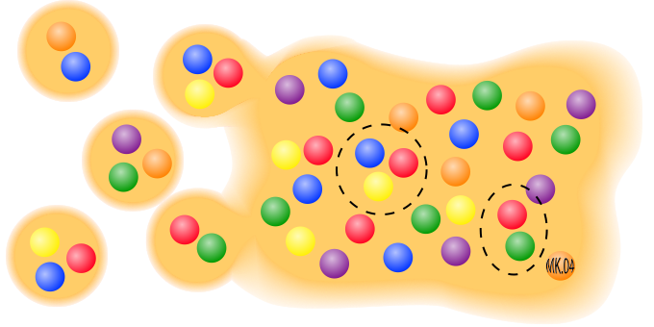
Recombination
Recombination (Fries et al, Greco et al, Molnar, Hwa, …) describes quark-scaling of v₂, but what about jet correlations?

Slide 8
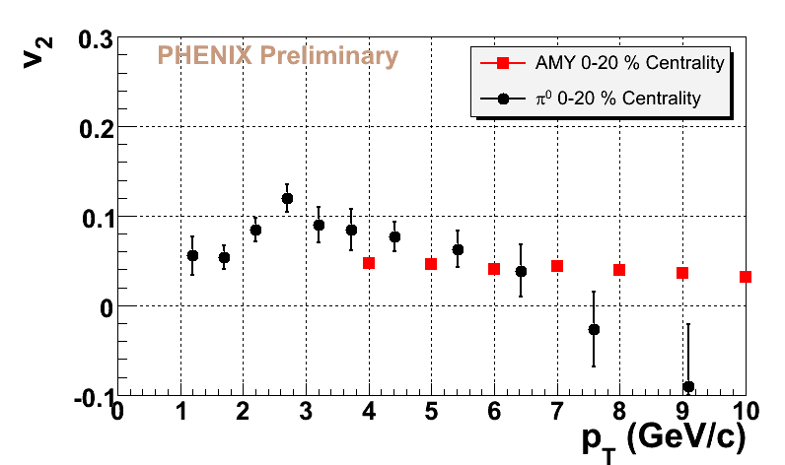
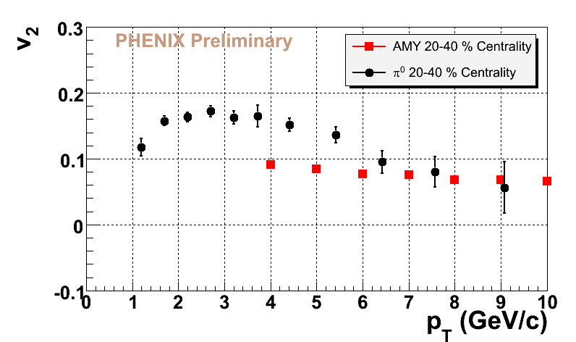
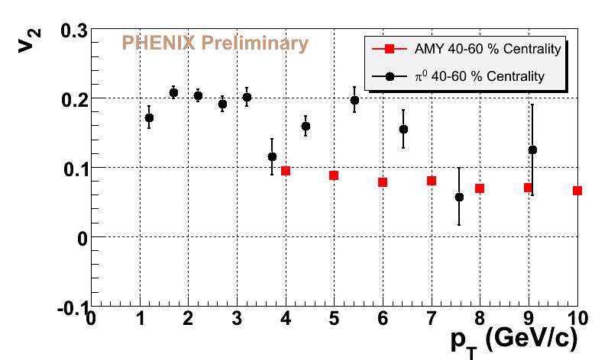
π⁰ v₂ Theory Comparison: AMY (Turbide et al.)
Calculations based on Arnold, Moore, Yaffe (AMY) formalism
  JHEP 0305:51 2003
Energy loss only (BDMS++)
High-p_{T}
  v₂ appears to decrease to energy loss calculation
Low(er)-p_{T}
  Something additional going on… (not just the protons)
While the data appear to approach the energy loss limit at high p_{T}, there is something extra going on in 3-6 GeV/c region

Slide 9
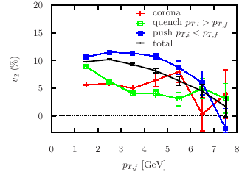
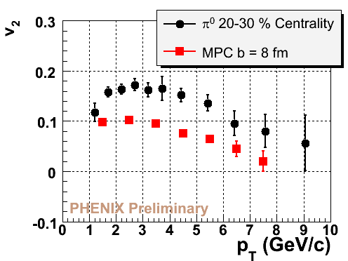
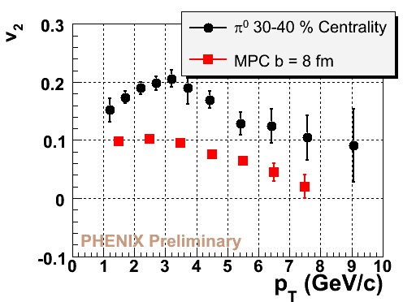
π⁰ v₂ Theory Comparison: D.Molnar
Molnar Parton Cascade (MPC)
  nucl-th/0503051
Contains:
  Energy loss due to interactions
  p_{T} boost due to interactions
Consistency would suggest:
  QGP?
  sQGP?
Model shown here is for one set of parameters
  Can larger opacity reproduce the v₂?
High-p_{T} “slopes” consistent

Slide 10
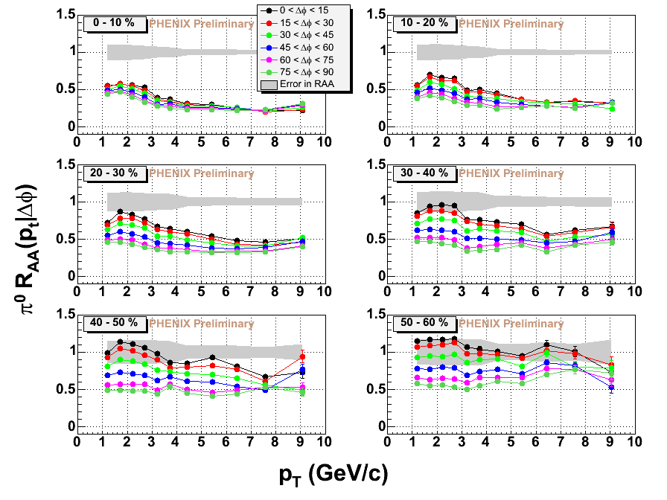
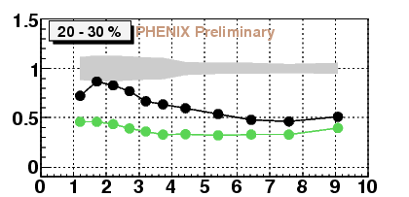
What do we learn from RAA(Δφ, p_{T})
  Constant R_{AA} below 7 GeV/c not “intrinsic”.
    Some additional physics varying w/ p_{T}.
  That physics must require spatial /flow anisotropy.
  “bump” below 3 GeV/c in all centrality bins ?!
  Extra yield in plane ?
D. Winter QM05, B. Cole QM05

Slide 11
Conclusions?
  What’s responsible for larger v₂ at intermediate p_{T}?
    Flow + recombination (Fries et al, Greco et al, Hwa)?
    Partons pushed to higher p_{T} (à la Molnar)? Collisional energy loss?
    Other explanations ….
    Larger energy loss crossing the flow field (Wiedemann et al)? ….
  Perhaps heavy flavor can shed more light on the picture….

Slide 12
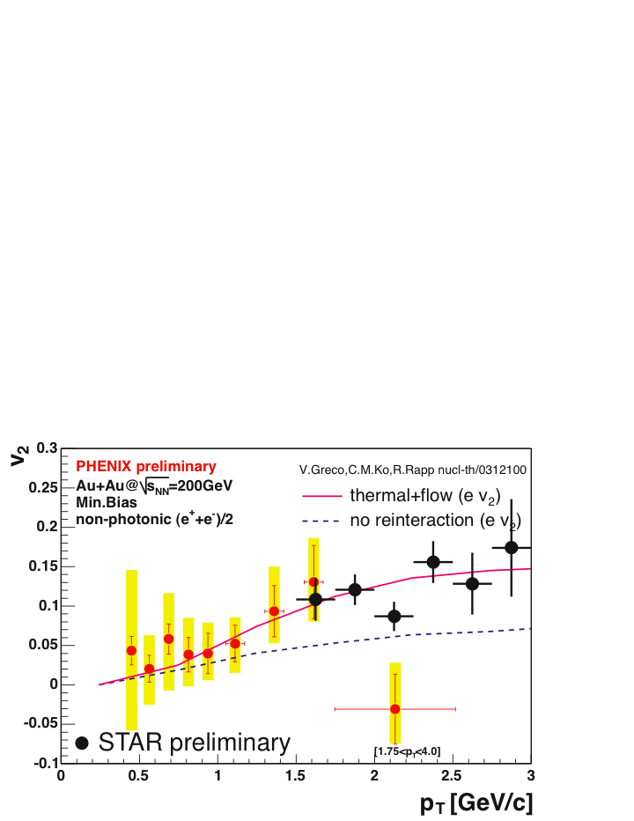
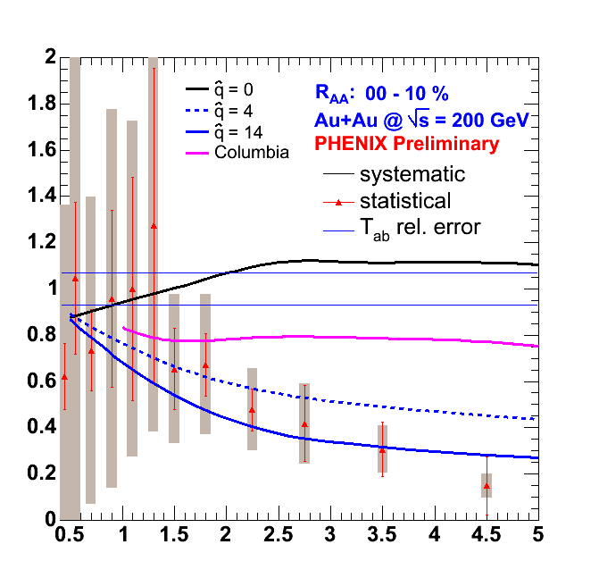
Heavy flavor v₂ and R_{AA}
Single electrons from charm and bottom decays
v₂ measurement agrees with calculation assuming thermalization of charm
R_{AA} is a challenge for energy loss calculations

Slide 13
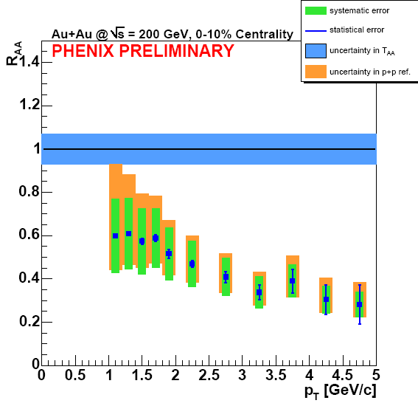
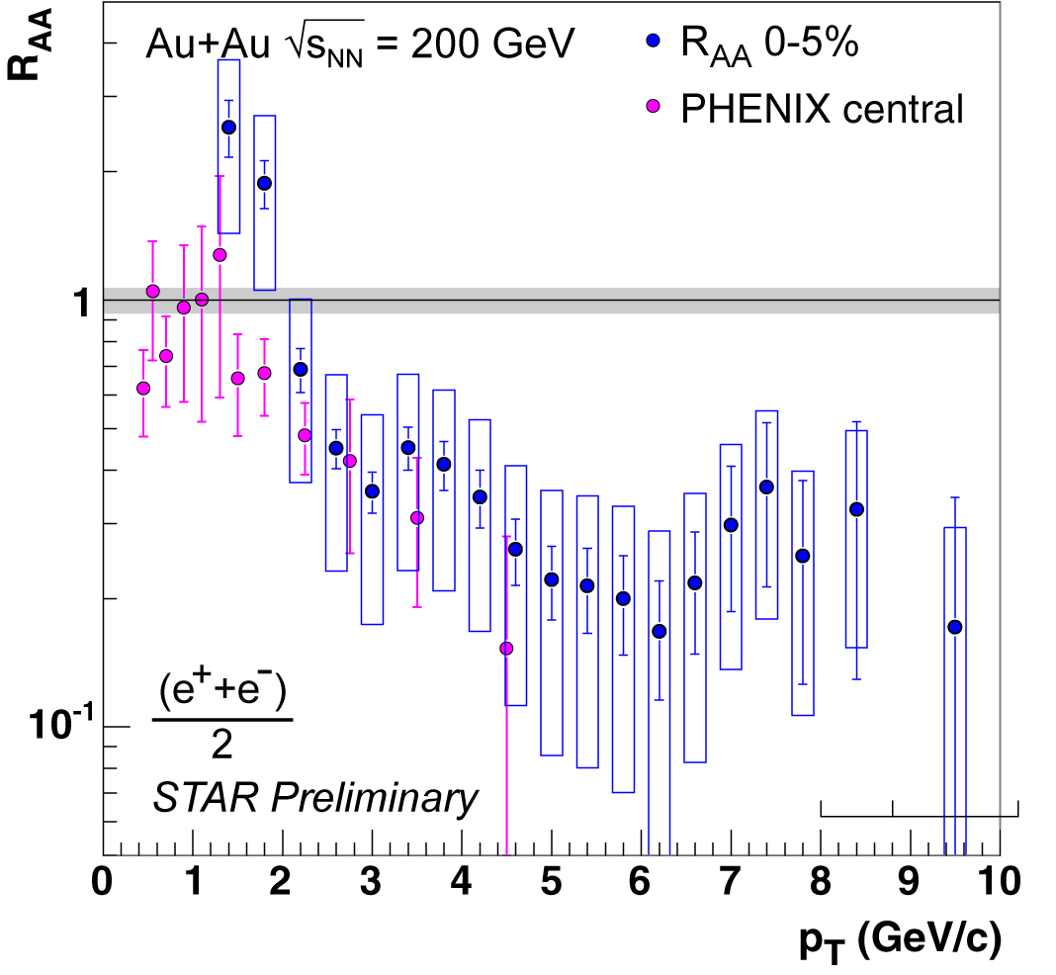
Heavy flavor suppression measurements at RHIC
V. Greene, S. Butsyk, QM2005 talks
J. Dunlop, J. Bielcik; QM05 talks
Significant reduction at high pT suggest sizable energy loss!
Can this be explained by radiative energy loss?

Slide 14
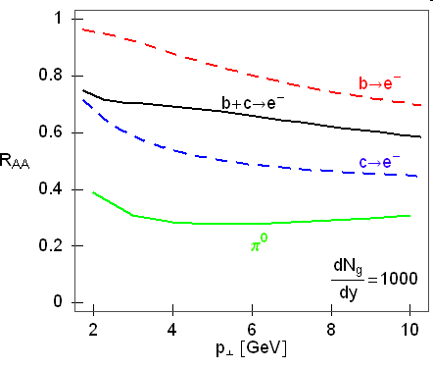
R_{AA} for charm and bottom decays
Djordjevic et al.
At pt~5GeV, R_{AA}(e⁻)  0.70.1 at RHIC.

Slide 15
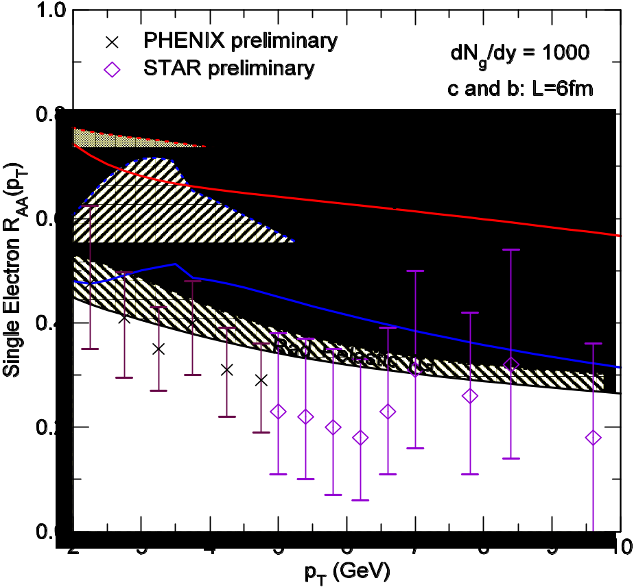
Single electron suppression with the elastic energy loss
(S. Wicks, W. Horowitz, M.D. and M. Gyulassy, in preparation.)
Include elastic energy loss
Reasonable agreement with single electron data, even for dN_{g}/dy=1000.

Slide 16
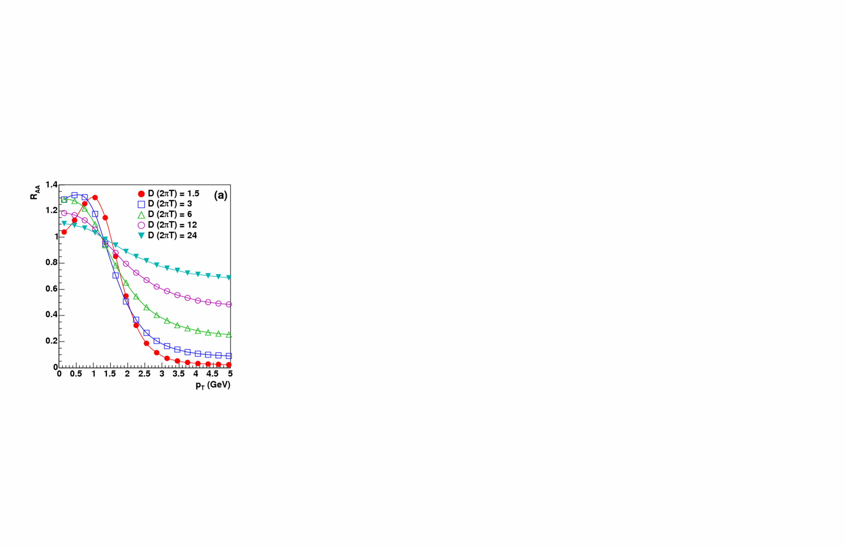
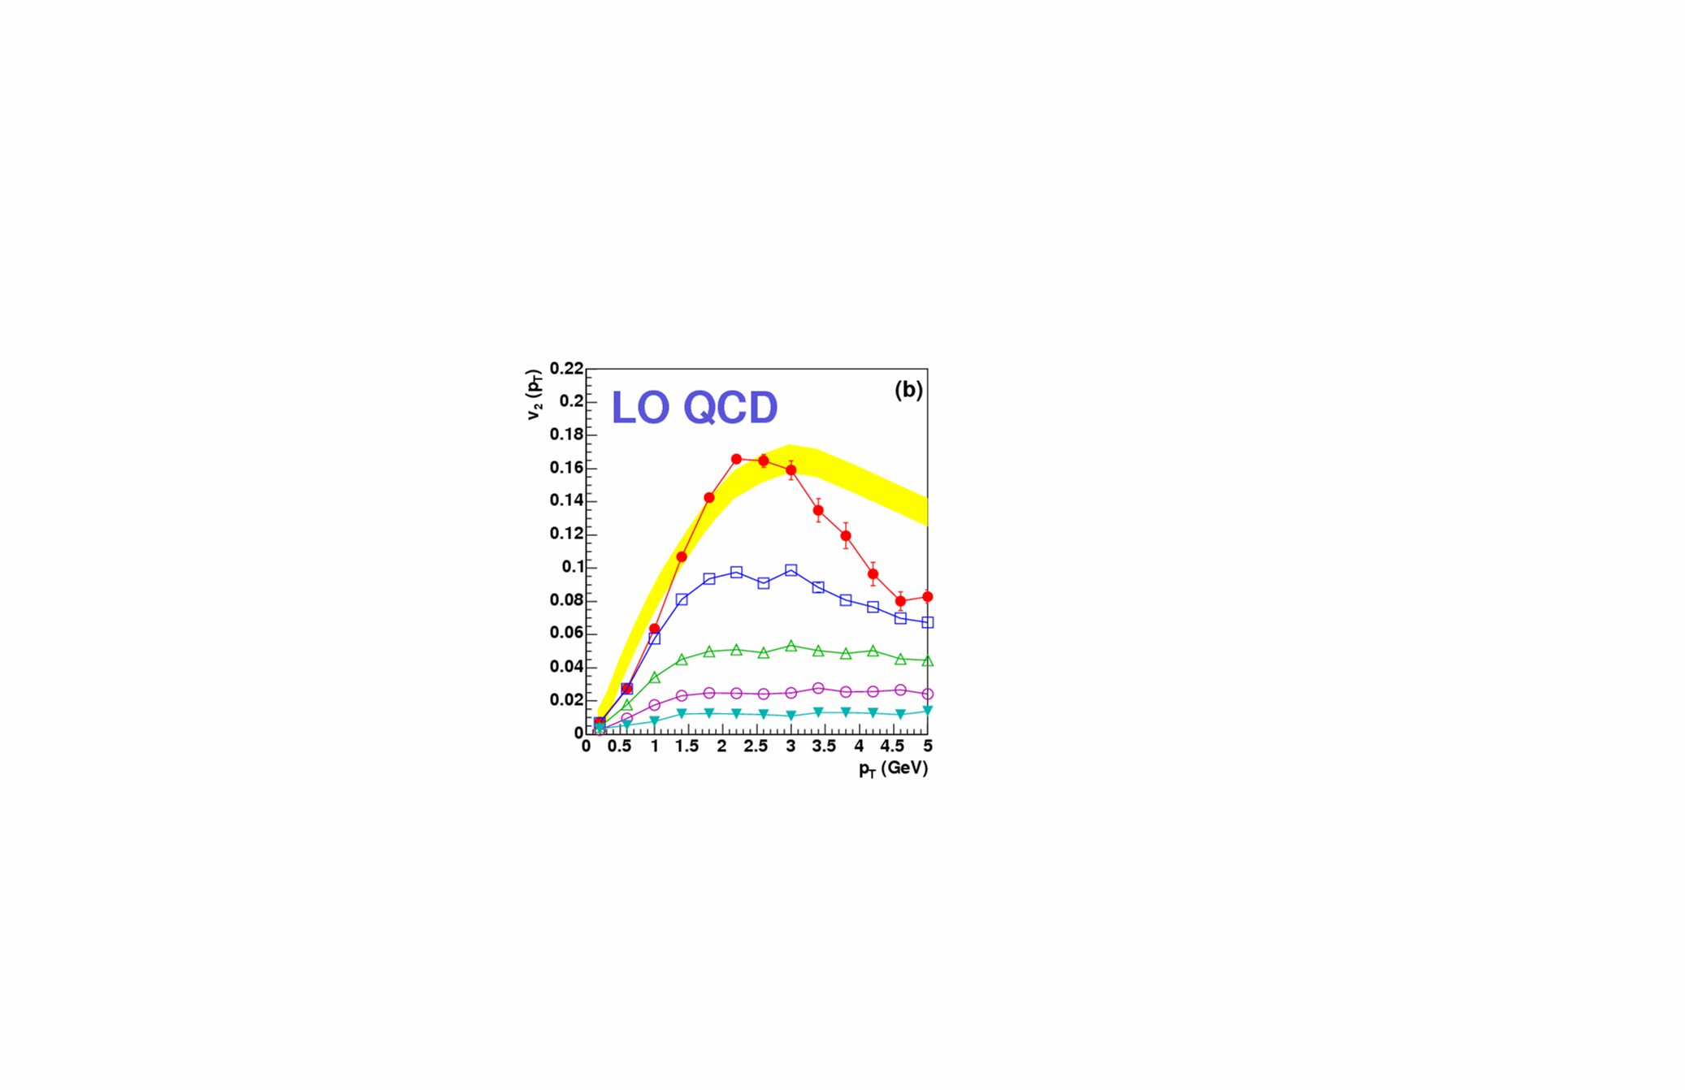
HQ Langevin Solutions to Hydro + pQCD
Charm-pQCD cross sections with variable α_{s} , μ_{D}=1.5T fix
Hydrodynamic bulk evolution with T_{c}=165MeV, τ ≈ 9fm/c
Nuclear Modification
α_{s} , g
1 , 3.5
0.5 , 2.5
0.25,1.8
Elliptic Flow
correlation: small R_{AA} ↔ large v₂
realistic coupling /drag coefficients?
[Moore+Teaney ’04]

Slide 17
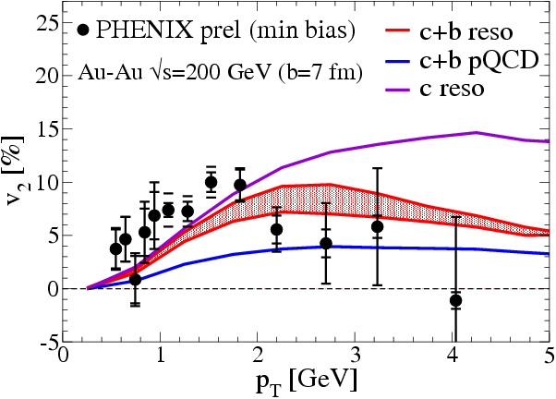
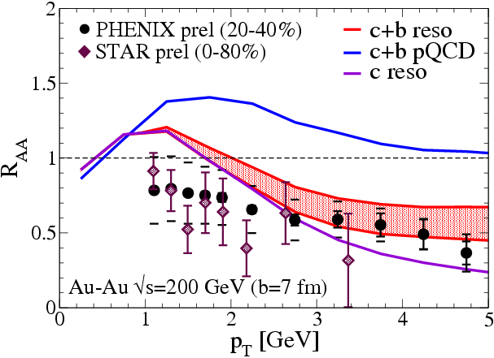
Calculation of elastic energy loss for charm and bottom
Elliptic QGP fireball with D-/B-resonances, coal./frag. and decay
Elliptic Flow
Nuclear Modification Factor
[van Hees,Greco
+Rapp ’05]
how to fix level of coalescence ?
induced gluon radiation?!

Slide 18
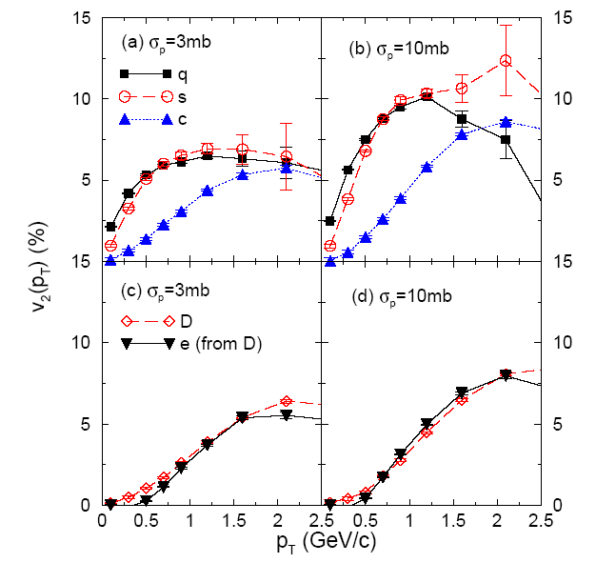
Parton Cascade
with fixed σ(q,g-c), forward/isotropic, coalescence
Elliptic Flow
[MPC,
Molnar]
Cross section has moderate effect on v2 of charm
no bottom included

Slide 19
Summary
Flat R_{AA} is an “accident” (at least for p_{T} between 3 and 7 GeV/c)
Large v₂ for p_{T} between 3 and 7 GeV/c cannot be described by energy loss alone
Do hadron yields from soft production extend to 7 GeV/c? If so, how?
  Recombination + Flow?
  Interactions “pushing” softer particles to higher p_{T}? (unique to RHIC?)
What is the mechanism for charm thermalization in the medium?
  Recombination + survival of heavy-quark resonances? (unique to RHIC?)
Is the energy loss resulting in high p_{T} hadron suppression only radiative or also collisional?
Do we really understand energy loss at RHIC?
  Not completely

Slide 20
Measurements to do
A:
γ– jet (X.-N. Wang) and leading hadron –γ correlations
Heavy vs light flavor at high pT
Charm-triggered dijet correlations
Medium + jets interplay in correlations (“Mach cones”, jets+v2) – 3-particle correlations
Multi-dimensional tomography: pT-Φ-Ψ_{rp} -centrality–η1−η2−flavor
B:
Gluon jets (J/psi – jet correlations)
Leading hadron – dilepton correlations; resonances in jets (in near/away-side correlations)

Slide 21
Rate estimate (Kirill Filimonov, Breckenridge 2005)
Number crunching for run4 data:
- Invariant cross section at 10 GeV from Pythia: 5.6x10⁻⁹ mbGeV⁻²
- Invariant yield is 5.6x10⁻⁹ mbGeV⁻² divided by σ_{pp}^{inel}(42 mb) =1.3 x10⁻¹⁰GeV⁻²
Multiply by <N_{binary} (minbias)>=256, get 341x10⁻¹⁰GeV⁻²
- Multiply by 2πp_{T}Δη=125.6, get 4.2x10⁻⁶/GeV
- Assume integrated luminosity of 250μb⁻¹, 6.8 barn AuAu cross section,
get 1.7x10^9 events.
At 8 GeV, it's about 3 times larger, at 12 GeV, 3 times smaller.
Folding in dead time, calorimeter acceptance in run4:
~1800 direct photons at 10 GeV
    dN/dpT is then 7200/GeV @10 GeV in BEMC STAR calorimeter
    (not counting STAR Endcap calorimeter at 1<η<2)

Slide 22
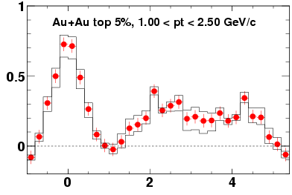
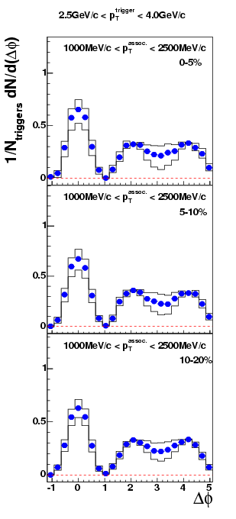
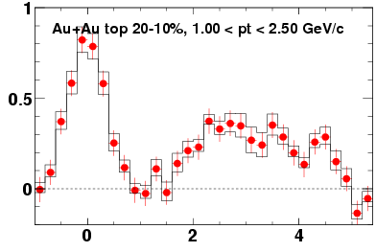
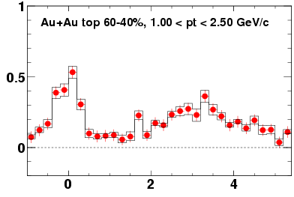
Correlation Functions (STAR)
4 < p_{T} ^{trig} < 6 GeV/c
1 < p_{T}^{assoc} < 2.5 GeV/c
2.5 < p_{T} ^{trig} < 4 GeV/c
1 < p_{T}^{assoc} < 2.5 GeV/c
See talk, J. Ulery
(section 3c) and
poster, M. Horner (#70)
1/N_{trig} dN/d(Δφ)
broad away-side correlations.
consistent with flat.
- large angle gluon radiation: Vitev
- conical flow: Stoecker,Shuryak,Muller
- jets deflected by medium flow
Δφ (radian)

