Slide 1

Some Striking New
STAR Results
Carl A. Gagliardi
Texas A&M University
for the Collaboration
STAR
A few of the most important, qualitatively new results from STAR.

Slide 2
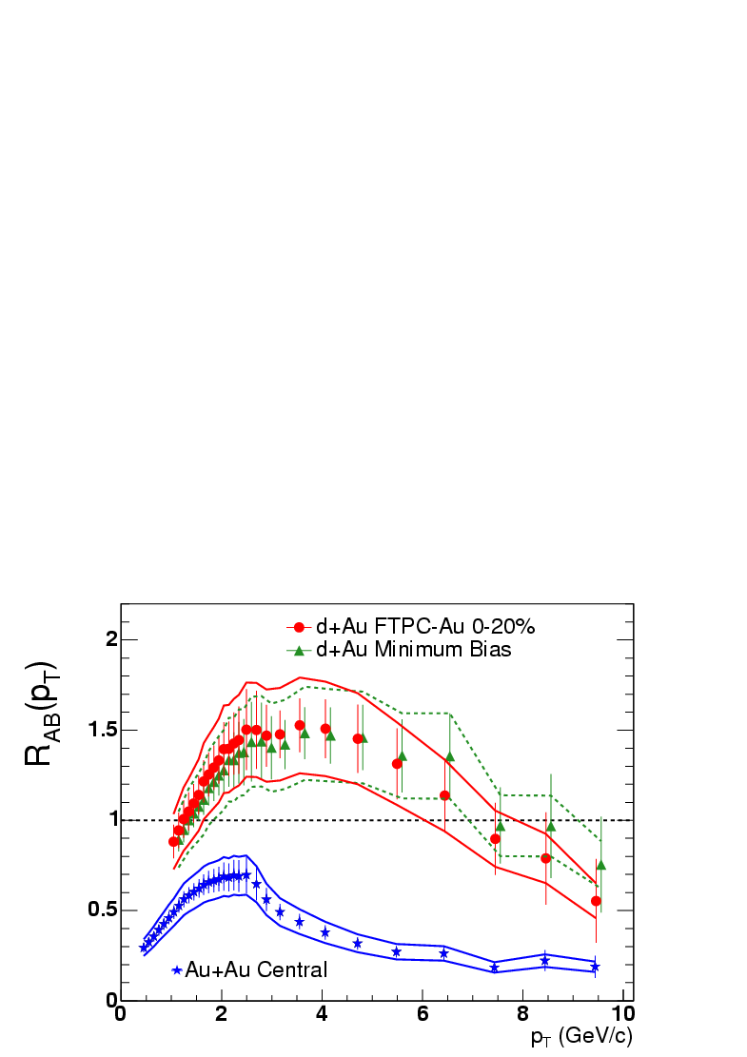
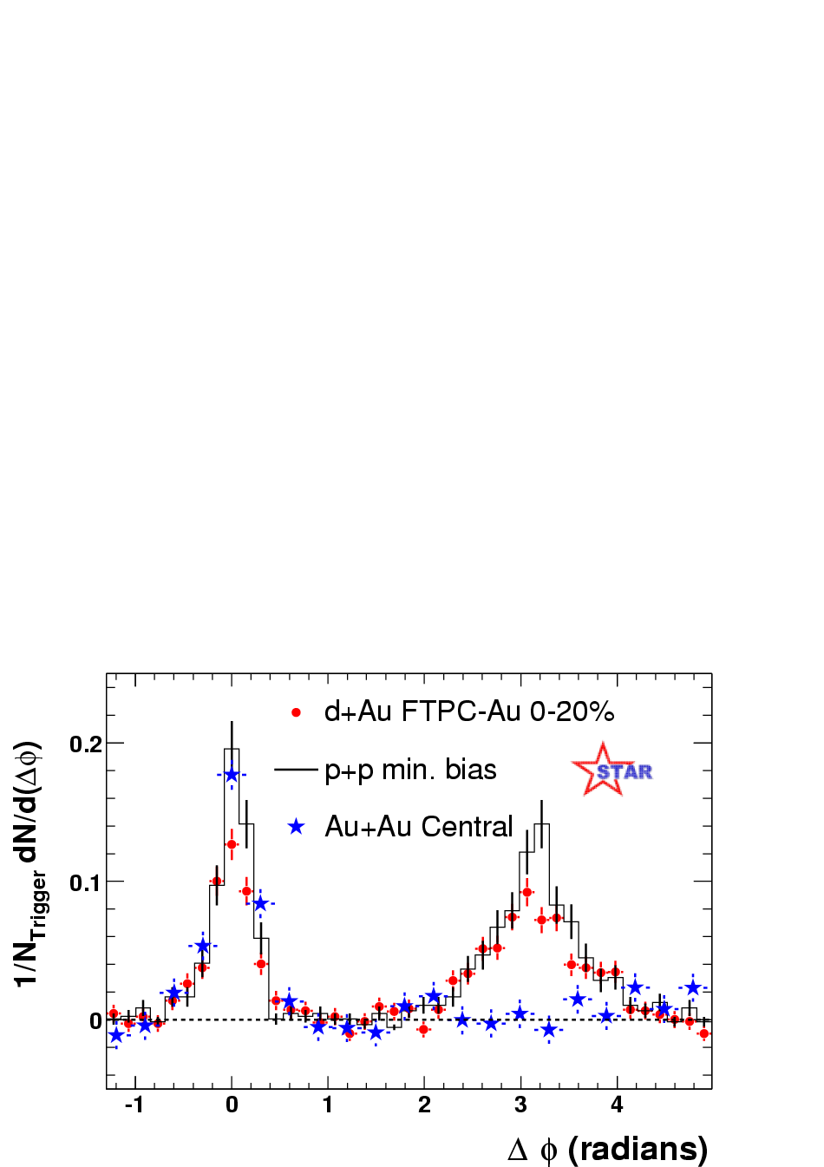
As we left Oakland
STAR
Phys. Rev. Lett. 91, 072304 (2003).
Pedestal&flow subtracted
In central Au+Au collisions:
  Strong suppression of inclusive hadron production
  Disappearance of the away-side jet
d+Au looks like p+p
Jet quenching in the dense medium

Slide 3
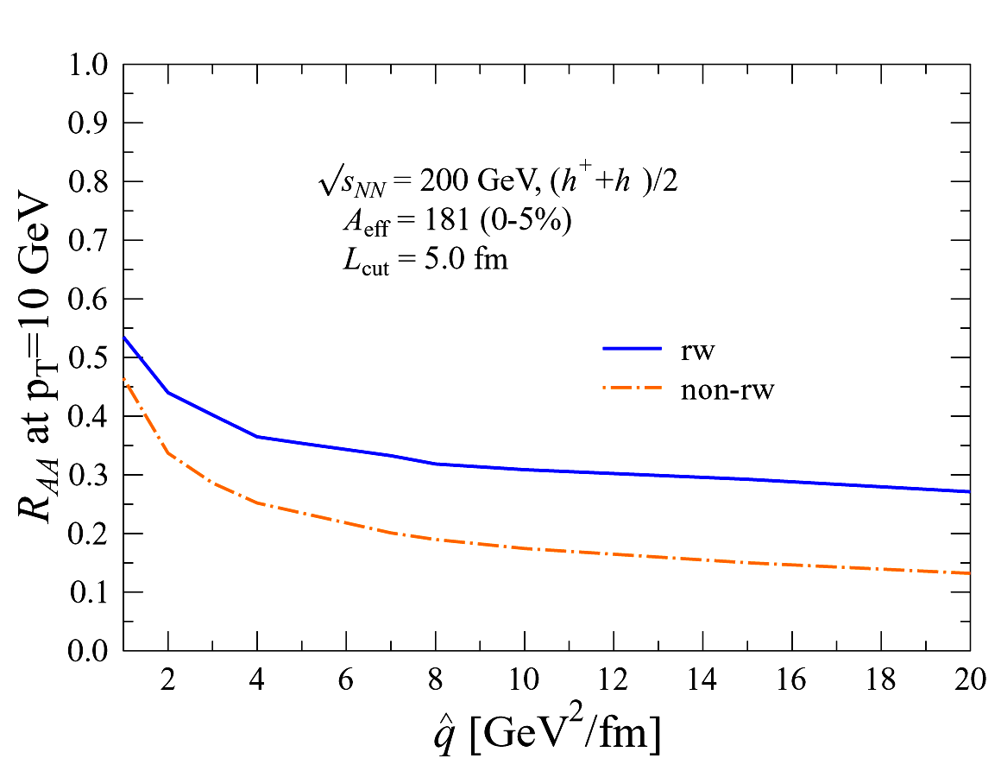

Limitations of R_{AA}
K.J. Eskola et al., NP A747, 511
R_{AA} at 10 GeV/c
?
Central R_{AA} Data
(proportional to gluon density)
Leading hadrons preferentially arise from the surface
Limited sensitivity to the region of highest energy density
Need more penetrating probes

Slide 4
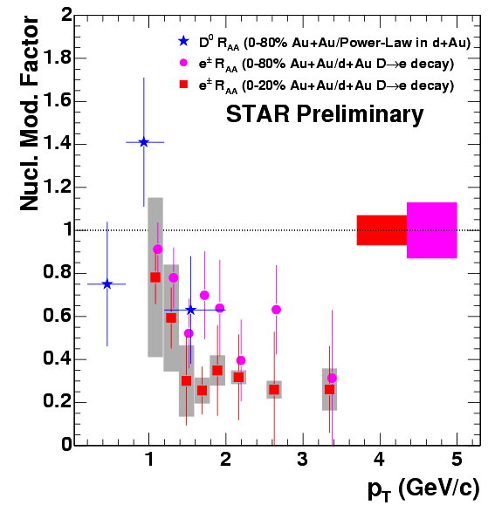
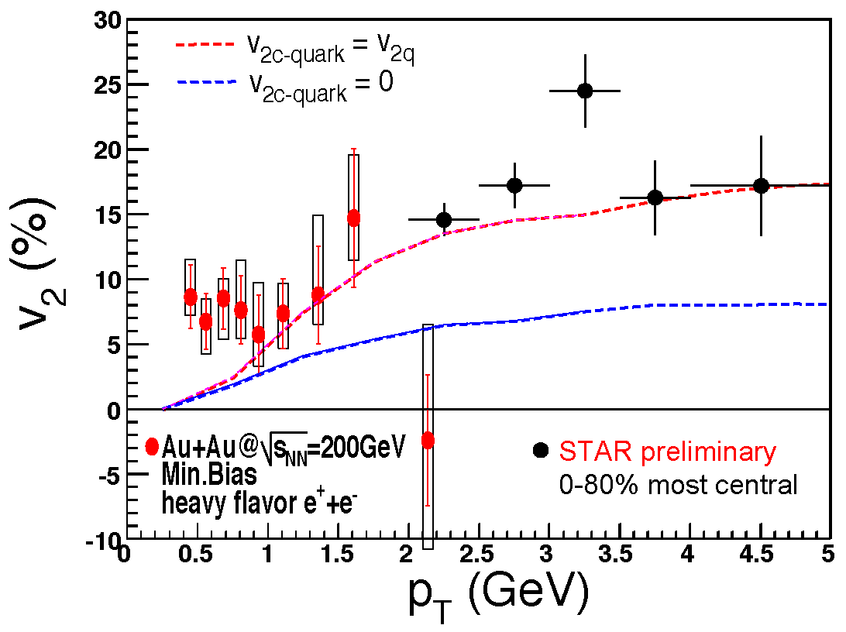
Charm and electron R_{AA} and v₂
H. Zhang, sect 5c
F. Laue, sect 5a
Identified D⁰ consistent with binary scaling at low p_{T}
Non-photonic electrons arise primarily from c and b
Large charm suppression and v₂ at intermediate p_{T}

Slide 5
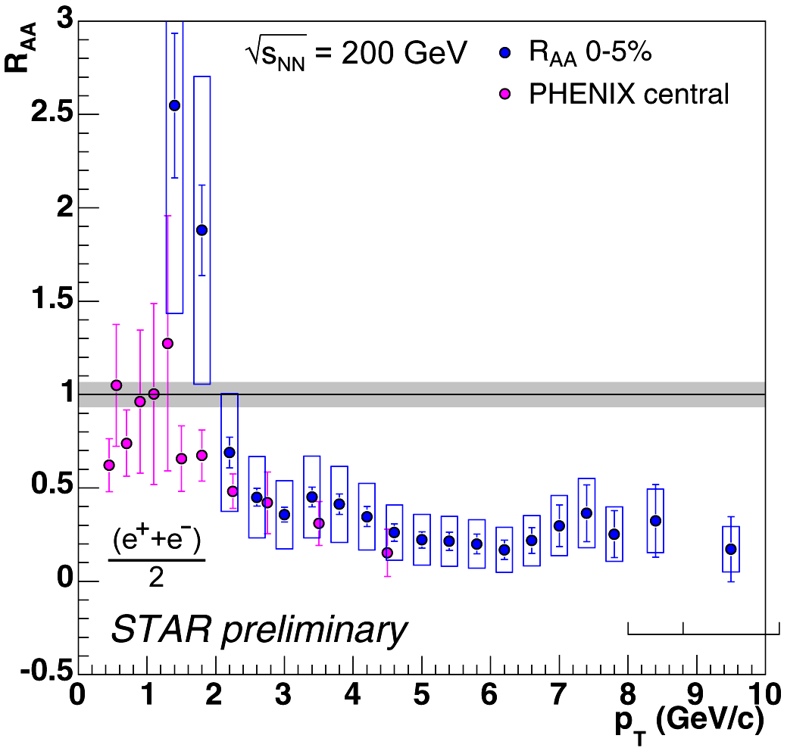
What happens as we raise the p_{T}?
J. Bielcik, sect 5c
In central Au+Au collisions, non-photonic electrons are very strongly suppressed at high p_{T}
Notes:
New plots without grid ans w/o d+Au in centrality 2 3. Shaded region reflecting d_Nbin

Slide 6
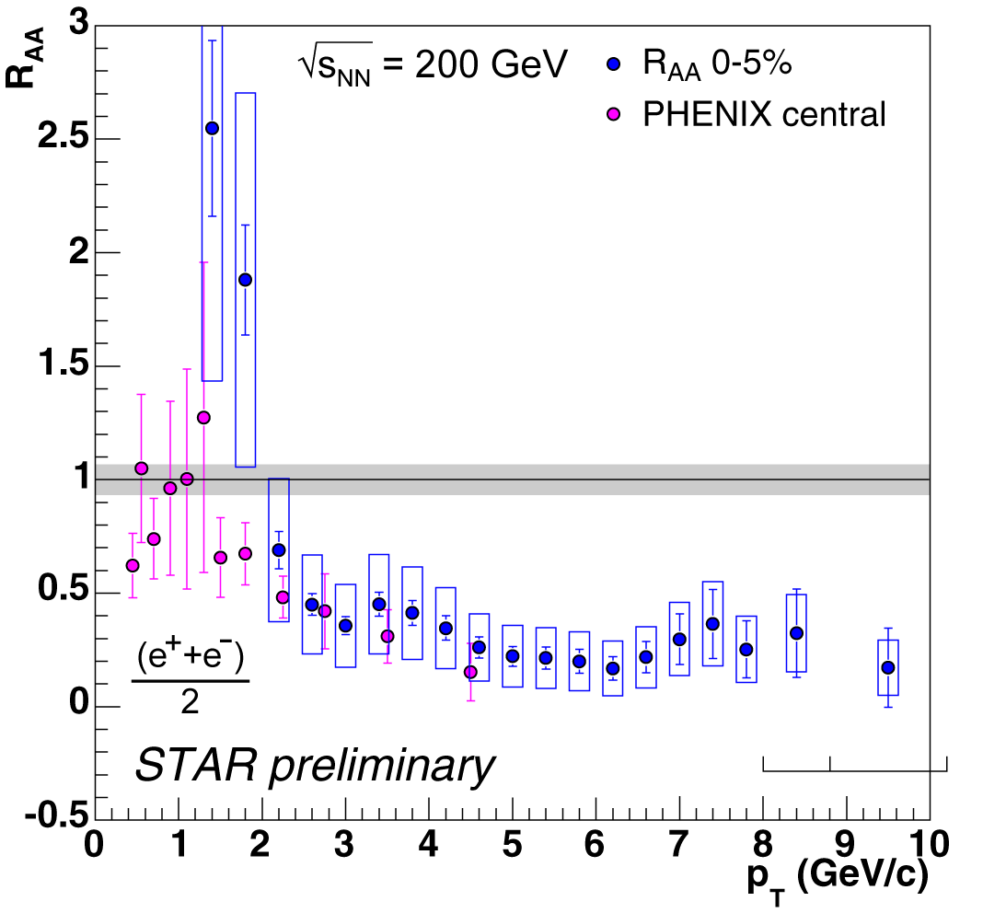
How suppressed is suppressed?
Gluons and light quarks
STAR
Heavy quarks
High-p_{T} electron suppression is comparable to inclusive charged hadron suppression

Slide 7
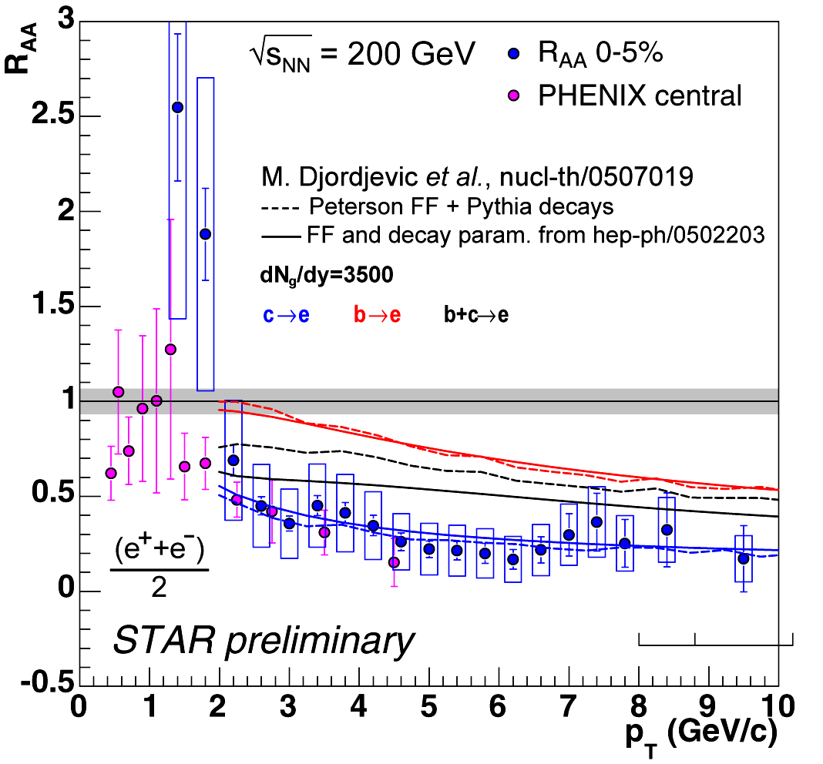
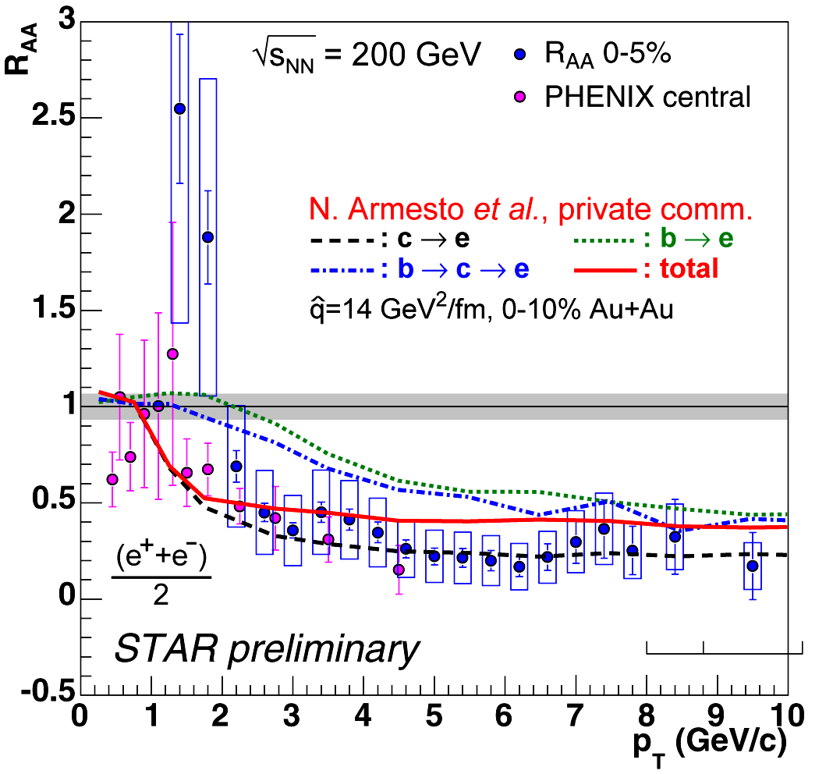
Not what we expected!
Data agree with c → e predictions if the density is quite high
But b → e should be there, too
  Is our understanding of c and b production correct?
  Is our understanding of partonic energy loss correct?
  How strong are the in-medium interactions?
  How dense is the medium?

Slide 8
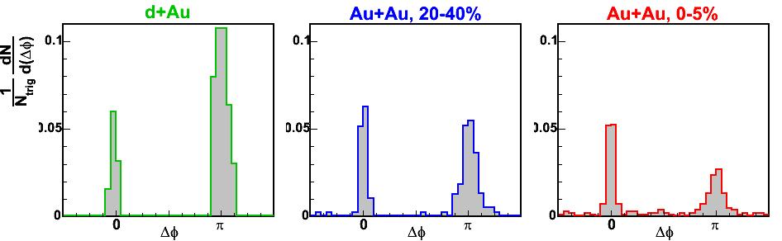
Di-jets at much higher p_{T}
8 < p_{T}(trig) < 15 GeV/c
p_{T}(assoc)>6 GeV
D. Magestro, sect 3b
STAR Preliminary
No background subtraction!
Clear emergence of the away-side jet
Notes:
Start off with 2 assoc, then move to 6 assoc

Slide 9
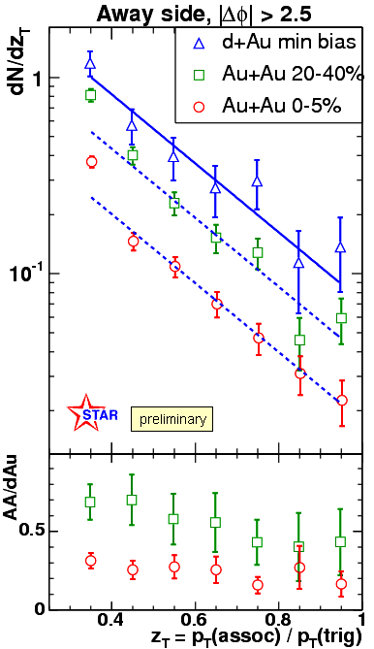
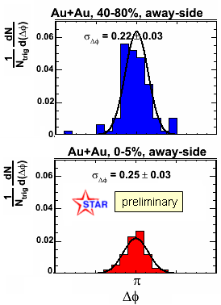
Di-jets and the interaction mechanism
D. Magestro, sect 3b
Scaling factors relative to d+Au
~0.54
8 < p_{T}(trig) < 15 GeV/c
~0.25
Direct measurement of the medium modification (and lack thereof) of the away-side jet
  Away-side width and fragmentation function
  Can partonic energy loss models describe these simultaneously?

Slide 10
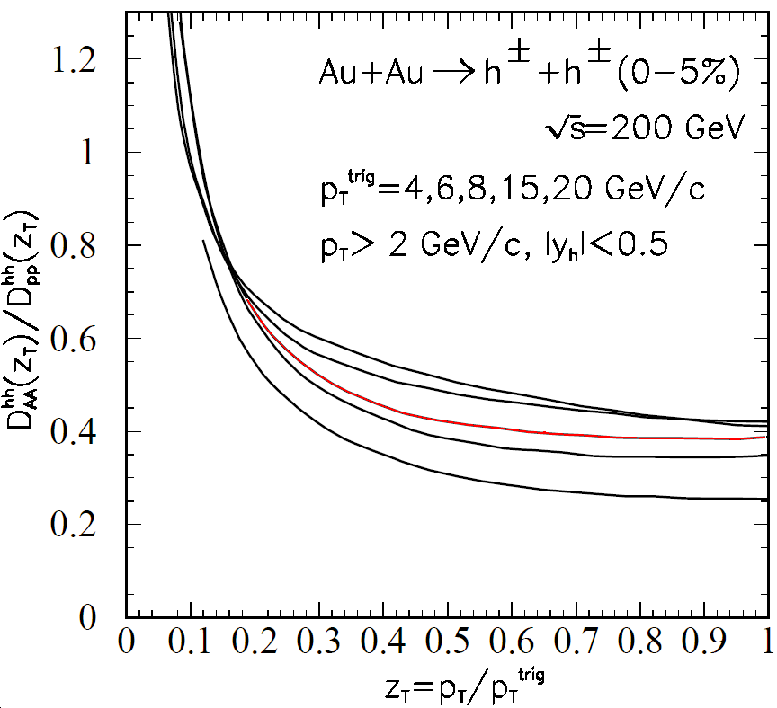
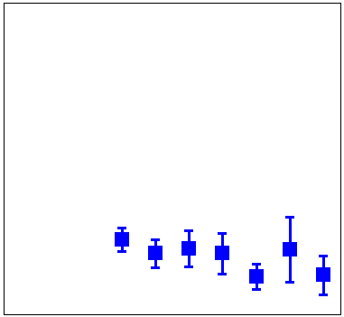
Di-jets and the medium
X-N Wang, PLB 595, 165 (2004)
8 < p_{T}(trig) < 15 GeV/c
■ = STAR preliminary
Yield provides a better upper limit on the density of the medium
  Constrain the number of active degrees of freedom?
  [Müller, Rajagopal, hep-ph/0502174]

Slide 11
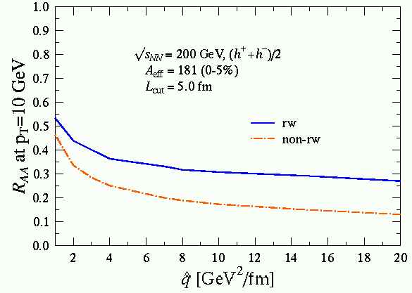
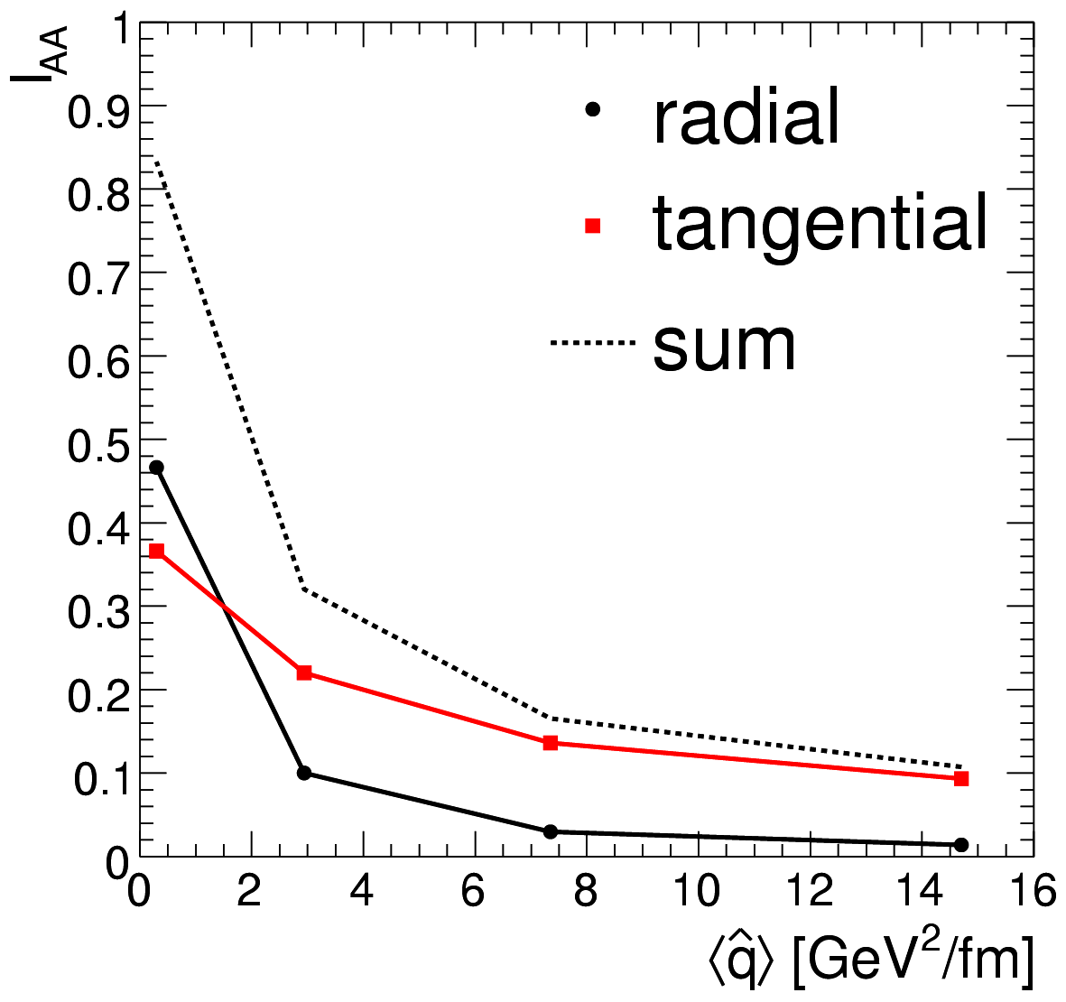

Putting the pieces together
From M. Van Leeuvan
Eskola et al., hep-ph/0406319
Poster by Dainese, Loizides and Paic
R_{AA} ≈ I_{AA} ≈ 0.20-0.25
R_{AA} and I_{AA} in quantitative agreement:
≈ 5-7 GeV²/fm in central Au+Au @ RHIC
(Excluding theory uncertainties)

Slide 12
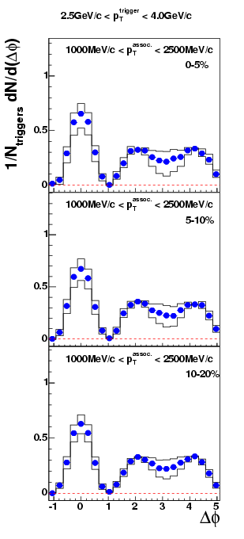
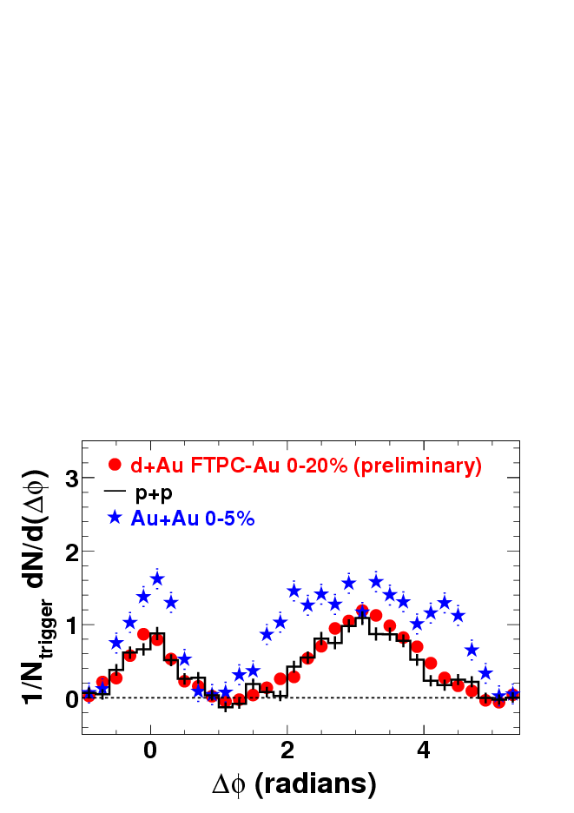
How does the medium respond?
4.0 < p_{T}^{trig} < 6.0 GeV/c
J. Ulery, sect 3c
2.5 < p_{T}^{trig} < 4.0 GeV/c
M. Horner, poster #70
1.0 < p_{T}^{assoc} < 2.5 GeV/c
2.0 < p_{T}^{assoc} < p_{T}(trig) GeV/c
0.15 < p_{T}^{assoc} < 4.0 GeV/c
STAR Preliminary
Measure low-p_{T} associated hadrons
  Away-side particles increase in number and soften in p_{T}
  Away-side flat or small dip for intermediate p_{T}^{trig}

Slide 13
Conical flow?
near
Δφ₂
Does a shock wave form?
Three-particle correlations
  Conical flow: associated particles may appear on opposite sides of Δφ = π
  Deflected jets: associated particles on the same side of Δφ = π
Medium
away
Conical flow
Δφ₁
near
Δφ₂
Medium
Casalderrey-Solana, Shuryak and Teaney, hep-ph/0411315
Stocker, NP A750, 121
Ruppert and Muller, PL B618, 123
away
Deflected jets
Δφ₁

Slide 14
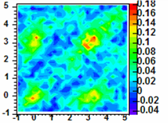

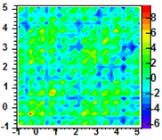
Three-particle correlations in d+Au and Au+Au
p_{T}^{trig}=3-4, p_{T}^{assoc}=1-2 GeV/c
2-particle corr, bg, v2 subtracted
near
J. Ulery, sect 3c
d+Au min-bias
Difference in Au+Au
average signal per radian²:
center – corner =
0.3 ± 0.3 (stat) ± 0.4 (syst)
center – cone =
2.6 ± 0.3 (stat) ± 0.8 (syst)
Δφ₂=φ₂-φ_{trig}
Medium
away
Conical flow
Elongated along
diagonal: k_{T} effect?
deflected jets?
Distinctive features
of conical flow are
not seen in present
data with these p_{T}
windows.
near
Au+Au 10%
Δφ₂=φ₂-φ_{trig}
dN²/dΔφ₁dΔφ₂/N_{trig}
Medium
away
Deflected jets
Δφ₁=φ₁-φ_{trig}

Slide 15
Conclusion
Suppression of non-photonic electron yield at high-p_{T}, and
Re-emergence of the away-side jet at high-p_{T}
  Improved upper and lower limits on the energy density
  Severe test of our understanding of partonic energy loss
Three-particle correlations with an intermediate-p_{T} trigger
  k_{T} effects or deflected jets, or …
  Characteristic signature of conical flow is not observed
Overall, STAR has a wealth of new data!
  Answer questions we’ve been asking
  Help us ask questions we weren’t smart enough to ask before
The answers to those questions will tell us
  What is the strongly interacting matter that we are creating at RHIC?
  What are its properties?

Slide 16
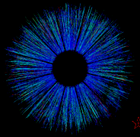
The STAR Collaboration
STAR
U.S. Labs:
Argonne, Lawrence Berkeley, and Brookhaven National Labs
U.S. Universities:
UC Berkeley, UC Davis, UCLA, Caltech, Carnegie Mellon, Creighton, Indiana, Kent State, MIT, MSU, CCNY, Ohio State, Penn State, Purdue, Rice, Texas A&M, UT Austin, Washington, Wayne State, Valparaiso, Yale
Brazil:
Universidade de Sao Paolo
China:
IHEP - Beijing, IPP - Wuhan, USTC,
Tsinghua, SINAP, IMP Lanzhou
Croatia:
Zagreb University
Czech Republic:
Nuclear Physics Institute
England:
University of Birmingham
France:
Institut de Recherches Subatomiques Strasbourg, SUBATECH - Nantes
Germany:
Max Planck Institute – Munich University of Frankfurt
India:
Bhubaneswar, Jammu, IIT-Mumbai, Panjab, Rajasthan, VECC
Netherlands:
NIKHEF/Utrecht
Poland:
Warsaw University of Technology
Russia:
MEPHI – Moscow, LPP/LHE JINR – Dubna, IHEP – Protvino
South Korea:
Pusan National University
Switzerland:
University of Bern
Notes:
Let me put up the most important slide: the STAR collaboration,
and I want to thank my STAR colleagues to give me the opportunity to present this talk on their behalf.
Thank you for your attention.

Slide 18
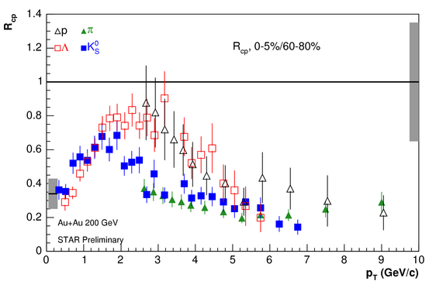
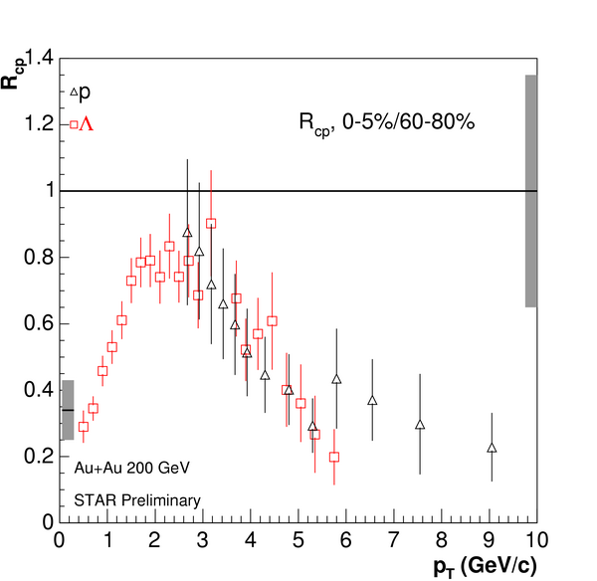
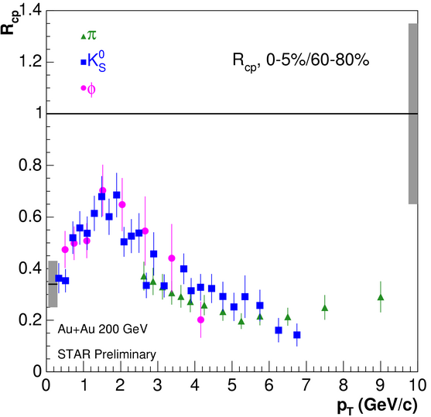
Identified particle R_{CP}
Φ definitively follows K⁰ at intermediate p_{T} : mass is not the source
All particles consistent for p_{T} > ~5-6 GeV/c
Barannikova, sect 1a; Cai, sect 1a; Salur, sect 5a
Notes:
Make a link to fragmentation picture: origin of v2 at high pt, if due to fragme

Slide 19
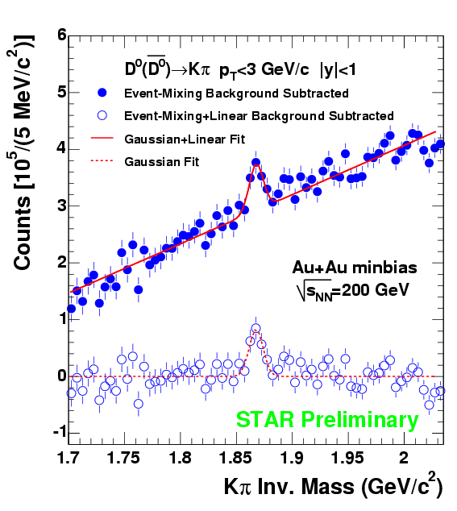
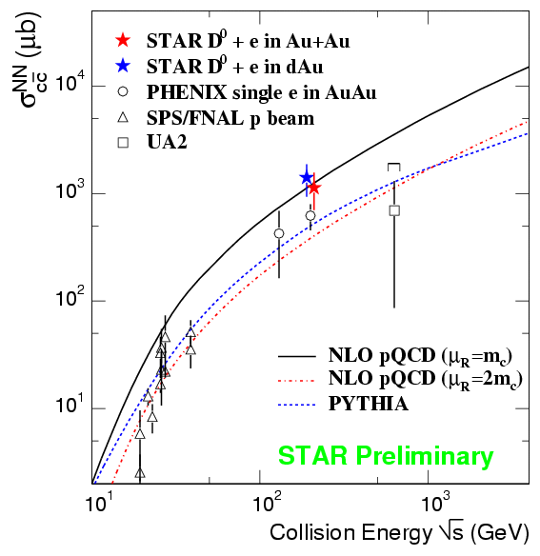
Charm production
First direct measurement of open charm in Au+Au Collisions
Total charm cross-section in Au+Au: N_{binary} scaling from d+Au
Zhang, sect 5c

Slide 20
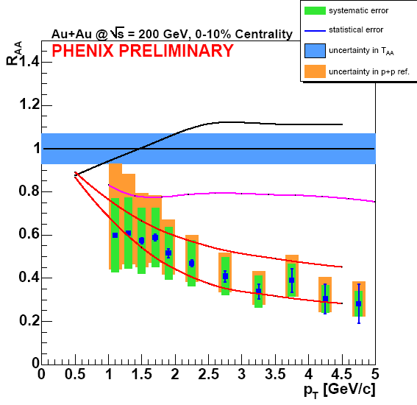
PHENIX figure from Vicki Greene’s talk
STAR and PHENIX non-photonic electron R_{AA} measurements agree very well

Slide 21
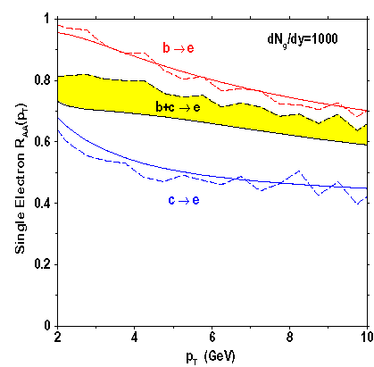
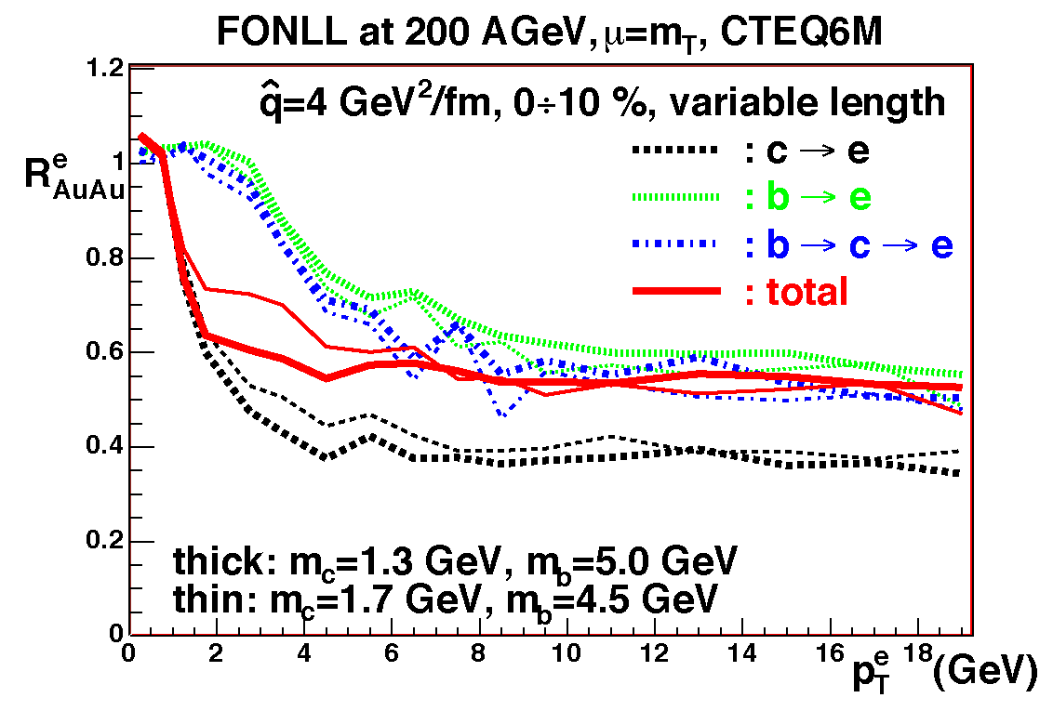
Electron R_{AA} predictions with lower densities
M. Djordjevic et al., nucl-th/0507019
N. Armesto et al, private comm.

Slide 22
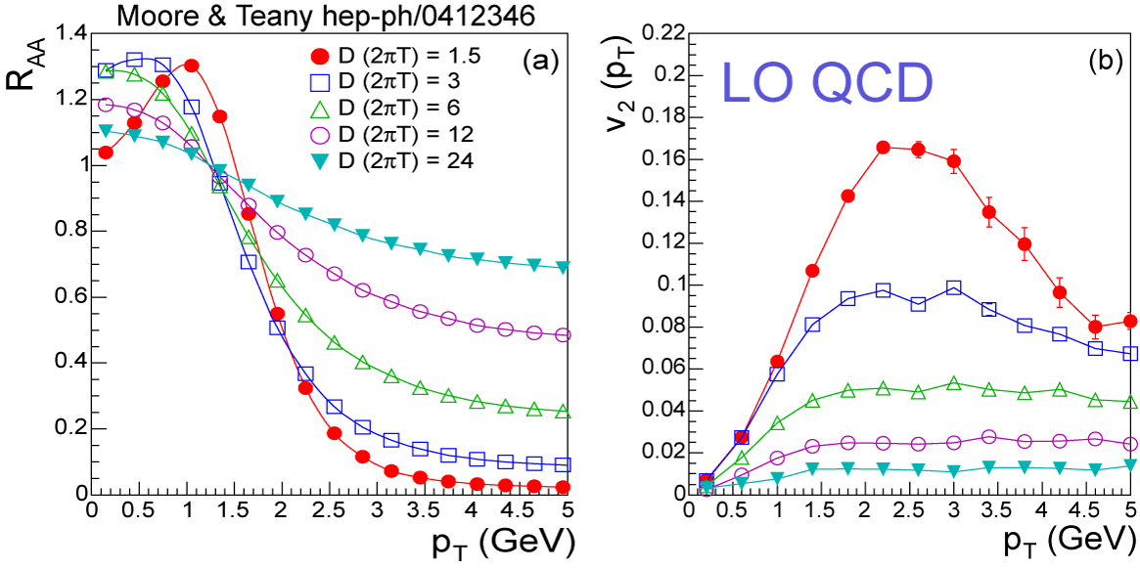
Alternative scenario: collisional contribution
Moore & Teaney, hep-ph/0412346
AMPT:
(C.M. Ko)
← σ=10 mb
← σ=3 mb
← pQCD
Large collisional (not radiative) interactions also produce large suppression and v₂

Slide 23
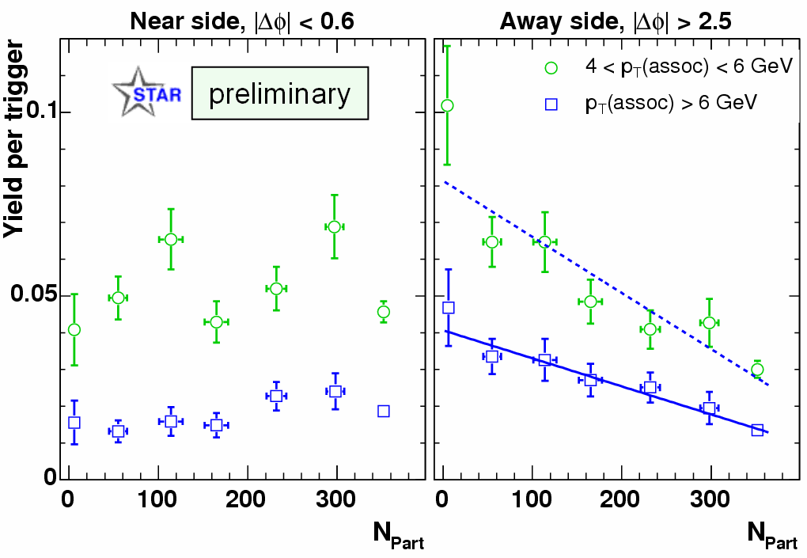
Centrality dependence of near and away-side yields
D. Magestro, sect 3b
Fit scaled
by x2
8 < p_{T}(trig) < 15 GeV/c
Near-side yields consistent within errors
Away-side yields decrease monotically with increasing N_{Part}
  Suppression pattern similar for two p_{T}(assoc) ranges!

Slide 24
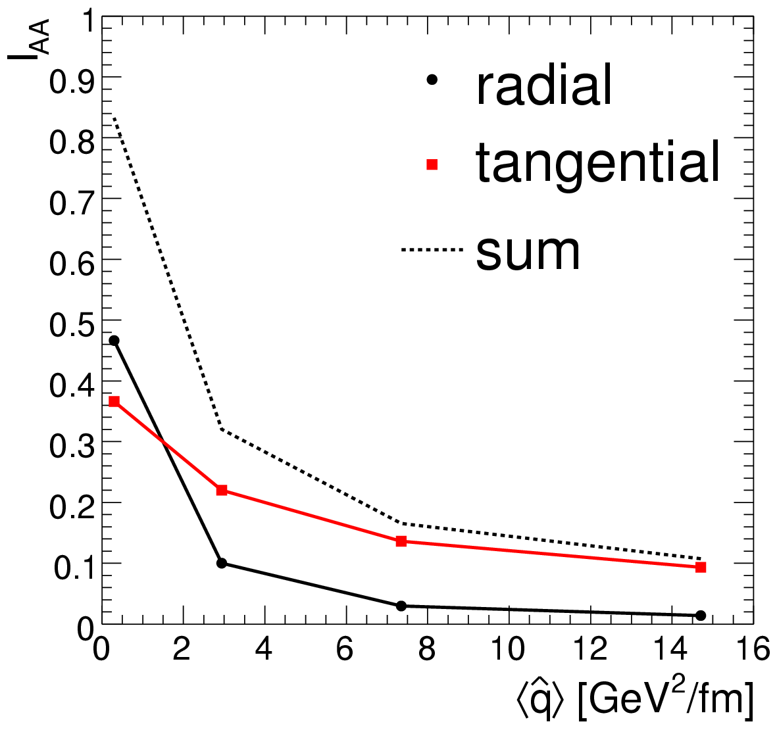
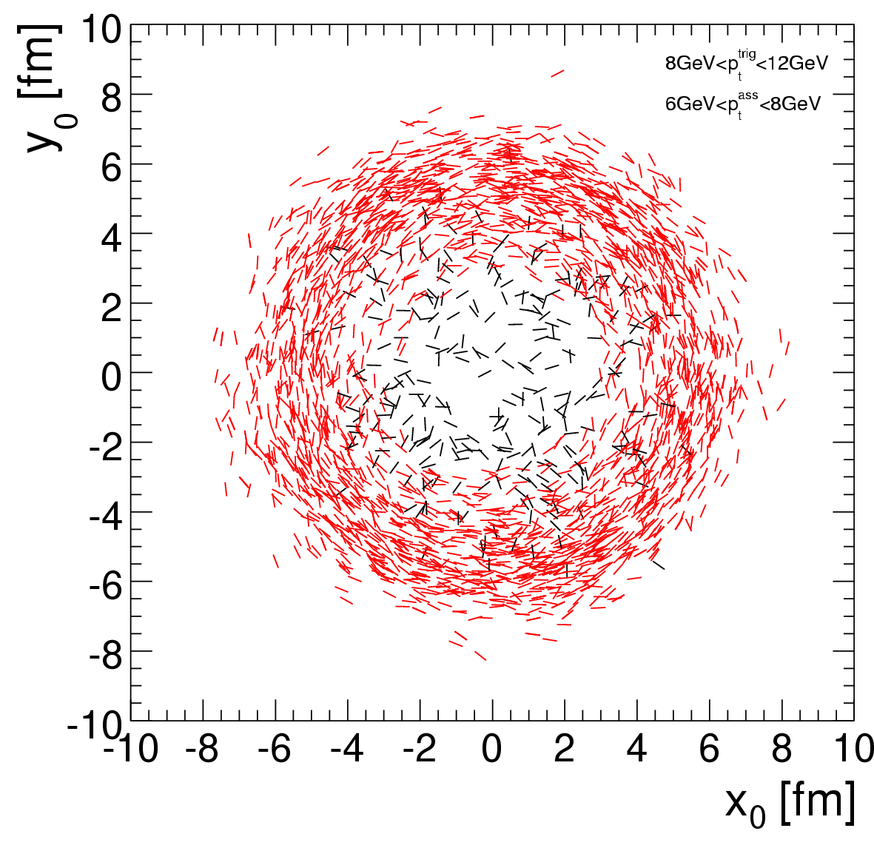

Surface emission for dijets?
Poster by Dainese, Loizides and Paic
Emission points for dijets also show surface bias, tangential emission
I_{AA} dominated by tangential pairs for large

Slide 25
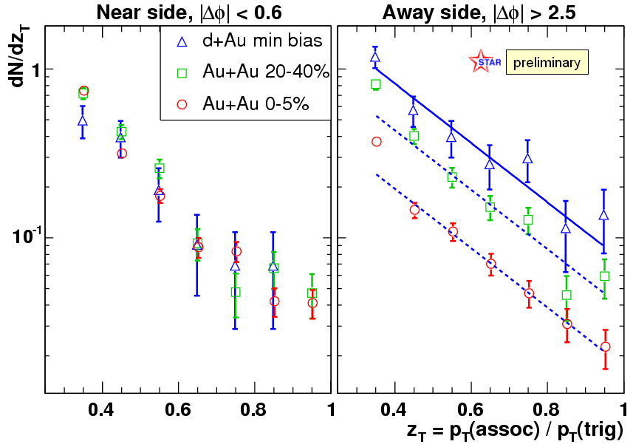
Hadron-triggered fragmentation functions
D. Magestro, sect 3b
Scaling
factors
~0.54
~0.25
8 < p_{T}(trig) < 15 GeV/c
Away-side D(z_{T}) suppressed, but shape unchanged

Slide 26



An upper bound on energy density?
Müller and Rajagopal: From entropy and jet quenching to deconfinement hep-ph/0502174
  The number of degrees of freedom can be determined independently of direct measurements of temperature
Energy density:
Entropy:
Degrees of freedom:
  A lower bound on ν(T) is constrained by an upper bound on energy density

Slide 27
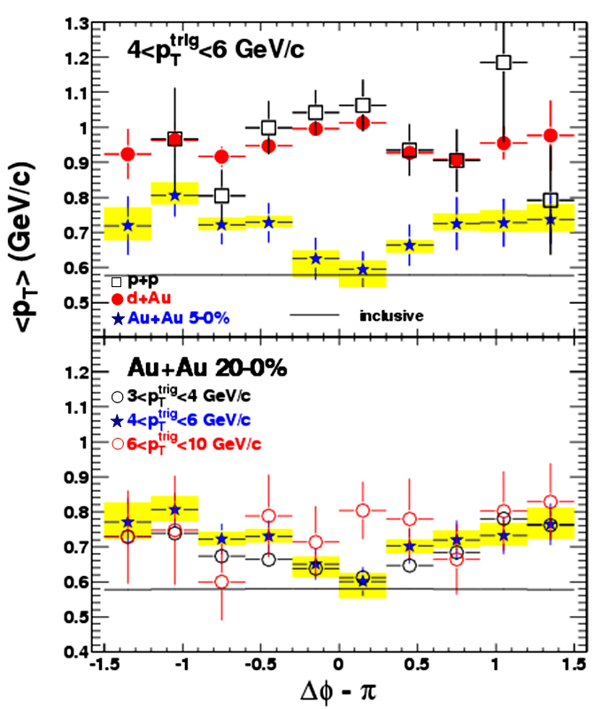
Mean p_{T}
J. Ulery, sect 3c
STAR Preliminary
<p_{T}>=pt-weighted correlation / number correlation.
<p_{T}> is more robust.
  Some of the systematic errors cancel.
Dip on the away side in central Au+Au for moderate p_{T}^{trig}.
  Appears more thermalized with medium.
STAR Preliminary

